Slide 1
Criminal History Issues and Solutions – Overview
Minnesota Sentencing Guidelines Commission
June 6, 2024 meeting
Richard S. Frase, Commission Member, and
Benjamin N. Berger Professor of Criminal Law Emeritus, University of Minnesota

Slide 2
Introduction
Criminal History enhancements are found in all American sentencing guidelines systems, and are likewise a nearly universal sentencing factor in non-guidelines systems in the U.S. and abroad.
But until recently, very little was known about –
the varied formulas used in different guidelines systems, and the impacts of different formulas on sentence type and severity;
the validity of the most common rationales for these enhancements;
the costs and negative consequences of such enhancements.
The Robina Criminal History Project team and other researchers have sought to shed light on all of these neglected matters.

Slide 3
Topics today
I. Overview of Criminal History impacts in Minnesota, at present and over time
II. Rationales for Criminal History Enhancements
Retribution – Are repeat offenders more culpable? Why? How much?
Crime control – Are CH enhancements cost effective?
Public opinion – Does it strongly support existing CH enhancements?
III. Costs and other negative consequences of such enhancements
IV. Possible Solutions

Slide 4
I. Overview of Criminal History impacts in Minnesota, at present and over time
CH enhancements have a major and growing impact on the type and severity of recommended and imposed sentences under the Guidelines. Here are several ways to measure the current and changing impact –
The CH “multiplier” – how much more severe are recommended custody sentences for highest-history offenders, compared to lowest-history offenders?
Answer – on the standard grid, recommended highest-history prison terms are, on average, 2 times more severe than recommended lowest-history prison terms. (Note: many of the latter are stayed terms; if in lieu of the stayed terms we use the mid-point of the allowable jail-sentence range [0-12 months], the grid average multiplier rises to 4.7)

Slide 5
Minnesota Main Grid

Slide 6
Overview of Criminal History impacts in Minnesota, at present and over time
Here is a second CH impact measure –
The “pushed into prison” effect of an elevated CH score -- how many offenders are recommended for prison solely because of their high CH score?
(These are offenders, convicted of felonies ranked at medium- or low offense severity, who would not be recommended for prison if their CH scores were lower – their high score pushes them across the disposition line into grid cells subject to presumptive executed-prison terms.)
Answer – in 2019, 22 percent of offenders (combining all three grids) fell into “Zone 2” of the grids.
Pre-guidelines (1978), only 5 percent of offenders fell into Zone 2.

Slide 7
Offenders recommended for prison come from three zones on the Minnesota Guidelines grids, for example:

Slide 8
Overview of Criminal History impacts in Minnesota, at present and over time, cont’d
Here are two more CH impact measures –
What proportions of offenders have high CH scores?
Answer – In 2019, 29 percent of offenders had 4 or more CH points
Pre-guidelines (1978), only 7 percent of offenders had that many points .
What proportion of offenders have no scoreable priors (CH=0)?
Answer – in 2019, 28 percent of offenders had CH=0.
Pre-guidelines (1978), 59 percent of offenders had CH=0.

Slide 9
II. Rationales for Criminal History enhancements
Retribution (Just Deserts)
Assumption: Crimes committed by repeat offenders are more blame-worthy and deserve increased punishment in proportion to prior record.
Crime Control
Assumptions: 1) Repeat offenders pose risks of recidivism (continued offending) in direct proportion to their prior records; AND
2) Giving proportionately more severe punishments to higher-risk offenders prevents crime in a cost-effective manner.
Public Opinion
Assumption: The public strongly supports existing CH enhancements.

Slide 10
Rationales for Criminal History Enhancements, cont’d -- Retribution (Just Deserts)
Are crimes by repeat offenders more blameworthy?
Why? How much more blameworthy?
Some writers who strongly favor punishment based on retributive values argue that prior convictions should not be considered because they do not increase an offender’s deserved punishment for a new crime –
prior convictions do not aggravate either the harm caused or risked by that new crime, or the offender’s culpability (mens rea, motives, etc.) in committing the crime; and
the offender has already been punished for the prior crimes and cannot fairly be given new punishment for those (indeed, to do so would violate Double Jeopardy rules).

Slide 11
Rationales for Criminal History Enhancements, Retribution (Just Deserts) – cont’d
However, most writers who strongly favor punishment based on retributive values would allow prior record to be considered at sentencing to some extent. Among those writers there is broad agreement on the following principles --
First offenders are significantly less blameworthy than repeaters.
After that, desert increases modestly with rising prior record.
Overall, desert depends much more on the seriousness of the offense(s) being punished than on prior record. Accordingly --
Prior record enhancements must be “capped,” not go on increasing.
Prior record should never carry more weight than the gravity of the crime being sentenced. Thus, enhancement should never more than double the recommended typical-case penalty for a first offender (some writers would set the enhancement ratio lower -- at 1.5, not 2.0).

Slide 12
Rationales for Criminal History Enhancements, cont’d – Crime Control
Do repeat offenders pose risks of recidivism (continued offending) in direct proportion to their prior records? In particular:
1) Does the criminal history score accurately predict recidivism risk?
2) Does each component of the score add predictive value?
3) What kinds of recidivism crimes does a higher CH predict?
Until recently, these questions had not been addressed by sentencing commissions or outside researchers -- criminal history scores were based on historical sentencing patterns and/or intuition, and the scores were simply assumed to accurately predict recidivism risk.
Research in Minnesota, Pennsylvania, and the federal system has now examined and collected data on some of these issues.

Slide 13
Three CH-and-Recidivism Questions (previous slide), & Findings
1. What is the relationship between Minnesota’s criminal history score and offender rates of recidivism?
Major Findings --
Increases in the score are accompanied by steadily higher rates of recidivism. However…
The biggest jumps in recidivism rates occur on the low and high ends of the criminal history score range (CH=1 vs CH=0; and CH=7 points vs CH= exactly 6 points).
For offenders at CH=0, true first-time offenders have much lower rates of recidivism than those with one or more unscored priors.
For offenders at CH=0 through CH=3, recidivism decreases with age (at CH=4, offenders 45 and older have the lowest recidivism rate, while those 25 to 34 and 35-44 have the highest rates).
Notes:
Each component of the score increases the total score and thus results in a higher incarceration rate and longer sentences for offenders in the Minnesota system. Thus, we would expect that each component of the score would also increase the score’s ability to classify recidivists and non-recidivists.

Slide 14
Three CH vs Recidivism Research Questions, & Findings, cont’d
2. Does each component of the criminal history score (e.g. juvenile adjudications, custody status points) add to the score’s predictive utility in targeting recidivists? [and even if it does -- is the added power worth the costs and negative consequences? See infra.]
Major Findings --
Some score components add little or no predictive power to the score:
Custody status points and misdemeanor points add only modest predictive power (raising AUC statistics for both from .63 to .64).
Juvenile points add no predictive power to the score.
Felony weighting adds no predictive power to the score (indeed, recidivism odds are negatively correlated with Severity ranking).
However, half-point down-weighting is justified on grounds unrelated to prediction of recidivism; that policy was adopted to reduce the number of non-person offenders subject to presumptive prison terms.
Notes:
Each component of the score increases the total score and thus results in a higher incarceration rate and longer sentences for offenders in the Minnesota system. Thus, we would expect that each component of the score would also increase the score’s ability to classify recidivists and non-recidivists.

Slide 15
Three CH-and-Recidivism Research Questions (previous slide), & Findings, cont’d
3. What kinds of recidivism crimes does a higher CH predict?
Major Findings --
Most recidivism offenses are either a property crime or a drug crime, and that remains true of high-CH-score offenders – among offenders in the two highest CH categories who later recidivate, about two-thirds recidivate with a property or a drug crime.
Notes:
Each component of the score increases the total score and thus results in a higher incarceration rate and longer sentences for offenders in the Minnesota system. Thus, we would expect that each component of the score would also increase the score’s ability to classify recidivists and non-recidivists.

Slide 16
Summary: CH enhancements and Recidivism Risk
Offenders with longer criminal histories are more likely to recidivate.
However -- the Guidelines Criminal History Score doesn’t always reflect this relationship well.
The CH score sometimes produces increases in recommended sentence length and severity that exceed increases in recidivism risk.
The CH score includes individual scoring components that provide no (or low) added predictive benefit while increasing the sentence severity of a significant number of offenders.
The CH score most often targets low-level repeat offenders – not offenders most likely to recidivate with a violent or serious crime.
Other risk factors (e.g., offender age) interact with prior record to produce different likelihoods of recidivism within each score, but these interactions are not factored into recommended sentences.
Notes:
Minnesota, Pennsylvania, Federal CH score

Slide 17
Rationales for CH Enhancements, Crime Control, cont’d -- Are Prior Record Enhancements Cost Effective?
Even if repeat offenders pose risks of continued offending in proportion to their prior records, is it likely that imposing prison or more prison on these offenders will translate into cost-effective crime control benefits?
Justification | Critique re: application to prior record
Rehabilitation – address the personal causes of offending | More prison often does not improve the odds of rehabilitation (due to limited prison program resources; also not a therapeutic or real-world environment).
Specific Deterrence – teach the offender a lesson | Research fails to find much effect, in part because longer prison terms make some of the offenders more crime-prone.
General Deterrence – deter others by fear of punishment | Research suggests that marginal increases in penalty severity do not yield measurable increase in general deterrence benefits (“certainty” yields more).
Incapacitation – physically prevent offenders’ crimes through incarceration | Even at its best, selective incapacitation (targeting the most violent and/or most frequent repeat offenders) is overly broad. Most prior record enhancements apply to lower-level offenders. Also, some imprisoned offenders are replaced by other criminals; some are made more crime-prone; and many will become less crime-prone, due to age alone, long before the expiration of a lengthy prison terms.
Notes:
INACP: in one sense go too far, in another sense don’t go far enough.
CONCLUSION: We’ve stopped short of saying there are no crime control benefits for recidivist premiums. But we have suggested the connections between PREs and utilitarian purposes are not as straightforward as one might initially think. This raises several related questions...

Slide 18
Rationales for Criminal History Enhancements, cont’d – Public Opinion
Does the public strongly support Criminal History enhancements?
Answer: Research reveals public support for such enhancements as a general matter, but also support for more lenient policies in some respects, compared with existing guidelines policies –
The public favors shorter lookback (“decay”) periods: prior crimes would no longer be counted after 10 years.
The public would not count juvenile court priors at all.

Slide 19
III. Costs and negative consequences of Criminal History enhancements
1. Increased size and expense of prison populations.
2. Reduced proportionality of punishment severity to conviction offense gravity.
3. Increased need for prison beds to house property and other nonviolent offenders.
4. Increased numbers of aging, low-risk, high-cost prison inmates.
5. Increased racial disproportionality in prison populations.
6. Interference with offender efforts to reintegrate into society.

Slide 20
Costs and negative consequences of Criminal History enhancements – cont’d
1. Increased size and expense of prison populations
Elevated criminal history scores cause large numbers of offenders convicted of medium- and low-severity crimes to be recommended for and receive prison, who would otherwise have non-prison sentences.
Moreover, as noted earlier, the proportion of such “Zone 2” offenders has grown substantially since the Guidelines first went into effect. Such offenders now account for about two-thirds of the cases with presumptive executed-prison sentences under the Guidelines.
For all offenders, in all zones of the grids, steadily rising criminal history scores increase the duration of recommended and imposed prison terms.

Slide 21
Offenders recommended for prison come from three zones on the Minnesota Guidelines grids, for example:

Slide 22
Costs and negative consequences of Criminal History enhancements – cont’d
2. Reduced proportionality of punishment severity to conviction offense gravity
Elevated criminal history scores cause many offenders to be recommended for and receive sentences more severe than those given to offenders convicted of more serious crimes.
Example (prison disposition): On the MN standard grid, highest-history offenders at Severity Level 1 have a recommended disposition (executed prison) more severe than for lowest-history offenders at Severity Level 7 (stayed prison term).
Example (prison duration): the recommended prison duration for highest-history offenders at Severity Level 1 (19 months) is greater than the recommended duration for lowest-history offenders at Severity Level 5 (18 months).

Slide 23
Minnesota Main Grid

Slide 24
Costs and negative consequences of Criminal History enhancements – cont’d
3. Increased need for prison beds to house property and other nonviolent offenders
Many guidelines systems have chosen to give priority to high-offense-severity and violent offenses, when using expensive prison resources. But non-violent and lower-severity offenders tend to have higher criminal history scores, sending large numbers of these offenders to prison.
Example: About two-thirds of Zone 2 offenders [medium- and low-offense severity, recommended for prison due to elevated criminal history] have been convicted of a non-person offense.
Example: about 60 percent of offenders receiving the greatest CH enhancements (those in the two highest CH score categories) have been convicted of a property or a drug crime (most often: property).

Slide 25
Costs and negative consequences of Criminal History enhancements – cont’d
4. Increased numbers of aging, low-risk, high-cost prison inmates
Even with lookback limitations, many older offenders have high criminal history scores. Yet older offenders, even many with high scores, have lower recidivism rates, and costs to hold them can be high. Large numbers of them go to prison because of their record.

Slide 26
Costs and negative consequences of Criminal History enhancements – cont’d
5. Increased racial disproportionality in prison populations
African American and Native American offenders tend to have higher criminal history scores, so prior record sentence enhancements are a major contributing factor to over-representation of these groups in prison populations.

Slide 27
Costs and negative consequences of Criminal History enhancements – cont’d
6. Interfering with offender efforts to reintegrate into society
For most offenders the journey toward total desistance is interrupted by lapses back into criminality. But many offenders, even some with substantial conviction records, make significant efforts to achieve desistance despite continued lapses. Imposing enhanced punishment on such an offender may impede progress in rebuilding a career or supporting a family, and can magnify the employment, housing and other debilitating consequences of conviction.
Surprisingly, no existing system gives formal credit for an offender’s good faith albeit unsuccessful efforts toward desistance, or takes account of trends toward less serious or less frequent offending.
However, several guidelines states do give offenders formal credit for substantial crime-free gaps in offending.

Slide 28
IV. Possible Solutions – a preliminary list
In general – any change that reduces the numbers of offenders with high CH scores will lessen most if not all of the high-costs and other negative consequences listed above. Some ways to have fewer high CH scores are:
reduce or drop CH points based on prior misdemeanors, juvenile adjudications, and/or custody status;
reduce or drop felony up-weighting (assigning more than one point);
shorten look-back periods and/or add a further wash-out option based on crime-free gaps (see next slide);
reduce or stop counting Hernandez-rule same-day “prior” convictions (only one other guidelines state has a rule like Hernandez);
limit eligibility for the highest CH categories to offenders with one or more violent priors (several other guidelines states do this);
limit CH enhancements to priors that are the same or similar to the current crime (= the strongest retributive case for enhancement)

Slide 29
IV. Possible Solutions – a preliminary list, cont’d – other ideas
Reduce severity level overlaps to improve offense-based proportionality.
Adopt more modest increases in recommended prison durations across the middle CH categories (2, 3, and 4), or consider collapsing CH into fewer categories, to better match penalties to different levels of recidivism risk.
Reduce recommended sentences for first-time offenders (Washington has such a policy; it’s justifiable on both retributive and offender-risk grounds).
Enact policies that give credit for an offender’s efforts toward desistance, trends toward less serious or less frequent offending, crime-free gap periods, and/or his or her advancing age.
Given judges authority to depart based on atypical circumstances of the offender’s prior record -- just as judges now may depart based on atypical circumstances of the conviction offense. Such atypical CH circumstances might relate to the nature of the prior offenses and/or to subsequent major life-course changes (e.g., marriage or other long-term relationship, parenthood, stable housing and/or employment, successful treatment) which cause the CH score to over-predict recidivism risk.

Slide 30
Thank for your attention!
Questions?

Slide 31
[ Bonus slides from here on…]

Slide 32
Felony Reconviction Rates, by Minnesota Guidelines Criminal History Score
6.9%
Notes:
Copy of a slide from last presentation
Outcome: felony reconviction
7 point jump on both
4 all others

Slide 34
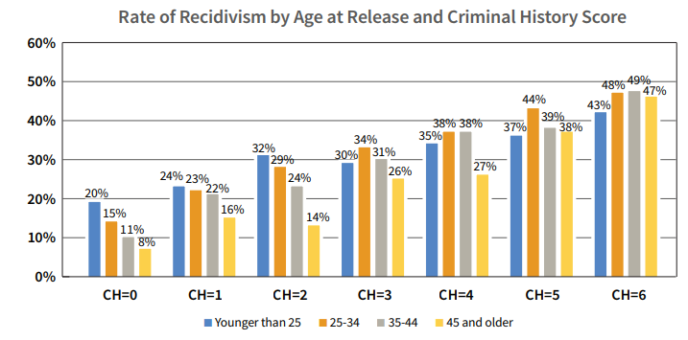

Slide 35
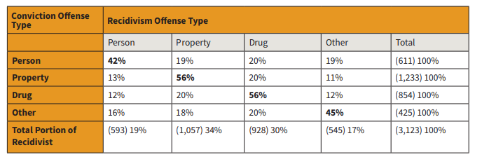
Recidivism Specialization by Offense Type

Slide 36
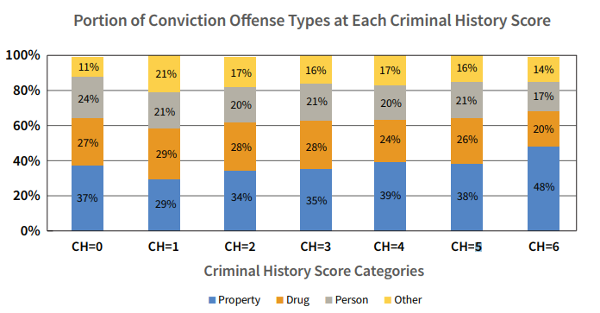

Slide 37
Unanswered Questions About Criminal History, Sentencing, and Recidivism
How well do varying formulations of the criminal history score target high-risk and serious offenders?
Empirical research done in MN, PA, and federal system.
How should jurisdictions sentence low-risk, serious offenders compared to high-risk, low-level offenders?
How do non-codified considerations of criminal history affect sentencing under guidelines?
How do such factors affect sentencing in non-guideline states?
How do other risk factors (age, offense type, etc.) interact with the criminal history score to affect likelihood of recidivism?
Should these be codified into sentencing schemes?
How does the sentence itself (prison; not) affect risk of recidivism?

Slide 38
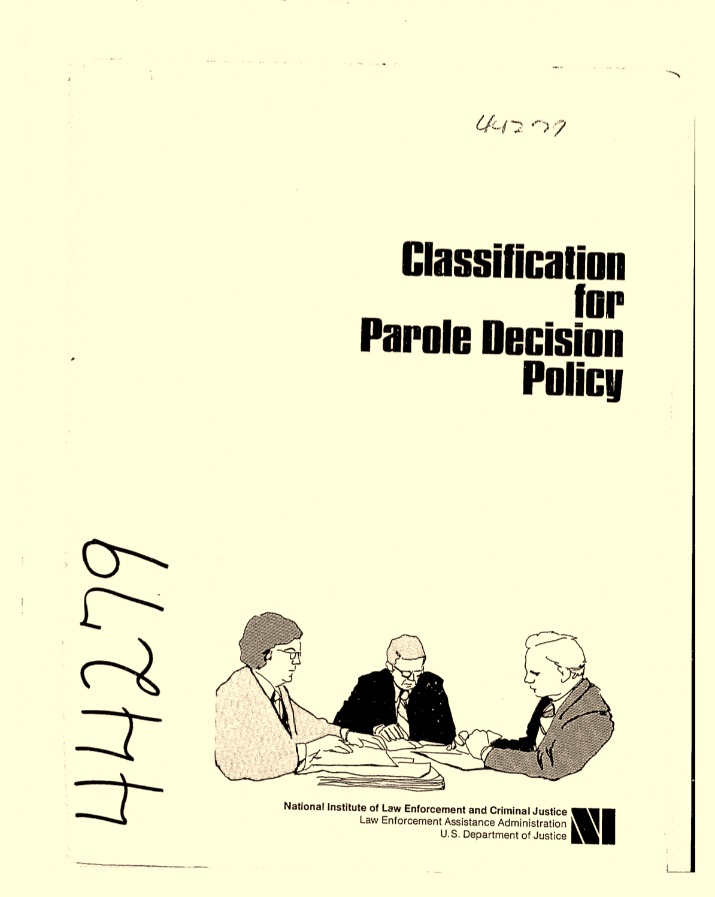
IV. Origins of Guidelines Criminal History Scores
Federal Parole Guidelines (1960s)
1979: Statewide Sentencing Guidelines
Ad hoc voluntary sentencing guidelines (early 70s)
Parole GL team embarks on Pilot Sentencing GL project (mid 70s)
A longer prior record didn’t always correlate with more prison, in pre-guidelines periods.
The architects of pilot guidelines projects built out the grid anyway.

Slide 39
Origins Cont’d (1970s Pilot Project)
Maricopa County
For the general model, the researchers considered 21 potential criminal-history-related variables. Of these, 19 variables held a statistically significant relationship with disposition (and the other two variables were marginally significant, at .057 and .093).
But only four of the 21 variables were related to the minimum and maximum sentence-length outcomes at statistically significant levels.

Slide 40
Origins Cont’d
Cook County
Many Individual cells did not conform to the overall pattern, whereby increasing offense and offenders scores were paralleled by increasing prison-length sentence severity.
But rather than creating a separate scoring mechanism to predict the prison length decision, the researchers “utilized the minimum and maximum sentences of contiguous cells to resolve this problem.”
As a result, “mapping the length of sentences was not predictive in the statistical sense.”
Notes:
They found that release decisions were generally based on three “focal concerns” of crime seriousness, parole prognosis, and institutional behavior, and that release decisions “could be predicted fairly accurately by knowledge of their crime seriousness and prognosis ratings.” Id. at 15.
Id. at 16.
For their reflections, see Don M. Gottfreson et al., Guidelines for Parole and Sentencing—A Policy Control Method (Lexington Books 1978) [hereinafter Policy Control Method]; Don M. Gottfredson et al., Making Paroling Policy Explicit, 21 Crime & Delinq. 34, 38–39 (1975) (explaining how the United States Board of Parole requested the initial guidelines and how the researchers formulated the original guidelines). The United States Board of Parole was later renamed the United States Parole Commission.

Slide 41
Origins Cont’d
Maryland
In constructing the Maryland grids, the Maryland staff first sought to base the grids on empirical analysis. However, these efforts “proved ‘inconclusive’ and ‘disappointing’”.
Consequently, the grids were constructed with the consideration of the empirical analysis supplemented with “a good deal of collective judgment.”
In fact, “The Advisory Board’s choice of factors was little, if at all, influenced by the analytic results. . . . Score weights were also set independent of any analysis or modeling.”
As with the pilot Albany Guidelines, the grids were “shaped on the basis of analyzing the decision to incarcerate (IN/OUT) rather than sentence length[.]”
The result, based on an impact evaluation performed after the guidelines had been in effect for a year, was that “offenders with serious prior convictions received significantly more severe sentences under the guidelines than they had before.”
Notes:
Source: Analytic Basis,

Slide 42
Origins Cont’d
Minnesota
Criminal history enhancements in the initial, 1980 guidelines were based in part on pre-guidelines time served before first parole release, but prison durations were deliberately increased for offenders with high criminal history scores, and were lowered for offenders with low criminal history scores (Parent 1988, ch. 7).
Thus -- like the three jurisdictions explored above, variations in offender criminal history had a greater effect on recommended prison duration under the initial Minnesota guidelines than they had had under pre-guidelines sentencing practice.
Notes:
Source: Analytic Basis,

Slide 43
V. Some Major Takeaways
The patterns and overall magnitude of criminal history enhancements are difficult to justify on a retributive (Just Deserts) theory of punishment.
The crime control benefits of marginal prison increases based on increases in prior record are more tenuous than may be expected.
Guidelines criminal history scores and recommended sentence severity do not always correspond to differences in recidivism risk.
There is some evidence that public opinion may be receptive to giving less weight to older convictions and to juvenile priors.
Some early guideline grids may have inflated prior record premiums as to recommended sentence length, compared with prior practice.

Slide 44
Process Recommendations
Sentencing commissions need to:
explicitly identify the purposes they want criminal history enhancements and each criminal history score component to serve;
use sentencing data to assess how well those purposes are being served; and
Based on such data and assessments, consider changes in guidelines criminal history rules, to better achieve the commission’s purposes.

Slide 45
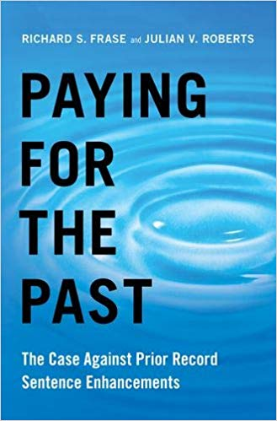
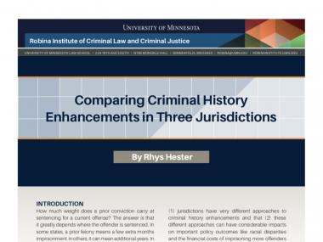
Website: www.robinainstitute.com
Select publications:
See also: Richard S. Frase, “Criminal Record,” in The Oxford Handbook of Punishment Theory and Philosophy (Jesper Ryberg, ed.) (Oxford University Press, forthcoming)

Slide 46
SELECTED BIBLIOGRAPHY
Frase (forthcoming) “Criminal Record,” in The Oxford Handbook of Punishment Theory and Philosophy (Jesper Ryberg, ed.) (Oxford University Press.
Frase (2009) What explains persistent racial disproportionality in Minnesota’s prison and jail populations? Crime & Justice 38:201-280.
Frase & Roberts (2019) Paying for the Past: The Case Against Prior Record Sentence Enhancements. Oxford University Press.
Frase, Roberts, Hester, & Mitchell (2015) Criminal History Enhancements Sourcebook. Robina Institute, sentencing.umn.edu.
Hester (2019) Prior record and recidivism risk. American Journal of Criminal Justice 44(3):353-375.
Hester, Frase, Laskorunsky, & Mitchell (2019) Rethinking the role of criminal history in sentencing in Spohn & Brennan (eds) Handbook on Sentencing Policies and Practices in the 21st Century. Rutledge.
Hester, Frase, Roberts, & Mitchell (2018) Prior record enhancements at sentencing: Unsettled justifications and unsettling consequences. Crime & Justice 47:209-254.
Hester, Roberts, Frase, & Mitchell (2018) A measure of tolerance: Public attitudes on sentencing enhancements for old and juvenile prior records. Corrections: Policy, Practice and Research 3:137-151.
Jacobs (2015) The Eternal Criminal Record. Harvard University Press.
King (2019) Cumulative impact: Why prison sentences have increased. Criminology 57:157-180.
Laskorunsky (2018) Minnesota Criminal History Score Recidivism Project. Robina Institute, sentencing.umn.edu.
Roberts (1997) The role of criminal record in the sentencing process. Crime & Justice 22:303-362.
Roberts (2008) Punishing Persistent Offenders. Oxford University Press.
Roberts and von Hirsch (Eds) (2010). Previous Convictions at Sentencing: Theoretical and Applied Perspectives. Bloomsbury Publishing.
Tamburrini & Ryberg (Eds) (2012). Recidivist Punishments: The Philosopher’s View. Lexington Books.

