Slide 1
Board Meeting
June 17, 2025

Slide 2
What does a Service Provider Do? For the Employer→
Contacts employers to enroll them in the Program
Works with employers to set up payroll interface
Receives ongoing payroll deductions from employer

Slide 3
Collects individual employee data: name, social security number, address, etc.
Posts ongoing contributions to employee’s accounts
Posts daily investment gains and losses and makes any trades as requested by the employee
Provides account statements
What does a Service Provider Do? For the Employee→

Slide 4
A Service Provider Offers:
Online Customer Service | Customer Service Call Center | Complete Daily Transaction
Employee can review their account and make changes: contributions and investment allocations | Employee can review their account and make changes: contributions and investment allocations | Post contributions
Makes investment trades | Makes investment trades | Makes daily investment trades
Review account history | Request transaction forms | Processes withdrawals
Educational materials

Slide 5
Other Important Decisions Impacted by Today’s Decision
Participant fees
Investment options
Adequacy of $5 million appropriation

Slide 6
Decision Today
1. Create a Stand Alone Program or enter into a Partnership.
2. Which Service Provider if we decide on a Stand Alone Program or which Partnership?

Slide 7
Decision today will likely come down to →
Cost vs. Control
Confidence in Service Provider or Partner
Mitigating Risks

Slide 8
Decision Factors: Program Structure
 | Launch a Stand Alone Plan | Join a Partnership
Program Control | More favorable [Board controls] | Less favorable [Initial decisions already made]
Investment Design | More favorable [Board controls] | Less favorable [Initial decisions already made]
Timing | Less favorable [Longer to implement] | More favorable [Expedited implementation]
Participant Fees | Less favorable [Higher provider costs] | More favorable [Economies of scale sooner]
State Costs | Less favorable [Start-ups are expensive] | More favorable [Economies of scale]

Slide 9
Stand Alone vs. Partnership Decisions Benefits and Drawbacks
Investments
Stand Alone
Control over investment menu design
Ability to leverage institutional investment relationship and experience of team and consultants
Requires allocation of time and resources to make and monitor investment decisions
Increased oversight if creating custom target dates
Partnership
Partnership decides investment – MNSCRB would have one vote rather than complete control
Working with different states that may have different policies
Multiple states monitoring investments and sharing ideas
Ability to gather scale in assets possibly resulting in lower investment fees

Slide 10
Stand Alone vs. Partnership Decisions Benefits and Drawbacks
Administrative Capabilities and Costs
Stand Alone
Can establish own fee structure
Higher initial cost and likely ongoing costs
Board can make own decisions regarding service provider, length of contract and avoid “getting stuck” with the partnership decisions
Board has more say in website design, reports, and customer service
Total control over communication plan and materials
Partnership
Fee structure is set by the partnership
Lower initial cost and likely lower future costs
Some vulnerability if the partnership decides to terminate the relationship with a service provider – MNSCRB would then have to change as well
Website can be customized to add a “Minnesota” feel to it, but cannot deviate much from the website used by the partnerships
Limited control over communication plan and materials

Slide 11
Process to Hire a Service Provider | Enter into a Partnership
Board approved sending two RFPs
Stand Alone Service Provider
RFPs Posted
Posted March 31, 2025, with responses due by May 16, 2025
Board Directed Staff to work w/ the MN State Board of Investment Staff & AKF Staff
To make a recommendation to the Board
Partnerships
We are making a recommendation today but have blocked out a tentative Board meeting for July 10th if you would like additional information or would like to conduct interviews.

Slide 12
Review Team
Investments – SBI Staff
Patc Ammann, Portfolio Manager Senior, MN State Board of Investment
Ryan Tucker, Investment Analyst Senior, MN State Board of Investment
Service Provider and Partnership Review
Dave Bergstrom, Interim Director
AKF Consulting, Andrea Feirstein

Slide 13
Critical Items to Consider when selecting a Service Provider
Capability
Data Security
Customer Service
Long-term Viability

Slide 14


Service Provider Review
Provides services for:
Colorado Partnership Stand Alone
Colorado Oregon
Maine New Jersey
Delaware New York
Vermont Virginia
Nevada Maryland
Connecticut Partnership
Connecticut
Rhode Island
Provides services for:
Illinois, California

Slide 15
Stand Alone RFP Review
Strengths for Both
Vestwell Strengths
Ascensus Strengths
Data Security
Ability to handle all transactions
Program reporting capabilities
More payroll integration process alternatives
Shorter customer service hold times and fewer dropped calls
Ability to identify employers who have filed a Form 5500 (employers already offer a retirement plan and would not need to be contacted)
Leader in starting Auto IRA business; responsible for most Auto IRA assets and accounts
Proposal includes one field representative in Minnesota
Preferred website and marketing material look and feel

Slide 16
Proposed Stand Alone Plan Fee Structures
Dollar-based Fee
Fee Type | Paid to | Vestwell |  | Ascensus
Ongoing Administration | MNSCRB | TBD |  | TBD
 | Provider | $24² |  | $22
 |  |  |  | 0.20%
Ongoing Administration | MNSCRB | TBD |  | TBD
 | Provider | 0.20%¹ |  | 0.20%
Start-up | Provider - Total | $1,450,000: |  | $1,800,000 to $2,550,000
 | Year 1 | $500,000 |  | $1,000,000
 | Year 2 | $500,000 |  | $800,000
 | Year 3 | $250,000 |  | $250,000³
 | Year 4 | $100.000 |  | $250,000³
 | Year 5 | $100,000 |  | $250,000³
Paid by Participants
Plus
Asset-based Fee
Paid by MNSCRB
¹ Subject to fee breakpoints at > $2 billion AUM (see slide 18) ² Subject to fee breakpoints at > 200,000 funded accounts (see slide 18) ³ Not assessed if funded accounts > 35,000

Slide 17
Proposed Vestwell Fee Structures
Dollar-based Fee
Fee Type | Paid to | Stand Alone Plan |  | Colorado |  | Connecticut
Ongoing Administration | MNSCRB | TBD |  | TBD |  | TBD
 | Vestwell | $24² |  | $22² |  | $24³
Ongoing Administration | MNSCRB | TBD |  | 0.05% |  | 0.02%
 | Vestwell | 0.20%¹ |  | 0.15%¹ |  | 0.17%¹
 | Year 1 | $500,000 |  | $250,000 |  | $250,000
 | Year 2 | $500,000 |  | $250,000 |  | $250,000
 | Year 3 | $250,000
 | Year 4 | $100,000
 | Year 5 | $100,000
 | Total | $1,450,000 |  | $500,000 |  | $500,000
Paid
By
Participants
Plus
Asset-based Fee
Paid
By
MNSCRB
Start-up paid to Vestwell
¹ Subject to fee breakpoints after assets under management hit $2 billion ² Subject to fee breakpoints upon reaching 200,000 funded accounts ³ Subject to fee breakpoints upon reaching 75,000 funded accounts

Slide 18
Proposed Fee Breakpoints
Fees paid by investors will decrease as the Plan grows
Dollar-based Fee
Threshold |  | Stand Alone Plan |  | Colorado |  | Connecticut
0 to 75,000 accounts |  | $24 |  | $22 |  | $24
75,001 to 200,000 accounts |  | -- |  | -- |  | $20¹
200,001 to 350,000 accounts |  | $20 |  | $20¹ |  | $20
> 350,001 accounts |  | $18 |  | $18 |  | $18
$0 to $2 billion |  | 0.20% |  | 0.15% |  | 0.17%
$2 billion to $4 billion AUM |  | 0.15% |  | 0.12% |  | 0.15%
> $4 billion |  | 0.10% |  | 0.10% |  | 0.12%
 |  |  |  | 0.20%
Asset-based Fee
¹ Fees will likely drop in one to two years.

Slide 19
Appropriation Analysis
Stand Alone
Partnership
 | Beginning Balance | MNSCRB Budget | Start-up Fees | Total Cost | FY end Balance 6/30
7/1/2025 | $5,000,000 | $800,000 | $500,000 | $1,300,000 | $3,700,000
7/1/2026 | $3,700,000 | $800,000 | $500,000 | $1,300,000 | $2,400,000
7/1/2027 | $2,400,000 | $800,000 | $250,000 | $1,050,000 | $1,350,000
7/1/2028 | $1,350,000 | $800,000 | $100,000 | $950,000 | $400,000
7/1/2029 | $400,000 | $800,000 | $100,000 | $950,000 | ($550,000)
 | Beginning Balance | MNSCRB Budget | Start-up Fees | Total Cost | FY end Balance 6/30
7/1/2025 | $5,000,000 | $800,000 | $250,000 | $1,050,000 | $3,950,000
7/12026 | $3,950,000 | $800,000 | $250,000 | $1,050,000 | $2,900,000
7/1/2027 | $2,900,000 | $800,000 | $0 | $800,000 | $2,100,000
7/1/2028 | $2,100,000 | $800,000 | $0 | $800,000 | $1,300,000
7/1/2029 | $1,300,000 | $800,000 | $0 | $800,000 | $500,000
7/1/2030 | $500,000 | $800,000 | $0 | $800,000 | ($300,000)

Slide 20
Additional Participant Fees
Fee Type
Vestwell charges uniform fees for additional service-based fees
Vestwell
Annual Electronic Statement Fee | $0
Annual Paper Statement Fee | $10
Paper Check Fee | $5
Rollover from the Plan | $50

Slide 21
Investment Analysis: Investment Responsibilities
Investment Items | Stand-Alone (MN) | Partnership (Alliance)
Service Provider | Ascensus or Vestwell | Vestwell
Investment Philosophy | MN | Alliance
Investment Governance | MN | Alliance
Investment Policy Statement | MN | Alliance
Investment Menu Design | MN | Alliance
Annual Investment Review | MN with Service Provider | Alliance, Service Provider, and Consultant
Model Allocation Management (if applicable) | MN | Investment Advisor/Consultant with Alliance Approval
Investment Fee Factors | SBI Relationship Pricing | Alliance AUM
Performance Reporting | Service Provider | Service Provider and Investment Consultant
In a stand-alone Program, MN would have autonomy in overseeing the investment program
In a Partnership, MN would have a vote when making decisions
Service Providers have similar abilities and output with investment operational items.

Slide 22
Investment Analysis: Building the Investment Menu
Diversification and Risk Considerations
Offer broad asset class investment choices.
Simplicity and Accessibility
Offer clear, easy-to-understand range of investment options.
Provide a diversified default option for those who prefer not to choose.
Support savers with different levels of return objectives.
Support savers with varying levels of risk tolerance.
Include a target-date option that automatically adjust the saver’s allocation over time.
Investment Objective: Provide savers with access to simple, affordable, and effective retirement savings options.
Affordability
Offer competitively priced investment options.
Access to institutional share classes.
Institutional Management
Keep investment management fees low so that more money stays invested.
Offer investment options managed by reputable investment firms with an attractive long-term track record.
Provides research capabilities and trading infrastructure.
Access to highly skilled portfolio managers, risk managers, and analysts.
The three Programs under consideration meet the investment objective.

Slide 23
Investment Analysis: Investment Menu Design
 | Stand Alone | CO Partnership | CT Partnership
Target Date Series* Do It For Me | State Street Target Retirement Series Glidepath allocation is most conservative five-years into retirement. | State Street Target Retirement Series Glidepath allocation is most conservative five years into retirement. | Custom Target Date Series Glidepath allocation is most conservative at retirement.
Risk-Based Options Do It With Me | Vanguard Balanced Index Fund |  | Growth Moderate Growth Conservative Growth Balanced Income & Growth Income Portfolio Cash Preservation
Stand Alone Options Do It Yourself | Vanguard Total Stock Market Index Vanguard Total International Stock Market Index Vanguard Total Bond Market Index State Street U.S. Government Money Market | BlackRock iShares Total U.S. Stock Market Index BlackRock iShares MSCI Total International Index State Street Aggregate Bond Index State Street U.S. Government Money Market
Target Date Retirement Fund
All three Programs use the Target Retirement Fund as the default investment solution for a broad range of savers.
TDF offers savers an automated, simple, diversified, professionally managed, low-cost investment option.
SSGA has experience in glidepath construction and management, a long-term track record, and high-quality institutional management.
*Glidepath underlying funds and target allocation are provided in the Appendix.

Slide 24
Investment Analysis: Investment Management Expenses
 | Stand Alone | CO Partnership | CT Partnership
Target Date Series* | 9 BPS | 9 BPS | 3.6 BPS
Risk Based Options*
Stand-Alone Options
All three Programs include investment options of passively managed low-cost funds.
BPS (basis points) is a unit of measure used in finance to express fees as a percent of invested assets. One basis point equals 1/100th of 1%, or 0.01%.
Target Date Retirement Fund expenses are influenced by management of the glidepath (manager vs consultant), allocation to investment strategy (domestic and international equity/bonds/cash), and underlying fund expenses.
*A list of the underlying Funds is provided in the Appendix.

Slide 25
Investment Analysis: Default Investment Expenses
 | Ascensus Stand Alone Plan | Vestwell Stand Alone Plan | CO Partnership | CT Partnership
Target Date Series Investment Management Expense | 0.09% | 0.09% | 0.09% | 0.036%
Program Asset Based Fees | 0.20% Service Provider TBD MN State Fee | 0.20% Service Provider TBD MN State Fee | 0.15% Service Provider 0.05% MN State Fee | 0.17% Service Provider 0.02% MN State Fee
Total of Fees impacting the NAV | 0.29% + MN State Fee | 0.29% + MN State Fee | 0.29% | 0.226%
Annual Dollar Based Fee | $22 Service Provider TBD MN State Fee | $24 Service Provider TBD MN State Fee | $22 Service Provider TBD MN State Fee | $20 Service Provider TBD MN State Fee
The asset-based fee charged by MN (MN State Fee) is not known at this time, but its inclusion will result in a higher fee total for a Stand-Alone Plan relative to the Partnership Structures.

Slide 26
Investment Analysis: Summary of Program Options
The MN Secure Choice Stand-Alone Program and both CO and CT Partnership Structures provide an effective investment lineup with a diversified default option in the Target Date Retirement Fund. Investments are primarily managed by institutional investment firms in low-cost, passively managed funds that seek to generate returns similar to an index.
Minnesota Secure Choice (Stand-Alone Program)
MN has full autonomy in overseeing the program's investments. SBI is responsible for over $147 billion in assets as of 1Q25, of which $14.3 billion is in participant-directed investment plans, including two state-sponsored programs totaling $2.6 billion in assets. SBI has an established investment team with a focus on different asset classes that works collaboratively across investment programs.
MN will offer a streamlined investment menu with low fees. Savers can invest in a diversified portfolio, the Target Date Retirement Fund option, one risk-based portfolio option, or create their own portfolio using four standalone broad asset class options. Investment funds are publicly traded.
Partnership for a Dignified Retirement Plan (CO Partnership)
The Plan was established in January 2023 with an aggregated asset base of $135+ million and has five member states. Member states have a voice through voting.
Offers a streamlined investment menu with low fees. Savers can choose to invest in a diversified portfolio, the Target Date Retirement Fund option, or create their own portfolio using four standalone broad asset class options. Investment funds are publicly traded.
Alliance for Retirement Security (CT Partnership)
The Plan was established in April 2022 with an aggregated asset base of $40+ million and is currently onboarding its first member state. Member states have a voice through voting.
Offers a streamlined investment menu with low fees built on customizing offerings for its savers. The custom Target Date Retirement Fund and seven risk-based model portfolios are constructed by the investment advisor using eleven investment funds managed by three different fund managers.

Slide 27
Appendix – Program Matters

Slide 28
Service Provider Fees
Dollar Amount
$250
$500
Dollar Level Fees
$22
$22
Asset Based Fees (0.20%)
50¢
$22
$22
$22
$1,000
$5,000
$10,000
$10
$2
$1
$20
Total Cost
$22.50
$23
$24
$32
$42
5% Return
$12.50
$25
$50
$250
$500

Slide 29
Asset-based Fee vs. Dollar-based Fee
Asset-based Fee
Small accounts pay less/larger accounts. For example, if the fee is 0.20%, an account of $1000 pays $2.00, a $10,000 account pays $20
Will bring in very little money at the start of the Program.
As assets grow, the revenue will increase.
It is likely that participants will earn enough to offset their fees since it is a small percentage of their account value.
Dollar-based Fee
Every participant pays the same amount. For example, $20.
Will drive Service Provider revenue at the start of the Program.
As participation increases, the revenue will increase.
It is possible that a participant may pay fees in excess of what they might earn.
Fairest way to collect fees.

Slide 30
Colorado Partnership Statistics
Partnership Totals
Funded Accounts | Enrolled Employers | Total Assets Under Management
99,704 | 22,230 | $134,897,385*
Participant dollar-based fees drop $2
when Partnership reaches 200,000 (will happen in foreseeable future)
*Asset base fees drop from .15% to .12% when $2 billion is reached (likely to take a long time)
 | Funded Accounts | Enrolled Employers | Total Assets Under Management
Colorado SecureSavings Program: January 2023 | 77,471 | 16,829 | $117,807,413.98
Maine Retirement Investment Trust (MERIT): January 2024 | 13,659 | 2,630 | $13,179,613.88
Delaware EARNS: July 2024 | 5,854 | 1,682 | $3,284,443.72
VermontSaves: December 2024 | 2,720 | 1,089 | $625,913.90
Nevada NEST Program: May 2025

Slide 31
Connecticut Partnership Statistics
Partnership Totals
Funded Accounts | Enrolled Employers | Total Assets Under Management
31,000 | 4,472 | $40,091,000*
Participant dollar-based fees drop $2
when Partnership reaches 75,000 (will happen in foreseeable future)
*Asset base fees drop from .15% to .12% when $2 billion is reached (likely to take a long time)
Connecticut: April 2022 | Funded Accounts | Enrolled Employers | Total Assets Under Management
 | 31,000 | 4,472 | $40,091,000
Rhode Island: May 2025, launching in June 2025 | Funded Accounts | Enrolled Employers | Total Assets Under Management

Slide 32
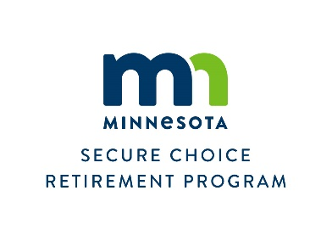
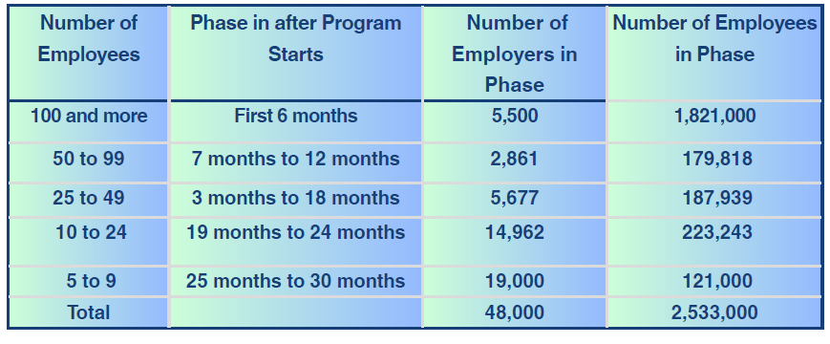
Phased Enrollment and Compliance Timeline FIRST PHASE EXPECTED TO START THE 1ST QUARTER OF 2026

Slide 33
Appendix – Investment Analysis

Slide 34
Appendix: Target Retirement Date Funds Performance
Notes to the Performance Table

Slide 35
Appendix: Stand Alone & Risk Based Performance

Slide 36
Appendix: Partnerships Available to Minnesota
 | Colorado Partnership | Connecticut Partnership
Program Name | Partnership for a Dignified Retirement | Alliance for Retirement Security
Alliance Members | CO, ME, DE, VT, NV | CT, RI
Service Provider | Vestwell | Vestwell
AUM | $135,897,385 | $40,910,000
Custodian | BNY Mellon | BNY Mellon
Investment Advisor |  | BNY Mellon formerly “Lockwood Advisors"
Investment Consultant | Segal Marco Advisors (CO); each state uses its own investment consultant and/or internal team. | Segal Marco Advisors (CT).
Investment Governance | MN Committee Representation Must adopt an aligned IPS Quarterly and Annual Investment Reviews Simple Majority Vote with a quorum | MN Committee Representation Quarterly and Annual Investment Reviews Simple Majority with the Lead State as the final vote if a tie.
Default Investment Options | Account owners who do not choose an investment option will be invested temporarily in the Capital Preservation Option, SSGA’s Institutional U.S. Govt Money Market Fund, for the first 30 days. After 30 days, defaulted into the Target Retirement Date Option based on birth year and expected retirement year. | Account owners who do not choose an investment option will be invested in the Capital Preservation Option, Vanguard’s Cash Reserve Federal Money Market Fund, for the first 60 days. After 60 days, defaulted into the Target Retirement Date Option based on birth year and expected year of retirement at age 65.

Slide 37
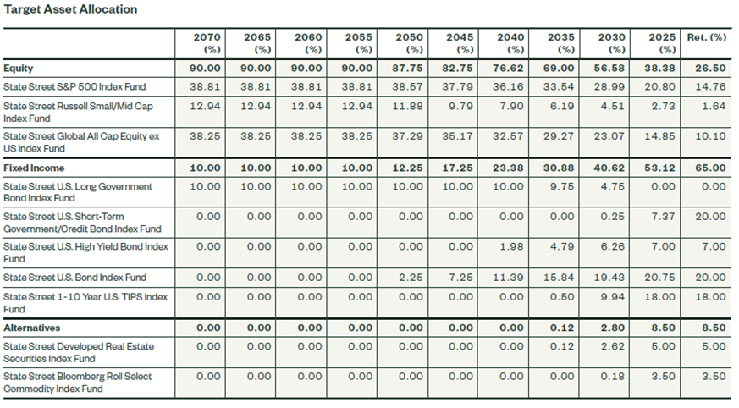
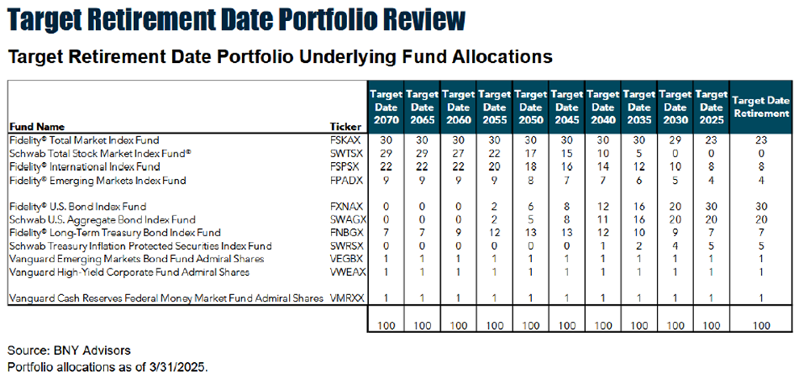
Appendix: Target Allocations
SSGA Target Date Retirement Fund
Target Allocations
Connecticut Custom Target Date Retirement Fund
Target Allocations

Slide 38
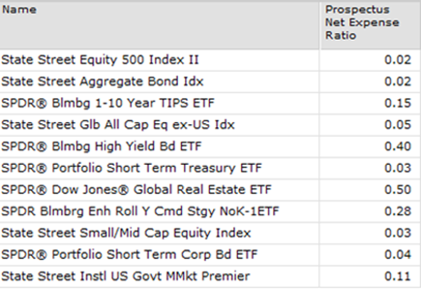
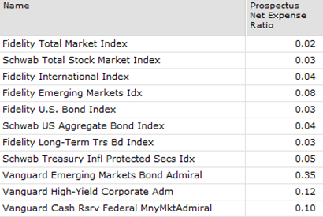
Appendix: Underlying Funds
Connecticut Custom Target Date Retirement and Risk-Based Model Portfolios
Underlying Funds
SSGA Target Date Retirement
Underlying Funds

