Slide 1

Board Meeting
January 10, 2025

Slide 2
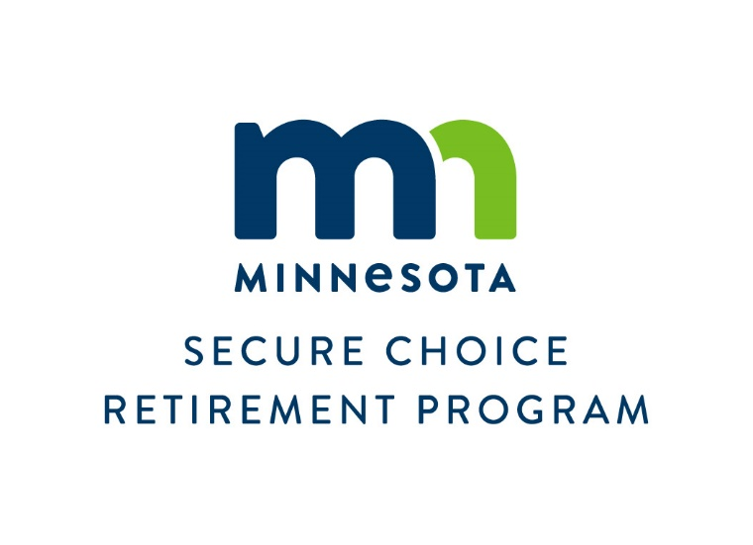
Default Contribution Rates, Default Escalation Rates, Maximum and Minimum Contributions
Default Rates and Auto Escalation Rates in Various States with Similar Programs
State | Contribution Default | Annual Escalation | Default Cap
Oregon | 5% | 1% | 10%
Illinois | 5% | 1% | 10%
California | 5% | 1% | 8%
Connecticut | 3% | N/A | N/A
Maryland | 5% | 1% | 10%
Colorado | 5% | 1% | 8%
Virginia | 5% | 1% | 10%
Maine | 5% | 1% | 8%
Minnesota (proposed) | 5% | 1% | 8%
Change law to separate the Default Rate from
the Maximum Rate
Establish Minimum Rates after Record Keeper is Selected

Slide 3


Compliance Policy Follow-up When Contributions are Withheld But Not Remitted
Staff work closely with employers to resolve compliance issues quickly.
Federal DOL standard should be used.
“as soon as they can be reasonably segregated from an employer’s general assets, but no later than the 15th business day of the month following the payroll date when contributions are withheld.”
Treat as wage theft.
If deductions are not remitted in a timely manner, the Minnesota DOLI and affected employees should be notified, and a schedule should be developed to follow-up on the case.
If the problem persists, the wage theft should be reported to the Attorney General’s office (Minnesota Statutes 187.07, subdivision 6).
The law should be changed to eliminate the requirement that no penalties be assessed during the first year of non-compliance for employers who withhold contributions but do not remit them.

Slide 4

Compliance Policy Follow-up When Contributions are Withheld But Not Remitted
The law stating that penalties should be commensurate with the penalties for not remitting state-tax withholding should be replaced with the following:
Employers must pay the missed contributions to the record keeper to put into the participant’s account.
The employer must pay missed investment gains to put in the participant’s account.
If there are investment losses during this period of noncompliance, they will not be deducted from the employee’s account
The employer should pay the Program and record keeper for the cost of calculating and fixing the error.
For a second offense, and any subsequent offenses, a penalty fee of $250 should be paid to the program.
The 30-day grace period to rectify other noncompliance problems will not apply in cases where contributions are deducted from an employee’s account but not remitted to the Program.

Slide 5


Request for Proposal to Hire an Operational Consultant
Where a consultant could provide advice:
Assist the Board in deciding whether to create a new plan or enter a partnership with other states.
Review the Requests for Proposal if the Board decides to create a stand-alone program or review the requests to enter into a Joint Powers Agreement if the Board decides to enter into a partnership.
Advise on best practices regarding Program implementation, ongoing administration, fee structure, and marketing.
Provide ongoing advice regarding industry developments, legislative or regulatory changes, marketing and outreach, governance policies and risk management.
Develop metrics to measure the success of the Program.
Identify Program weaknesses.
Perform a long-term budget projection to determine the financial viability of the Program.

Slide 6


Annual Board Report
January 2025
The Law Requires the Annual Report To Include:
Total plan assets
Number of participating employers
Number of participating savers
Average contribution
Number of participants who have opted out of the Program
Plan expenses
Required by
Minnesota Statutes,
Chapter 187.08
Subdivision 8, section 10
The Board may want to include other data in the future
The report will also include the following:
Estimated impact of the Program on social safety net programs
Penalties and violations for noncompliance and disciplinary actions for enforcement

Slide 7

Proposed 2025 Law Changes
Withdrawals and Distributions
Delay implementation of lifetime income options to July 1, 2028
Employer Distribution of Program Information
During Initial Enrollment
Maintain requirement that materials will be provided to employees at least 30 days prior to withholding their first contribution
Future Hires after Initial Enrollment Period
Information must be distributed within 30 days of hire date
Eliminate the language that reads “if the covered employee does not elect to opt out of the program”
Conflict of Interest; Economic Interest Statement for the Executive Director
Executive Director must follow same conflict of interest as required of the Board
Executive Director must file an economic interest statement with the Campaign Finance and Public Disclosure Board

Slide 8
Create a New Program or Join a Partnership
Create a Stand-Alone Program | Partnership with Existing Program in Other States
Decide what investments to offer | Investment choices are pre-determined
Hire a Record Keeper | Record Keeper is pre-determined
Total authority of how fees are assessed | Fees are pre-determined with minimal flexibility
Do you want field representatives provided by record keeper | Partnership determines whether field representatives are provided by record keeper
More control over interactive transactional web site Program can offer its own web site which provides access to the transactional web site | Interactive transactional web site can be slightly customized for each state, but within an established template. Program can offer its own web site which provides access to the transactional web site
Can request access to customized reports | Standard reports
Direct Fiduciary Oversight | Fiduciary Oversight is through a committee process
More control over Program details | Partnership controls Program details
Significantly higher initial cost since Record Keeper has more financial risk with a stand-alone Program. (How fast does the Program grow? How many people opt out? How many employers will start their own retirement Program? How much does the Program want to customize?) | Lower initial cost since Record Keeper has already established revenue and can spread the risk among several programs. Little customization.
Higher ongoing cost during five-year term of the contract. The record keeper wants to make a profit | Lower ongoing cost during five-year term of the Agreement. The start-up costs are lower, and the risk is spread among several Programs
Longer implementation time | Shorter implementation time

Slide 9
Establishment of a Board Committee to Facilitate the Selection of a Record Keeper or a Partnership with Another State-facilitated Auto-IRA Program
Hire an operational consultant | January 15 | April 15
Permanent Executive Director Search | January 15 | May 1
Solicit Proposals for Record Keeping or Joining a Partnership |  | March 1 June 1
*An alternative would be to direct the Interim Director to handle the RFP process and have the State Board of Investment Staff
and the consultant present results to the full Board.

Slide 10

Thank You!

