Slide 1

Marc Majors, Deputy Commissioner for Workforce Development

Slide 2
Historic Legislative Session
The February Budget Forecast projected a $17.5 billion surplus.
The 2023 Legislature passed historic investments in legislative priorities, including passing a $72 billion biennial budget and infrastructure investments of $2.6 billion.
For DEED, this amounts to almost $1.8 billion in total investments in FY24-25.

Slide 3

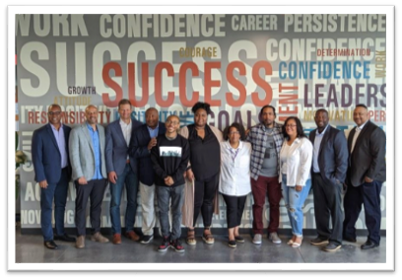
Drive for 5 Workforce Fund
The Jobs bill provides $20 million in the FY24-25 biennium for the Drive for 5 Workforce Fund to prepare the workforce to enter five of the most critical occupational categories in the state with high-growth jobs and family-sustaining wages:
Technology
Caring professions
Education
Manufacturing
Trades
Competitive grants focused on training + support services with funding for Trade Association sector partnerships to engage business associations in job matching.

Slide 4

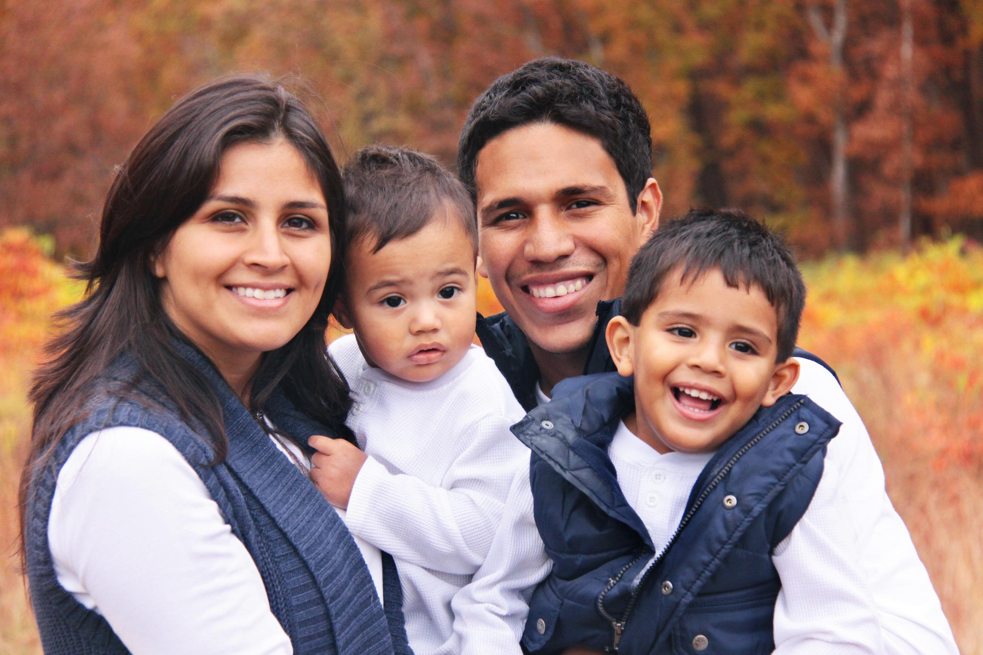
Targeted Population Workforce Programs
This Jobs bill invests $50 million million in the FY24-25 biennium and $2.550 million in the FY26-27 biennium in employment services and training to bring workers who have been overlooked for employment – particularly people of color – into the workforce at family-sustaining wages.
This is a critical initiative to bring Minnesotans into the workforce, ensure employers have the staff to help their business thrive, and move Minnesota’s economy forward.

Slide 5

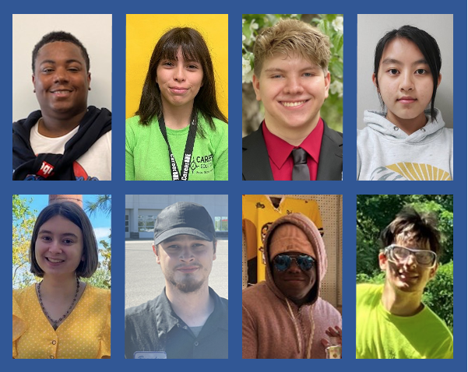

Youth Workforce Development
The Jobs bill doubled the existing funding to put $20 million in the FY24-25 biennium toward youth workforce development – which will serve over 38,000 young people.
This expands Minnesota’s results-driven Youth at Work, Minnesota Youth Program and YouthBuild programs to prepare more Minnesota young people to enter the workforce focused and work-ready.

Slide 6
Clean Economy Equitable Workforce
$3 Million in FY24-25 in grants for:
Workforce readiness programs
Must prepare workers for careers in the high-demand fields of construction, clean energy, and energy efficiency
Focused on workers who are Black, Indigenous, and People of Color
Grants to nonprofit organizations that serve historically disenfranchised communities with preference for organizations that are new providers of workforce programming or which have partnership agreements with registered apprenticeship programs

Slide 7
Additional Grant Opportunities
Pathways to Prosperity - Currently Open
Women Economic Security Act - Currently Open
Southeast Asian Grants - Currently Open
Adult and Youth Supportive Services - Adult is currently Open
Getting to Work - Currently Open
Can-Train - Released in the Fall

Slide 8

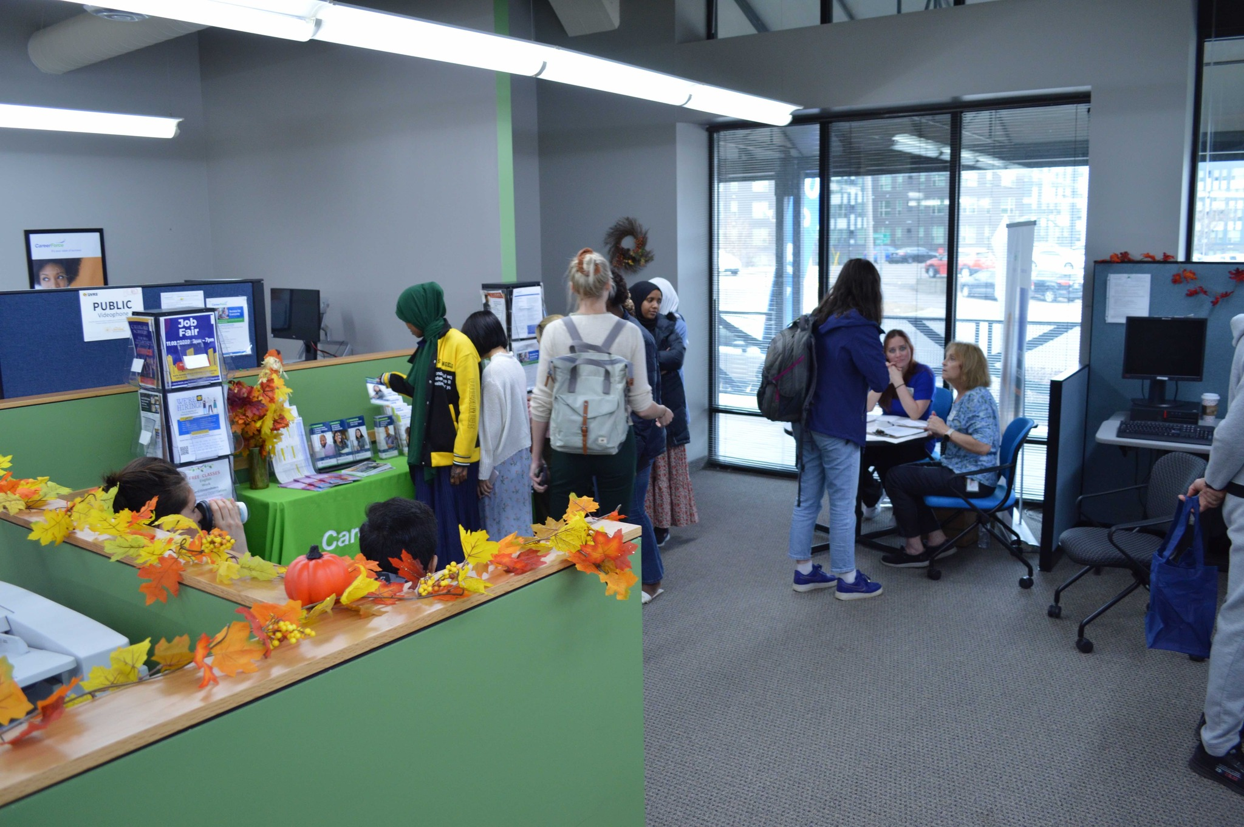
Office of New Americans
The Jobs bill creates the Office of New Americans and funds it at $1.5 million in each biennium. The office will:
Support immigrant and refugee integration
Reduce barriers to employment, and
Improve connections between employers and job seekers.
Minnesota’s new Americans create robust businesses, offer extraordinary cultural contributions, and play a critical role in meeting labor needs throughout Minnesota. But there are multiple barriers to getting established in Minnesota.

Slide 9
Thank You!

