Slide 1




Partnership Program for Spring Leaf-Off Imagery
March 7, 2012

Slide 2
Agenda for Today’s Meeting
Introductions and Overview
Project Specifications
Acquisition Region(s)
Control Targets
Project Status
Partnership Opportunities & Schedule

Slide 3
Steering Committee
Steve Kloiber – MnDNR
  Primary funding partner; technical guidance
Chris Cialek – MnGeo
  Project management, coordination, contracting
Pete Jenkins – MnDOT
  Control target coordination; technical guidance

Slide 4
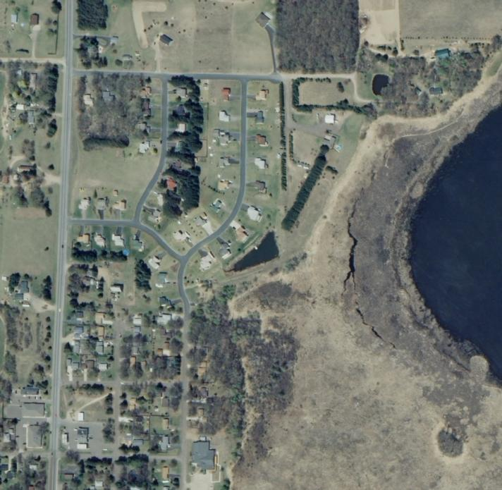
Overview
Statewide project to collect leaf-off color imagery over 5 years
Spurred on by DNR efforts to update wetlands mapping
0.5-meter (20-inch) nominal resolution
Offer local partnership options to buy-up at improved 1-foot res.

Slide 5
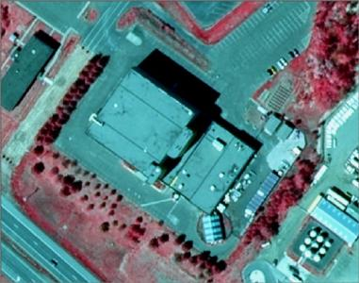
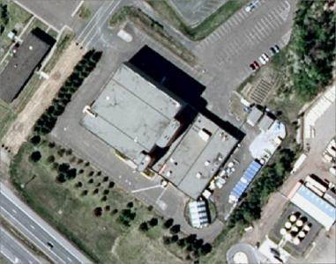
Project Specifications
Four Spectral Bands
Near IR
Red
Color Infrared
Green
Blue
Natural Color

Slide 6
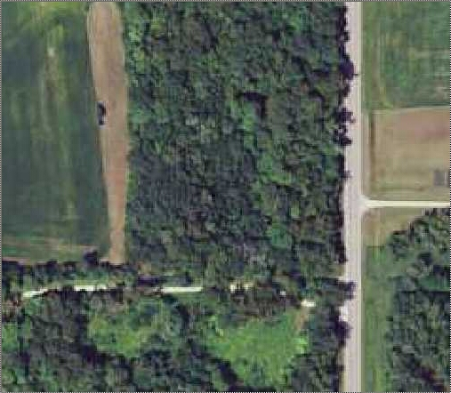
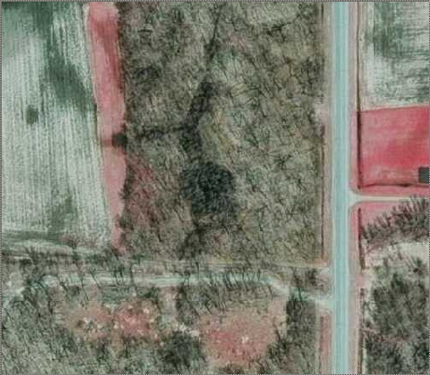
Project Specifications – Leaf-Off

Slide 7

Project Specifications - Format
Ortho-rectified quarter quad (tif)
Compressed county mosaic (jp2)
Digital stereo pairs (tif)

Slide 8
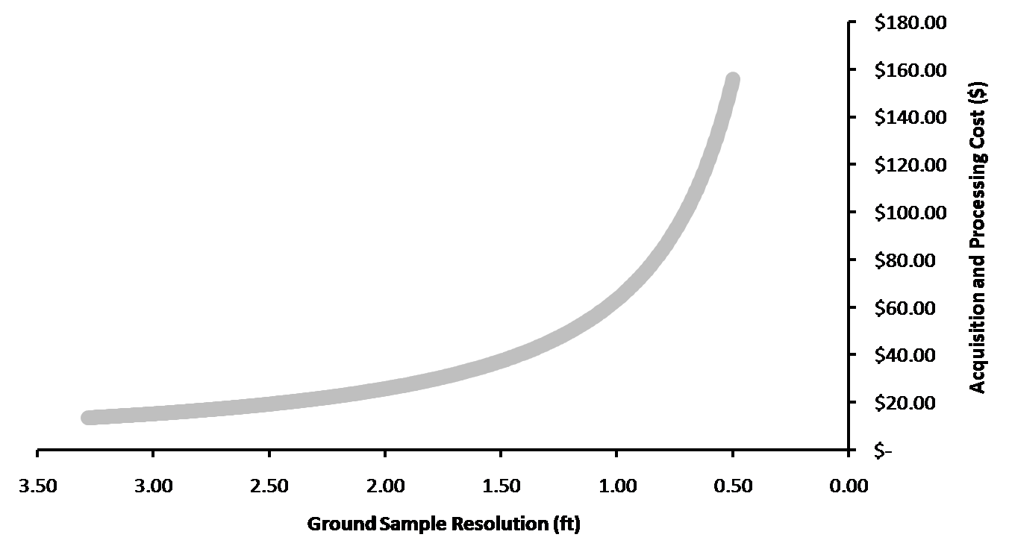
What Resolution?
Cost vs. benefit
Managing risk
  Tight time window
  Large, complex project
  Manage the number of variables/requirements

Slide 9
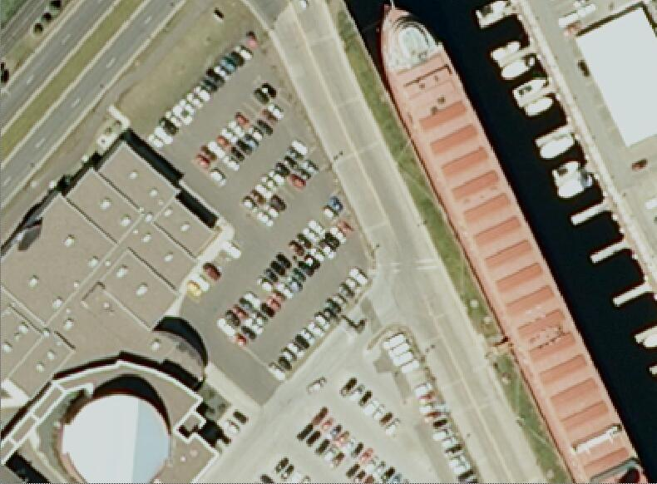
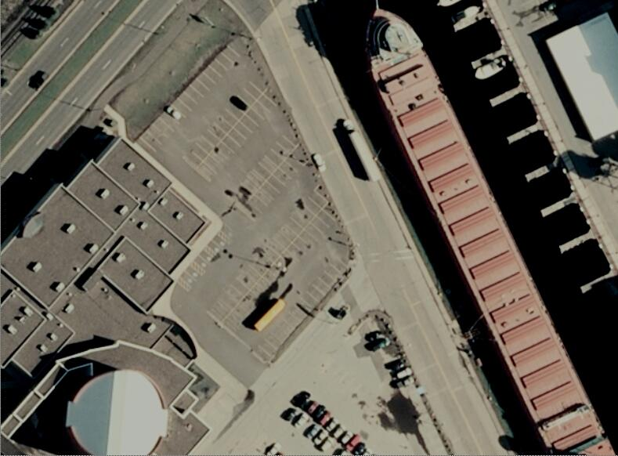
Project Specifications - Resolution
50-cm or 30cm

Slide 10
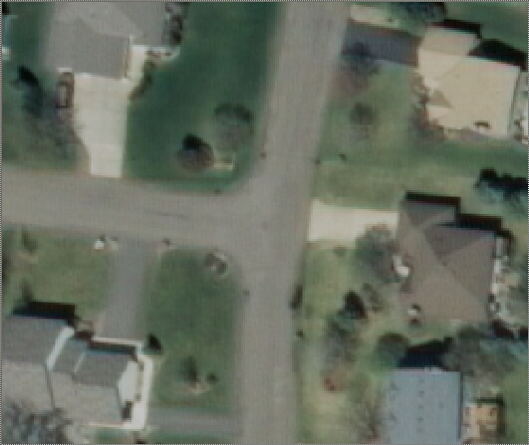
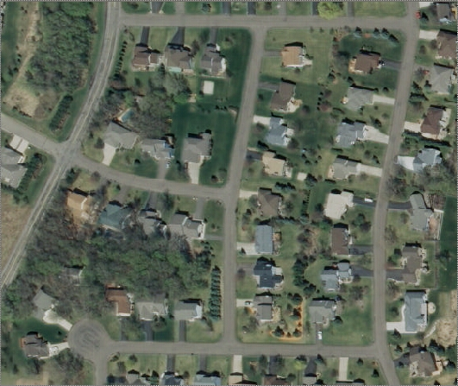
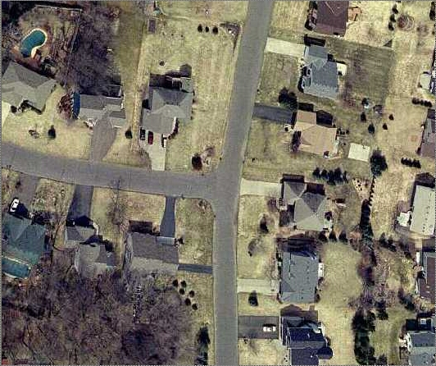
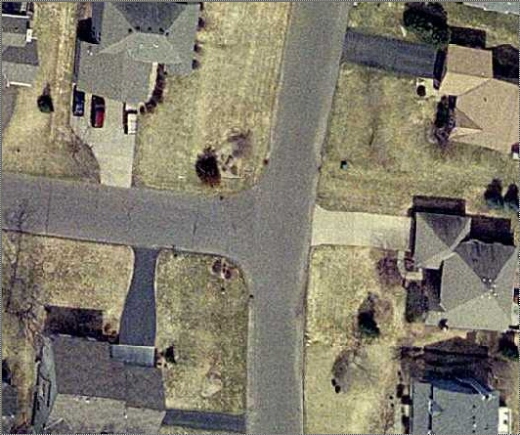
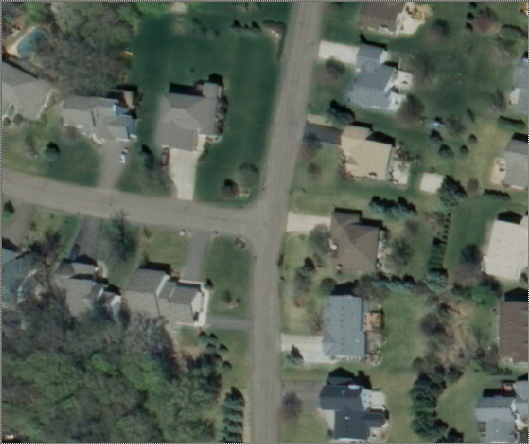
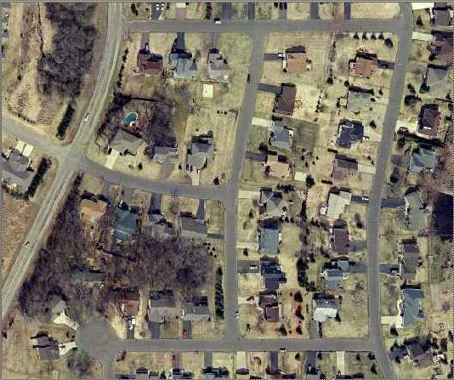
Resolution Comparison
12-inch GSD
6-inch GSD
1 inch = 200 feet (1:2400)
1 inch = 100 feet (1:1200)
1 inch = 50 feet (1:600)

Slide 11
Project Specifications – Positional Accuracy
Map Scale | Ground Sample Resolution | ASPRS Accuracy 95% (NSSDA) (ft)
1:1500 | 0.15 m (6-inch) | 3.06
1:3000 | 0.30 m (1-ft) | 6.12
1:5000 | 0.50 m | 10. 0
1:10000 | 1.00 m | 20.1
Tested 95% Accuracy
Northeast 2009 = ±11.5 ft
East-Central 2010 = ±4.40 ft
South 2011 = ±4.65 ft

Slide 12
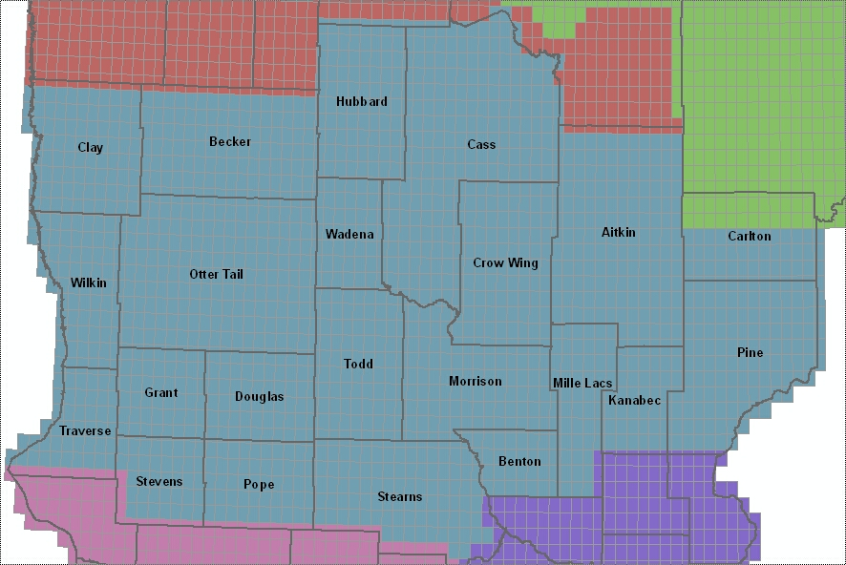
Central Acquisition - 2013
14.2 Million Acres

Slide 13
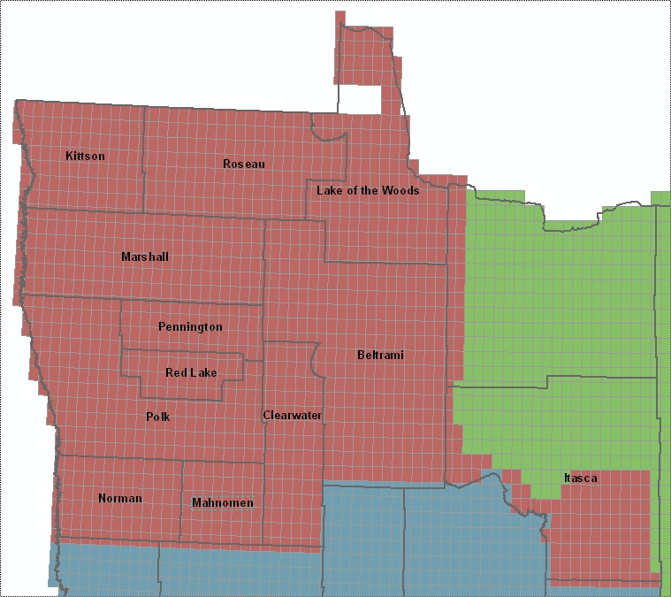
Northwest Acquisition – (2014?)
10.5 Million Acres

Slide 14
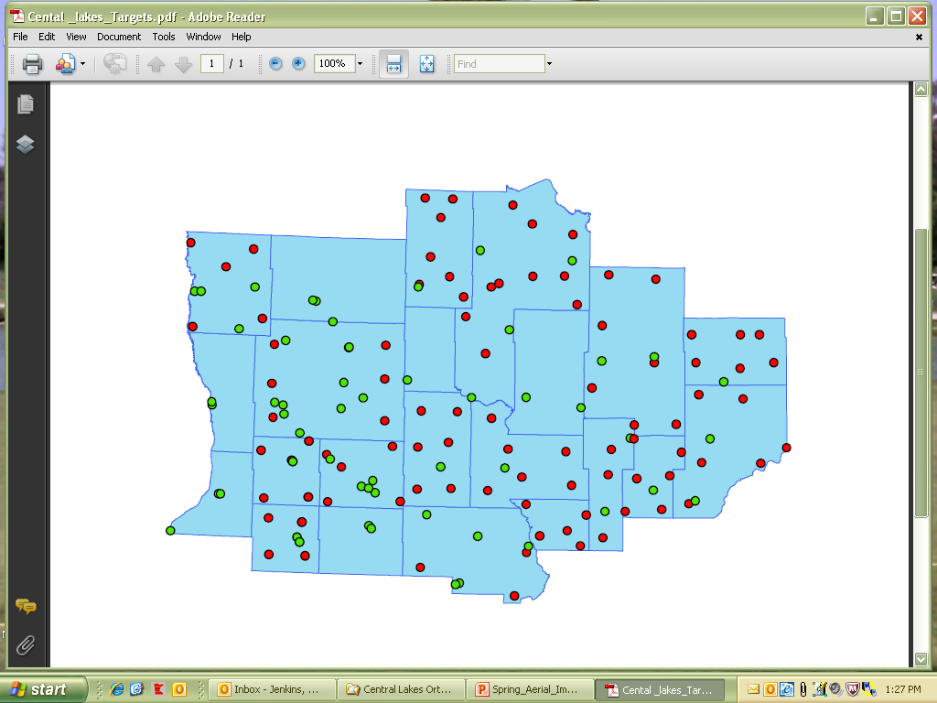
2008 FSA Target Inventory

Slide 15
2011 Target Requirements
Two ways to capture target data
Targets (2008)
Physical features

Slide 16
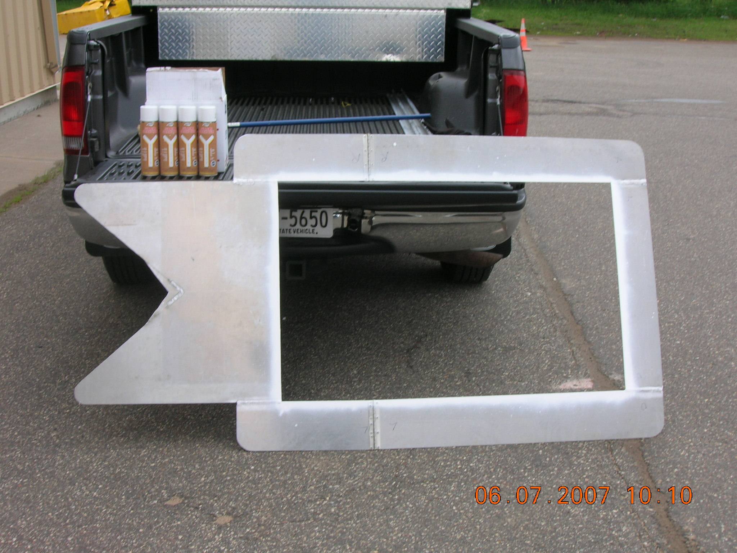
Single Leg Template

Slide 17
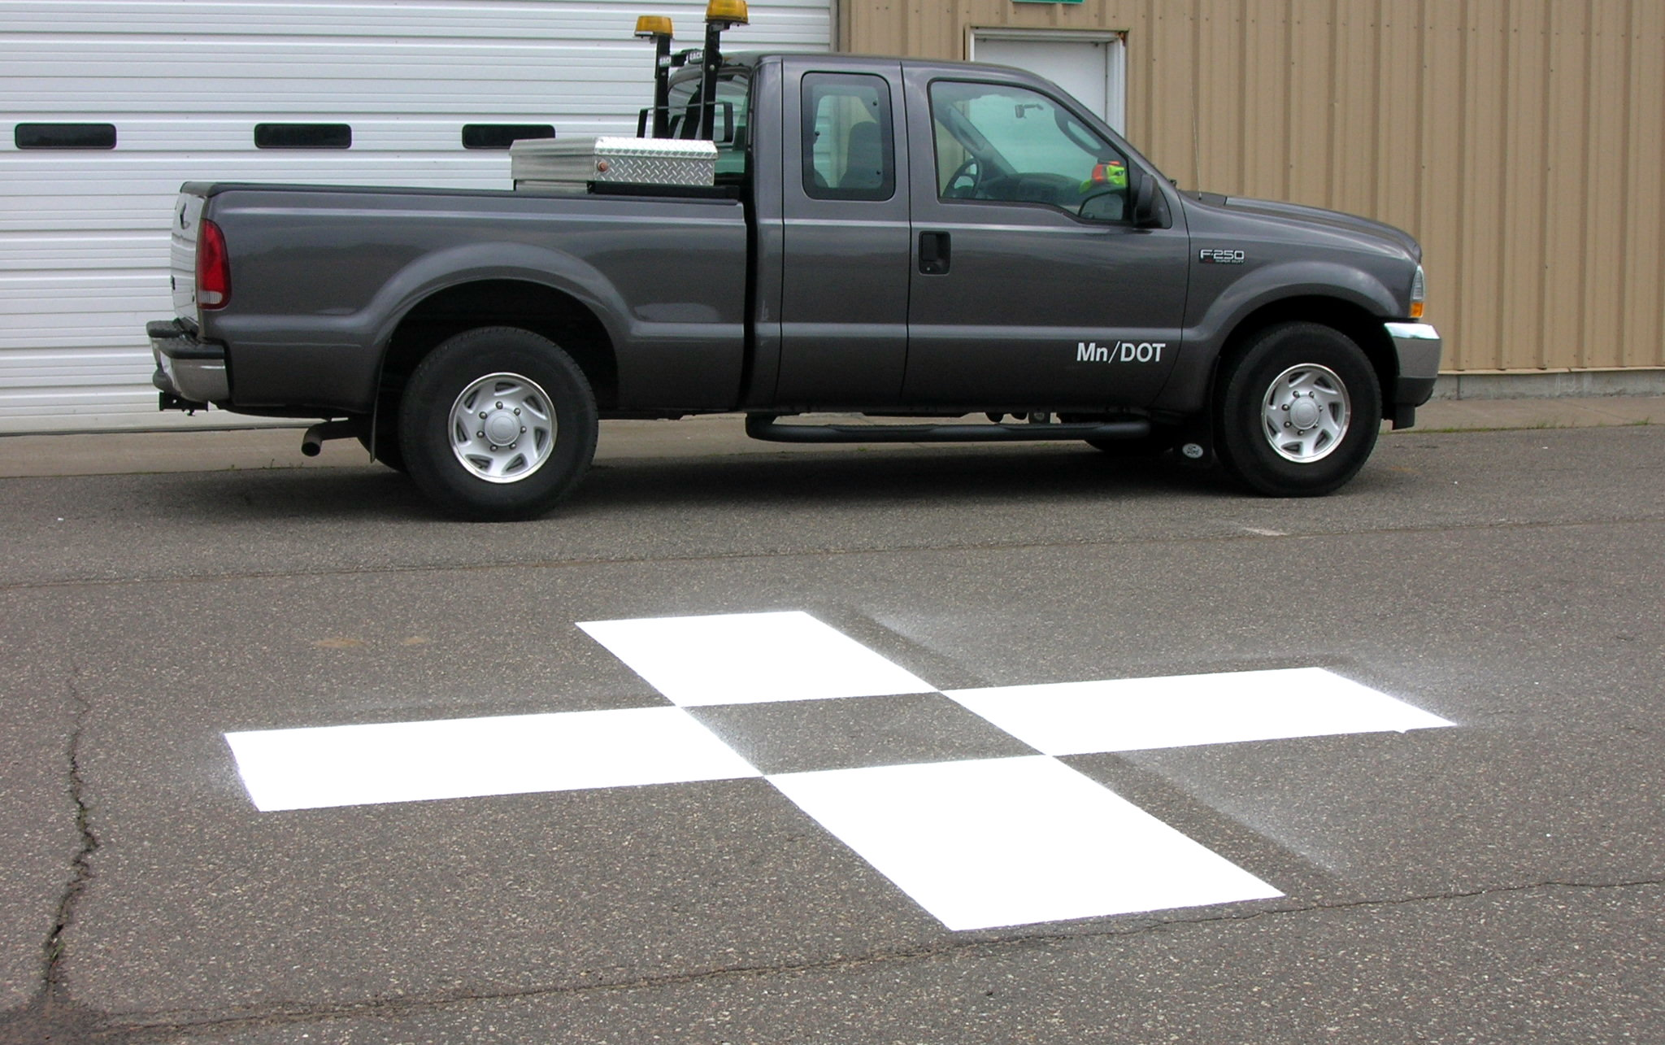
Completed Target

Slide 18
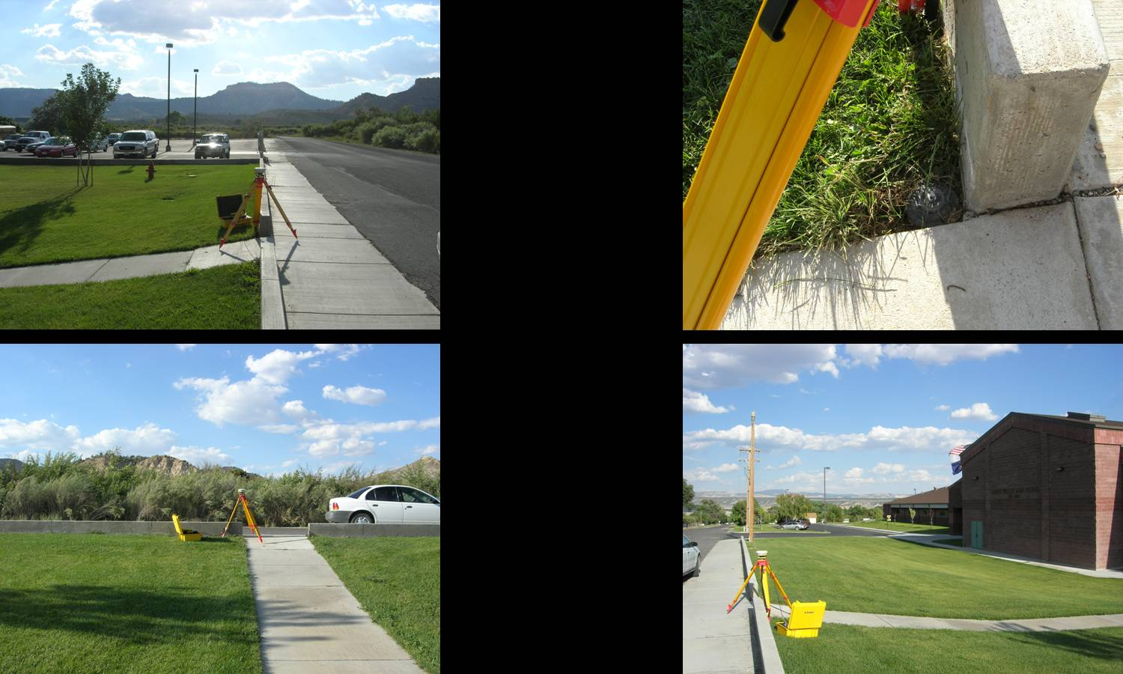
Physical Features

Slide 19
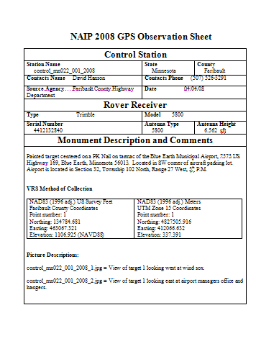
Documentation
2008 FSA Observation Sheet
Use the same form
Pictures are necessary
Will share data with FSA

Slide 20
What is Needed?
Existing targets need to be re-painted
New targets for counties with low numbers
Follow up with documentation

Slide 21
SAIP Partnership Opportunities
Standard Statewide coverage:
  ½ meter (1.6 feet)
  Four band; leaf off
  Stereo and ortho (no provision for oblique at this time)
Buy-ups offer:
  Increased resolution/detail
  Improved accuracy
  Complete specific area of interest
  Volume pricing

Slide 22
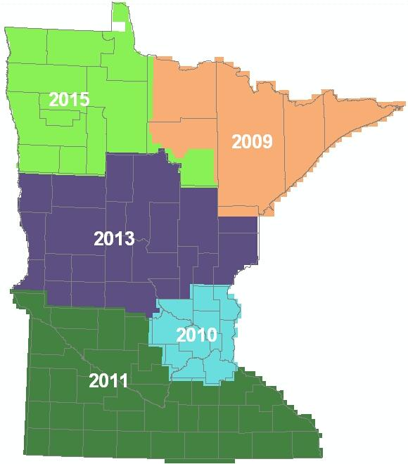
SAIP Partnership Opportunities
How?
  Joint Powers Agreement
  Interagency Agreement
  Purchase Order

Slide 23

2010 Metro Imagery Partnerships
CONTRACT
INTERAGENCY AGREEMENT
PURCHASE ORDER
JOINT POWERS AGREEMENT
DNR
Metropolitan Council
INFORMAL AGREEMENT
Rice County
MnGeo
USGS/NGA
Dakota County
Scott County
MMCD

Slide 24
Estimated Cost at Three Resolutions
 | 1/2-meter | 1-foot | 6-inch
State contribution | $ 17 | $ 17 | $ 0
County contribution | $ 0 | $ 28 | $ 133
Total cost/square mile | $ 17 | $ 45 | $ 133

Slide 25
Comparative Costs
 | 1/2-meter | 1-foot | 6-inch
Wisconsin 2010 (WROC) | $ 34² | $ 75² | $ 300²
Maine 2012 | $24²* | $ 58² | $ 141²
MINNESOTA BUY-UP | $ 0¹ | $ 28¹ | $ 133¹
2 foot resolution
¹ ASPRS Accuracy Class I
² ASPRS Accuracy Class II

Slide 26
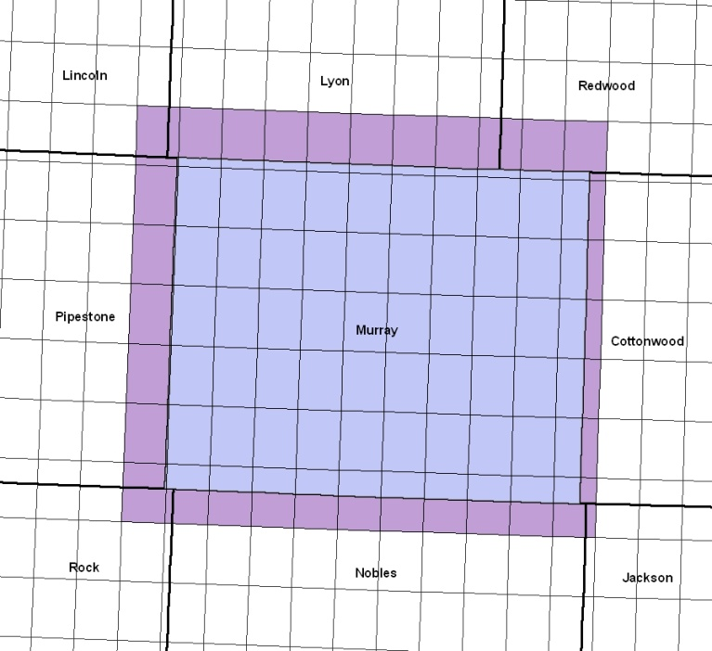
Estimated Cost and Compactness
 | 1-foot Large & Compact | 1-foot Small & Scattered
State contribution | $ 17 | $ 0
County contribution | $ 28 | $ 47
Total cost/square mile | $ 45 | $ 47
 | MURRAY COUNTY
To county line: | 745 sq. mi. X $47 = | $35,000
To quad line: | 1,035 sq. mi X $28 = | $29,000

Slide 27
Spring Aerial Imagery Program Partnerships 2009 – 2011

Slide 28
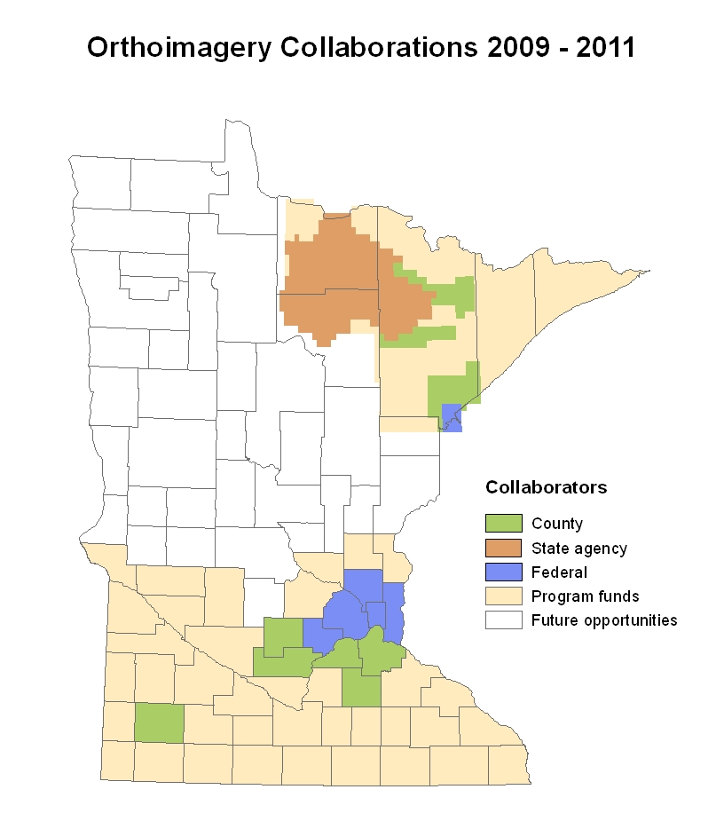

Slide 29
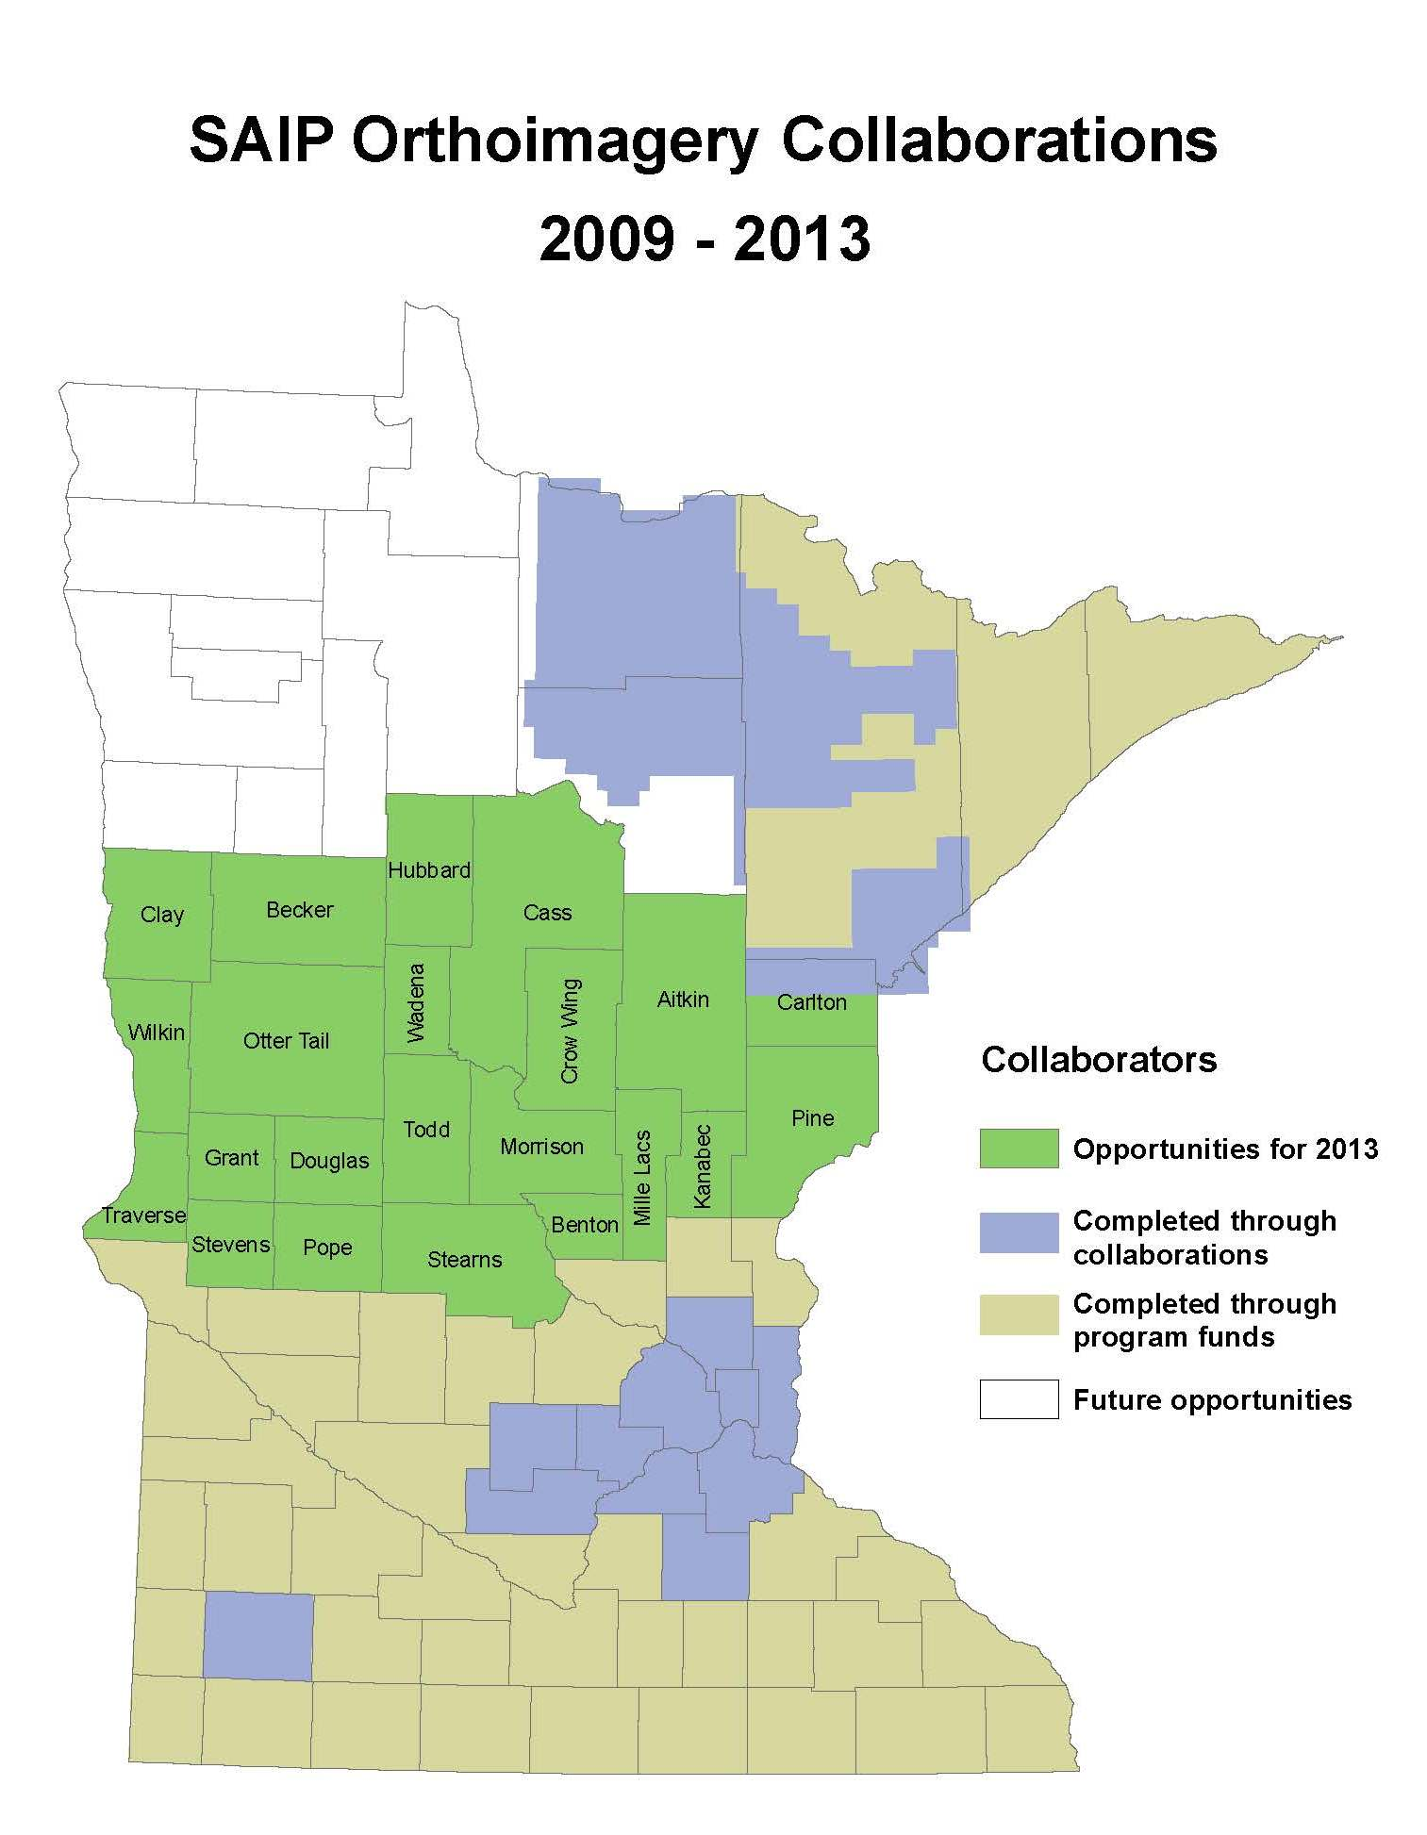

Slide 30
Tentative Schedule
2012
March – May: Partnership information meetings
November: Letters of intent
December: RFP issued
2013
January – March: Proposals due/evaluated, final vendor negotiations, award made, partnership Joint Powers Agreements executed
March – May: Field observations, control point refresh, flights
May – November: Data delivered evaluated; QA/QC
December: Final delivery, acceptance

Slide 31
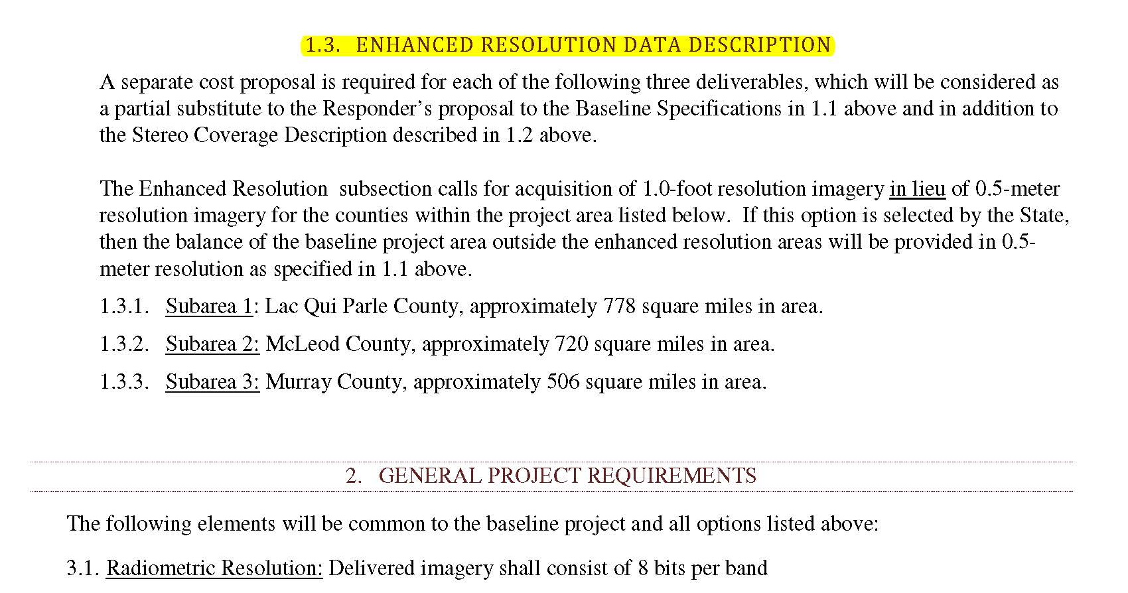
Request for Proposals (RFP)

Slide 32
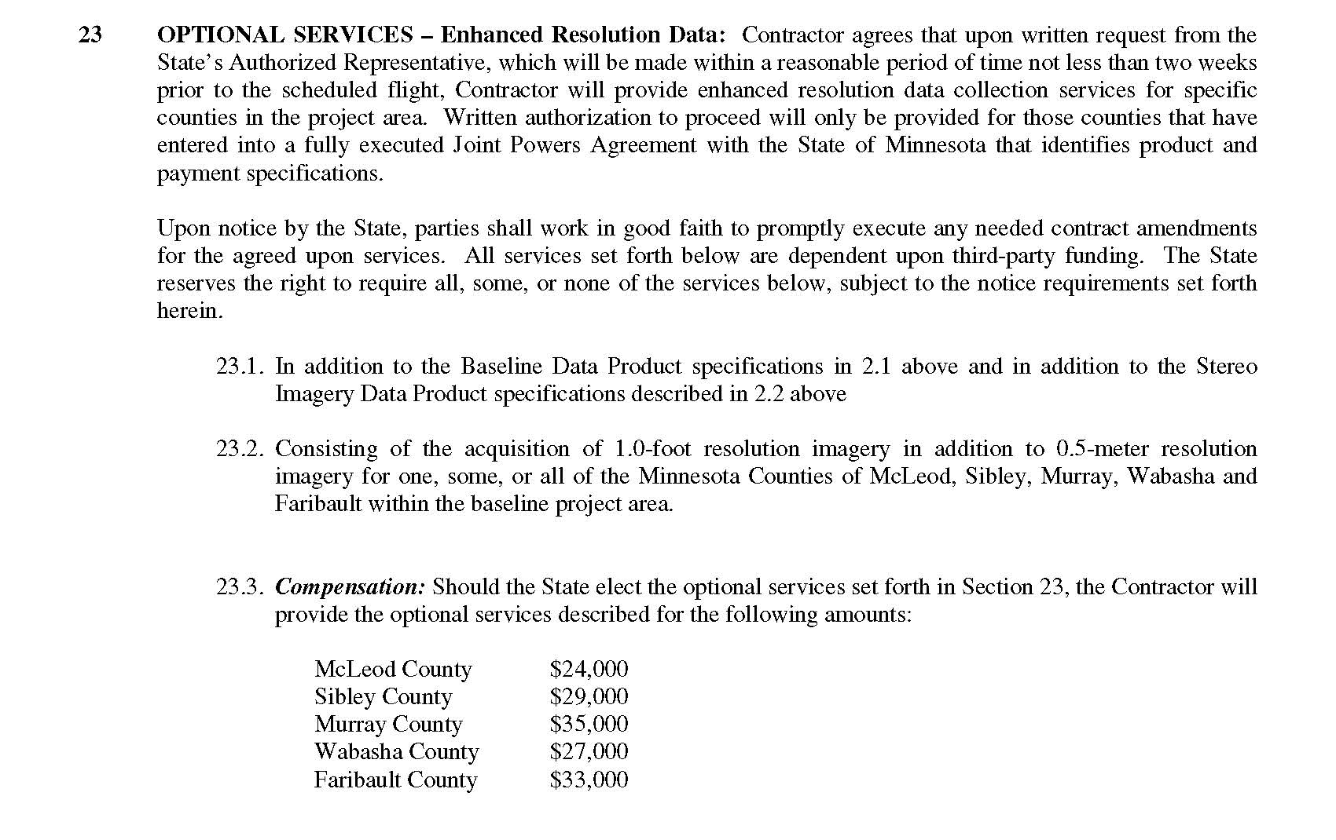
Contract

Slide 33
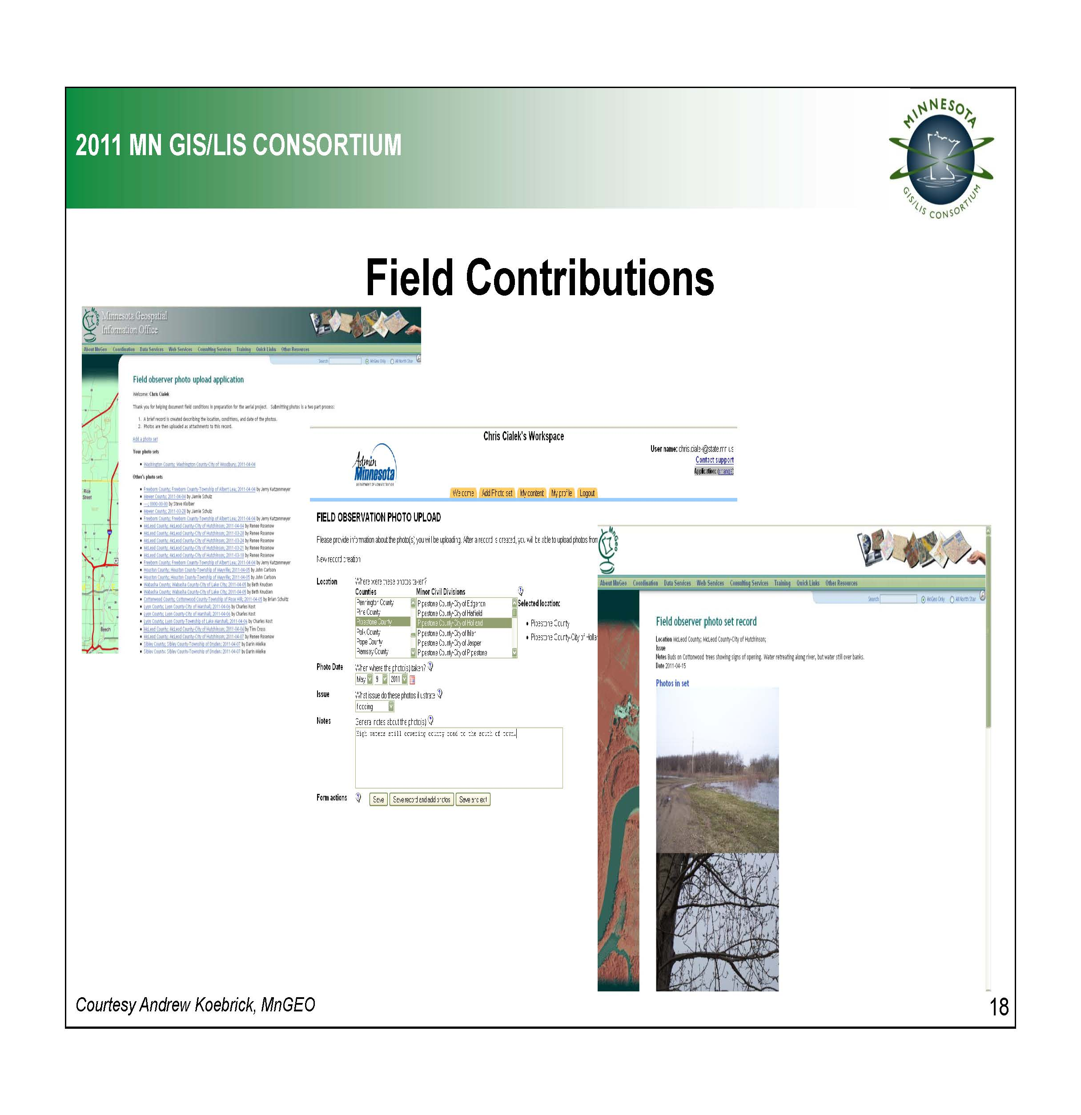

Slide 34
Data Management
Quarter quadrangle GeoTiffs, county mosaics, stereo, metadata
Data storage at DNR, partner organizations, back-up at MnGeo
Publicly available
Accessible through Web Mapping Service

Slide 35
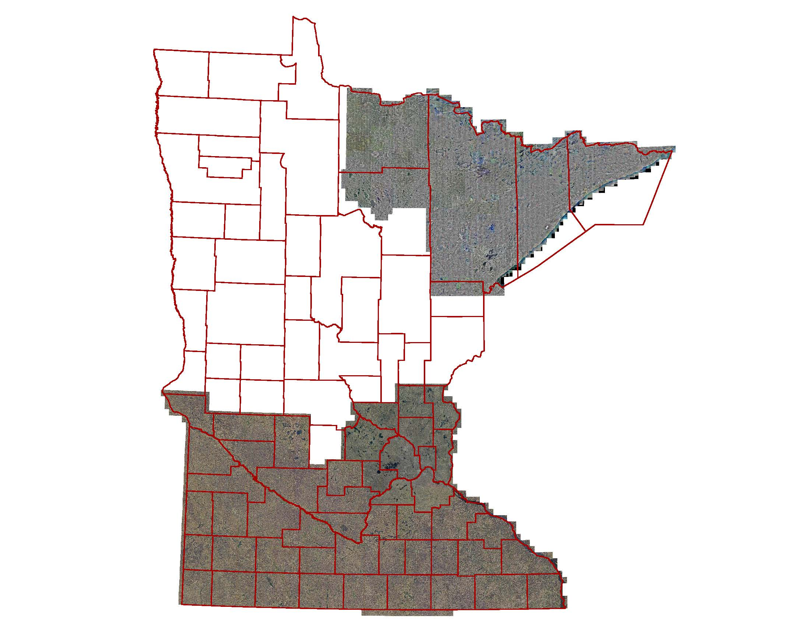
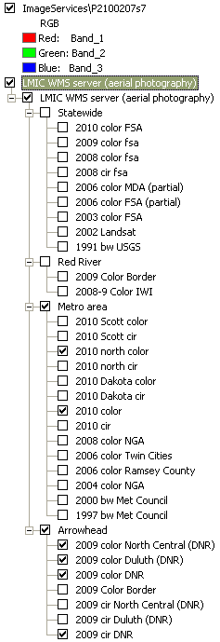
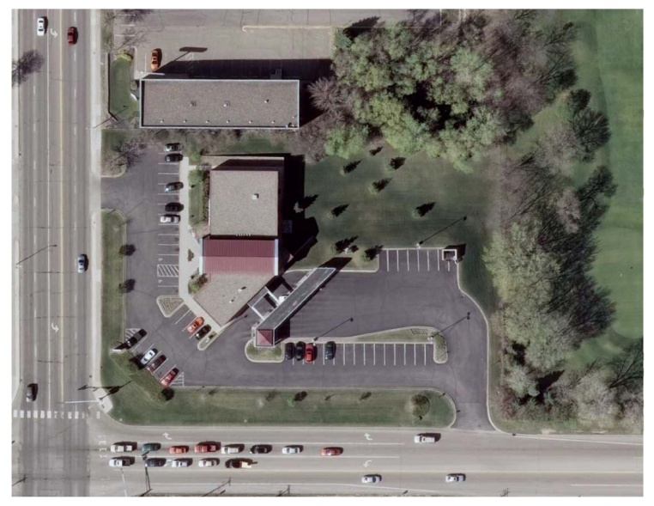

Slide 36
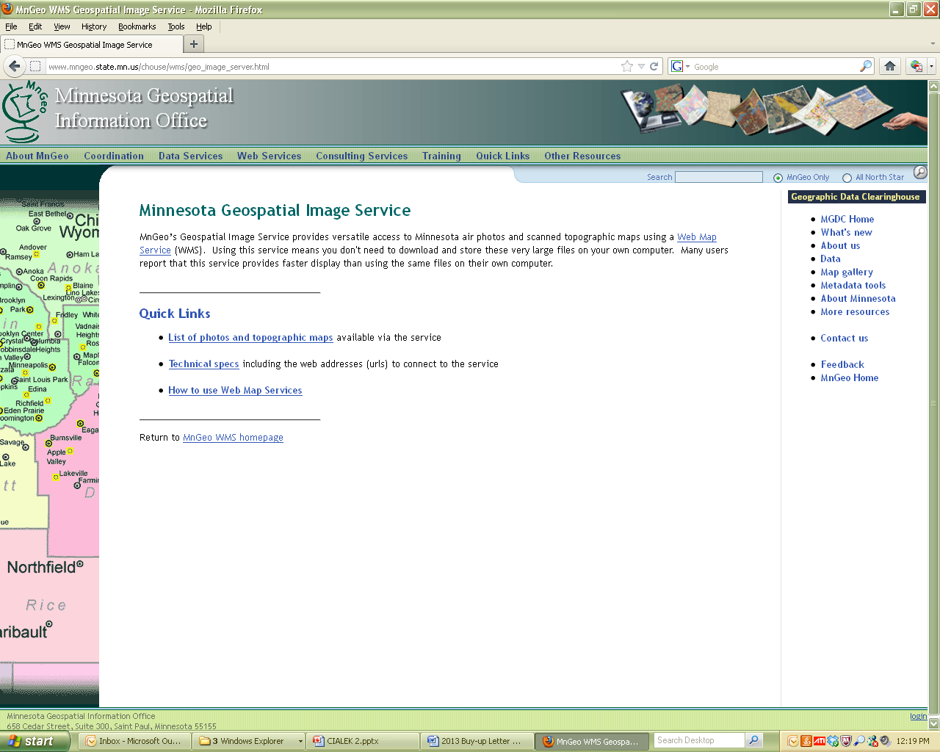
http://www.mngeo.state.mn.us/chouse/wms/geo_image_server.html

Slide 37
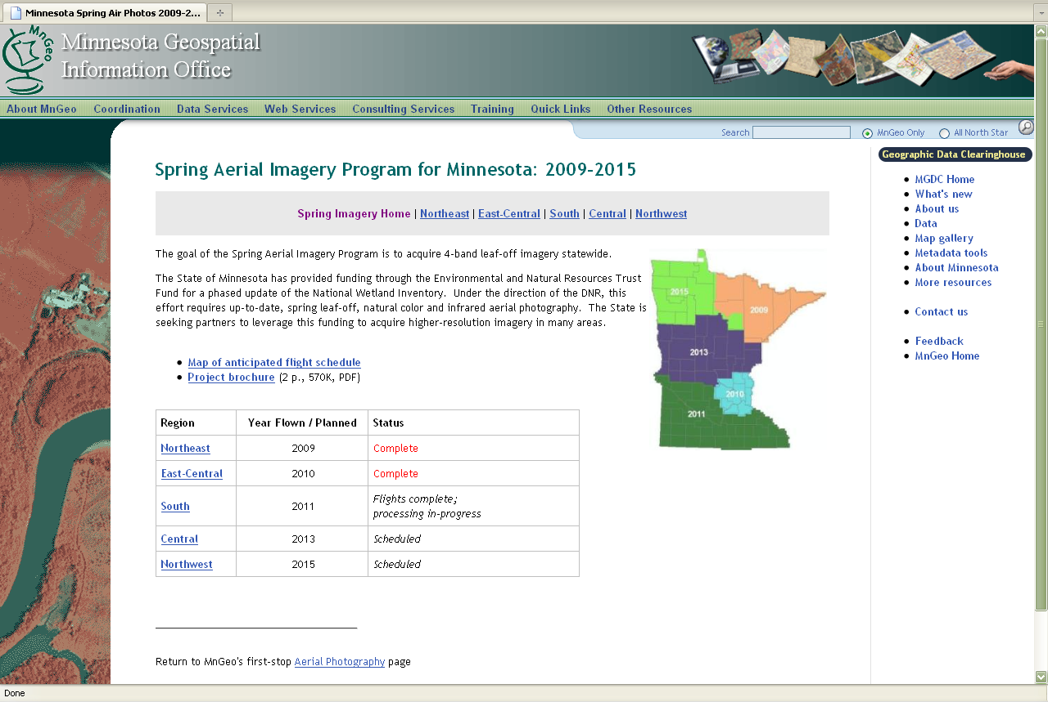
http://www.mngeo.state.mn.us/chouse/airphoto/spring2009-2015.html

Slide 38
Spring Leaf-Off Imagery for Minnesota
THANK YOU FOR ATTENDING
Q & A
steve.kloiber@state.mn.us
651.259.5164
chris.cialek@state.mn.us
651.201.2481
peter.jenkins@state.mn.us
651.366.3457

