Slide 1
Accessing and Viewing Minnesota LiDAR Data On-line
MnTOPO – A place to view, print, and download LiDAR Elevation Data
Tim Loesch
MN.IT Services @
Minnesota Department of Natural Resources
Mn GIS/LIS Conference
October 10, 2013

Slide 2
MnTOPO Elevation Portal
Background
Introducing the MnTOPO Elevation Data Portal
Portal Capabilities – what it is, and what it is not….
Downloading Data
  Options and formats…..
Questions and Answers….

Slide 3
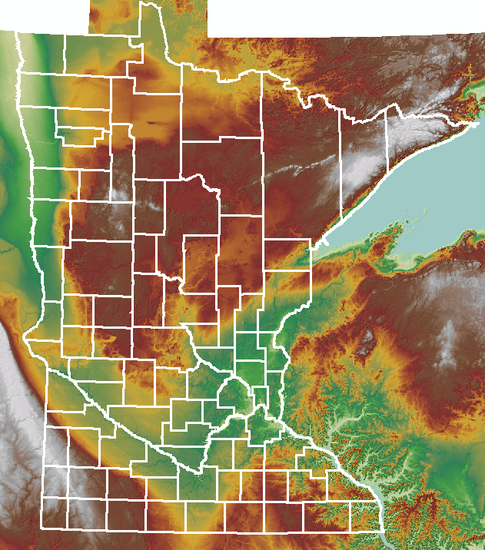
MnTOPO Elevation Portal
Minnesota Elevation Mapping Project
  High accuracy elevation data
    Statewide Availability
    Open Data – Available to everyone
    Common format and structure
    Fully documented

Slide 4

MnTOPO Elevation Portal
Funded by a variety of sources
  Minnesota Clean Water Legacy
  State of Minnesota
  Federal Government (USGS, NRCS, COE)
  Minnesota Counties and Cities
  State of North Dakota

Slide 5
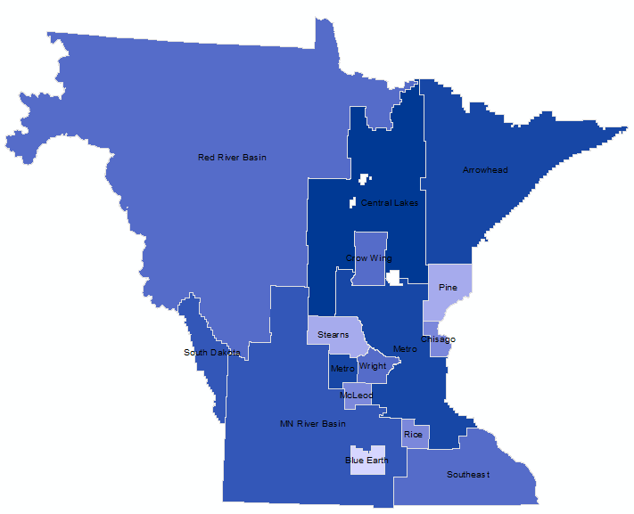
MnTOPO Elevation Portal
15 different collects
  2005 – 2012

Slide 6
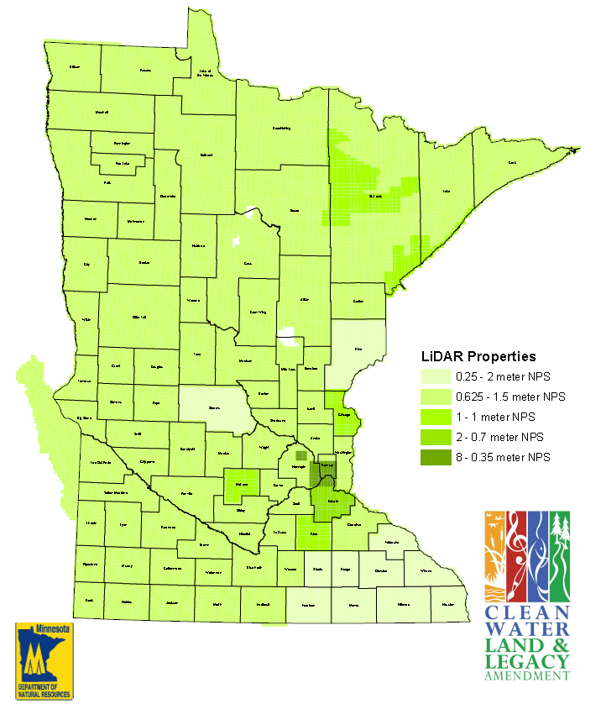
MnTOPO Elevation Portal
Point spacing
  0.25 – 8 pts/meter

Slide 7

MnTOPO Elevation Portal
ME
The last few years…Project Management
  Contracts – 6
  Amendments - 5
  Inter-agency agreements (2)
  Grants (2)
  Joint Powers Agreements (4)

Slide 8
MnTOPO Elevation Portal
YOU
The last few years - Distribution and Access
  FTP access is available
  Good for large downloads
  Not ideal for all users
I just want the damn data!

Slide 9
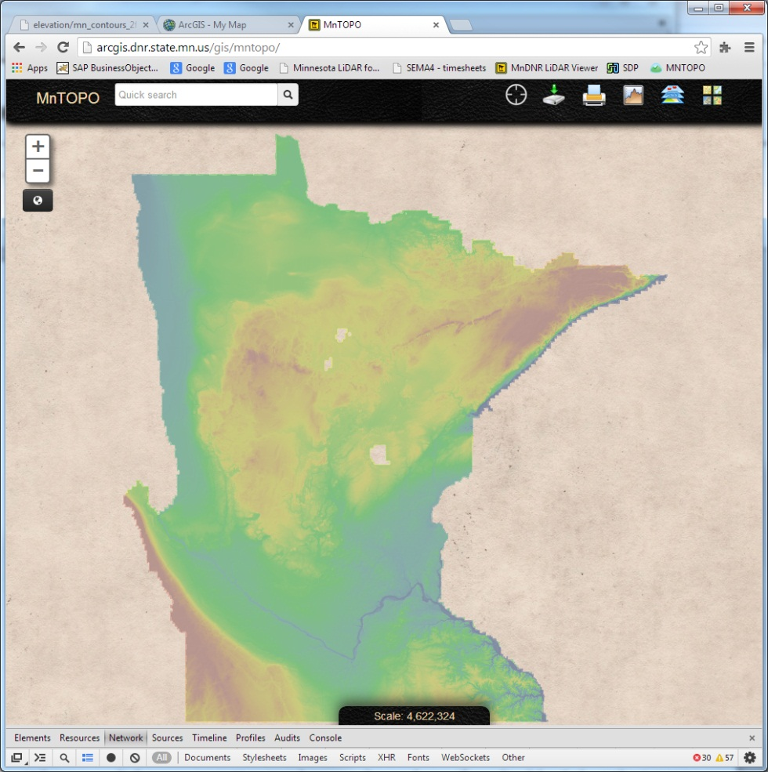
MnTOPO Elevation Portal
MnTOPO - On-line access to Elevation data
http://arcgis.dnr.state.mn.us/gis/mntopo
Notes:
Introducing MnTOPO – the Minnesota elevation data portal

Slide 10
MnTOPO Elevation Portal
MnTOPO - On-line access to Elevation data
  Collaborative effort between DNR, MN.IT @ DNR and MnGEO
  @ DNR
    Application coding and hosting
    Map and data services for viewing
  MnGEO
    Data processing and storage
    Bundling and fullfillment of data packages

Slide 11

MnTOPO Elevation Portal
MnTOPO - On-line access to Elevation data
  Browser Based Application
Notes:
A number of overarching goals for the application
Browser based
Centrally Managed
Consuming Web Services – Bing, ESRI, DNR, MnGEO Etc….
Javascript and HTML5
Easily provide access to the public

Slide 12


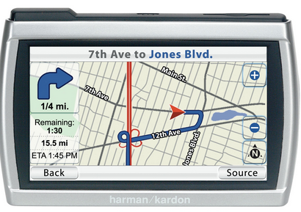
MnTOPO Elevation Portal
MnTOPO - On-line access to Elevation data
  GPS enabled
Notes:
Wanted to enable field use by accessing GPS and showing your location on screen
Enables Mobile application use
Requires HTML5 to access location capabilities on device.

Slide 13

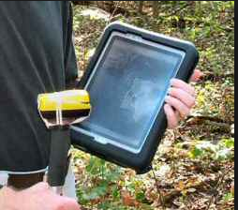
MnTOPO Elevation Portal
MnTOPO - On-line access to Elevation data
  Mobile Device ready
Notes:
Manipulating touch screens – provided it’s own set of issues
hover help…
dealing with touch screens
Accessing location capabilities
Phones are another challenge because of their small size….

Slide 14
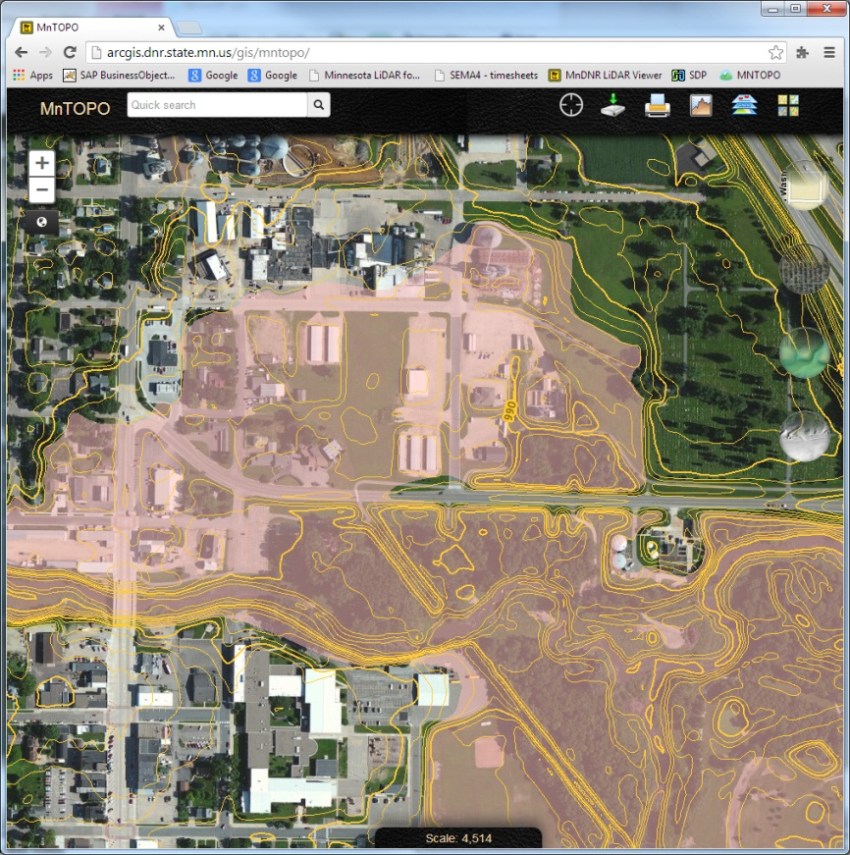
MnTOPO Elevation Portal
MnTOPO – On-line access to Elevation data
  Map Display
    Backgrounds
      Basemap (ESRI/BING)
      Air photos (ESRI/BING)
      Terrain – Colored DEM over the top of hillshade
      Hillshade
    Overlays
      2, 10, 50 ft Contours
      LiDAR Flight Lines
      FEMA Flood Data
Notes:
System had to have map display capabilities
Backgrounds and overlays….

Slide 15
MnTOPO Elevation Portal
MnTOPO - On-line access to Elevation data
  Map Display
    Elevation data tile-cached for speed
    Web Mercator projection
    1:2,257 – 1:4,622,324 scales
  These factors affect printing……..
Notes:
Raster tile cache – 20 levels (hillshade and elevation)
Vector tile cache - levels dependent on contours 2’, 10’, or 50’

Slide 16
MnTOPO Elevation Portal
MnTOPO - On-line access to Elevation data
  Searching
    Uses BING Search Engine
      Addresses, place names, coordinates

Slide 17
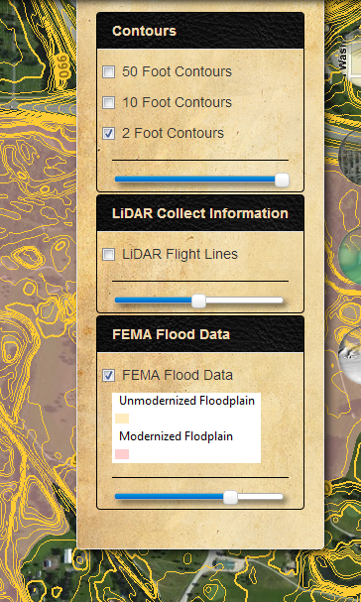
MnTOPO Elevation Portal
MnTOPO – On-line access to Elevation data
Transparency Sliders
Notes:
Vector Overlays have transparency sliders to increase or decrease transparency….

Slide 18
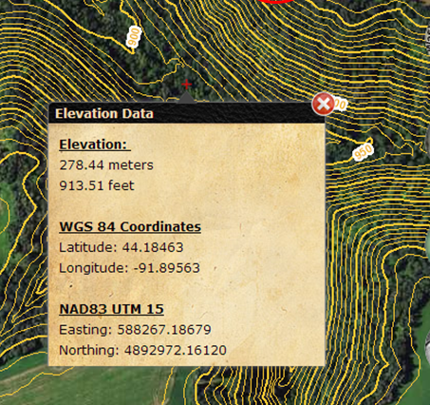
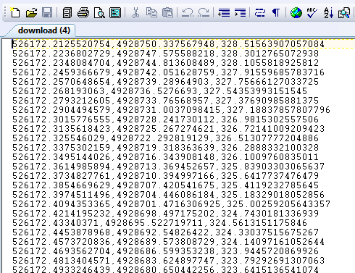
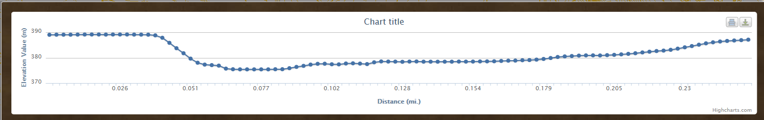
MnTOPO Elevation Portal
MnTOPO - On-line access to Elevation data
  Retrieve Elevation Information
Notes:
Application had to be able to retrieve and display elevation information
Profiles and point locations

Slide 19
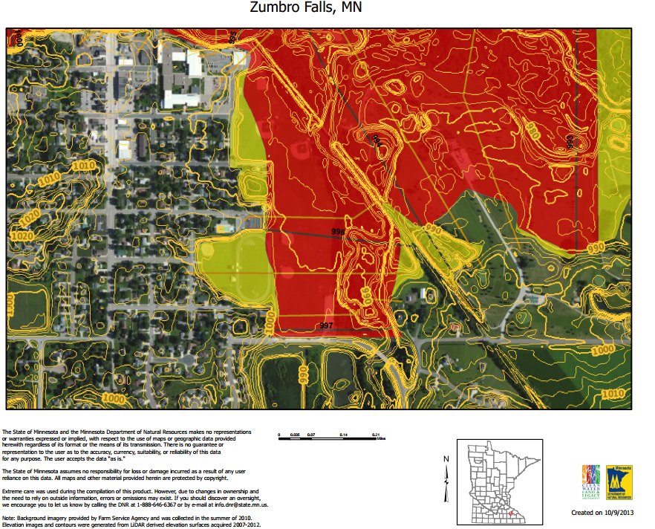
MnTOPO Elevation Portal
MnTOPO - On-line access to Elevation data
  Create PDF Maps
Notes:
8.5x11 – portrait and landscape
11x17 – portrait and landscape
Print on your own…..

Slide 20
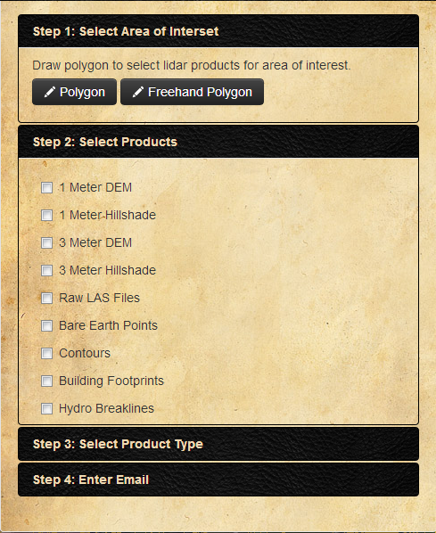
MnTOPO Elevation Portal
MnTOPO - On-line access to Elevation data
  Download Data
    Draw a polygon
    Select products
    Select Product Type
      Open
        Shapefile (vector)
        Binary (raster)
        LAS/LAZ
      ESRI
        Geodatabase
  LAS files
Notes:
Can download all data available
Select an area using a polygon or freehand polygon
Select your product

Slide 21
MnTOPO Elevation Portal
MnTOPO - On-line access to Elevation data
  Download Data – other things to know…
    UTM Zone 15, NAD83
    Raster and Vector data are merged/mosaiced
    LAS data is stored as compressed LAZ files
      LAS data is NOT merged
    Metadata is included
    10gb download limit

Slide 22
MnTOPO Elevation Portal
MnTOPO - On-line access to Elevation data
  What it is not….
  MnTOPO is not a GIS System
    Can’t do precise zooms due to Tile-Cache limitations
    Is not meant to provide high accuracy profiles required by some applications
    Cannot zoom in past 1:2,257
    Overlays and backgrounds are limited
    Internet printing is what it is……

Slide 23
MnTOPO Elevation Portal
MnTOPO - On-line access to Elevation data
Future Plans
  Add additional derived elevation products to display
  Additional Overlays (watersheds, parcels, etc)
  Improve printing predictability
  Profiles –
    Upload shapefiles for profiles
    Profiles are graphics with editable vertices
  Augment search criteria –
    PLS

Slide 24
MnTOPO Elevation Portal
Credits……
  Sean Vaughn – Subject Matter Expert
  Pete Olson – app developer
  Nancy Rader – documentation, guidance and support
  Brent Lund – development and project management
  Jim Dickerson – data processing
  Jeremy Moore – interface development
  Mike Tronrud – Tile-cache development
  Zeb Thomas – data maintenance
  Fred Logman – project management

Slide 25
MnTOPO Elevation Portal
http://arcgis.dnr.state.mn.us/gis/mntopo

