Slide 1

LISTENING SESSION
we’ll begin shortly

Slide 2

Welcome
Thanks for joining
New to WebEx?
  You’re on mute
  Look for polls
  Submit questions anytime to
    work.well.mmb@state.mn.us
Notes:
All people and teams are touched
All places are touched: workplaces, homes, communities around the world
New workplace expectations with impact on self and others
Conditions are still developing
No one knows how long we’ll be in this uncertain, “interim” state.
Worrisome conditions certainly. And – without overdoing it – these are also the kinds of conditions that breed significant innovations and unexpected succeses.

Slide 3
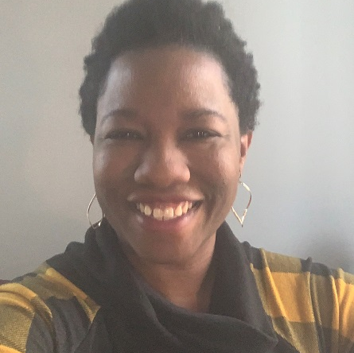
Landyn Prescott-Miles
Organizational Health Consultant with SEGIP-Health Solutions
  Employee Assistance Program
12 years with the State of Minnesota
Currently working from home
Current mood: Caffeinated

Slide 4

Objective of Listening Session
To connect employees during the COVID-19 pandemic by providing an opportunity hear other’s experiences, ask questions, and learn about resources to support your wellbeing.
Notes:
All people and teams are touched
All places are touched: workplaces, homes, communities around the world
New workplace expectations with impact on self and others
Conditions are still developing
No one knows how long we’ll be in this uncertain, “interim” state.
Worrisome conditions certainly. And – without overdoing it – these are also the kinds of conditions that breed significant innovations and unexpected succeses.

Slide 5

Session agenda
Hear from panelists
Three panelists share their experiences.
Discussion
Ask questions, share advice, or ask for recommendations from colleagues.
Learn about resources
Free resources are available to support you and your family.
Engage in the conversation
To the level of your comfort

Slide 6



How are you doing?
Everyone is touched by the pandemic
Rapid change and uncertainty causes anxiety and fear
New workplace expectations causes stress
Notes:
All people and teams are touched
All places are touched: workplaces, homes, communities around the world
New workplace expectations with impact on self and others
Conditions are still developing
No one knows how long we’ll be in this uncertain, “interim” state.
Worrisome conditions certainly. And – without overdoing it – these are also the kinds of conditions that breed significant innovations and unexpected succeses.

Slide 7
POLL: How are you feeling about how you are managing your work and home life?
Lousy: very demoralized, frustrated or lonely; not optimistic for improvement
Struggling: occasional satisfaction or success, but not happy overall
Good enough: feeling more satisfied and hopeful than not
Really well: despite annoyances, I’m kind of enjoying this
Submit your answer on this side

Slide 8
MEET YOUR PANELISTS AND HEAR THEIR STORIES

Slide 9
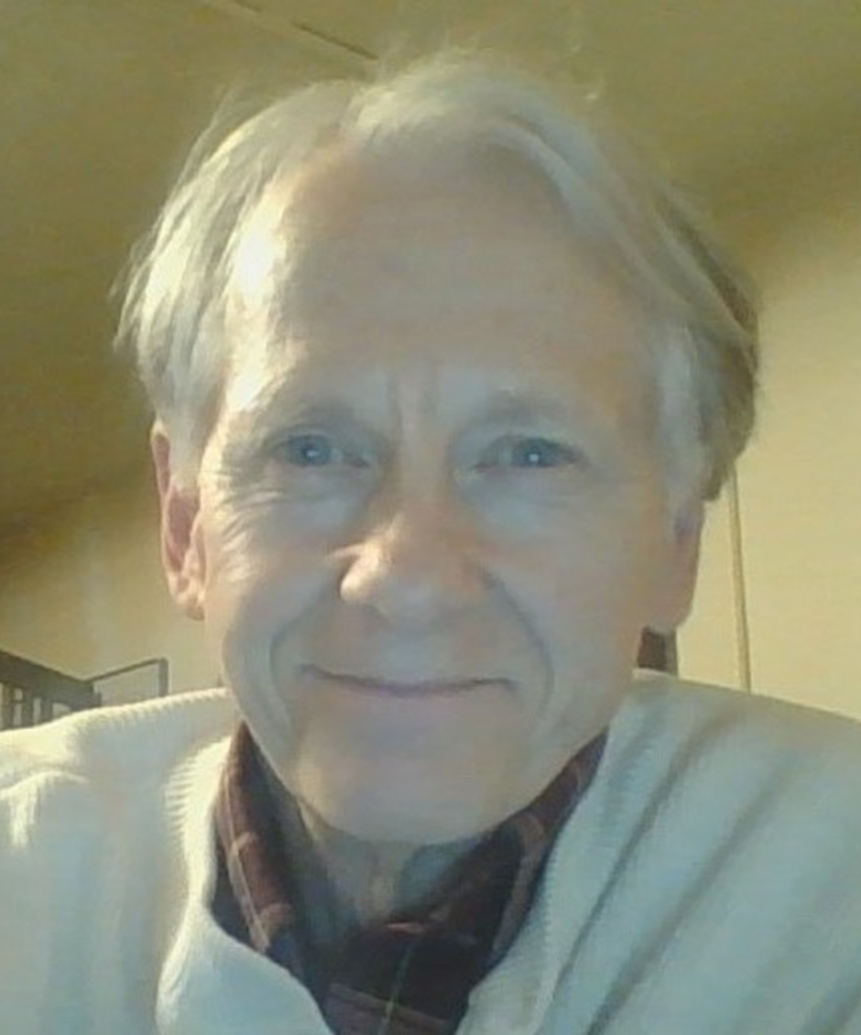
NED ROUSNAMIERE
Guest Expert
My job is to help you be healthy
  Health risk management
  Employee Assistance Program
19 years with the State of Minnesota
Current mood: riding the wild surf of change and technology!

Slide 10
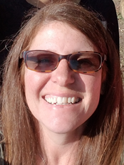
HEATHER RAUTIO
Panelist
MMB-SEGIP
  Billing and Operations Supervisor with Employee Insurance
  Four years with the State of Minnesota
Currently working from home
Current mood: Keep on keeping on!

Slide 11
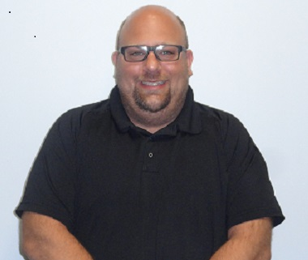
SHANE WARNKE
Panelist
Department of Human Services
  Director of Safety
14.5 years with the State of Minnesota
Currently working on site
Current mood: Cool, calm, and collected
Notes:
This is a time in which Minnesotans have and continue to display solidarity, in continuing to follow directives to protect or most vulnerable. This time has truly emphasized what is most important, family.
The power of community has been made prevalent, as many have stepped up to help the less fortunate, and our frontline workers continue to demonstrate their commitment and compassion to their craft. Thank you.

Slide 12
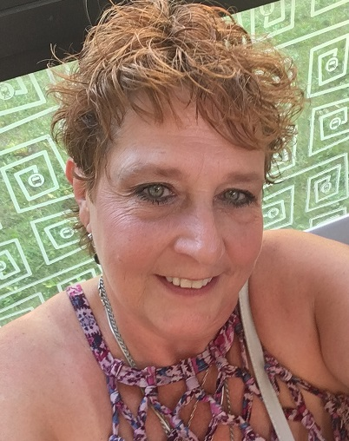
SUSAN KUSZ
Panelist
Department of Employment and Economic Development
  State Services for the Blind
15 years with the State of Minnesota
Current mood: Staying positive!

Slide 13
DISCUSSION
We want to hear from you! Ask questions or share your experiences: work.well.mmb@state.mn.us
Notes:
Are we going to do the Q&A box or the email? I added the email address to an earlier slide…

Slide 14
RESOURCES TO SUPPORT YOU

Slide 15
Resources to help you focus on your overall health
Employee Assistance program
SEGIP Health Benefits
Wellbeing Program
Virgin Pulse platform
Encourages you to participate in activities to improve your health
Offers activities that support mindfulness and stress management
Call anytime at
800-657-3719
Available to all employees and immediate family members
Offers five free counseling sessions, per topic, per year
Free online visits allow you to talk to mental health care providers from home
Doctors on Demand: BlueCross BlueShield and HealthPartners members
MDLive: PreferredOne members
Notes:
Our Wellbeing Program, which is run through Virgin Pulse.
Our wellbeing program offers activities that can help you improve your overall health and wellbeing. FURTHERMORE, when you participate in these activities you get points, which can help you earn a FINANCIAL reward for next year.
There’s a wide range of activities available in the program, including tracking steps and health coaching, that can help you start and sustain healthy behaviors. Maintaining good physical health can play an important role in BUILDING OUR RESILIENCE TO stress.
Our wellbeing program also offers other activities that are specific to mental health.
Whil – this activity leads you through videos and audio sessions that help you practice mindfulness
Journeys – this multi-day activity leads you through 10- minute exercises and affirmations that can help you SHRUG OFF STRESS
Employee Assistance Program
Our Employee Assistance Program is another important resource that we provide employees and family members. Here are a few reasons why it is so valuable:
It is available any time online or by phone.
If you need support for almost anything, the EAP program is a good place to start. From legal advice, to help searching for childcare, to financial services – they have it all. IT’S Like first call for help for state employees and families
EAP PROVIDES EFFECTIVE resources to support mental health – or TO JUST SORT OUT YOUR concerns. Each year, you or your immediate family members can talk to a counselor for free, five sessions, per topic. That means if you used this benefit earlier in the year to talk about anxiety, you can use it at no cost again to talk about concerns during COVID-19.
The experts at eap can also put you in touch with other community resources that are available to you. I highly encourage you to check out their services and see how they can support you.
SEGIP benefits
Finally, if you are covered by our insurance plan, we have excellent benefits that support you. One of the benefits is free access to online care when you use your health plan’s designated vendor. This is available for common conditions, such as sinus infections, AND EARLY SIGNS OF COVID-19, but it also covers mental health care visits. You can use this service as many times as you need.
After this meeting, we’ll send a follow up email with all of these resources in them. They are also available on the SEGIP webpage.

Slide 16

Health and Wellbeing website

Slide 17
COVID-19 Resources
MN Department
of Health
Center for
Disease Control
BeReadyMN
Shares the latest Minnesota health and resource information
Provides information and updates on COVIDE-19 for employees
Offers the latest federal government information

Slide 18
POLL: What are you going to do to support your health today?
Use one of our wellbeing resources, such as Virgin Pulse or EAP
Get some exercise
Call or facetime a family member or friend
Something else for my health
Submit your answer on this side.
Notes:
As a part of our commitment to take care of ourselves and those around us, let’s complete our last poll. What are you going to do today to support your health?
(GIVE TIME FOR PEOPLE TO RESPOND – VOICE OVER)
Your options are
a – use one of the resources I mentioned on the last page, such as our wellbeing program, EAP or online care providers
b. Getting some exercise, which is a great way to help manage stress
c. Spending some time talking with a family member or friend – these social interactions can also help bolster our spirits and allow us to check in on the wellbeing of those around us
d. Something else! Hopefully you have some ideas on things you can do – but you know your health needs better than anyone.
…And who will you tell about your commitment? We know that we are more likely to follow through when others are aware of our commitments.
Again, we will certainly get through this best by getting through it together. Be there for others, and let others be there for you.
Back to you Myron!

Slide 19
THANK YOU
Submit your feedback to
work.well.mmb@state.mn.us
And
Complete the survey poll in the
Webex window!

