Slide 1
Iron Range Resources & Rehabilitation Board Meeting Thursday, September 25, 2025 | 3:30 p.m.

Slide 2
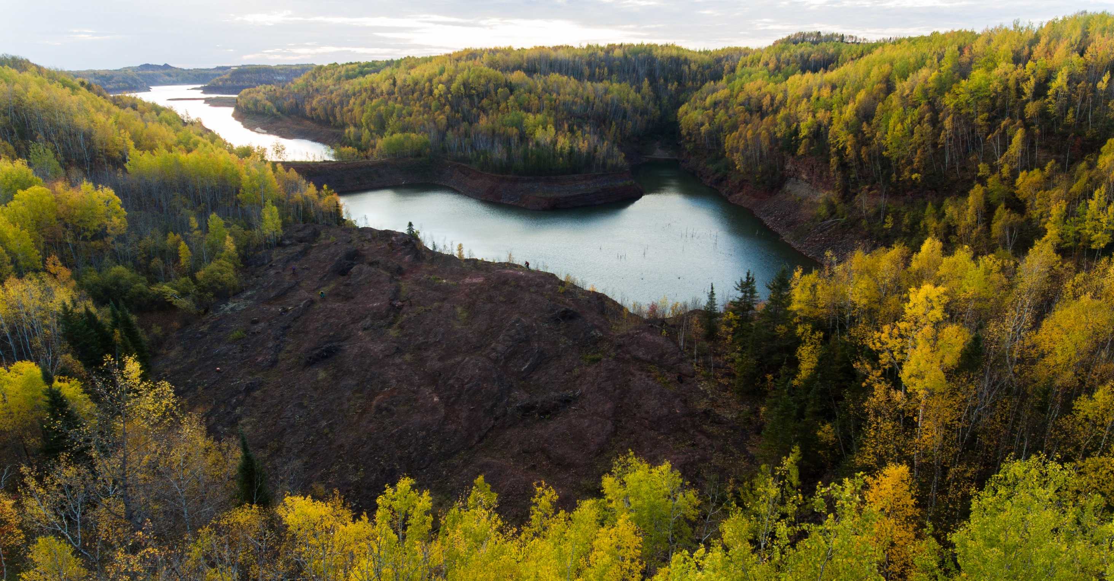
AGENDA
Call to Order
Roll Call
Approval of the May 29, 2025, Meeting Minutes See Addendum A
Commissioner’s Comments
Minerals Article/2024 Tax Omnibus Bill Projects
Business Development Projects
FY26 Budget Amendments
a. FY26 Development Partnership Program
Natural Resources Research Institute (NRRI)
Public Works Projects
Housing Projects
Other
Adjournment

Slide 3
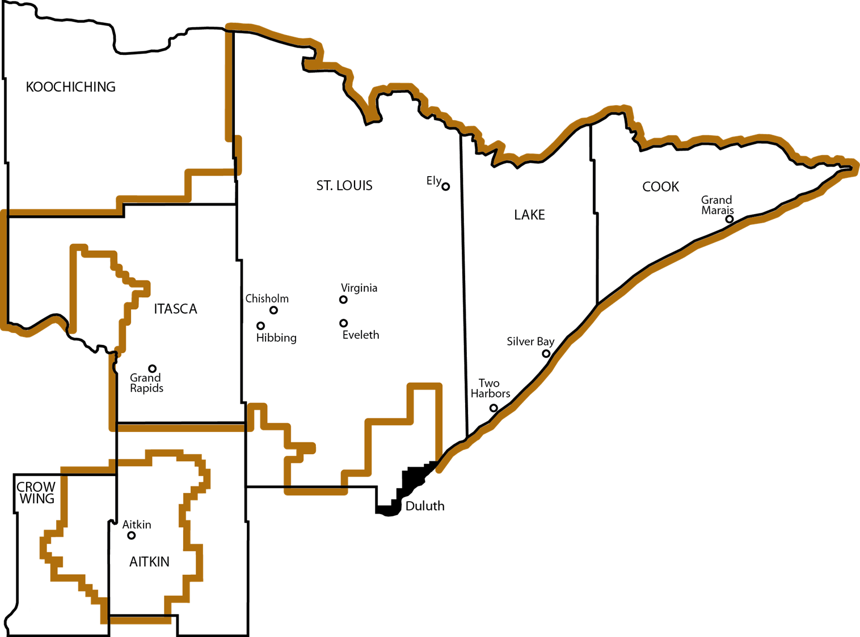
Agency Investments
TOTAL AGENCY INVESTMENT $19,059,000

Slide 4

MINERALS ARTICLE/2024 TAX OMNIBUS BILL PROJECTS/AUTHORIZE PRIOR EXPENDITURES
Whitney Ridlon Jeri Venne Director of Community Development Grants Management Coordinator (218)735-3004 (218)735-3012 Whitney.Ridlon@state.mn.us Jeri.Venne@state.mn.us

Slide 5
Minerals Article Projects
Purpose: Under the guidance of Bond Counsel, IRRR will issue revenue bonds for the financing of up to 82 identified grants in the 2024 legislation that was enacted. (Laws for Minnesota 2024, Chapter 127, Article 69, Sections 15-16). Projects that were awarded $1 million or more are required to present their project to the IRRR Board and submit a spending plan.
Ely Independent School District: $5,000,000 Rock Ridge Independent School District: $1,000,000

Slide 6
BUSINESS DEVELOPMENT Ryan Malich Scott Sundvall Executive Director of Development Loan Officer (218)735-3041 (218)735-3015 Ryan.Malich@state.mn.us Scott.Sundvall@state.mn.us

Slide 7
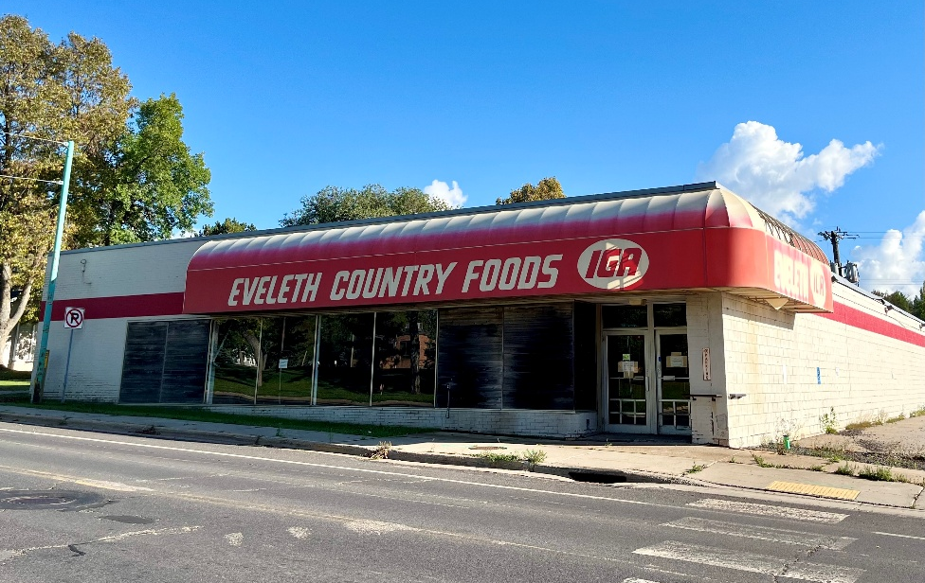
EVELETH ECONOMIC DEVELOPMENT AUTHORITY
IRRR Non-Recourse Loan: $5,550,000
Loan Terms would be 0% Interest for 20 years
Total Project Investment: $5,550,000
Number of Jobs: Planned New - TBD Retained – TBD Project: Purchase the former Eveleth IGA building and make the repairs needed to ready it for a tenant to occupy the premises and operate it as a grocery store.
Resolution No. 26-001

Slide 8

HIBBING FABRICATORS INC.
Agency Investment: $115,000
Total Project Investment: $240,000
Number of Jobs: Planned New - TBD Retained - 39
Project: Purchase two new Mitsubishi BB 4013 electric press breaks.
Resolution No. 26-002

Slide 9
FY26 Budget Amendment
Dave Kallio Accounting Director (218)735-3018 Dave.Kallio@state.mn.us

Slide 10

FY26 Budget Amendment: Development Partnership
FY26 Budget Amendment: Development Partnership: Increase the Development Partnership program budget from $2,000,000 to $2,600,000 to pay for a $600,000 Development Partnership grant to University of Minnesota Duluth’s Natural Resources Research Institute (NRRI). The funds will be derived from the Taconite Environmental Protection Fund (TEPF).
Resolution No. 26-003

Slide 11
University of Minnesota Duluth’s Natural Resources Research Institute (NRRI)
Jason Janisch Climate & Energy Policy Advisor (218)735-3057 Jason.Janisch@state.mn.us

Slide 12
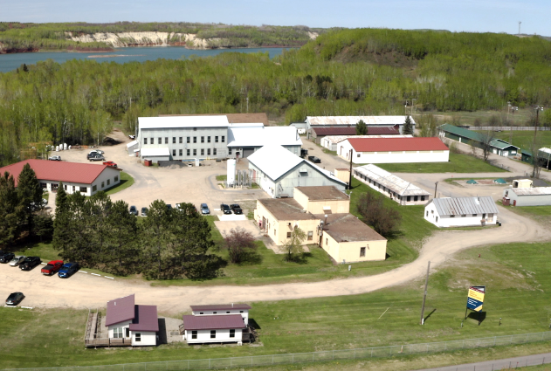
Natural Resources Research Institute (NRRI) Grant
Purpose: Provide a $600,000 Development Partnership grant to University of Minnesota Duluth’s Natural Resources Research Institute (NRRI) to complete the installation and commissioning of a world-first Direct Reduced Iron (DRI) Research Furnace. Economic Impact
Number of Projects: 1
Agency Investment: $600,000
Total Project Investment: $1,200,000
Resolution No. 26-004

Slide 13
Public Works Whitney Ridlon Chris Ismil Director of Community Development Community Development Representative (218)735-3004 (218)735-3010 Whitney.Ridlon@state.mn.us Chris.Ismil@state.mn.us

Slide 14

Public Works
Purpose
Public Works grants support local and Tribal governments with infrastructure funding that provides essential services and promotes economic development.
Economic Impact
Number of Projects: 14
Agency Investment: $4,429,000
Total Project Investment: $106,933,801
Number of Project Increases: 2 Agency Investment: $287,000

Slide 15
Public Works Projects
Grantee | Project Description | Agency Investment | Total Project Investment
City of Aurora | Road reconstruction, curb, gutter and sidewalk replacement and water and sewer line upgrades. | $500,000 | $12,700,000
City of Beaver Bay | Replacing aging and failing sanitary sewer and water lines. | $250,000 | $1,164,500
City of Biwabik | Furnishing and installing 652 new water meters throughout the city. | $185,000 | $406,000
Central Iron Range Sanitary Sewer District | New sewer main extension and hookup. | $400,000 | $45,137,000
Chisholm-Hibbing Airport Authority | Design and rehabilitation of an aircraft taxi lane. | $27,000 | $821,419

Slide 16
Public Works Projects
Grantee | Project Description | Agency Investment | Total Project Investment
City of Coleraine | Purchase and installation of new water meters. | $300,000 | $802,000
Cook County/Grand Marais Joint Economic Development Authority | Taxi lane reconstruction. | $175,000 | $1,500,699
City of Ely | Water main and sewer line extension and hookup. | $169,000 | $3,684,000
Feeley Township | Town hall and cemetery upgrades. | $52,000 | $105,370
Goodland Township | Town hall upgrades. | $84,000 | $251,235

Slide 17
Public Works Projects
Grantee | Project Description | Agency Investment | Total Project Investment
City of Hibbing | Construction of a new regional public safety center. | $1,500,000 | $38,152,698
City of Leonidas | Storm sewer upgrades and road reconstruction. | $300,000 | $1,168,000
City of Mountain Iron | Slip lining of sanitary sewer main. | $200,000 | $455,880
City of Tower | Upgrades to city public buildings and updates to airport zoning. | $287,000 | $585,000

Slide 18
Public Works Project Amendments
Grantee | Project Description | Grant Increase | Original Grant
Biwabik Township | Expand Biwabik Township firehall. | $120,000 | $161,000
City of Calumet | Upgrades to city hall. | $167,000 | $300,000
Resolution No. 26-005

Slide 19
Housing Whitney Ridlon Shawn Herhusky Director of Community Development Community Development Representative (218)735-3004 (218)735-3067 Whitney.Ridlon@state.mn.us Shawn.Herhusky@state.mn.us

Slide 20

Housing
Purpose
Housing grants assist projects or programs that result in the creation of new housing units or the rehabilitation of existing housing units. The program will support housing solutions that align with local priorities and regional employer’s needs. Economic Impact
Number of Projects: 8
Agency Investment: $2,078,000
Total Project Investment: $21,529,440
New Housing Units: 84
Rehabilitated Housing Units: 60
New Lots for Future Housing Units: 12

Slide 21
Housing Projects
Grantee | Project Description | Agency Investment | Total Project Investment
Aurora Housing & Redevelopment Authority | Neighborhood Revitalization Mini Grant Program focused on home exterior improvements. | $11,500 | $11,500
Cook County Housing & Redevelopment Authority | Extending utility infrastructure to connect 12 future homes. | $350,000 | $922,147
City of Ely | Drainage system repairs to reduce flooding, sidewalk, door and gutter replacement. | $146,500 | $293,000
Itasca County Habitat for Humanity | Utility infrastructure, site work and construction. | $150,000 | $561,694

Slide 22
Housing Projects
Grantee | Project Description | Agency Investment | Total Project Investment
Lake County Housing & Redevelopment Authority | Developing 75 market rate workforce apartments. | $850,000 | $17,386,049
North St. Louis County Habitat for Humanity | Utility infrastructure, sitework and construction of eight home sites across Iron Range communities. | $500,000 | $1,916,856
Toivola Meadowlands Development Board | Replacing the siding, window trim and storm doors at Meadowlands Manor. | $45,000 | $90,000
City of Virginia | Redeveloping the second story of an existing commercial building into a new residential housing unit located on the city’s main street. | $25,000 | $336,694
Resolution No. 26-006

Slide 23
THANK YOU Commissioner Ida Rukavina (218)735-3023 Ida.Rukavina@state.mn.us

