Slide 1
Iron Range Resources & Rehabilitation Board Meeting Thursday, May 29, 2025 2:00 p.m.

Slide 2
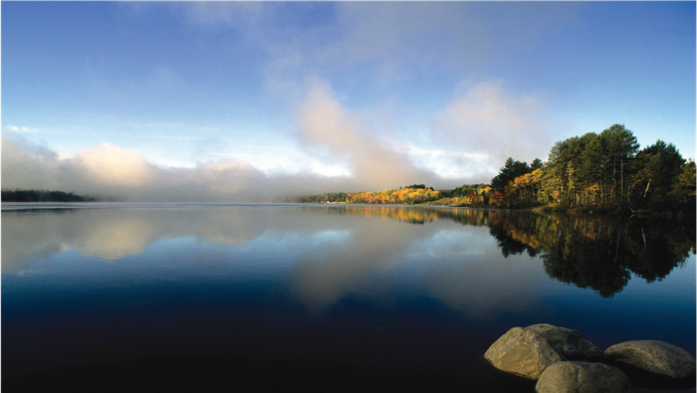
AGENDA
Call to Order
Roll Call
Approval of the March 26, 2025, Meeting Minutes
See Addendum C
Commissioner’s Comments
Minerals Article/2024 Tax Omnibus Bill Projects
Iron Range Schools and Community Development Account See Addendum B
Iron Range Higher Education Account
Giants Ridge Recreation Area (GRAA) Tax
FY25 Budget Amendments
a. Regional Trails
b. Housing
c. Public Works
Public Works
Broadband Infrastructure
FY26 Budget
See Addendum A
Other
Adjournment

Slide 3
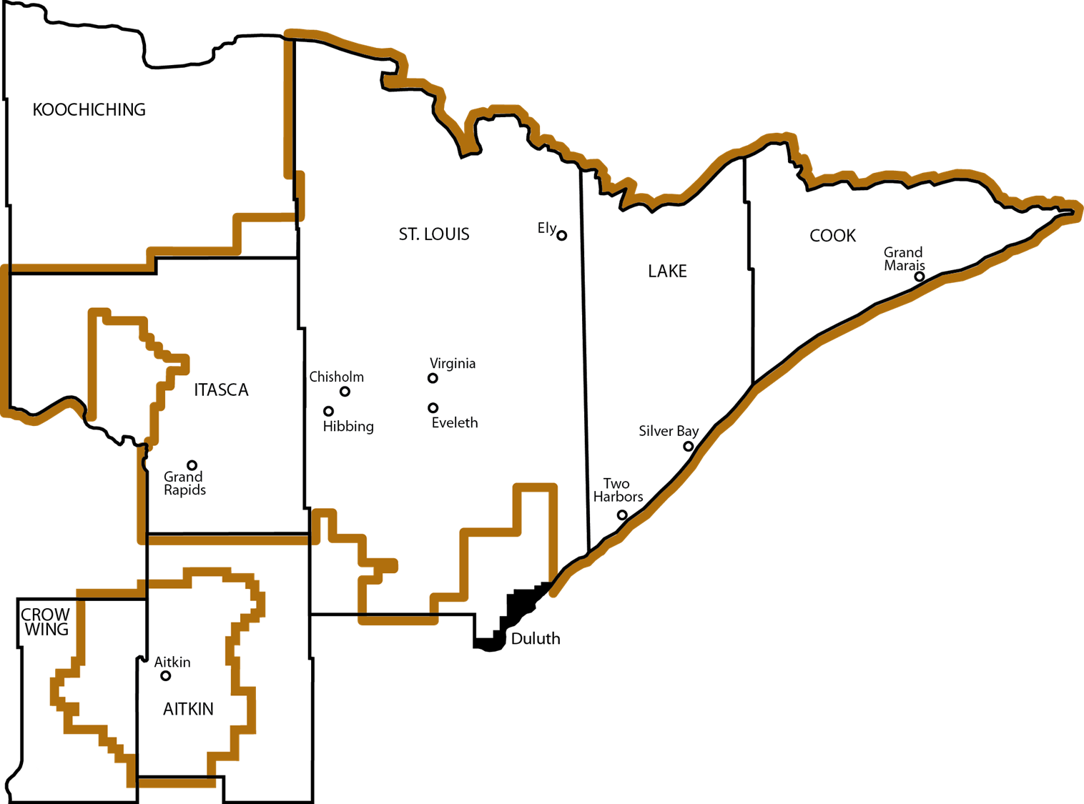
Agency Investments
TOTAL AGENCY INVESTMENT $38.8 million

Slide 4

MINERALS ARTICLE/2024 TAX OMNIBUS BILL PROJECTS/AUTHORIZE PRIOR EXPENDITURES
Whitney Ridlon Jeri Venne Director of Community Development Grants Management Coordinator (218)735-3004 (218)735-3012 Whitney.Ridlon@state.mn.us Jeri.Venne@state.mn.us

Slide 5
Minerals Article Projects
Purpose: Under the guidance of Bond Council, IRRR will issue revenue bonds for the financing of up to 82 identified grants in the 2024 legislation that was enacted. (Laws for Minnesota 2024, Chapter 127, Article 69, Sections 15-16). Projects that were awarded $1 million or more are required to present their project to the IRRR Board and submit a spending plan.
City of Babbitt: $1,500,000 City of Biwabik: $1,000,000
Department of Iron Range Resources & Rehabilitation: $7,600,000 City of Hibbing: $1,150,000
Hibbing Public Utilities: $1,770,000 City of Mountain Iron: $2,000,000 Northland Learning Center: $1,080,000
City of Silver Bay: $3,000,000

Slide 6
Iron Range Schools and Community Development Account
Whitney Ridlon Director of Community Development (218)735-3004 Whitney.Ridlon@state.mn.us

Slide 7

Iron Range Schools and Community Development Project: Aitkin Independent School District 001
Purpose: The Iron Range Schools and Community Development Account provides disbursements to assist school districts with the payment of bonds that were issued for qualified school projects, or for any other school disbursement as approved by the commissioner of Iron Range Resources and Rehabilitation after consultation with the IRRR Board.
Project: To support infrastructure and site development for the construction of a new PreK-6 elementary school. Agency Investment: $5,000,000
Total Project Investment: $70,440,400

Slide 8

Iron Range Schools and Community Development Project: Cook County Independent School District 166
Purpose: The Iron Range Schools and Community Development Account provides disbursements to assist school districts with the payment of bonds that were issued for qualified school projects, or for any other school disbursement as approved by the commissioner of Iron Range Resources and Rehabilitation after consultation with the IRRR Board.
Project: To support the construction of an athletic and activities complex.
Agency Investment: $5,000,000
Total Project Investment: $38,180,000
Resolution No. 25-023

Slide 9
Iron Range Higher Education Account Roy Smith Director of Education and Talent Development (218)735-3039 Roy.Smith@state.mn.us

Slide 10

Iron Range Higher Education
Programs | Total Agency Investment
Iron Range Engineering | $100,000
Manufacturing | $990,000
Veterinary Technician | $157,000
Total | $1,247,000
Resolution No. 25-024

Slide 11
Giants Ridge Recreation Area Tax Sean Peyla Facilities and Operations Manager (218)735-3005 Sean.Peyla@state.mn.us

Slide 12

Giants Ridge Recreation Area Tax Projects
Projects | Total Agency Investment
Purchase Trail Maintenance Equipment | $55,000
Construct Hiking Trail Bridge | $20,000
Construct Mountain Bike Trails | $125,000
Expand Mountain Bike Skills Park | $100,000
Total | $300,000
Resolution No. 25-025

Slide 13
FY25 Budget Amendments
Dave Kallio Accounting Director (218)735-3018 Dave.Kallio@state.mn.us

Slide 14
FY25 Budget Amendments
Purpose
To make amendments to the FY25 budget to support projects in the Regional Trails, Housing and Public Works grant programs.
Economic Impact
Number of Projects: 11
Agency Investment: $7,804,494
Resolution No. 25-026

Slide 15
FY25 Budget and Grant Amendment Projects
Danae Beaudette Shawn Herhusky Chris Ismil Community Development Community Development Community Development (218)735-3022 (218)735-3067 (218)735-3010 Danae.Beaudette@state.mn.us Shawn.Herhusky@state.mn.us Chris.Ismil@state.mn.us

Slide 16

FY25 Budget Amendment: Regional Trails
Purpose
Regional Trails grants assist with the design, engineering and construction of various types of trails.
Economic Impact
Number of Projects: 1
Agency Investment: $2,160,000
Total Project Investment: $4,320,000

Slide 17
FY25 Budget Amendment: Regional Trails
Grantee | Project Description | Agency Investment | Total Project Investment
Northeast Regional ATV Trail Joint Powers Board | The project consists of engineering, permitting, right-of-way acquisition and various improvements for five ATV Trail Clubs. | $2,160,000 | $4,320,000
Resolution No. 25-027

Slide 18

FY25 Budget and Grant Amendment: Housing
Purpose Housing grants assist projects or programs that result in the creation of new housing units or the rehabilitation of existing housing units. The program supports housing solutions that align with local priorities and regional employer’s needs.
Economic Impact
Number of Projects: 1
Agency Investment: $3,737,404
Total Project Investment: $9,684,404

Slide 19
FY25 Budget and Grant Amendment: Housing
Grantee | Project Description | Agency Investment | Total Project Investment
City of Ely | The project consists of infrastructure and the construction of a new three-story, 37-unit market rate workforce apartment building. IRRR previously approved $850,000 for the project in March 2024. | $3,737,204 | $9,684,404
Resolution No. 25-028

Slide 20


Public Works Projects
Purpose
Public Works grants support local and Tribal governments with infrastructure funding that provides essential services and promotes economic development Community Infrastructure grants assist projects that support residential infrastructure and public facility improvements.
Economic Impact
Number of Projects: 9
Agency Investment: $1,907,290
Total Project Investment: $16,806,329

Slide 21
FY25 Budget Amendment: Public Works
Grantee | Project Description | Agency Investment | Total Project Investment
City of Babbitt | Water and sewer line extensions to serve an existing business. | 60,000 | 120,000
City of Biwabik | Replacement of an aging and failing sanitary sewer line. | 70,500 | 153,635
City of Bovey | Public utilities relocation and extension to a new business development. | 267,790 | 1,239,740
City of Chisholm | Water, sewer, storm sewer and total street reconstruction for a portion of 5th Street Southwest. | 600,000 | 1,582,360

Slide 22
FY25 Budget Amendment: Public Works
Grantee | Project Description | Agency Investment | Total Project Investment
City of Cook | Roof and HVAC upgrades and interior improvements to the Cook Public Library. | 85,000 | 336,800
Kelsey Township | Town hall renovations. | 70,000 | 140,201
Lawrence Township | Town hall renovations and foundation upgrades. | 23,000 | 64,500
City of Virginia | Infrastructure relocation and upgrades to serve business development. | 165,000 | 389,000

Slide 23
FY25 Budget Amendment: Public Works Grant Amendment
Grantee | Project Description | Agency Investment | Total Project Investment
City of Tower | Permanent utilities placement for six sustainable homes and new harbor development to include 14 townhomes, 12 condo-style apartments and 7,500 square feet of commercial space. | 566,000 (TEPF) 482,000 (Hwy 1) | 12,780,393
Resolution No. 25-029

Slide 24
Public Works Chris Ismil Community Development Representative (218)735-3010 Chris.Ismil@state.mn.us

Slide 25
FY25 Grant Amendment: Public Works
Grantee | Project Description | Agency Investment | Total Project Investment
Crane Lake Township | Bayside Drive construction complete. Campground shower and bathroom facility construction funding gap. | 250,000 | 9,300,000
Resolution No. 25-030

Slide 26
Broadband Infrastructure Whitney Ridlon Director of Community Development (218)735-3004 Whitney.Ridlon@state.mn.us

Slide 27

Broadband Infrastructure
Purpose
Broadband Infrastructure grants assist projects that help households and businesses reach the state of Minnesota broadband speed goal. Economic Impact
Number of Projects: 1
Agency Investment: $383,000
Total Project Investment: $1,111,743
Households Served: 35

Slide 28
Broadband Infrastructure
Grantee | Project Description | Agency Investment | Total Project Investment
Paul Bunyan Rural Telephone Cooperative | The project consists of expanding Paul Bunyan Rural Telephone Cooperative fiber optic to serve 35 unserved households in unorganized township T62N-R21W in rural Saint Louis County. This is an expansion of the Paul Bunyan network north of Morcom Township. | $383,000 | $1,111,743
Resolution No. 25-031

Slide 29
FY2026 Budget Dave Kallio Accounting Director (218)735-3018 Dave.Kallio@state.mn.us

Slide 30
FY26 Proposed Budget
Purpose
Iron Range Resources & Rehabilitation has proposed a $68,376,391 budget for Fiscal Year 2026 to support economic growth and regional development in northeastern Minnesota. The funding will be allocated across several key categories:
Projects and Programs – supporting community development, infrastructure, and workforce initiatives
Giants Ridge – enhancing the year-round recreation and tourism facility
Operations and Development – maintaining internal operations and strategic planning efforts
Resolution No. 25-032

Slide 31
THANK YOU Commissioner Ida Rukavina (218)735-3023 Ida.Rukavina@state.mn.us

