Slide 1
SFY 24-25 MN Youthbuild Program New Grantee Overview – Part 2
Minnesota Dept. of Employment & Economic Development
Office of Youth Development
October 20, 2023

Slide 2
Questions during today’s webinar!
If you have questions regarding today’s presentation—or anything relating to the MN Youthbuild statutory requirements or your work plan and budget, feel free to bring it up during the webinar or e-mail me at nancy.waisanen@state.mn.us

Slide 3
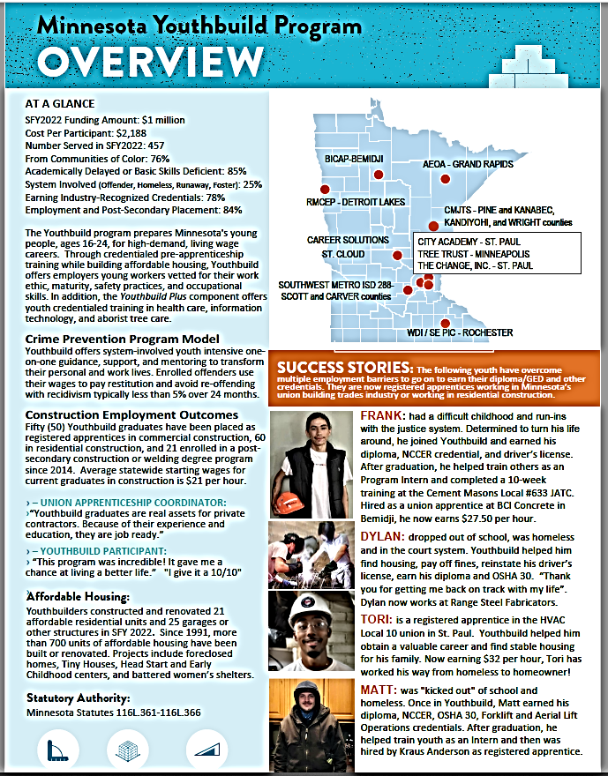
///////
MN Youthbuild Program Overview
MN Youthbuild is a codified state-funded program. Statutory Authority can be found at 116L.361 to 116L.366. The statute is detailed and precise, covering: (1) Definition of terms, (2) Eligible participants and building projects, (3) Required program components, and (4) Grantee reporting requirements.
The Youthbuild Program provides eligible youth, ages 16-24, construction and safety skills training and work experience while building affordable housing and other eligible building structures. Participants also receive case management, career guidance and planning, support services, and employment preparation services such as work readiness, leadership, and life skills training. While enrolled, youth must be working towards their secondary education diploma or GED. Upon program completion, youth receive placement support in employment, post-secondary or other occupational skills training.
Currently, MN Youthbuild has fourteen program locations across Minnesota (seven in Greater MN and seven in the metro area) serving about 500 youth per year in active participation and the 12-month follow-up period.

Slide 4
Legal and Statutory Requirements of the MN Youthbuild Program
SFY 24 – SFY 25 MN Youthbuild Grants

Slide 5
Compliance with Child Labor Laws and Davis Bacon Act
Grantees are allowed to offer stipends, wages, and incentives to youth for their participation in one or more program activities.
DEED recommends the use of stipends (rather than wages) to youth while training/work experience on a construction or project site to avoid any legal or compliance issues with child labor laws or Davis Bacon Act provisions.
State and federal child labor law generally prohibits workers under the age of 18 from working on a construction site or operating hazardous machinery.
Davis Bacon Act provisions require all employees to be paid prevailing wages when working on state- or federally funded construction sites, including affordable housing projects.

Slide 6
Cont. 2
The MN Youthbuild Program is recognized by MN Department of Labor and Industry (DLI) as an approved training program under MN Rules 5200.0930. This currently exempts 16- and 17-year-old Youthbuild participants from certain prohibited work activities as long as work experience and training meet conditions listed under federal child labor law exemptions from hazardous occupations.
Applicants who wish to serve 16- and 17-year-old youth and pay youth wages for construction training/work experience must comply with state and federal child labor laws. Limited apprentice/student-learner exemptions apply to hazardous work duties (*roofing/work on or about a roof, excavation operations, power-driven circular saws, reciprocating saws, band saws, guillotine shears, chain saws, wood chippers, and abrasive cutting discs, machines for woodworking, metal forming, punching, shearing). Exemptions are allowed when the following conditions are met: (1) Work is incidental to the training; (2) Work shall be intermittent, for short periods of time, and under the direct and close supervision of a qualified, experienced person; (3) Student learners are given safety instruction; and (4) A schedule of organized and progressive work processes to be performed on the job has been prepared.

Slide 7
Cont. 3
Youth who receive a stipend, rather than a wage, are not considered employees with respect to state and federal child labor and Davis-Bacon Act regulations.
Incentives may also be provided to participants to encourage completion of goals, such as earning an education, occupational, or safety credential/certificate.
Local programs must have written policies and procedures in place when offering stipends and incentives to youth participants.

Slide 8
Participant Eligibility under M.S. 116L.361-116L.366
Eligible participants must be between the ages of 16 and 24, and be
  economically disadvantaged or eligible for the high school Graduation Incentives Program*
  and
  have not completed a high school diploma or its equivalent and be at-risk of dropping out of high school or have dropped out.

Slide 9
Definitions of Eligible Participant Terms
Dropped out of high school: youth who are not attending school and have not received a secondary school diploma or its equivalent.
At-risk for dropping out: youth currently enrolled in school or a GED/high school equivalency program and who, in the opinion of an official of the school, are in danger of dropping out of the school. This may include youth experiencing barriers or challenges to school success.
Economically disadvantaged: An individual whose income is no higher than 100% of the poverty level. Youth who are eligible to receive or are receiving free school lunch are considered to be economically disadvantaged.
Eligible for the High School Graduation Incentives Program: A pupil under the age of 21, if the pupil: (1) performs substantially below the performance level for pupils of the same age in a locally determined achievement test; (2) is behind in satisfactorily completing coursework or obtaining credits for graduation; (3) is pregnant or is a parent; (4) has been assessed as chemically dependent; (5) has been excluded or expelled according to sections 121A.40 to 121A.56; (6) has been referred by a school district for enrollment in an eligible program or a program pursuant to section 124D.69; (7) is a victim of physical or sexual abuse; (8) has experienced mental health problems; (9) has experienced homelessness sometime within six months before requesting a transfer to an eligible program; (10) speaks English as a second language or has limited English proficiency; or (11) has withdrawn from school or has been chronically truant; or (12) is being treated in a hospital in the seven-county metropolitan area for cancer or other life threatening illness or is the sibling of an eligible pupil who is being currently treated, and resides with the pupil's family at least 60 miles beyond the outside boundary of the seven-county metropolitan area.

Slide 10
Eligible Construction and Rehabilitation Projects under M.S. 116L.361-116L.366
The work experience (and construction and safety training) component must include projects that result in the rehabilitation, improvement, or construction of:
  Residential units for low-income families or individuals, or homeless persons;
  Improvements to the energy efficiency and environmental health of residential units and other green jobs purposes; such as insulating, air sealing, caulking, weather stripping as needed and installing solar panels or energy-efficient windows.
  Facilities and ancillary structures (raised bed gardens, sheds, etc.) to support community garden projects for low-income communities; or
  Facilities and incidental structures which provide education, social service, or health services and serve low-income communities or families and individuals. Examples of eligible facilities include the following:
(1) Head Start or day care centers, playhouses or other incidental structures;
(2) Homeless or battered women shelters;
(3) transitional housing and tiny houses;
(4) youth or senior citizen centers;
(5) community health centers; and
(6) community garden facilities.

Slide 11
Components of Youthbuild Program Model
  Construction skills and safety training combined with work experience in a project-based setting which results in at least one eligible building project. Training may be, in part, in a classroom or workshop setting, and then combined with work experience on a construction building site. Recommended training/work experience over a 12-month period is about 400 hours or more per youth.
  Employment preparation services include work readiness training, leadership development, peer support, career planning and exploration, life skills, financial literacy, job search skills, and post-secondary education support. Recommended hours in employment preparation over a 12-month period is about 300 hours or more per youth.
  Case management, counseling, and support services to reduce barriers to successful completion and placement. Counselors typically advise youth for about an hour per week. For youth interested in the building trades, goals should include obtaining a driver’s license and insured reliable vehicle.
  A secondary education component in which participants are enrolled and working to complete their secondary high school education. This may be separate from direct programming when a local school is a partner. Youthbuild staff must track academic progress and provide tutoring and support as needed for successful completion of diploma or GED.
  Placement assistance and support for employment in the registered apprenticeship and the building trades; alternatively, placement assistance in post-secondary education, occupational training, or employment in a career or occupational field of interest may also be pursued. Placement assistance is typically provided to participants near completion and 12-months after exiting the program, as needed.

Slide 12
Local Partnerships
Collaboration between the Grantee and local and regional partner organizations is key to successful programming.
  A public or charter high school, Adult Basic Education or GED provider; such as Transitions Plus, Minneapolis Academy and Career Center, Wellstone International, and more.
  A housing development/management organization or agency (or applicant experience and ability to develop and mange their own affordable housing),
  Local Workforce Development (WDA), such as City of Minneapolis or Hennepin County, or local non-profit organization that provides workforce training services to youth,
  Local employer (s), such as construction contractor or company, a building trades organization, or apprenticeship training center,
  Post-secondary education or occupational certificate training provider,
  Other community organizations and local service agencies.

Slide 13
Questions?
If you have any questions please bring them up at this time, Otherwise, you may contact me at nancy.waisanen@state.mn.us.

