Slide 1


(DWFAP) Spring Webinar 5-16-2024
2.0

Slide 2
YST Program
What is the Youth Skills Training (YST) program?
Supporting partnerships between industry and education
Creating opportunities for students to learn about careers in industries
Providing industry-related classes for high school credit and safety training
Establishing safe, healthy and meaningful paid work experiences for student learners (16-17 years old)
Developing a pathway for future talent for local industries

Slide 3
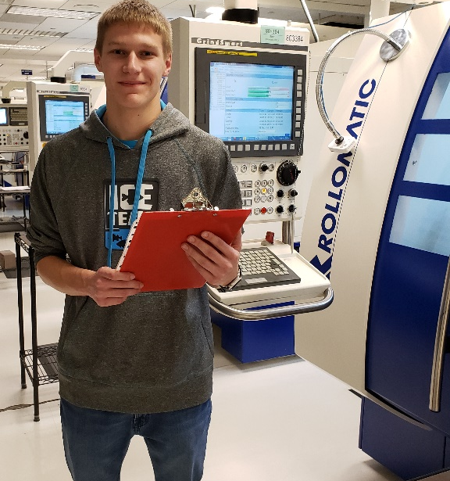

YST Program
Current YST eligible industries:
Advanced Manufacturing
Agriculture
Automotive
Health Care
Information Technology

Slide 4
YST Program Goals
GOALS:
Support the creation of local partnerships
High Schools Employers Chambers of Commerce Workforce Groups Nonprofit organization Postsecondary institutions
Local Partnerships
High Schools
Employers
Community
Organizations

Slide 5
YST Program Goals
GOALS (cont.):
2. introduce students to careers in high-growth, high-demand industries
3. prepare students for successful careers
4. address the shortage of skilled employees
Exposure
Education
Experience

Slide 6
Paid Work Experiences
Learn & Earn model
Develop paid work experiences for 16 and 17-year-old “student learners” to participate in safe, healthy and meaningful on-the-job training at employer sites
Classroom
instruction
to learn skills
Paid work experience to develop skills
Youth Skills Training program
YST@DLI

Slide 7
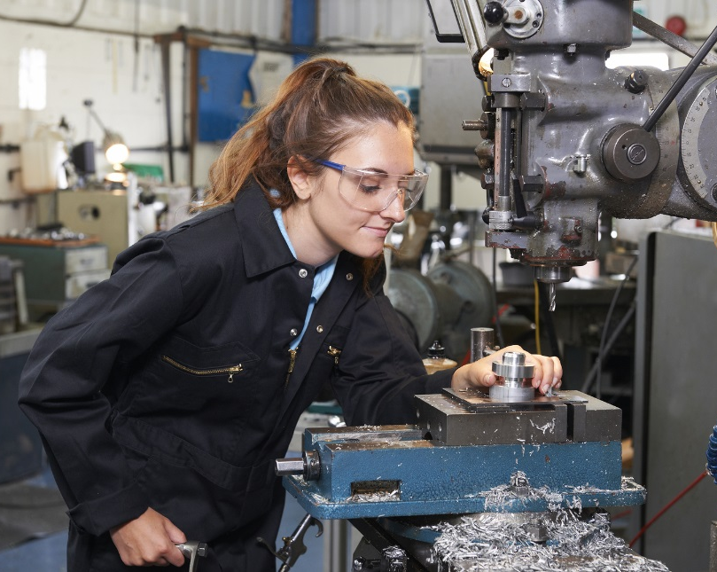
School Requirements
School requirements:
Industry exposure opportunities for students of all ages
Industry-related classes for high school credit
Industry-recognized credential/certification
Paid work experience for students 16 years of age and older

Slide 8

Employer Requirements
Employer requirements:
Partner with local schools
Seek employer approval through YST program
Create a safe, healthy, meaningful paid work experience
Train and mentor student learners
By meeting YST requirements and receiving approval from DLI, student learners are allowed to work in industries that may otherwise be prohibited by child-labor laws.

Slide 9
YST Grants
YST program grant funding:
Total of $1.5 million in grant funding awarded each year
Grants up to $100,000 awarded to local partnerships
Two-year grant period
Over 75 YST grants have been awarded throughout the state since the start of the program in 2017
*Grant funding is not required to create a program or participate in YST

Slide 10
YST Grants
YST grant funding uses:
Marketing and advertising programs
Recruiting schools, employers and students
Student transportation
Staff to coordinate and monitor program outcomes
Student credentials/certifications
Supplies and curriculum
**Funds cannot be used to pay student wages**

Slide 11
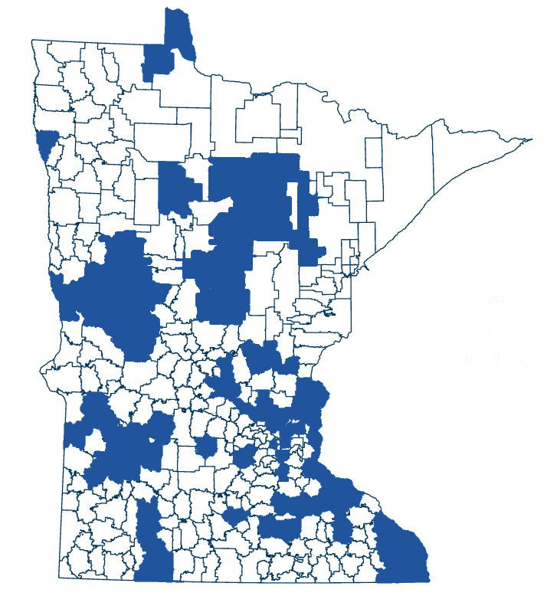
YST Program Grantees
YST grantees
Red Wing Ignite
Hutchinson Schools
Twin West
White Bear Lake Schools
Winona
Elk River Schools
Forest Lake Schools
Vadnais Heights Economic Development (VHEDC)
SW MN Private Industry Council
Intermediate District #287
Bloomington Schools
Ramsey County Workforce
Genesys Works
Spark-Y
Bemidji Schools
Detroit Lakes Schools
Goodwill Industries
Lakeville Schools
Monticello Schools
North Branch Schools
Princeton Schools
SW Metro District #288
Hibbing
Boys & Girls Club of Central MN
Southeast Service Cooperative
American Nursing & Technical
Burnsville Schools
ISD #112 ECC
Roseville Area Schools Mankato Public Schools
Chisago Lakes Schools
Grand Rapids Area Chamber of Commerce
Milaca Public Schools
East Grand Forks Schools
Otter Tail County
Venture Academy
Stillwater Area Schools
Alexandria Schools
Sourcewell
Edina Public Schools
Breckenridge Schools
Workforce Development Inc

Slide 12
YST Program Grantees
New YST grantees (round 7)
Albert Lea Schools
Cambridge-Isanti Schools
Fergus Falls Schools
Great River School
Hennepin West Consortium
Hermantown Schools
Itasca Area Schools Collaborative
Camden High – Minneapolis
Wellstone High School – Minneapolis
Moorhead Schools
New Prague Schools
Parkers Prairie Schools
Perham Schools
ROCORI School District
Staples-Motley Schools

Slide 13
YST Program
Since start of program in 2017:
81,984 students provided with industry exposure
41,550 students have completed industry-related classes
2,934 students have earned an industry-related credential
947 students have participated in a paid work experience

Slide 14
YST Program
School/Employer/Community Partnership Opportunities
Tours of local employers
Classroom speakers
Job shadow experiences
Consumable donations
Training for Teachers and Staff
Mentoring program
Classroom instructor for the day
Scholarship opportunities
Informational Interviewing
Open Houses
Monetary donations for (marketing, field trips, equipment etc.)

Slide 15
Contact Information
Rich Wessels Jo Daggett
Program Manager Program Consultant
651-284-5184 651-284-5354
Rich.Wessels@state.mn.us Jo.Daggett@state.mn.us
www.dli.mn.gov/yst

