Slide 1
Overview of Work-Based Trainings
May 16, 2024

Slide 2
Session Objectives
Consider
Why consider work-based training (WBT) as a critical part of employment services.
Breakdown
Breakdown and analysis of WBT data taken from WF1.
Overview
Overview of Incumbent Worker Training (IWT) cost category set aside for PY22 & PY23 budgets by Workforce Development Areas (WDAs).
Review
Review WBT definitions, financial coding, and performance impacts.
Notes:
Our aim for this session is to share

Slide 3
Work-based Trainings
Work-based training presents a great opportunity for:
fostering increased employer engagement,
implementing sector strategies,
and encouraging industry partnerships,
Work-based training allows employers to train their employees while continuing to be productive members of the workforce.
Sections 20 CFR 680.700 through .840 govern Work-based Training.
They include:
Transitional Jobs
Work Experience & Internship
On-the-job Training (OJT)
Customized Training
Apprenticeship
Incumbent Worker Training (IWT)
Notes:
In general, training services can be critical to the employment success for many youth, adults and dislocated workers. (New skills, up-skills, credentials, licensure, etc.)
Under WIOA, work-based trainings provide additional options and flexibilities for participants.
These activities can be coded as training costs or career services costs.
Amy will cover more details later in the presentation.
Code of Federal Regulations (CFR)

Slide 4
PY20/FY21 – Present (PY23/FY24)
*All participants enrolled in WBT; report date - 3.28.24
WAD – WIOA Adult
DW – Dislocated Worker
Notes:
So, we wanted to get a sense of how these trainings are currently being used. To do that, we ran a report from Workforce One database of all participants enrolled in WBT for PY20 through present. We ran the report on March 28th, so, it is possible that numbers have changed since. But this will give a good sense of how we’re using these training services.
A couple of things to highlight here are:
We’re currently enrolling more dislocated workers than WIOA Adult participants
Our use of WBT has been increasing over the past years
Incumbent Worker Training is being used the most
Apprenticeship is being used the least
In case you’re wondering what’s the difference between IWT and IWCW:
IWT - WIOA or SDW funds are used and the activity has to result in a credential.
IWT Waiver - SDW funds are used and the activity does not result in a credential.
**State funding can use both activities (credential is optional). WIOA IWT must end in a credential.

Slide 5
WBT Enrollment: PY20/FY21 – Present (PY23/FY24)
* All participants enrolled in WBT; report date – 3.28.24
Notes:
You can see that WBT enrollments have been increasing over time.
Keep in mind that SFY 24 numbers are from only 3 quarters of a total of 8 quarters (79% of previous year’s total).
I believe that we’re on track to surpass SFY23.

Slide 6
WBT Break-down by Type
*All participants enrolled in WBT; report date - 3.28.24
Notes:
Looking at the breakdown by type:
Incumbent worker is used the most. When you combine IWT and IWT Waiver, it’s 71% of all enrollments.
We also see that work readiness and OJT are being used a fair amount of time.
Apprenticeship and Customized Training are the least used.

Slide 7
WBT Enrollment: Breakdown by Program
*All participants enrolled in WBT; report date - 3.28.24
Notes:
Like I mentioned before, we currently have more dislocated worker enrollments than Adult.
DW make up 94% of all WBT enrollments, while Adult is only 6%.

Slide 8
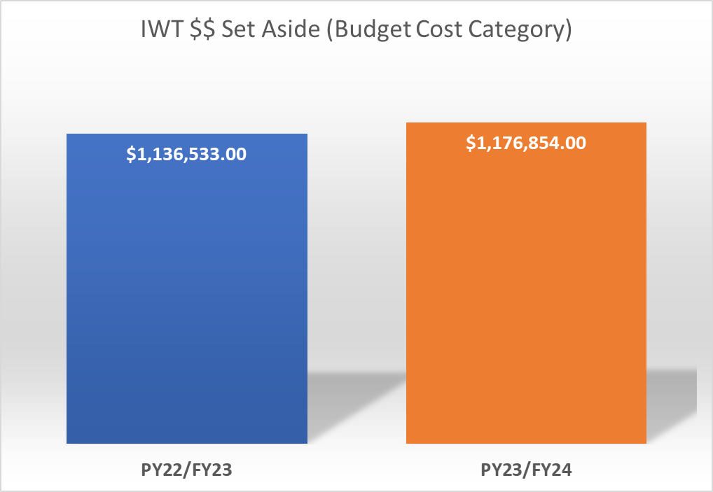
IWT Budget Cost Category Set Aside – PY22/FY23 & PY23/FY24
Notes:
When it comes to IWT set aside per program years PY22 and PY23, there’s about 40K difference.
Set aside refers to budget cost category designation.
Here’s an example of how that shows up on the RPR/FSR form.
Amt. is 20% of total approved budget

Slide 9
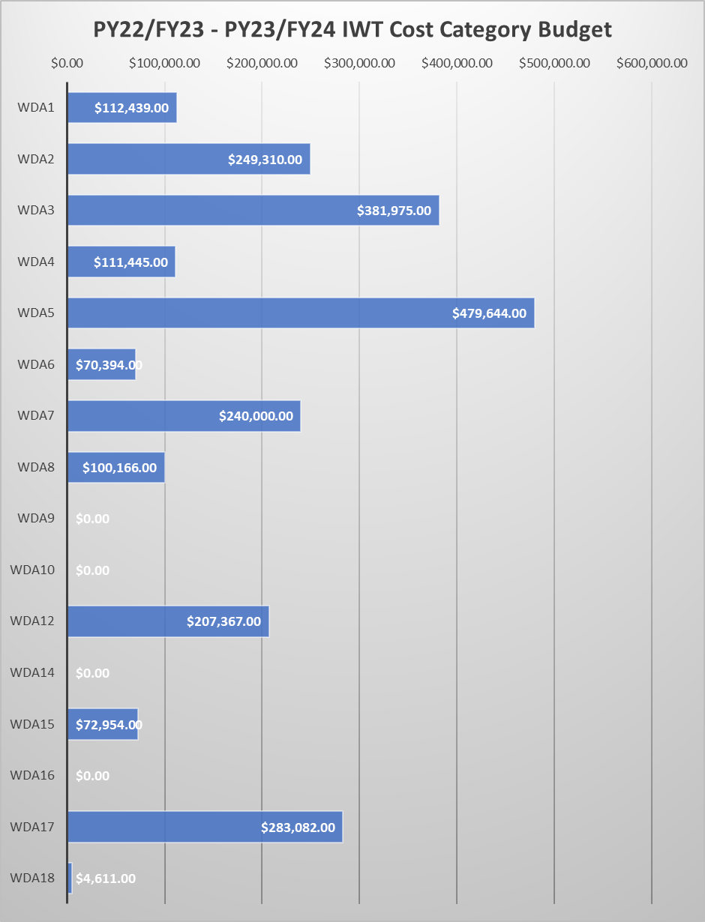
PY22/FY23 – PY23/FY24 IWT Cost Category Budget
Notes:
This graph shows workforce development areas’ set aside amounts for IWT
WDAs 5, 3, 17 and 2 are leading in IWT of set aside funds.
Since this graph was created, we’ve had a couple more WDAs, that didn’t have IWT funds set aside, modify to move training dollars to IWT line item.

Slide 10
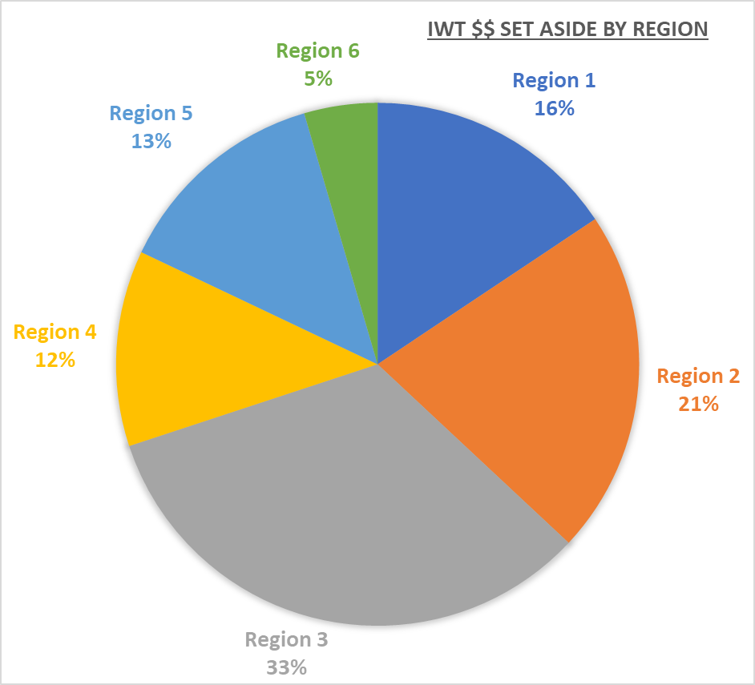
Notes:
From a regional perspective, the top 3 regions using IWTs are:
Region 3 at 33%,
Region 2 at 21%, and
Region 1 at 16%
Both 5 and 4 have substantial amounts set aside as well

Slide 11
Reminders
Work-based training is an allowable activity in WIOA Adult, WIOA DW, State DW as well as other programs
Grantee can use up to 10% of Adult & DW funds for Transition Jobs
Up to 20% of State DW funds can be used for IWT per PY
Up to 20% of WIOA Adult & DW funds (combined) can be used for IWT per PY
Reimbursements to employers for up to 75% of wages for OJT
Notes:
Before I turn it over to Amy, I wanted to leave you with a few reminders…

Slide 12
Work-based Training Definitions, Financial Coding, and Performance Impacts
Amy Carlson, Performance Accountability Supervisor

Slide 13
Work-based Training Definitions, Financial coding, and Performance Impacts
Apprenticeship
Definition: Provides a unique combination of structured learning with on-the-job training from an assigned mentor. Related instruction, technical training or other certified training is provided by apprenticeship training centers, technical schools, community colleges, and/or institutions employing distance and computer-based learning approaches. Registered Apprenticeship Programs must be certified by the Minnesota Department of Labor and Industry. All Registered Apprenticeships must include an industry recognized credential.
Financial Coding: Training costs
Performance Impacts: Requires annual Measurable Skill Gains, at lease 1 captured credential, and earnings in the 2nd and 4th quarters after program exit.
Customized Training
Definition: Training that is designed to meet the specific requirements of an employer (including a group of employers) that is conducted with a commitment by the employer to employ an individual upon successful completion of the training and for which the employer pays a significant portion of the cost of training according to several criteria.
Financial Coding: Training costs
Performance Impacts: Requires annual Measurable Skill Gains, at lease 1 captured credential, and earnings in the 2nd and 4th quarters after program exit.

Slide 14
Work-based Training Definitions, Financial coding, and Performance Impacts (Continued)
Incumbent Worker Credential Waiver (STATE FUNDED DISLOCATED WORKER ONLY)
Definition: Only to be used for participants with an eligibility basis of Incumbent Worker. This activity means the participant is still employed and to prevent a layoff, they require training. The training needed will not end in a credential. Once training is completed, they will exit the program and remain employed in a secure position.
Financial Coding: Training costs
Performance Impacts: Requires annual Measurable Skill Gains and earnings in the 2nd and 4th quarters after program exit.
Incumbent Worker Training (STATE or WIOA FUNDED DISLOCATED WORKER)
Definition: Only to be used for participants with an eligibility basis of “Incumbent Worker”. This activity means the participant is still employed and to prevent a layoff, they require training. The training needs to end in an industry recognized credential. Once training is completed, they will exit the program and remain employed in a secure position.
Financial Coding: Training costs
Performance Impacts: Requires annual Measurable Skill Gains, at lease 1 captured credential, and earnings in the 2nd and 4th quarters after program exit.

Slide 15
Work-based Training Definitions, Financial coding, and Performance Impacts (Continued)
OJT – Public or Private
Definition: On-the-Job Training (OJT) is primarily designed to provide a participant with the knowledge and skills necessary for the full performance of the job. An OJT provides knowledge or skills essential to the full and adequate performance of the job, provides reimbursement to the employer of up to a percentage of the wage rate of the participant for the extraordinary costs of providing the training and additional supervision related to the training; and is limited in duration as appropriate to the occupation for which the participant is being trained, taking into account the content of the training, the prior work experience of the participant, and the service strategy of the participant, as appropriate. For more information and requirements of an OJT, see DEED’s Customized Training and On-the-Job Training (WIOA) Policy.
Financial Coding: Training costs
Performance Impacts: Requires annual Measurable Skill Gains and earnings in the 2nd and 4th quarters after program exit.
Work Experience
Definition: An internship or work experience is a planned, structured learning experience that takes place in a workplace for a limited period of time. Internships and other work experience may be paid or unpaid, as appropriate and consistent with other laws, such as the Fair Labor Standards Act. An internship or other work experience may be arranged within the private for-profit sector, the non-profit sector, or the public sector. Labor standards apply in any work experience setting where an employee/employer relationship, as defined by the Fair Labor Standards Act, exists.
Financial Coding: Career Service costs (unless in coordination with “WIOA training”)
Performance Impacts: Requires earnings in the 2nd and 4th quarters after program exit.

Slide 16
Work-based Training Definitions, Financial coding, and Performance Impacts (Continued)
Work Readiness Services
Definition: Activities, programs, or services designed to help an individual acquire a combination of basic academic skills, critical thinking skills, digital literacy skills, and self-management skills are considered work readiness services. These include services that build competencies in: Utilizing resources; Using information; Working with others; Understanding systems; Skills necessary for successful transition into and completion of postsecondary education or training, or employment; and Other employability skills that increase an individual’s preparation for the workforce
Financial Coding: Career Service costs (unless in coordination with “WIOA training”)
Performance Impacts: Requires earnings in the 2nd and 4th quarters after program exit.
Pre-vocational Services
Definition: Short-term services including development of learning skills, communication skills, interviewing skills, punctuality, personal maintenance skills, and professional conduct services to prepare individuals for unsubsidized employment or training. In some instances, pre- apprenticeship programs may be considered as short-term pre-vocational services. Workshops covering topics such as resume writing, interviewing techniques, online job searches, LinkedIn, networking, career exploration or interest assessments are examples of pre-vocational services. Job Clubs and Career Fairs are also considered pre-vocational services.
Financial Coding: Career Service costs (unless in coordination with “WIOA training”)
Performance Impacts: Requires earnings in the 2nd and 4th quarters after program exit.

Slide 17
Thank You!
CONTACT: DWFAPrograms.DEED@state.mn.us
Notes:
Thank you for your partnership in this work! We hope that the information we provided motivates you and your stakeholders to examine how work-base training is being implemented currently and what changes you might consider to serve both individuals and employers more effectively.
Your hard work and dedication help to achieve DEED’s purpose to facilitate an economic environment to produce jobs and improve the quality of the state’s workforce. If we didn’t get to your question or if you think of additional questions or need additional information, please reach out anytime. Thanks again.
I’ll turn it back over to…

