Slide 1
WIOA Titles I and IV: Coming Together to Serve Youth
Statewide Training, March 2022

Slide 2
Training Goals
We are WIOA partners- we want to strengthen our collaboration
Understand our respective responsibilities under WIOA
Identify all resources that support youth
Know how to help youth navigate across the WIOA titles
Emphasize the youth’s experience- warm handoffs, shared work together, and behind the scenes work

Slide 3
Agenda
Overview of Our Shared System
Title I/LWDA Youth Programs
Title IV: DEED VRS and SSB
Moving Forward: Title I&IV Collaboration
Q and A

Slide 4
Overview of Our Shared System

Slide 5
Workforce Innovation and Opportunity Act (WIOA)
Signed into law on July 22, 2014
Landmark legislation designed to strengthen and improve our nation's public workforce system
Two primary customers:
Job seekers: Access employment, education, training, and support services to succeed in the labor market. Focus on youth and those with significant barriers to employment.
Employers: Match employers with the skilled workers they need to compete in the global economy

Slide 6
Precursors to WIOA
Smith-Fess Act
1920
1935
Social Security Act
Manpower Development and Training Act
1962
1964
Economic Opportunity Act
Rehabilitation Act and Comprehensive Employment and Training Act
1973
1982
Job Training Partnership Act
Workforce Investment Act
1998
Wagner-Peyser Act
1933

Slide 7
WIOA: Bringing our System Together
Reauthorizes the nation’s 6 core workforce training programs
Aligns the workforce programs through:
State unified plan
Common performance measures across all programs
A structured system that includes: State and local boards and “One-Stop Centers” (CareerForce)

Slide 8
Four Titles of WIOA and Six Core Programs
Title I: Workforce Development Activities
Adult Employment Services (WIOA-Adult)
Dislocated Workers Employment Services
Youth Employment Services (WIOA-Youth)
Title II: Adult Education and Literacy
Adult Education and Literacy Services (MN Adult Basic Education- ABE)
Title III: Wagner-Peyser Act
Wagner-Peyser Employment Services (Job Service)
Title IV: Rehabilitation Act of 1973
Vocational Rehabilitation (Vocational Rehabilitation Services- VRS and State Services for the Blind- SSB)

Slide 9
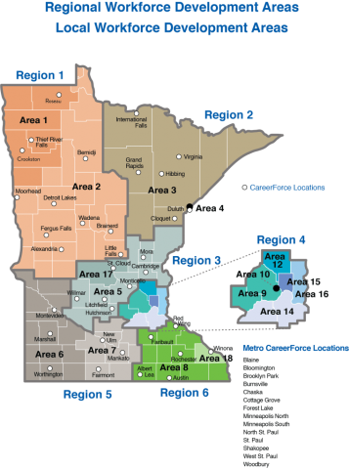
One System, Many Components
One System, Many Components
1 State Workforce Development Board (GWDB)
6 Regional Workforce Development Areas
16 Local Workforce Development Areas/Boards
Statewide CareerForce locations

Slide 10
Oversight and Funding of WIOA Title I Programs
U.S. Department of Labor
DEED
Local Workforce Development Boards (LWDBs)
LDWBs oversee their Local Workforce Development Areas (LWDAs)

Slide 11
Local Workforce Development Boards (LWDBs)
Charge: Provide local input and direction for meeting workforce development goals as outlined in state and federal statute.
Members: Appointed by local elected officials. Community business leaders, labor unions, educational institutions, economic development agencies, and other community based organizations. The chair of the board and a majority of the members are representatives of the private sector, involved in local area businesses.
NOTE: VRS and SSB managers are members of the LWDBs
Staffing: Each LWDA has a Director, who in most cases provides staff support to the local workforce board. The director is in charge of administering employment and training services. In some areas, the director is a county or city employee; in others, elected officials contract with a nonprofit agency that hires the director or the board itself hires a director.

Slide 12
LWDB Duties
Convening agents of workforce system partners
Establish policies
Monitor workforce development activities, budgets and performance outcomes within the LWDA
Create an employer services plan
Select CareerForce locations and other service delivery options
And more

Slide 13
16 Local Workforce Development Boards/Areas (LDWBs/LDWAs)
Anoka County Workforce Development Board (Area 12)
Career Solutions (Stearns-Benton Counties) Local Workforce Development Board (Area 17)
Central Minnesota Jobs and Training Services (Area 5)
Dakota-Scott Workforce Development Board (Area 14)
Duluth Workforce Development Board (Area 4)
Hennepin-Carver Workforce Development Board (Area 9)
Minneapolis Workforce Development Board (Area 10)
Northeast Minnesota Workforce Development Board (Area 3)
Northwest Private Industry Council Workforce Development Board (Area 1)
Ramsey County Workforce Development Board (Area 15)
Rural Minnesota Concentrated Employment Program Workforce Development Board (Area 2)
South Central Workforce Council (Area 7)
Southeast Minnesota Workforce Development Board (Area 8)
Southwest Minnesota Workforce Development Board (Area 6)
Washington County Workforce Development Board (Area 16)
Winona County Workforce Development Board (Area 18)

Slide 14
Oversight and Funding WIOA Title IV (VR) Programs
U.S. Department of Education
DEED
Vocational Rehabilitation Services (VRS) has 22 teams and 48 offices, many located in CareerForce locations
State Services for the Blind (SSB) has 12 offices, many located in CareerForce locations

Slide 15
VRS Offices and Directories
Additional VRS Contacts:
Field Staff Directory (accessible .xls) - Statewide contact information on all VRS counselors, placement staff, tech staff, listed alphabetically by office
VRS Student Career Services Staff - Find the VRS staff assigned to each high school
Administrative Staff Directory - staff who work in VRS administrative offices
RAMs Directory - Rehabilitation Area Managers located throughout the state
https://mn.gov/deed/job-seekers/disabilities/find-vrs/

Slide 16
SSB Offices and Directories
Main Office
(St. Paul)
Bemidji
Brainerd
Duluth
Fergus Falls
Hibbing
Hutchinson
Mankato
Marshall
Rochester
St. Cloud
West St. Paul
SSB Offices and Directories: https://mn.gov/deed/ssb/about/contact/

Slide 17
Title I/LWDA Youth Programs

Slide 18
Youth Programs Administered
All LWDAs administer:
WIOA Title I Youth Program
Minnesota Youth Program (MYP)
LWDAs may also administer many other workforce development programs:
Youth at Work
Minnesota Youthbuild
TANF Innovation Project
Pathways to Prosperity
And more

Slide 19
WIOA Youth Program
Assist youth with one or more barriers to employment to:
Prepare for postsecondary education and employment opportunities
Attain educational and skills training credentials
Secure employment with opportunities for advancement

Slide 20
WIOA Youth Program Overview
Activities:
Career exploration and guidance
Support for education attainment
Skills training in in-demand industries
Good jobs along a career pathway

Slide 21
Who WIOA Youth Program Serves
WIOA Youth program serves out-of-school youth (OSY) who:
Are not attending school
Age 16-24
Has one or more employment barriers
And in-school youth (ISY) who:
Are attending school
Age 14-21
Low income
Has one or more employment barriers

Slide 22
WIOA Youth Program Priorities
Out-of-school youth (OSY)
Minimum of 75% of funds allocated to States and local areas, except local area funds for administrative expenses, must be used to provide services to OSY
Work experience
Not less than 20% of funds allocated to local areas, except local area funds for administrative expenses, must be used to provide ISY and OSY with paid and unpaid work experience

Slide 23
Minnesota Youth Program (MYP)
Minnesota Youth Program (MYP)
Provide short-term employment and training services to low-income and at-risk youth ages 14 to 24 who lack the academic and applied skills considered critical in the workplace.
Focus on work readiness and work experience

Slide 24
Eligibility
Application
Each LWDA has their own application
Application lasts 6 months
Eligibility
Verification forms (identification [birth certificate and social security card], income verification, other items depending on the program the youth is applying for)
Proof of Selective Service registration (if 18+), unless they have an exemption

Slide 25
Enrollment
Objective assessment: Formal and informal. If training is involved, an assessment of reading and math that provides a grade level equivalency.
Consider accommodations
Can use assessment information from other partners (ie. school, VRS) as long as it was within the past 6 months and meets program criteria
Individual Service Strategy (ISS): Is the plan developed with each eligible youth.
If there are support services needed, they would be identified (ie. transportation)
Is up to the LWDA staff (employment specialist, counselor, etc.) to decide if a youth would be co-enrolled in more than one program that the LWDA administers

Slide 26
Exit and Follow-up
Are exited when they met program objectives from ISS or are no longer engaged
If there hasn’t been contact for 90 days, they have to automatically be exited
Upon exit, follow-up with them for 12 months on a quarterly basis:
Are you still working? Was there an increase in wages? A new or better job?
Did you stay in and/or complete school or other credentials?
Did something change and do you need to re-enroll?

Slide 27
Services Provided Include
Comprehensive career-related guidance and planning
Employment opportunities linked to academic and occupational learning
Paid and unpaid work experience opportunities and internships
Job shadowing
Occupational skills training
Apprenticeship and/or pre-apprenticeship opportunities
Alternative secondary school options to complete high school
Career pathway and post-secondary training exploration
Tutoring, study skills training, instruction leading to secondary school completion, including dropout prevention strategies
Leadership development opportunities
Mentoring
Supportive services (financial assistance with certain costs related to gaining employment or completing an educational goal)
Follow-up services to ensure continued success
Adult mentoring
Financial literacy and budgeting assistance
Entrepreneurial skills development
Alternative secondary school services

Slide 28
Other Possible Programs

Slide 29
Statewide Data: DEED Youth Programs (Service Levels for BIPOC Youth in Minnesota)
Program | Number of Youth Served | Number of BIPOC Youth | Percentage of BIPOC Youth Served | Estimated Number of BIPOC Youth in Poverty** | Percentage of BIPOC Youth in Poverty
WIOA Youth (PY 20) | 2,476 | 1,593 | 64%
Minnesota Youth Program (SFY 21)* | 2,684 | 1,468 | 55%
Youth at Work Opportunity Grants (SFY 21)* | 7,040 | 5,385 | 76%
Youthbuild (SFY 21) | 436 | 339 | 72%
TANF Youth (SFY 21) | 176 | 104 | 59%
Youth Support Services (SFY 21) | 753 | 557 | 74%
TOTAL: | 13,565 | 9,446 | 70% | 35,037† | 35%
*Minnesota Youth Program and Youth at Work grantees also serve approximately 15,000 youth annually through group services and presentations that are not case managed by grantees.
**Ages 15-24
† Data from the 2019 American Community Survey 1-year Estimates for Minnesota

Slide 30
Statewide Data: Who do we serve?
Over 13,500 case-managed youth and young adults between the ages of 14 and 24+ in SFY 21
7 of 10 youth served identify as BIPOC
7 of 10 youth are economically disadvantaged at enrollment
4 of 10 are basic skills deficient at enrollment
1 of 4 identify as a youth with a disability

Slide 31
Title I Case Examples
Title I Case Examples

Slide 32
Title IV: DEED-VRS and SSB

Slide 33
VRS Mission
Empower youth and adults with disabilities
to explore, prepare for and achieve their goals
for competitive integrated employment

Slide 34
SSB Mission
To facilitate the achievement of vocational and personal independence by Minnesotans who are blind, visually impaired or DeafBlind

Slide 35
Services VRS and SSB Provide
Career Counseling
Job Training
Job Placement
Services to Keep a Job
Adjustment to Blindness (SSB)
Pre-Employment Transition Services
And more!

Slide 36
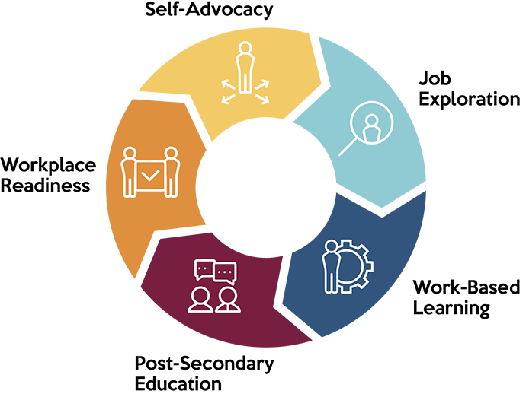
Pre-Employment Transition Services (Pre-ETS)
Job Exploration Counseling
Work-Based Learning Experiences
Postsecondary Education Counseling
Workplace Readiness Training
Instruction in Self-Advocacy

Slide 37
SSB Team Approach
Pre-ETS/Transition Core Team
Agency director and deputy director of programs
Workforce Development Unit Supervisor
Transition Coordinator
Work Opportunities Navigator
Rehabilitation counselors with transition caseloads
Assistive technology specialist
Employment Team specialist
Additional rehabilitation counselors with varying specialties

Slide 38
VRS: 2 Levels of Support for Students (click here for link)
Introductory Career Services (“Pre-ETS Only”)
a.k.a. Pre-ETS for “potentially eligible” students
VRS staff: Pre-ETS Representatives
Typical starting point for 9-11th graders
VR Career Services (“Pre-ETS Plus”)
a.k.a. the full VR program
VRS staff: VR Counselors
Typical starting point for 11th & 12th graders and students in 18-21 transition programming

Slide 39
Process: Introductory Career Services
VRS Pre-ETS Representative provides an application to the student
Get signed release of information for school, parents
Eligibility:
VRS needs to verify from school or other professional that the student has an IEP, 504 plan or other medical/mental health documentation of a disability
Youth needs to be between ages 14-21 and be in an education program
Pre-ETS Rep works with student, school, others to identify which of the 5 Pre-ETS the students needs
The needed Pre-ETS are then provided (either by VRS or through a contracted partner)

Slide 40
Vocational Rehabilitation (VR) Process
Application & Intake
Eligibility and Priority for Services (PFS)
Assessment of VR Needs
Employment Plan (EP)
Case Closure

Slide 41
Application & Intake
Once an individual has decided they want to apply for VRS, they are invited to meet with a VR counselor for an intake meeting.
VR services are explained and an application is provided
Intake is also about getting to know the individual, building rapport, and starting to gather the information necessary for the counselor to determine eligibility
Timelines:
A group or individual orientation to Vocational Rehabilitation Services will be available on at least a weekly basis.
Intake must happen within 10 business days of VRS’ receipt of application.

Slide 42
Four Pillars of Eligibility
Four Pillars of Eligibility:
Does this person have a documented impairment?
Is there a substantial impediment to employment?
Does the person require VR services to prepare for, secure, retain, advance, or regain competitive integrated employment?
Is this person presumed to benefit in terms of an employment outcome from VR services?

Slide 43
Priority for Services (PFS)
By law, those with the most significant disabilities must be served first
To do this, seven “areas of functional limitations” are assessed (next slide)
PFS should be completed the same day as eligibility whenever possible

Slide 44
The Seven Functional Areas
Mobility
Self-Direction
Self-Care
Interpersonal Skills
Communication
Work Tolerance
Work Skills

Slide 45
Timelines for Eligibility and PFS
A timely eligibility and PFS decision is when the decision is made within 10 business days of receiving sufficient information
Eligibility and PFS must be decided as soon as possible but no longer than 60 calendar days from the date the agency receives an application for services.

Slide 46
Assessment of VR Needs
Is key to developing an appropriate Employment Plan.
Uncovers the individual’s unique strengths, interests, abilities, limitations and life circumstances which establish the foundation of the counseling process.
Also lays out the rationale for the job goal and services to be provided.
Timeline:
Initial stand-alone Assessment of VR Needs prior to writing Employment Plan
Continues through the life of the case

Slide 47
Employment Plan
A communication tool between the person and the counselor on how to reach the vocational goal
Includes:
Job goal
All services to be provided to reach that goal
Progress measures
Other responsibilities

Slide 48
Timeline for Employment Plan
Timeline:
As early as possible but no later than 90 days from the date the person enters a planning status
Transition students:
Must have in place prior to leaving the school setting
May start with a broad goal and then amend the plan when that goal is refined

Slide 49
Case Closure
Many reasons for closure- but the best is when a person has achieved competitive integrated employment!
Timeline: Case closed 90 days after reaching job stability

Slide 50
VRS: Number of Individuals Served

Slide 51
Who does VRS Serve?

Slide 52
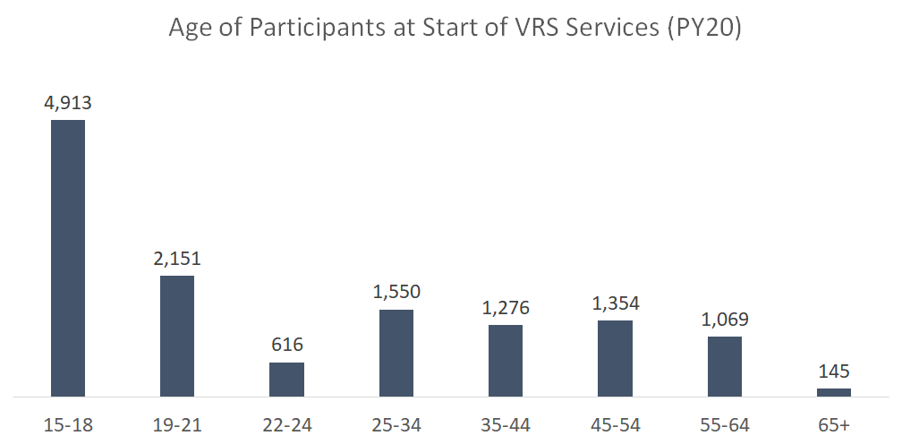
VRS: Age of Participants

Slide 53
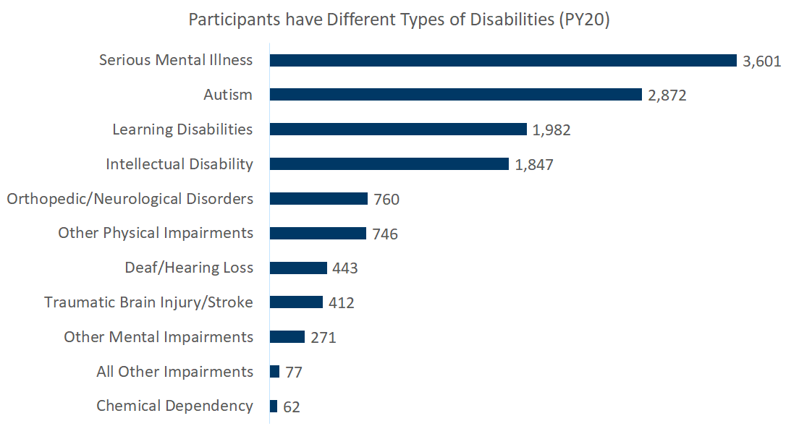
VRS: Types of Disabilities

Slide 54
SSB Data
Total number served in program year 2020 (July 1, 2020 – June 30, 2021): 605
Individuals age 20 and under: 127

Slide 55
Title IV (VR) Case Examples
Title IV (VR) Case Examples

Slide 56
Moving Forward: Title I&IV Collaboration

Slide 57
Moving Forward: Title I&IV Collaboration
My Vault as a tool for collaboration and information sharing
Call to Action

Slide 58
My Vault

Slide 59
What is My Vault?
Secure, personal account used by people with disabilities and those who support them to explore and plan, store and share files, create contact lists, and clearly document activities that lead to an informed choice.
Disability Hub MN - Vault

Slide 60
How do I access My Vault?
www.disabilityhubmn.org

Slide 61
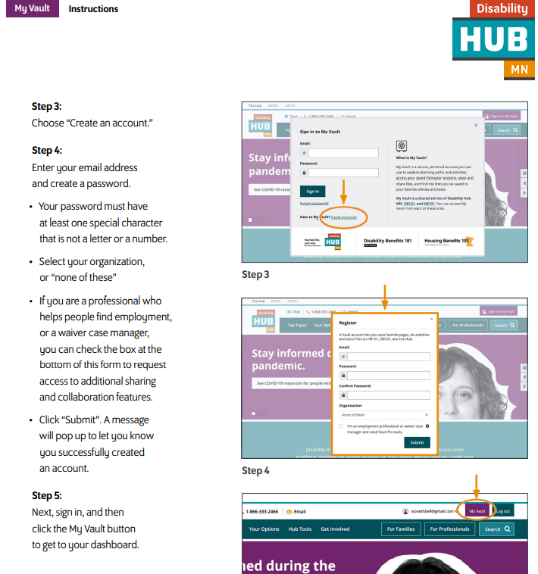
How to Create a My Vault Account
Disability Hub MN - My Vault

Slide 62
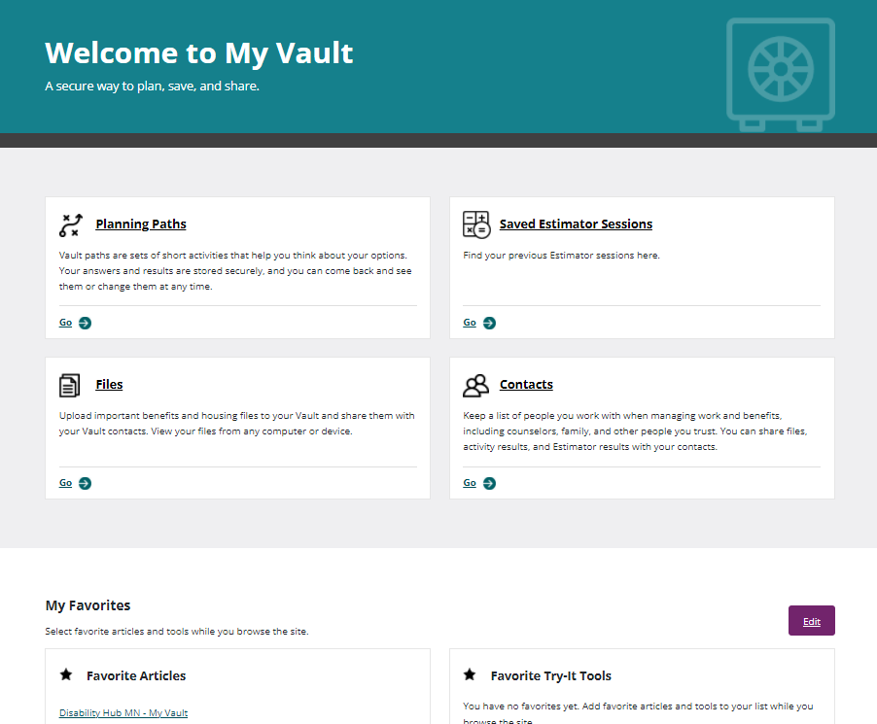
How do I use My Vault with youth and adults?
Disability Hub MN: My Vault
Create your own account
Help the people you support create their own accounts
Use My Vault to improve communication and collaborate
Share activities, documents, and information using My Vault

Slide 63
35-Minute My Vault Training
35-Minute My Vault Training

Slide 64
Call to Action!
Hold local meetings by end of May with LWDA staff along with VRS and SSB partners that serve youth in that LWDA region. Chris McVey and Alyssa Klein at VRS will help in setting these up.
Meeting agenda: Review the training and discuss:
How is programming administered in our geographic area?
How can we improve referrals and co-enrollment between our programs?
How do we take our partnership to the next level?
What questions remain?
Submit meeting notes to Chris at chris.mcvey@state.mn.us

Slide 65
Questions?

Slide 66
Contact Information
Nicole Swanson, Anoka County LWDA Director: nicole.swanson@co.anoka.mn.us
Chris McVey, DEED-VRS Director of Strategic Initiatives: chris.mcvey@state.mn.us
Cory Schmid, DEED Youth Development Staff, cory.schmid@state.mn.us
Bridgett Backman, Anoka County Employment Services Manager: bridgett.backman@co.anoka.mn.us
Darcy Hokkanen, Anoka County Program Coordinator: darcy.hokkanen@co.anoka.mn.us
Alyssa Klein, DEED-VRS Transition and Pre-ETS Coordinator: alyssa.klein@state.mn.us
Sara Sundeen, DEED-VRS Community Partnerships Specialist: sara.sundeen@state.mn.us
Sheila Koenig, DEED-SSB Transition Coordinator: sheila.koenig@state.mn.us

