Slide 1
Task Force on Workforce Development System Reform
Wednesday, August 13, 2025
WiFi: winter24

Slide 2
Agenda
Time | Topic | Presenter/Facilitator
8:00 A.M. | Welcome & Call to Order | Commissioner Matt Varilek, DEED
8:20 A.M. | Discussion on Task Force Priorities | Task Force Members
9:10 A.M. | Task Force Organization Co-Chair Roles, Responsibilities & Election Task Force Norms & Expectations | Task Force Members
9:30 A.M. | Break
9:45 A.M. | Workforce Development System Overview | Katie McClelland, Governor’s Workforce Development Board Executive Director
10:25 A.M. | Task Force Work Ahead Define Scope of Work Determine Meeting Topics & Cadence Stakeholder Feedback Priorities | Task Force Members
10:55 A.M. | Closing & Next Steps | Commissioner Matt Varilek, DEED

Slide 3
Introductions
Name
Title
Organization
Area or Region of the State You’re Representing

Slide 4
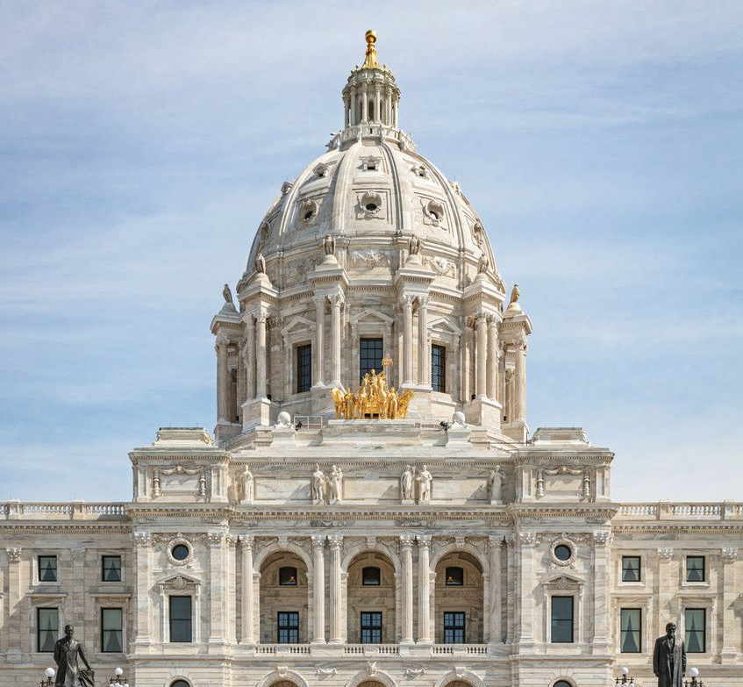
Task Force on Workforce Development System Reform: Purpose & Mandate
Established by 2025 Special Session (SF17 / Ch. 6)
To examine how Minnesota develops workforce strategies, sets goals, and allocates funds to meet statewide workforce development needs.
Scope of Work
Review existing workforce development programs in Minnesota, including those funded by the federal and state governments; Study the current system for funding workforce development efforts; Investigate potential metrics for evaluating workforce development program outcomes; Make recommendations for changes to practices, programs, funding, and laws related to state workforce development efforts; and Propose draft legislation to implement any of the task force's recommendations.

Slide 5
Deliverables & Statutory Deadlines
14 June 2025
Task Force effective date
July 2025
Appointment deadline (30 days)
Aug. 2025
First meeting held; co-chairs elected
Feb. 2026
Preliminary Report due
Jan. 2027
Task Force sunsets
*WIOA State Plan Modifications Due
Task Force Report & Legislation Due

Slide 6
GWDB
Carol Anderson –Rural Minnesota Concentrated Employment Program (RMCEP) Workforce Development Board
Michael Berndt –Dakota-Scott Workforce Development Board
Task Force Membership
Task Force Co-Chair Misun Bormann –Southeast Minnesota Workforce Development Board
DEED Commissioner Matt Varilek
Legislators
Task Force Co-Chair Rep. Dave Baker (R – Willmar, Jobs Committee Co-Chair)
Sen. Bobby Joe Champion (DFL – Minneapolis, Jobs Committee Chair)
Rep. Dave Pinto (DFL – Saint Paul, Jobs Committee Co-Chair)
Nicole Mattson –Hennepin-Carver Workforce Development Board
Sen. Carla Nelson (R – Rochester, GWDB Member)

Slide 7
Task Force Priorities
What brought you to or interested you in participating in the Task Force?
Is there an area of the duties you’re most interested in
Single biggest priority or program you’re interested in for improving the workforce development system?
Scope of federally and state funded programs
Funding systems
Evaluation
Notes:
Baker: Legislative Audit, how are CareerForce centers being used, Workforce Development Fund – tax on businesses but want to know how and why its being used and more taxes being used
Carol: Input from the local workforce centers, rural representation – Carol would want to host a meeting, locals CBOs have a hard time. Also looking at using AI
*Send full group legislative auditors report
Sen Nelson: connecting people to services, like the idea of different locations for meeting
Sen. Champion: how well people navigate legislative process and competitive process – how are we making sure funding is fair and accessible for everyone including in design and evaluation of grants
Michael: apprenticeship aligned to postsecondary – not an alternative option. Where do we get around the challenges that are put in place by the grantees
Nicole: how to maximize the small amount of resources that we have, workforce centers used to mean something to the community and have more resources co-located (libraries)
Misun: transparency, how are we prioritizing and disseminating dollars – why do we have the dollars, what is the problem we’re trying to solve and get to prioritize. How do we simplify system and make it easier to understand and navigate. Who is best positioned to receive dollars to do what they’re being asked to do
Varilek: simplicity as a goal, brought up tension of large GWDB and lots of LWDAs; challenge of too many hoops and also concerns about fraud

Slide 8
Task Force Organization

Slide 9
Co-Chairs Roles and Responsibilities
1. Leadership and Governance
Jointly lead the task force in accomplishing the stated purpose.
Serve as primary conveners and facilitators of task force meetings.
Maintain a nonpartisan and collaborative tone, ensuring equitable representation of viewpoints from across the state and sectors.
2. Meeting Management
Preside over a minimum of six public meetings, as required by law, between the effective date and January 15, 2027.
Work with GWDB staff and task force members to develop agendas and meeting materials
Facilitate meaningful dialogue and decision-making
Ensure compliance with the Minnesota Open Meeting Law (Chapter 13D)
3. Oversight of Mandated Duties
Ensure the task force successfully carries out its legislative mandate under Subd. 5
4. Community and Stakeholder Engagement
Lead the task force in seeking inclusive statewide input
Promote transparent and equitable engagement, ensuring all voices are heard
5. Coordination and Reporting
Collaborate with GWDB staff to ensure timely preparation of the preliminary report (due Feb 15, 2026) and final report (due Jan 15, 2027), which must:
Document the task force’s work and findings
Include all recommendations and proposed legislation
Ensure reports are submitted to legislative committees and publicly accessible

Slide 10
Task Force Members Norms and Expectations
1. Commitment to the Mission: Uphold the task force’s charge to examine and improve Minnesota’s workforce development system with integrity, focus, and respect for the diverse communities it serves.
2. Attendance and Preparation: Attend all scheduled meetings and review materials in advance. Notify co-chairs or GWDB staff of any anticipated absences as early as possible.
3. Respectful Collaboration: Foster a respectful and inclusive environment. Allow space for all members to contribute and listen actively without interruption.
4. Nonpartisan Approach: Engage in discussions and decision-making with a focus on evidence, equity, and effectiveness—free from partisan advocacy or political bias.
5. Transparency and Open Meetings: Operate in accordance with Minnesota’s Open Meeting Law. Respect the public nature of the task force’s work and contribute to transparency in all deliberations.
6. Equity and Community Voice: Center equity by elevating voices from underserved communities and valuing lived experience. Promote input from a diverse range of stakeholders statewide.
7. Constructive Dialogue and Consensus Building: Aim for consensus where possible. Engage in civil, solution-oriented dialogue even when perspectives differ. Communicate early and often about concerns over potential recommendations.
8. Accountability to Deliverables: Stay aligned with the timeline and reporting responsibilities. Collaborate to produce meaningful recommendations and draft legislation by the statutory deadlines.
9. Confidentiality When Appropriate: While meetings are public, respect confidentiality when discussing sensitive stakeholder input or draft recommendations not yet public.
10. Support for Co-Chairs and staff: Work constructively with GWDB staff and support co-chairs in guiding the task force toward its goals.

Slide 11
Open Meeting Law Overview
With limited exceptions, all meetings of public bodies must be open to the public.
Minnesota Supreme Court stated three purposes for the OML:
  To prohibit actions taken at secret meetings
  To assure the public’s right to be informed
  To give the public an opportunity to present its views to the public body
    BUT the OML does not require public bodies to reserve time for public comment
Gatherings subject to the law – “quorum rule” *
  Quorum (majority) or more of full public body, or quorum of any of the public body’s committees, subcommittees etc. AND
  Quorum (majority) discusses, decides or receives information as a group on issues relating to its official business
*(Moberg v. Independent School District No. 281, 336 N.W.2d 510 (Minn. 1983)
Notes:
*Check about roll call vote on virtual meetings – read out?

Slide 12
Open Meeting Law Overview
Gatherings NOT subject to the law – “quorum rule”
  Gatherings of less than a quorum of members
  Chance or social
  Training/team building activities so long as business is not discussed
Types of Meetings
  Regular meetings
    Schedule of meetings on file at primary office
  Special meetings
    Any meeting not on the regular schedule
    3-day advance posting on website, including date, time, place, and meeting purpose
  Emergency meetings
    Special meetings called because circumstances don’t allow for a 3-day prior notice
    Good faith effort to notify media that requested notice

Slide 13
Open Meeting Law Overview
Use of Email
  Avoid “discussion”
  One-way communication between the chair/staff and members of a public body is permissible, such as sending meeting materials via email to all board members, with no discussion or decision-making.
Closed Meetings
  Meetings can be closed only if required or permitted in the law
  All closed meetings must be recorded (attorney-client exception)
  No general “personnel exception” to close a meeting
  Statement on the record before closing a meeting
    Legal authority to close the meeting
    Describe what will be discussed
Link to additional information on closed meetings: Minnesota Department of Administration Open Meeting Law Overview

Slide 14
Break

Slide 15
Workforce Development System Overview
Katie McClelland | GWDB Executive Director

Slide 16
Workforce Development System Overview
Federal Workforce Development Landscape
State Workforce Development Implementation
Interagency Workforce Alignment Task Force
Local Area Workforce Development Implementation
State Workforce Development Reform Activities

Slide 17
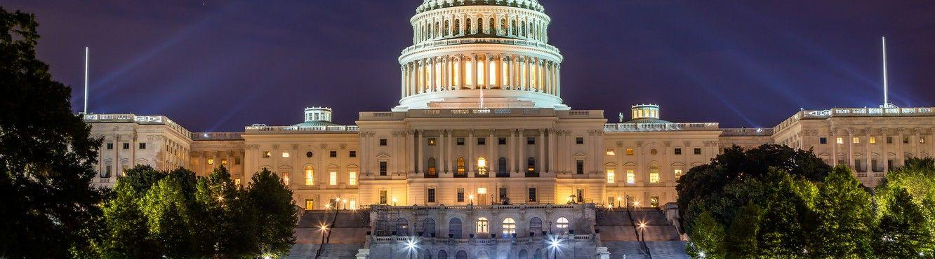
Federal Workforce Development Landscape

Slide 18
GWDB Purpose
About the GWDB:
Employer-led board created out of federal and state statute
Who We Serve:
State agencies and local workforce boards
Workforce professionals
Employers and job seekers
~60 voting and non-voting members, 50% business voting members
Enterprise leadership, state& local elected officials, unions, education, and community-based organizations members
Continuing to "reimagine" the role and work of the GWDB
The Governor and State Legislature
The purpose of the State Workforce Development Board (WDB) is to convene State, regional, and local workforce system and partners, to—
Enhance the capacity and performance of the workforce development system;
Align and improve the outcomes and effectiveness of Federally-funded and other workforce programs and investments; and
Through these efforts, promote economic growth.
Engage public workforce system representatives, including businesses, education providers, economic development, labor representatives, and other stakeholders to help the workforce development system achieve the purpose of the Workforce Innovation and Opportunity Act (WIOA); and
Assist to achieve the State's strategic and operational vision and goals as outlined in the State Plan.
20 CFR 679.100

Slide 19
Minnesota GWDB State Statute
Subd. 2a. Board meetings; chair.
Subd. 4. Executive committee duties.
The board shall hold regular in-person meetings at least quarterly and as often as necessary to perform the duties outlined in the statement of authority and the board's bylaws.
The executive committee must, with advice and input of local workforce boards and other stakeholders as appropriate, develop performance standards for the state workforce centers.
By January 15, 2019, and each odd-numbered year thereafter, the executive committee shall submit a report to the senate and house of representatives committees with jurisdiction over workforce development programs regarding the performance and outcomes of the workforce centers. The report must provide recommendations regarding workforce center funding levels and sources, program changes, and administrative changes.
116L.665 WORKFORCE DEVELOPMENT BOARD.

Slide 20
GWDB Statutory Charge & Committee Alignment
GWDB Committee | Statutory Charge
Executive Committee | Full Board strategic direction through agenda setting Bi-annual state legislative reports Funding levels, program changes, admin changes Performance standards for WF centers
Sector Partnerships Committee | Defining in-demand industry sectors & Occupations, Defining and developing strategies for sector partnerships Strategies for effective outreach to individuals & employers Strategies for career pathway development and use
State & Local Coordination Committee | Review statewide policies & programs for system alignment & coordinated service delivery – including of CareerForce Centers State performance accountability measures Identification and review of regions and local areas
Innovative Service Delivery Committee | Technological improvements for access to & quality of CareerForce System Strategies to align technology and data across CareerForce partners to enhance service delivery Policies for coordination of services through CareerForce

Slide 21
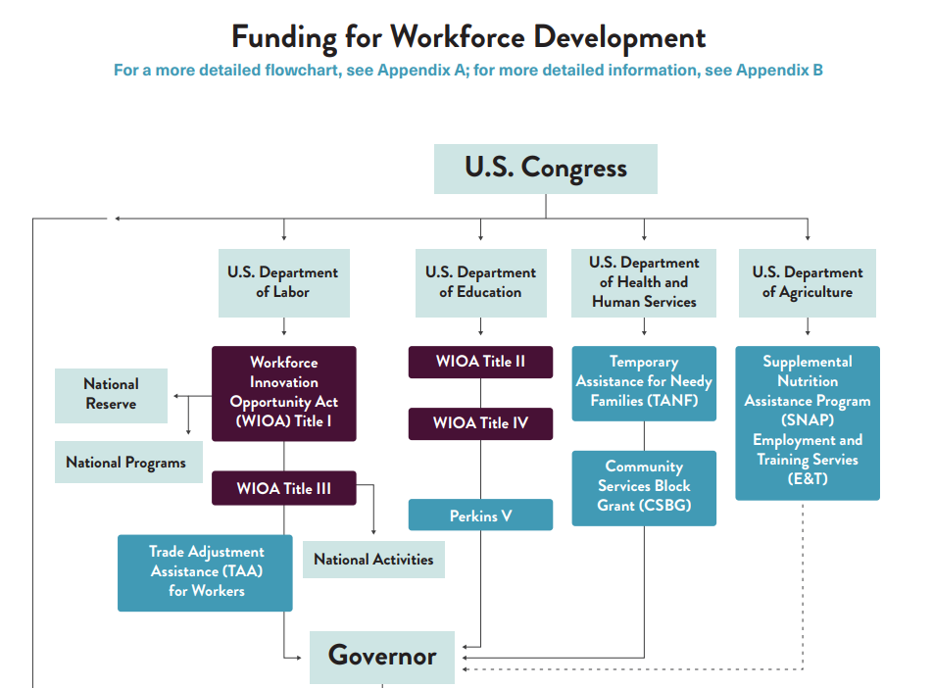
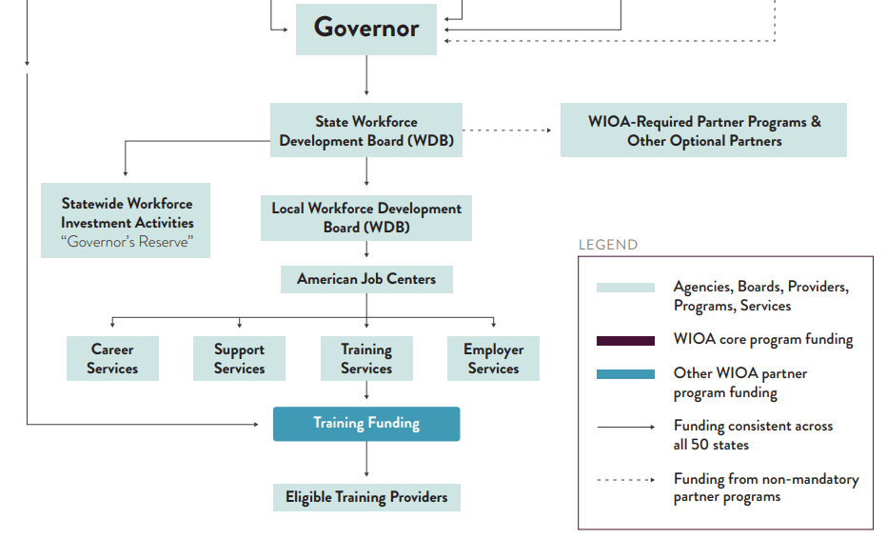
WIOA Combined Plan Funding Streams
Source: A Guide to the American Workforce System

Slide 22
WIOA Performance Accountability
WIOA requires local areas to meet or exceed federal and state performance targets
Metrics include employment rates, median earnings, credential attainment, skill gains
Effectiveness in serving employers also measured

Slide 23
Minnesota WIOA Funding Trends FY 2022 - 2026

Slide 24
Workforce Development Federal Funding Land
Passed Into Law:
Reconciliation Package
Recissions Package
2025 Continuing Appropriations& Extensions Act
Make America Skilled Again (MASA) Proposal
WIOA Reauthorization Proposal
Fiscal Year 2026 Appropriations Acts
H.R. 1
President’s FY 2026 US DOL Budget Proposal
A Stronger Workforce For America Act
H.R. 4
Proposals Not Yet Passed Into Law:

Slide 25
Workforce Pell Grants – Implementation Timeline
Fed Responsibilities
(U.S. Department of Education)
State Responsibilities
(Governor/GWDB)
Now until Nov. 1, 2025
Conduct Negotiated rulemaking
Now – Mid 2026
Identify in-demand occupations and align short-term programs
Late 2025
Issue final rule and provide implementation guidance
Mid 2026
Develop process for Governor and State Board program eligibility & agency program approvals
By July 1, 2026
Workforce Pell program launch for award year 2026-2027
By July 1, 2026
Submit approved programs and prepared for program launch
Notes:
Kevion

Slide 26

State Workforce Development Implementation

Slide 27
Federal
(funding + guardrails)
U.S. DOL – WIOA Titles I & III; Veterans (VETS)
U.S. ED – Perkins V (CTE) & Adult Ed oversight
HHS – TANF work programs
USDA – SNAP Employment & Training (E&T)
State
(strategy + program operations)
Governor / GWDB – statewide strategy, planning, coordination, Interagency Alignment
DEED:
DLI – Registered Apprenticeship (RAPs), workforce standards
MDE – K‑12 CTE; Adult Basic Education (ABE) policy & funding oversight
Minnesota State + OHE – postsecondary CTE, community/technical colleges; training & credentials
DHS – TANF/SNAP E&T alignment; wraparound services
DOC – reentry, work release, employer partnerships
DHS, MDH, MMB – workforce program partners
Regional & Local
(delivery + tailoring)
16 Local Workforce Development Boards (via MAWB) – strategy & oversight locally
Career Force locations & providers – day‑to‑day service delivery
Adult Basic Education consortia – foundational skills
County human services & city programs – case management, supports
Tribal governments & urban Indian orgs – sovereign and community‑based delivery
Employer & Community (demand + wraparound)
Employers & associations – sector partnerships (Drive‑for‑5, CHIPS coalition, local chambers, etc.)
Unions/JATCs – apprenticeship pathways
Nonprofits & intermediaries – job readiness, training, placement, retention
Economic development (Greater MSP, Great St. Cloud, Greater Mankato, APEX) – growth alignment, industry connections
Philanthropy – innovation pilots and gap funding
Transportation, housing, childcare, libraries – barrier removal & access
WIOA Titles I & III: Career Force system;
Labor Market Info;
Voc Rehab (VRS/SSB)
Veteran employment & training
CTE – middle & high school coursework & experiential learning, community college credentials
Higher ed – degrees and credentials through community and technical colleges and four-year institutions
System Map
Minnesota’s Workforce Development Network from 30,000 ft

Slide 28
DEED State Workforce Programs
WIOA Supplemental
DEED Competitive Grants
State Dislocated Worker Program
Pathways to Prosperity (P2P)
Rural Career Counseling Coordination (RCCC)
Youth at Work
YouthBuild
Minnesota Job Skills Partnership (MJSP) Partnership & Pathways Grants
Drive for 5 Workforce Fund
Transformative Career Pathways
Service to Success Grants/ Office of Public Service
Office of New Americans Integration Grants

Slide 29
Cross-agency Workforce Programs
Program | Agency
Building Trades Pathways | DLI
Construction Worker Mental Health | DLI
Registered Apprenticeship Programs Teacher Apprenticeship Program | DLI
Dual Training Pipeline | DLI
Youth Skills Training Programs | DLI
Program | Agency
Direct Care Workforce Package | DHS
Behavioral Health Workforce | DHS
Human Services Employment Programs | DHS
Healthcare Workforce Programs | MDH
EMS Workforce Support | MDH
Program | Agency
Grow Your Own Teacher Grants | MDE
Special Education Teacher Pipeline | MDE
North Star Promise | OHE
Student Emergency Assistance Grants | OHE
Prison Educator Programs | DOC
Reentry and Work Release | DOC

Slide 30

CareerForce
Minnesota’s one-stop operators are known as CareerForce, with 55 CareerForce locations around the state to serve jobseekers and employers
CareerForce locations are operated by local workforce boards in partnership with DEED and the GWDB
Programs and services provided include:
Core WIOA Titles I-IV: Adult, Dislocated Worker, Youth, Wagner-Peyser, Adult Ed, Voc. Rehab
Other partners: TANF, SNAP E&T, Job Corps, UI, SCSEP, Veteran's Employment Services, etc.
Partners must share infrastructure costs and participate in service coordination
Employment Services: basic career services to help jobseekers including resume workshops, job searching assistance, career counseling, and much more!
Access to education and training
Employer services such as Employer of Day and Hiring Fairs
Access CareerForce virtually at CareerForce.mn.gov

Slide 31
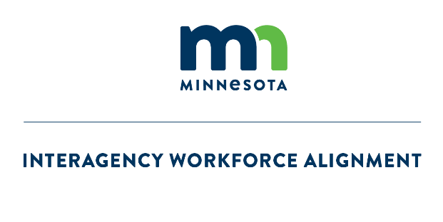
Interagency Workforce Alignment Task Force

Slide 32
Building Enterprise Workforce Development Alignment
Overarching Aim of Using the IWA as the Space for Interagency Alignment: Enable thoughtful, strategic, aligned, and proactive interagency decision-making and collaboration, and hold ourselves accountable for reaching a 4.4% vacancy rate overall and in the Drive for Five sectors.
Aim 1: Ensure Enterprise-wide alignment and defined agency ownership of workforce efforts across the Drive for 5 Sectors.
Aim 2: Define metrics and measurable goals to track progress on stated outcomes and timelines.
Aim 3: Ensure effective internal and external communication about statewide talent attraction and retention strategies.

Slide 33
Overall Priorities of the IWA Taskforce
Goal: Enable thoughtful, strategic, aligned, and proactive interagency decision-making and collaboration and hold ourselves accountable for reaching a 4.4% vacancy rate overall and in the Drive for Five sectors.
Create alignment among Enterprise workforce supports in the Healthcare sector
Align internal and external educator pipeline initiatives
Evaluate the cumulative impact of workforce programs to ensure alignment
Improve understanding of workforce outcomes
Develop a framework to inventory and assess the alignment and reach of workforce programs across the Enterprise
Address the high vacancy rate in the healthcare sector
Work with industry stakeholders to improve job quality and retention among healthcare workers
Establish strategies for effective communication of Enterprise workforce efforts
Develop policies and practices for interagency communication of efforts
Build strong external communications to improve customer experience
Aim 1: Alignment
Aim 2: Metrics
Aim 3: Communication
Responsible Party:
IWA Taskforce
IWA Workgroup
GWDB Committee
Results Management (MMB)

Slide 34
Alignment Strategy Framework
    Vision for Alignment
    Alignment means that while state agencies operate independently, our efforts are intentionally moving in the same direction: building a more coordinated, effective, and equitable workforce development and support systems that meet the needs of all Minnesotans.
    Alignment Goals - These are the high-level outcomes (beyond the vacancy rate) all workgroups are working toward:
    Mutual awareness of workforce development programs and resources between agencies
    Minimize redundancies between workforce development programs and resources
    Common metrics and tracking of objectives
    Aligned messaging around workforce development goals
    Alignment Components– These are what the workgroups will look at when analyzing the workforce programs across agencies. They may look at other areas, but at a minimum they must consider these in their work:
    Reporting Requirements
    External Communications
    Grant application processes
    Internal Communications
    Policy alignment
    Tools and Resources (databases, forms, calendars etc. utilized to operate the programs)
Notes:
During the June 11th IWA Taskforce meeting, the Taskforce members worked together to edit the Alignment Strategy Framework.
If there are additional edits requested by Taskforce members who could not attend the meeting, these should be submitted to Patti by July 1st. This framework will be provided to the workgroups and committees after that date.

Slide 35

Local Area Workforce Development Implementation

Slide 36
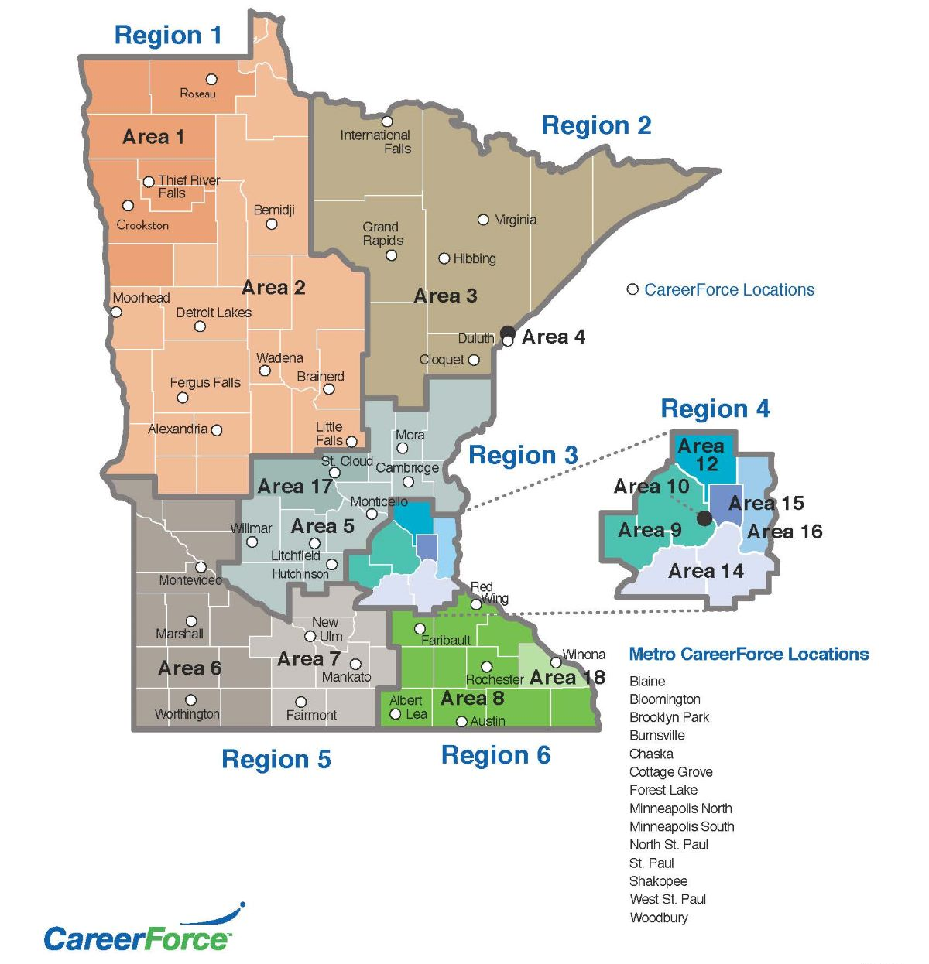
Minnesota’s 16 Local
Workforce Development
Boards (LWDBs)
Designated by the Governor based on economic/labor regions and administrative capacity
Must coordinate regionally when applicable
Serve as the foundation for delivering WIOA services locally

Slide 37
Minnesota’s 16 Local Workforce Boards
Inter-County Community Council Workforce Development Board
Rural MN Concentrated Employment Program Inc. Workforce Development Board
Northeast Minnesota Office of Job Training Workforce Development Board
Duluth Workforce Development Board
Central Minnesota Jobs and Training Services Workforce Development Board
Southwest Minnesota Private Industry Council
South Central Workforce Council
Southeast Minnesota Workforce Development Board
Hennepin-Carver Workforce Development Board
Minneapolis Workforce Development Board
Anoka County Workforce Development Board
Dakota-Scott Workforce Development Board
Ramsey County Workforce Innovation Board
Washington County Workforce Development Board
Stearns-Benton Career Solutions Workforce Development Board
Winona Workforce Development Board

Slide 38

Local Workforce Board Core Functions
LWDBs Charge
Analyze local economic conditions, labor market data, and workforce needs.
Use this information to guide investment of public resources.
Develop strategies to meet local workforce needs.
WIOA Requirements
Develop local plans aligned with the state strategy
Designate One-Stop Operators and select service providers
Oversee program and fiscal performance
Engage employers and support sector strategies

Slide 39
LWDB Service Delivery
The directives of LWDBs are then implemented by:
Counties
Cities
Local nonprofits, working under a Joint Powers Agreement
For example:
4,575 youth served through one-on-one services and an additional 40,374 youth served through outreach to schools under the Minnesota Youth Program in SFY2024.
5,931 individuals served through the State Dislocated Worker Program in SFY2024.

Slide 40
LWDB Design and Membership
Chair of the Board is a member of the private sector.
Members are appointed by a designated Local Elected Official – usually a County Commissioner or Mayor.
Each board has an Executive Director, who staffs the board.
Board membership must include:
  51% Local business leaders
  State agencies
  Post-secondary education
  Labor
  Adult Basic Education
  Economic development

Slide 41
State Workforce Development Reform Activities

Slide 42

Current state of workforce development improvements
Improve the Workforce Development System
INTERAGENCY
WORKFORCE
ALIGNMENT
(IWA)
Task Force on Workforce Development System Reform
Improve interagency coordination and alignment
Understand and recommend legislation to improve the workforce system
Alignment
Metrics
Communication
Program Scope
Funding
Evaluation
GOVERNOR’S WORKFORCE DEVELOPMENT BOARD
(GWDB)
Improve how the workforce system is implemented
Sector Partnerships
Service Delivery
Service Coordination

Slide 43

Workforce Development System Ideal State
STATE
AGENCIES
Advance interagency coordination and alignment of the workforce development system
LEGISLATURE
Draft legislation to supplement and improve the workforce development system
State Workforce Development Strategy
Recommend strategies and priorities for how to improve workforce system implementation

Slide 44
Task Force Scope & Meetings

Slide 45
Task Force Scope
Option 1: Full Workforce System
Look at full breadth of the workforce system
Option 2: Jobs and Labor Committees
Look only at programs within the jurisdiction of the Jobs and Labor Committees
Includes DEED and DLI
All WIOA Combined State Plan Programs
Look across state committee jurisdictions
Reference or touch on programs outside of committee’s jurisdiction as relevant, but will not include in the final recommendations
Option 3: Look only at DEED
Include only federal and state programs that are operated through DEED
Reference or touch on programs outside of committee’s jurisdiction as relevant, but will not include in the final recommendations

Slide 46
Proposed Task Force Meeting Cadence
Meeting Overview
  Task Force Meetings
    5-hour hybrid meetings with working lunch
    In-depth meetings begin December 2025, break for legislative session, and resume June 2026
    October 2025: 2-hour meeting to preview, discuss and provide feedback on scope of upcoming meetings
    December 2025 - First week of February 2026: Review current state of federal and state programs, funding systems, and metrics for evaluation. Report will include information on current state and any initial legislative recommendations
    February – May 2026: Task Force member-led stakeholder engagement sessions during legislative session (no official meetings)
    June – August 2026: Review opportunities for improvement for each area of the Task Force’s duties
    September – December 2026: Review recommendations, final report and legislation with final vote in December 2026
.
Notes:
How to engage in between meetings?

Slide 47
Proposed Timeline
Proposed Task Force Calendar October 2025 – January 2027
Oct 2025 Thursday, Oct. 30: 1 – 3 pm Planning Meeting with to discuss scope of upcoming work Stakeholder survey feedback Initial engagement with key stakeholders to define scope | Nov 2025 Quarterly GWDB/MAWB Meeting Stakeholder survey feedback Initial engagement with key stakeholders (individually) | Dec 2025 Friday, December 12: 10 am – 3 pm Task Force Meeting RE: Current State of State and Federal Programs | Jan 2026 Friday, January 9 10 am – 3 pm Task Force Meeting RE: Current State of State and Federal Funding Systems
Feb 2026 Friday, February 6 10 am – 3 pm Task Force Meeting RE: Current State of State and Federal Metrics for Evaluation & Review Interim Report Quarterly GWDB Meeting | March 2026 Stakeholder feedback sessions | April 2026 Stakeholder feedback sessions | May 2026 Stakeholder feedback sessions Quarterly GWDB Meeting
June 2026 Task Force Meeting RE: Identified Opportunities- Program Scope | July 2026 Task Force Meeting RE: Identified Opportunities – Funding Systems | Aug 2026 Task Force Meeting RE: Identified Opportunities – Metrics for Evaluation Quarterly GWDB Meeting | Sept 2026 Task Force Meeting RE: Discussing recommendations
Oct 2026 No meetings – staff updates | Nov 2026 Task Force Meeting RE: Review Draft Report & Recommendations Annual GWDB/MAWB Meeting | Dec 2026 Task Force Meeting RE: Finalize report & recommendations – vote on approval | Jan 2027 Presentation on Task Force outcomes

Slide 48
Meeting Pre-Work and Content
Meeting Pre-Work
Meeting Content
  In-depth information to review of topic area, sent 1-week in advance
  Summary of recent & topic-area relevant stakeholder feedback
  Proposed discussion questions
    In-depth overview of topic area, covering both state agencies and state legislature’s impact on the topic area
    Subject matter experts join as requested
    Opportunities for discussion and requests for further analysis or exploration of an area to be covered at future meeting
    Identify any areas of agreement on recommendations based on topic of focus
    Preview of upcoming session & requests for specific topics to be covered
.
Notes:
Need a 1-pager from each center on what is working and whats not, whats changing at the local level, who is
Look at federal but really understand what is happening locally
Use legislative research folks too

Slide 49
Thank You!
Staff Contact: Katie McClelland | Executive Director, Governor’s Workforce Development Board
Katie.McClelland@state.mn.us

