Slide 1
Transportation Economic
Development Infrastructure (TEDI)
Request for Proposals
Informational Meeting
July 2025

Slide 2
TEDI Authorizing Legislation
Minnesota Statute 116J.436

Slide 3
TEDI Program History
Program started in 2010
Six previous funding rounds
$18.6 Million awarded to 20 projects by DEED
2012 | 2015 | 2017 | 2019 | 2021 | 2023
International Falls | St. John’s Township | Brooklyn Park | Mankato | Chaska | Brooklyn Center
Rice County | Mankato | Chaska | Minneapolis | Renville County | Norwood YA
Mankato | Wells* | Pennington County | Sherburne County | McLeod County | Carver County*
Delano* | Princeton | Duluth |  | Big Stone County
 |  |  |  | Dayton
*Indicates DEED TEDI and MnDOT TED funds were awarded

Slide 4
TEDI Background/Purpose
Created to foster interagency coordination between the MnDOT and DEED to finance infrastructure to create economic development opportunities, jobs, and improve all types of transportation systems statewide.
MnDOT and DEED working together, but separate applications

Slide 5
TEDI Eligible Projects
Predesign and design
Acquisition of land
Construction and reconstruction
Infrastructure improvements that will promote economic development

Slide 6
TEDI Eligible Projects
Projects must increase employment and improve transportation systems to accommodate private investment and job creation.

Slide 7
TEDI Eligible Projects
DEED funds can not be used on trunk highway improvements, but can be used for needed infrastructure improvements and non-trunk highway street improvements in coordination with trunk highway improvement projects undertaken by MnDOT
Can be combined with MnDOT TED funds or on other non-trunk highway public infrastructure projects

Slide 8
TEDI Eligible Applicants
Local units of government
Must be the entity that will own the public infrastructure

Slide 9
TEDI Funding Information
Funds provided as a grant
$1,762,000 available
Additional funds available through MnDOT TED program

Slide 10
TEDI Maximum Award
There are no funding limits for proposals requesting funds from the TEDI Program.
  Limited funding available in 2025 with $1.76 million available.
  Larger levels of funding (but less than $1.76 million) may be requested if there is significant job creation, local tax base increase and other factors that warrant the increased funding amount.

Slide 11
TEDI Match Requirement
There is no match requirement
  Major components of scoring are the level of private investment and the leverage of non-state funds. Applications with little or no leverage will likely be uncompetitive.
A local governmental unit’s resolution certifying that the match being pledged in the application is in place is required. A sample resolution is in the application.

Slide 12
TEDI Selection Criteria
Job Creation (25 points)
Increase in Local Tax Base (20 points)
Level of Private Investment (15 points)
Leverage of Nonstate Funds (15 points)
Improvement to the Transportation System (25 points)
Appropriate geographical balance between the metropolitan area and greater Minnesota
  (lower scoring applications can bump high scoring applications if DEED deems it necessary for geographic balance)
Applications must receive a minimum of 50 points to be eligible for funding.

Slide 13
TEDI Competitive Applications
A strong, well-documented need and an effective solution. This would include documented financial costs, reasonable budgets, secured leverage resources
Committed business(es), number of full-time jobs created or being created and their salaries (Table A)
Project Readiness – will the project be started soon after DEED approval;
Evidence that the Eligible Applicant can perform and complete the tasks stated within the application.

Slide 14
TEDI Application Submittal
Eligible applicants must email their application to Jeremy.lacroix@state.mn.us
Application format should meet the following requirements:
One PDF file for application and attachments
All pages in application should be 8.5” x 11”
Maximum file size of under 5MB
Applications must be received by DEED by 4:00 pm on September 29, 2025.
You will receive an email confirmation that your application was received. If you do not receive a confirmation, you should assume the application was not received.

Slide 15
TEDI Application Timeline
June 30 - RFP announcement distributed
June 30 – September 29 - Applications prepared
July 10 - Informational session
September 29- Applications due
December - Projects selected and approved

Slide 16
TED & TEDI Project Example: Perham
  Better access to Barrel O’Fun, Tuffy’s Pet Foods, Kenny’s Candies and a new hospital
  Creation of 240 jobs
  $270,000 of private funds
  $500,000 DEED TEDI funds
  $3.5 million of MnDOT TED funds
  Total project cost is $6,711,762

Slide 17
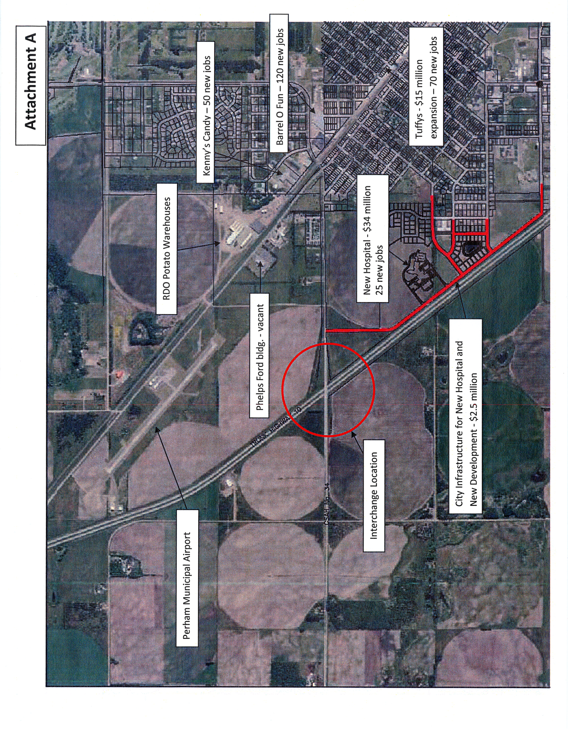
TED & TEDI Project Example: Perham

Slide 18
TED & TEDI Project Example: Windom
New Industrial Park with turning lanes
New Facilities for Toro, Fast Sprayers and others
125 jobs created/retained
$550k from DEED, $545k from MnDOT
Total Project Costs $2.4 million

Slide 19
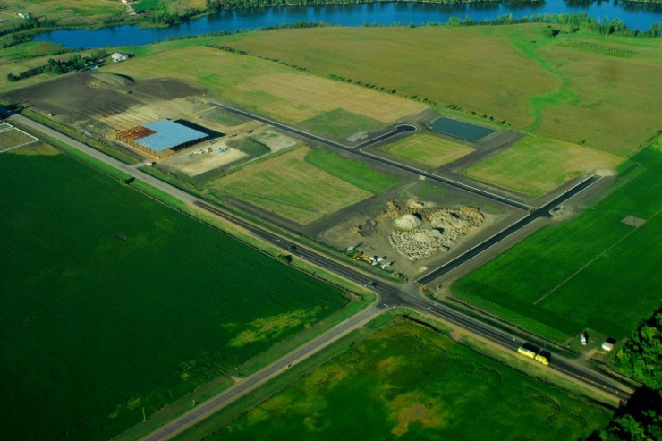
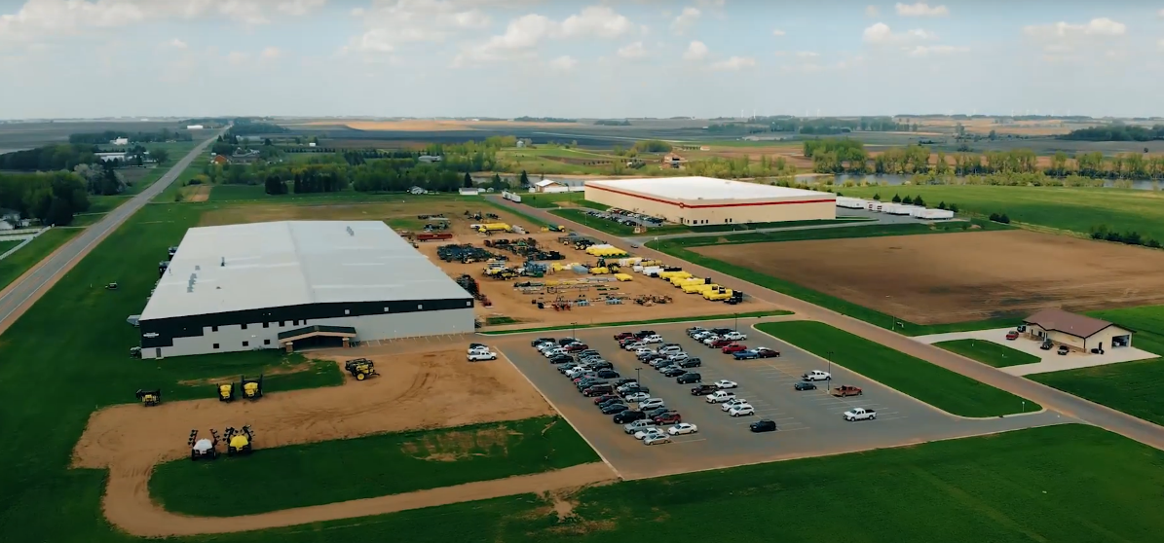
TED & TEDI Project Example: Windom

Slide 20
TEDI Project Example: Mankato
New street in industrial park
Access to new buildings MRCI, FedEx, RDT
218 jobs created
Total Project Costs $1.4 million
$969,218 of DEED funds

Slide 21
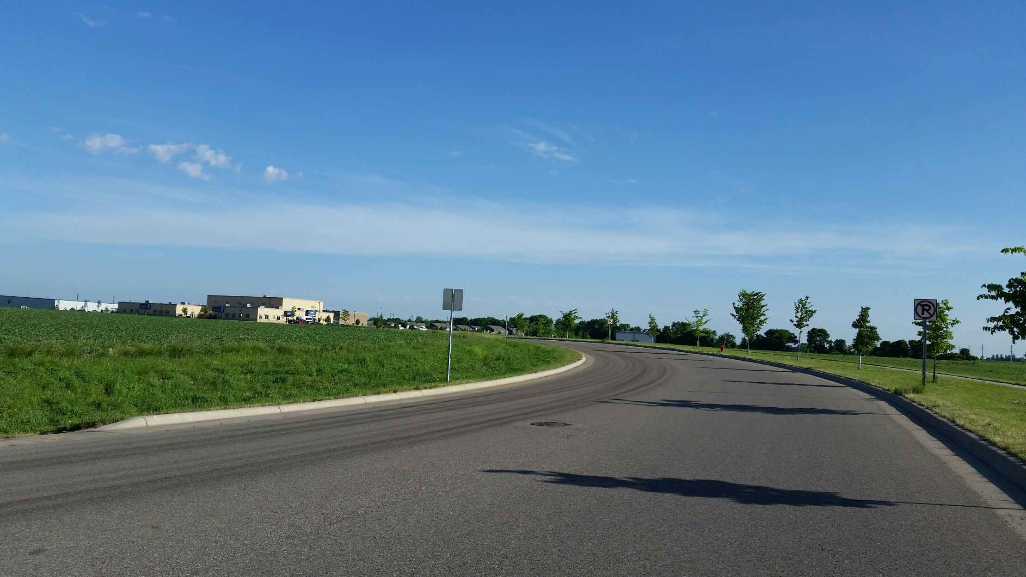
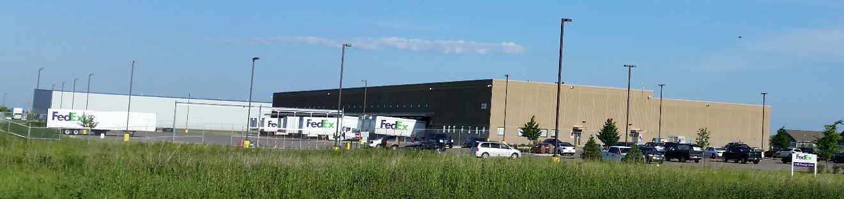
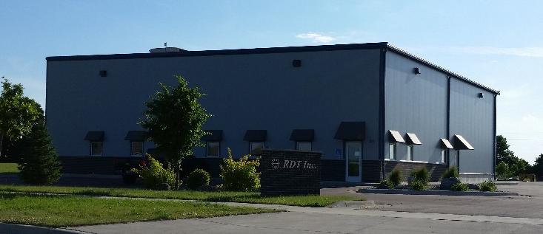
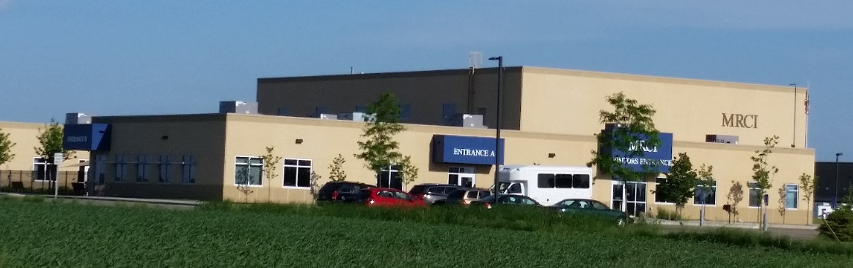
TEDI Project Example: Mankato

Slide 22
TEDI, BDPI, IBDPI Program Information
Jeremy LaCroix
651-259-7457
Jeremy.lacroix@state.mn.us
https://mn.gov/deed/government/financial-assistance/business-funding/ted/

Slide 23
Greater MN Business Development Public Infrastructure (BDPI)
$4 Million available for Greater MN Infrastructure Projects
Up to 50 percent of eligible project costs
Must exclusively serve Eligible projects which excludes retail, office, housing
Apply at any time
Not the TEDI application

Slide 24
Innovative Business Development Public Infrastructure (IBDPI)
$600,000 available for Infrastructure Projects (metro included)
Must meet serve legislatively defined “Innovative” business
Not usually used for speculative development
Apply at any time
Not the TEDI application

