Slide 1
Service to Success Grantee Onboarding
Sherene Judeh | State Director of Public Service

Slide 2

Agenda
Welcome and Intros
Grant Overview
Grant Requirements
  Enrolling Members
  Workforce One (WF1)
Grant Fiscal Training and Reporting
Invoicing and Reimbursement Payment Requests (RPR)
Monitoring
Technical Assistance
Wrap Up
Notes:
Ann

Slide 3

Welcome and Introductions
Notes:
Mee

Slide 4
Grant Overview
Notes:
Mee

Slide 5
Purpose and Authorization
This grant is authorized in MN Statute SF 17, Session Law.
The purpose of the Service to Success grant is to create, strengthen, and expand career pathways aligned to public service opportunities in Minnesota.
The grant is intended to fund expansion of service to career pathways and innovations that enable more Minnesotans to obtain industry-recognized credentials while gaining experience through public service participation.

Slide 6
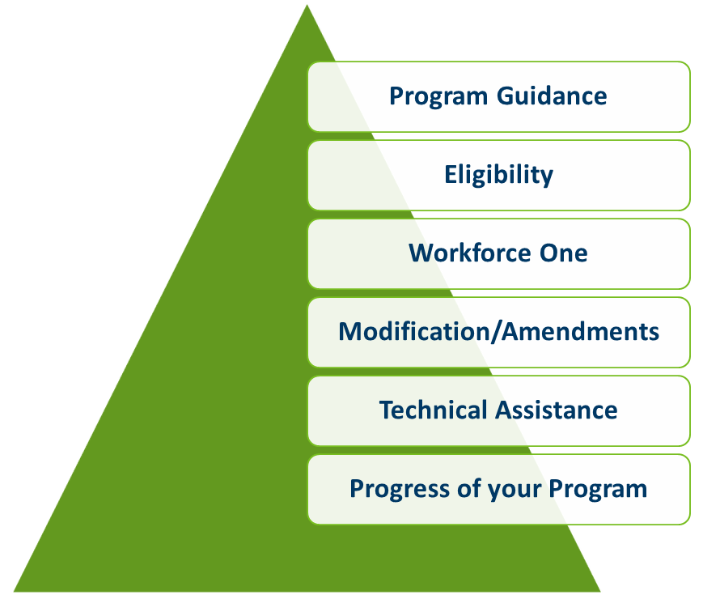
Coordinator Duties
Each Grantee is assigned a Grant Coordinator who will be your main
point of contact throughout the grant.
Program Guidance
Eligibility
Workforce One
Modification/Amendments
Technical Assistance
Progress of your Program
Notes:
Sarah
Each Grantee is assigned a Grant Coordinator who will be your main point of contact throughout the contract. The ACP team is Grantee focused, not program specific. This means that no matter which ACP Program contract/grant you receive, you will have one point of contact in your Coordinator (the majority of the time).
Program Guidance: Your Grant Coordinator provides program guidance. We also have several resources/guides on the ACP website, and we will go through those a bit later in this presentation.
Eligibility: Your contract dictates who you are eligible to serve with the funds but if you have question about participant eligibility, Grant Coordinators can assist with questions.
Workforce One: is required to use for all State Workforce Programs, Grant Coordinators can trouble shoot WF1 questions.
Modification/Amendments: if you think you may need to modify your contract at any point, please reach out to your Grant Coordinator.
Technical Assistance: Grant Coordinators are available for technical assistance throughout the contract period.
Progress of your program: Your Grant Coordinator will be reviewing your quarterly reports and available for assistance if you fall behind your projected outcomes. And always want to celebrate your successes.

Slide 7
Contract Changes
Notes:
Darcy

Slide 8
Modifications/Amendments
A modification/amendment is a change to the current contract/work plan/budget/partnership chart. Making changes outside of the approved work plan/budget requires a modification.
Modifications/Amendments may be granted on a case-by-case basis.
Note: If significant changes are being requested, the modification/amendment may not be approved.
A request for modification/amendment must be submitted to your Grant Coordinator.
Any approved modification/amendment is effective on the date the contract modification/amendment is fully executed and cannot be applied retroactively.
Notes:
Darcy
A modification/amendment is a change to the current contract/work plan/budget/partnership chart. Making changes outside of the approved work plan/budget requires a modification.
Modifications/amendments may be granted on a case-by-case basis. Note: If significant changes are being requested, the modification/amendment may not be approved.
Any modification/amendment request must be submitted to your Grant Coordinator.
Any approved modification/amendment is effective on the date the contract modification/amendment is signed by all parties (fully executed) and changes reflected in the modification may not be applied retroactively.

Slide 9




Extensions
Extensions of contracts are determined by DEED leadership, as funding follows the state biennium
An extension may be granted to extend the time available to spend out grant funds
Extensions are based on the progress of the program and funding availability
Extensions will not be considered until the final quarter of the contract
Notes:
Darcy
Extensions of contracts are determined by DEED leadership, as funding follows the state biennium and there are statutory limitations on how long of an extension can be provided
An extension may be granted to extend the time available to spend out grant funds
Extensions are based on the progress of the program and funding availability and not automatically approved
Extensions will not be considered until the final quarter of the grant contract
Extensions will not be considered within 45 days of the end of the grant contract

Slide 10
Program Components
Notes:
Mee

Slide 11
Program Components Listed
Application/Intake
Eligibility
Public Service Participation
Training (Credential/Non-Credential)
Notes:
Mee
In the next few slides, we will talk what DEED calls “Program Components.” These are the Application/Intake Form, Eligibility, Assessments, Employment Plan, Training, Support Services/Incentives, and Subgrantees/Contractors

Slide 12
Application/Intake Form: Overview
Applications/Intake Forms are created by grantees.
The Application captures self-attested eligibility criteria.
For easier data entry, questions should follow the Workforce One (WF1) Program Enrollment screen.
Examples of an Application can be found on the ACP webpage under Forms section.
Notes:
Mee
Applications/Intake Forms are created by grantees
The Application capture self-attested eligibility criteria
For easier data entry, questions should follow the Workforce One Program Enrollment screen
Examples of an Application can be found on the ACP webpage under Forms section

Slide 13
Application/Intake Form: Required Elements
Full legal name, address, phone, email, SSN, DOB, gender, race
Citizenship/Right to Work
Veteran Status
Tax household information
Benefit/eligibility questions based on contract
Education information
Employment information
All enrollment questions from WF1 enrollment page
Acknowledgement statement, applicant signature, date
Notes:
Mee
Full legal name, address, phone, email, SSN, DOB, Gender, Race
Citizenship/Right to Work
Veteran Status
Tax household information
Benefit/Eligibility questions based on contract
Education information
Employment information
All enrollment questions from WF1 enrollment page
Acknowledgement Statement, Applicant Signature, Date

Slide 14
Participant Eligibility
The following MUST be collected as part of the intake process and a copy uploaded to Workforce One’s Electronic Document Storage.
                Proof of:
  Citizen or Right to Work
  Date of Birth/Proof of Age
  Name
  Minnesota Residency Requirement
  Social Security Number
  Privacy Notice/Equal Opportunity is the Law Form must be reviewed and given/offered to each participant.
  Refer to “ACP Documentation Needed to Support Participant Eligibility” in the Resources and Guides section of ACP webpage as needed. If you have questions about eligibility, reach out to your Grant Coordinator.
Notes:
Mee
The following MUST be collected as part of the intake process and a copy uploaded to WF1’s Electronic Document Storage
Proof of:
Citizen or Right to Work
Date of Birth/Proof of Age
Name
Minnesota Residency Requirement
Social Security Number
Privacy Notice/Equal Opportunity is the Law Form must be reviewed and given/offered to each participant
For more information on eligibility documentation, please refer to ACP Documentation Needed to Support Participant Eligibility on the ACP Webpage under Resources and Guides

Slide 15
Program Requirements
Ensure program design will meet intended Service to Success outcomes
Conduct an Intake
Determine Eligibility
Maintain Participant Data
Request Reimbursements for Program Costs
Submit Quarterly Reports
Participate in Monitoring Visits
Notes:
Darcy

Slide 16
Eligibility: Grant Requirements
Specific eligibility requirements and eligible services were outlined in the Request for Proposal (RFP).
Refer to your organization’s contract for the specific target population your organization will serve.
Your contract is developed based on the proposal you submitted in response to the RFP.
Notes:
Mee
Eligibility – Grant Requirements
Specific eligibility requirements and eligible services were outlined in the RFP. When you applied for funding, you identified the target population you would serve.
Your contract is developed based on the proposal you submitted in response to the RFP.
Refer to your organization’s contract for the specific target population your organization will serve. You’ll find this information the in the Grant Information Summary at the beginning of your contract and in the narrative section. Make sure you are serving who you say you are going to serve.

Slide 17
Measurable Outcomes
Measurable Outcomes are defined in your workplan/contract.
Outcomes are reported to DEED through Workforce One via Activities and Exits.
These outcomes are the basis for assessing program success.
Notes:
Darcy
Measurable outcomes are defined by the DEED competitive grant program and defined in your work plan/contract.
These outcomes are used to assess your program’s success.
Workforce One is the system used to track and report outcomes to DEED. This is done by Activities and Exits. Capturing outcomes in WF1 is SO important because DEED uses Workforce One to measure program success.

Slide 18
Measurable Outcomes (cont.)
Enrollments
Continue to higher level of education
Participants in public service activities
Participants attaining work-related certificates and/or industry-recognized credentials
Successful exits to employment
Notes:
Darcy
Program Outcomes are tracked in the Workforce One system. Those outcomes include:
Enrollments - Your contract states the projected number of participants you plan to serve. Each participant entered into WF1 is counted toward your total enrollments.
Participants attaining work-related certificates and/or industry recognized credentials – these are tracked by the activities that participant are entered in to within WF1. A copy of a participant’s certificate/credential must be uploaded to the EDS system
Placing participants in employment is the primary goal. It is the responsibility of each grantee to work with participants on their next educational step on their career pathway or through to job placement.
A participant that obtains a promotion or wage increase with current employer is also considered a positive outcome.
Participants who continue to a higher level of education are also consider a positive outcome.

Slide 19
Program Outcomes: Uniform Report Card
Established by Minnesota Statute 116L.98 - The uniform report card is the state’s performance dashboard for most workforce development programs
Information for the Report Card is pulled quarterly.
The Report Card measures Enrollment, Training, Exits, Training Completion, and Employment outcomes.
The Report Card is public information.
This is one of the reasons it is important for organizations to ensure data quality in Workforce One (WF1).
Each program should identify one or more Workforce One (WF1) data owners.
Notes:
Darcy
Established by Minnesota Statute 116L.98 - The uniform report card is the state’s performance dashboard for most adult workforce development programs
Information for the Report card is pulled from Workforce One quarterly
The Report card measures Enrollment, Training, Exits, Training Completion, and Employment outcomes
The Report card is published and is public information
This is one of the reasons it is important for organizations to ensure data quality in Workforce One
Data should be entered into Workforce One within 15 business days of the event

Slide 20
Participant Files
Grantees must maintain an electronic file in Workforce One for each participant.
Contents of the file MUST include:
  Application/Enrollment form
  Eligibility documents (proof of identity, social security number verification(or other I-9 verification, student ID if applicable) (these get uploaded)
  Proof of Right to Work in the U.S. (if not a citizen)
  Any certificates/credentials earned (e.g., copy of a CNA license, a diploma, or a certificate)
  Acknowledgement of Receipt for Support Services, if applicable
Notes:
Darcy
Grantees must maintain an electronic file in Workforce One for each participant.
Contents of the file MUST include:
Application/Enrollment form
Employment Plan
Eligibility documents (proof of identity, MN residency, and social security number verification)
Proof of Right to Work in the U.S. (if not a citizen)
Academic Assessment scores (showing math/reading grade equivalent scores)
Any certificates/credentials earned (e.g. copy of a CNA license, a diploma, or a certificate)
Acknowledgement of Receipt for Support Services
Employment Verification (pay stub, offer letter, or
completed employment verification form)

Slide 21
Participant Data Privacy
Participant data is considered private data. Each participant must be informed of their data privacy and receive a copy of the Privacy Notice/Equal Opportunity is the Law form. This will also be sent out to you via email.
Consent to Share Information forms are required where appropriate.
Participant files must be retained for 6 years after closure (7 years total).
Notes:
Darcy
Participant data is considered private data. Each participant must be informed of their data privacy and receive a copy of the Privacy Notice/Equal Opportunity is the Law form.
Consent to Share Information forms are required when appropriate
Sensitive information such as Medical Records need to be marked private in EDS.
Participant files must be retained for 6 years after closure (7 years).

Slide 22
Quarterly Reports
Quarterly Progress Reports are required and due to your Grant Coordinator by the 15th of the month following the end of the quarter.
Rotation is as follows:
    July 1-September 30- Due by October 15th
    October 1-December 31– Due by January 15th
    January 1st through March 31st – Due by April 15th
    April 1st through June 30th – Due by July 15th
Per the State of Minnesota’s Office of Grants Management Policy 08-09, “Grant payments shall not be made on grants with past due progress reports unless the state agency has given the agency a written extension.”
Notes:
Darcy
Quarterly Progress Reports are required and due to your ACP Coordinator by the 30th of the month following the end of the quarter:
Rotation is as follows:
July 1st through September 30th – Due by October 30th
October 1st through December 31st – Due by January 30th
January 1st through March 31st – Due by April 30th
April 1st through June 30th – Due by July 30th
Tip: Set a reminder on your calendars for these due dates.
Per the State of Minnesota’s Office of Grants Management Policy 08-09, “Grant payments shall not be made on grants with past due progress reports unless the state agency has given the agency a written extension.”

Slide 23
Quarterly Reports: Resources
Quarterly Report templates for each grant program will be sent via email at least 30 days in advance of the due date.
Questions about Quarterly Reports should be directed to your Grant Coordinator at publicservice.deed@state.mn.us.
Notes:
Darcy
Quarterly Report templates for each grant program are available on the ACP webpage under each program
Quarterly Report Instructions , Quarterly Report Training, and How to Pull Reports in Workforce One can be found in the Resources and Guides section of the ACP Webpage

Slide 24

Workforce One
Notes:
Beth

Slide 25
What is Workforce One?
Workforce One (WF1) is a web-based case management system for employment and training programs funded, managed, and used by DEED and the Department of Children, Youth, and Family Services
Used to track services for many state and federally-funded workforce programs
We use Workforce One for two things: Case Management, and Reporting
Notes:
Beth
Workforce One (WF1) is a web-based case management system for employment and training programs funded, managed, and used by DEED and the Department of Children, Youth, and Families.
WF1 is used to track services for many state and federally-funded workforce programs.
Per MN statute 116L.98 adult workforce-related programs funded in whole or in part by state funds must use DEED’s reporting system, which is WF1.
As a grantee, you are required to input all data into Workforce One, regardless if your organization uses another database.

Slide 26
What Do Grantees Do in Workforce One (WF1)?
Enter enrollments and application information
Upload documents to WF1’s Electronic Documentation Storage (EDS)
Add activities corresponding to the services you are providing
Capture support services/incentives provided
Enter case notes to capture participant contact
Track outcomes
Exit participants
Notes:
Beth
What do grantees do in Workforce One?
Enter enrollments and application information
Upload documents to WF1’s Electronic Documentation Storage (EDS)
Add activities corresponding to the services you are providing
Capture support services/incentives provided
Enter case notes to capture participant contact
Track outcomes
Exit participants

Slide 27
What is Workforce One Data Used For?
DEED will use WF1 to determine if your organization is:
  enrolling participants at the rate you planned according to your workplan
  providing services that are justified and appropriate
  staying in frequent contact with your participants (case notes)
  exiting participants who have completed services timely and whether you have achieved the program objectives with those exits
The data you enter in WF1 will also be used to calculate your organization’s outcomes. This information is available to the public, the legislature, and other stakeholders.
Notes:
Beth
What is Workforce One data used for?
DEED will use WF1 to determine if your organization is:
enrolling participants at the rate you planned according to your workplan
providing services that are justified and appropriate
staying in frequent contact with your participants through case notes
exiting participants who have completed services timely and whether you have achieved the program objectives with those exits
The data you enter in WF1 will also be used to calculate your organization’s outcomes. This information is available to the public, the Legislature and other stakeholders.
Also, Grant Coordinators use WF1 to “spot check” Reimbursement Payment Requests (RPRs). If Workforce One does not accurately reflect your program activities it may slow down payment to your organization.

Slide 28
Case Management in Workforce One
Enrollments:
  Participants must meet all eligibility requirements and have all necessary documentation before being enrolled in your program and in WF1
Activities:
  Participant activities show how they are moving through your programs
  All participants will have activities
  Reflect the participants progress throughout the program
  Provide a snapshot to whoever is looking at the record
  Consistency with activities is important!
Support Services:
  Any support provided to participants throughout your program must be documented in WF1. This includes support services like a bus card but also includes incentives.
  The supports provided are determined by the grantee’s workplan and
budget
Notes:
Beth
Enrollments:
Participants must meet all eligibility requirements and have all necessary documentation in their file before being enrolled in your program and in WF1
Activities:
Participant activities show how they are moving through your programs
All participants will have activities
Reflect the participants progress throughout the program
Provide a snapshot to whoever is looking at the record
Activities TRACK and REPORT OUTCOMES!
Consistency with activities is important!
Support Services:
Any support provided to participants throughout your program must be documented in WF1. This includes support services like a bus card but also includes incentives.
The supports provided are determined by the grantee’s workplan and budget

Slide 29
Case Management in Workforce One (continued)
Case notes
  Must demonstrate participant engagement
  Must show one-on-one live contact at least every 30 days (mass case notes do not count toward live contact)
Opening/Closing Activities
  Activities reflect what the participant is working on while in your program
Exits:
  Whenever a participant is no longer receiving services or enrolled in your program
  90 days without contact, you must exit participant
  Participant completes their goals or their term of service
  Reasons will vary based on the program (for most programs, exiting to employment is the goal!)
  Data entry must be timely and entered within 15 days of the event’s occurrence
Notes:
Beth
Case notes
Must demonstrate participant engagement
Must show one-on-one live contact at least every 30 days (mass case notes do not count toward the live contact requirement)
Opening/closing activities
Important for the activities to be open/closed based on what the participant is working on while in your program.
Reasons to Exit a Participant:
Whenever a participant is no longer receiving services.
90 days without contact, you must exit participant
Participant completes their goals
Reasons will vary based on the program and outcomes you’re administering (most programs exiting to employment is the goal!)
Data entry must be timely and entered within 15 days of its occurrence. We sometimes see that organizations working in two different data systems may put off entering information into WF1 and do “batch jobs” of data entry. This is NOT okay. You must enter data in real time into WF1. DEED pulls reports at various times, and we need to see real time progress toward outcomes at any given time throughout the grant period.
To reiterate: Adult Career Pathways programs require data be entered within 15 days.

Slide 30
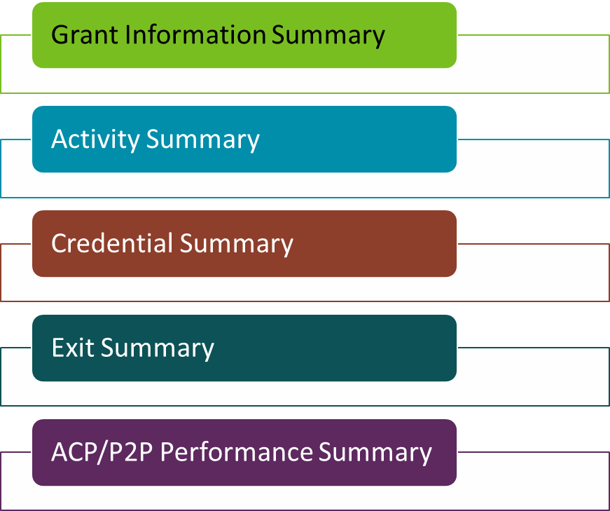
Workforce One Reports
Grant Information Summary
Activity Summary
Credential Summary
Exit Summary
ACP/P2P Performance Summary
Notes:
Beth
These five reports will need to be pulled when you complete your Quarterly Reports.
Grant Information Summary Report – this report is the report you will use the most often as it gives a snapshot of enrollments, 30-day contact, open training activities, support services entered, and exits.
Activity Summary Report – shows all the activities that are open for the participants enrolled in your program’s funding stream.
Exit Summary Report – shows all the exits and the exit reasons.
Credential Summary – shows the types of credential participants have pending or have obtained.
ACP/P2P Performance Summary Report – shows planned and actual outcomes broken down into categories like enrollments, training, and exits and calculates the percentage of goals achieved at any given time.

Slide 31
Workforce One Reports (cont.)
Directions for pulling reports can be found on the ACP Webpage under Resources & Guides.
There is also a recorded WF1 Reports and Advanced Search Training (2 hours) that we recommend.
Notes:
Beth
Directions for pulling reports can be found on ACP Webpage under Resources & Guides. There is also a recorded WF1 Reports and Advanced Search Training (2 hours) that we recommend.

Slide 32
Workforce One (WF1) Training
You will be invited to a Workforce One Training Session
It is required that someone from your organization attend a training session
In advance of that training you will want to identify your Workforce One Case Managers (the folks on your team who you will want to enter data regularly)
Those Case Managers should be invited to the Workforce One training
Case managers should request a sandbox and complete the required paperwork in advance of the training session

Slide 33

Getting or Changing Access to Workforce One
www.mnworkforceone.com
Step by step directions for getting access to Workforce One
  Agency Level Data is most common for case managers/navigators
  COFFR Level Data should be requested if you are a manager OR a provider subcontracting with/through another provider and enter data under their COFFR
  Access Group:
    Case management 2 – ETP; completing data entry or managing a caseload
    Agency System Mgmt 2 – ETP; a manager who will need the privilege to edit data
Notes:
Beth
To obtain or change access to WF1 please see the step-by-step directions via the link.
Agency Level Data is most common for case managers/navigators.
COFFR Level Data should be requested if you are a manager OR a provider subcontracting with/through another provider and enter data under their COFFR
Access Group:
Case management 2 – ETP; completing data entry or managing a caseload
Agency System Mgmt 2 – ETP; a manager who will need the privilege to edit data
Just as a reminder-Workforce One does not have full functionality in Safari. Edge or CHROME work the best. You 'might' have success with other browsers, but we know the functionality is stable in Edge and CHROME. If anything is not working as you expect, try a different browser.

Slide 34
Workforce One Sandbox
Workforce One (WF1) has a training website called the Sandbox
  Organizations can test new features
  Offer internal training to new staff or allow new staff to practice enrolling participants
To request a Sandbox account, please email the Workforce One team at: workforceone.deed@state.mn.us
Please do not enter real participant/member (customer) information into the Sandbox
Notes:
Beth
Workforce One (WF1) has a training website called the Sandbox.
Organizations can test new features
Offer internal training to new staff or allow new staff to practice enrolling participants
To request a Sandbox account, please email the Workforce One team at: workforceone.deed@state.mn.us
Please don’t enter real customer information into the Sandbox

Slide 35
Workforce One Training
Case Management Training Part 1 and Part 2
Training is targeted for new users or those wanting a refresher on Workforce One functionality.
Recorded training found in the Resources and Guides section of the ACP Webpage
Workforce One Training
This example training (from a different program) will demonstrate step by step directions on how to enroll a participant from start to finish. Great for new grantees, new staff, or people needing a refresher.
Tip: follow along with the enrollment process (pausing the video when needed) and practice enrolling your own made-up participant in the WF1 Sandbox. Please never use actual participant information in the Sandbox.
Notes:
Beth
Several different Workforce One trainings are available on our website:
ETP Programs Case Management Training Part 1 and Part 2
Training is targeted for new users or those wanting a refresher on Workforce One functionality.
Recorded training found in the Resources and Guides section of the ACP Webpage
ACP Workforce One Training
Training will demonstrate step by step directions on how to enroll a participant from start to finish. Great for new grantees, new staff, or people needing a refresher.
Tip: follow along with the enrollment process (pausing the video when needed) and practice enrolling your own made-up participant in the WF1 Sandbox. Please never use actual participant information in the Sandbox.
While ACP Program Coordinators make every attempt to assist grantees with WF1, if you hire new staff any time throughout the grant period, it’s the responsibility of the grantee to make sure their new staff are trained on WF1.

Slide 36
Additional Workforce One Training & Resources
Upcoming Service to Success Workforce One Training
Workforce One Training Videos - In WF1 under Resources Tab, User How –To Guides. Videos that are 3-5 minutes long.
Electronic Document Storage Training - Recorded webinar and PowerPoint slides found in the Resources and Guides section of the ACP Webpage.
ACP Workforce One User Guide – A helpful guide with step-by step directions for components of WF1 from another DEED program.
Notes:
Beth
Additional Workforce One Training and Resources you might find helpful:
ACP Workforce One User Guide – a helpful guide with step-by-step directions for components of WF1. Guide is available on the Office of Adult Career Pathways website. The guide will show you how to complete an enrollment, how to manage activities, how to enter support services, how to close a case, and several other helpful items. The guide is not meant to take the place of the recorded training, rather, it’s a tool to use back at your desk. Since WF1 updates frequently, the guide will be updated frequently. Be sure to check the website for the most recent version.
Workforce One Training Videos - In WF1 under Resources Tab, User How –To Guides. Videos that are 3-5 minutes long. WF1 staff are working on creating more training videos.
Electronic Document Storage Training – A recorded webinar and the PowerPoint slides for the training regarding how to use WF1’s Electronic Document Storage component, as well as a Navigation Guide, is found on the Resources and Guides section of the ACP Webpage.
WF1 Refreshers– Spring 2026
ACP team will be providing virtual live training/s on WF1 in the spring of this year. This will allow your staff to get set up with WF1, watch recorded trainings and get familiar with the WF1 system.

Slide 37
Grant Fiscal Training
Notes:
Mee

Slide 38

Fiscal Agenda
Accounting Principles
Cost Guidance
Cost Categories
Allowable Costs
Accrual Accounting
Cost Allocation
Reimbursement Payment Requests
Questions
Notes:
Fiscal Agenda Slide 58:
Thank you for the break and our Program Colleagues for giving our team a chance to present to you all the Financial Training piece of this grant onboarding training.
The Fiscal Agenda is here on this slide. The slides have the information written on them and you will get those later. We are covering the topics of Accounting Principles, Cost Guidance, Cost Categories, Allowable Costs, Accrual Accounting, Cost Allocation, and then Reimbursement Payment Requests. We plan to take questions via chat at the end of this financial part of the presentation. Next Slide please.

Slide 39
Accounting Principles

Slide 40
Minnesota Statute 16B.98
Under Minn. Stat. § 16B.98, Subd.8, the Grantee’s books, records, documents, and accounting procedures and practices of the Grantee or other party relevant to this grant contract agreement or transaction are subject to examination by the Commissioner of Administration, by the State granting agency, and/or the State Auditor or Legislative Auditor, as appropriate, for a minimum of six years from the end of this grant contract agreement, receipt and approval of all final reports, or the required period of time to satisfy all state and program retention requirements, whichever is later.

Slide 41
Generally Accepted Accounting Principles (GAAP)
Per Generally Accepted Accounting Principles (GAAP), financial records must be complete, consistent, and comparable to support transparency, accountability, and accuracy. Additionally, the State of Minnesota Grantee Contract Agreement requires grantees to maintain accurate records and provide them upon request for monitoring and reconciliation purposes.

Slide 42
General Ledger
Definition: A general ledger is the central recordkeeping system in accounting where a company’s financial transactions are recorded.
A system-generated General Ledger is required and must include:
  Grant identifier(s) clearly assigned and used to track all grant-related transactions.
  Detailed expenditure records by chart of accounts (e.g., wages, supplies, rent)
  Clear distinction between revenue and expenditures
  Transaction descriptions that are color coded to explain the nature of each entry
  Accurate dates indicating when costs were incurred

Slide 43
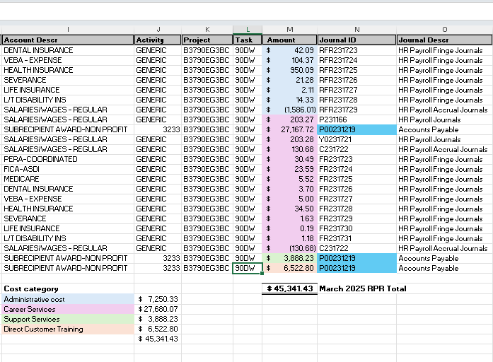
Example General Ledger (system-generated)

Slide 44

Knowledge Check
Grantees are required to have a system-generated general ledger to manage their DEED grant(s)?

Slide 45
Knowledge Check - Answer
Grantees are required to have a system-generated general ledger to manage their DEED grant(s)?
Answer: True

Slide 46
Administrative Costs
As indicated in the RFP the contracting process, administrative costs are limited to 5% of total funds granted
Administrative expenses can be greater or less than 5% on a given Reimbursement Payment Request (RPR) but must not exceed 5% of the total expenditures on the final RPR
All Administrative costs must be substantiated by documentation of actual costs incurred (i.e., organizations cannot bill a flat 5% or averaged costs each month)
Notes:
policy 521 that limits the state grantees administrative budget to no more than 10%.
If the full grant is not spent, then10% of the amount that you have actually expended on the grant.

Slide 47
Administrative Costs: Examples
Administrative expenses are associated with functions not related to the direct provision of services to program participants.
Examples include:
Financial management
Facilities management
Audit, General legal, Human resources
Automated systems
Management of sub grantees
Any contract that is “administrative” in function (HR, Accounting, Audit)
Notes:
administrative expenses are associated with functions, not directly related to the direct provision of services

Slide 48
Expenditures for Admin Staff
Expenditures for administrative staff (appropriately allocated and consistently applied) may include:
Salary/fringe for admin staff (accountant, director, etc.)
Operating costs (related to staff providing admin services - rent, phone, supplies, etc.)
Negotiated overhead rate
Travel and per diem

Slide 49
Direct Services
Direct Services are costs associated with providing direct services to participants, including:
Case management/navigation for participants
Development of the participant’s training and credential plan
Counseling and career planning
Salary/fringe for staff involved in providing grant-specific services to participants

Slide 50
Direct Services continued
Staff travel for staff involved in provider's grant-specific services to participants
Staff training and development
Short-term prevocational services and/or work readiness skills for participants
Operating costs (related to staff providing direct/career services - rent,
phone, supplies, etc.)
Other participant costs
Note: If staff members are providing direct pre-vocational customer trainings, then staff time spent in the classroom and reasonable classroom preparation may be billed to this category.

Slide 51
Direct Customer Training
Direct Customer Training is for participant tuition and required books and fees, and may include:
Credentialed and non-credentialed training
Required school fees, books, and tools
Required uniforms/boots for training
Participant wages and fringe benefits related to work experience
Note: If staff or contractors are providing direct non-credentialed or credentialed customer training, staff time or contractor time spent in the classroom and reasonable classroom preparation may be billed to this category.

Slide 52
Direct Customer Training continued
Direct Training expenditures must be:
Part of the participant’s service to career pathway
Pre-approved by the case manager/counselor/navigator
Consistent with the Grantee’s approved contract with DEED
Direct Training expenditures may not be obligated or incurred:
Prior to the participant’s Workforce 1 (WF1) date of enrollment

Slide 53
Support Services 1
Support Services costs are for:
Services and items considered necessary for a participant to remain in the program
Reimbursements are for what was distributed to the participant. For example, if the grantee buys 100 bus cards but distributes 20 of them, then we reimburse for 20 cards
Reimbursements are for money spent, not the face value. (Ex. a $40 bus card purchased for $32)
Note: Participants are to be referred to community resources before incurring
support service costs.

Slide 54
Support Services Requirements
Support Services expenditures must be:
Part of the participant’s service to career pathway
Pre-approved by the case manager/counselor/navigator
Consistent with the Grantee’s approved contract with DEED
Support Services expenditures may not be obligated or incurred:
Prior to the participant’s Workforce 1 (WF1) date of enrollment

Slide 55

Support Services Requirements continued
The grantee must have a Support Service policy
Supporting documentation must be in the name of the participant
Support Services expenditures must be traceable to the initial source
Participants must sign for durable goods (bus and gas cards, clothes, etc.)

Slide 56
Support Services: Examples
Examples of support services:
Basic school supplies
Bus passes/gas cards
Books and tools that are needed and not required in association with training
Clothing required for work/interviews
Class D driver license/government id renewal fees (not reinstatement or revoked)
Housing/rental assistance
Health and medical assistance
Personal counseling
Reasonable car repair, if related to getting to work/training

Slide 57
Outreach and Recruitment Costs
Outreach costs include the promotion of grant specific services.
Examples of allowable outreach costs:
The recruitment of personnel required by the grantee for performance of the award
Program outreach to meet the requirements of the award
Table/space rental to promote grant services at career fairs/hiring events/community events
Costs of displays and exhibits
Costs of meeting rooms used in conjunction with shows and other special events
Costs of advertising media and related administrative costs
Notes:
If you have outreach costs, I advise looking at the documentation needed to support outreach in the cost guide. It's a lot of documentation detail.
Any media should credit the DEED grant
Overall cost category guidance - Very important to keep your supporting documentation (receipts and invoices) to be able to substantiate your costs

Slide 58
Outreach Costs with No Outreach Cost Category
If there is no Outreach category on the RPR, then capture the approved outreach activities as follows:
Administrative outreach activities (the recruitment of personnel required by the grantee for performance of the award, etc.) are billed as administrative costs
Activities related to outreach, program costs, job development, (advertising grant approved services in a local paper, for example) are billed to direct service
Salary/benefits of employees engaged in setting up and
displaying exhibits are billed to direct services
Purchase of tents and tables are billed to direct services
Notes:
To promote grant specific services, not the agency.

Slide 59

Outreach Costs: Unallowable Costs
Examples of unallowable outreach costs:
Costs of meetings and conventions related to other activities
Costs of promotional items and memorabilia
Costs of advertising to promote the grantee

Slide 60

Knowledge Check – Question #1
What Percentage are Administrative Costs capped at?
This Photo by Unknown Author is licensed under CC BY-SA

Slide 61
Knowledge Check – Answer #1
What Percentage are Administrative Costs capped at?
Answer: 5%
(5% of expenditure at grant end)
This Photo by Unknown Author is licensed under CC BY-SA

Slide 62
Accrual Accounting
Notes:
I'm going to talk through some accounting terms since we do have fiscal folks on the on the webinar.

Slide 63

Accrual Accounting 2
Grantees must separately account for the receipt, obligation, and expenditure of funds by award or fund source.
Obligations and expenditures must fall within the period of performance of the grant.
Notes:
the most important requirement for accounting for your grant is that you must be able to account for the revenue obligations and expenditures of the grants separately from any other funding source.
we need to be able to follow a straight line all the way through.
all obligations and expenditures must occur within the performance period of your grants. In this case, that is whatever your effective date is for the grant through the end date

Slide 64
Accrual Accounting Overview
Transactions are recognized in the accounting period in which they occur
Revenue is recognized when earned
Expense is recognized when incurred
  may be cash disbursement (gift/gas cards)
  may be delivery of goods/services
  may be costs due staff, or contractor
Notes:
accrual accounting is the basis of accounting that is used by government organizations as opposed to cash basis accounting and
the difference with between the 2 is that in accrual counting revenue is recognized when it is earned not necessarily when it's received and expenditures are recognized when they're incurred and not necessarily when they're paid.
And we'll delve into some of the examples a little bit further in the next few slides.

Slide 65
Accrual Accounting: Obligations
Obligations
Orders placed for property and services, contracts and sub- awards made, and similar transactions during a given period that require payment during the same or a future period
Legally binding
Budget authority must be available
Note: Plans and budgets are not obligations (ear-marks)
Notes:
an obligation is a legally binding Action that saves the intention to pay for something in the immediate period, or in a future period.
in order to enter into an action, you must have the budget authority to enter into that action we're talking about
so this is a step beyond just having a plan for something or a budget for something. This is where you're actually encumbering the funds.

Slide 66
Accrual Accounting: Accruals
Accruals (or accrued expenditures)
Net increases (or decreases) in amounts owed for:
  goods and other property received
  services performed by employees or contractors
Indirect expenses incurred
Notes:
once the expense has been incurred, then it becomes in an accrued expense.
we include direct and indirect costs in these, and we'll get more into those in a little bit in the cost allocation.

Slide 67
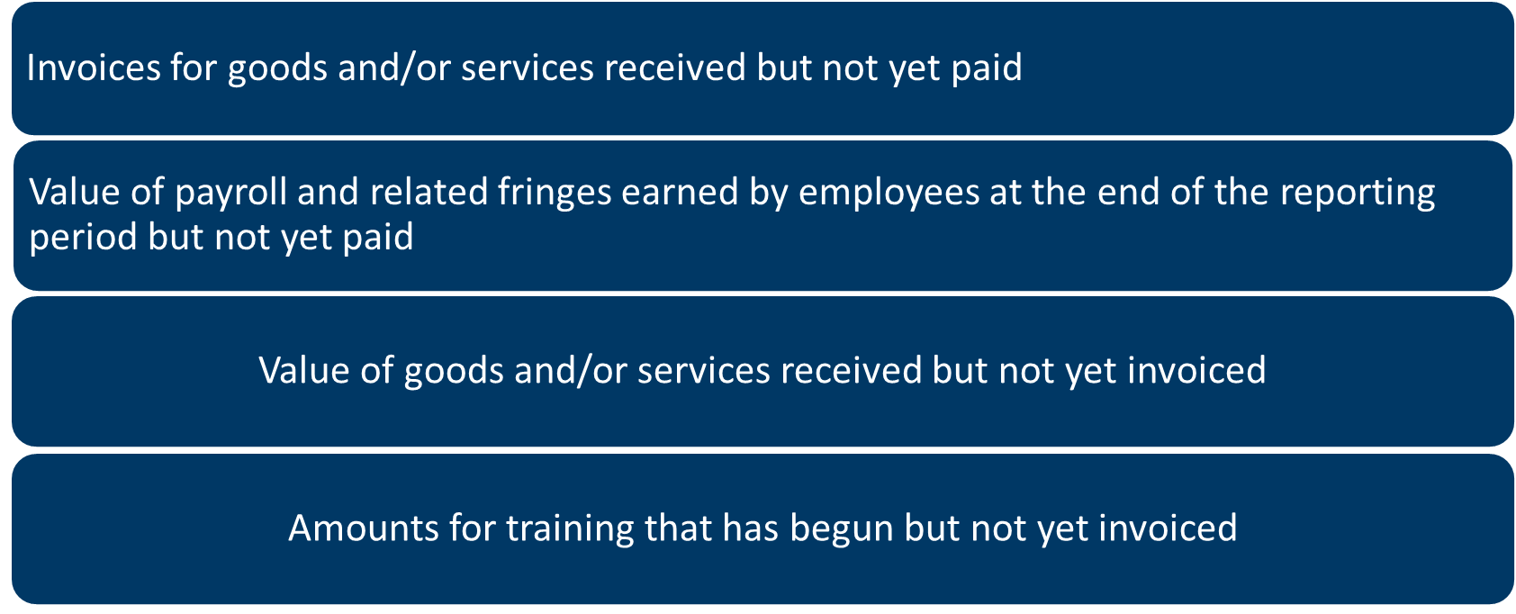
Accrual Accounting: Examples of Accruals
Examples of Accruals
Invoices for goods and/or services received but not yet paid
Value of payroll and related fringes earned by employees at the end of the reporting period but not yet paid
Value of goods and/or services received but not yet invoiced
Amounts for training that has begun but not yet invoiced

Slide 68
Accrual Accounting: Matching Revenue and Expenses
Accrual accounting records revenue and expenses when they occur and matches income and related expenses in the same fiscal period, regardless of the timing of the receipt or disbursement of actual cash.
For example, office supplies purchased (and received) in the month of April and paid in May when the credit card bill is received would be recorded in April under the accrual method of accounting.

Slide 69

Knowledge Check – Question #2
True or False?
With Accrual Accounting, we need to be able to follow expenditures all the way through from a system-generated General Ledger through support documentation (i.e. invoices & receipts)?

Slide 70
Knowledge Check – Answer #2
True or False?
With Accrual Accounting, we need to be able to follow expenditures all the way through from a system-generated General Ledger through support documentation (ie: invoices & receipts)?
Answer: True

Slide 71
Cost Allocation

Slide 72
Cost Allocation 1
The process of assigning a cost, or a group of costs, to one or more cost objective(s), in reasonable proportion to the benefit provided or other equitable relationship.
Notes:
This means: How do you determine which funding sources pay for which costs?

Slide 73

Cost Allocation 3
Relative Benefit and Proportional Benefit
A cost is allowable to that award or cost objective in accordance with relative benefits received.
If a cost benefits two or more projects or activities in proportions that can be determined without undue effort or cost, the cost must be allocated to the projects based on the proportional benefit.

Slide 74
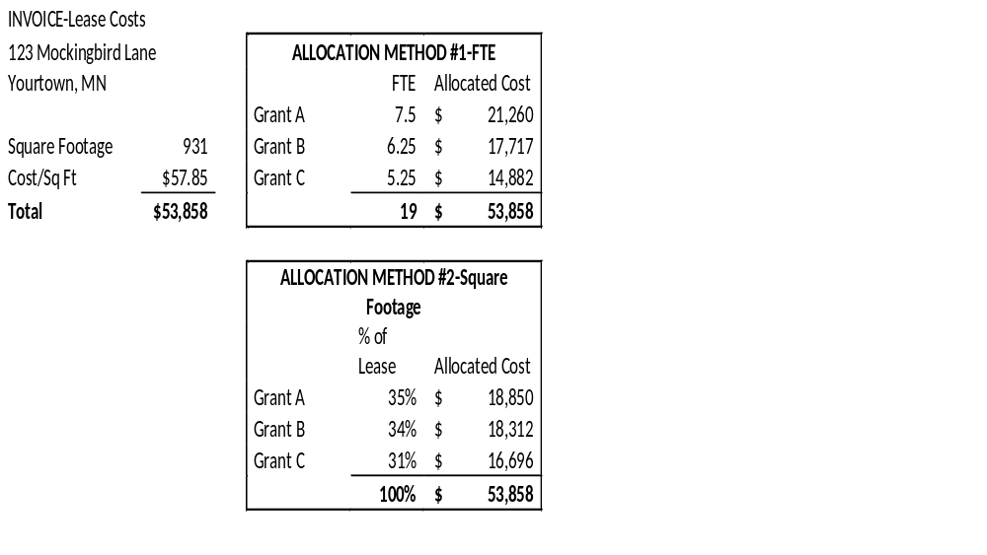
Cost Allocation Example
Each grantee must have an approved cost allocation methodology in place.
Methodologies may be based upon the type of expenditure.
Common methods include
  FTE
  Square Footage
Notes:
how we assign these proportional benefits is called a cost allocation methodology

Slide 75
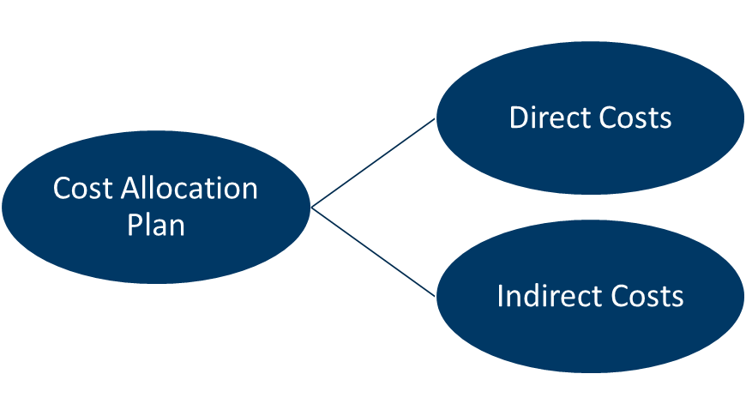
Cost Allocation 5
Cost Allocation Plan
  Direct Costs
  Indirect Costs
Notes:
Cost Allocation Plan - A document that identifies, accumulates, and distributes allowable direct costs (or indirect costs for governmental organizations) and identifies the allocation methods used for distribution.

Slide 76
Cost Allocation 6
DIRECT COSTS
Costs that can be directly assigned to activities relatively easily and with a high degree of accuracy. Examples include:
Salary for a case manager who only works with a particular grant
Square footage of space occupied by the case manager
Communications devices, such as a cellphone, used by the case manager
Supplies used by the case manager

Slide 77
Cost Allocation 7
INDIRECT COSTS
Administration and facilities costs incurred in support of multiple programs, but not a specific program cost
Charged back to the program through an approved indirect cost rate or cost allocation plan
Originate either within the recipient organization or department or another department that supports the overall organizational operations

Slide 78

Cost Allocation 8
Examples of Indirect Costs:
Salaries for executive director, accountants, human resources staff, etc.
Square footage of space occupied by indirect staff
Communications devices, such as a cellphone, used by indirect staff
Supplies used by indirect staff

Slide 79
Cost Allocation 9
Costs must be accorded consistent treatment.
A cost may not be assigned to one grant as a direct cost and to
another as an indirect cost.
Costs may not shift from one cost objective to another to overcome funding deficiencies, avoid restrictions imposed by law or grant agreement, or other reasons.
  From one grant to another grant
  From administrative to program cost category
  From direct to indirect cost or vice versa

Slide 80
Reimbursement Payment Request (RPR)
Notes:
Mee

Slide 81
SWIFT system: How to get reimbursed
SWIFT (State Wide Integrated Financial Tools) is the PeopleSoft based online financial, procurement, and reporting system used by the State of Minnesota.
All DEED grantees must register in SWIFT with their organization’s legal name and address and maintain their organization’s contact information throughout the grant.
DEED has 30 days to process RPR/FSR.
SWIFT Help Desk: https://mn.gov/mmb/accounting/swift/help-desk/

Slide 82
Reimbursement Payment Request (RPR) 1
Costs must be requested based on actual expenditures incurred during reporting period, not budget divided by the number of months in the grant
Costs must align with:
  Grant legislative language/intent
  Approved (work plan and budget) within the executed grant contract between DEED and grantee
  Office of Grants Management policies
  DEED policies
  The grantee’s internal policies and procedures
Notes:
As mentioned earlier, this form will be sent with the final contract packet. It will include instruction on how to complete the form. A more in-depth fiscal and monitoring training will be available later this summer.

Slide 83
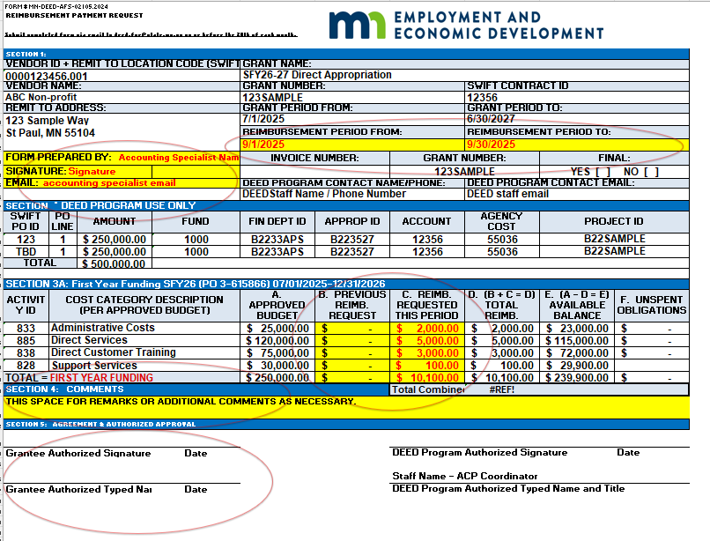
Sample
RPR
Notes:
**SARAH's NOTE 1/13/26: We need a new screen of the current RPR.
This is a sample Reimbursement Payment Request or RPR and will be in Excel format when you receive your grant paperwork. It is busy looking form, but you only need to focus on 4 main parts, which are highlighted in yellow and circled in red. In section 1, you will need to enter the RPR Preparers name, phone number, email, and the Preparer needs to include a signature for each RPR submitted. The next part in section 1, is the Reimbursement Period, usually at the beginning of the month to the end of that month. The first RPR will have Invoice #1 entered, and should be sequential for the subsequent RPRs submitted. Your accounting system may have a numbering system you can reference that you can use as long as it is sequential on the RPR form. The form also asks if this is the Final RPR and you will mark No until the last month of reimbursement/ or last RPR you submit to DEED for reimbursement.
We require separation of duties, therefore the preparer and authorized signer, who will review the form, must be different and both people MUST type and sign their name on the RPR form.
There is also a Match section and Program Income section on the RPR that may need to be fill in if this applies to your grant contract.

Slide 84

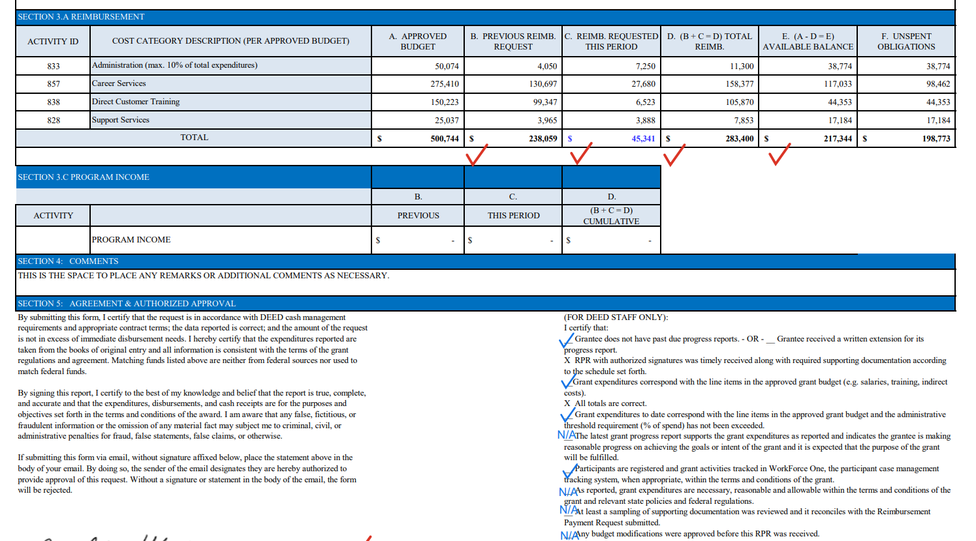
Sample RPR + Sample General Ledger
March 2025 Sample RPR
Sample General Ledger
Notes:
**SARAH's NOTE 1/13/26: We need a new screen of the current RPR.
This is a sample Reimbursement Payment Request or RPR and will be in Excel format when you receive your grant paperwork. It is busy looking form, but you only need to focus on 4 main parts, which are highlighted in yellow and circled in red. In section 1, you will need to enter the RPR Preparers name, phone number, email, and the Preparer needs to include a signature for each RPR submitted. The next part in section 1, is the Reimbursement Period, usually at the beginning of the month to the end of that month. The first RPR will have Invoice #1 entered, and should be sequential for the subsequent RPRs submitted. Your accounting system may have a numbering system you can reference that you can use as long as it is sequential on the RPR form. The form also asks if this is the Final RPR and you will mark No until the last month of reimbursement/ or last RPR you submit to DEED for reimbursement.
We require separation of duties, therefore the preparer and authorized signer, who will review the form, must be different and both people MUST type and sign their name on the RPR form.
There is also a Match section and Program Income section on the RPR that may need to be fill in if this applies to your grant contract.

Slide 85
RPR 2
The RPR should be submitted every month whether there are expenditures or not. If there are no expenditures, enter $0
Any subgrantee/recipient expenses must be rolled up into one single RPR submitted to DEED using the same cost categories as the grantee
Grantees must use the form provided by DEED’s Employment and Training Programs Division (ETP)
There must be a separation of duty. The person preparing the form must be different than the person authorizing the payment request. The authorizer must have signature authority for the particular grant
Notes:
Common mistakes include:
- Dates
- Cumulative carry over amount
- Rounding issues
- Preparer and approver cannot be same person
- Signature authority not on file or out of date
- Mathematical/formula errors
- Incorrect reimbursement period

Slide 86
RPR 3
The completed RPR must be submitted to the publicservice.deeed@state.mn.us e-mail account on or before the 20th of the month for the previous month
Documentation is required with your RPR. Additionally, all documentation supporting costs must be retained and made available to DEED upon request
New grantees will be required to submit the general ledger for the first month of the contract to ensure understanding of fiscal requirements

Slide 87

Common Mistakes
Dates
Cumulative carry over amount
Rounding issues
Preparer and approver cannot be same person
Signature authority not on file or out of date
Mathematical/formula errors
Incorrect reimbursement period
Notes:
If importing from your accounting system, make sure the previous column = prior month column. Check for rounding errors in totals

Slide 88
Questions?

Slide 89
Monitoring
Notes:
Mee

Slide 90
Question #1
Which of the following best describes the purpose of DEED's grant monitoring? (select all that apply)
It’s only conducted when problems arise.
It’s required by regulations and policy.
It’s a routine part of grant agreement.
It helps DEED identify technical assistance needs.
B, C, and D.

Slide 91
Question #2
Which of the following is a common misconception about DEED's grant monitoring? (select one)
A. Monitoring is the same as an audit
B. Monitoring is conducted for all grantees as a routine practice
C. Monitoring helps identify areas for technical assistance
D. Monitoring ensures compliance with grant policies

Slide 92

Monitoring Requirements&
Purpose

Slide 93
Grantee Monitoring Requirements
DEED is required to conduct compliance monitoring of workforce development grantees receiving Federal or State funds. This includes:
Programmatic
Fiscal
Administrative
Monitoring ensures accountability, transparency, and proper use of public funds.
Notes:
DEED is required to conduct programmatic, fiscal, and administrative compliance monitoring of Federal and State awarded workforce development grantees. 20 CFR 683.410, 2 CFR part 200, MN OGM Policy 08-10, & DEED’s Oversight and Monitoring Policy

Slide 94
Purpose of Monitoring
Monitoring helps ensure accountability and continuous improvement by:
✔ Assessing compliance (contract and program guidance)
✔ Ensuring the correct use of funds
✔ Reviewing expenditures
✔ Tracking performance goals
✔ Ensuring participant data accuracy and case management
✔ Identifying technical assistance needs
Notes:
Monitoring helps ensure accountability and continuous improvement by:
✔ Assessing compliance
✔ Ensuring the correct allocation of funds
✔ Reviewing expenditures
✔ Tracking performance goals
✔ Ensuring participant data accuracy and case management
✔ Identifying technical assistance needs
Monitoring can also serve as a vehicle to identifying needs for funding in the future and for providing enhanced programming to communities in need.

Slide 95
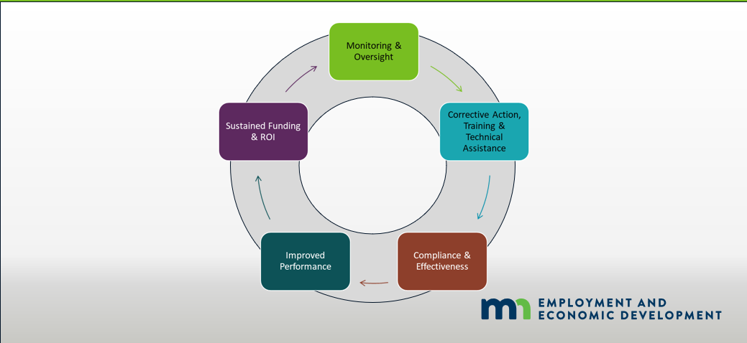
Monitoring Drives Continuous Improvement
Circle of items with arrows pointing to the next item on the list
Monitoring & Oversight
Corrective Action, Training & Technical Assistance
Compliance & Effectiveness
Improved Performance
Sustained Funding & ROI
Notes:
Monitoring Drives Continuous Improvement
Oversight ensures accountability and identifies risks early
Findings lead to targeted support through technical assistance
Compliance + performance = program success
Grantees improve practices based on feedback
Demonstrating impact protects and strengthens funding
Example: Monitoring Leads to Better Outcomes
A few years ago, DEED monitored a large youth-serving organization that subgranted funds to many partners statewide. DEED discovered the grantee wasn’t conducting required programmatic monitoring or financial reconciliations of their subgrantees.
As a result, DEED issued a Corrective Action and provided tools—such as monitoring templates, guides, and best practices—to help the grantee strengthen oversight.
The following year, during their own subgrantee review, the grantee identified that one partner was struggling with placing youth in work experience. Using their improved monitoring process, they worked with the subgrantee on employer outreach strategies.
Result:
Youth work experience placements increased by 25%, and employer partnerships were strengthened—demonstrating how monitoring, corrective action, and support can lead to real program improvement.

Slide 96
What to Expect During a Monitoring Visit

Slide 97
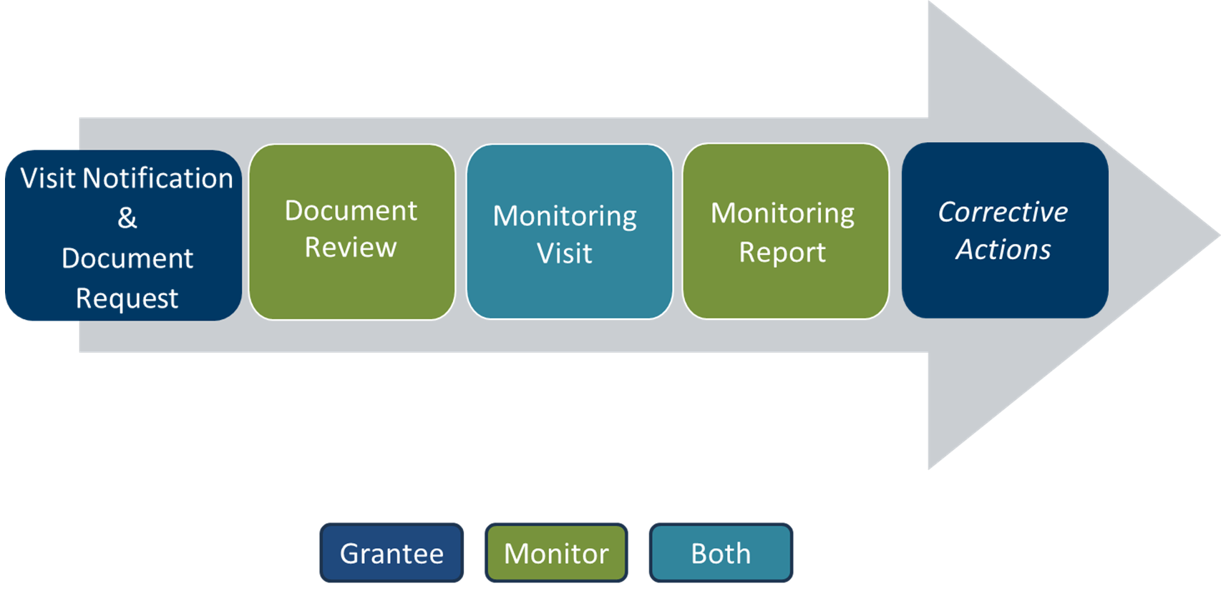
Cycle of a Monitoring Visit
Grantee: Visit Notification & Document Request
Monitor: Document Review
Both: Monitoring Visit
Monitor: Monitoring Report
Grantee: Corrective Actions
Notes:
This is an overview of the monitoring cycle.
The colors represent who does the work in each step.
Next, we’ll discuss each step in more detail.

Slide 98
Notification of Visit & Document Request
Monitor will:
Notify grantee of pending monitoring visit
Include a list of fiscal and program documents needed from the grantee
Provide list of participant #’s that will be reviewed within WF1
Indicate a deadline (typically 2-3 weeks)
Grantee will return:
A completed Monitoring Guide
General Ledger from the start of the grant
Detailed General Ledger for selected RPR and source documentation
Program policies (per request)
Other items upon request
Notes:
You’ll receive an email from your Monitor which will have a letter detailing what information is needed, a deadline for completion, and attachments to complete.
Grantee ensures WF1 is up to date
Policies such as support services policy
Other items may be MOUs, sample outreach material, org chart

Slide 99

Document Review
Monitor will review (but not limited to):
Completed program and fiscal monitoring guides
Financials
  RPRs
  General Ledgers
  Source documentation (proof of payment, invoices, timesheets, etc.)
Program Information
  Approved contract/workplan
  WF1 data
  Program policies
  Performance outcomes
  Quarterly reports
Notes:
Cash balances, audit reports (not this presentation)

Slide 100
During the Monitoring Visit (On-site or Virtual)
Sample Meeting Agenda:
10:00-10:15 Introductions and Overview of Visit
10:15-10:45 Review of Program Guide
10:45-11:15 Financial Reconciliation
11:15-11:45 File Review
11:45-12:00 Technical Assistance (as needed), Summary of Monitoring Review, & Next Steps
Notes:
Our opportunity to learn more about your programs, hear your challenges and what’s going well

Slide 101
Monitoring Report & Follow-up
The Monitoring Report will include:
Summary of visit
Performance outcomes
Results of the financial reconciliation
Any areas of concern
Any Corrective Actions (when applicable)
  What the finding was, steps needed to resolve it
Notes:
Area of Concern- participants had case notes entered more than 15 business days after the date of occurrence
Corrective Action- lack of identity information to prove residency; reimburse DEED for ineligible participant
Areas of Concern can become Corrective Actions if they are repeated issues over several reports

Slide 102
Corrective Actions
Due
  30 days from issuance of Monitoring Report
Resources
  Monitor
  Grant Coordinator
Notes:
Could be less time if at the end of the grant period
Grantee provides response addressing each corrective action noted in the monitoring report

Slide 103
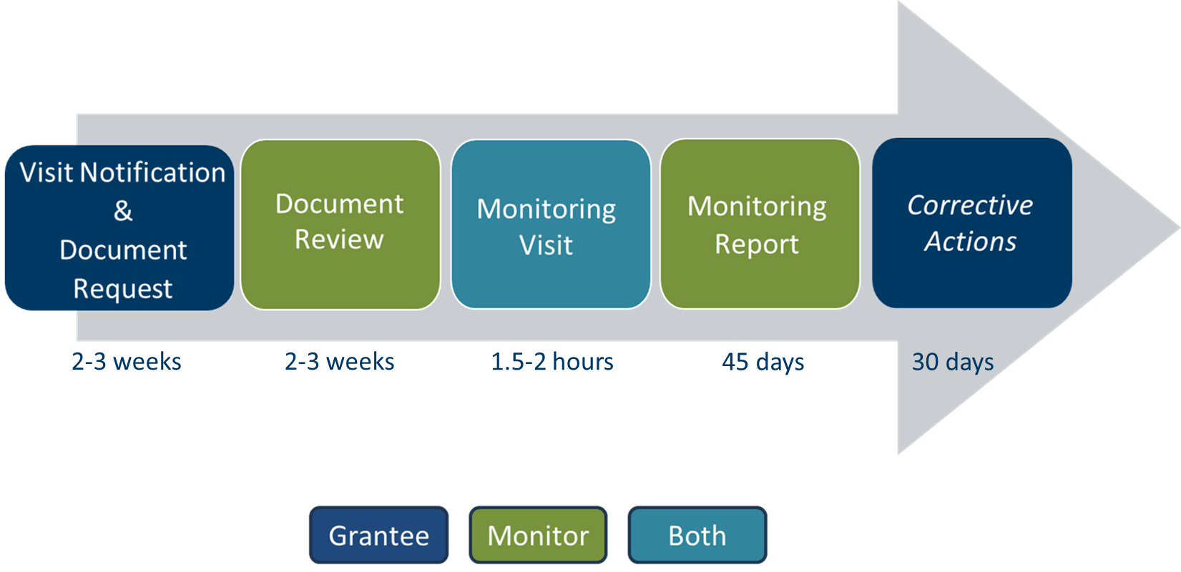
Cycle of a Monitoring Visit 1
Grantee: Visit Notification & Document Request 2-3 weeks
Monitor: Document Review 2-3 weeks
Both: Monitoring Visit 1.5-2 hours
Monitor: Monitoring Report 45 days
Grantee: Corrective Actions 30 days
Notes:
Grantee receives the notification and has a deadline 2-3 weeks later to submit all requested documentation
Monitor has 2-3 weeks to review documentation, request additional documentation as needed, prepare for visit
Monitoring visit typically takes 1.5-2 hours, could be remote or in person
Monitor will email Monitoring Report generally within 45 days after the visit
If there are Corrective Actions, they will typically be due within 30 days of receipt of the Monitoring Report

Slide 104

Questions

Slide 105
Technical Assistance
Notes:
Mee

Slide 106
Common Terms
Workforce One or WF1 – DEED's case management system where you will document participant eligibility, activities, and exits regularly.
RPR- Reimbursement Payment Requests. These are due monthly along with a system generated general ledger and supporting documentation.
ACP- Adult Career Programs. A DEED division responsible for making grants. They have a host of supporting materials for grantees on their webpage.
OPS- Office of Public Service.
Notes:
Sarah
ACP Webpage - much of what is covered in today’s training is referenced in the guides on our webpage.
ACP Competitive Onboarding Virtual Session - recording and PowerPoint will be posted to the ACP webpage.
Grant Coordinators Technical Assistance - Coordinators are available to assist with questions, however, please check the resources on the website before contacting your coordinator. Coordinators may not be able to respond to every inquiry immediately. Please be mindful that Grant Coordinators are not available to individually onboard new staff if your organization should have staff turnover.

Slide 107
Technical Assistance
Grant coordinator is available to support you: publicservice.deed@state.mn.us
Grant coordinator will set up a 30 and 90 day check ins with grantees
Grant coordinator will host optional technical assistance and program leadership sessions to support program implementation

Slide 108
Additional Information
Adult and Career Pathways Webpage – much of what is covered in today’s training is referenced in the Resources and Guides section on this webpage.
Today’s Onboarding Session - recording and PowerPoint will be posted to the Office of Public Service webpage.
Grant Coordinators/Technical Assistance – your grant coordinator is available to assist with questions, however, please check the resources on the website before contacting your coordinator. Coordinators may not be able to respond to every inquiry immediately.
Notes:
Sarah
ACP Webpage - much of what is covered in today’s training is referenced in the guides on our webpage.
ACP Competitive Onboarding Virtual Session - recording and PowerPoint will be posted to the ACP webpage.
Grant Coordinators Technical Assistance - Coordinators are available to assist with questions, however, please check the resources on the website before contacting your coordinator. Coordinators may not be able to respond to every inquiry immediately. Please be mindful that Grant Coordinators are not available to individually onboard new staff if your organization should have staff turnover.

Slide 109
Thank you!
Sherene Judeh |State Director of Public Service

