Slide 1
Introduction to Minnesota Paid Leave
Webinar scheduled to begin
12:00 p.m. Central Time
Notes:
Thanks for joining us. We’ll get started with the session after a few opening announcements.
I’m Greg Norfleet, director of the Minnesota Paid Leave Program, and I will be facilitating the session today.

Slide 2
Minnesota Paid Leave
May 8, 2025

Slide 3
Why Paid Leave Matters
Minnesotans take care of each other. In our communities, families, and workplaces, we step up and help the people we care about.
Minnesota Paid Leave will support people when they need time to care for themselves and their loved ones.
Supporting your employees when they need time for leave builds connections in our families, communities, and workplaces, and improves employee retention, performance and morale on the job.
Minnesota Paid Leave will help ensure Minnesotans don't need to choose between financial stability and being there for their families.
info.paidleave.mn.gov

Slide 4
Minnesota’s Paid Leave Law
The Minnesota Paid Leave law, enacted in May 2023 and updated in May 2024, makes paid family and medical leave coverage available to Minnesota workers beginning Jan. 1, 2026.
The law provides job protections and payments from the state to individuals who need time off to care for themselves or their loved ones.
Minnesota Paid Leave will be funded by premiums made up of contributions from employees and employers.
Paid Leave will send benefit payments directly to Minnesotans on leave.

Slide 5
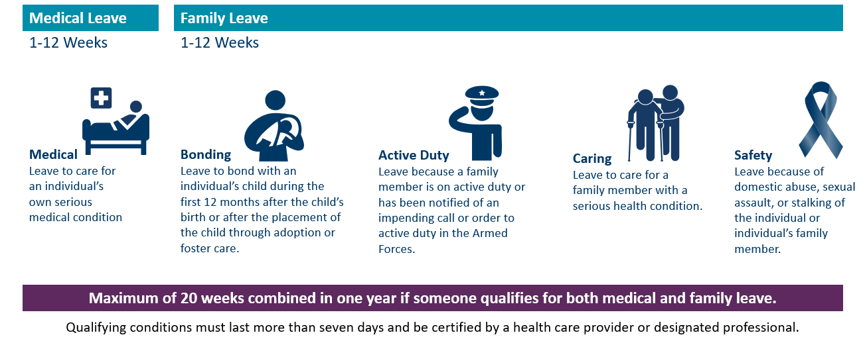
Covered Leave
Medical Leave: Up to 12 Weeks
Medical: Leave to care for an individual’s own serious medical condition
Family Leave: Up to 12 weeks
Bonding: Leave to bond with an individual’s child during the first 12 months after the child’s birth or after the placement of the child through adoption or foster care.
Caring: Leave to care for a family member with a serious health condition.
Safety: Leave because of domestic abuse, sexual assault, or stalking of the individual or individual’s family member.
Active Duty: Leave because a family member is on active duty or has been notified of an impending call or order to active duty in the Armed Forces.
Maximum of 20 weeks total leave in a benefit year.
Qualifying conditions must last more than seven days and be certified by a health care provider or designated professional.
info.paidleave.mn.gov
Notes:
Qualifying conditions must last more than seven days, and a health care provider or designated professional must certify the need for leave and the amount of time.
A person may take up to 12 weeks for Medical leave: for their own mental or physical illness, treatment or preventive care
A person can take up to 12 weeks of Family leave for covered events:
Bonding/parental leave: bond with a new child after birth, foster or adoption
Safety Leave: domestic assault, sexual abuse or stalking
Caring Leave: family member’s mental or physical illness, treatment or preventive care
Active Duty Leave: family member on active duty or notified of impending order
In a single benefit year, an individual can take a maximum total of 20 weeks of combined medical and family leave.
Across all these covered events, a health care provider or designated professional must certify the need for leave and the amount of time off required.

Slide 6
Covered Employees
Not covered, can opt in:
Independent contractors
Self-employed individuals
Tribal Nations
Not covered, can’t opt in:
Federal government employees
Exempt seasonal employees
Railroad employees
Covered employees include:
Covered employees include:
Full-time, part-time workers
Most seasonal employees
Owner-officers who draw a salary
Agricultural workers
Employees of religious organizations
Temporary workers
Student workers
Employed family members
First responders
Elected and appointed officials
Full-time, part-time workers
Most seasonal employees
Owner-officers who draw a salary
Agricultural workers
Employees of religious organizations
Temporary workers
Student workers
Employed family members
First responders
Elected and appointed officials
Not covered, can opt in:
Not covered, can’t opt in:
Independent contractors
Self-employed individuals
Tribal Nations
Federal government employees
Exempt seasonal hospitality employees
Railroad employees
info.paidleave.mn.gov
Notes:
This is a great slide. Let’s document a definition for each, and also document where inclusion is different in other programs (UI, ESST, etc.)

Slide 7
Minnesota Employees
Scenarios:
I have employees who work mostly in Wisconsin, are they covered?
No.
My business is in North Dakota, but some of the people I hire live in Minnesota - are they covered?
It depends on where they work.
I’m a traveling salesman and do work across the entire Midwest, am I covered?
It depends on how much you work in each state.
Paid Leave covers Minnesota employees. The Paid Leave law defines Minnesota employees as:
Employees who worked 50 percent or more of the prior year in Minnesota, or
For employees who did not work 50 percent or more of the year in any one state, those who live in Minnesota.
Scenarios
I have employees who work mostly in Wisconsin, are they covered?
My business is in North Dakota, but some of the people I hire live in Minnesota - are they covered?
I’m a traveling salesperson and do work across the entire Midwest, am I covered?
No.
It depends on where they work.
It depends on how much you work in each state.
info.paidleave.mn.gov

Slide 8
Paid Leave Wage Payments
Paid Leave helps Minnesotans focus on what matters, whether that's caring for a child, recovering from an illness, or supporting a loved one.
Minnesotans can get up to 90% of usual wages, up to a maximum of $1,372 per week (based on 2024 numbers).
Lower-wage workers get more support. If you earn less, you'll get a higher percentage of your paycheck covered while on leave.
You must have earned at least 5.3% of the statewide average annual wage in the past year to be eligible ($3,700 in 2024).
If you receive payments from Unemployment Insurance, Workers’ Compensation, or Social Security Disability Insurance during an absence, you are not eligible for Paid Leave payments.

Slide 9
Paid Leave Job Protection
Job protected leave improves employee retention, as workers can take the time they need to bond and care without having to choose between their job and their family.
An employee who has taken family or medical leave must be restored to the same position or an equivalent position with the same pay, status, benefits, length of service, and seniority as prior to the date of leave.
Paid Leave job protections begin 90 days from the date of hire, but employees may have additional job protections under other state programs like Minnesota Pregnancy and Parental Leave.

Slide 10
Employer Roles and Responsibilities
Making Paid Leave Work

Slide 11
Building Paid Leave: Key Employer Milestones
2025​
2026​
Equivalent Plan Exemption requests open for employers
Employers need to notify their employees about Paid Leave benefits by Dec. 1, 2025
Payroll Deductions start Jan. 1, 2026
Benefits and leave available to Minnesotans Jan. 1, 2026
Small Business Assistance funding available Jan. 1, 2026
First quarterly premium due by April 30, 2026
info.paidleave.mn.gov

Slide 12
Employers' Role in Paid Leave
Reporting & Premiums
Payroll deduction & premium payment
Wage Reporting
Educate & Inform
Workforce Posters
Individual Notifications
Leave Administration
Coordinate other leaves and payments to employees on leave
Support return to work
Collaborate & Improve
Collaborate on how to operationalize the law
Provide input on how to improve over time
As an employer, you play an important role in helping your employees learn about and access Paid Leave and in building an effective program.
Reporting & Premiums
Educate & Inform
Payroll deduction & premium payment
Wage Reporting
Workforce Posters
Individual Notifications
Leave Administration
Collaborate & Improve
Coordinate other leaves and payments to employees on leave
Support return to work
Collaborate on how to operationalize the law
Provide input on how to improve over time
As an employer, you play an important role in helping your employees learn about and access Paid Leave and in building an effective program.
info.paidleave.mn.gov

Slide 13
Reporting Wages
To determine if someone is eligible for Paid Leave payments, Minnesota employers need to report wage data for their employees.
The Paid Leave program is using the same online reporting system as Unemployment Insurance (UI) to reduce the administrative burden for employers.
Wages will be reported once per quarter using the current UI wage detail reporting process and format.
As of February 1, employers have reported wages for more than 3.4 million employee records through the UI online portal.
Need help?
If you need assistance verifying or establishing your wage detail account, UI Customer Service Representatives are available to help.
Phone: 651-296-6141
Hours: M-F, 8:00 a.m. – 4:30 p.m.
info.paidleave.mn.gov

Slide 14
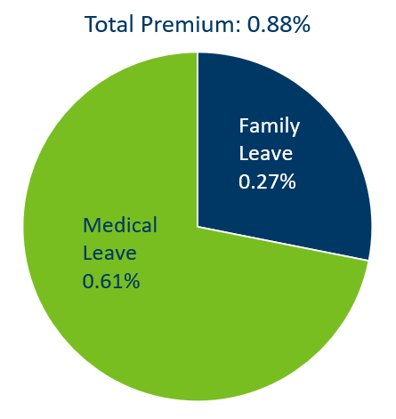
Paid Leave Premiums
Paid Leave will be financed by premiums collected from employee payroll deductions and employer contributions.
When Paid Leave begins for Minnesotans in 2026, the premium rate will be 0.88%.
The premium rate is applied on wages up to the Social Security cap ($176,000).
The total premium rate covers both family leave and medical leave.
Pie chart showing the breakdown of the premium rates. The total premium is 0.88% of a person’s wages up to the social security cap. The premium for medical leave is 0.61% of a person’s wages up to the social security cap. The premium for family leave is 0.27% of a person’s wages up to the social security cap.
info.paidleave.mn.gov

Slide 15
Sharing the Premiums
Premiums will be shared between employers and employees.
The first premiums are due by April 30, 2026.
Starting January 1, 2026, employers can deduct up to 50% of premiums from employee paychecks.
Employers may choose to pay more than their required portion for some or all employees.

Slide 16
Small Employer Premiums
Small employers pay a reduced premium.
For small employers, their standard contribution is reduced by half.
To qualify, an employer must have 30 or fewer employees, and an average employee wage of 150% or less of the statewide average ($107,016 in 2025).
This reduced employer premium does not change the amount owed by employees.

Slide 17
Scenario: Paid Leave Premiums
Total Workforce (Quarterly)
Two tables that illustrate how much an employer and their employees would pay in a certain scenario. In this scenario, the employer has 50 employees. Each employee makes $70,000 per year, for a total annual payroll of $3,500,000. Each quarter, the total paid leave premiums are $2,362.50 for family leave and $5,337.50 for medical leave, for a total of $7,700.00. The employer pays at minimum half of this, or $3,850, and the employees, collectively, pay up to the other half, or $3,850. Per employee, per week, this looks like a paycheck deduction of $1.82 for family leave and $4.11 for medical leave, or a total weekly paycheck deduction of $5.93.
Scenario
Family Leave
Medical Leave
Total
Employees: 50
Average employee wage: $70,000
Total annual payroll: $3,500,000
Employer’s Portion (min):
$1,181.25
$2,668.75
$3,850.00
Employees'
$1,181.25
$2,668.75
$3,850.00
Portion (max):
Total
$2,362.50
$5,337.50
$7,700.00
Contribution:
Average Employee (Weekly)
Family Leave
Medical Leave
Total
Employee's
$1.82
$4.11
$5.93
Portion (max):

Slide 18
Scenario: Small Employer Premiums
Total Workforce (Quarterly)
Two tables that illustrate how much an employer and their employees would pay in a certain scenario. In this scenario, the employer has 10 employees. Each employee makes $70,000 per year, for a total annual payroll of $700,000. This makes the employer a small employer. Each quarter, the total paid leave premiums are $354.38 for family leave and $800.63 for medical leave, for a total of $1,155.01. The employer pays at minimum one-third of this, or $385.01, and the employees, collectively, pay up to the other two-thirds, or $770.00. The employer’s portion of the premiums is half of what it would be for a standard employer. There is no change to the employee’s individual or collective portion. Per employee, per week, this looks like a paycheck deduction of $1.82 for family leave and $4.11 for medical leave, or a total weekly paycheck deduction of $5.93.
Scenario
Family Leave
Medical Leave
Total
Employees: 10
Average employee wage: $70,000
Total annual payroll: $700,000
Employer's
$118.13
$266.88
$385.01
Portion (min):
Employees'
$236.25
$533.75
$770.00
Portion (max):
Total
$354.38
$800.63
$1,155.01
Contribution:
Average Employee (Weekly)
Family Leave
v
Medical Leave
Total
Employee's
$1.82
$4.11
$5.93
Portion (max):

Slide 19
Small Employer Assistance
Starting in January 2026, funding will be available to support small businesses during an employee’s absence. Paid Leave Administrators will be able to apply for this funding once an employee is approved for leave.
Qualifications:
30 or fewer employees
Average employee wage of under 150% of Statewide Average Annual Wage ($107,016 in 2025)
Benefits:
Funding up to $3,000 to
Hire temporary workers
Qualifications:
Benefits:
30 or fewer employees
Average employee wage of under 150% of Statewide Average Annual Wage ($107,016 in 2025)
Funding up to $3,000 to
Hire temporary workers
Increase an existing workers’ wages to substitute for an employee

Slide 20
Coordination of Benefits
Paid Leave will provide tools to support employers in coordinating different benefits.
Supplemental Benefits
Some benefits can be used with Paid Leave to bring payments closer to a worker’s regular salary. Think of it like “topping off” Paid Leave payments.
Sick time
Vacation pay
Paid time off
Short-term disability
Benefit Offsets
Some benefits, if taken during an absence, could reduce payments:
If a payment is not designated as a supplemental benefit, it’s likely an offset.
Supplemental Benefits
Benefit Offsets
Some benefits can be used with Paid Leave to bring payments closer to a worker’s regular salary. Think of it like “topping off” Paid Leave payments.
Sick time
Vacation pay
Paid time off
Short-term disability
Some benefits, if taken during an absence, could reduce payments:
If a payment is not designated as a supplemental benefit, it’s likely an offset.

Slide 21
Informing Your Workforce
By December 2025, Minnesota employers must:
By December 2025, Minnesota employers must:
Hang a workforce poster in a conspicuous place in English and any language spoken by five or more employees or independent contractors.
Notify individual employees directly in their native language within 30 days of hire (or 30 days before premium collection begins).
Most Minnesotans learn about their rights and benefits in the workplace.
Minnesota Paid Leave will help you be an effective and enthusiastic messenger to your employees so you can benefit from the improved retention, productivity, and morale Paid Leave brings.
Minnesota Paid Leave will create the poster and a model notification letter and make them available in multiple languages on our website.
Most Minnesotans learn about their rights and benefits in the workplace.
Minnesota Paid Leave will help you be an effective and enthusiastic messenger to your employees so you can benefit from the improved retention, productivity, and morale Paid Leave brings.
Minnesota Paid Leave will create the poster and a model notification letter and make them available in multiple languages on our website.
Hang a workforce poster
Notify individual employees
in a conspicuous place in English and any language spoken by five or more employees or independent contractors.
directly in their native language within 30 days of hire (or 30 days before premium collection begins).
info.paidleave.mn.gov

Slide 22
Help Make Paid Leave Work
Your partnership and experience help make Paid Leave work.
Check out FAQs on our website: info.paidleave.mn.gov
Register for a UI account: uimn.org/employers/
Sign up for Paid Leave updates: Minnesota Paid Leave Newsletter
Send us questions: Paid Family and Medical Leave Question Form
Watch for upcoming opportunities to engage and provide feedback on program and product design
info.paidleave.mn.gov

Slide 23
Public Outreach Grants
Public Outreach Grants
Grants are available to community-based organizations to:
Build capacity to provide Paid Leave outreach, education, and technical assistance for employees, employers, and self-employed individuals.
Increase equitable awareness, understanding, and access to Paid Leave​.
Complement and amplify the ongoing outreach, engagement, communications, and strategy work of the Paid Leave team.
Apply by May 30, 2025,
at 4:30 p.m. CST
For more information, visit: info.paidleave.mn.gov/about/grants
info.paidleave.mn.gov

Slide 24
Thank you + Questions
Kate Kunitz | Minnesota Paid Leave

Slide 25
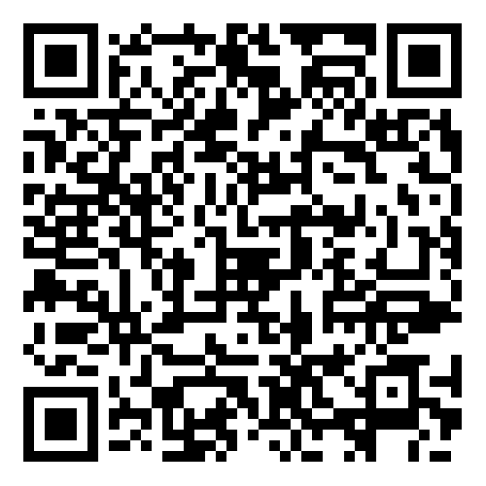
Help us improve!
Use this QR code to provide feedback about today's session. Paid Leave Feedback Survey
Notes:
https://forms.office.com/Pages/ResponsePage.aspx?id=RrAU68QkGUWPJricIVmCjO5PKN3qFedFqwBFXCcsYY9URDFXQjZJUEtGNUdNMkU4VEVaUjYyT1VDTC4u

