Slide 1
Opportunity Zones Overview and Nomination Process
Neal Young, Economic Analysis Director

Slide 2
What is an Opportunity Zone?
Opportunity Zones were established by Congress in the Tax Cut and Jobs Act of 2017 to encourage long-term investments in low-income and urban communities nationwide.
Investors can get tax benefits from making investments in Opportunity Funds, which invest in projects in Opportunity Zones.
The program was reauthorized in the One Big Beautiful Bill Act of 2025.

Slide 3
What Are The Tax Benefits of Opportunity Zones?
U.S. investors are eligible to receive:
  A temporary tax deferral for capital gains invested in an Opportunity Fund.
  A step-up in basis for capital gains reinvested in an Opportunity Fund.
  Rural investments receive a triple step-up in basis.
  A permanent exclusion from taxable income of capital gains from the sale or exchange of an investment in a qualified opportunity zone fund if the investment is held for at least 10 years.

Slide 4
2018 Compared to 2026
In 2018, 509 census tracts in Minnesota were determined to be eligible by the U.S. Treasury Department.
Counties, cities of the first class and Tribal Governments were asked to prioritize which census tracts they wanted to be designated as Opportunity Zones.
128 census tracts from this list were designated as Opportunity Zones in 2018.​ Of these 128, only 69 are eligible for designation this time.
In 2026, eligibility changes reduced the number of eligible tracts and the resulting number of designations.
In 2026, 289 census tracts are eligible, with 73 nominations for Opportunity Zone designations (~25% of eligible census tracts).
Another major change in the law this time around is that rural areas are provided greater tax advantages. Of Minnesota’s 289 eligible census tracts, 182 (63%) qualify as rural.

Slide 5
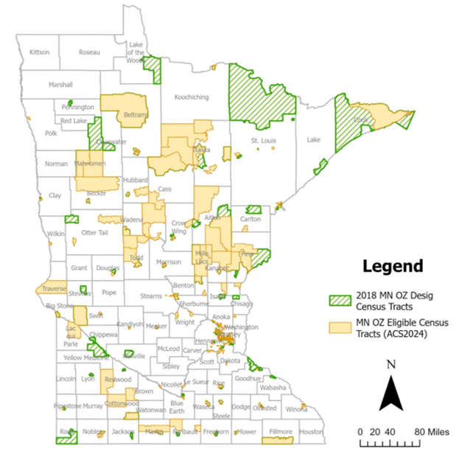
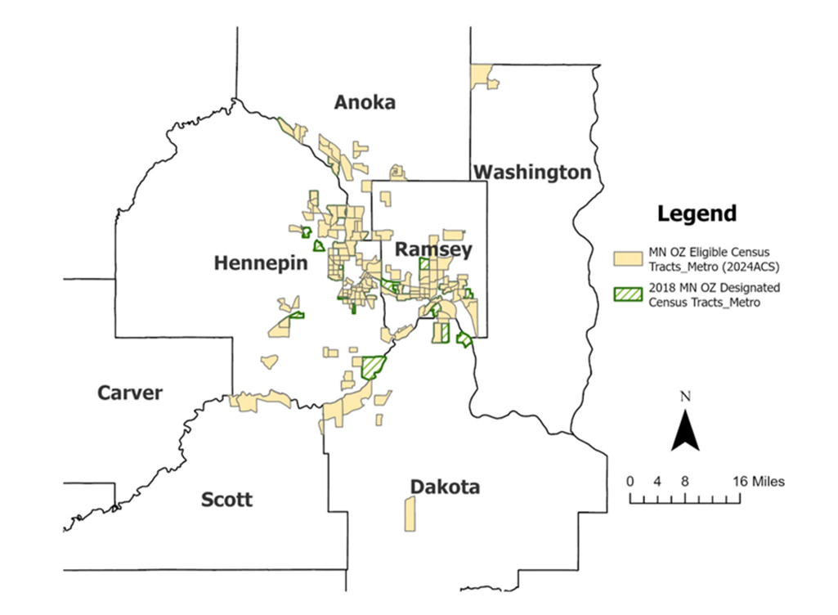
Eligible Census Tracts

Slide 6
The Nomination Process
U.S. Treasury Department has announced the authoritative list of eligible census tracts: https://home.treasury.gov/system/files/131/OZ2-Eligible-LIC-Tracts-Data-Transparency-03232026.xlsx.
Each Governor is authorized to designate 25% of the eligible census tracts as Opportunity Zones in their state. Governors control the nominating criteria.
In Minnesota, this means the Governor can designate 73 census tracts as Opportunity Zones out of 289 eligible low-income census tracts.
The 90-day designation window begins on July 1, 2026 and is due approximately September 28, 2026, with an extension potentially available for 30 days (October 28, 2026).
New Opportunity Zones are formally designated on January 1, 2027.

Slide 7
Input from Local Governments For the Nomination Process
We feel strongly that local communities have the on-the-ground expertise to recommend which census tracts should be nominated.
As a result, we are engaging counties, cities of the first class and Tribal Governments that have eligible census tracts to understand their priorities
We are conducting an informal solicitation process to obtain priority census tracts to help make final decisions for submittal during the 3rd Quarter of 2026.

Slide 8
Counties with No Eligible Tracts
28 counties: Carver, Chippewa, Clearwater, Dodge, Grant, Houston, Jackson, Kittson, Lake, Lake of the Woods, Le Sueur, Lincoln, Lyon, Marshall, McLeod, Murray, Norman, Pennington, Pope, Red Lake, Renville, Rock, Roseau, Sibley, Stevens, Wabasha, Watonwan, Yellow Medicine
If your Geography has no eligible census tracts, that is the final decision from the federal government on eligibility for this program.
For these counties, no response to the informal solicitation is expected or required.

Slide 9
Counties With Eligible Census Tracts
Minnesota County | Census Tracts per county
Total, MN OZ Eligible census tracts | 289
Hennepin | 73
Ramsey | 45
Anoka | 21
St. Louis | 16
Stearns | 9
Itasca | 8
Dakota | 7
Olmsted | 6
Mille Lacs | 5
5 counties: Beltrami, Blue Earth, Cass, Todd, Winona | 4
9 counties: Aitkin, Brown, Clay, Kandiyohi, Mower, Nobles, Pine, Rice, Scott | 3
16 counties: Becker, Cottonwood, Crow Wing, Faribault, Freeborn, Hubbard, Isanti, Kanabec, Koochiching, Mahnomen, Martin, Morrison, Otter Tail, Swift, Washington, Wright | 2
20 counties: Benton, Big Stone, Carlton, Chisago, Cook, Douglas, Fillmore, Goodhue, Lac qui Parle, Meeker, Nicollet, Pipestone, Polk, Redwood, Sherburne, Steele, Traverse, Wadena, Waseca, Wilkin | 1

Slide 10
Tribal Governments with Eligible Tracts
Six Tribal Governments have a total of 18 eligible census tracts:
  Bois Forte (1)
  Grand Portage (1)
  Leech Lake (4)
  Mille Lacs (8)
  Red Lake (1)
  White Earth (3)

Slide 11
Timeline
Local decision-makers have 60 days to provide their rankings to DEED and Minnesota Housing:
Initial information distributed to local decision-makers: May 1, 2026
  First Webinar: May 6, 2026
  Second Webinar: June 3, 2026
Deadline to receive rankings from local decision-makers: June 30, 2026
Recommendation due to Treasury September 28, 2026 with an extension potentially available for 30 days (October 28, 2026).

Slide 12
Process to Prioritize and Rank Eligible Census Tracts
The map (found here: https://www.arcgis.com/apps/dashboards/c473c71f0704408f934fbdc342caf1f1) shows the eligible census tracts in your county/city/tribal area or region. We request that you to work collaboratively to prioritize and rank your eligible census tracts for nomination by Governor Walz as an Opportunity Zone.
Submit the Application Spreadsheet for your geography:
The Application Spreadsheet includes three (3) tabs:
Applicant Info

Slide 13
Spreadsheet Tab 2
Narrative
Principles to Prioritize and Rank Opportunity Zones:
Local decision-makers are asked to explain how the following principles lead them to their ranking of eligible census tracts:
  Needs of the low-income community and other partners serving the zone including data about the unemployment rate, high poverty rate and low median income
  Potential for positive impact to further equity and inclusion and minimize displacement and gentrification
  Commitment(s) to support the zone by industry, education, nonprofits and governments including ongoing collaborations (i.e. promise zones, empowerment zones and renewal communities)
  Development possibilities within the zone in the next 5 years including affordable and workforce housing and economic development
  Engagement with organizations who have indicated an interest in creating Opportunity Funds
  Businesses and emerging businesses with investment potential in the zone
  Potential positive impact the zone could have on the most distressed communities
  Highlight any existing OZ projects in your area that have occurred during the first round of the program.

Slide 14
Spreadsheet Tab 2, Continued
Collaboration:
Outline how you collaborated and received input from community, nonprofit, industry and business partners as well as the residents of the communities most in need of investment in making your recommendations.
Opportunity Funds:
The promise of Opportunity Zones can only be met if Opportunity Funds are created that deploy private investment into Opportunity Zones. We strongly encourage you to reach out to any entities (i.e. community banks, foundations, CDFIs, CDCs) that may be working to create an Opportunity Fund as you create your priorities. While this is very early in the process, please share with us any entities you have reached out to about creating Opportunity Funds for Opportunity Zones in your region.

Slide 15
Spreadsheet Tab 3
Rank Eligible Census Tracts:
Please rank your eligible census tracts by priority for designation (ie, if your geographic area has 3 eligible census tracts, rank your first choice 1, second choice 2, 3rd choice 3, etc.).
In the spreadsheet, add or subtract ranking numbers as needed based on the number of eligible census tracts in your geographic area.

Slide 16
Resources
Eligible Census Tracts for Nomination as 2027 Opportunity Zones Authoritative Eligible Tract Resource from U.S. Department of Treasury (filter for Minnesota or relevant county to narrow your search)
Map of all eligible census tracts: National mapping resource (zoom in on Minnesota or search for Minnesota counties)
U.S. Department of Treasury Opportunity Zone Resources
Link to Economic Innovation Group information about Opportunity Zones
Urban Institute tool to inform 2026 Opportunity Zone selections for state and local decisionmakers
Link to full bill that includes Opportunity Zones language

Slide 17
DEED/MHFA’s Role
DEED/MHFA provide education to local governments about the Opportunity Zone program and assist the Governor's Office in designation of census tracts. Once the nomination is submitted, DEED/MHFA have no role in program administration.
Cities approve developments that may be funded by Opportunity Zone investments - ex. an apartment building in Minneapolis
DEED/MHFA are not engaged on any Opportunity Zone eligible projects
  Projects do not inform DEED/MHFA on benefits or outcomes
  In the past, there was no public data on the effectiveness of Opportunity Zone designations. There is expected to be more reporting in this iteration, but DEED/MHFA have no role in reporting.

Slide 18
https://mn.gov/deed/business/financing-business/tax-credits/opp-zones/
The email address to use for questions and submissions for this process is: EconomicAnalysis.deed@state.mn.us

