Slide 1


NEIGHBORS CONNECT DIGITAL ACCESS PROGRAM
02/2026
Created by Technologist Computers

Slide 2


ABOUT US
Technologist Computers is a social enterprise that believes in technology that is accessible and affordable to everyone. We are a team of skilled professionals who specialize in providing reliable and efficient on-site and emergency technical support for various industries. Whether you need help with equipment maintenance, system upgrades, fixing network, computer repairs or troubleshooting, we've got you covered.

Slide 3
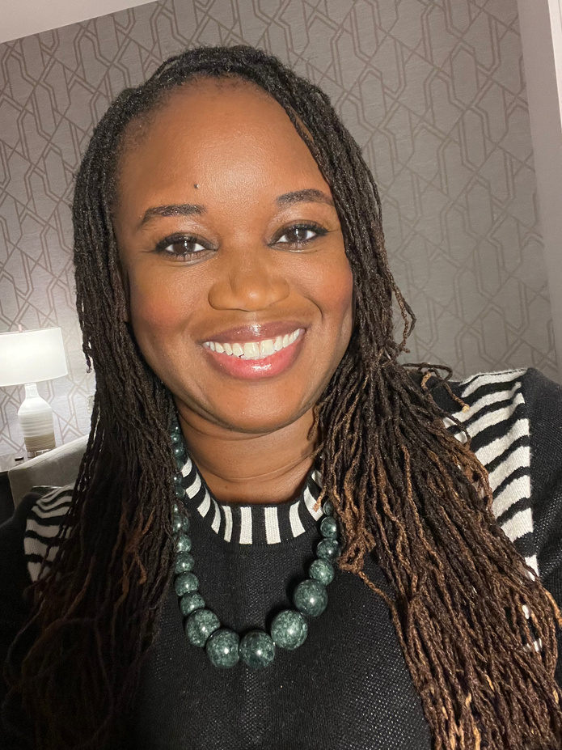


INI AUGUSTINE
DIRECTOR FOUNDER
Ini Augustine is a network engineer, social innovator, and serial entrepreneur. Her social enterprise Technologist Computers, sells computers, IOT, and technical support to help fund their three community outreach programs, Project Nandi, Way of the Root Farm, & Joy on Film. As a member of the Governor's Task Force on Broadband, she continues to advocate for the internet for all Minnesotans. Ini is the founder of the Black Broadband summit, which aims to discuss shared experiences around lack of access, teach how the internet works, and create community led solutions to closing the digital divide.

Slide 4
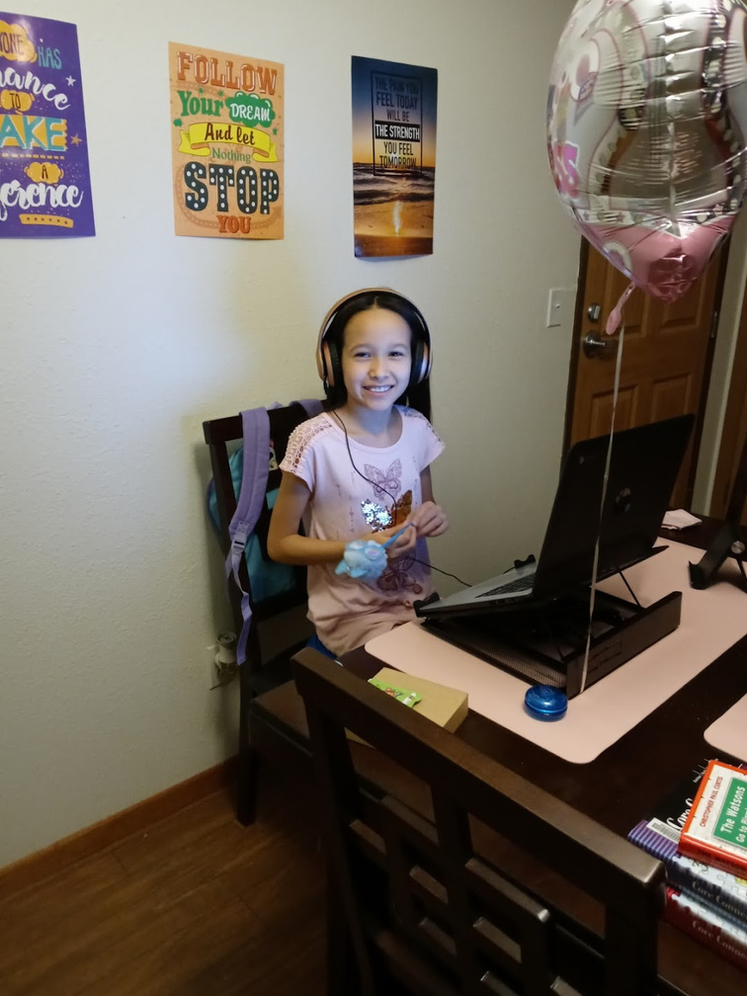
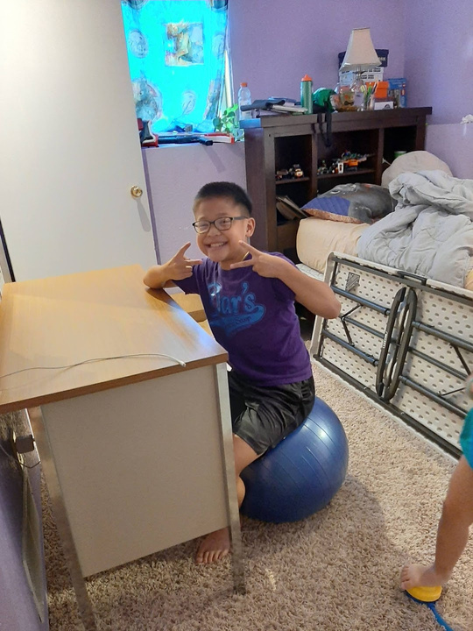
PROJECT OVERVIEW

Slide 5
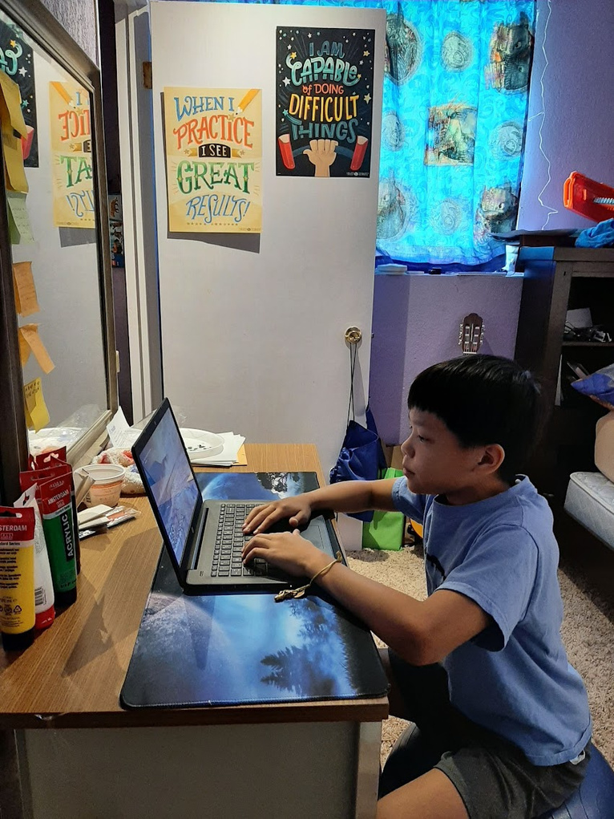
DIGITAL SKILLS TRAINING
  Computer skills: Understand how to power on computer, connect to internet, open browser, check email, access the Northstar Digital Literacy Program
  Join and access Google Meet
  Online safety skills: Secure website navigation, privacy protection, threat and scam identification and prevention

Slide 6

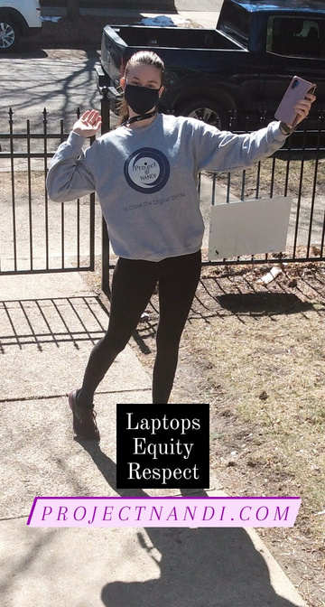
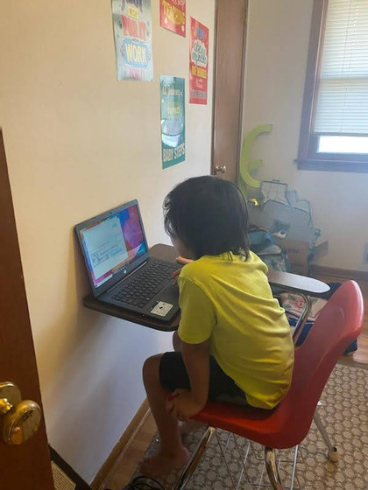
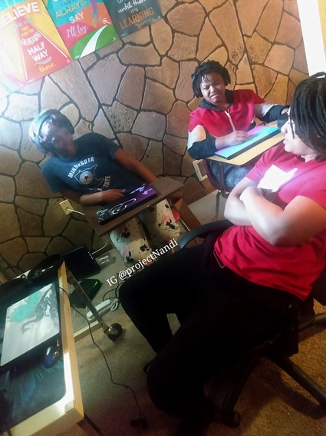
CORE SERVICE DELIVERY
  Digital skills training delivered through partnerships with Hennepin County Library, and Sabathani Community Center.
  Development and implementation of innovative training programs
  Impact and outcome monitoring

Slide 7
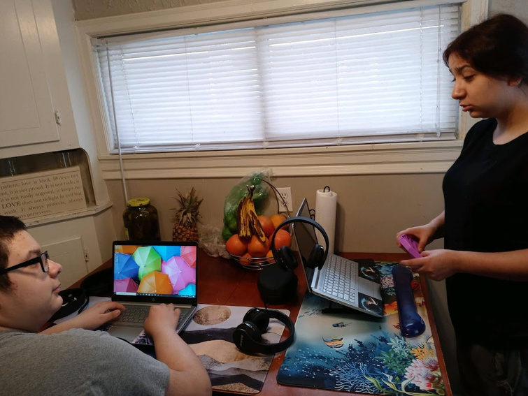
CORE SERVICE DELIVERY
  Quarterly progress meetings with County staff
  Group and individual support for accessing Hennepin County services, job applications, telehealth, and distance learning
  Secure device distribution for County-provided devices after training sessions are completed

Slide 8
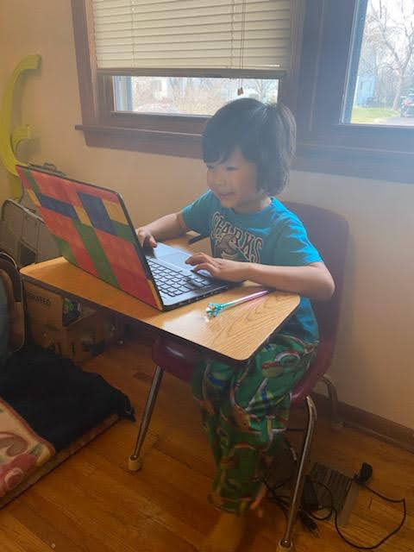
GEOGRAPHIC AREAS SERVED
  Library-Based Services: We plan to partner with Hennepin County Library locations to reserve space and access computer systems for training sessions

Slide 9
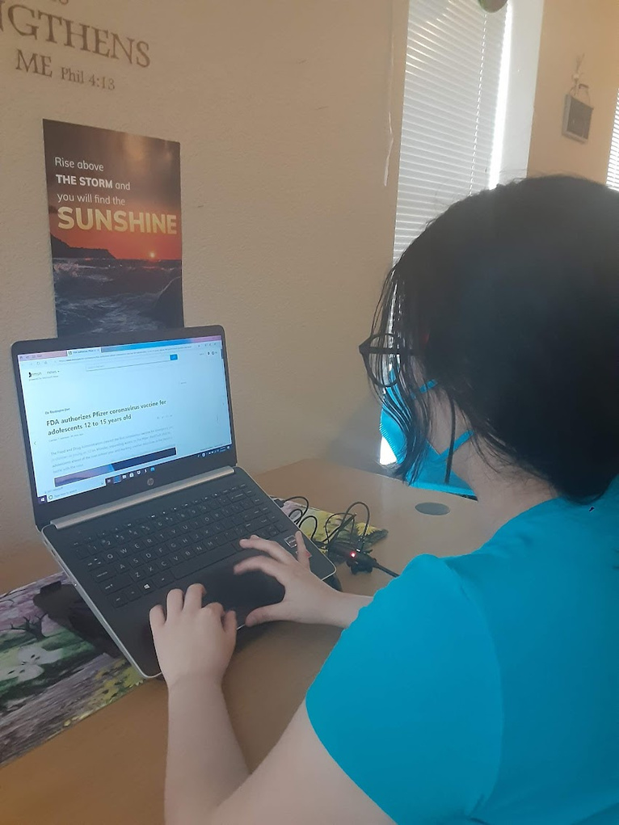
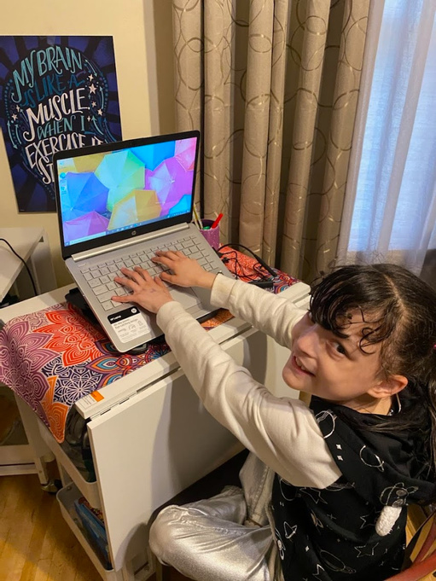
PROJECT PLANS

Slide 10
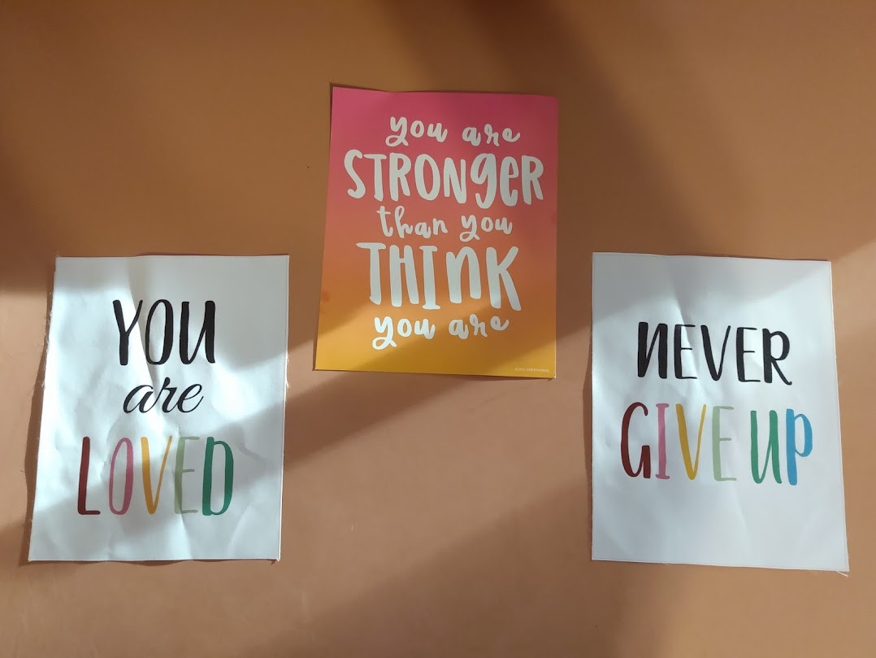
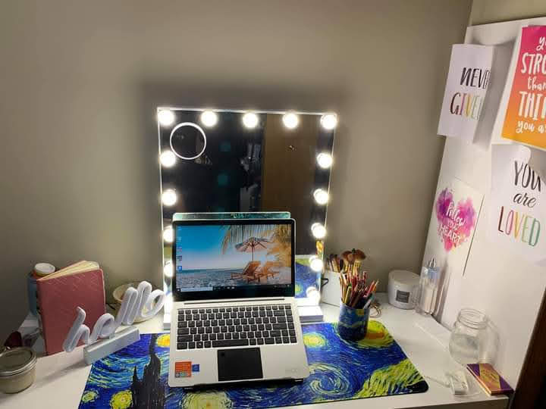
SPECIALIZED FOCUS AREAS
  Senior-Focused Education: Senior-specific training on devices, connectivity, and online safety

Slide 11
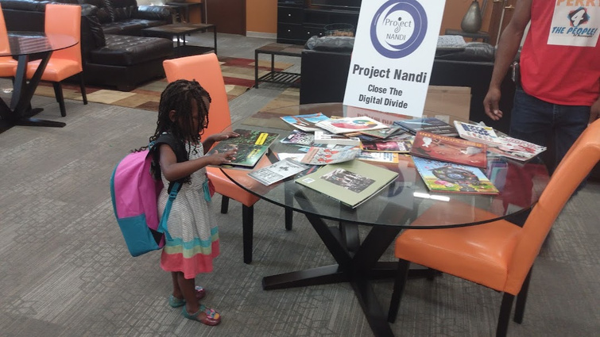
DIGITAL SKILLS TRAINING
  Culturally responsive, trauma-informed curriculum design acknowledging technology barriers faced by marginalized communities
  Learning approach combining in-person instruction and self-paced materials
  Learning models utilizing community leaders as co-facilitators and cultural bridges
  Life-skills integration connecting technology training directly to participants' immediate goals in education, employment, and healthcare

Slide 12
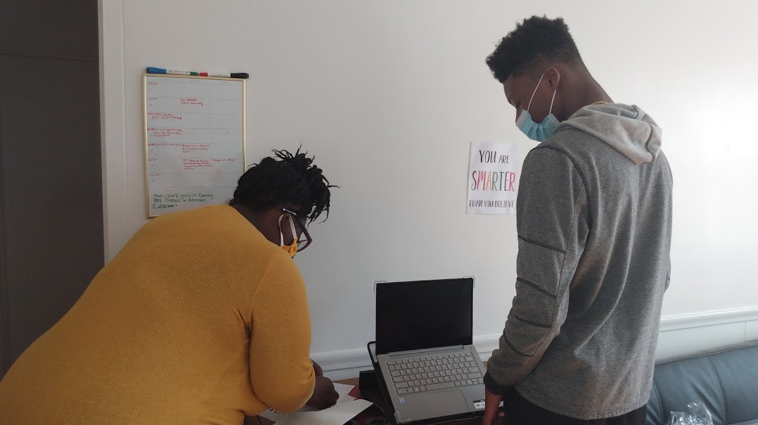
SENIOR-FOCUSED
  Slow-paced, repetitive learning methodology with frequent review and practice sessions
  Large print materials, audio alternatives, and high-contrast visual aids
  Safety-first approach emphasizing scam prevention, privacy protection, and secure online practices

Slide 13
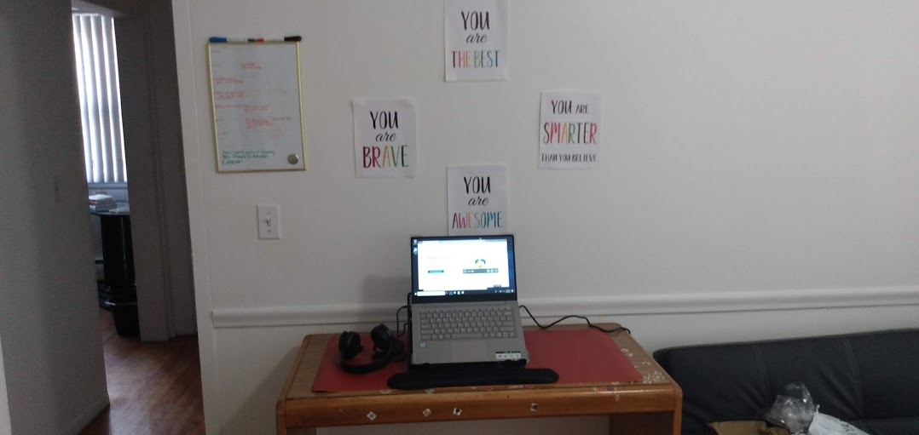
SENIOR-FOCUSED
  Comfortable, familiar training environments with community center and facility partnerships
  Integration with existing senior programming and social activities for holistic support

Slide 14
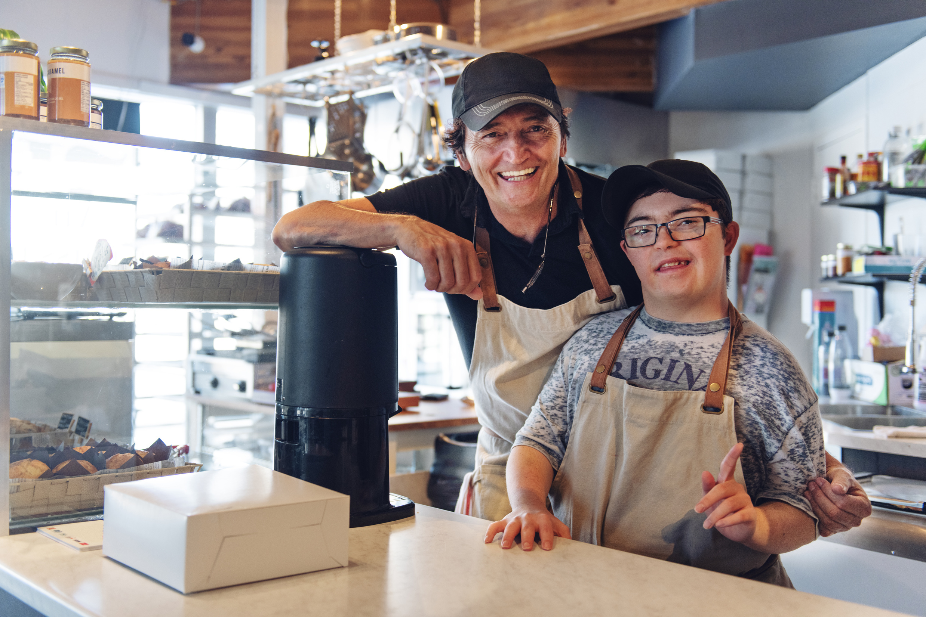
SMALL BUSINESS
25 Hours of IT Support through Elevate Hennepin
  Website Design
  Software/Hardware Consulting
  Cybersecurity
  IT Consulting

Slide 15
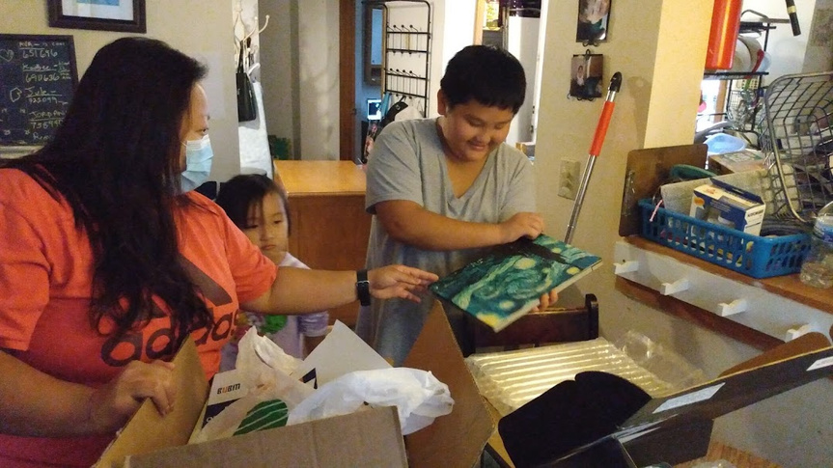
TRAINING COMPLETION
  Once training sessions are completed the trainee will be able to keep the computer that they have been learning on.

Slide 16
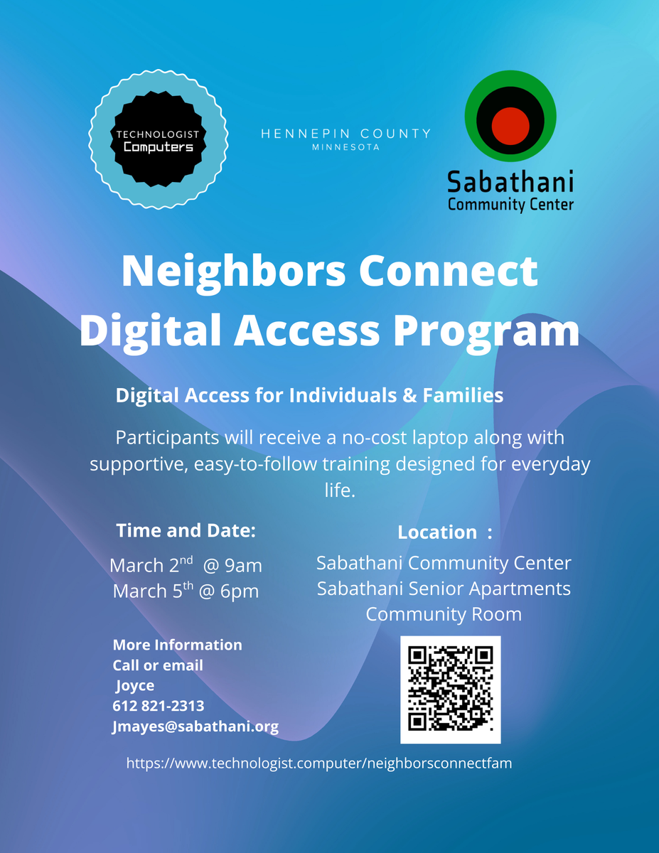
FAMILY AND INDIVIDUALS

Slide 17
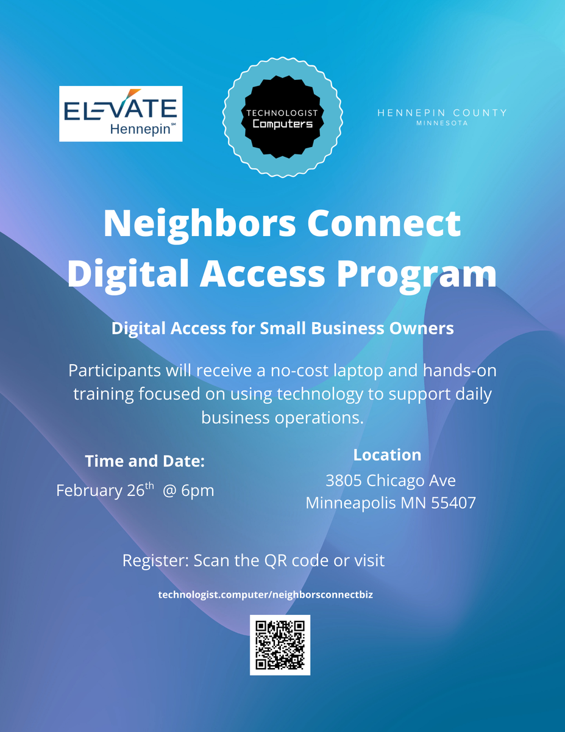
SMALL BUSINESSES

Slide 18
THANK YOU
Contact Ini Augustine:
Phone: (651) 300-9093
Email: ini@technologist.computer
Online: www.technologist.computer

