Slide 1

State Broadband Goals
Minnesota Governor’s Broadband Task Force
September 2025

Slide 2
About Pew
The Pew Charitable Trusts uses data to make a difference. Pew addresses the challenges of a changing world by illuminating issues, creating common ground, and advancing ambitious projects that lead to tangible progress. ​
​
​
​
The Pew Charitable Trusts’ broadband access initiative works with state and federal lawmakers, researchers, and other partners to accelerate the nation’s progress to universal, affordable high-speed internet service.​
2
Broadband Landscape 2025

Slide 3
State Broadband Goals
History of State Speed Goals and Definitions
Federal Policy Changes
  IIJA: 5-Year Action Plans and DEA
  Recent FCC Orders
Industry Trends
Current Landscape of State Goals
​
​
​
3

Slide 4

History of State Goals
1996 - 2020
4

Slide 5
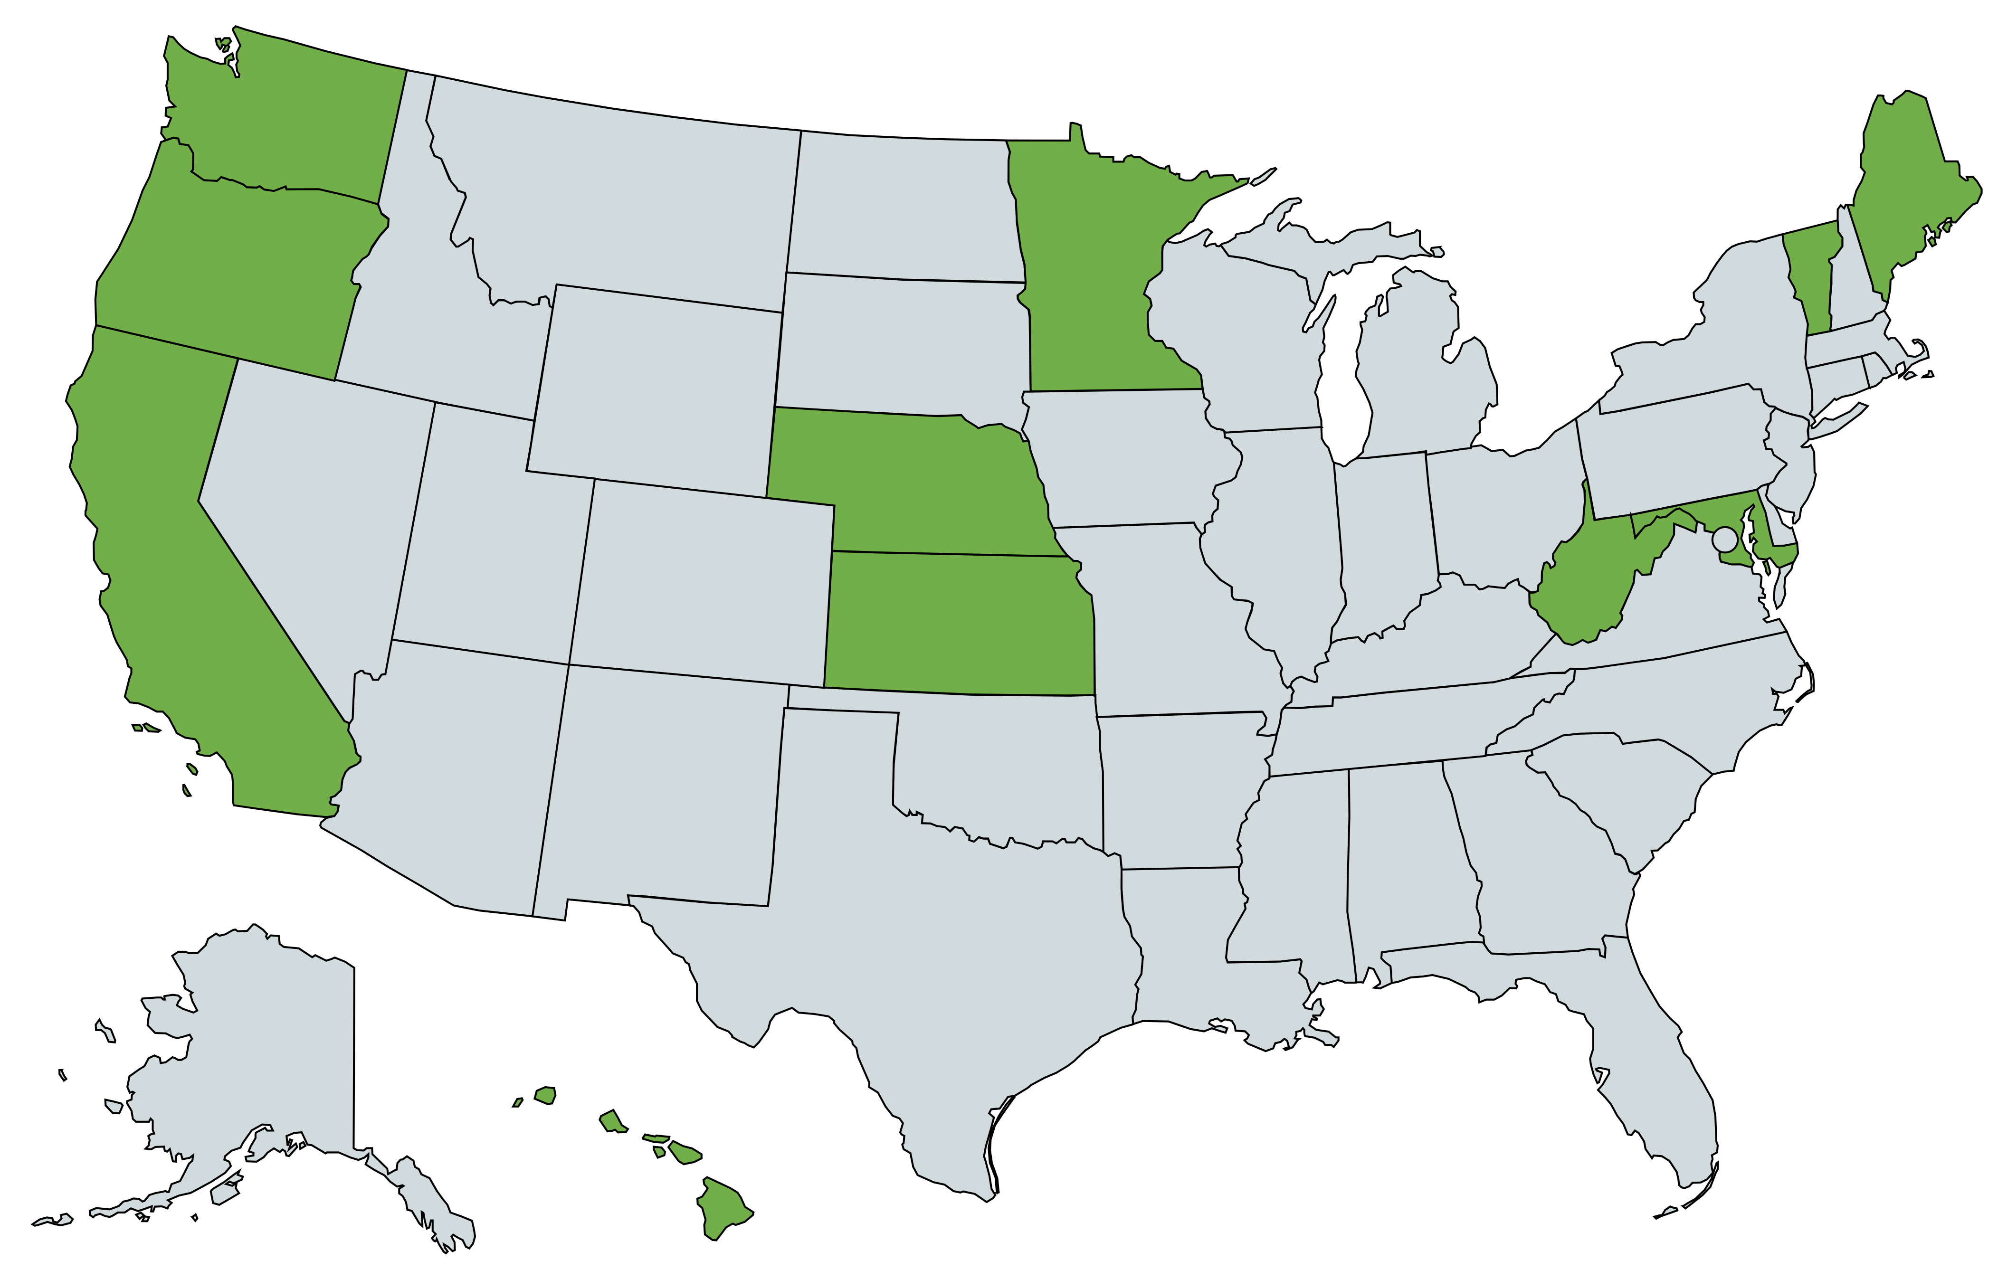
State Broadband Goals
Pew identified 11 states with formal goals for broadband connectivity before 2020. These were established via a combination of:
Legislative Statutes
Utility Commission Rules
Executive Orders
Others have set goals as part of broadband plans or by an advisory council
E.g., Louisiana's BEL Commission and Wisconsin Governor’s Task Force
These goals can cover deployment targets (% of homes and businesses, or urban/rural parity), the affordability of services, and the minimum speed.
5

Slide 6
High-level statements of intent
Oregon (2003)
promote access to broadband services for all in order to:
  improve the economy…
  improve the quality of life…
  reduce the economic gap between communities that have access to broadband digital applications and services and those that do not…
  …for both present and future generations.
Kansas (1996)
Ensure that every Kansan will have access to a first-class telecommunications infrastructure that provides excellent services at an affordable price…
Residents of this state should have access to broadband telecommunications service at a minimum 25/3 Mbps.
6

Slide 7
Targeting Specific Years
Washington (2019)
By 2024, all businesses and residences have access to high-speed broadband that provides minimum speeds of at least 25/3 Mbps
By 2026, all communities have access to at least 1G symmetrical broadband service at anchor institutions
By 2028, all businesses and residences have access to at least one provider of broadband with speeds of at least 150/150 Mbps.
7
7

Slide 8
Combination of Goals and Measurements
Hawaii (2010)
“access to broadband communications for all households, businesses, and organizations throughout Hawaii by 2012:
  at speeds and prices comparable to the average speeds
  and prices available in the top three performing countries in the world…
Increase broadband availability at affordable costs to low-income and other disadvantaged groups, including making low-cost, broadband capable computers available to eligible recipients…”
8

Slide 9
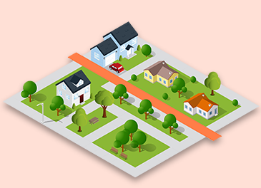
Federal Policy Changes
BEAD and the FCC
9

Slide 10

IIJA - BEAD and DEA
IIJA required each state to draft a 5-Year Action Plan and a Digital Equity/Opportunity Plan detailing how they would achieve “universal coverage” and increase the adoption and affordability of connections. These established de facto five-year goals for states.
Some states codified these goals, including through legislation that created their broadband offices or appropriated federal funding. For example:
  Alaska’s HB363 (2022) established the broadband office and tasked it with achieving the state’s broadband goals.
  New York’s SB 1336 (2025) established the state’s DEA program within its broadband office and directed it to implement the goals in their state plan.
FCC
In 2024, the FCC raised its 2015 broadband definition from 25/3 Mbps to 100/20 Mbps, 1G per 1,000 student standards for schools, and set a long-term goal of 1G/500M. Currently the FCC has an open inquiry on if the long-term goal is appropriate.
10

Slide 11
Affordability
Impact of the Affordable Connectivity Program (ACP)
ACP increased internet adoption nationally by 2.9 percentage points in 2023, representing 3.8 million households.
  With a greater impact in rural areas: 6.9%
ACP reduced “churn,” estimating to have helped keep 11.5 million “subscription vulnerable” households connected
Reduced customer turn-over improved the business cases for participating ISPs, increasing the “average revenue per user” with a 25% reduction in break-even costs when building new networks.
11

Slide 12
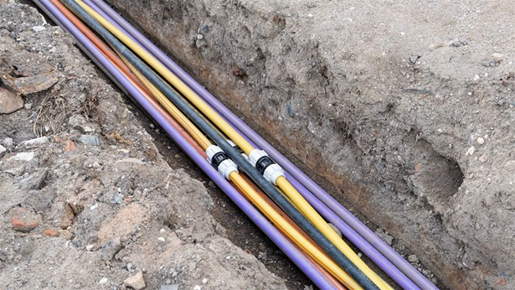
Industry Trends
Speed Demands and Adoption
12

Slide 13
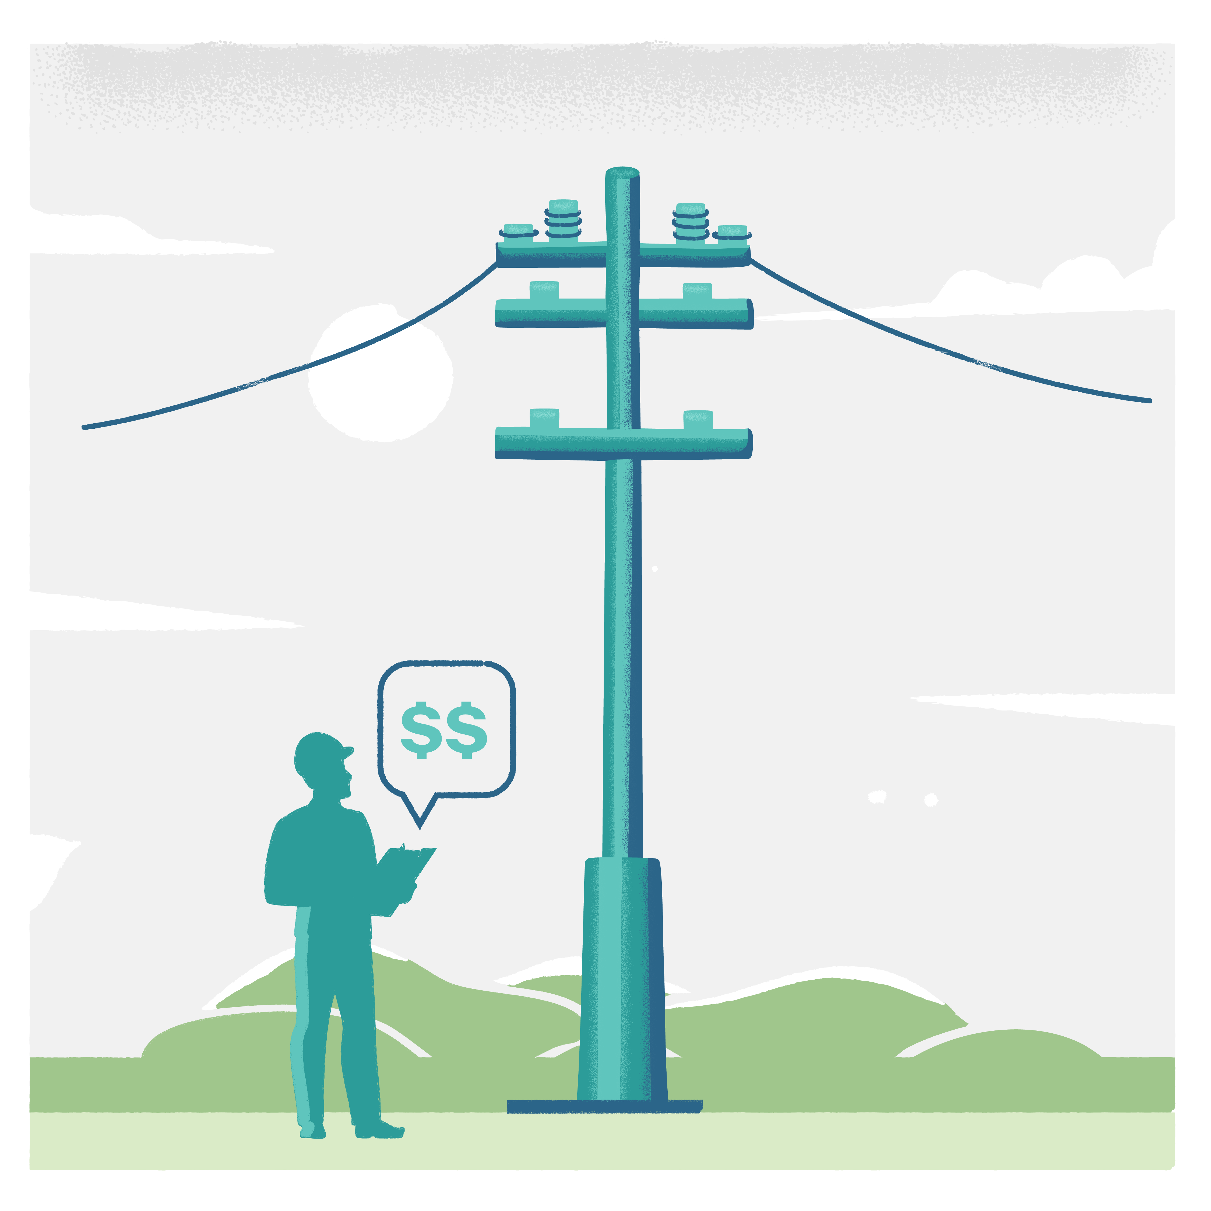

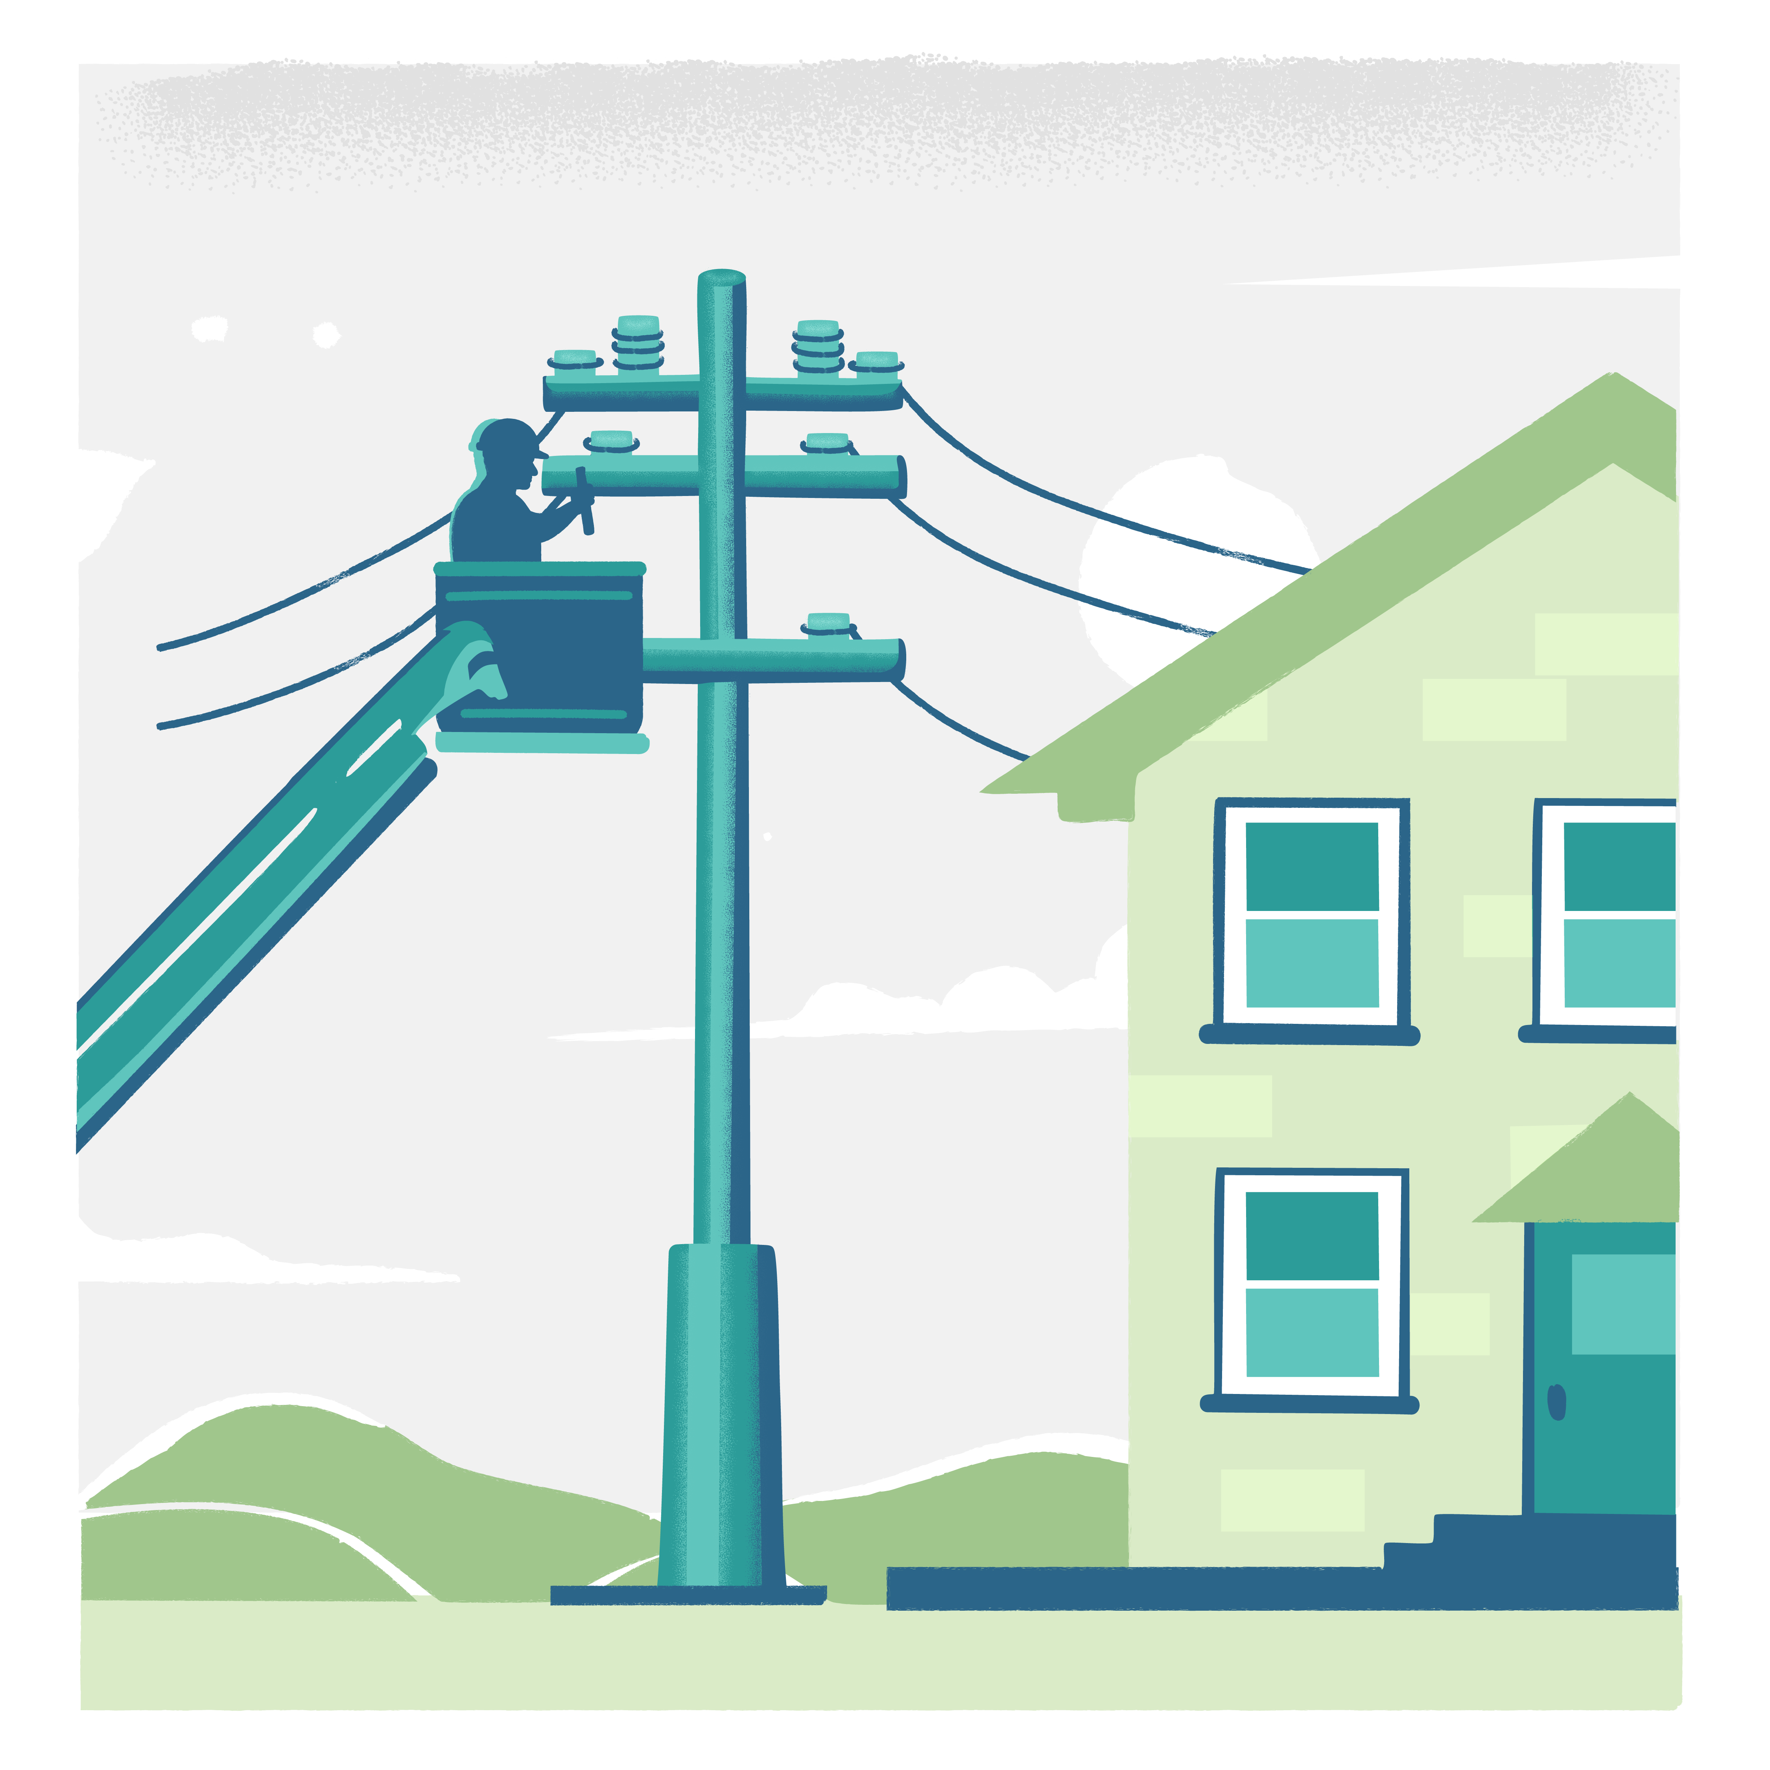
Increasing Demand Across Sectors
Agriculture
Farm offices can often require a minimum of 100 Mbps symmetrical and in-field equipment/buildings can require wireless coverage, according to 2021 research published by the Benton Institute.
Healthcare
Telehealth use has rapidly increased, growing from 0.1% of patient visits in 2021 to ~17% of all patient visits in 2023.
Internet-enabled services like remote patient monitoring have been shown to reduce healthcare costs by up to 20%.
Education
The FCC's current bandwidth goals for schools is 1 Mbps per student
Students with access high-speed connections at home report higher test scores, particularly those with access to fiber.
13

Slide 14
Consumer Trends
Demand for higher speeds
Per US Telecom, the most popular services in 2024 have an average speed of 301/96 Mbps, compared to 141/51 Mbps in 2015.
New advancements in AI are increasing demand for fiber-connected data centers.
Adoption and GDP
According to the Urban Institute, higher-speed broadband networks, particularly fiber networks, has been shown to move broadband adoption rates in rural areas to more than 80% (2022).
CORI has found that rural counties with high internet adoption see higher business growth (213%) and higher GDP (44%).
14

Slide 15

Current Landscape
State Policy
15
January 10, 2023

Slide 16
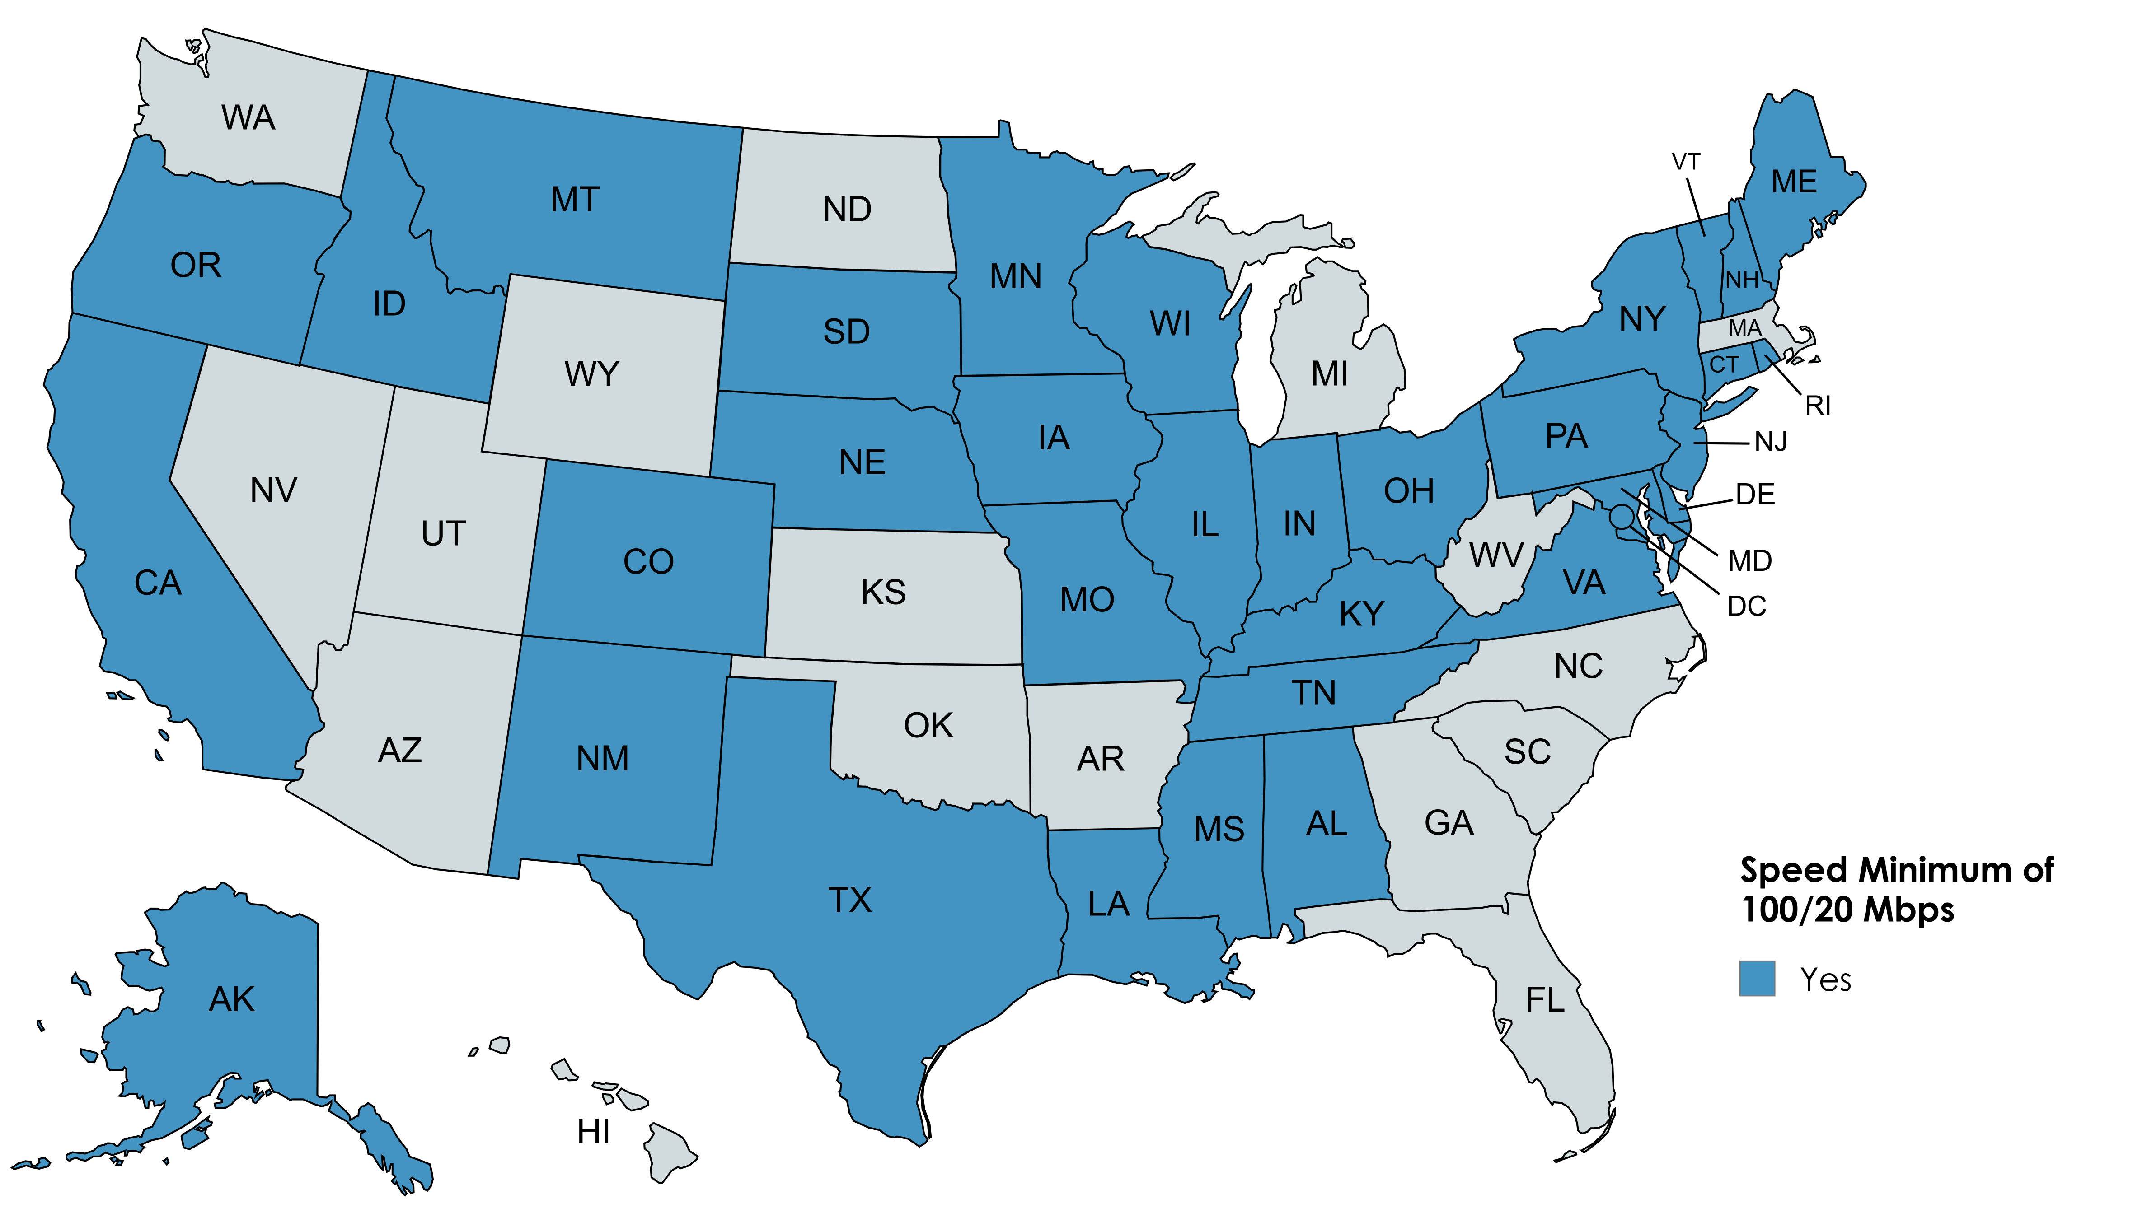
State Speed Standards
31 states have increased their minimum speed standards to 100/20 Mbps, either for their deployment program (including to align with federal funding requirements) or for the state’s definition of broadband.
16

Slide 17
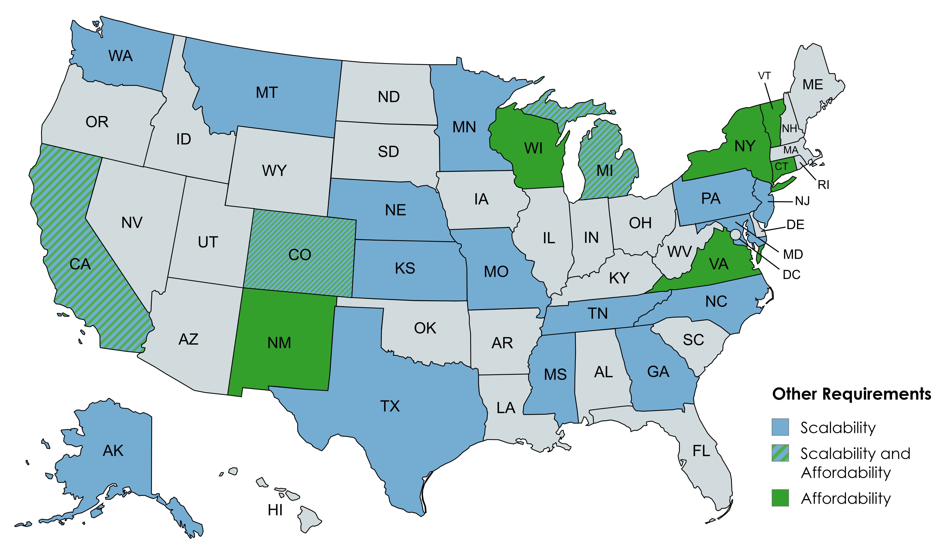
Beyond Minimum Speeds
9 states are also incorporating the cost of service available to customers and 18 states are prioritizing the scalability of funded networks.
Scalability may be defined as “networks that can easily upgrade to higher speeds over time” or to “meet future demands.”
17

Slide 18
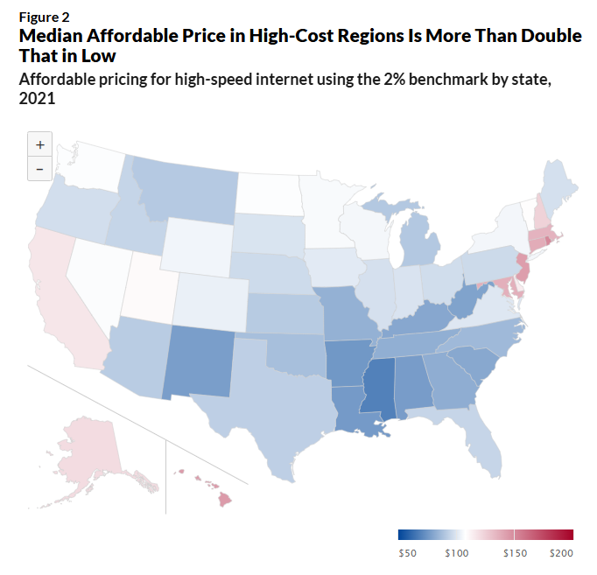
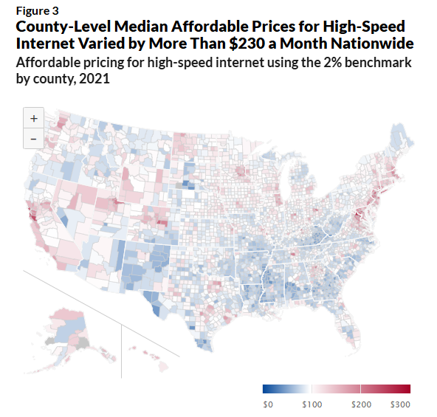
Affordability
What is considered affordable for internet costs can vary between communities and regions.
Pew found that the median “middle-class” broadband price of $96.63 would be considered unaffordable for families earning less than $60,000 per year.
18

Slide 19
States are meeting and setting new goals
Wisconsin (2024) - Governor’s Task Force
  By 2029, all homes and businesses will have broadband at speeds of at least 100/20 Mbps and all community anchor institutions will have reliable downloads of at least 1G
  Prioritizing “future proof” awards, with an emphasis on fiber
Illinois (2025) – Broadband Advisory Council
  Connecting all public schools, public libraries, and State-owned correctional facilities to the Illinois Century Network to reliable gigabit level broadband service by 2030.
  Council is tasked with creating a feasibility study, and measuring current progress
19

Slide 20
Pew’s Promising Practices
In 2020, Pew identified components for states to incorporate and continually evaluate as a part of their grant programs tied to broadband availability, quality, and affordability.
These components hold true, and evaluation and policy refinement remain a leading recommendation to state lawmakers.
Policy evaluation requires that states create frameworks to:
Develop well-defined goals for broadband deployment
Establish baselines to measure progress
Assess both implementation and emerging needs tied to availability, quality, and affordability
20

Slide 21
Contact information
Jake Varn | jvarn@pewtrusts.org
21

