Slide 1
Minnesota’s Labor Force Trends
Cameron Macht
Regional Analysis & Outreach Manager
cameron.macht@state.mn.us
https://mn.gov/deed/data/regional-lmi/
Notes:
Thanks for the opportunity to present to this group – it is my pleasure. My name is Cameron Macht and I am the Regional Analysis & Outreach Manager for DEED. Please note that there is a tremendous amount of information available, and in 10 minutes this presentation will only scratch the surface, but will hopefully provide a good context for your meeting. We are happy to be a resource for you.

Slide 2
Local Area Unemployment Statistics
The state’s unemployment rate was back to 3.1% in December 2021
Peaked at 11.3% in May 2020 (highest on record – back to 1976)
Back to 93,906 unemployed workers in Dec. 2021
Down from a peak of 348,262 workers in May 2020
Down from 98,843 unemp. workers in Dec. 2019
Holding at 3,030,443 available workers in Dec. 2021
Hovered around 3,030,000 workers throughout the entire year of 2021
Down -86,638 workers from Feb. 2020

Slide 3
Labor Force Participation
The number of workers aged 55 years & over increased from 350,342 in 2000 to 734,657 in 2019 (+384,315 workers; +109.7%)
Workers 55 years & over accounted for 13.0% of the total labor force in 2000
Workers 55 years & over now account for 23.6% of the total labor force in 2019
Labor force participation rates were climbing for older workers
From 22.7% for workers aged 65-74 in 2000 to 28.1% in 2019
From 6.0% for workers aged 75 & over in 2000 to 7.0% in 2019
Pandemic recession may have changed that!
Notes:
For decades, we knew that a retirement wave was coming based on demographic shifts as baby boomers age. But the behavioral changes due to the pandemic leading to accelerated retirements weren't predictable even two years ago. Both the demographic and accelerated retirement trends are being seen around the country. This article takes a summary look at how decisions to retire early due to concerns over COVID-19, changes in life priorities, or healthier-than-expected retirement funds will impact Minnesota's labor force.
Unfortunately, up-to-date detailed data required to do a detailed analysis on recent retirement shifts in Minnesota, similar to the U.S. analysis provided by the Atlanta Federal Reserve Bank, is unavailable. However, by applying the 2nd quarter 2019 to 2nd quarter 2021 changes in U.S. 55 years and older aggregated labor force participation rates to Minnesota's U.S. 55 years and older aggregated labor force rates, it is estimated that Minnesota retirements increased by between 29,000 to 59,000 due to behavioral change above previously expected retirements from demographic change over the last two years.
The 29,000 to 59,000 range is based on Minnesota's behavioral change in labor force participation ranging from half of the U.S. change to the same as the U.S. change. Even if the lower 29,000 estimate is correct, the number of older Minnesotans who retired earlier than planned due primarily to the pandemic accounts for a substantial percentage of Minnesota's pandemic-induced labor force shortfall of 95,000 workers versus projections for August 2021.

Slide 4
Labor Force Participation
85% of the state’s labor force is White (down from 88.7% in 2010)
The state’s White labor force declined by -2,000 workers from 2010 to 2019
Labor force participation rates were higher for every other race group except American Indians, and had been increasing since 2010
Black or African American labor force increased by +48,100 workers
Asian labor force grew by +41,200 workers
Labor Force of some other race grew +23,500
Two or more races grew by +21,500 workers
Hispanic or Latino grew by +32,300 workers
Minnesota has 325,000 Foreign-born workers – up +80,000 since 2010 (+33%)
74% labor force participation rate (up from 70.4% in 2010)

Slide 5
Labor Force Participation
Labor force participation rate dropped from 70% to 68%
Female lfpr dropped from 66.2% to 63.6%
Lowest rate reported from 2000 on – previous lowest was 64.4% in Feb. 2017
Male lfpr dropped from 73.9% to 71.8%
Down about -85,000 workers total since Feb. 2020
Down about -50,200 female workers since Feb. 2020
Down about -34,700 male workers
White labor force participation rate has dropped from 69.9% to 68.1%
Black lfpr dropped from 71.3% to 66.4%
But is up from a low of 64.3% in Feb. 2021
Hispanic lfpr rose from 76.3% to 78.3%
Highest lfpr on record

Slide 6
Labor Force Participation
It’s not just us – there are similar trends across the United States
Rates are starting to rise again for 25-54 year olds, but are still down (83.0% vs. 82.0%)
Rates are also rising for 55 years & older, but are still down (40.3% vs. 39.1%)
Male lfpr have been dropping for nearly a century! (69.0% vs. 67.4%)
Female lfpr has been rising for nearly a century! (57.9% vs. 56.6%)
Black lfpr dropped across the U.S.
From 62.7% to 58.4% back to 61.6%
Hispanic lfpr is down in the U.S.
From 67.9% to 63.1% to 66.2%
Workers with Disabilities are up!
From 20.7% to 22.8%
Foreign-born Workers are down!
From 66.9% to 61.8% to 65.6%

Slide 7
Labor Force Projections
The state’s labor force growth has slowed down
From an average of more than 41,000 new workers per year (1990s)
To an average of 15,500 new workers per year (2010s)
Projected to slow down to about 8,600 new workers per year over the next decade
Immigrants accounted for nearly half of labor force growth from 2010-2019
Almost all of the state’s labor force growth is projected to occur in the Twin Cities metro area (+6.0%)
Central = +0.6%
Southeast = -0.9%
Northwest = -1.0%
Northeast = -4.9%
Southwest = -5.2%

Slide 8
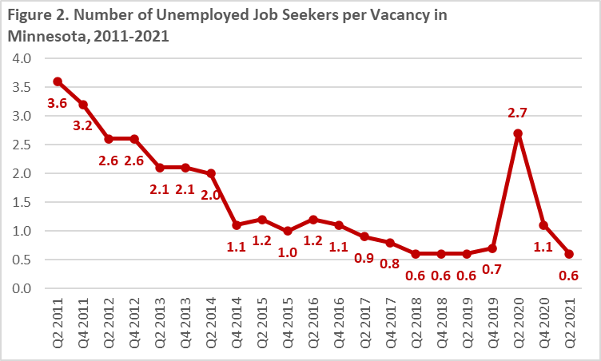
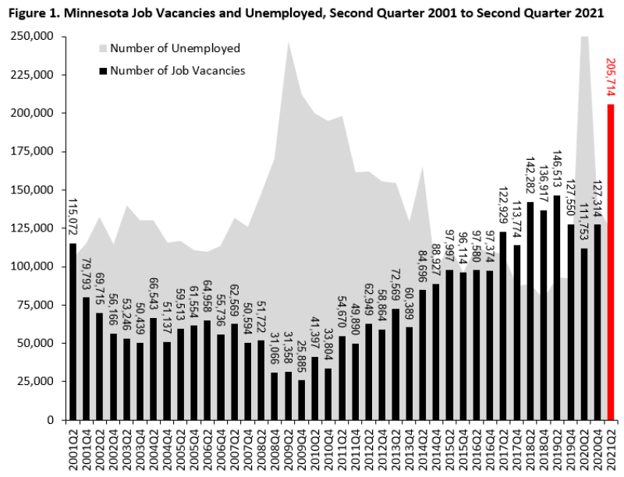
Minnesota Vacancies Surge in 2021
Record vacancy levels in 2nd Qtr. 2021 – 205,714 vacancies!
+95,000 from 2nd Qtr. 2020
+60,000 from 2nd Qtr. 2019
Job Vacancy Rate of 8.0%
Double 4.0% in 2nd Qtr. 2020
12 of 20 industries set new records
Health Care & Social Assistance had 39,727 vacancies (1 in 5)
Accommodation & Food Svcs. had 37,363 vacs. (+150%)
Retail Trade had 36,174 vacs.
Unlike the Great Recession
Manufacturing had 14,621 vacs. (+347%)
Notes:
Through the first 10 months of 2021, Minnesota employers added just over 190,000 jobs back onto their payrolls, climbing back above 2.9 million jobs in October. Though the state is still below pre-pandemic employment levels, this is an encouraging sign of continuing recovery from the COVID-19 recession in 2020. Minnesota's job gains are outpacing the U.S. growth rate so far this year, but much like the past five years, the state's labor market tightness has constrained even faster economic growth.
From the end of the Great Recession in early 2010 until March of 2020, the state's economy continued to reach new employment peaks each year in the longest-running economic expansion on record. However, the state's steady – but slowing – labor force growth constrained even more potential job growth. If we had more workers, we could have filled more jobs.
In fact, DEED's semiannual Job Vacancy Survey has revealed a progressively increasing number of vacancies each year since 2010 as employers struggled to find workers for available jobs. This trend continued all the way up to the start of the pandemic – and is even more pronounced coming out of the pandemic recession. With the state's labor force currently still down about 85,000 workers compared to February 2020, Minnesota employers posted a record high 205,700 job vacancies in the second quarter of 2021. That number was up nearly 95,000 vacancies compared to last summer, during the outset of the pandemic, and broke the previous record from the second quarter of 2019, prior to the pandemic, by almost 60,000 vacancies.
Job Vacancy Survey data show that from 2017 to 2019, the state had less than one available job seeker for each vacancy as hiring demand outpaced labor force growth. There was a short reversal during the second quarter of 2020 as unemployment spiked and employers paused hiring activity due to the coronavirus, then with more than 205,000 vacancies and less than 125,000 unemployed workers in the second quarter of 2021, there were again nearly twice as many open positions as available job seekers in Minnesota.
This unprecedented spike in postings translates into a job vacancy rate of 8.0%, or eight job openings per 100 filled jobs. This is the highest on record, and is double the 4.0% rate one year ago and also up from around 5.0% in 2018 and 2019. The job vacancy rate got as low as 1.0% in the fourth quarter of 2009, and had hovered between 1% and 3% from 2002 until 2014, when vacancies began outpacing worker availability. The current ratio suggests that the labor market is the tightest it's ever been, with employers in every industry finding it difficult to fill open positions.
12 of 20 industries reported new record numbers of vacancies in the second quarter of 2021, reflecting intense demand for workers across the entire economic spectrum. Only two industries – Information and Public Administration – saw declines over the past year, though both were still relatively high in historic terms

Slide 9
Job Vacancy Survey
Questions?
Cameron Macht
Regional Analysis & Outreach Manager
cameron.macht@state.mn.us
Labor Market Information Office
http://mn.gov/deed/data/
Please let us know how we can help!

