Slide 1
GWDB Q3 Board Meeting
The Inn on Lake Superior, Duluth Minnesota
11:00 am – 3:30 pm

Slide 2
Call to Order & Introductions
Surya Iyer, GWDB Chair | DeLinda Washington, GWDB Vice Chair

Slide 3

Table Introductions

Slide 4
Time | Topic | Presenter/Facilitator
11:00 A.M. | Call to Order and Opening Remarks New Board Member Introductions | Surya Iyer, GWDB Chair DeLinda Washington, GWDB Vice Chair
11:15 A.M. | GWDB Business Meeting Approval of Q2 GWDB Meeting Minutes* GWDB Quarterly Report* Upcoming GWDB Business Preview | Surya Iyer, GWDB Chair
11:25 A.M. | Interagency Workforce Alignment Quarterly Report | Commissioner Matt Varilek, DEED
11:55 A.M. | State and Federal Legislative Updates | Nathan Ratner, DEED Government Relations Katie McClelland, GWDB Director
12:45 P.M. | Lunch
1:15 P.M. | Board Operations Updates Bylaws Review and Update Introduce Chairs, Rosters and Next Steps | Nolan Thomas, GWDB Engagement Specialist
1:45 P.M. | Workforce Development System Overview, Goals and Priorities: Understanding GWDB’s Role in the System | Katie McClelland, GWDB Director
2:45 P.M. | Task Force on Workforce Development System Reform Discussion | Facilitated by GWDB staff
3:25 P.M. | Wrap-up and Next Steps | Surya Iyer, GWDB Chair DeLinda Washington, GWDB Vice Chair

Slide 5
GWDB Q3 Meeting Goals
Review Legislative Updates Impacting the GWDB & State Workforce System
Brief the board on workforce-related legislation at the state and federal level.
Deepen Workforce Development System Understanding & Begin to Chart Future
Develop a deeper understanding of Minnesota’s workforce system and GWDB’s role within it and begin to identify goals and priorities for Minnesota’s workforce system of the future.
Provide feedback to the Task Force on Workforce Development System Reform
Identify GWDB priorities for Task Force review regarding federal and state program scope, funding mechanisms and evaluation.
Build Relationships
Connect with fellow board members and local partners attending the MAWB conference.

Slide 6
GWDB Business Meeting
Surya Iyer | GWDB Chair

Slide 7
Business Items
*Vote Required
Approval of Q2 GWDB Meeting Minutes*
GWDB Quarterly Report*
Upcoming GWDB Business Preview

Slide 8
IWA Update to the GWDB
Matt Varilek | Commissioner
Department of Employment and Economic Development

Slide 9
Building Enterprise Workforce Development Alignment
Overarching Aim of Using the IWA as the Space for Interagency Alignment: Enable thoughtful, strategic, aligned, and proactive interagency decision-making and collaboration, and hold ourselves accountable for reaching a 4.4% vacancy rate overall and in the Drive for Five sectors.
Aim 1: Ensure Enterprise-wide alignment and defined agency ownership of workforce efforts across the Drive for 5 Sectors.
Aim 2: Define metrics and measurable goals to track progress on stated outcomes and timelines.
Aim 3: Ensure effective internal and external communication about statewide talent attraction and retention strategies.

Slide 10
Overall Priorities of the IWA Taskforce
Goal: Enable thoughtful, strategic, aligned, and proactive interagency decision-making and collaboration and hold ourselves accountable for reaching a 4.4% vacancy rate overall and in the Drive for Five sectors.
Create alignment among Enterprise workforce supports in the Healthcare sector
Align internal and external educator pipeline initiatives
Evaluate the cumulative impact of workforce programs to ensure alignment
Improve understanding of workforce outcomes
Develop a framework to inventory and assess the alignment and reach of workforce programs across the Enterprise
Address the high vacancy rate in the healthcare sector
Work with industry stakeholders to improve job quality and retention among healthcare workers
Establish strategies for effective communication of Enterprise workforce efforts
Develop policies and practices for interagency communication of efforts
Build strong external communications to improve customer experience
Aim 1: Alignment
Aim 2: Metrics
Aim 3: Communication
Responsible Party:
IWA Taskforce
IWA Workgroup
GWDB Committee
Results Management (MMB)

Slide 11
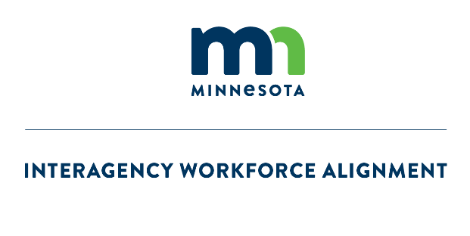
Definition: Alignment Strategy Framework
Overall vision for the alignment work providing context and inspiration
Alignment Vision
High level outcomes all workgroups are working towards
Alignment Goals
Alignment Components
Individual items the workgroups consider when analyzing the workforce programs across agencies
Notes:
There are 3 primary pieces of the framework.
• The ALIGNMENT VISION provides the context and inspiration for the work. What is the long-term, golden castle on the hill we are building. It is what we would use as a definition if asked what we mean by alignment.
• The ALIGNMENT GOALS are the high-level outcomes all the workgroups are working towards. This is beyond the vacancy rate of course. There must be other goals. Other ways we are looking at success in this work.
• ALIGNMENT COMPONENTS are the individual items the workgroups will analyze when looking at the workforce programs. These may change, but we want to give them some guidance on those that are most important. What are the ones you want to prioritize?

Slide 12
Alignment Strategy Framework
    Vision for Alignment
    Alignment means that while state agencies operate independently, our efforts are intentionally moving in the same direction: building a more coordinated, effective, and equitable workforce development and support systems that meet the needs of all Minnesotans.
    Alignment Goals - These are the high-level outcomes (beyond the vacancy rate) all workgroups are working toward:
    Mutual awareness of workforce development programs and resources between agencies
    Minimize redundancies between workforce development programs and resources
    Common metrics and tracking of objectives
    Aligned messaging around workforce development goals
    Alignment Components– These are what the workgroups will look at when analyzing the workforce programs across agencies. They may look at other areas, but at a minimum they must consider these in their work:
    Reporting Requirements
    External Communications
    Grant application processes
    Internal Communications
    Policy alignment
    Tools and Resources (databases, forms, calendars etc. utilized to operate the programs)

Slide 13
Update on the MN Inventory of Workforce Supports and Shared Outcomes pilot
MN Inventory of Workforce Supports
Added additional agencies, so currently includes 8 agencies (MDE, DEED, DHS, DLI, OHE, DCYF, MDH, PELSB)
Beginning piloting of the MIWS within the Enterprise to support use of tool
Planning for continued expansion, maintenance, and identifying a permanent home for the inventory
Shared Outcomes Pilot
Purpose is to explore the feasibility of developing shared outcomes metrics across participating pilot programs
Pilot is focused on workforce development programs that support overlooked workers
  Overlooked workers are those from groups with high unemployment and low labor force participation as compared to state averages
Includes 6 programs from 4 agencies (DEED, OHE, DLI, MDE)

Slide 14

IWA/GWDB Committee Updates

Slide 15
NOW, NEAR, FAR
Now
Near
Far
0-6 MONTHS
July 1, 2025 – Dec. 31, 2025
6 Mos – 1 Yr
Jan. 1, 2026 – June 30, 2026
1 YEAR +
July 1, 2026, & Beyond
Description:
The timeframes refer to when the recommendations would be completed by the committees and submitted to the appropriate board and/or taskforce for action.
Notes:
All of the committees will be using a KanBan technique for planning called Now, Near, Far (sometimes also called Now, Next, Later). This prioritizes items more easily and allows groups to quickly move to action planning.
For the IWA committees and workgroups, the timeframes refer to when actions/goals are happening or when the recommendations will be completed and submitted to the appropriate board and/or taskforce for action.
So for the Caring Professions and Education committees, when would the recommendations come to the GWDB to be considered.

Slide 16
IWA/GWDB Caring Professions

Slide 17
Areas of Focus and Charge
IWA/GWDB Caring Professions Committee
  IWA/GWDB Caring Professions Committee Area of Focus:
  Public and private programs in the long-term care profession focused on retention efforts, decreasing turnover, and increasing the recruitment of new talent (specifically from populations previously underutilized in the industry).
The charge is to:
Identify and recommend strategies for strengthening alignment across the state between public and private programs in the long-term care profession which focus on retaining staff, decreasing turnover and increasing the recruitment of new talent from populations previously underutilized in the industry.
Develop a process to identify successful emerging practices and programs to accelerate and scale.
Identify and recommend communication strategies to:
  Elevate the importance of the industry and professions to stakeholders, policy makers and the general public.
  Inform students and families about workforce initiatives which support the long-term care industry, its funding, and programs.
  Relevant organizations about long-term care workforce initiatives, funding, and programs.
Recommendations of this Committee will be forwarded for further action to the IWA Taskforce, and the full Governor’s Workforce Development Board.
Notes:
The IWA/GWDB Caring Professions Area of Focus and Charge has been edited and adopted by the group.

Slide 18




IWA/GWDB Caring Profession Sub-Committee Structure
IWA/GWDB Caring Professions Committee
Programming:
Collection
Evaluation/Metrics
Best Practices
Systems:
Identify Issues
Recommendations
Prioritization
Communication:
Elevate Profession
Inform on Workforce Initiatives
    Programming: Review private and public workforce development programming, identify and elevate best practices (metrics etc), address duplication etc.
    Systems: Determine the policy and systemic issues within LTC workforce, create recommendations for changes, prioritize short term and long-term, impact-effort
    Communication: Recommend opportunities to elevate the industry, inform students, parents, communities, elected officials and relevant organizations about workforce initiatives and career pathways.
Notes:
This is a graphic representation of the sub-committee committee structure showing the 3 different groups and their primary focus.
A survey was sent out to committee members after the meeting asking them to rank their sub-committee preferences. It also allowed them to indicate if they were interested in a leadership role on any of the sub-committees.
There is a one-day in person intensive scheduled for August 5th with all members of the committee to establish action plans for all of the sub-committees.

Slide 19
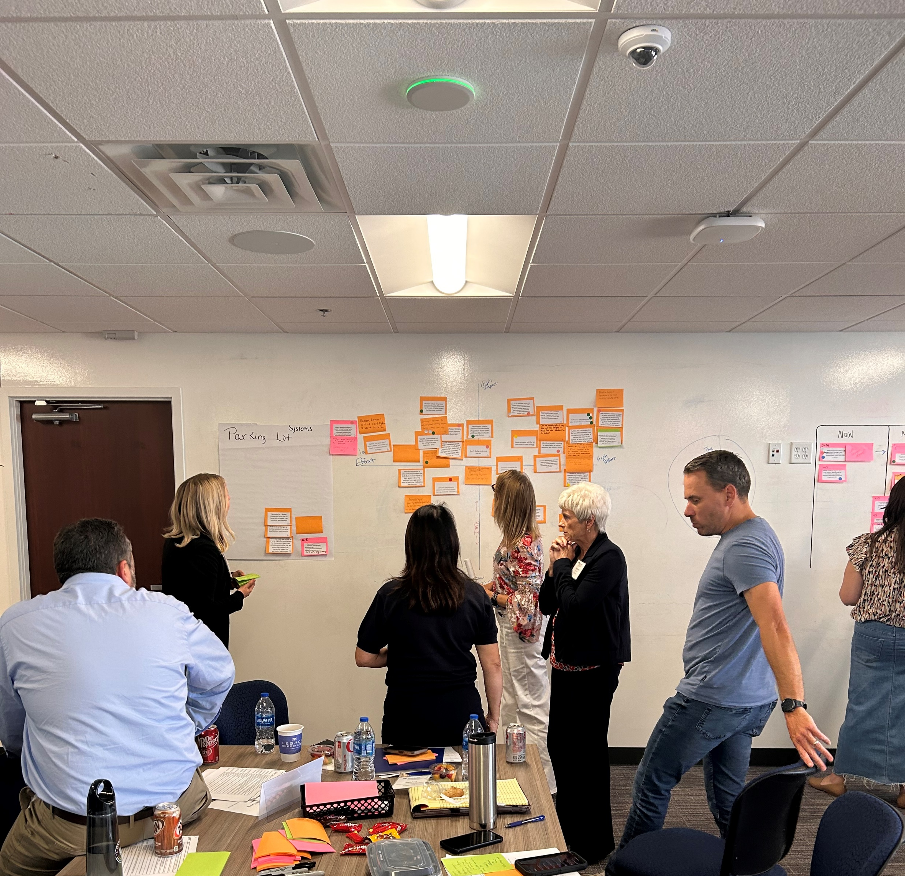
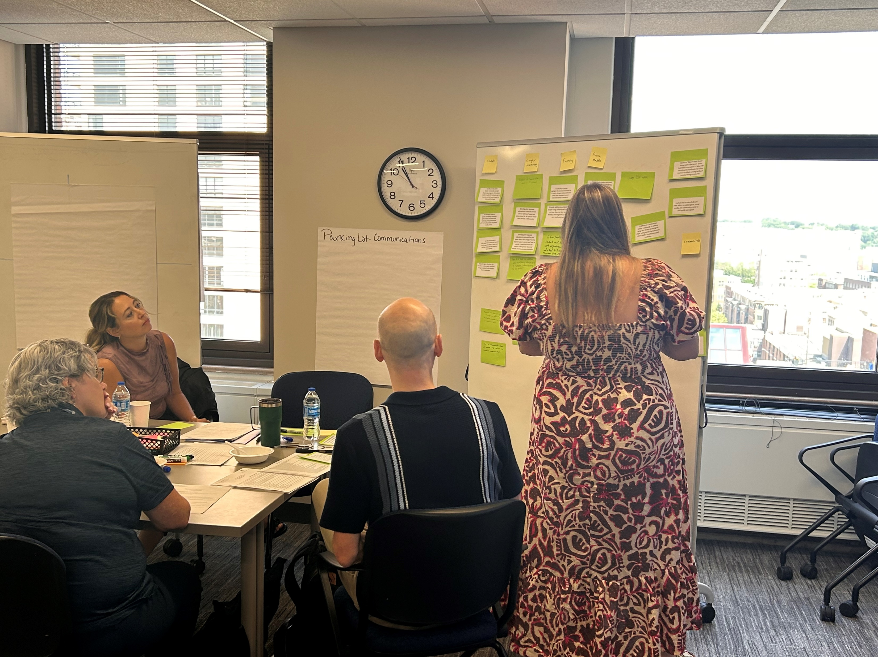
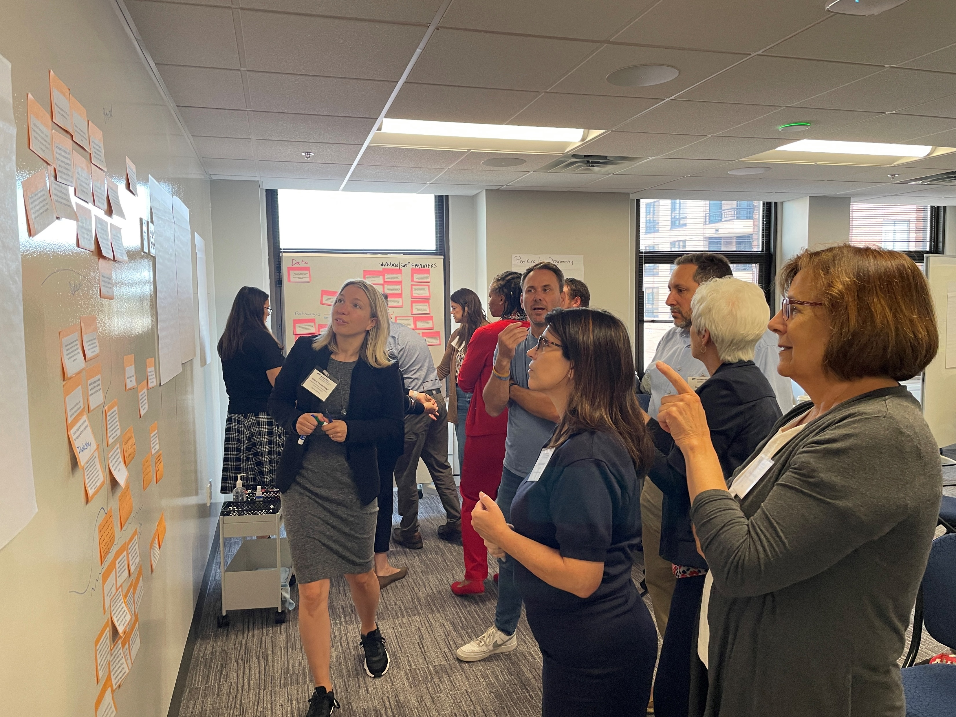
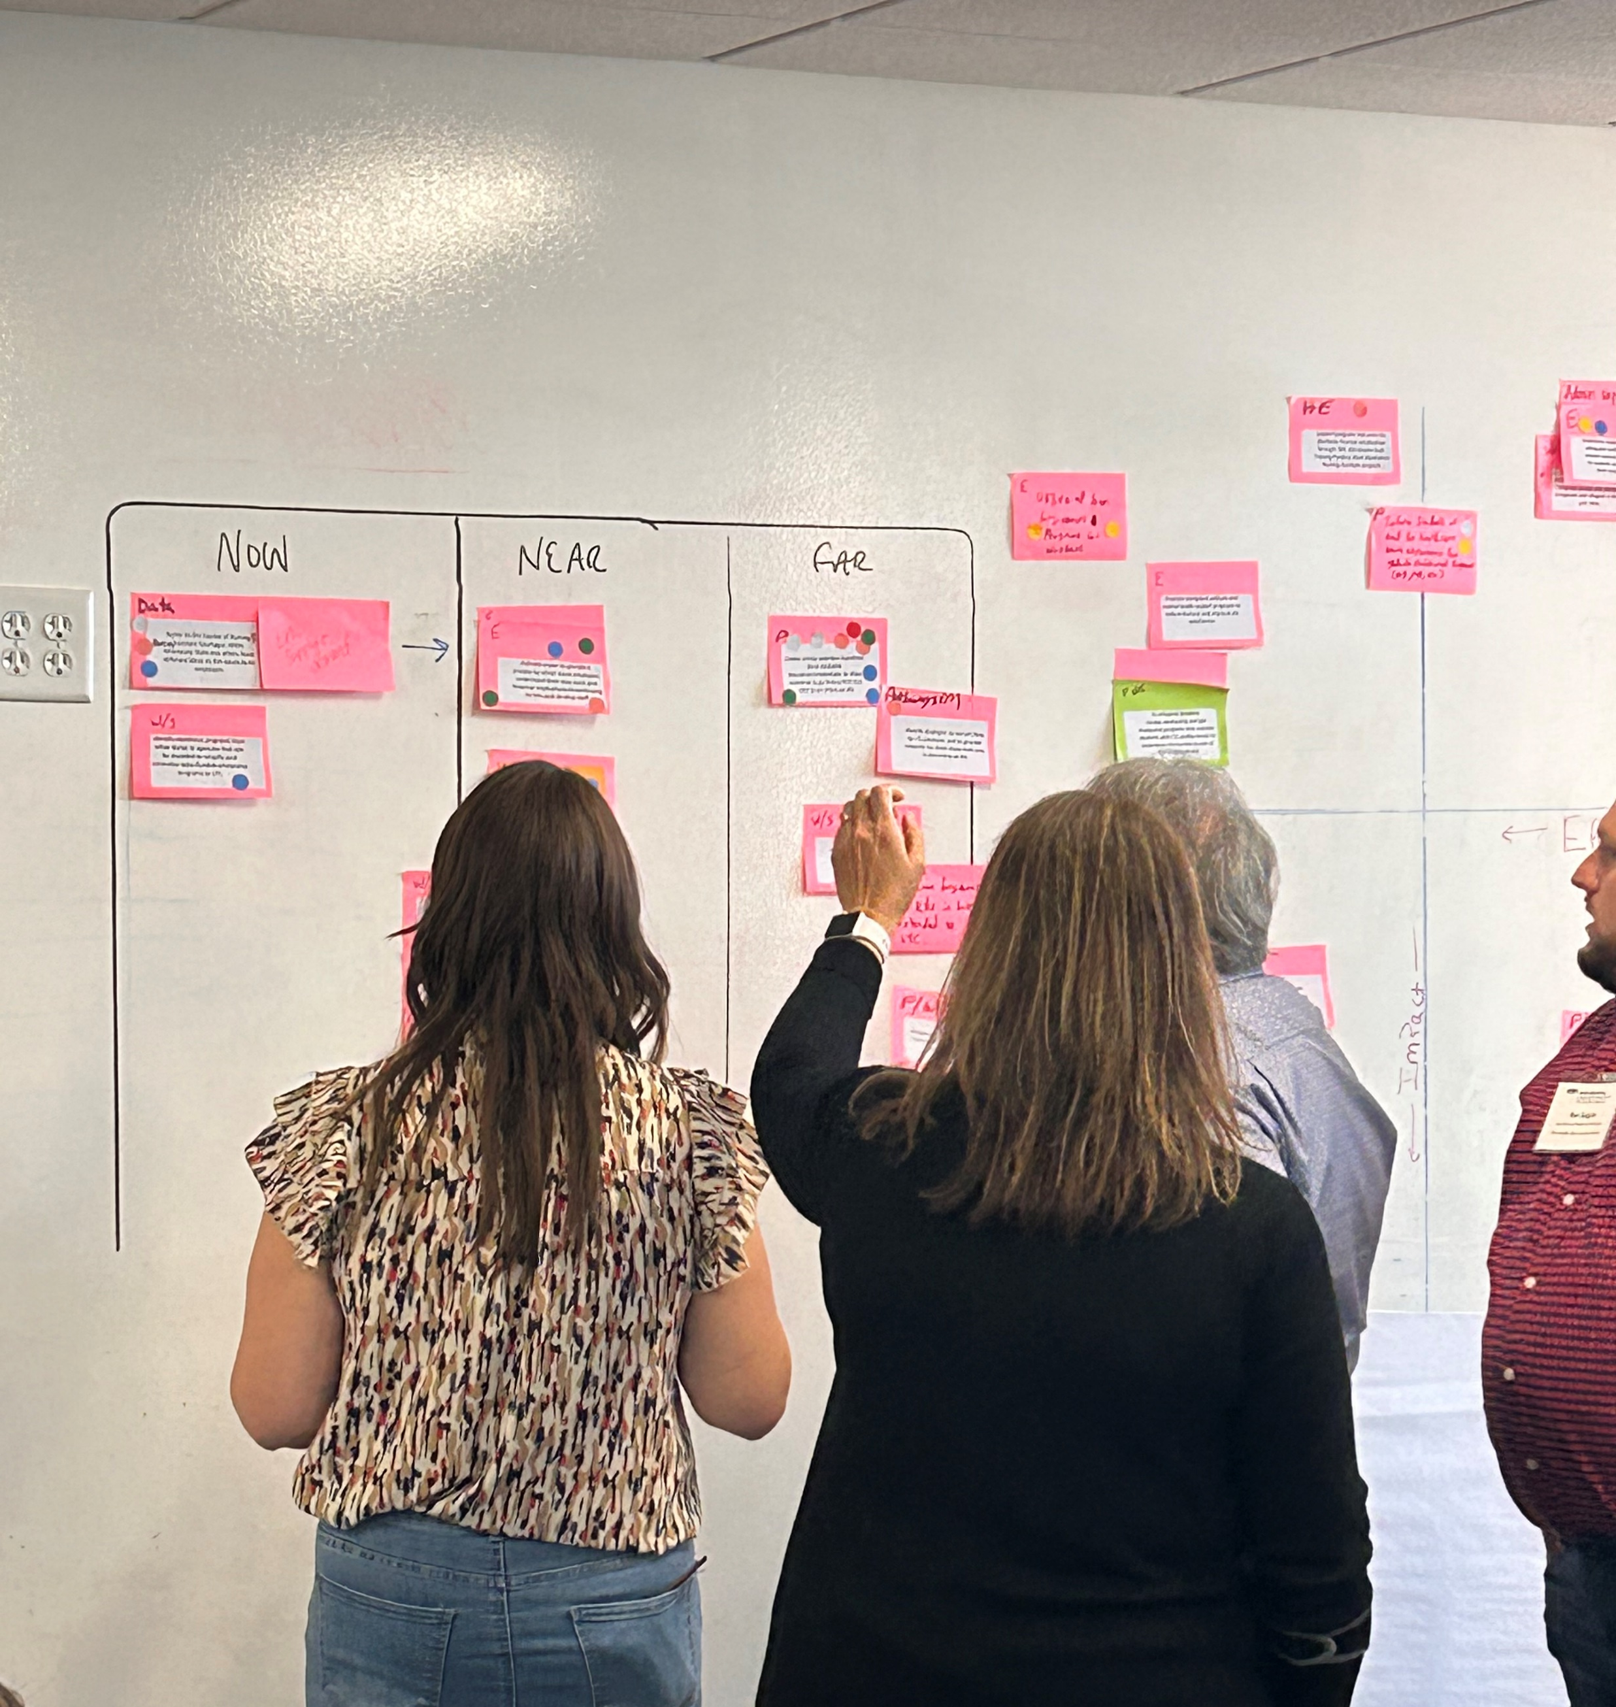
August 5th Caring Professions Intensive
Committee members first sorted the brainstormed ideas sent in for each sub-committee.
Then they used the Impact-Effort Matrix to prioritize them.
They then created their workplan using the Now, Near, Far methodology.
Finally, they created an Action Plan for their highest priority item, as voted on by the full committee.

Slide 20
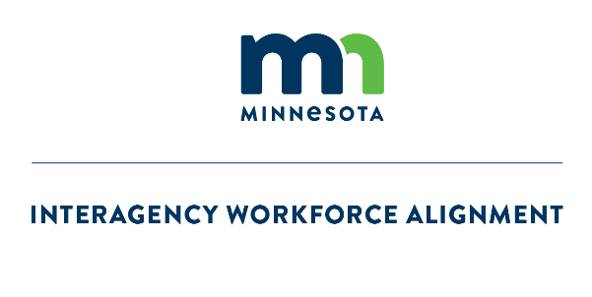

IWA / GWDB/ MNP20 Education
Committee

Slide 21
Areas of Focus and Committee Charge
IWA/GWDB/MNP20 Committee on Educator Workforce
  Align internal and external educator workforce initiatives
The charge of the GWDB-MNP20 Committee on Educator Workforce is to:
Identify and recommend strategies for strengthening alignment between educator workforce efforts and across the state
Identify and recommend metrics to be used in determining successful emerging practices and programs to accelerate and scale
Identify and recommend strategies to increase communication:
A. To students and families about educator workforce initiatives, funding, and programs
B. To and between relevant organizations about educator workforce initiatives, funding, and programs
Recommendations of this Committee will be forwarded for further action to the IWA Taskforce, full Governor’s Workforce Development Board and to the Minnesota P-20 Education Partnership.

Slide 22
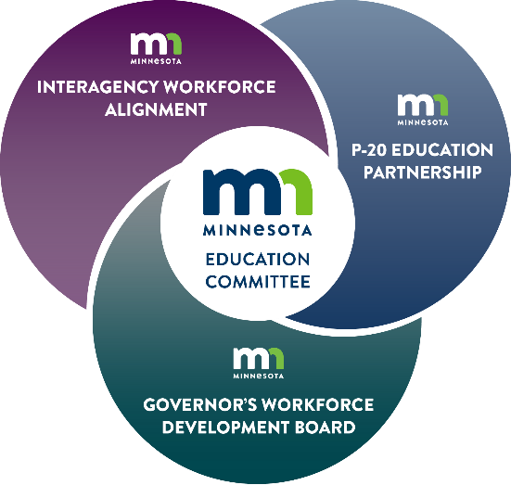

Sub-Committee Structure
Grow & Thrive Sub-Committee
Diversity, Equity and Inclusion and Retention
Notes:
The Educator’s Journey was used as the basis for the sub-committee structure with one small change. The sub-committees will be EXPLORE, BECOME and a combined GROW AND THRIVE. The Educator’s Journey is described as follows:
Explore - Increase awareness and interest in education careers among a diverse range of individuals through recruitment initiatives such as marketing campaigns. Providing clear messaging to help individuals see teaching as a viable and meaningful career path, especially for underrepresented groups.
Become - Preparing teachers through diverse and accessible pathways, ensuring that all teachers are equipped to serve a broad range of students. Emphasizing the importance of multiple quality licensure pathways, and eliminating barriers such as financial and institutional obstacles to becoming a licensed teacher.
Grow - Supporting the successful early years of teaching by providing comprehensive induction programs, offering mentorship at all schools, facilitating professional development for new licensure fields, and ensuring a seamless transition from “Become” with the ultimate goals of increasing new teachers' preparedness and reducing attrition rates.
Thrive - Creating a supportive and equitable learning and working environment for educators, where they are valued, have what they need to succeed, and are empowered through teacher leadership opportunities to support the growth of other teachers.
Each sub-committee will concentrate on the workforce programs in their part of the educator’s journey.

Slide 23

Sub-Committee Structure
Explore: Focused on how we recruit to the teaching profession and all that entails (not just young people but all ages).
Become: Looking at the variety of ways to prepare teachers, the best practices and the leakages from the programs, the Big P and little p policy issues around licensure.
Grow & Thrive: Concerned with keeping teachers during those first few years and beyond. Will look into what is done for those who stay in the profession to address burnout, professional development, leadership growth etc.
All Sub-Committees Must Consider Implications for All Levels of P-20:
Early Childhood
K-12
Post-Secondary
Notes:
In addition, each sub-committee must also:
Include DEI in their thinking
Look at retention both in terms of who do they lose along the way and who do they retain
Implications for all levels of P-20 from Early Childhood and K-12 as well as the role Post-Secondary plays and
The sub-committees have been formed and are up and running. Additional members have been added to a few of the groups in order to round out the membership and add different perspectives.

Slide 24
State and Federal Legislative Update
Nathan Ratner | DEED Government Relations
Katie McClelland | GWDB Executive Director

Slide 25
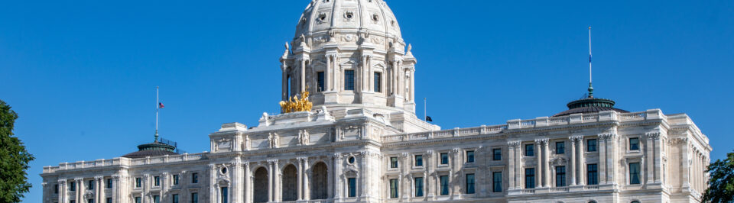
State Legislative Updates
Department of Employment & Economic Development (DEED)
Nathan Ratner | DEED Government Affairs

Slide 26
DEED End of 2025 Session Overview
The Jobs and Economic Development omnibus bill was negotiated after the end of the regular session and passed in special session
The final global target for Jobs and Economic Development set out a $30 million reduction in FY26-27 and a $40 million reduction in FY28-29 for DEED
Despite these limitations, several critical programs were appropriated funding for the 26-27 biennium. Drive for 5 was appropriated $6M each year
There were also several policy provisions included in the omnibus bill.
The Jobs bill passed in the Senate 40-27. The Jobs bill passed in the House 96-37

Slide 27
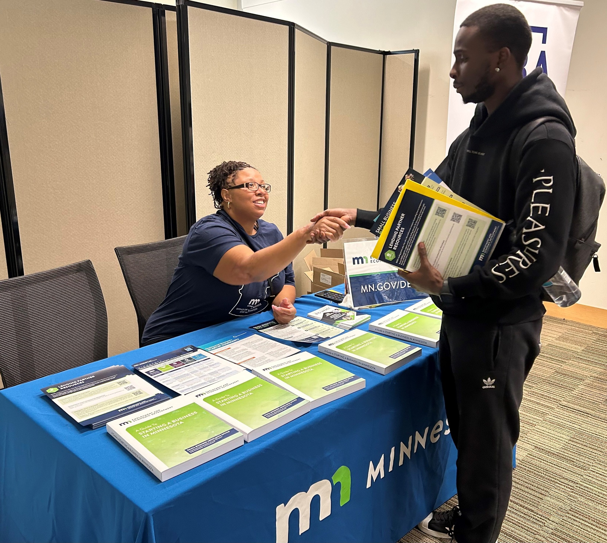
Drive for 5 Initiative
The Legislature approved $6,000,000 annually in FY 2026-27 from the Workforce Development Fund for the Drive for 5 Initiative.
Drive for 5 addresses the state’s job vacancy challenge and prepares a workforce for high-growth careers with family-sustaining wages in five key sectors: (1) technology, (2) trades, (3) caring professions, (4) manufacturing, and (5) educational and professional services.
Funding will be used for:
  Competitive Grants for Workforce Development Organizations ($3.375 million/yr).
  Competitive Grants for Trade Associations for Job Placement ($1.5 million/yr).
  Employer Engagement Team ($1.125 million/yr).

Slide 28
Drive for 5 Workforce Initiative
Drive for 5 competitive grants for workforce development organizations have established and innovative approaches to training, reskilling, and building career pathways for key industry sectors.
Drive for 5 competitive grants for Trade Associations have ensured that workforce training efforts are aligned with employer demands and connect graduates with businesses looking to hire.
The Drive for 5 Employer Engagement Team works throughout local workforce development areas to assist with addressing the hiring needs of Minnesota’s businesses through direct connection to job seekers and program participants in the CareerForce system.

Slide 29

Service to Success Initiative
The Legislature approved $1,000,000/yr in FY 2026-27 and $500,000/yr ongoing from the General Fund for the Service to Success Initiative.
Funding for the Service to Success Initiative will be used in three ways:
  $200,000 each year to establish the Office of Public Service to lead the Service to Success Initiative.
  $50,000 each year is to support career pathways development in partnership with the Minnesota Department of Education (MDE).
  $750,000 each year for grants to expand recruitment, retention, and completion of public service opportunities.

Slide 30
Service to Success Initiative
There are thousands of public service opportunities available to Minnesotans every year, yet the wide variety of programs and positions lack coordination and awareness.
Service to Success targets existing gaps in public service, including:
  Lack of career pathways for individuals leaving public service programs into relevant careers, including public service careers, and alignment to further educational opportunities;
  Lack of overall strategy for state investments across agencies into public service programs;
  Lack of alignment across agencies in how to best use public service programs to align with education and workforce development initiatives in key areas of focus.

Slide 31
Office of Public Service
The Office of Public Service will:
  Support the development of career pathways for individuals leaving public service programs into relevant careers;
  Develop an overarching strategy for state investments across agencies into public service programs; and
  Coordinate across agencies in how to best use public service and align to education and workforce development initiatives for key areas of focus (health care, education, etc.).

Slide 32
Budget Neutral Recommendations

Slide 33
GWDB Board Membership Policy Changes
Section 13 of the bill – Modifies membership language to ensure compliance with underlying federal legislation and WIOA Combined State Plan goals, including:
Moves Department of Human Services to be a non-voting member. Change resulting from WIOA Combined Plan programs moving to Department of Children, Families and Youth (DCYF) – DCYF’s Commissioner became a voting member last legislative session
Moves the Minnesota Association of Workforce Boards to a voting member

Slide 34
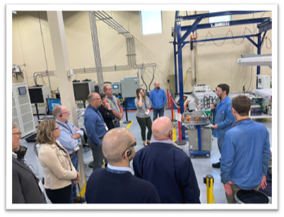
Minnesota Forward Fund Modifications
The Minnesota Forward Fund FY 2024 appropriation was amended to: (1) be available until spent and (2) remove the requirement that funds must be used as matching funds required by federal programs.
The Minnesota Forward Fund has positioned Minnesota to compete for and win large investments that are occurring as the United States works to create domestic production and supply chains that are resilient for economic security and economic enhancement opportunities.
With the change, the Minnesota Forward Fund will be better situated to help Minnesota compete for business expansion and attraction projects in response to a changing economic development and federal funding landscape.
Notes:
Matt speaks – provides an overview
Good morning and thank you for this opportunity to present DEED’s capital budget requests today.
These request represent what we believe will be required to meet the current pipeline of demand for these programs until FY26 (the next regular bonding year).
Summary
DEED’s Capital Budget requests are focused on ensuring Minnesota communities have the resources they need to support economic development, business growth, and job creation and retention.
DEED’s capital budget request includes:
Business Development Public Infrastructure grant program (BDPI) - $8 million
Transportation Economic Development Infrastructure grant program (TEDI) - $5 million
Innovative Business Development Public Infrastructure grant program (IBDPI) - $2 million
Funding for the Administration of Local Grants - formula
Together, the three grant programs – [Greater Minnesota] Business Development Public Infrastructure (BDPI), Innovative Business Development Public Infrastructure (IBDPI) and Transportation Economic Development Infrastructure (TEDI) – provide communities with financial assistance for public infrastructure and transportation needed to support business development, expansions, or relocations, and economic development more broadly.
These programs assist communities by lowering development costs, resulting in opportunities to create or retain jobs, leverage private investment, and expand their local tax base.
How DEED arrived at these amounts:
Past demand and projected future needs informed these budget requests. Our requests were developed based the expected demand for these programs and discussions with our local government partners to determine the right amount of funding to advance DEED’s goal of ensuring businesses are globally competitive and locally engaged in their communities.
Turn the next slides over to Meredith

Slide 35
Minnesota Job Skills Partnership Modifications
The Legislature modified to the Minnesota Job Skills Partnership (MJSP) Pathways and Partnership Programs to allow larger maximum grant awards and to allow training providers to request market rates for training.
The MJSP Pathways and Partnership Programs help promote economic development by providing businesses with the training they need to remain competitive, develop capacity at our Minnesota educational institutions, and provide workers with economic opportunity by training them in in-demand skills.
The change will result in higher quality project proposals as well as greater demand for MJSP programs.
Notes:
Matt speaks – provides an overview
Good morning and thank you for this opportunity to present DEED’s capital budget requests today.
These request represent what we believe will be required to meet the current pipeline of demand for these programs until FY26 (the next regular bonding year).
Summary
DEED’s Capital Budget requests are focused on ensuring Minnesota communities have the resources they need to support economic development, business growth, and job creation and retention.
DEED’s capital budget request includes:
Business Development Public Infrastructure grant program (BDPI) - $8 million
Transportation Economic Development Infrastructure grant program (TEDI) - $5 million
Innovative Business Development Public Infrastructure grant program (IBDPI) - $2 million
Funding for the Administration of Local Grants - formula
Together, the three grant programs – [Greater Minnesota] Business Development Public Infrastructure (BDPI), Innovative Business Development Public Infrastructure (IBDPI) and Transportation Economic Development Infrastructure (TEDI) – provide communities with financial assistance for public infrastructure and transportation needed to support business development, expansions, or relocations, and economic development more broadly.
These programs assist communities by lowering development costs, resulting in opportunities to create or retain jobs, leverage private investment, and expand their local tax base.
How DEED arrived at these amounts:
Past demand and projected future needs informed these budget requests. Our requests were developed based the expected demand for these programs and discussions with our local government partners to determine the right amount of funding to advance DEED’s goal of ensuring businesses are globally competitive and locally engaged in their communities.
Turn the next slides over to Meredith

Slide 36
Updating Workforce Program Outcomes Measures
The Legislature modified the definition of credential to allow for non-postsecondary credentials under Minn. Stat. § 116L.98, subd. 2.
Certificates offered from private training providers, such as welding and Commercial Driver’s License training, coding boot camps, provide accessible pathways to high wage, in-demand careers do not get counted as credentials under the current definition. The proposal refines evaluation of workforce development programs to accurately reflect their impact.
Notes:
Matt speaks – provides an overview
Good morning and thank you for this opportunity to present DEED’s capital budget requests today.
These request represent what we believe will be required to meet the current pipeline of demand for these programs until FY26 (the next regular bonding year).
Summary
DEED’s Capital Budget requests are focused on ensuring Minnesota communities have the resources they need to support economic development, business growth, and job creation and retention.
DEED’s capital budget request includes:
Business Development Public Infrastructure grant program (BDPI) - $8 million
Transportation Economic Development Infrastructure grant program (TEDI) - $5 million
Innovative Business Development Public Infrastructure grant program (IBDPI) - $2 million
Funding for the Administration of Local Grants - formula
Together, the three grant programs – [Greater Minnesota] Business Development Public Infrastructure (BDPI), Innovative Business Development Public Infrastructure (IBDPI) and Transportation Economic Development Infrastructure (TEDI) – provide communities with financial assistance for public infrastructure and transportation needed to support business development, expansions, or relocations, and economic development more broadly.
These programs assist communities by lowering development costs, resulting in opportunities to create or retain jobs, leverage private investment, and expand their local tax base.
How DEED arrived at these amounts:
Past demand and projected future needs informed these budget requests. Our requests were developed based the expected demand for these programs and discussions with our local government partners to determine the right amount of funding to advance DEED’s goal of ensuring businesses are globally competitive and locally engaged in their communities.
Turn the next slides over to Meredith

Slide 37
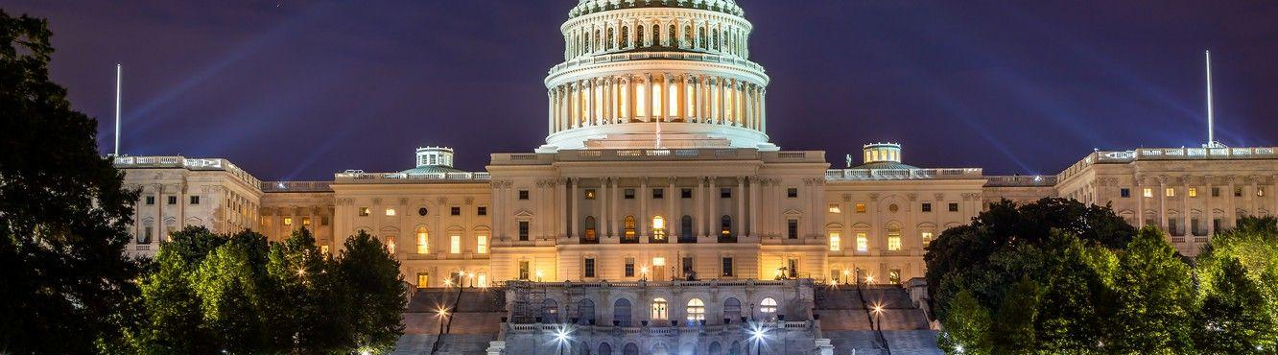
Federal Workforce Development Updates
Katie McClelland | GWDB Executive Director

Slide 38
Workforce Development Federal Funding Land
Passed Into Law:
Reconciliation Package
Recissions Package
2025 Continuing Appropriations& Extensions Act
Make America Skilled Again (MASA) Proposal
WIOA Reauthorization Proposal
Fiscal Year 2026 Appropriations Acts
H.R. 1
President’s FY 2026 US DOL Budget Proposal
A Stronger Workforce For America Act
H.R. 4
Proposals Not Yet Passed Into Law:

Slide 39
Federal Actions Moving Forward
Reconciliation Package
Workforce Pell Grants
Recissions Package
No direct impact to workforce system
Cuts impacted public television, radio and foreign aid
Indirect impact through SNAP and Medicaid Work Requirements

Slide 40
Federal Actions on Hold
Federally Authorized Legislation
FY 2025 Appropriations Act
Job Corps Program
Federal Guidance/Notices
DOJ, HHS, ED: Personal Responsibility & Work Opportunity Reconciliation Act, 90 Fed. Reg. 32,023
DOL: Training and Employment Guidance Letter (TEGL) No. 10-23, Change 2; TEGL 08-21
IAA Between DOL and ED on Perkins CTE and Adult Ed Oversight

Slide 41
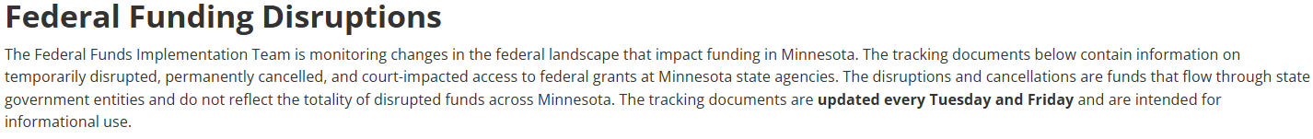
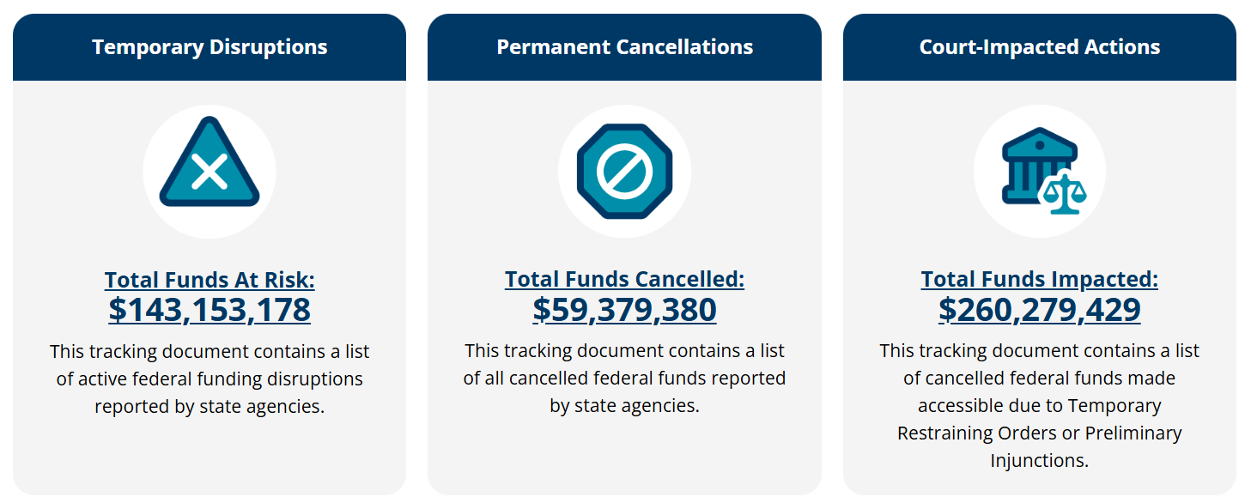
Tracking Federal Funding Uncertainty in Minnesota
Source: Federal Funds Implementation/Data and Reporting
Data as of 8/5/25

Slide 42
Workforce Development Proposals
A Stronger Workforce for America Act (ASWAA)
Required review of LWDAs
50% Training Requirement, with 8% for supportive services
Make America Skilled Again (MASA) Budget Proposal
Shifts decision making authority at all levels of the workforce system
~24% budget cut to workforce programs, shifting to state block grant by streamlining or eliminates federal workforce programs
Simplifies IFAs, Expands One Stop Operators
Changes to accountability - for local outcomes
Increased state reservation/set-aside for “Critical Industry Skills Fund” or “Industry/Sector Partnership/Career Pathways Development Fund”
Focuses narrowly on short-term employment outcomes
Notes:
Shifts power away from WDBs toward individuals and employers: Proposes training vouchers that reduce the role of boards in determining service delivery models and provider eligibility.
Streamlines or eliminates federal workforce programs: Would consolidate programs, reducing administrative burden but also potentially shrinking resources for board-led planning and oversight.
Reduces federal oversight and mandates: Gives states more leeway to design workforce systems without required local board structures or planning processes — possibly diminishing WDB influence.
Focuses narrowly on short-term employment outcomes: Moves away from broader measures like skills gains or training completion, which may deprioritize local board strategies focused on long-term career pathways.

Slide 43
Expanded SNAP Work Requirements
Expands work requirements for adults without dependents from age 18 to 54 to age 18 to 64, and applies these requirements to families with children, exempting only adults with children under age 14.
Roughly 29,000 Minnesota adults currently in SNAP could be newly-subject to the SNAP work requirements.
Impacted adults will only qualify for 3 months of SNAP if they don’t comply with the work requirements or meet an exemption.
Removes current exemptions for veterans, people experiencing homelessness, and youth aging out of foster care.
Adds new exemptions for American Indians, Alaska Natives, Urban Indians, and California Indians.

Slide 44
Workforce Pell Grants – Purpose & Program Basics
*As enacted through the Congressional Reconciliation Package signed into law on July 4, 2025
Purpose:
  Increase access to in-demand, career-aligned education and training
  Support learners pursuing credentials that lead to good-paying jobs without requiring a traditional 2- or 4-year degree
Eligible Programs Must:
  Be between 150-599 clock hours and 8-15 weeks in length
  Be title IV-eligible and accredited
  Have been offered for at least 1 year by the institution
  Submit and meet annual accountability metrics to stay eligible
Notes:
Katie

Slide 45
Workforce Pell Grants – Purpose & Program Basics
Governors, in consultation with state workforce boards, will determine program eligibility using this criteria:
  Aligned with high-skill, high-wage, or in-demand sectors
  Meets employer hiring needs
  Leads to either:
    A stackable, portable credential, OR
    A single recognized credential that prepares students for direct employer
  Provides clear pathways to further education, including:
    Academic credit transferability toward a certificate or degree
Notes:
Katie

Slide 46
Workforce Pell Grants – Implementation Timeline
Goes into effect July 1, 2026, for the 2026-27 academic year
U.S. Department of Education will likely hold negotiated rulemaking on further specifics and implementation of Workforce Pell
In the meantime, Minnesota will need to:
  Identify in-demand occupations and align with short-term programs
  Develop process for Governor and GWDB to determine eligibility
  Identify approved programs and work with local workforce development boards and higher education partners for implementation
Notes:
Kevion

Slide 47


Workforce Pell Grants – Implementation Timeline
Fed Responsibilities
(U.S. Department of Education)
State Responsibilities
(Governor/GWDB)
Now until Nov. 1, 2025
Conduct Negotiated rulemaking
Now – Mid 2026
Identify in-demand occupations and align short-term programs
Late 2025
Issue final rule and provide implementation guidance
Mid 2026
Develop process for Governor and State Board program eligibility & agency program approvals
By July 1, 2026
Workforce Pell program launch for award year 2026-2027
By July 1, 2026
Submit approved programs and prepared for program launch
Notes:
Kevion

Slide 48

Time for Lunch!

Slide 49
Board Operations Updates
Nolan Thomas, GWDB Engagement Specialist

Slide 50
Bylaws Update Full Timeline
Thurs. 31 July
Wed. 15 Oct.
Full Task Force Wrap-Up Meeting
Full Taskforce Group Discussion
Tue. 24 July
Initial Edits Due
Wed. 2 Jul
Form submission due and initial language from GWDB Staff
Wed. 13 Aug.
Discussion at Full GWDB Meeting
Wed. 12 Nov.
Present Final Draft to Full Board
Present bylaws revisions to the Governor's Office for approval
November

Slide 51
Why are we making changes now?
We must ensure compliance – must be reviewed every 5 years.
Changes have been made to the board's structure and strategies.
The Minnesota statutes § 116L.665, governing the GWDB, has been updated.
The economic and legislative landscape is quickly evolving.
There are opportunities to streamline and modernize board operations.

Slide 52
Section 1: Pre-Articles
Authority, Vision & Mission, Membership, Meetings, Funding
Proposed Updates to Bylaws:
Meeting Cadence
Clarifying that quarterly meetings are the statutory minimum. The board may meet more frequently if desired, through policy rather than changing the bylaws.
Funding Section*
Proposing clarifying statutory language that the existing state statutory $350,000 GWDB funding requirement refers to existing agency funds and new legislative language authorizing the GWDB to pursue discretionary grants.
Executive Committee Oversight
Adds a requirement for quarterly budget updates to the Executive Committee.

Slide 53
Section 2: Articles I–IV
Board Name, Purpose, Legal Authority, Four Core Functions
Proposed Updates to Bylaws:
Discretionary Functions
A new paragraph allows the board to consult external experts, seek non-formula grants, and coordinate with state and regional economic development efforts.
Sector Strategies
The language now prioritizes “identified sector partnerships” to reflect current statewide strategy, while leaving flexibility for future shifts.
Local Board Feedback Loop
Added a sentence committing to regular two-way communication between the state board and local workforce boards to support better alignment.

Slide 54
Section 3: Articles V–VI
Membership Terms, Attendance, Officer Roles, Reimbursement
Proposed Updates to Bylaws:
Removal Criteria
Replacing the “miss one meeting” rule with a more practical attendance threshold—such as 75% participation—with a clause for conduct unbecoming. The new approach allows for discretion around emergencies and virtual participation.
Board Size
Reviewing membership categories while ensuring the board meets federal representation requirements (largest board in the country with ~60 members as compared to an average of 33).
Reimbursement Policy
Clarifying that virtual participation qualifies for the standard per diem, but not for mileage or lodging reimbursement.

Slide 55
Section 4: Articles VII–IX
Meetings, Public Access, Quorum, Voting, Commissioner Designees
Proposed Updates to Bylaws:
Meeting Modality
Allow hybrid or virtual meetings in accordance with Minnesota Open Meeting Law. This ensures compliance and makes it easier for rural members to participate fully.
Commissioner Designees
Clarifying that only deputy or assistant commissioners listed in writing may vote on a commissioner’s behalf. Other attendees may join as observers but will not have voting rights.

Slide 56
Section 5: Articles X–XIII
Committee Structure, Executive Committee, Amendments, Robert’s Rules
Proposed Updates to Bylaws:
Standing Committee Cap
A cap of five standing committees is proposed. Task forces or ad hoc groups would handle any additional work to keep things focused and manageable.
Committee Charters
Each standing committee would be required to have a board-approved charter, including its purpose, membership, and a sunset review every two years.
Committee Chair Selection
Committee members would elect their own chair and vice chair, with final ratification by the full board. This change is meant to increase engagement and leadership development.
Executive Committee Composition
Designating the at-large representative on the Executive Committee to formally become the MAWB representative, to strengthen ties with local boards.

Slide 57
Standing Committee Status Update
Sector Partnerships
State & Local Coordination
Innovative Service Delivery
Committee Chair: Misun Bormann (Mayo)
Sector Partnerships Stakeholder Convening on Tuesday, September 16, from 9:00 AM to 1:00 PM.
First Committee Meeting September 23, 1:30 – 2:30 pm
First Committee Meeting on September 19th
Standing Committee launched on July 23rd.
Currently developing recommendations on statewide sector strategies, job quality standards, and eligibility guidance for Workforce Pell grants.
Committee Chair: Rob Stark (Edward Jones); Committee Vice Chair: Cate Duin (MAWB)

Slide 58
Innovative Service Delivery: Stakeholders we are recruiting
Local Boards & Practitioners
Employers & Industry
Community Partners
Cross-Agency Partners
Data & Systems Experts
Contact Nolan Thomas if you are interested: nthomas@state.mn.us

Slide 59
Innovative Service Delivery: Key Updates & Next Steps
Acknowledgement
Thank you to the Board for your input during the Q2 brainstorming session — this shaped our early direction.
Key Themes from Brainstorming
Enhance use of workforce data (demographics, dashboards, forecasting)
Improve employer readiness & service accessibility
Leverage technology to connect employers, educators, and workers
Increase inclusion for underrepresented populations
Next Steps
September 19th 9:00-11:00am: Convene first committee meeting
Review purpose & charge; confirm focus areas/goals
Begin drafting KPIs based on Board input
Return to Board for endorsement before detailed plan development

Slide 60
Workforce Development System Overview, Goals and Priorities
Katie McClelland | GWDB Executive Director

Slide 61
GWDB Purpose
About the GWDB:
Employer-led board created out of federal and state statute
Who We Serve:
State agencies and local workforce boards
Workforce professionals
Employers and job seekers
~60 voting and non-voting members, 50% business voting members
Enterprise leadership, state& local elected officials, unions, education, and community-based organizations members
Continuing to "reimagine" the role and work of the GWDB
The Governor and State Legislature
The purpose of the State Workforce Development Board (WDB) is to convene State, regional, and local workforce system and partners, to—
Enhance the capacity and performance of the workforce development system;
Align and improve the outcomes and effectiveness of Federally-funded and other workforce programs and investments; and
Through these efforts, promote economic growth.
Engage public workforce system representatives, including businesses, education providers, economic development, labor representatives, and other stakeholders to help the workforce development system achieve the purpose of the Workforce Innovation and Opportunity Act (WIOA); and
Assist to achieve the State's strategic and operational vision and goals as outlined in the State Plan.
20 CFR 679.100

Slide 62
WIOA’s Charge for the State Board
The State board shall assist the Governor in—
The development, implementation, and modification of the WIOA State Plan
Review of statewide policies, programs, and development of recommendations on actions that should be taken by the state to align workforce development programs
Development and continuous improvement of the workforce development system, including review of local areas and regions
Development and updating of comprehensive state performance accountability measures
Identification and dissemination of information on best practices
Development and review of statewide policies affecting the coordinated provision of services through the one-stop delivery system
Development of strategies for technological improvements to facilitate access to, and improve the quality of, services and activities provided through the one-stop delivery system,
Development of strategies for aligning technology and data systems across one-stop partner programs to enhance service delivery
The development of allocation formulas for the distribution of funds to local areas
The preparation of the annual performance reports
Development of the statewide workforce and labor market information
The development of such other policies as may promote statewide objectives for, and enhance the performance of, the workforce development system
Sec. 101(d): State Workforce Development Board Functions
29 U.S. Code § 3111

Slide 63
Minnesota GWDB State Statute
Subd. 2a. Board meetings; chair.
Subd. 4. Executive committee duties.
The board shall hold regular in-person meetings at least quarterly and as often as necessary to perform the duties outlined in the statement of authority and the board's bylaws.
The executive committee must, with advice and input of local workforce boards and other stakeholders as appropriate, develop performance standards for the state workforce centers.
By January 15, 2019, and each odd-numbered year thereafter, the executive committee shall submit a report to the senate and house of representatives committees with jurisdiction over workforce development programs regarding the performance and outcomes of the workforce centers. The report must provide recommendations regarding workforce center funding levels and sources, program changes, and administrative changes.
116L.665 WORKFORCE DEVELOPMENT BOARD.

Slide 64
GWDB Statutory Charge & Committee Alignment
GWDB Committee | Statutory Charge
Executive Committee | Full Board strategic direction through agenda setting Bi-annual state legislative reports Funding levels, program changes, admin changes Performance standards for WF centers
Sector Partnerships Committee | Defining in-demand industry sectors & occupations, Defining and developing strategies for sector partnerships Strategies for effective outreach to individuals & employers Strategies for career pathway development and use
State & Local Coordination Committee | Review statewide policies & programs for system alignment & coordinated service delivery – including of CareerForce Centers State performance accountability measures Identification and review of regions and local areas
Innovative Service Delivery Committee | Technological improvements for access to & quality of CareerForce System Strategies to align technology and data across CareerForce partners to enhance service delivery Policies for coordination of services through CareerForce

Slide 65
What GWDB Doesn’t Do
Important guardrails to keep us strategic—not operational
State Workforce Development Boards
Operate programs day to day: Program execution is the responsibility of state agencies, local workforce boards, education and training providers, CBOs, etc.
Serve individual jobseekers or businesses directly: GWDB creates recommendations for system implementation; local boards and providers handle customer-facing delivery.
Conflict with statutory requirements: Each agency and program remains accountable to statutory requirements.

Slide 66
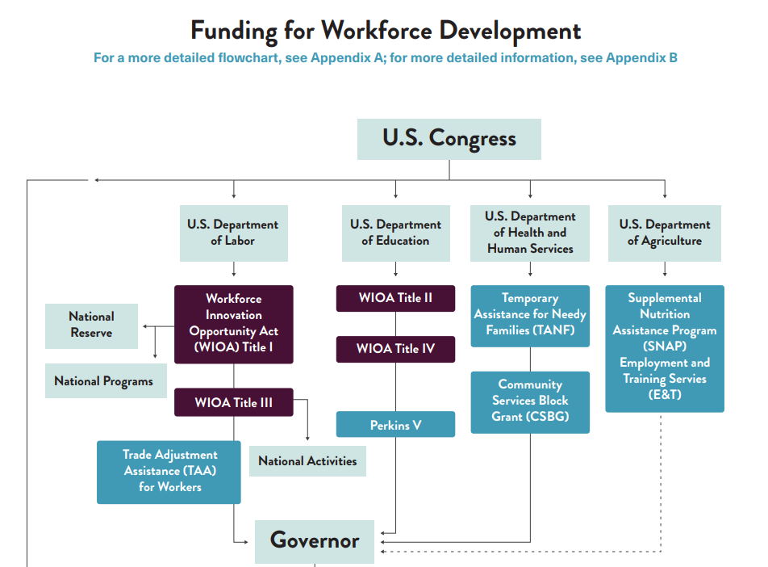
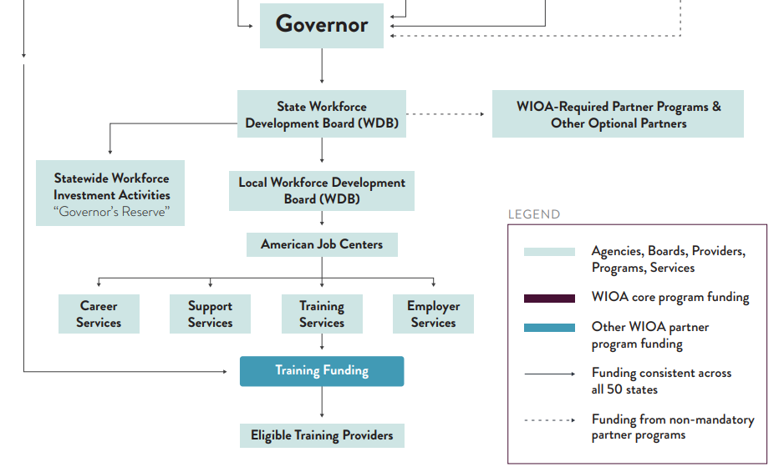
WIOA Combined Plan Funding Streams
Source: A Guide to the American Workforce System

Slide 67
From Federal to State: Flow of Funds
How WIOA Combined Plan Programs Move Through Minnesota
Title I: WIOA Adult, Dislocated Worker (DW), and Youth
U.S. DOL
DEED
Local Workforce Boards
CareerForce providers & partners
Title II: Adult Basic Education (ABE)
U.S. ED
MDE
Local ABE Consortia (districts, nonprofits)
Title III: Wagner-Peyser Employment Services
U.S. DOL
DEED
CareerForce employment service staff
Title IV: Vocational Rehabilitation Services
U.S. ED (RSA)
DEED (VRS/SSB)
Direct services + partnerships
Perkins V (CTE)
U.S. ED
Minnesota State + MDE
Secondary/ postsecondary CTE programs
TANF & SNAP E&T (Work Supports)
HHS & USDA
DCYF
County/local employment service providers

Slide 68
Federal
(funding + guardrails)
U.S. DOL – WIOA Titles I & III; Veterans (VETS)
U.S. ED – Perkins V (CTE) & Adult Ed oversight
HHS – TANF work programs
USDA – SNAP Employment & Training (E&T)
State
(strategy + program operations)
Governor / GWDB – statewide strategy, planning, coordination, Interagency Alignment
DEED:
DLI – Registered Apprenticeship (RAPs), workforce standards
MDE – K‑12 CTE; Adult Basic Education (ABE) policy & funding oversight
Minnesota State + OHE – postsecondary CTE, community/technical colleges; training & credentials
DHS – TANF/SNAP E&T alignment; wraparound services
DOC – reentry, work release, employer partnerships
DHS, MDH, MMB – workforce program partners
Regional & Local
(delivery + tailoring)
16 Local Workforce Development Boards (via MAWB) – strategy & oversight locally
Career Force locations & providers – day‑to‑day service delivery
Adult Basic Education consortia – foundational skills
County human services & city programs – case management, supports
Tribal governments & urban Indian orgs – sovereign and community‑based delivery
Employer & Community (demand + wraparound)
Employers & associations – sector partnerships (Drive‑for‑5, CHIPS coalition, local chambers, etc.)
Unions/JATCs – apprenticeship pathways
Nonprofits & intermediaries – job readiness, training, placement, retention
Economic development (Greater MSP, Great St. Cloud, Greater Mankato, APEX) – growth alignment, industry connections
Philanthropy – innovation pilots and gap funding
Transportation, housing, childcare, libraries – barrier removal & access
WIOA Titles I & III: Career Force system;
Labor Market Info;
Voc Rehab (VRS/SSB)
Veteran employment & training
CTE – middle & high school coursework & experiential learning, community college credentials
Higher ed – degrees and credentials through community and technical colleges and four-year institutions
System Map
Minnesota’s Workforce Development Network from 30,000 ft

Slide 69
DEED State‑Funded Supplemental Workforce Programs
Minnesota Legislature Base‑Funded Programs (How the State Fills WIOA’s Gaps)
Program | What Gap It Fills
State Dislocated Worker Program | Supports laid-off workers who don’t qualify for WIOA (e.g., short-tenure workers, certain industry layoffs, undocumented status) and allows faster response to mass layoffs
Youth at Work | Offers employment, career exposure, and wraparound supports for at-risk youth who may not meet WIOA youth eligibility or are ineligible due to documentation or family income
YouthBuild | Blends construction training, education, and support for out-of-school youth, often justice-involved or parenting—especially in communities of color and rural areas
Rural Career Counseling Coordination (RCCC) | Funds career counselors embedded in rural workforce areas to improve access and alignment for jobseekers and employers outside metro hubs
Braided Funding & Local Alignment
  →CareerForce centers may co-enroll individuals across multiple titles/programs
  →Local Workforce Development Boards manage braided funding streams based on participant needs
  →Performance data and cost-sharing are governed by local MOUs & partner agreements

Slide 70
DEED Competitive Workforce Initiatives (FY 26‑27 Biennium)
Other State Innovation & Pilot Grants
Program | What It Does
Pathways to Prosperity (P2P) | Accelerates adult career pathways for low‑income Minnesotans and communities of color—integrated basic skills + industry‑specific training + wraparound supports
Minnesota Job Skills Partnership (MJSP), Job Training Incentive Program (JTIP), Automation Training Incentive Program (ATIP) | Incumbent‑worker and new‑hire training customized to employer needs; funds college–industry partnerships statewide
Drive for 5 Workforce Fund* | Scale talent pipelines in health care, tech, manufacturing, education, trades—aligned with governor’s “Drive for 5” priorities
Transformative Career Pathways | Large‑scale, multi‑partner projects that create or expand high‑demand pathways—focus on equity and regional impact
Service to Success / Office of Public Service | Scholarships + paid work‑based learning to channel talent into public‑sector and critical public service jobs
Office of New Americans Integration Grants | Provides employment readiness, credentials evaluation, and small‑business support for immigrants & refugees

Slide 71
DLI Competitive Workforce Initiatives (FY 26‑27 Biennium)
Program | Agency | What It Does
Teacher Apprenticeship Program | DLI | $7M total for 'Grow Your Own' apprenticeship pathways through 2029
Building Trades Pathways | DLI | $500K to Virtual Academy, $800K for Building Strong Communities, $238K Helmets to Hardhats
Construction Worker Mental Health | DLI | $1M for mental health and suicide prevention in construction through 2029
Registered Apprenticeship Programs | DLI | Provides paid, on-the-job training and classroom instruction that leads to industry-recognized credentials in high-demand careers
Dual Training Pipeline | DLI | Supports employers with creating or enhancing competency based, earn-and-learn dual-training approach to meeting their workforce needs
Youth Skills Training Programs | DLI | $1.5M in funding for 17 partnerships to offer meaningful work experience in advanced manufacturing, agriculture, automotive, health care and information technology

Slide 72
MDE/OHE/DOC Competitive Workforce Initiatives
(FY 26‑27 Biennium)
Program | Agency | What It Does
Grow Your Own Teacher Grants | MDE | $86.85M over FY2026-27 for teacher prep grants to diversify and fill educator shortages
Special Education Teacher Pipeline | MDE | Supports licensure pathways and teacher prep for special ed candidates
North Star Promise | OHE | Continues tuition-free public college for families earning under $80K; clarified eligibility for first-time bachelor's students
Student Emergency Assistance Grants | OHE | $4.5M to Minnesota State colleges for student crisis financial support
Prison Educator Programs | DOC | $16.8M for basic education, vocational training and post-secondary programs
Reentry and Work Release | DOC | Nearly $12M annually for employment services and work release transition

Slide 73
DHS/MDH Competitive Workforce Initiatives (FY 26‑27 Biennium)
Program | Agency | What It Does
Direct Care Workforce Package | DHS | Over $70M for PCA wages, benefits, training and recruitment
Behavioral Health Workforce | DHS | Continued support for mental health scholarships and loan forgiveness
Human Services Employment Programs | DHS | Stable funding for MFIP, disability employment, youth jobs and DEED Vocational Rehabilitation Services
Healthcare Workforce Programs | MDH | Some pilot trainings sunset; $3M St. Cloud medical school for new doctors
EMS Workforce Support | MDH | $27.5M for EMT training, staffing grants and rural ambulance operations

Slide 74

CareerForce
Minnesota’s one-stop system is known as CareerForce, with 55 CareerForce locations around the state to serve jobseekers and employers
CareerForce locations are operated by local workforce boards in partnership with DEED and the GWDB
Programs and services provided include:
Core WIOA Titles I-IV: Adult, Dislocated Worker, Youth, Wagner-Peyser, Adult Ed, Voc Rehab
Other partners: TANF, SNAP E&T, Job Corps, UI, SCSEP, ABE, Veteran's Employment Services, etc.
Partners must share infrastructure costs and participate in service coordination
Employment Services: basic career services to help jobseekers including resume workshops, job searching assistance, career counseling, and much more!
Access to education, training, and support services
Employer services such as Employer of Day and Hiring Fairs
Access CareerForce virtually at CareerForce.mn.gov

Slide 75
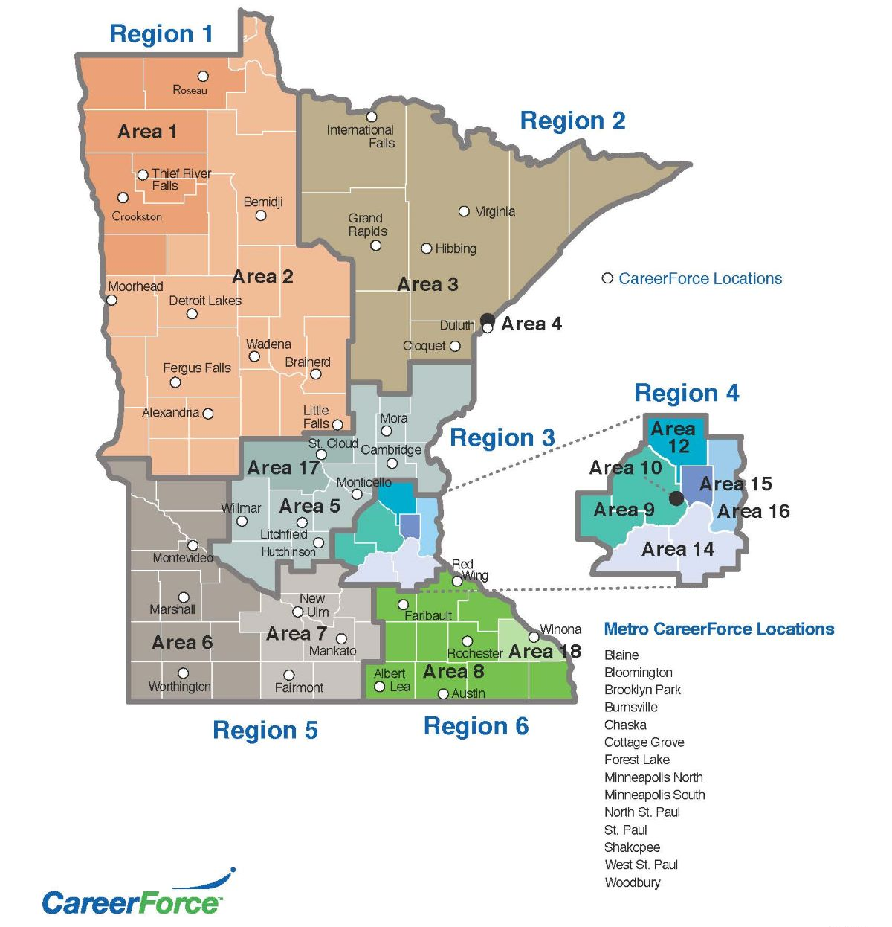
Minnesota’s 16 Local
Workforce Development
Boards (LWDBs)
Designated by the Governor based on economic/labor regions and administrative capacity
Must coordinate regionally when applicable
Serve as the foundation for delivering WIOA services locally

Slide 76
Minnesota’s 16 Local Workforce Boards
Inter-County Community Council Workforce Development Board
Rural MN Concentrated Employment Program Inc. Workforce Development Board
Northeast Minnesota Office of Job Training Workforce Development Board
Duluth Workforce Development Board
Central Minnesota Jobs and Training Services Workforce Development Board
Southwest Minnesota Private Industry Council
South Central Workforce Council
Southeast Minnesota Workforce Development Board
Hennepin-Carver Workforce Development Board
Minneapolis Workforce Development Board
Anoka County Workforce Development Board
Dakota-Scott Workforce Development Board
Ramsey County Workforce Innovation Board
Washington County Workforce Development Board
Stearns-Benton Career Solutions Workforce Development Board
Winona Workforce Development Board

Slide 77

Local Workforce Board Core Functions
LWDBs Charge
Analyze local economic conditions, labor market data, and workforce needs.
Use this information to guide investment of public resources.
Develop strategies to meet local workforce needs.
WIOA Requirements
Develop local plans aligned with the state strategy
Designate One-Stop Operators and select service providers
Oversee program and fiscal performance
Engage employers and support sector strategies

Slide 78
LWDB Service Delivery
The directives of LWDBs are then implemented by:
Counties
Cities
Local nonprofits, working under a Joint Powers Agreement
For example:
4,575 youth served through one-on-one services and an additional 40,374 youth served through outreach to schools under the Minnesota Youth Program in SFY2024.
5,931 individuals served through the State Dislocated Worker Program in SFY2024.

Slide 79
LWDB Design and Membership
Chair of the Board is a member of the private sector.
Members are appointed by a designated Local Elected Official – usually a County Commissioner or Mayor.
Each board has an Executive Director, who staffs the board.
Board membership must include:
  51% Local business leaders
  State agencies
  Post-secondary education
  Labor
  Adult Basic Education
  Economic development

Slide 80
WIOA Performance Accountability
WIOA requires local areas to meet or exceed federal and state performance targets
Metrics include employment rates, median earnings, credential attainment, skill gains
Effectiveness in serving employers also measured

Slide 81
Minnesota WIOA Funding Trends FY 2022 - 2026

Slide 82

Current state of workforce development improvements
Improve the Workforce Development System
INTERAGENCY
WORKFORCE
ALIGNMENT
(IWA)
Task Force on Workforce Development System Reform
Improve interagency coordination and alignment
Understand and recommend legislation to improve the workforce system
Alignment
Metrics
Communication
Program Scope
Funding
Evaluation
GOVERNOR’S WORKFORCE DEVELOPMENT BOARD
(GWDB)
Improve how the workforce system is implemented
Sector Partnerships
Service Delivery
Service Coordination

Slide 83

Workforce Development System Ideal State
STATE
AGENCIES
Advance interagency coordination and alignment of the workforce development system
LEGISLATURE
Draft legislation to supplement and improve the workforce development system
Statewide Workforce Development Strategy
Recommend strategies and priorities for how to improve workforce system implementation

Slide 84
Benefits of State-Wide Strategy
Alignment
Across state agencies, legislature and the GWDB
Strengthens Equity
Improved Workforce Outcomes
Often includes targeted actions to close gaps for underserved groups ensuring equitable access for all.
Identifying priorities helps direct resources to where they are needed most – serving more people & improving outcomes
Benefits of a State-Wide Workforce Development Strategy
Maximizes Resources
Attracts & Retains Businesses
Helps state agencies and partners best utilize funding streams and investments for greatest impact.
A clear, coordinated plan shows employers that the state is serious about workforce development & coordinated in its efforts.
Accountability
Easier to track progress, adjust, and show ROI to all audiences.

Slide 85


Differences Between Talking Points & State-Wide Strategy
Talking Points
State-Wide Strategy
01
Purpose & Scope
Communicate key messages with more narrow scope
Guide comprehensive workforce policy with broad, multi-sector & multi-stakeholder scope.
02
Depth
High-level messaging and supporting facts
Deeper strategy with goals, metrics, roles and accountability.
03
Audience
External – media, legislators, employers & general public
Internal and External – policymakers, state agencies, workforce boards, employers etc.
04
Time Horizon
Short-Term for immediate or near-term use
Long-term – typically 3 – 10 yrs with short-, mid- and long-term goals

Slide 86
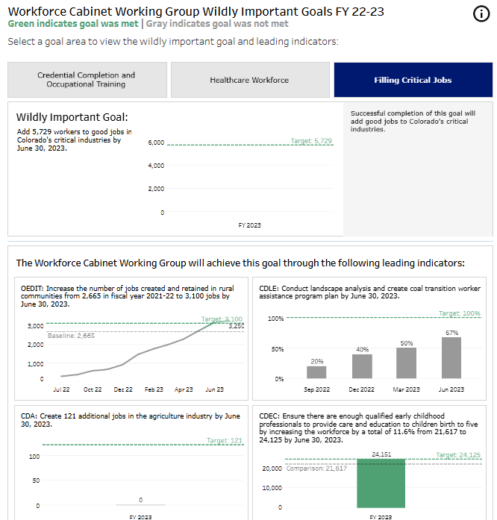
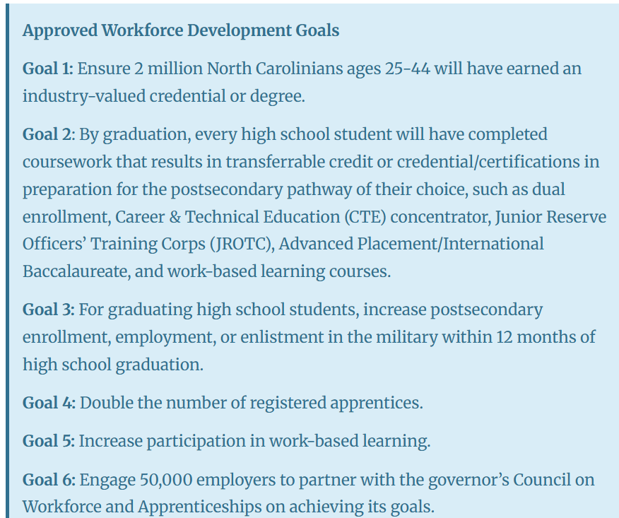
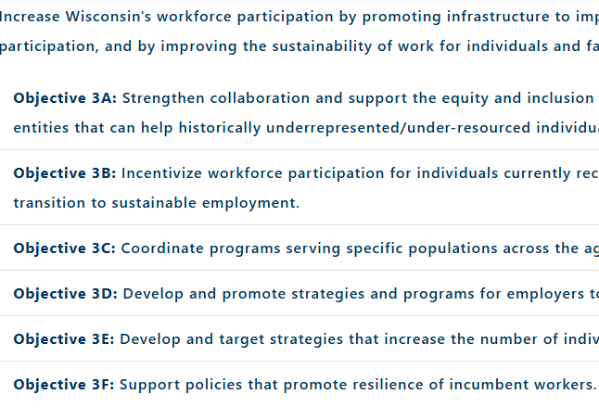
Examples of State Workforce Goals
Colorado
North Carolina
Wisconsin

Slide 87
What a Final Product Could Look Like
    Statewide Workforce Development Strategy
    One to two sentences summarizing what all workforce partners across the state are driving towards.
    Workforce Goals - These are the high-level outcomes all workforce partners are working toward:
    Your
    Suggested
    Measurable
    Goals
    Here
    Workforce Priorities – These are what workforce stakeholders will look at when analyzing changes, improvements, financial decisions related to the workforce system. They may look at other areas, but at a minimum they must consider these in their work:
    Your
    Suggested
    Priorities
    Here

Slide 88
Workforce Development System Goals & Priorities Brainstorm
Workforce Development System Priorities: What activities, services, programs, etc. should be prioritized to ensure that we have a high-quality, efficient and equitable workforce development system that meets federal and state statutory requirements?
Are there areas that should be deprioritized in this shifting landscape or that don’t result in high-quality outcomes?
Workforce Development System Goals: What are tangible, measurable goals the workforce system should be aspiring to achieve over the next 3 – 5 years? What about 5- 10 years?
Are there current goals your organization is working towards that should be scaled?
Are there goals that should be deprioritized?
Workforce Development System Strategy: What key themes, words, phrases should describe the state’s future workforce development strategy?

Slide 89
Task Force on Workforce Development System Reform Discussion
Facilitated by GWDB staff

Slide 90

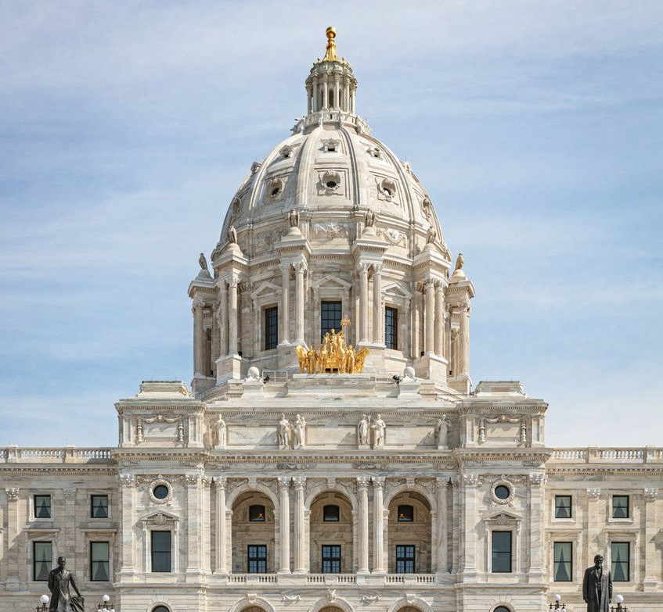


Task Force on Workforce Development System Reform: Purpose & Mandate
Established by 2025 Special Session (SF17 / Ch. 6)
To examine how Minnesota develops workforce strategies, sets goals, and allocates funds to meet statewide workforce development needs.
Scope of Work
Review existing workforce development programs in Minnesota, including those funded by the federal and state governments; Study the current system for funding workforce development efforts; Investigate potential metrics for evaluating workforce development program outcomes; Make recommendations for changes to practices, programs, funding, and laws related to state workforce development efforts; and Propose draft legislation to implement any of the task force's recommendations.

Slide 91


GWDB
Misun Bormann –Southeast Minnesota Workforce Development Board
Carol Anderson –Rural Minnesota Concentrated Employment Program (RMCEP) Workforce Development Board
Michael Berndt –Dakota-Scott Workforce Development Board
Task Force Membership
Nicole Mattson –Hennepin-Carver Workforce Development Board
Legislators
Sen. Carla Nelson (R – Rochester, GWDB Member)
Sen. Bobby Joe Champion (DFL – Minneapolis, Jobs Committee Chair)
Rep. Dave Baker (R – Willmar, Jobs Committee Co-Chair)
Rep. Dave Pinto (DFL – Saint Paul, Jobs Committee Co-Chair)
DEED Commissioner Matt Varilek

Slide 92
Deliverables & Statutory Deadlines
14 June 2025
Task Force effective date
July 2025
Appointment deadline (30 days)
Aug. 13, 2025
First meeting held; co-chairs elected
Feb. 2026
Preliminary Report due
Jan. 2027
Task Force sunsets
*WIOA State Plan Modifications Due
Task Force Report & Legislation Due

Slide 93
Board Breakout:
Informing the Task Force on Workforce System Reform
Group Topics and Facilitators
Pick one of the four groups (will rotate 1 time)
Use guiding questions and slides as reference points
Discuss what’s working, what’s missing, and what needs to change
Identify practical solutions and bold ideas
Instructions
GWDB Staff will record feedback and share it with the Task Force
  Review of Current State & Federal Programs (Carol Anderson)
  System for Funding Workforce Programs (Misun Bormann)
  Metrics for Evaluating Program Outcomes (Michael Berndt)
  Changes to Practices, Programs, Funding, and Laws (Nicole Mattson)

Slide 94
Wrap-up and Next Steps
Surya Iyer, GWDB Chair | DeLinda Washington, GWDB Vice Chair

Slide 95
Review of Goals
Reviewed Legislative Updates Impacting the GWDB & State Workforce System
01
Deepened Workforce Development System Understanding & Begin to Chart Future
02
Provided feedback to the Task Force on Workforce Development System Reform
03
Deepen Relationships between GWDB & MAWB
04

Slide 96
Upcoming Meetings
Next committee meeting dates
Sector Partnerships Stakeholder Convening on Tuesday, September 16
Sub Committee on Trades – Monday, August 18th
IWA/GWDB/MNP20 Education Committee – Monday, August 18th
Sub-committee meetings are ongoing
IWA/GWDB Caring Professions Committee Meeting – Thursday, September 4, 2025
Sub-Committee meetings are ongoing
Innovative Service Delivery – September, TBD
State & Local Coordination – September, TBD
Nov 12 at Edinburgh → GWDB Q4 meeting

Slide 97
GWDB Staff
Katie McClelland: Katie.McClelland@state.mn.us
Nolan Thomas: nolan.thomas@state.mn.us
Kevion Ellis: Kevion.Ellis@state.mn.us
Patti Balacek: Patti.Balacek@state.mn.us
Sarah Arentson: Sarah.Arentson@state.mn.us
Colleen Harris: Colleen.Harris@state.mn.us

