Slide 1

SherburneBiz.com
Update to Energy Transition Advisory Committee
Brian Fleming
Economic Development Coordinator
Sherburne County
February 10, 2026

Slide 2

Agenda
Sherburne County EDA Purpose Statement
Sherburne County EDA Business Attraction Goals
SherburneBiz.com Marketing Advertisement
SherburneBiz.com Overview

Slide 3

Sherburne County EDA- Purpose Statement
“The purpose of the Sherburne County EDA is to support entrepreneurship, advocate for existing businesses, mitigate barriers to economic development, and continually work toward economic resilience and diversification.”

Slide 4
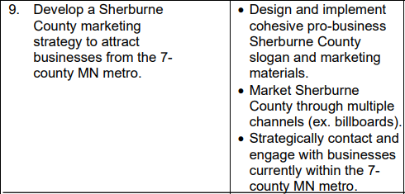
Sherburne County EDA- Business Attraction

Slide 5

Sherburne County EDA- Advertising

Slide 6

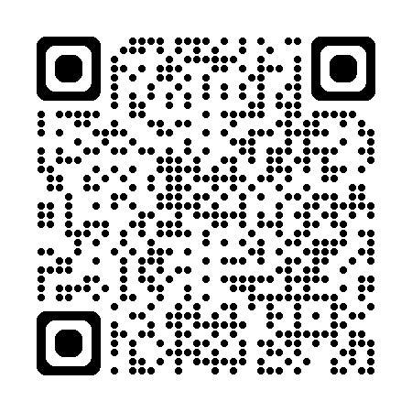
Sherburne County EDA- SherburneBiz.com

Slide 7


Sherburne County EDA- SherburneBiz.com

Slide 8
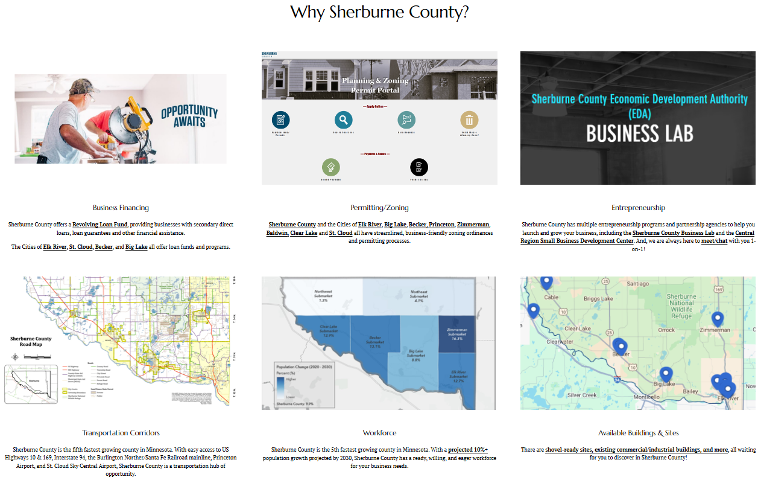

Sherburne County EDA- SherburneBiz.com

Slide 9
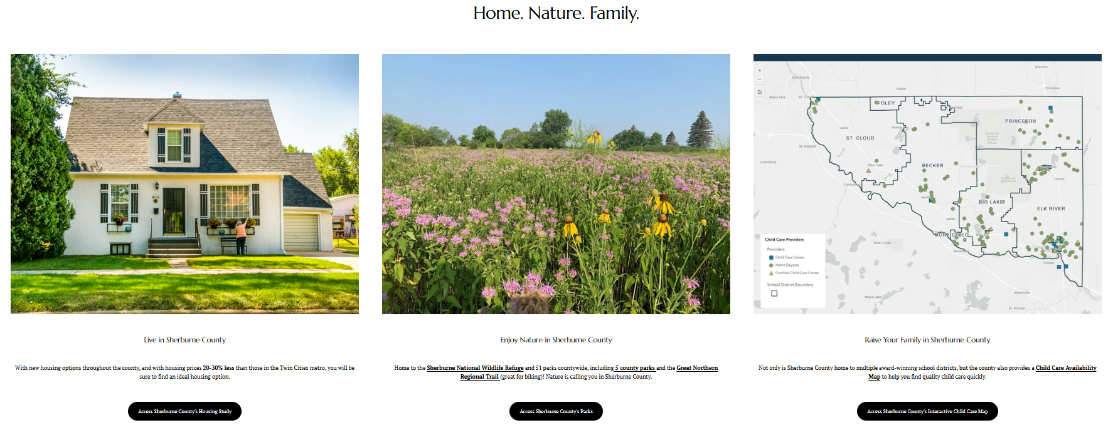

Sherburne County EDA- SherburneBiz.com

Slide 10
Thank you!
Questions?

