Slide 2
Introduction – Shane Zahrt
Shareholder Attorney/Lobbyist with Flaherty & Hood in St. Paul
Have represented the CUC at the Minnesota Capitol since 2016
Helped design and pass legislative and regulatory initiatives to support transitioning host communities

Slide 3
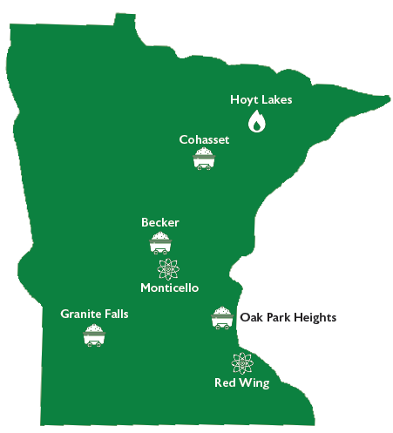
What is the Coalition of Utility Cities?
An organization of seven power plant host communities in Minnesota
Host (or have hosted) many of the state’s largest investor-owned power plants
Formed in 1998 to give cities a voice in policy decisions

Slide 4
Governor’s Budget Recommendation
Does not recommend funding for the Community Energy Transition Grant program
Would maintain base budget for Energy Transition Office staff
Recommends cuts to other programs some host communities have used:
Eliminate the base general fund budget for the Business Development Public Infrastructure Grant Program (BDPI)—A $2.87M/year reduction
Cut $1M/year from the Redevelopment Grant Program
Cut $750k/year from the Contaminated Site and Investigation grant program

Slide 5
CET Grants Legislation
House File 1588/Senate File 2377 - $6.5M appropriation for CET Grants
House Authors: Mekeland, Hill, Davis, Igo
Senate Authors: Mathews, Housley
House File 2072/Senate File 2570 - $10M appropriation for CET Grants
House Author: Hill
Senate Author: Hauschild
Neither bill has received a hearing as of 3/27/2025
General fund budget constraints and lack perception of declining urgency for Host Communities have impacted the discussion at the Capitol

Slide 6
Other legislation of interest
Abolishing the Nuclear Moratorium
Multiple bills, e.g. HF 2002/SF 2953
A “nuclear alliance” of more than 30 organizations has signed on to support the concept
Other bills to amend or expand the state’s carbon-free standard
E.g. HF 249/SF2710, to add timber and discarded wood biomass to the definition of “carbon free”
Bills face an uncertain future, but will be the subject of end-of-session negotiations.

Slide 7
Thank You!
Contact Information:
Shane Zahrt
SAZahrt@flaherty-hood.com
(651) 295-1123

