Slide 1
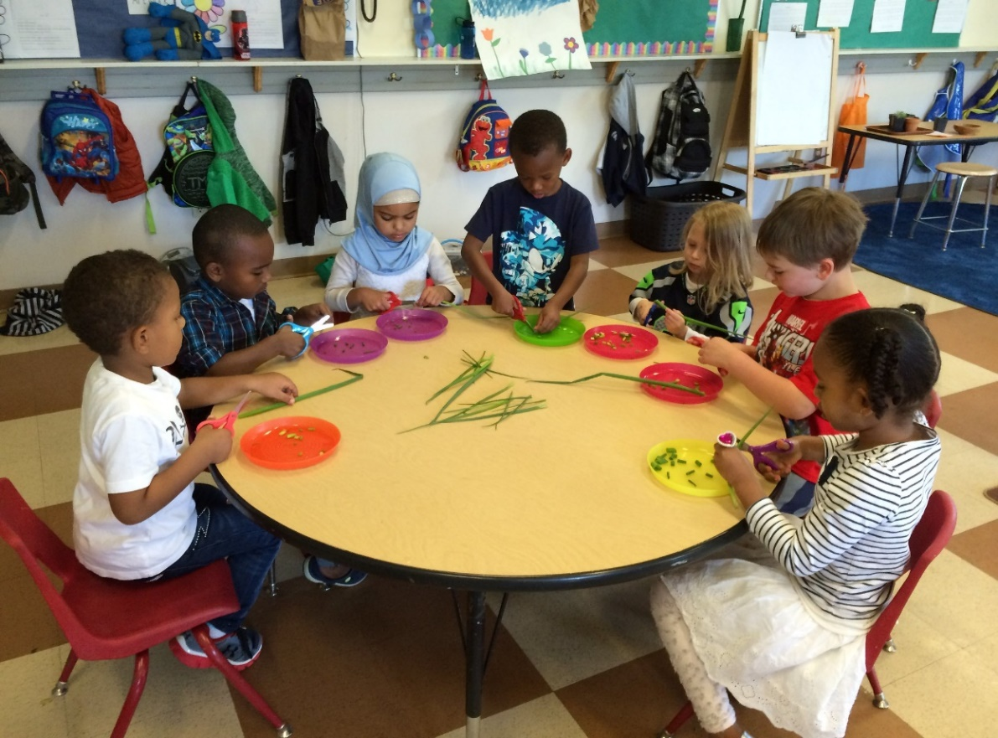

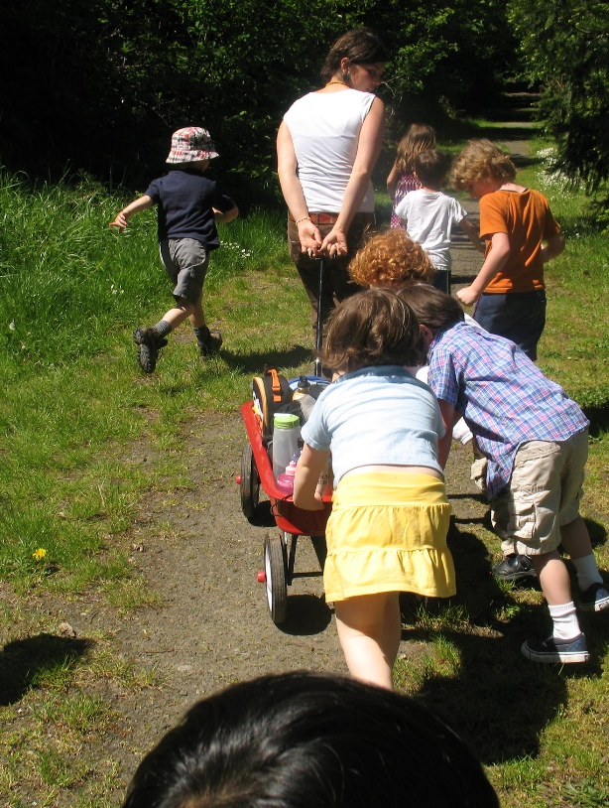
Child Care Economic Development Grant Program
RFP Information Session| February 19th, 2026
Carla Vita, Carla.Vita@state.mn.us, Brandon Toner, brandon.toner@state.mn.us,
Keshuna McCoy, Keshuna.McCoy@state.mn.us

Slide 2
Agenda
DEED’s Office of Child Care Community Partnerships
Goals and Objectives of the CCED Grant Program
Timeline
RFP Details
Proposal Format and Submission
Evaluation of Proposals and Awards

Slide 3

The Office of Community Child Care Partnerships was created in the FY2023 legislative session.
Elevate visibility of child care as an economic development issue
Provide communities a clear front door for issues at the intersection of child care and economic development
Support, coordinate, and promote investments that increase the quantity of quality child care
Key partner in cross agency coordination

Slide 4
Child Care Economic Development Grants
To provide grants to local communities to implement solutions to reduce the child care shortage in the state in support of the state’s and local communities’ economic development efforts
Sustainable and impactful one-time investments in human and/or physical capital
Leveraging local and private investment
Expanding existing facilities
Building out and equipping new facilities
Skilling up providers to expand supply
Technical assistance to providers to enter, expand and grow the industry

Slide 5
Timeline
RFP Release – February 5, 2026
Information Session – February 19, 2026
Questions accepted via email – February 5-March 5, 2026
Proposal Submission Deadline – March 17, 2026
Award Notification – April – May 2026
Contracts Executed – May 2026
Projects Complete – June 30, 2027

Slide 6
Available Funding
Grant awards are for May/June to June 30, 2027
The maximum award is $300,000
To be eligible for the maximum amount, the proposal must be used to expand licensed childcare capacity at a minimum of two locations. The maximum amount a single location proposal can request is $100,000.
A total of $1,425,000 is available for grants
Estimated number of awards: 5-8
50% minimum match, cash or in-kind
Matching waivers available for qualifying projects
A minimum of 50% of funds will go to Greater MN based projects

Slide 7
Eligible Applicants
Eligible recipients include a: public entity, Tribal Nation, community service agency, or 501(c)(3) having experience in one or more of the following: the operation of, planning for, financing of, advocacy for, or advancement of the delivery of childcare services.

Slide 8
Eligible Uses and Project Types
This program will award grants to local communities to implement projects that reduce the child care shortage and increase the number of quality child care providers in their community
Grant funds can used to implement projects in communities that provide:
Funding for child care business start-up or expansion
Training
Direct subsidies or incentives to retain employees
Facility modifications or improvements required for licensing
Assistance with licensing and other regulatory requirements.

Slide 9
Eligible Uses and Project Types
The focus is for “shovel ready” projects.
Can demonstrate the long-term sustainability of their business model.

Slide 10
Ineligible Uses and Project Types
This grant is not to be used as revenue for the financing of ongoing operations.
Wages
Supplies
Food
Rent/Mortgage

Slide 11
Collaboration and Matching
Programmatic partnerships and collaborations between organizations are eligible and encouraged to apply. The proposal must identify a lead fiscal agent who is responsible for the administration of the grant
Cannot “collude” with other Responders to the RFP
The budget should identify the sources of any project matching dollars
Proposals must also identify the dollar amount and percentage of state money involved in the total project cost

Slide 12
Matching Waiver
To help target funds, applicants can request a matching waiver if their project(s) meet one of more of the following conditions:
More than 75% of new child slots created with these funds are to serve infants and toddlers
More than 50% of the new child slots created with these funds are for child slots available outside of standard business hours (6:00 a.m. through 6:00 p.m.)
The project will be located in a geographic area, such as zip code or census tract, where 30% or more of children are Black, Indigenous, and/or people of color individuals
The project will be located in a geographic area, such as zip code or census tract, where at least 15% of children living in the geographic area are in families living in poverty.
The project is located in or will serve a Child Care Equity Access Area. To serve a Child Care Equity Access area, a program must be within 20 miles in outstate Minnesota or within 5 miles in the metro counties.

Slide 13
Proposal Format
Cover Page
One Page Executive Summary
Narrative Sections (double spaced, 11 point Calibri, max 15 pages).
Executive Summary (0 points)
Organizational Capacity and Relevant Experience (20 Points)
Project Description, Design and Methods (20 points)
Work plan (10 Points)
Partnerships (10 Points)
Performance and Evaluation (10 Points)
Sustainability Plan (10 Points) - New
Budget (10 Points)
Bonus Points (10 Bonus Points maximum)
Must use the application packet to submit the responses. The application is provided by link in the RFP.

Slide 14
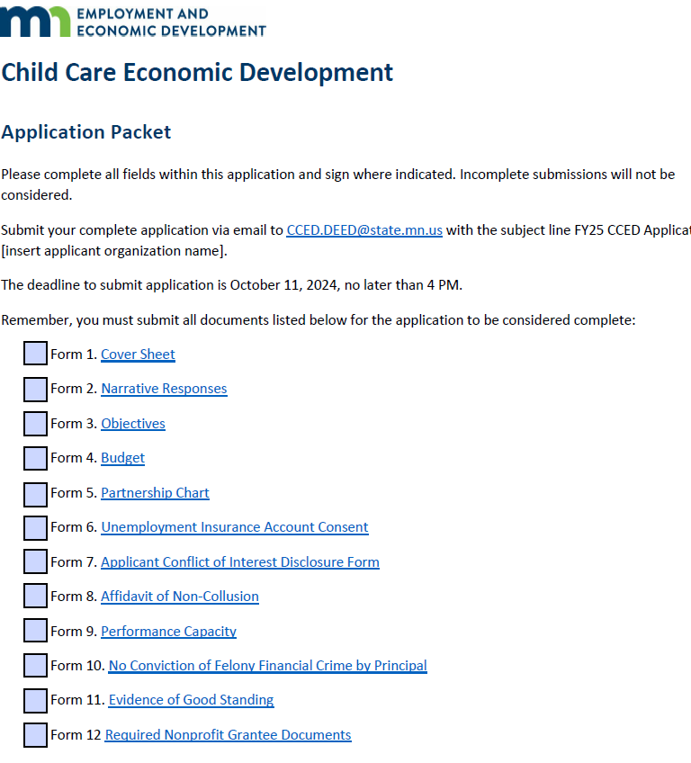
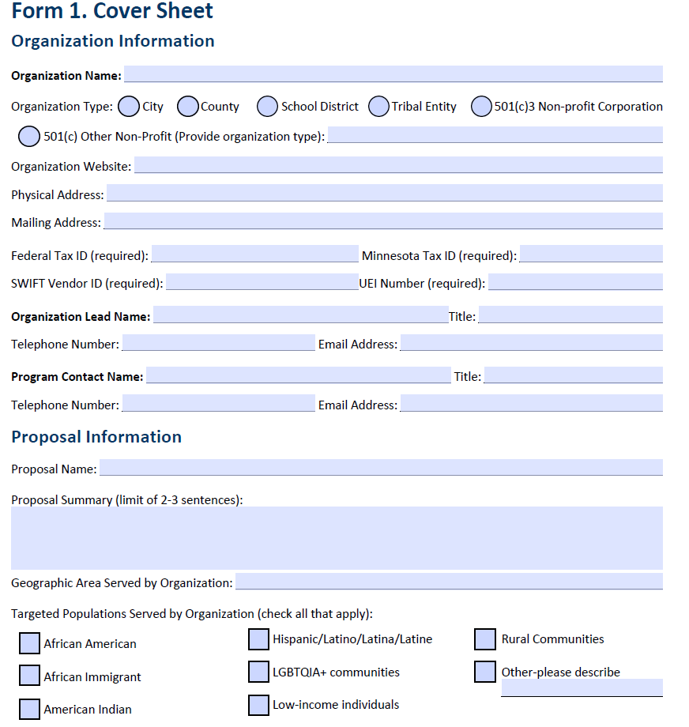
Proposal Format

Slide 15
Evaluation of Proposals
Reviewed, scored, and ranked by on a panel of subject matter experts and community reviewers who will provide a recommendation to the Commissioner of DEED for final review and awards decisions.
Scoring is on a 100 point scale with points available in seven sections and 10 bonus points maximum available.
This grant process is competitive and expected to have many more requests than can be funded.

Slide 16
Cover Sheet (Form 1) and Executive Summary
Provides organizational information
Summarizes proposal providing a clear overview of the designed project
Demonstrate an understanding of the services requested in the RFP
Provides a high-level description of the intended plan and goals

Slide 17
Executive Summary
The Executive Summary should be a high level overview of the project that can be presented to reviewers and state partners to describe the project.

Slide 18
Organizational Capacity and Relevant Experience
How is the lead applicant organization equipped to successfully lead the proposed project and meet the objectives of this grant?
Please describe the experience the lead applicant have in managing state and/or federal grants.
Describe staff experience in early childhood as it relates to the project.
Describe organization current staffing and current budget.
Has the agency been awarded an active grant from DEED in the past 5 years?

Slide 19
Project Description, Design, and Methods
What is the geographic scope of the project?
Why is the proposed project needed to increase the supply of quality childcare in the community?
What kind of solutions will be implemented to meet objectives of this grant?
How does the project demonstrate innovative approaches, techniques or strategies?
Does the proposed project use evidence-based or community-based best practices?

Slide 20
Workplan
What are the key activities to be funded through this project?
What are the goals and measurable outcomes for this project?
What is the timetable for completion of the project?
Is the timetable achievable within the timeline of the grant?
Must also complete Form 3 as part of the Workplan.

Slide 21
Partnerships
Who are the financial and programmatic partners supporting this project?
What contributions will each partner make to the proposed project?
Will the partnerships support ongoing operations?
Does the proposal demonstrate meaningful collaboration with key partners?
Does the proposal demonstrate support from the communities in which the project will take place?
A letter of support from all partners identified. This should be included as part of the attachments.

Slide 22
Performance and Evaluation
What is the number of childcare slots needed with the project area(s) to meet the needs of families?
How many childcare slots will be created with this funding?
What is the cost (in state dollars) per new childcare slot created?
How will measurable outcomes be tracked?
How will evaluation material and outcomes be used to ensure the grant objectives are met?
Will the project utilize any community-based evaluation processes?

Slide 23
Sustainability Plan
Identify the major risks to maintaining this increased child care capacity and explain your mitigation strategy for those risks. Example might include workforce needs, financial viability, future facility needs, regulatory issues and so on.
If your program or project involves community partners such as local and regional government, businesses, non-profits, religious institutions, local education, and individuals, explain their role in supporting the long-term sustainability of the projects that will be supported by this grant.
Please include letters of commitment from those supporting organizations. Letters should detail what resources those partners will be contributing to the project, including any long term commitments to support the retention of child care capacity supported by the grant.

Slide 24
Budget and Matching
Must meet 50% matching requirement OR qualify for matching waiver
This section should specify the grant amount requested and detail all expenses for the proposed project.
Identify supporting services, associated costs and which components are essential to delivering project outcomes.
Include a budget narrative for the applicant and each subcontracting entity. The explanation should provide sufficient detail to justify the total amount budgeted in each category. .

Slide 25
Bonus Points
Is the project located in a service area where 30% or more of children are Black, Indigenous, and people of color?
The project will be located in a geographic area, county, such as zip code or census tract, where at least 15% families living in poverty.
Is the project located in a Child Care Access Equity Area? Child Care Access Equity Areas Map. To serve a Child Care Access Equity Area, a program must be within 20 miles in outstate Minnesota and within 5 miles in the metro counties.
Maximum of 10 points possible

Slide 26
Other Required Documents
Letters of Support from all partners identified (Partnerships)
Form 5 Partnership Chart
If a partner has a potential conflict of interest, such as providing donations to the applicant or sitting on the applicant’s board of directors, attach a letter of disclosure explaining the relationship of the partner to the applicant organization.
Letters of Commitment from supporting organizations (Sustainability Plan)
Financial Review Documents
Pre-Award Risk Assessment and one of the following:
Grant applicants with annual income of under $50,000, or who have not been in existence long enough to have a completed IRS Form 990 or audit should submit their most recent board-reviewed financial statements.
Grant applicants with total annual revenue of $50,000 or more and less than $750,000 should submit their most recent IRS Form 990.
Grant applicants with total annual revenue of over $750,000 should submit their most recent certified financial audit.

Slide 27
Submitting the Proposal
Proposals Due: 4:00 p.m., March 17, 2026
PDF Format with max file size of 25mb
Emailed to: CCED.DEED@state.mn.us
Late submissions will not be reviewed

Slide 28
Award Determinations
Review committee composed of DEED, other agency experts and community reviewers.
The Commissioner of DEED will review all panel recommendations and is responsible for award decisions
The award decisions of DEED are final and not subject to appeal
The Commissioner of DEED reserves the right to change the amount awarded to any selected project
Projects can not start until contracts are executed

Slide 29
Receiving an Award
If you are awarded a grant….
Receive an official award letter with the final award amount
Submit an updated work plan/budget if the final award is different from the request
Receive, review, and sign the grant contract and send to DEED
Receive an executed grant, a payment request form with instructions and begin your project!
Participate in the payment request, monitoring, reporting and close out process
All grants funds are dispersed on a reimbursement basis

Slide 30
Technical Assistance and Project Monitoring
A DEED grant staff will be assigned to your project. They will…
Provide ongoing technical assistance.
Receive and approve payment request and progress reports.
Conduct site visits and ongoing monitoring of the project.

Slide 31
Questions and Contact Information
Submit RFP questions to: CCED.DEED@state.mn.us
All questions and answers will be published in a FAQ and posted at DEED Competitive Grants and Contracts
Deadline to submit questions is 4:00 p.m., March 5, 2026.
Thank you!

