Slide 1
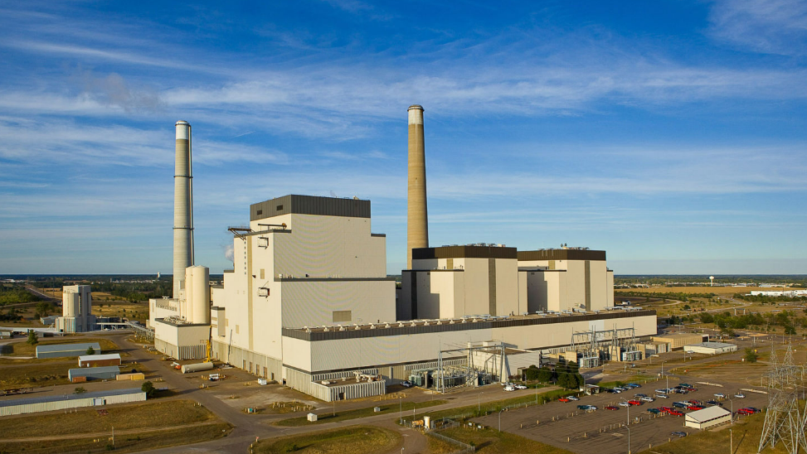
Energy Transition Office Community Energy Transition Grant Presentation to the ETAC
June 5, 2025, Fergus Falls

Slide 2
Overview of the Community Energy Transition
In 2023 the State Legislature approved $10M for the Community Energy Transition Grant Program to assist eligible communities to address the economic dislocation associated with the closing of a local electric generating plant: Sec. 116J.55 MN Statutes
Total Amount available to grant in FY 24 - $4,750,000
Total Amount available to grant in FY 25 - $4,750,000
Total Amount available to grant in FY 24 & 25 - $9,500,000
Applications are received on a rolling basis; maximum award is up to $1M in a calendar year

Slide 3
CET Grant Awarded in FY 24
Impacted Community: City of Granite Falls
Grant Awarded: $750,000
Project: Industrial Park/City East side Watermain
Project Goal: The funding will allow the City to install a watermain looping the City’s east side including the Industrial Park. The project will help many businesses already in the park and aid in attracting new business by being able to provide a stable utility.

Slide 4
CET Grant Awarded in FY 24
Impacted Community: City of Fergus Falls
Grant Awarded: $640,250
Project: Purchase of the Old Lumber Yard for Workforce Housing
Project Goal: The City of Fergus Falls will use the Community Energy Transition grant to acquire the Old Lumber Yard on Stanton Avenue for development into workforce housing. Support for workforce housing is crucial to build and maintain an adequate labor force to fill positions in major industries post-plant closure.

Slide 5
CET Grant Awarded in FY 24 cont’d.
Impacted Community: City of Monticello
Grant Awarded: $1,000,000
Project: Northwest Growth Area Utility Expansion
Project Goal: To continue this transition strategy, the City was awarded $1 million of the CET grant in FY 24 to complete the installation public utility services proposed in the Northwest Growth Area. The project will help to replace the jobs and tax base that will be lost from the plant closure. Study estimates that development in this area could add up to 4,300 jobs, plus $16 million in tax capacity.

Slide 6
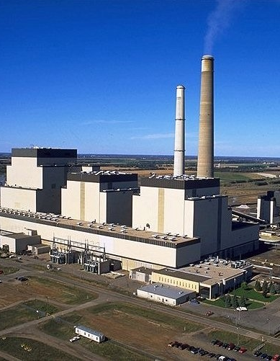
CET Grant Awarded in FY 24 cont’d.
Impacted Community: Sherburne County
Grant Awarded: $1,000,000
Project: TH 25 Tier 1 Environmental Documentation
Project Goal: This project to plan for transportation infrastructure investments and improved connectivity between I-94 and State Highway 10 that will attract new businesses and employees into the region, which is vital to the community's economic recovery efforts. Environmental clearance and preliminary design of the interchange are needed to attract businesses to the area and create jobs.

Slide 7
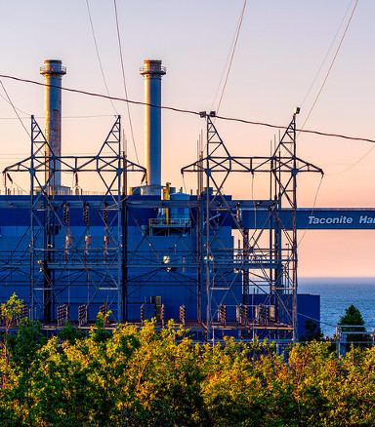
CET Grant Awarded in FY 24 cont’d.
Impacted Community: Cook County
Grant Awarded: $1,000,000
Project: Taconite Harbor Strategic Plan & Waste Transfer Station Construction
Project Goals: To encourage diversification and investment in critical public infrastructure, Cook County was awarded $1M to support strategic planning efforts related to the closure of Taconite Harbor Energy Center and construction of a new waste transfer station in Grand Marais.
Construction of an indoor waste transfer station will improve solid waste processing in Cook and eastern Lake County and is necessary for economic growth and diversification. Simply put, all industries, households and tourism activity require safe and reliable waste management.
Total Award In FY 24 - $4,390,250

Slide 8
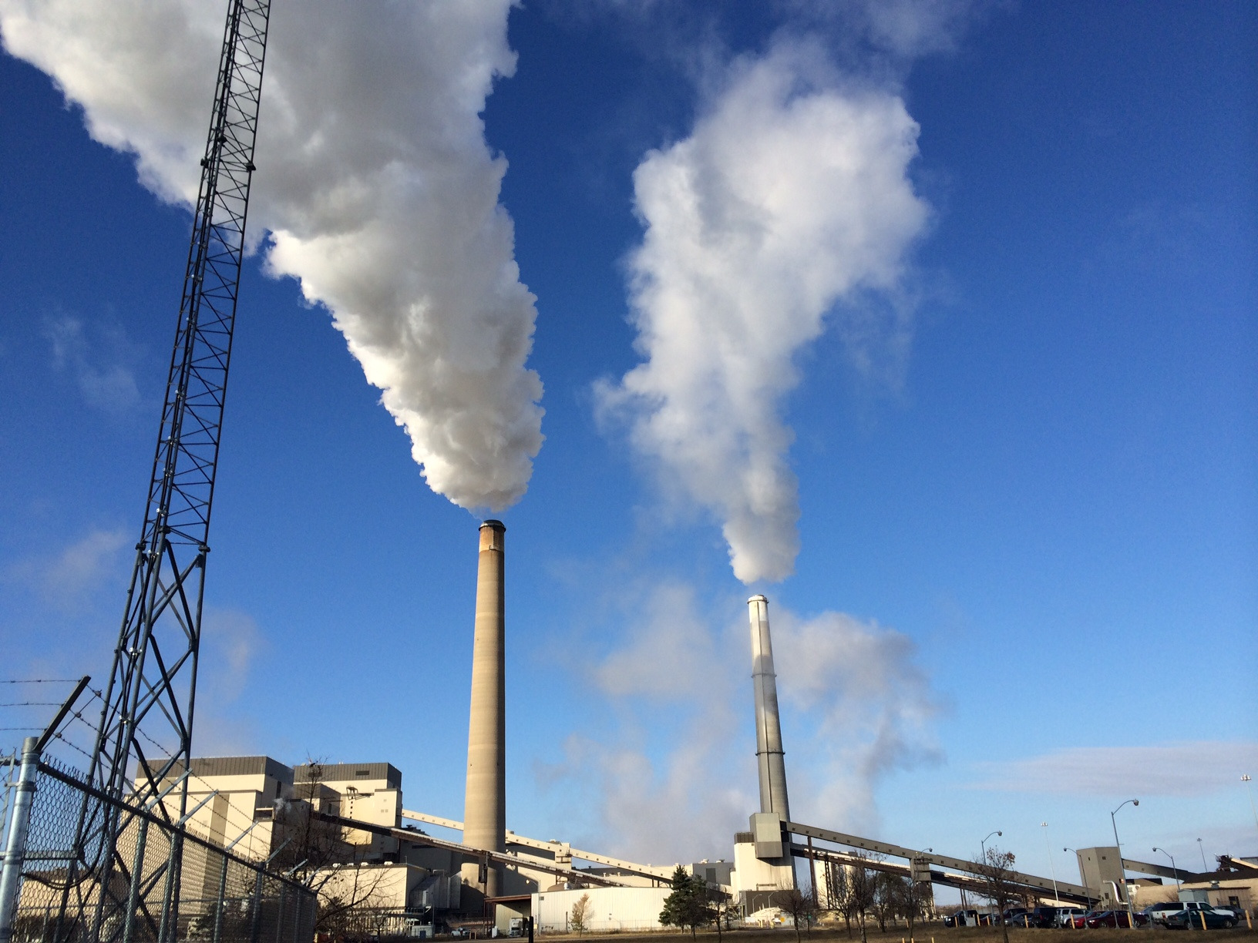
CET Grant Awards for FY 25
Impacted Community: City of Becker
Grant Awarded: $770,000
Project: Planning for grade separation Interchange at US Highway 10/MN TH Intersection
Project Goals: Becker was awarded $770,000 in CET grant funding to complete the planning process for a new grade separated interchange at the intersection of US Highway 10/MN Trunk Highway 25/County Road 52/BNSF Rail line/First Street and Edgewood Street in Becker (hereinafter referred to as “the
intersection.”) This intersection is the west entrance into the Becker Business Park. The project will accomplish economic impacts, safety improvements and huge benefits to the community

Slide 9
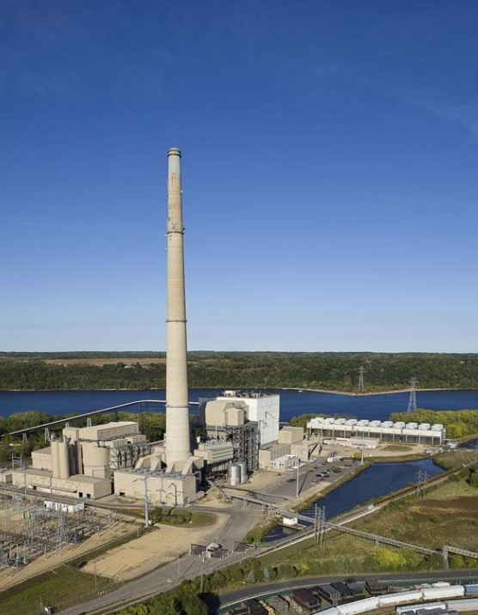
CET Grant Awards for FY 25 cont’d.
Impacted Community: City of Oak Park Heights
Grant Awarded: $440,000
Project: PFAS Treatment: Feasibility & Preliminary Design
Project Goal: The City of Oak Park Heights proposes to use the Community Energy Transition Grant funds for PFAS Treatment: Feasibility and Pre-Design. PFAS contamination is a pressing issue for Oak Park Heights.
The City has two drinking water wells, and both wells produce water that exceeds the Minnesota Department of Health’s (MDH) Health Based Guidance Values for PFAS. PFAS pollution may hamper the City’s economic development efforts and impact the overall quality of life in our community.

Slide 10
CET Grant Awards for FY 25 cont’d.
Impacted Community: City of Red Wing
Grant Awarded: $1,000,000
Project: Red Wing’s Economic Resiliency Transition Plan, The Future
Project Goals: The City of Red Wing was awarded $1M to complete strategic analysis and associated planning tasks to mitigate the effects of the Prairie Island Nuclear Generating Plant closure. Following our 2040 Community Plan, the city will develop a comprehensive Economic Resiliency Transition Plan and implementation tools to support a sustainable transition from an energy economy and a stable economic future for the community.

Slide 11
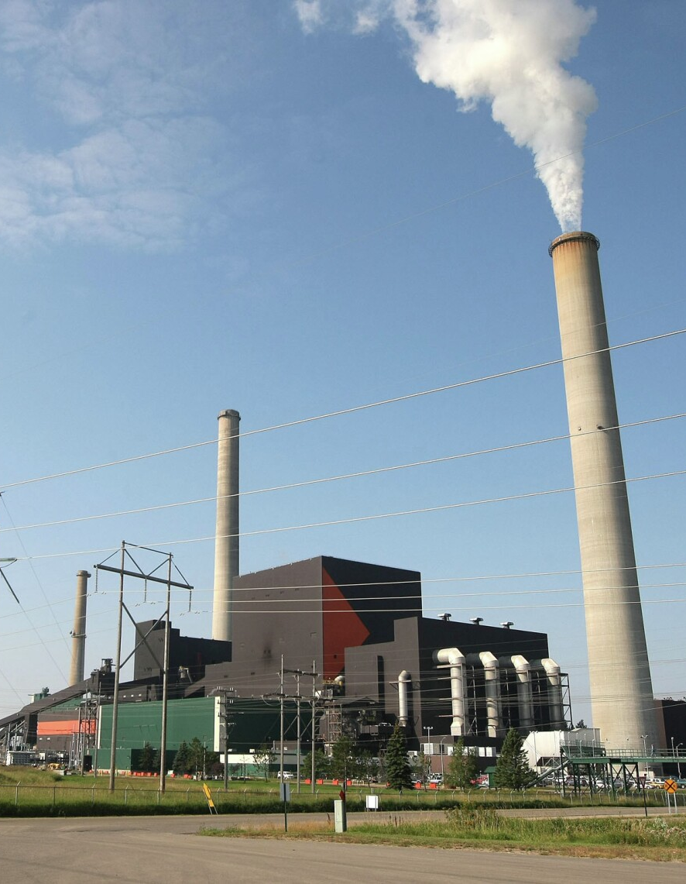
CET Grant Awards for FY 25 cont’d.
Impacted Community: Benton County
Grant Awarded: $1,000,000
Project: Removal of Transmission Lines Along CSAH 29 Corridor
Project Goals: Benton County was awarded $1M for the relocation of Xcel’s electric transmission poles along the CSAH 29 Corridor. The first phase of the project of constructing a roundabout at the intersection of CR29 and CR1 - which is part of the larger Beltline Corridor project. The implementation of this project will help a rapidly developing area of the St. Cloud APO Region linking metro growth centers with major residential, commercial, industrial and airport sites.

Slide 12
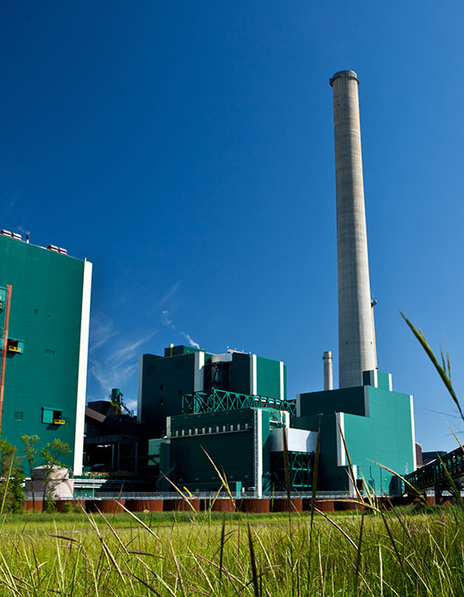
CET Grant Awards for FY 25 cont’d.
Impacted Community: City of Cohasset
Grant Awarded: $750,000
Project: Blackwater Banks Infrastructure Phase 3
Project Goals: The city of Cohasset was awarded $750,000 of the Community Energy Transition Grant Program to help fund the third phase of infrastructure costs for the Blackwater Banks Riverfront Development Project. This project is located on the Mississippi River in Cohasset and will substantially expand and enhance the growing community’s downtown area.
Completion of the infrastructure will create an investment-ready site that is fully prepared for development of new housing, recreational amenities, restaurants, retails, lodging, and more.

Slide 13
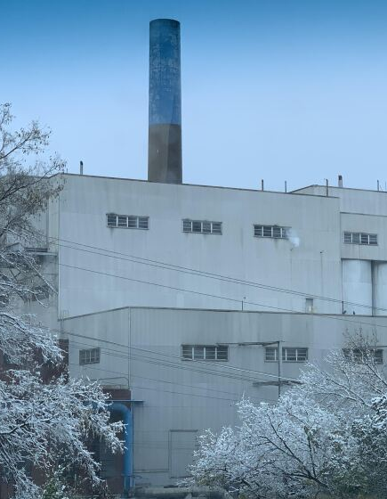
CET Grant Awards for FY 25 cont’d.
Impacted Community: Otter Tail County
Grant Awarded: $650,000
Project: Westridge Mall Redevelopment
Project Goals: The funding application to the Community Energy Transition program is being requested for the purchase and selective demolition of the vacant, blighted portion of the Westridge Mall in Fergus Falls.
Otter Tail County will take the necessary steps to advance the redevelopment of the site and work to ensure the preservation of four remaining businesses still physically connected to the mall structure but under separate ownership.

Slide 14
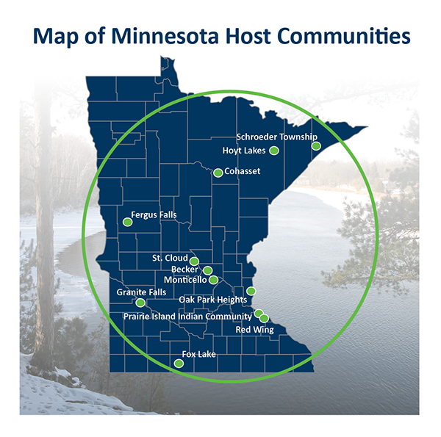
CET Grant Awards for FY 25 cont’d.
Impacted Community: City of Oak Park Heights
Grant Awarded: $374,812.50
Project: City of Oak Park Heights PFAS Treatment Phase 2
Project Goals: The City of Oak Park Heights proposes to use the Community Energy Transition Grant funds for PFAS Treatment Phase 2. The project includes performing engineering work to get the City’s plans to 60% complete to determine the process, equipment and estimated costs related to removing PFAS from the City’s water system.
As a proactive measure, the City aims to leverage this grant to target PFAS (Per- and Polyfluoroalkyl Substances) contamination, thereby fostering a safer, healthier, and more economically resilient community.
Total Award In FY 25 - $4,984,812.50

Slide 15
FY 24 & 25 Funding Breakdown
Total Grant Awarded in FY 24 - $4,390,250
Total Grant Awarded in FY 24 - $4,984,812.50
Remainder to be Awarded FY 25 - $124,937.50
The Energy Transition Office is currently reviewing an application to award the remainder of the funding for FY 25.

Slide 16
Questions?

Slide 17
Thank you!
Mike McCrownsey – Grants Specialist Coordinator
Mike.mccrownsey@state.mn.us
651-259-7037

