Slide 1
Sherburne County Interactive Child Care Finder
Brian Fleming
Sherburne County EDA Executive Director
June 2025

Slide 2
Overview
State of Child Care in Sherburne County
Interactive Child Care Finder Overview
Next Steps/Questions

Slide 3
Sherburne County Child Care need
Sherburne County has an approximate child care deficit of 2,759. (First Children’s Finance 2024 statistics)
Yet, currently there are at least 125 available child care spots in Sherburne County.
Our county has struggled to match parents/caretakers with the current availability we do have; until now…

Slide 4
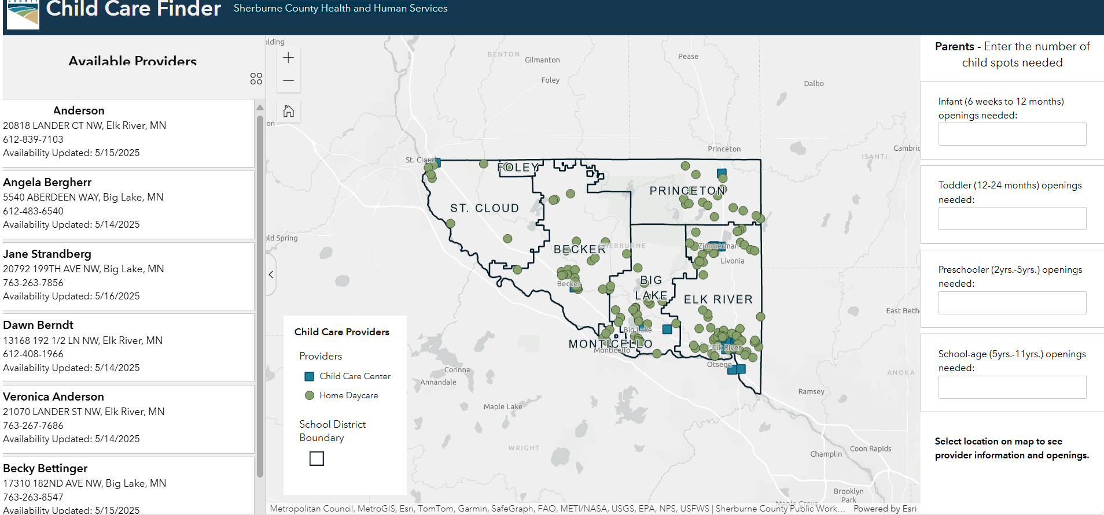
Interactive child care finder
Parents/caretakers can search for child care availability by age categories here.
(When availability changes, providers call/email Sherburne County Economic Development; we update the site within 48 business hours.)
https://gis.co.sherburne.mn.us/daycarefinder/

Slide 5
Next Steps/questions
Interactive child care finder map launched May 2025.
Already have better metrics on current child care availability (over 110 total open slots).
Goals
Promote map throughout Sherburne County through community partners, child care groups, etc.
Fill at least 30 child care slots throughout the County by Fall 2025.
Questions?

