Slide 1
DEED Overview
Brad Brzezinski, Northeast Regional Business Development Manager

Slide 2
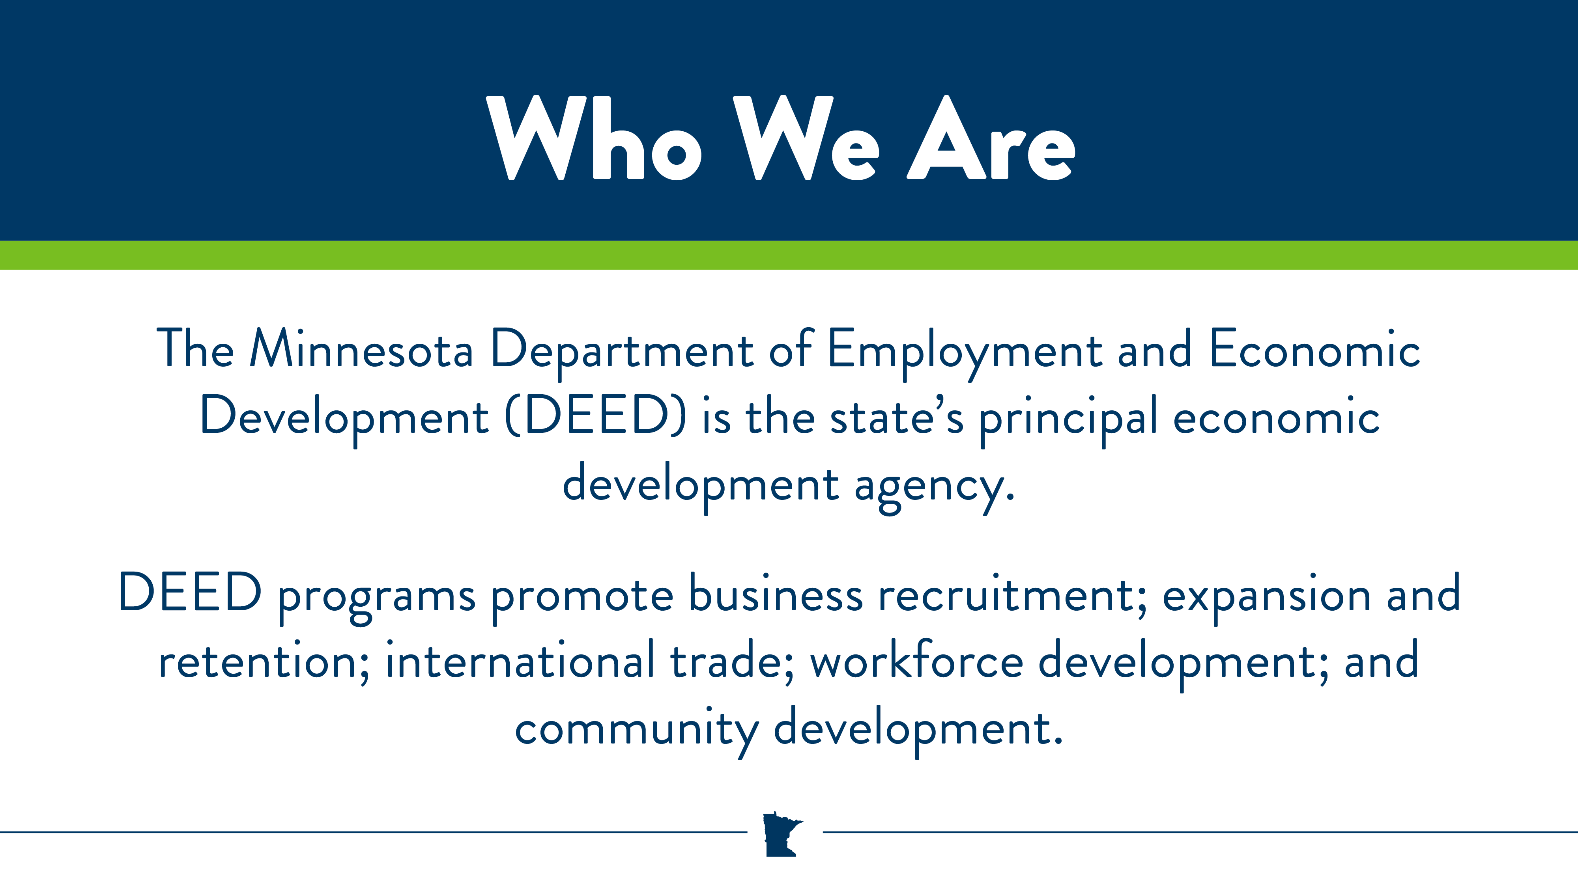

Slide 3
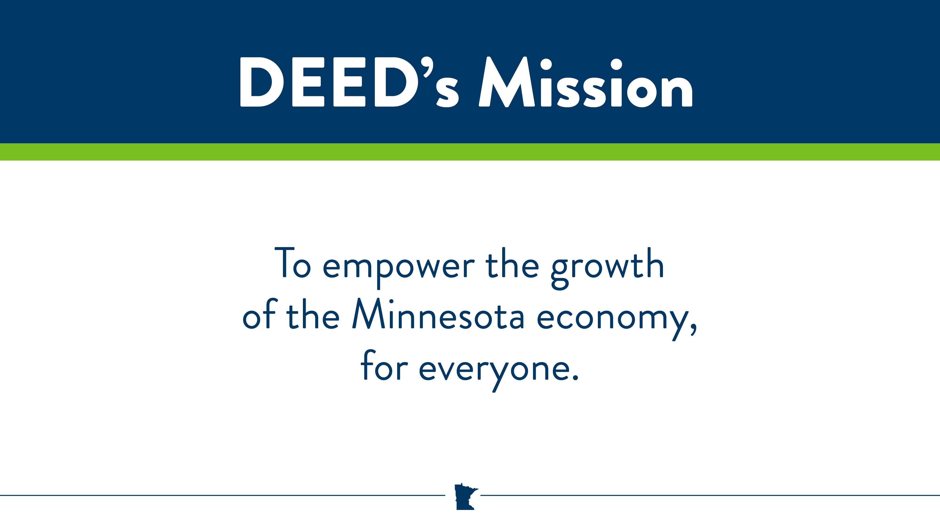

Slide 4
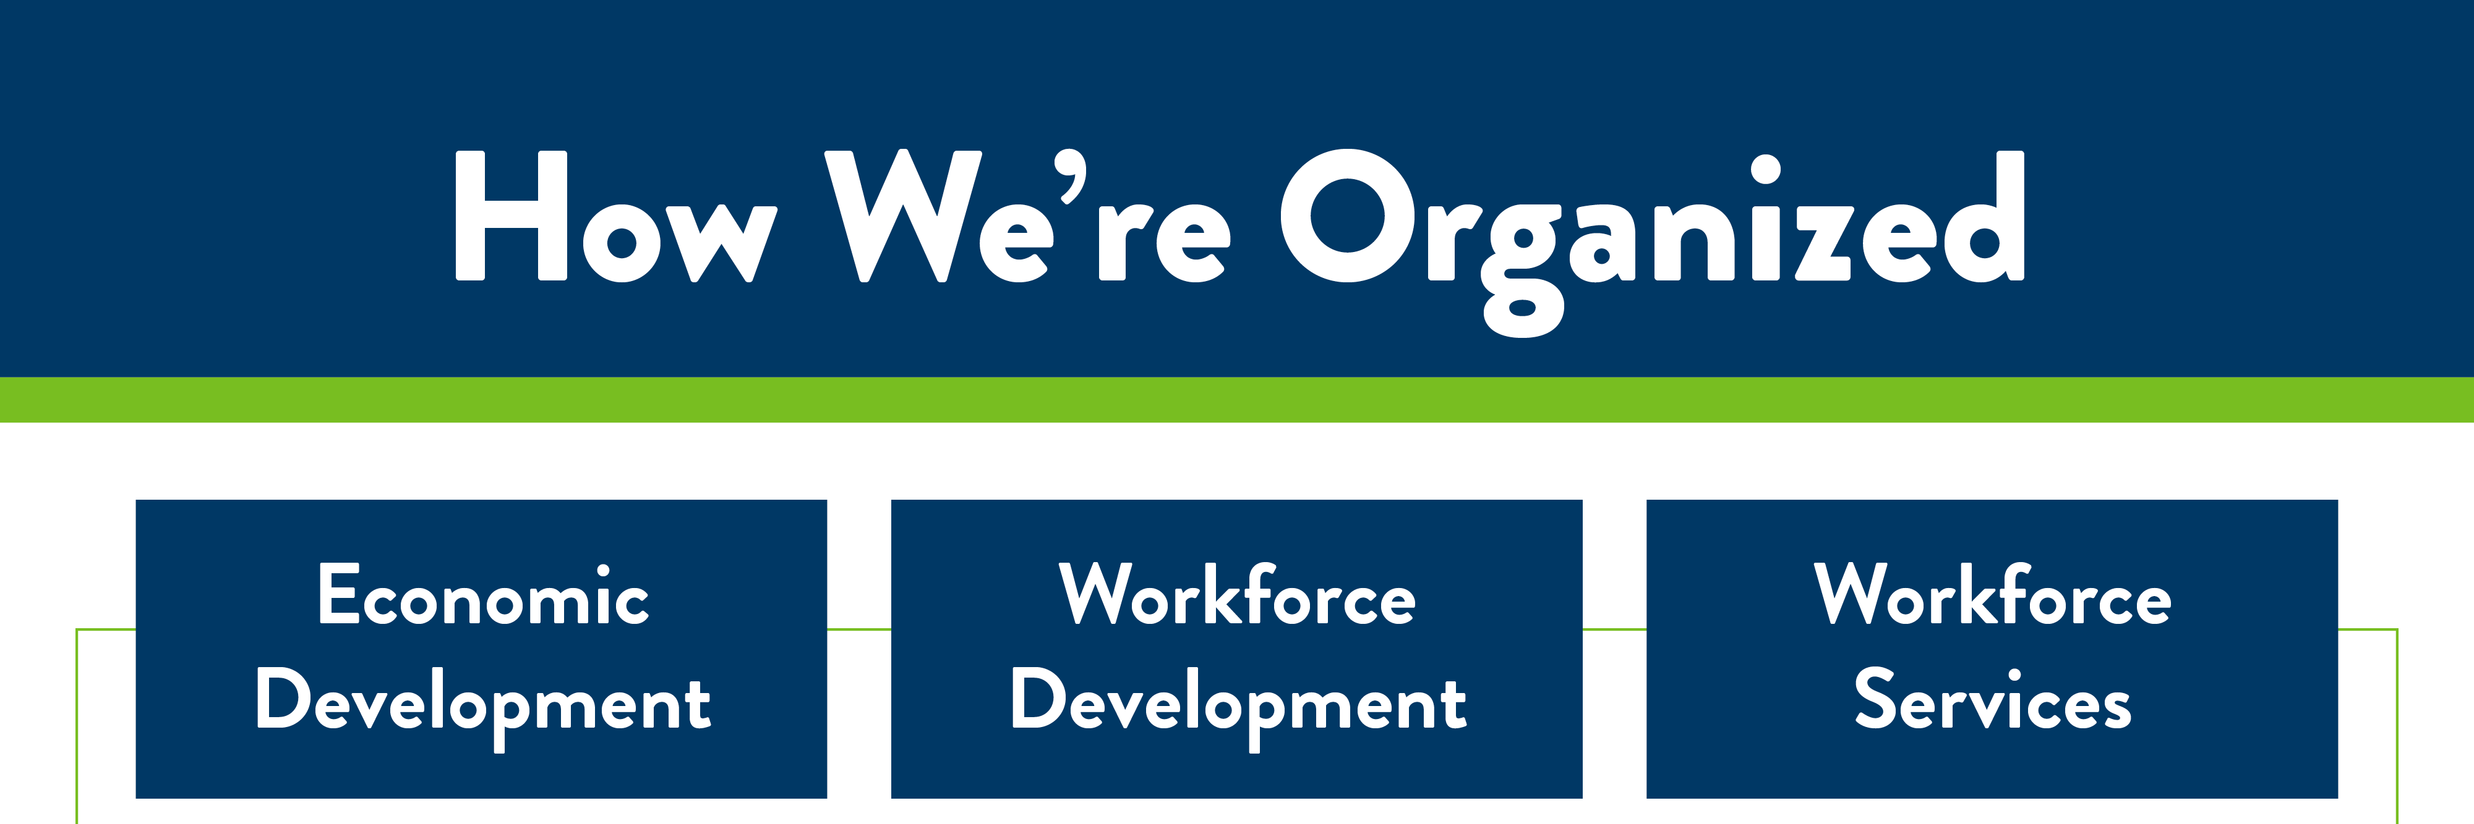
Help businesses grow and create jobs
Help people
find jobs and help businesses find the talent they need
Help people who are laid off, are unable to work or face other challenges to employment
Notes:
BCD – technical and financial services to help businesses and communities grow
Trade - provides the training and expertise that small and midsized companies need to export goods and services
Broadband - works to improve availability and use of high speed broadband services.
WD – variety of programs offered through WIOA and other state and federal programs to help job seekers

Slide 5

Economic Development
Economic Development supports the growth of businesses and communities through grants and loans, consultations, education sessions, and other programs and services.

Slide 6

Economic Development
This division includes:
Broadband Development
Business Development
Business Finance
Community Finance
Small Business and Innovation
Minnesota Trade Office

Slide 7
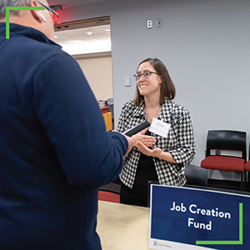
Business Finance
Business Finance programs help companies and communities retain existing jobs and create new high-quality jobs. Qualifying companies must meet specific job creation and wage goals.
Notes:
Financing initiatives include: • grant programs such as the Minnesota Job Creation Fund • loan programs such as the Minnesota Investment Fund and Emerging Entrepreneur Loan Program • tax benefit programs such as the Angel Tax Credit and the Greater Minnesota Job Expansion Program

Slide 8
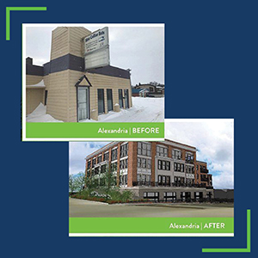
Community Finance
Community Finance provides financial assistance for projects that help communities stay vital and well positioned for economic growth. Eligibility for certain programs targets smaller communities and/or Greater Minnesota.
Notes:
Grant funding includes: • site cleanup and redevelopment of contaminated properties such as the Cleanup Revolving Loan Program • housing, public infrastructure, and commercial rehabilitation projects through the Small Cities Development Program • road and transportation projects

Slide 9
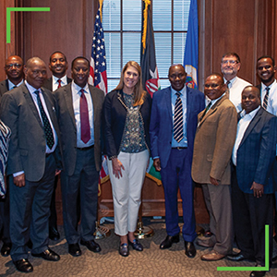
Minnesota Trade Office
The Minnesota Trade Office provides the training and expertise that small and midsized companies need to export goods and services successfully worldwide.
Notes:
Services include: • basic guidance for companies new to exporting • technical, regulatory, and logistical information for more experienced companies • market intelligence and research • help conducting business across borders and cultures • educational seminars, workshops, and events • a matching grant program to help qualifying businesses with export-related activities

Slide 10
Business Development
What do we do:
  The Office of Business Development focuses on projects likely to result in economic growth. Its goal is to help stimulate new business development and business expansions while retaining existing jobs and creating new jobs.

Slide 11
Business Development
Who are we:
  Seven Business Development Managers throughout the state
    Metro has two managers: Colleen Eddy and Matt Hauck
    Metro represents nine counties:
      Anoka, Carver, Chisago, Dakota, Hennepin, Isanti, Ramsey, Scott, Washington

Slide 12
Business Finance Programs
Job Creation Fund:
  Performance-based program for eligible industries
  Generally, up to $1 million total available per business
    $500,000 in Job Creation Awards & $500,000 in Capital Investment Rebates
  Create at least 10 full-time jobs & have $500,000 in capital expenditures
Minnesota Investment Fund:
  Grants provided to local governments who then make loans to businesses; works in partnership with private financing
  Interest rate/terms vary; loans may be forgiven in limited cases
  Up to $1 million; average about $450,000

Slide 13
Business Finance Programs
Minnesota Forward Fund:
The 2023 Minnesota Legislature appropriated $400 million to the Minnesota Forward Fund. Of that amount:
  $50 million is to provide businesses with matching funds required by federal programs
  $100 million is to match existing federal funds made available in the Consolidated Appropriations Act, Public Law 117-328, to be used to:
  $250 million is to match federal funds made available in the Chips and Science Act, Public Law 117-167
  Up to 15% of a total project cost, with maximum total project cost of $75 million per project, may be matched for a CHIPS Act project

Slide 14
State Small Business Credit Initiative Overview
Eligible business characteristics
  Located in Minnesota
  Fewer than 500 employees preferred, no more than 750 allowed
  Funds used for eligible business purposes
  Each transaction requires certification regarding use of proceeds, conflict of interest, SEDI ownership (if applicable), and that no principal is a sex offender
  Certain programs have additional eligibility restrictions
Automation Loan Participation
  Industries: manufacturing, distribution, technology and warehousing businesses
  Loan purpose: machinery, equipment or software to increase productivity and automation
  Gap financing tool for lead lender companion loan, looking for 5:1 ratio
  Up to $500,000, 5- to 7-year term, 1% interest
Growth Loan Fund
  Targets start-ups engaged in technologically innovative industries
  Loan of $100,000-$400,000 based on 20% of proposed equity raise
Minnesota Loan Guarantee
  Businesses apply directly with lenders
  80% guarantee up to $800,000
Small Business Loan Participation
  Borrowers apply directly with lenders
  DEED purchases 25% of lender’s loan

Slide 15
Thank you!
Brad Brzezinski, Northeast Regional Business Development Manager
218.310.7757
Bradley.Brzezinski@state.MN.US
www.mn.gov/deed

