Slide 1
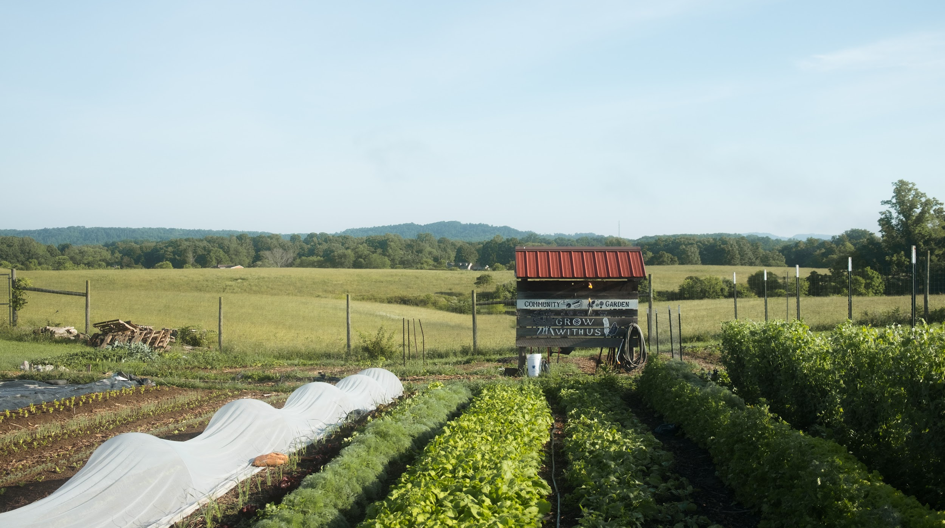

2025 Update
JTF Funding Opportunities
Presentation to MN Energy Transition Advisory Committee,
September 30, 2025
Notes:
HEIDI

Slide 2
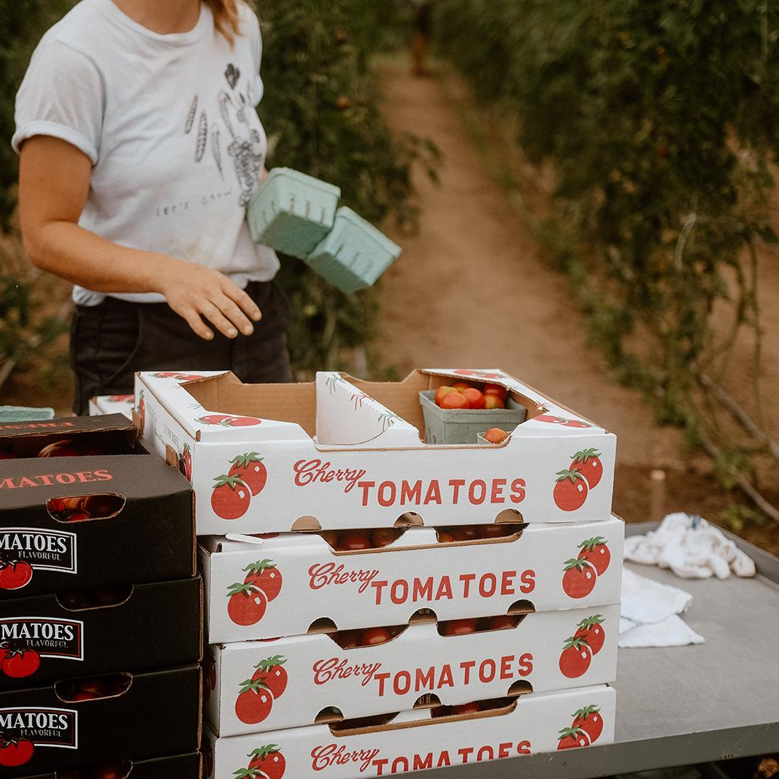
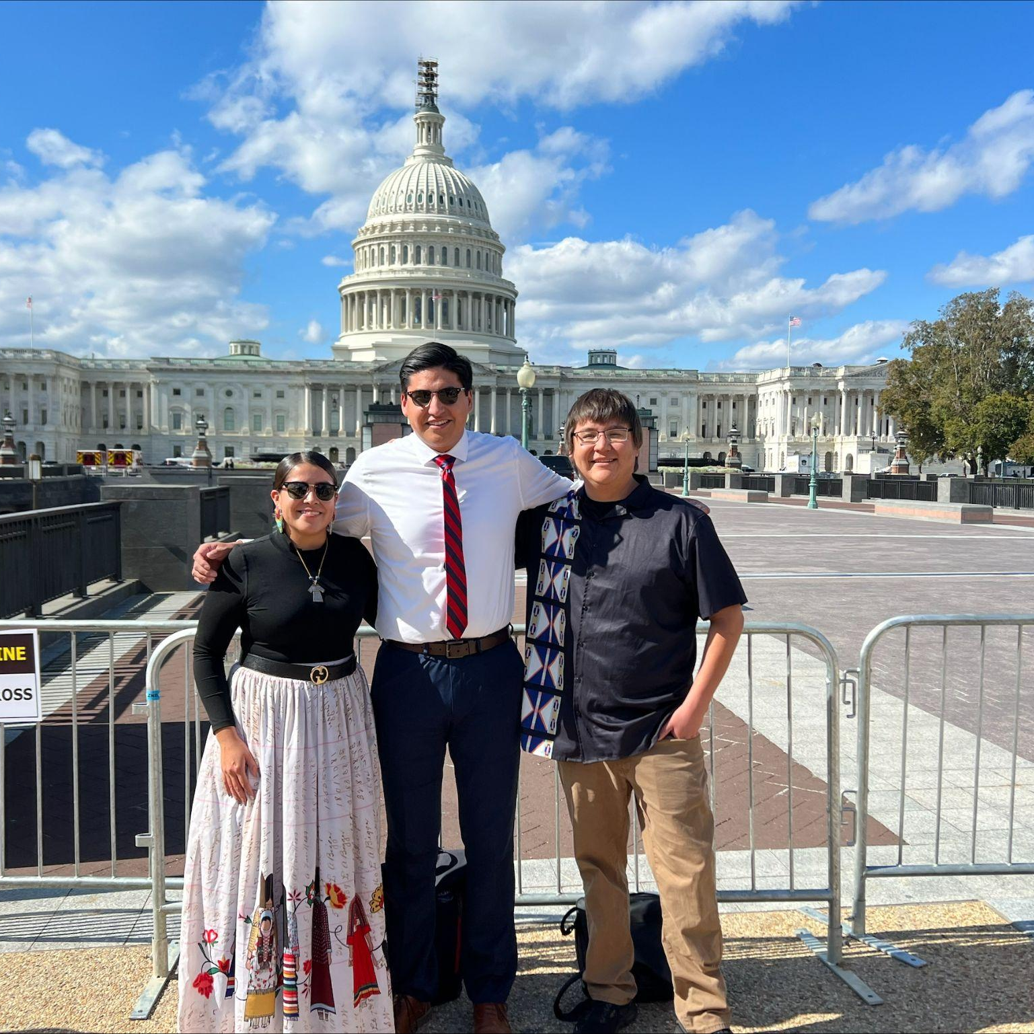
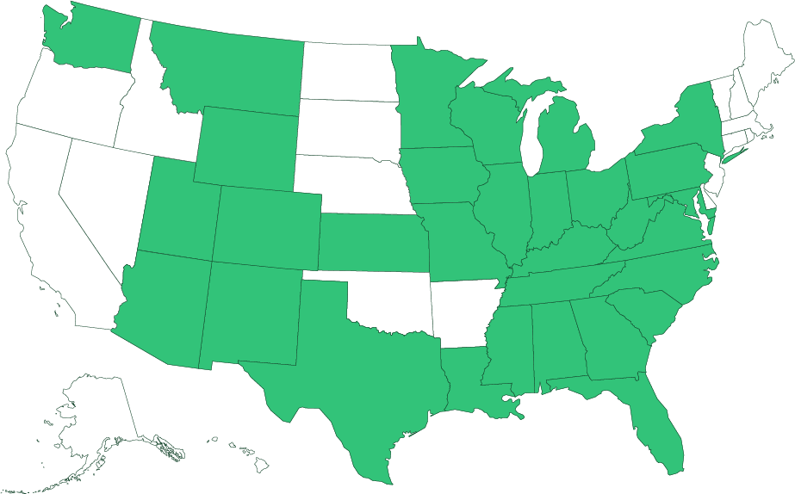



About the Just Transition Fund
Our mission is to create economic opportunity for the communities hardest hit by the transition away from coal.
Where We Work
372 counties ― or 10% of U.S. counties ― across the country are home to a coal mine and/or plant.
What We Do
We strengthen local economies by advancing economic solutions that are equitable, inclusive, and low-carbon.
Community Economic Development
Workforce Development
Broadband Infrastructure

Slide 3
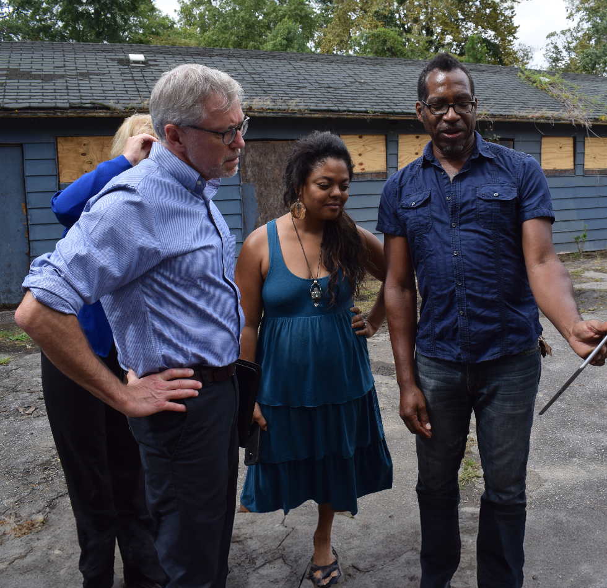
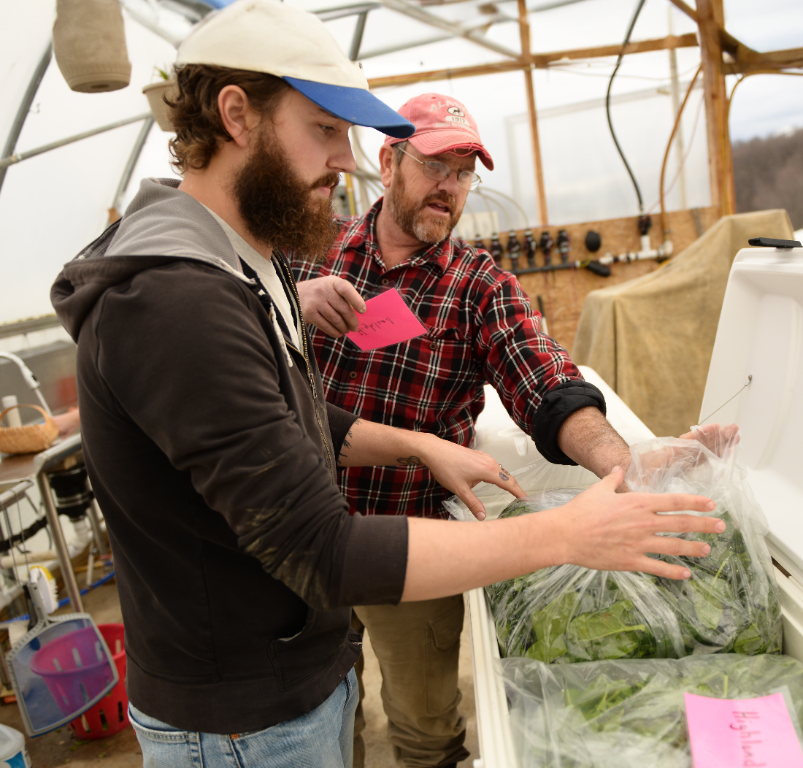
How We Work
Provide Grants and Technical Assistance for community-based nonprofit organizations, local governments, and Tribal governments to develop and scale local economic transition solutions.
Hybrid intermediary Part Grantmaker, Part Nonprofit Catalyst
Convene Network of Peers through annual convening(s), bringing together wide range of transition stakeholders to network, learn, and strategize.

Slide 4
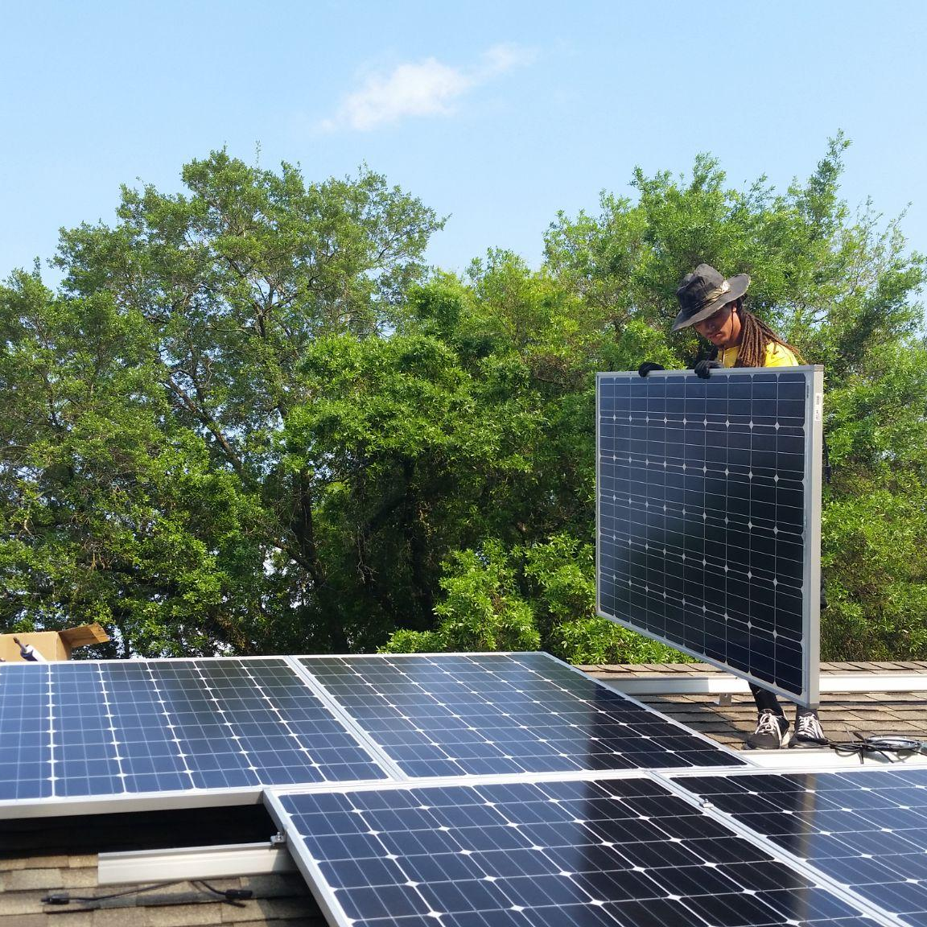
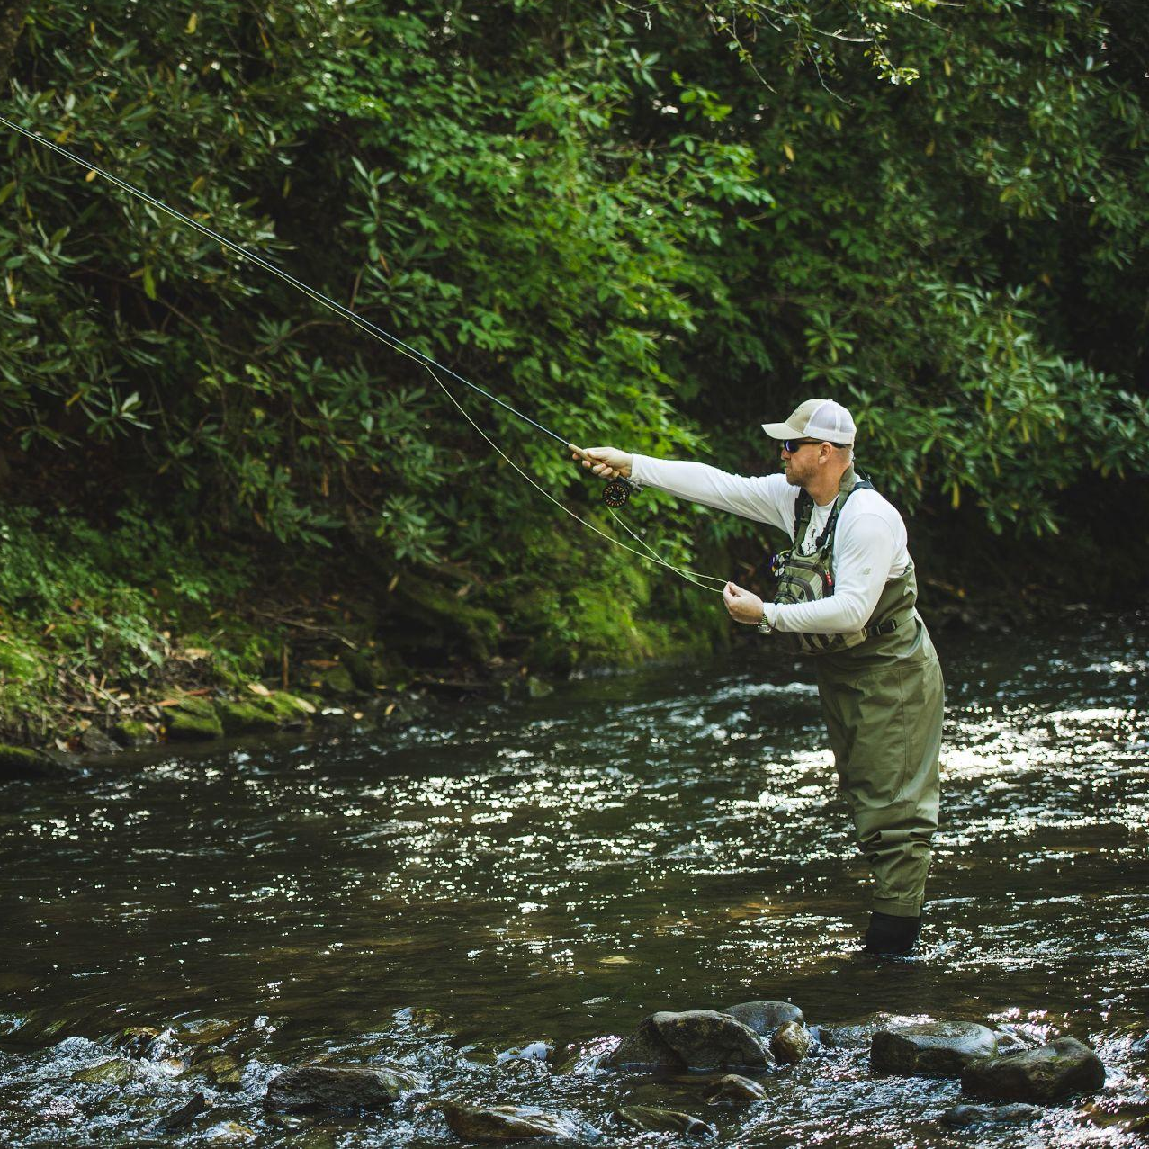



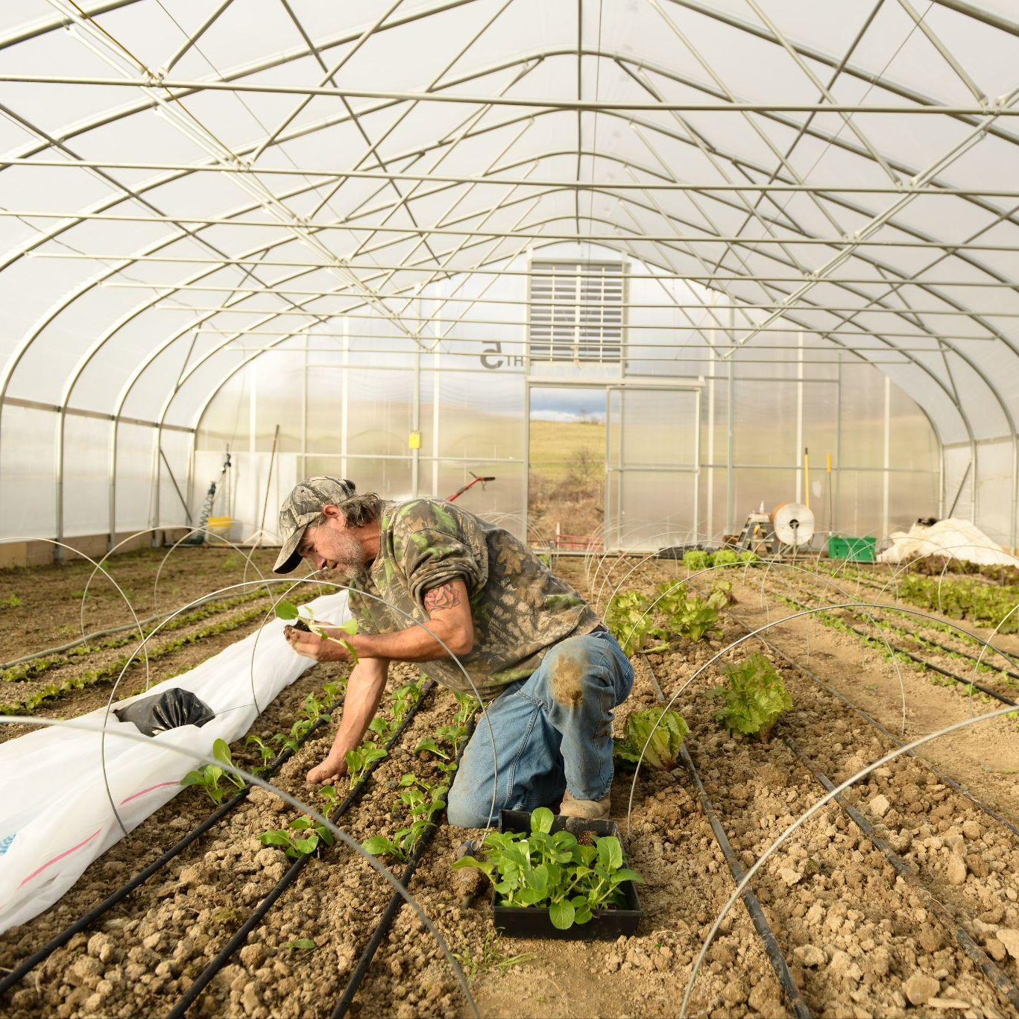


Federal Access Center
Project Examples the Lab Will Support
Entrepreneurship & Small Business Incubation
A downtown revitalization project to attract and retain local businesses. A business incubator network to provide training and access to capital to grow new entrepreneurs and small businesses.
Outdoor Recreation & Tourism
A “rails to trails” project that promotes regional tourism and new business development. Construction of an ecotourism complex.
Manufacturing
Attraction of a new battery manufacturing plant that retrains and upskills local workers. Retaining and growing existing local manufacturers by helping them expand into new markets.
Remote Work
Digital and other market-based skills training programs to connect local workers with
jobs they can do from home.
Coal Plant and Mine Reclamation & Repurposing
Installation of solar energy on abandoned mine land. Creation of energy/battery storage facilities at former coal plant sites.
For the past several years, our Federal Access Center helped coal communities access the historic federal investment to strengthen and diversify their local economies – spurring significant momentum across the country.
1. Flexible Grants (match, grant writing, capacity, studies, etc.)
The FAC supported communities through:
2. Technical assistance (federal navigation, grant review)

Slide 5
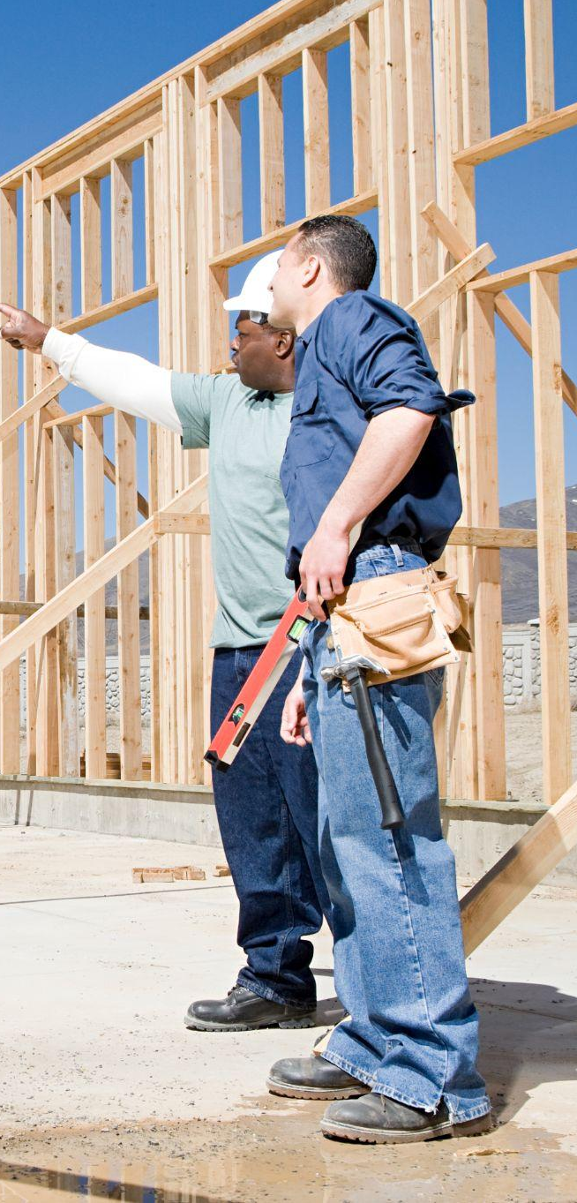



Our Strategies: Seed, Grow, Scale
⚘
Seed→
Prepare energy communities for fossil fuel plant and mine closures through capacity building grants.
Grow→
Grow critical economic and workforce development projects in energy communities.
Scale→
Drive private investment into projects with the power to transform local economies.

Slide 6
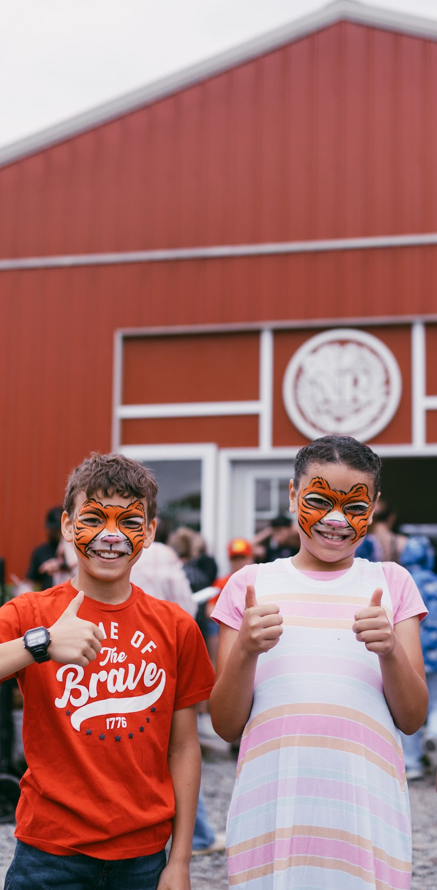
Local Economy Lab
Local Economy Lab
A multi-year initiative designed to grow and scale high-impact community led-economic development projects.
Criteria:
Place-based project that builds on community assets
Implementation phase
Measurable impact on the local economy with potential for scale
Potential to serve as a model
Organizations will receive:
Flexible grants of up to $500,000
Matchmaking with potential private sector partners
Help submitting competitive federal funding applications
Peer-to-peer networking and learning opportunities
Timeline:
2025 cohort to be announced later this year
Expected to re-open in spring 2026
A new, multi-year initiative that grows and scales projects with the power to transform local economies.
Matchmake with private sector capital
Host workshops to connect companies with coal communities
Create a menu of options for corporate engagement
Connect communities with catalytic philanthropic investment
Submit competitive funding applications
Identify creative financing strategies
Navigate landscape of remaining public funding opportunities
Learn from other rural communities
Hosting our annual National Convening (October in Minneapolis)
Fostering regular peer exchange
Tell the story of models that work
Capture and share proven strategies through our Blueprint for Transition, an open-source resource hub to guide other coal communities.
Notes:
Make this slide match the format of slide 7 – make the headers for the boxes the bullet points
Title: Already Closed for 2025: Local Economy Lab

Slide 7
Project Examples the Lab Will Support
Entrepreneurship & Small Business Incubation
A downtown revitalization project to attract and retain local businesses. A business incubator network to provide training and access to capital to grow new entrepreneurs and small businesses.
Outdoor Recreation & Tourism
A “rails to trails” project that promotes regional tourism and new business development. Construction of an ecotourism complex.
Manufacturing
Attraction of a new battery manufacturing plant that retrains and upskills local workers. Retaining and growing existing local manufacturers by helping them expand into new markets.
Remote Work
Digital and other market-based skills training programs to connect local workers with
jobs they can do from home.
Coal Plant and Mine Reclamation & Repurposing
Installation of solar energy on abandoned mine land. Creation of energy/battery storage facilities at former coal plant sites.

Slide 8

The Get Ready Challenge
The Get Ready Challenge
Supports communities that are planning for coal plant closures and in the early stages of developing new economic projects with potential to transform their local economy.
Organizations will receive:
Capacity building grants
Help securing public and philanthropic funding
Peer-to-peer networking and learning opportunities
Timeline: Applications expected to open in early 2026
We know the importance of building the pipeline and finding tomorrow's economic innovators.
It often takes years of strategy assistance and planning for organizations to become ready for large investment, and the best outcomes occur when communities plan early.
Over the last decade, we’ve supported many early stage projects that have gone on to secure large federal grants, including several Build Back Better winners.
The Challenge supports communities that are preparing for coal closures and starting to develop economic transition projects.

Slide 9
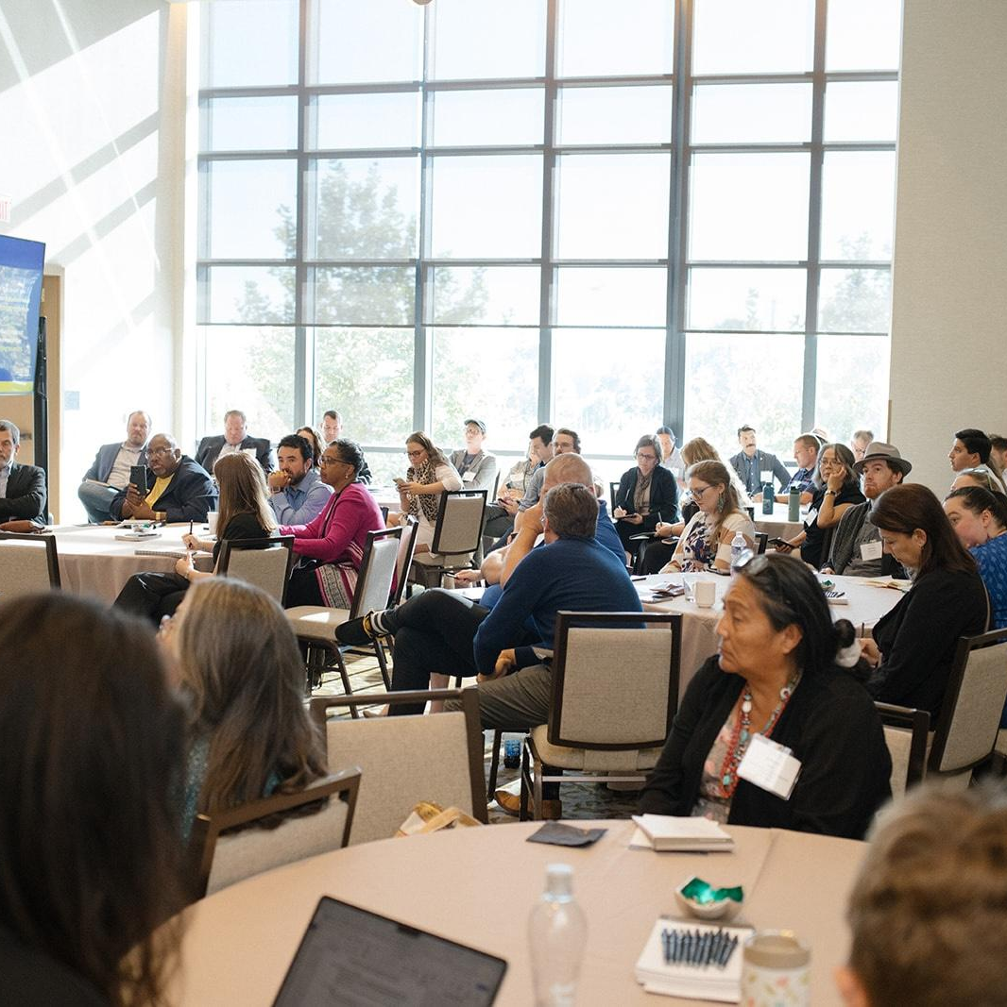

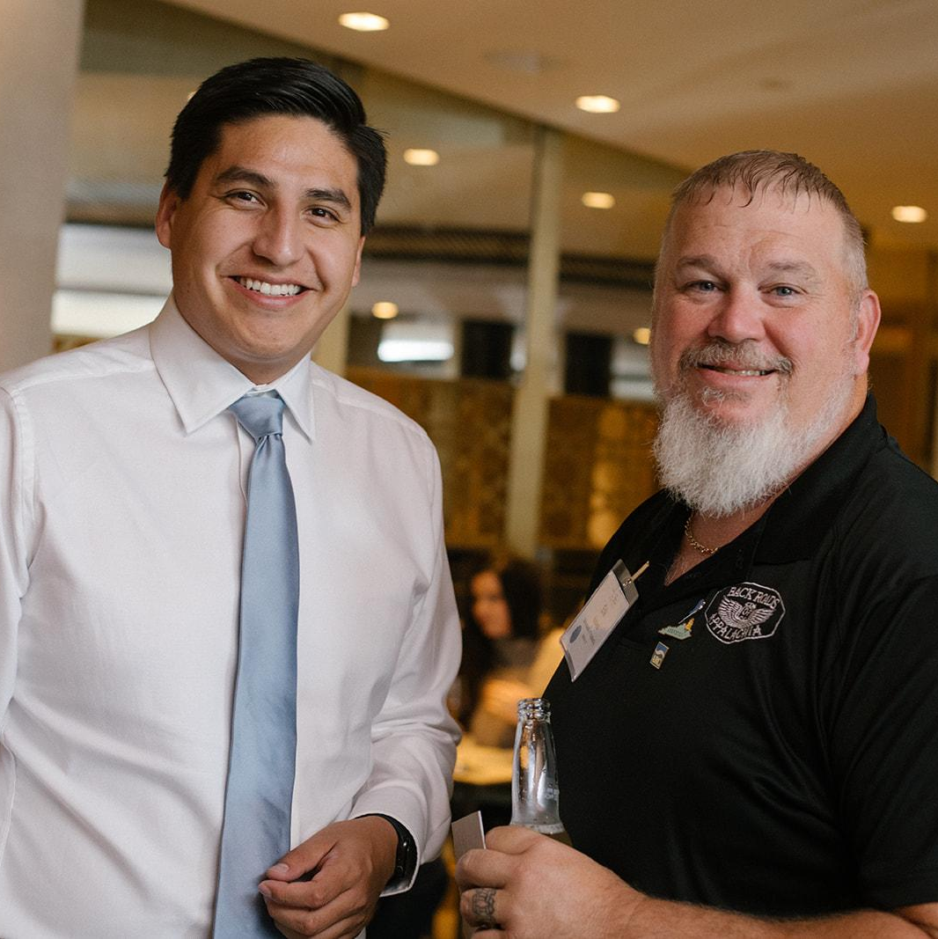
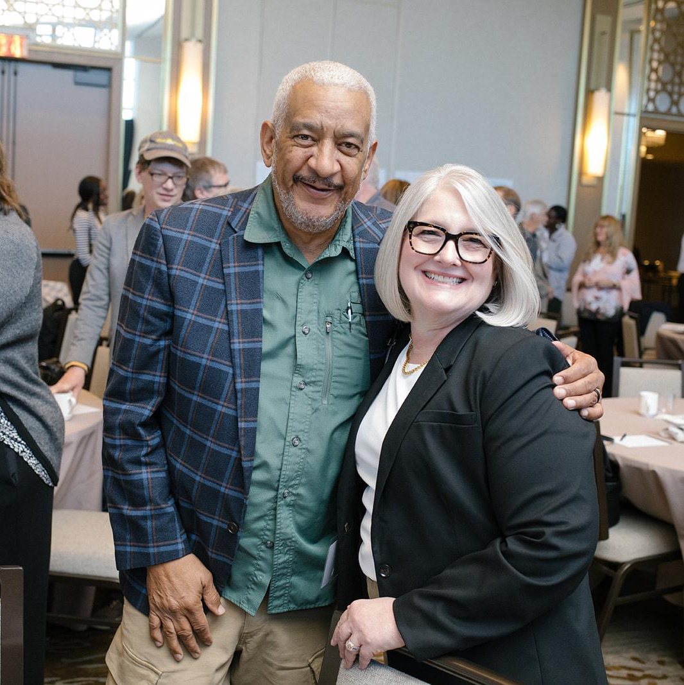

The Convening
We’re coming to Minneapolis! Our signature annual event helps to spread great ideas, build connections, and address shared challenges.
Our signature event brings transition stakeholders together to network, strategize, and learn.
Community leaders and practitioners
Policy experts
State, Local, and Tribal government
Labor leaders
Federal representatives
Private sector partners
Philanthropy
2025 Covening
Minneapolis, MN
October 28-30
94%
Attendees said it was the best event they attended in 2024
2024 Insights
Tuesday, October 28
Including a site visit to Becker!
2025
Midwest Gathering
Wednesday, October 29 Thursday, October 30

Slide 10
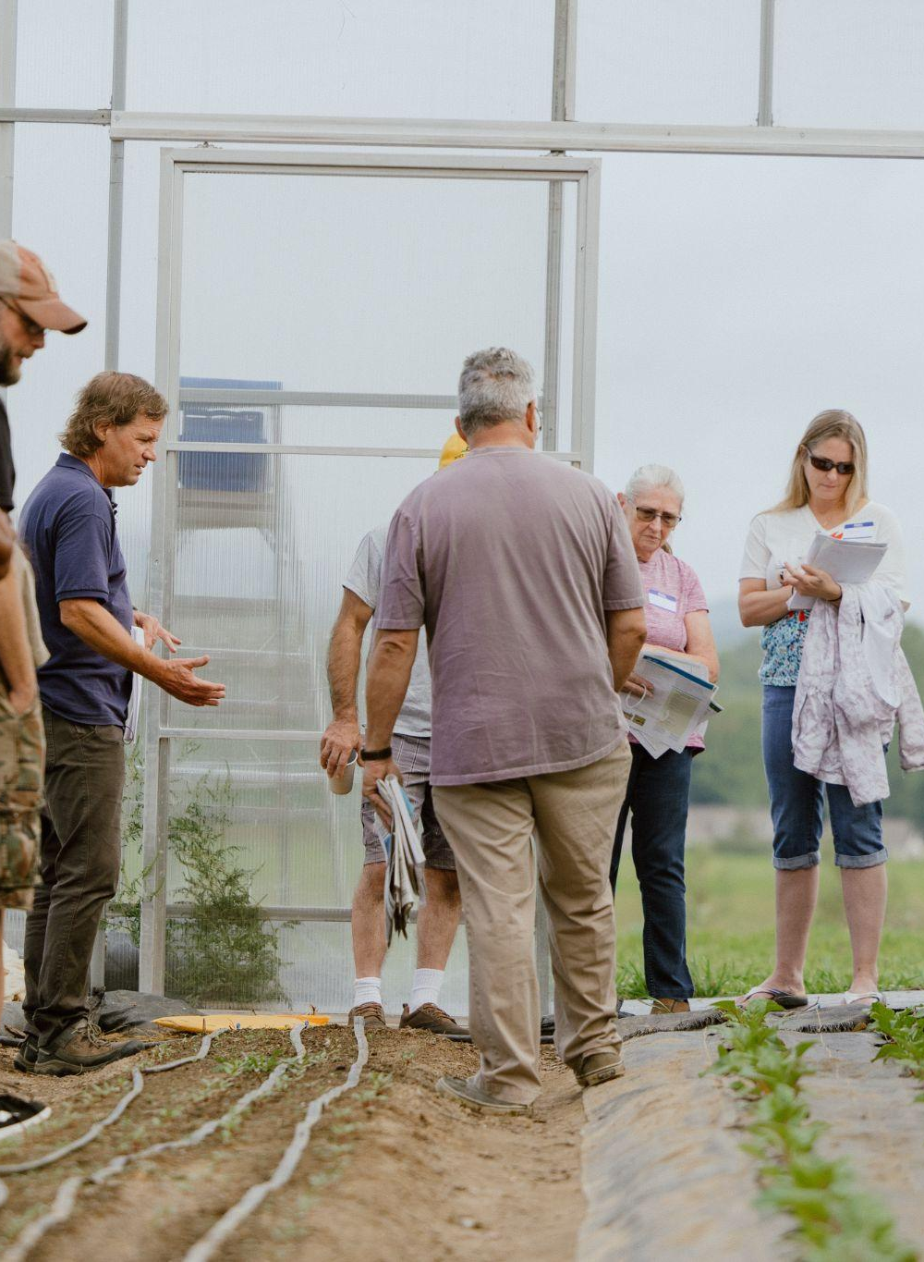
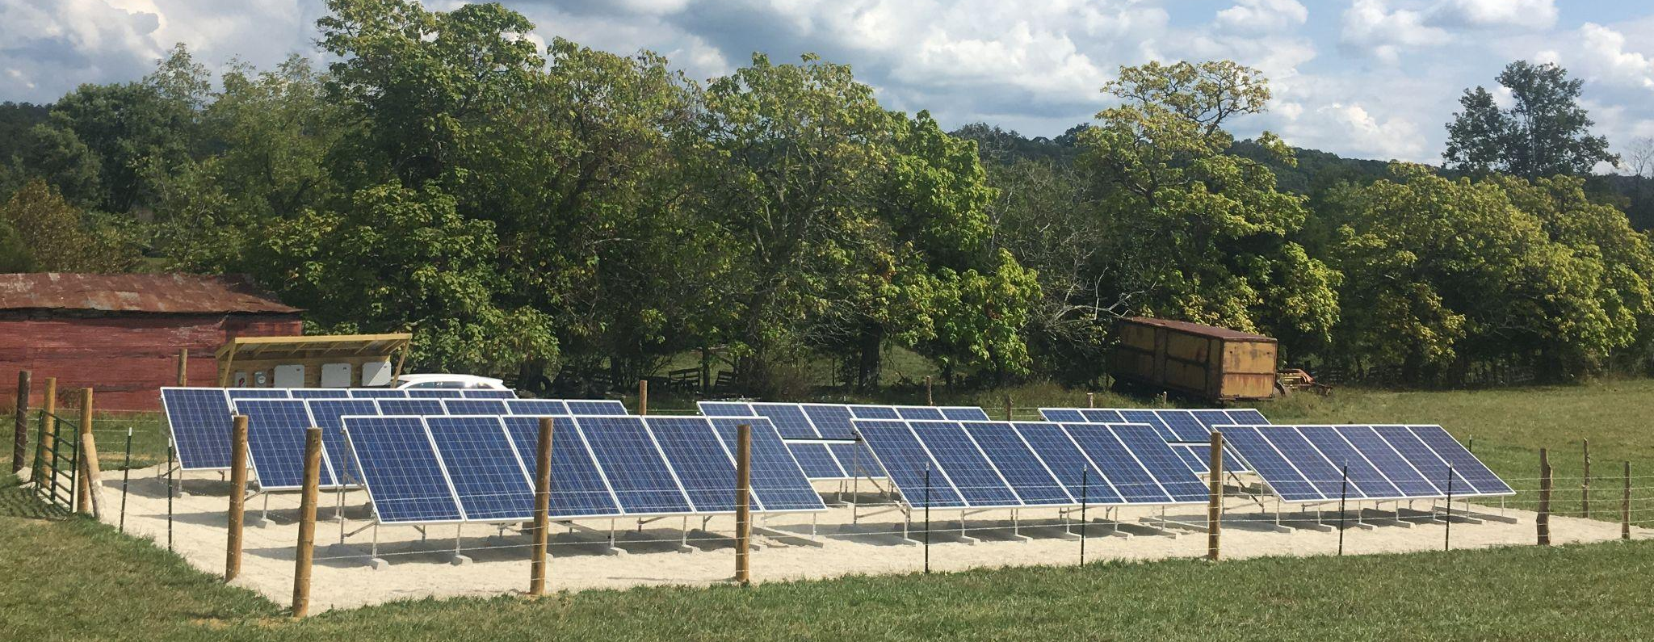
Contact
Rachael Young
Deputy Director of Partnerships
ryoung@justtransitionfund.org
Heidi Binko
Co-Founder and Chief Executive Officer
hbinko@justtransitionfund.org
Notes:
HEIDI

