Slide 1
GWDB Quarterly Full Board Meeting Wednesday, March 9, 2022 10:00 a.m. | Virtual Meeting (via Zoom)
GWDB website: https://mn.gov/deed/gwdb/

Slide 2
GWDB Appointments January-March 2022
New Appointments:
Commissioner Irene Fernando, Hennepin County Board of Commissioners
(Representative of Chief Local Elected Officials)
Kyle Van Acker, Goodwill Easter Seals of Minnesota
(Community-Based Organization Representative)
Josh Berg, Lifespark
(Business Representative; previously served as Local Elected Official Representative)
Deb Broberg, Real Time Talent
(Business Representative)
John Ramirez, Latino Economic Development Center
(Business Representative)
Reappointments:
Ali Rodway, Caribou Coffee
(Business Representative)

Slide 3
Introductions
Using the chat function in Zoom, please share:
Name
Organization
If you’re a GWDB Member, Designee (attending for a member), or a Guest
Reminder: For attendance purposes, please make sure the name displayed for you on Zoom makes your identity clear. If not:
Locate the window where your video (or initials) are displayed on Zom
Right-click that window, then select “Rename”
Type in your first & last name

Slide 4
Agenda for March 9, 2022
Welcome/Introductions – Laura Beeth, GWDB Chair
Legislative Priorities, Updates & Discussion – DEED Commissioner Steve Grove
Economic Development Awards as Drivers of Workforce Needs – DEED Deputy Commissioner Kevin McKinnon & Catalina Valencia, DEED Business Development Director
Labor Market Information (LMI): Workforce Trends & Data – Cameron Macht, DEED LMI
WIOA State Plan Modifications – Loren Nelson, GWDB Operations Committee Chair, & Ben Baglio, GWDB Director
Adjourn (by 12:00pm)

Slide 5
2022 WIOA State Plan Modifications: Background, Overview, & Strategic Elements for GWDB Review March 2022
Loren Nelson, Chair of the GWDB Operations Committee
Ben Baglio, GWDB Director

Slide 6
Overarching Goals of the 2014 Workforce Innovation and Opportunity Act (WIOA)
Replaced Workforce Innovation Act (WIA) as primary federal WFD law (& funding source)
Strategic alignment of workforce development programs
Increased cross-sector partnerships & cross-agency collaboration
Increase alignment between workforce development & education systems
More authority & flexibility for governors
Increase accountability & transparency of federal (WIOA) funding
Improve services for employers and workers/job seekers
Increase Career Pathways & work-based learning programming
More tailoring of programs to industry needs & earning industry-recognized credentials
Improve services and outcomes for individuals with disabilities
Increase access & improve outcomes for populations facing greatest barriers to employment (BIPOC, Veterans, Women, Disconnected Youth, Seniors, etc.)

Slide 7
WIOA State Plan: Refresher
WIOA requires states to produce State Plan on how they will use WIOA funds, deliver programming, coordinate services, & monitor outcomes
Funding through WIOA requires an approved Plan be in place
Strategic Elements of MN’s existing Plan (PY2020-23) approved by GWDB 3/2/20; DOL approved spring 2020
States must also update/modify these Plans every two years – may update more often, if they choose
Federal Guidance: delivered just before Christmas 2021, laid out expectations for what should be updated in existing State Plans; mostly a series of compliance-focused prompts to respond to
GWDB staff convened the “program administrators” multiple times, who oversee the programs in the Plan
DEED, MDE, DHS, DOC, DLI, OHE, MN State Colleges & Universities
GWDB staff then worked with these agencies to receive new language & incorporated proposed changes into a single document – which was posted for public comment on the GWDB website
GWDB staff will respond to inquiries & public comments

Slide 8
WIOA State Plan: Refresher (continued)
The GWDB Operations Committee reviews proposed modifications to the Plan, then makes a recommendation as a committee re:
Reviewing, modifying, and/or approving changes to the “strategic elements”
Authorizing GWDB/state staff to submit to the US Department of Labor (US DOL)
Operations Committee’s recommendation (3/3/22):
Approve strategic elements of the State Plan as proposed (in public comment draft)
Authorize staff to submit the Modified State Plan to US DOL
3/9/22: GWDB’s voting membership votes on the Operations Committee’s recommendation

Slide 9
State Plan Modifications: 2021-22 Processes/Timeline
Federal Guidance: issued late December 2021
Few substantive changes from 2020 Guidance
Most substantive changes were program-specific (concerning things like program delivery, etc.)
Increased emphasis on equity/disparities, which have grown since the pandemic
Program teams at each agency developed most of their own program-specific language/updates, some according to subsequent federal guidance received
GWDB staff convened and communicated with program administrators, received & compiled new language, modified language with various teams, & posted for comment
GWDB Director will respond to inquiries & public comments submitted (same as 2020)
March 8: Discussion with local workforce board directors on modifications
GWDB can develop further modifications at any point after these updates are approved

Slide 10
Minnesota’s WIOA Combined State Plan
At minimum, states must submit a State Plan that includes the four WIOA Core Title Programs:
WIOA Title I: WIOA Adult & Youth Programs – housed at DEED (ETP)
WIOA Title II: Adult Education & Family Literacy Programs – housed at MDE (ABE)
WIOA Title III: Wagner-Peyser Programs – housed at DEED (CareerForce)
WIOA Title IV: Vocational Rehabilitation Programs – housed at DEED (VRS & SSB)
States may submit a Combined Plan that includes the core programs & other federally-funded programs (to increase alignment)
Previous admin. elected to do a “Combined Plan” for the 2016-2020 Plan
2016-2020 Plan formed the basis for MN’s current Plan (PY2020-23) – which is still a “Combined Plan” (and preference of federal agencies)

Slide 11
Partner Programs
*Included in Minnesota’s 2020-23 WIOA Combined State Plan:
CTE programs (Perkins V) – MN State Colleges & Universities
Minnesota Family Investment Program (MFIP) – DHS
Supplemental Nutrition Assistance Program (SNAP E&T) – DHS
Trade Adjustment Assistance Program (TAA) – DEED
Jobs for Veterans State Grants (JVSG) – DEED
Senior Community Service Employment Program (SCSEP) – DEED
Reintegration of Ex-Offenders Program (Second Chance Act) – DOC
*Some Partner Programs have own sections, others referenced elsewhere

Slide 12
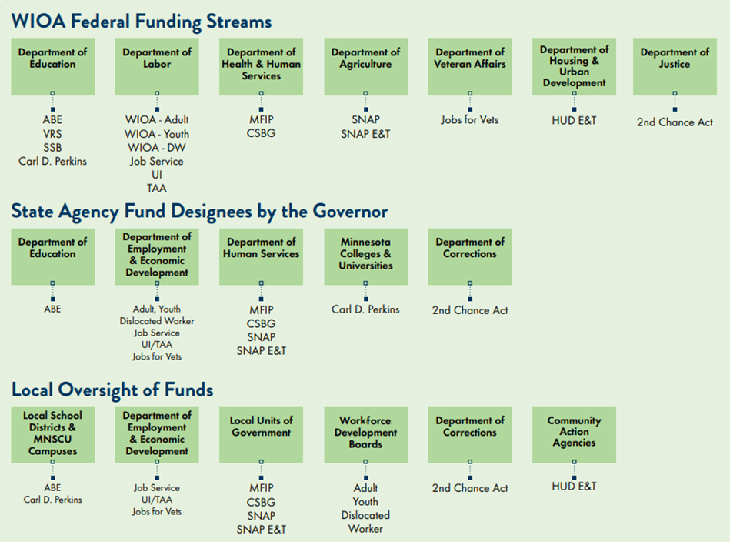

Slide 13
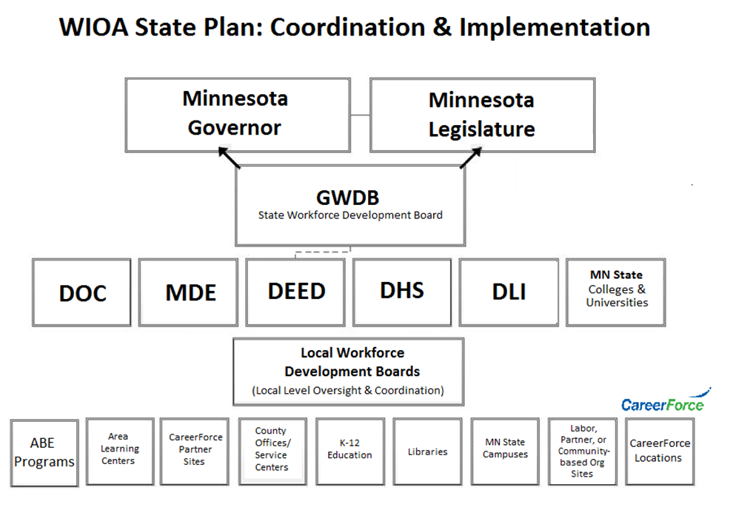

Slide 14
“Strategic Elements” of the State Plan: The GWDB’s Main Focus
GWDB input is found throughout the entire State Plan
GWDB staff worked closely with program teams, particularly CareerForce (Title III) and ETP (Title I), to develop updates & shared language
Strategic Elements under more direct scope of the GWDB include:
Mission
Vision
Goals
Overarching Strategies

Slide 15
Current State Plan Vision & Mission Statements (2022: No proposed changes)
Vision:
A healthy economy where every Minnesotan has meaningful employment and a family-sustaining wage, and where all employers are able to fill jobs in demand.
Mission:
To create a Career Pathway System that aligns local, state, and federal resources, policies, and services to meet the workforce needs of business and industry, and improves access to employment, education, and training services for Minnesota’s current and future workforce.

Slide 16
State Plan Goals (2022: No proposed changes)
Reduce educational, skills training, and employment disparities based on race, disability, gender, or disconnected youth.
Build employer-led industry sector partnerships that expand the talent pipeline to be inclusive of race, disability, gender, and age to meet industry demands for a skilled workforce.

Slide 17
Overarching Statewide Strategies
Business Engagement
Community Engagement
Customer-Focused Design
Funding and Resource Needs
Policy and System Alignment
System Management

Slide 18
Other State Plan Highlights
Public Comment Posting: https://mn.gov/deed/gwdb/priorities/wioa/
Economic & Labor Market Information: Pages 14-42
Developed by DEED’s Labor Market Information (LMI) team
Perhaps the most substantively updated section in 2022 (COVID-19 & related impacts)
Activities, Strengths, & Weaknesses of System: Pages 43-51
Vision, Mission, Goals & Strategies: Pages 53-63
Coordination/Alignment of Job Seeker & Employer Services: Pages 67-78
Workforce-Education Alignment: Pages 78-84
Workforce-Economic Development Alignment: Pages 84-87
Increased alignment is one of DEED’s top agency objectives in 2022 (OKR #4)
Program-specific sections: see Table of Contents
Developed primarily internally between leaders/staff within respective agency

Slide 19
GWDB State Plan Modifications: Operations Committee Recommendation
GWDB Operations Committee Chair:
Loren Nelson, Aurelius Manufacturing (Braham, MN)
Motion from the GWDB Operations Committee:
Approve the strategic elements of the Modified WIOA State Plan
(Mission, Vision, Goals, & Strategies)
Authorize staff to submit the Modified WIOA State Plan to the U.S. Department of Labor on behalf of the State of Minnesota

Slide 20
GWDB State Plan Modifications: Operations Committee Recommendation
Motion from the GWDB Operations Committee:
Approve the strategic elements of the Modified WIOA State Plan
Authorize GWDB staff to submit the Modified WIOA State Plan to US DOL
Questions/Comments will be fielded in this order:
GWDB members (voting or non-voting)
Designees from state agencies attending/voting on behalf of their agency’s commissioner
Other workforce partners or meeting participants
Voting Process & Reminders:
GWDB voting members may vote on this motion
Delegates representing State Agencies may vote on this motion if their state agency’s commissioner has authorized it
Voice vote (unless roll call vote is requested)

Slide 21
Adjourn
Thank you for attending today’s meeting!
Questions? Comments?
Ben Baglio, GWDB Director
Ben.Baglio@state.mn.us

