Slide 1
Jennifer Kuklenski
Regulatory Strategy and Policy Manager

Slide 2
400 megawatts of new wind
Add 400 megawatts of new wind projects by 2035 in addition to the 700 megawatts of renewables now in development
Expand energy storage resources by 100 megawatts by 2035
Maximize and expand customer-focused programs
Including energy efficiency and demand response
Conversion and continued use of Boswell Energy Center in Cohasset
Replacing the company’s last coal-fired baseload generation with fuel-flexible natural gas for immediate carbon reductions
Refuel Boswell Unit 3 (355 MW) by 2030 – will continue to explore biomass fuel opportunities
Boswell Unit 4 (585 MW) will be adapted to be 40% natural gas by 2030 if required by current carbon regulations – coordination underway with WPPI partner on future fueling alternatives
Plan highlights

Slide 3
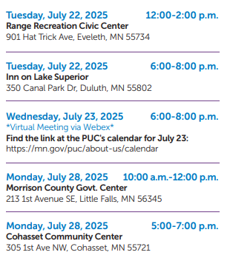
IRP PUBLIC PARTICIPATION
The Minnesota Public Utilities Commission (MPUC) collects public input on whether they should approve, modify or reject MP’s IRP
Public Hearings around MP’s service territory
Public Comments
Initial Comments due August 15; Reply due October 15
Public may submit comments to the MPUC, referencing Docket # E015/RP-25-127
To submit a comment online, go to https://mn.gov.puc/get-involved/public-comments/
Email consumer.puc@state.mn.us
Mail to: Minnesota Public Utilities Commission, 121 7th Place East, Suite #350, St Paul MN 55101
Commission hearing anticipated in Q2 2026

Slide 4
Thank you
The statements contained in this presentation and statements that ALLETE may make orally in connection with this presentation that are not historical facts, are forward-looking statements. Actual results may differ materially from those projected in the forward-looking statements. These forward-looking statements involve risks and uncertainties, and investors are directed to the risks discussed in documents filed by ALLETE with the Securities and Exchange Commission.
Notes:
Forward-looking statement

