Slide 1
FFY27 Annual Training
Energy Assistance Program
Refunds review; Name on Account review

Slide 2
Refunds Review
Mandy Braaten

Slide 3
Items to Note
SP and Vendor have roles in refund process
Refunds MUST be complete by September 15 of current program year
Vendors are to only submit refunds at the request of the SP

Slide 4
What We Know About Refunds
Refunds are sometimes confusing
Vendors submit refunds anytime, they don’t always wait for SP to request the refund
Refunds need to be dealt with timely
Refunds should be a consistent part of weekly self monitoring activities
SPs typically hear about HH vendor and address changes long after they happen. In most cases, before and after approval is indicated by the time at which the SP has been advised of the move or change.
  Exceptions to this rule would be in the example of an incident including error or fraud

Slide 5
Why Are Refunds Initiated
Payment error
  Fraud
  SP or HH error when completing/processing application
SP request due to new energy vendor
  HH moved either in current SP service area or to new SP service area
  HH changed fuel types
  HH changed fuel vendors
Vendor account was inactive or closed at time of payment
  Payments cannot be made to an inactive or closed account

Slide 6
Why Are Refunds Initiated, Cont.
In all other instances, any other EAP funds remaining on an account to be closed or made inactive by an energy vendor should be refunded directly to the HH or Unclaimed Property

Slide 7
Topics
Refund Initiation
Refund Identification
Managing the Refund
Lifecycle of a Refund

Slide 8
When Are Refunds Initiated

Slide 9
HH Is No Longer A Customer
HH contacts SP or Vendor with new address and vendor info
OR
Vendor makes reasonable effort to contact HH to advise funds remain and to contact SP with updated address and vendor info
  Call all available phone numbers
  Send letter to last known address

Slide 10
HH Is No Longer a Customer, cont.
If HH cannot be located or does not respond within 30 days, the vendor should:
  Refund benefit to HH (if new address is known)
  Forward to Unclaimed Property
Refunds of accurate payments go to the HH unless the refund occurs during the current program year and the HH’s new address and vendor(s) have been identified

Slide 11
HH Changes Delivered Fuel Vendor
After payment has been made, SP:
  Verifies new account info
  Determine funds remaining at original vendor
  Request Refund from original vendor
  Accept Refund
  Pay refunded amount to new vendor
Reminder: Refunds during current program year must be processed by September 15

Slide 12
HH Moves Within, or To A New, SP Service Area
HH contacts SP or Vendor with new address and vendor info
OR
Original vendor makes reasonable effort to contact HH to advise funds remain and to contact SP with updated address and vendor info (see slide 7 for additional info)
Refunds of accurate payments go to the HH unless the refund occurs during the current program year and the HH’s new vendor(s) have been identified

Slide 13
HH Moves Within, or To New, Service Area, cont.
If HH moved to new SP service area:
  Encourage HH to contact new SP
  If new vendor info is known, request refund from original vendor
  Transfer application to new SP

Slide 14
HH Moves Out of State
  If account was active at time of payment, vendor makes reasonable effort to contact HH to advise funds remain and to determine new address.
    Remaining credit goes to HH or Unclaimed Property
  If account was inactive at time of payment, vendor returns funds to SP
    Once refund is received, close the application
    HH may request the application be reactivated if they return during same program year.
    Remaining payments will then be made to new vendor

Slide 15
Approved HH Moves to Ineligible Dwelling
Do not reassess application
HH is eligible for payment of remaining account balance
  Remaining credit goes to HH by Vendor
  If HH cannot be located or address is unknown, payment is then forwarded to unclaimed property

Slide 16
Approved HH Moves to Nursing Home or Institution
This applies when all members move
  If any members remain in the HH, funds will remain as previously allocated
If application has not yet been approved
  Application will likely be denied ineligible dwelling
If after application was already approved:
  Void any remaining scheduled payments, if applicable
  If account was active at time of payment, remaining credit goes to HH or Unclaimed Property
  Remaining current year funds must be refunded by the vendor if payment was made to an inactive account
    After the refund is received close the application

Slide 17
All Members of a HH Die
If SP Learns Pre Approval/Pre Benefit Payout
Make notes in eHEAT
Send letter to HH advising denial due to all members have died
Close application
If SP Learns Post Benefit Payout
Vendor follows MN Unclaimed Property requirements
Void remaining payments in eHEAT
Make notes in eHEAT
Send HH letter advising remaining payments were cancelled as all HH members died
Close application

Slide 18
EAP Benefit Overpayment Due To Error or Fraud
Recovery efforts for overpayments of $10 or greater must occur
Adjust any remaining scheduled payments, if applicable
Request refund of any remaining credit on vendor account
Request remaining overpayment from HH (see Overpayment and Recovery of EAP Funds, Ch. 10, Pg. 6)
Submit Incident Report detailing occurrence and steps taken to correct overpayment

Slide 19

How Is the Refund Identified
Part of regular SP Self-Monitoring activities
Expectation for SP to review weekly, at minimum

Slide 20
Refund Identification

Slide 21
How to Find a Refund Submitted by Vendor
Payment Services>Vendor Payments
Select Payment Status “Proposed Refund”
Enter Program Year
Click “Go”

Slide 22
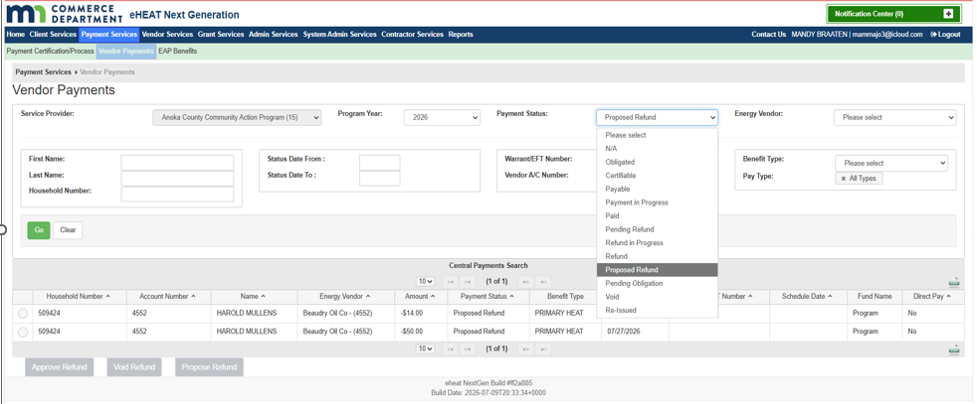
How to Find a Refund Submitted by Vendor eHEAT View

Slide 23
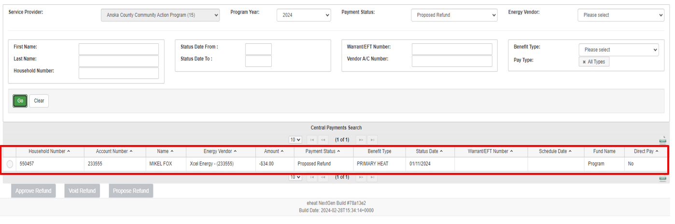
Proposed Refunds Will Show in Search Area

Slide 24
Managing the Refund

Slide 25
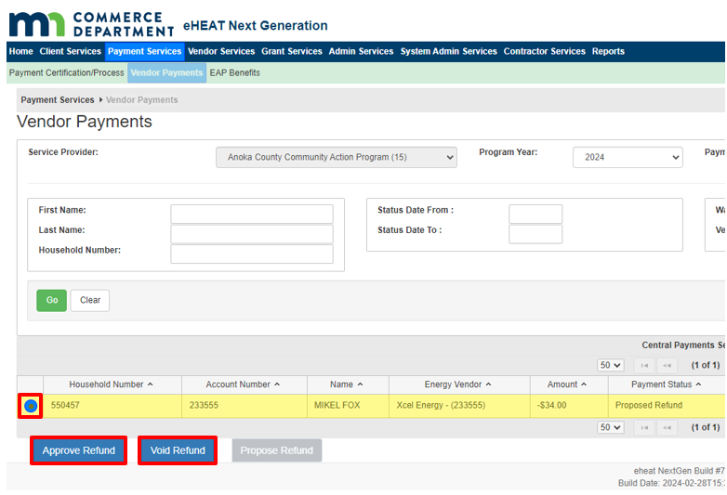
Refunds Cannot Stay as “Proposed Refund” - An Action Must Be Taken
Approve
  When SP knows new vendor info
  When SP requested refund due to payment error
Void
  When SP does not know the new vendor info
  SP did not request the refund
  This rejects the refund submission from vendor

Slide 26
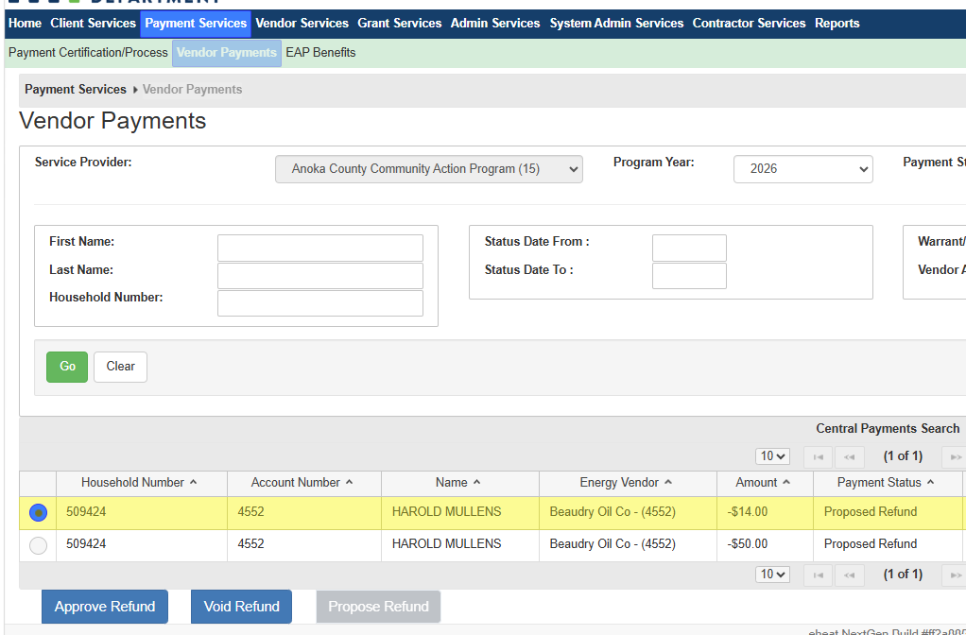
Approving the Refund, 1/3
When SP knows where to send the refund
  Click radio button next to HH you want to work with
  Click “Approve Refund”

Slide 27
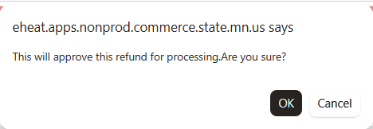
Approving the Refund, 2/3
  On the pop-up window select OK to approve the refund for processing.

Slide 28
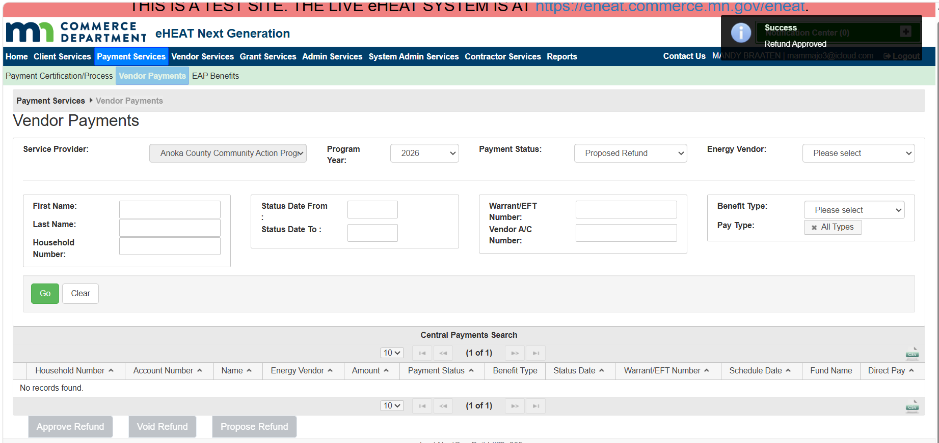
Approving the Refund, 3/3
  On the pop-up you will see the approval was a success
  The proposed refund now becomes a pending refund

Slide 29
Paying out a Refund
Refunds can be paid to a new energy vendor at any time once the Proposed Refund is approved by doing the following:
  Payment Services>EAP Benefits
  Select Refund Only “Yes”
  Enter Program Year
  Click “Go”
Any Pending Refunds will appear at bottom of screen
This can also be done via the Application>Payments>Primary Heat>Manage Payment
  Select “Add Vendor”, enter new EV name & the amount (must first add EV to HHs eHEAT file)
  Full amount must be paid out; don’t leave funds undistributed

Slide 30
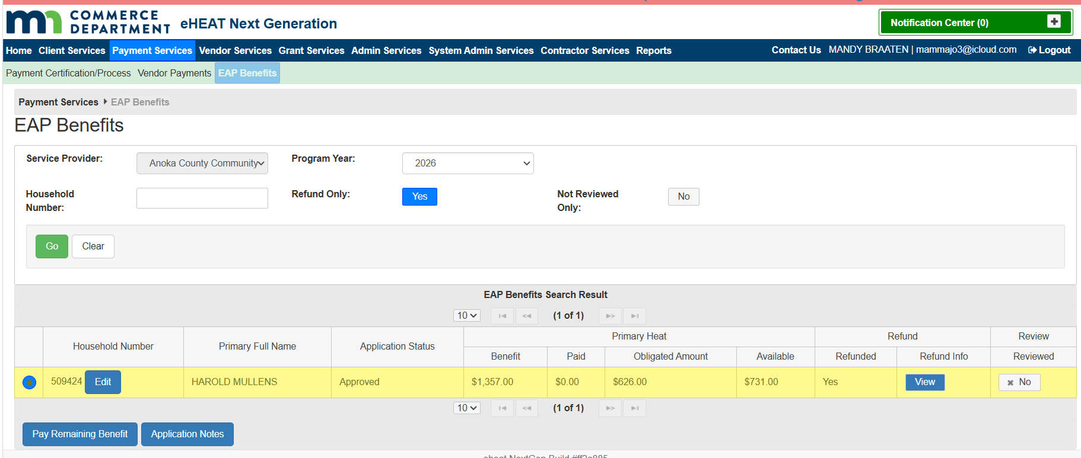
Image of Payment Services>EAP Benefits Pending Refund

Slide 31
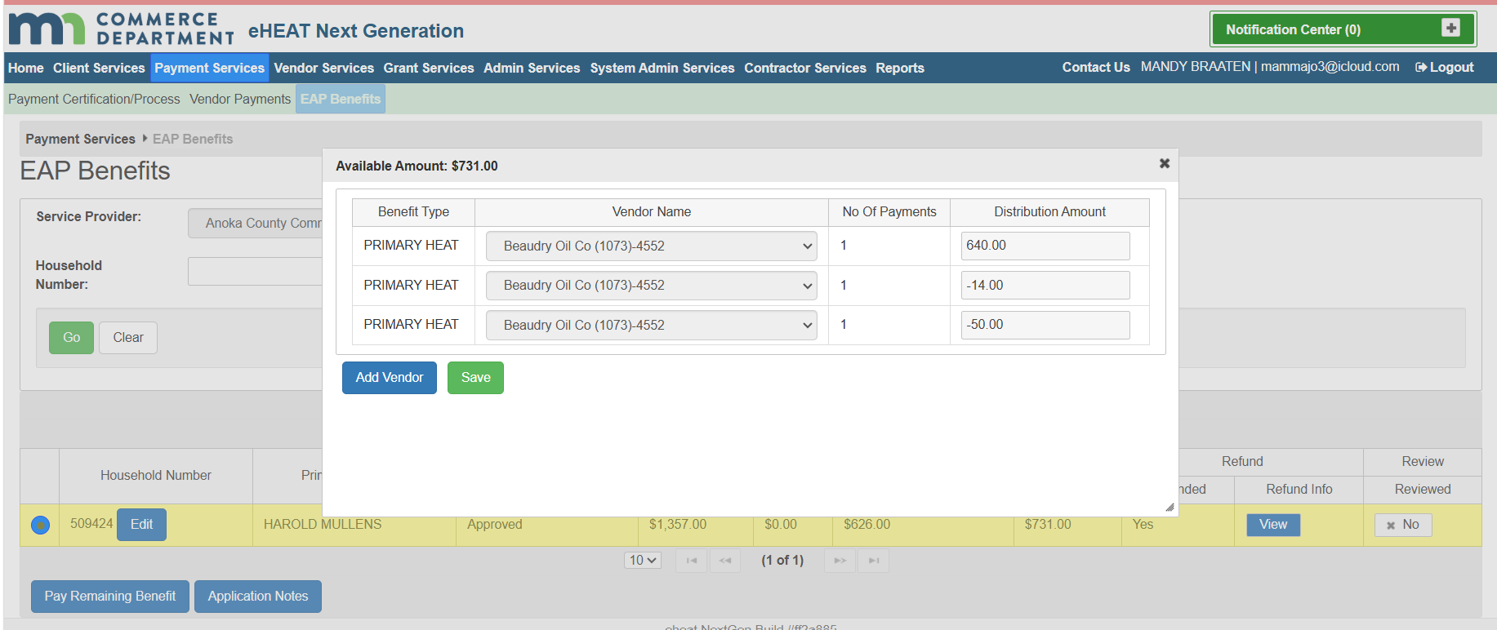
Paying out a Refund, 1/3
Select radio button next to HH you wish to pay
Click “Pay Remaining Benefit”

Slide 32
Paying out a Refund, 2/3
On the pop up, click add vendor

Slide 33

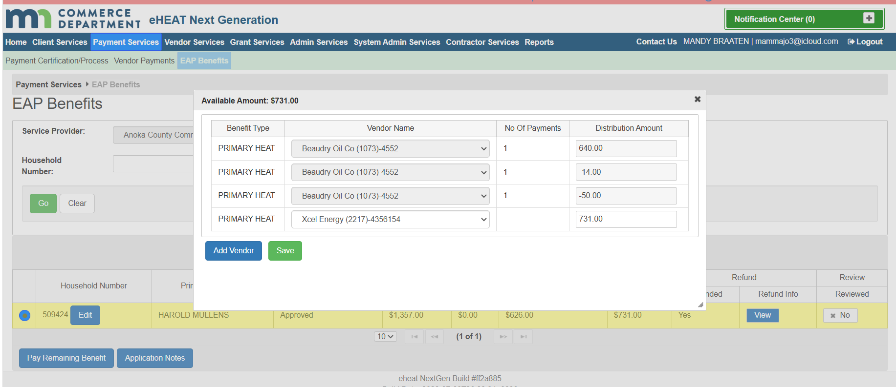
Paying out a Refund, 3/3
Add the vendor info and amount to be paid
Click Save
The pop-up will advise that you saved successfully

Slide 34
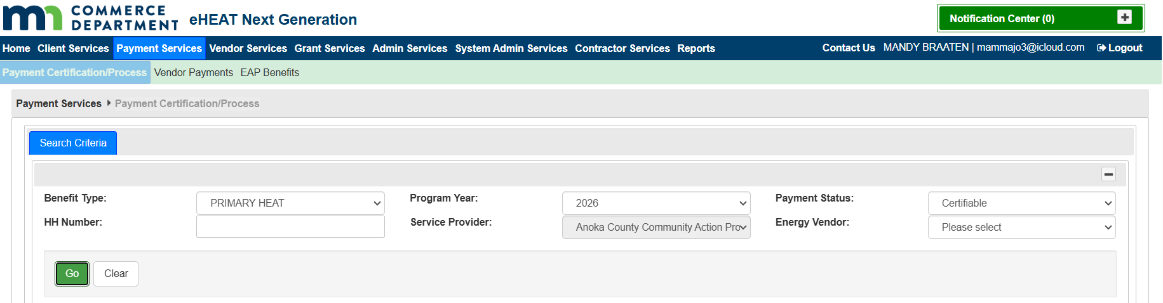
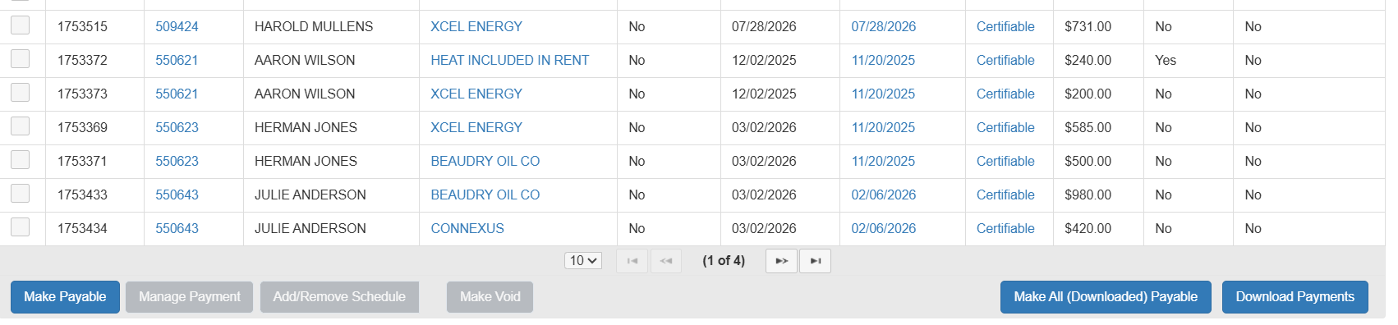
Finalizing the Payment
Payment Services>Payment Certification Process
  Search for Certifiable Payments
  Click Go
  Select radio button next to HH you wish to pay
  Select Make Payable

Slide 35
Payment Complete
  You have successfully processed a refund

Slide 36
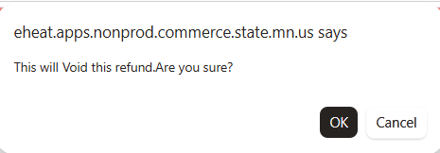
Voiding the Refund
When SP doesn’t know where to send the refund:
  Click radio button next to HH you want to work with
  Click “Void Refund”
  On Pop-up window select OK to void the refund

Slide 37
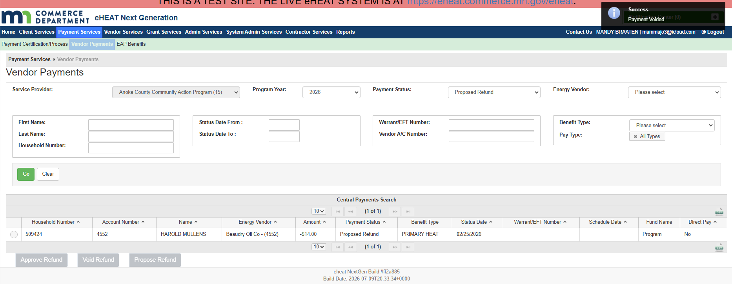
Voiding the Refund, cont.
  Pop up window will show “Success” Payment Voided

Slide 38
Where does a Voided Refund go?
It doesn't "go" anywhere. Void means you said no, there is no refund at that point.
The Vendor proposed the refund; the SP voided it because they did not request it.
No money was added or removed; it is like it didn't happen.
There will be a voided record (to show history that a proposed refund was entered and voided) but no other action occurs
You have successfully voided a refund

Slide 39
Managing ERR Refunds
eHEAT does not have a built-in ERR refund process
There are scenarios where funds need to be returned
  Payment made to wrong contractor
  Overpayment
When original check is uncashed and/or returned; fiscal will void the payment in eHEAT on the contractor payment screen and stop the payment in SWIFT
When check has been cashed or paid by EFT, contractor sends check to commerce, fiscal documents and logs payment, SP makes notes on ERR event and task explaining reason for refund

Slide 40
Life Cycle of a Refund

Slide 41
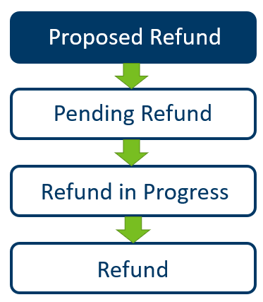
Proposed Refund
A “Proposed Refund” is generated when the vendor enters the refund
Proposed Refunds are found under Payment Services>Vendor Payments
SP must either Approve or Void a “Proposed Refund”
Voided refunds stop the refund process
  Vendors are notified when a refund is voided
  Vendors can re-enter voided refunds, if needed

Slide 42
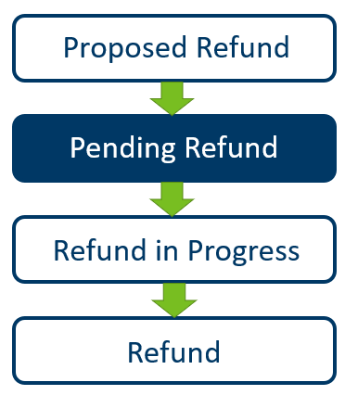
Pending Refund
A “Pending Refund” is a Proposed Refund that has been approved
Funds are immediately available for payment to new vendor
SP can only pay a “Pending Refund” to a new vendor or pay it back to the original vendor
  Sometimes, a refund will stay pending until the program year ends or a vendor submits a check (ex: behind the wall)
Pending Refunds remain pending until there is a future payment to that vendor the payment can be deducted from
  SPs do not directly advance Pending Refunds
An application with a “Pending Refund” cannot be closed
Notes:
To check the refunds waiting to be paid out you can go to eap benefits and work with them there.

Slide 43
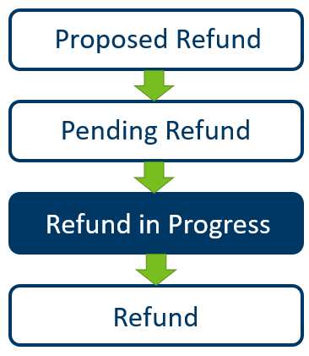
Refund in Progress
“Refund in Progress” is equivalent to Payment in Progress
Once there is a payment the refund can be deducted from, Pending Refund changes to “Refund in Progress”
  For example, money does not physically move between accounts. If the EV refunded $500 and we now owe them $1,000 in benefits for a new HH, the actual payment would be $500 as the originally refunded $500 is still on their account
  If the EV does not receive additional payments throughout the year, they would need to send a check to Commerce before program end for $500.

Slide 44
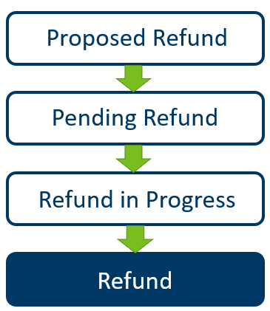
Refund
“Refund” is the final status of a refund
Refund in Progress changes to “Refund” when the payment it is deducted from is paid
  In our previous example, this would be the benefit payment for the HH receiving $1,000 in benefits: $500 from the refund $500 from a new payment issued
If a vendor sends a check for a current year refund, the status in eHEAT will immediately be “Refunded”

Slide 45
Q&A

Slide 46
Name on Account Review
Mandy Braaten

Slide 47
Topics
Name on Account History
Changes
  Pre/Post Approval
Entry in eHEAT
Summary

Slide 48
Name on Account History

Slide 49
From The Beginning
Policy began in FFY25
The name on a HH vendor account must match the name of a HH member listed on the app
EAP no longer pays to vendor accounts not in a HH member’s name
  The name on account cannot include non HH members or deceased persons
  If a vendor keeps a deceased person’s name on the account, you cannot make payments if the deceased person is listed as an account owner; the vendor must only list living HH members as the owners of the account for the account to be a name “Match”

Slide 50
From The Beginning, Cont.
eHEAT must have a “vendor” to pay
  “No Account in HH Name” vendor does not affect benefit determination, it just tells eHEAT where the payment goes
  “No Account in HH Name” vendor is used to advise eHEAT to make a direct payment to the HH

Slide 51

The Question Is…..

Slide 52

Is it a “Match”

Slide 53


Or “No Match”

Slide 54
What is Considered a Name Match
Birth name or documented formal name changes
  There must be reasonable evidence for birth name and documentation of other formal name changes
    e.g., marriage license, medical records, divorce decree, etc.
Hyphenated or multiple last names where an app or the vendor account includes only part of a hyphenated or multiple last name
Proper name vs. nickname
  e.g., Mo for Mohammed, Beth for Elizabeth, etc.

Slide 55
What is Considered a “No Match”
An attorney in fact (power of attorney), guardian, conservator, representative payee name
Any account owners that are not part of the approved EAP HH
An individual not counted as a HH member (e.g., ineligible non-citizen)
A deceased family member, regardless of their relationship to the app
A business, even if owned by a HH member

Slide 56
Changes Pre and Post Approval

Slide 57
When A Name On Account is Updated or Changed
This applies only to those individuals who were on the original application
Pre app approval:
  Validate with vendor
  Update app and eHEAT
  Make Notes
Post app approval:
  Validate with vendor
  Update eHEAT
  Make Notes
  Do not re-determine PH benefits
    HH may now be eligible for Crisis benefits

Slide 58
Entry in eHEAT

Slide 59
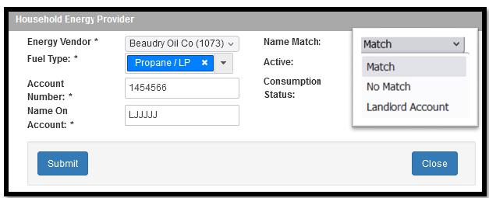
SP Identifies Accounts in eHEAT
As “Match”, “No Match” or “Landlord Account” in the Name Match field
eHEAT won’t make payments to the “No Match” account
If no accounts are in a HH member’s name
    Add the “No account in HH name” to the Energy Providers section in eHEAT to make the direct payment

Slide 60
No Account in Household Name Summary

Slide 61
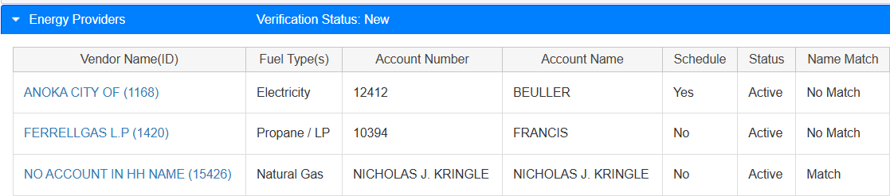
No Account in HH Name Summary
Should ONLY be present when ALL vendors are in a “No Match” status
“No Account in HH Name” vendor added
HH Receives Minimum $200 benefit
Direct Pay to HH

Slide 62
Summary, Continued
“No Name on Account” Vendor
    Does not include the HIR and EIR accounts
  Never add “No Name on Account” vendor to
    Heat and/or Electric Included in Rent HHs
    HH with Landlord Accounts

Slide 63
Q&A

