Slide 1
FFY27 Annual Training
Energy Assistance Program
eHEAT Enhancements

Slide 2
eHEAT Enhancements
Jon Brown

Slide 3
Topics
Deployed Enhancements
Planned Enhancements
Clarifications

Slide 4
Deployed Enhancements
Cancel Withdrawal letter
Post delivery confirmation notification
Online app search screen exports
Housing cost warning
Expected denial date sortable
History added for delivery confirm info
Agency Report of Work Production update

Slide 5
Planned Enhancements
Online app 18+ without income
Wood percent from previous year
No heat vendor checkbox
Lock consumption when accordion “Verified”

Slide 6
Clarifications
Online apps with one vendor
Editing RFI Letters

Slide 7
Deployed Enhancements

Slide 8
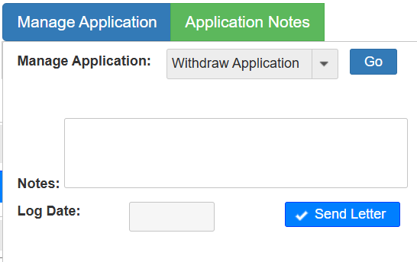
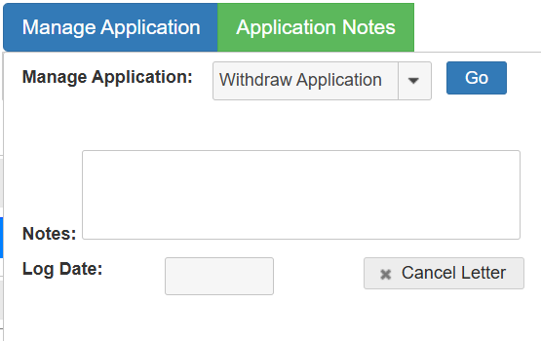
Cancel Withdrawal letter
Sometimes apps are withdrawn but a letter doesn’t need to be sent to the HH
SPs can toggle the “Send letter/cancel letter” button in the manage app window to stop a letter from going out

Slide 9
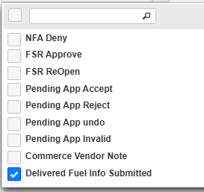
Post delivery confirmation notification
SPs can receive notifications when delivered fuel vendors submit Delivery Confirmation Info
Users must add “Delivered Fuel Info Submitted” to their Notifications and/or Workflow
When an EV submits Delivery Confirmation Info, subscribed users receive a notification in eHEAT and/or by email
The notification link directs users to the HH’s Crisis tab

Slide 10
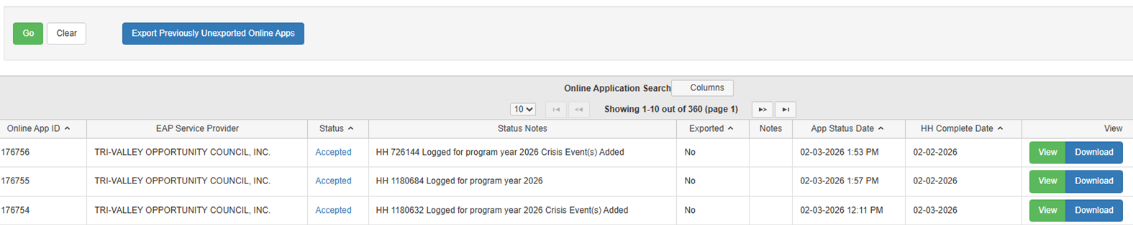
Online app search screen exports
Added sortable “Exported” Y/N column so SPs can see which online apps have been exported
Switches to Yes when “Export Previously Unexported Online Apps” button is used
“Export” button in the “View” column changed to “Download”

Slide 11
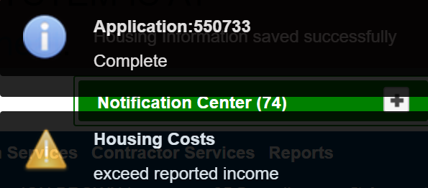
Housing cost warning
eHEAT checks reported income against housing costs and gives a warning message if housing costs are greater than income
Check happens when an application is made “Complete”
This is just a warning and does not prevent SPs from advancing the application

Slide 12


Expected denial date sortable
The “Expected Denial Date” column on the Client Services screen is sortable
Reminder this column only appears in search results when you search by Application Status “Incomplete”

Slide 13
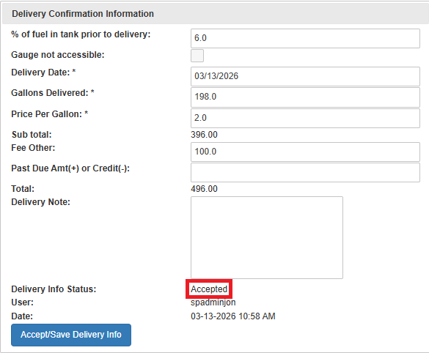
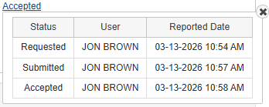
Delivery confirmation history
The Delivery Confirmation Information section records a history
The table shows who:
  Requested the information
  Submitted it
  Accepted it

Slide 14
Agency Report of Work Production update
Updated column names:
  Logged apps → Apps logged
  Processed apps → Apps touched
  Request additional info → Additional info Requested
  Certified Apps → Apps Approved
  Crisis Events → Crisis Requests Touched
Removed columns: Maintain Apps and ERR Events
Added columns: Apps Denied, Apps Completed, Apps Made Eligible, Apps Made Incomplete Apps Verified, Benefits Determined, Crisis Requests Completed, ERR Tasks Touched, ERR Tasks Completed

Slide 15
Planned Enhancements

Slide 16
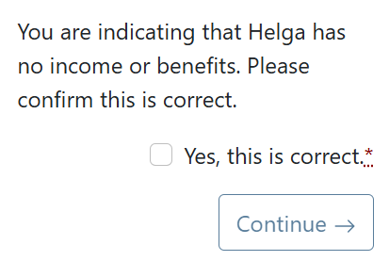
Online app 18+ without income
Paper app asks, “Member(s) over 18 with no income? Which member(s) and please explain_______”
Since SPs follow up when a member 18+ has no income the online app will attempt to gather this answer
When it's indicated an 18+ HH member has no income they will be prompted to explain
This information is not stored in eHEAT but will show on the online app summary

Slide 17
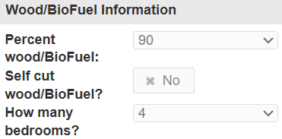
Wood percent from previous year
HHs that heat with wood/biofuel need to have their percent used for heating reviewed each year
Consumption is marked “Invalid” when there is a 30-percentage point (or more) increase or decrease from the previous year
To make this review easier we will be adding "Previous year percent wood/Biofuel" to the top of the information in the "Wood/BioFuel Information box"
If the previous year did not have wood as a heat source, it will show “None”

Slide 18
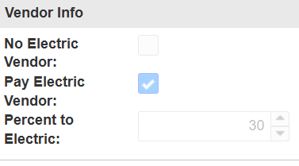
No heat vendor checkbox
While rare, some HHs don’t have a heat vendor/burden
Currently, eHEAT requires a primary heat vendor
Adding a "No Heat Vendor” checkbox to "Vendor Info" section on the Energy Providers accordion
When checked:
  Electric is primary heat and actual consumption is used for benefit determination
  If backup matrix is used it uses electric as the primary heating fuel and divides that amount in half (backup amount for electric heat divided by 2)

Slide 19
Lock consumption when accordion “Verified”
Currently consumption can be updated until the app is “Benefit Determined”
Early in program year SPs gather consumption only for it to be overwritten by consumption upload files
This causes SPs to go back and check the new consumption for discrepancies, or they miss that it was even updated
To prevent the overwrite from happening on apps that have already been reviewed the control locking consumption will be when the Energy Providers accordion is “Verified”

Slide 20
eHEAT Clarifications

Slide 21
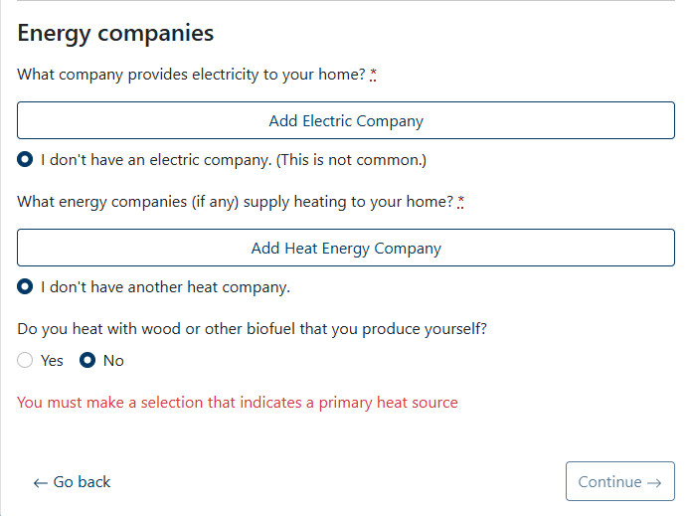
Online apps with only one energy vendor
HHs must enter at least one EV to continue
If they only select one, they can indicate:
  They don’t have an electric vendor
  Electric is same as their heat

Slide 22
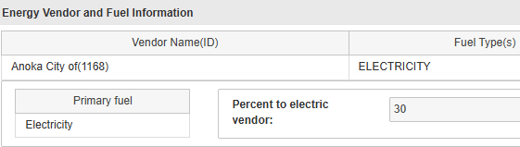
Online apps with only one energy vendor, cont.
Online app summary does not show an indicator that they selected no electric vendor or no heat vendor
  If only one vendor is shown one of those selections was made in order to continue
If only one vendor is indicated eHEAT does not provide HH with percent payment to EV and always comes through as default 30% to electric

Slide 23
Editing RFI Letters
RFI letters check for attachments when certain keywords are present like, “attached”
If there is no attachment, there is a reminder/warning
Default language includes “Please complete and return the attached form(s), if any, and send the information listed below:”
If no attachment is being sent with the letter, SPs can edit the text to change or remove that default “attached” language

Slide 24
Q&A

