Slide 1
FFY27 Annual Training
Energy Assistance Program
Ch. 13 – Program Fiscal Management

Slide 2
Ch. 13 – Program Fiscal Management
Commerce EAP
Notes:
Good afternoon! In this presentation, I’ll be covering Chapter 13 – Program Fiscal Management.

Slide 3

Topics
Updates to Ch. 13
  Electronic Funds Transfer (EFT) – p. 9
  Audits Section – pp. 10-12
  Submitting Audit Reports – p. 12
  Contracting and Bidding Requirements – pp. 12-13
  Uniform Guidance Training – p. 19
  Fiscal Reports Due Dates

Slide 4
Program Fiscal Management – Updates to Ch. 13

Slide 5

Electronic Funds Transfers (EFT) – p. 9
Minnesota Management and Budget (MMB) makes payments for EAP via Electronic Funds Transfer (EFT) or warrants (checks)
Links to EFT & Direct Deposit forms are no longer available
To sign up for EFT or to change existing bank account info:
  Vendors should contact MMB
  Email: Efthelpline.MMB@state.mn.us
  EAP Vendors: Service Providers (SPs), Mechanical Contractors, and Energy Vendors

Slide 6

Audits Section – p. 10
This section went from 3 to 2 pages – mostly minor changes
    Moved around or deleted sections
    Added info to align with the EAP Contract
      E.g., we added U.S. HHS, MN Department of Administration, & MN Attorney General to Access of Records

Slide 7

Submitting Audit Reports – p. 12
Added info in bold below
SPs must submit the most recent third-party financial audit to Commerce within 30 calendar days after receipt of the auditor's report or nine months after the end of the audit period, whichever is earlier, as required by 2 C.F.R. §200.512.
Notes:
Now the Manual states that “Service Providers must submit the most recent 3rd-party financial audit to Commerce withing 30 calendar days after the receipt of the auditor’s report or 9 months after the end of the audit period, whichever is earlier;” and we cited the Uniform Guidance.
To more closely align with the Uniform Guidance, as well as the Weatherization Assistance Program (WAP) Manual.

Slide 8

Contracting & Bidding Requirements – p. 12
Added info in bold below
Services and/or materials that are expected to cost between $25,000 and $99,999 must be competitively awarded based on a minimum of three (3) verbal quotes or bids or awarded to a targeted vendor.
Notes:
To align with the Minnesota Department of Administration’s Office of Grants Management (OGM) requirements.

Slide 9

Contracting & Bidding Requirements – p. 13
Added info in bold below
  However, Commerce may waive bidding process requirements when:
    (…)
    It is determined there is only one reasonably able and available legitimate or practical source for such materials or services and that Service Provider has established a fair and reasonable price
Notes:
The next update is also in the Contracting & Bidding Requirements, but now on Page 13. We added the information in bold below - it’s just a small tweak. Where bidding requirements may be waived, instead of “legitimate or practical source” we now say, “reasonably able and available source.” This update was made to align with the changes in the Office of Grants Management requirements.

Slide 10

Targeted Vendors – p. 13
Updated the link to CERT Program directory
  Due to change in vendor managing CERT portal
  Small Business Certification Program through Hennepin County, Ramsey County, and City of St. Paul: Central Certification (CERT) Program Directory

Slide 11
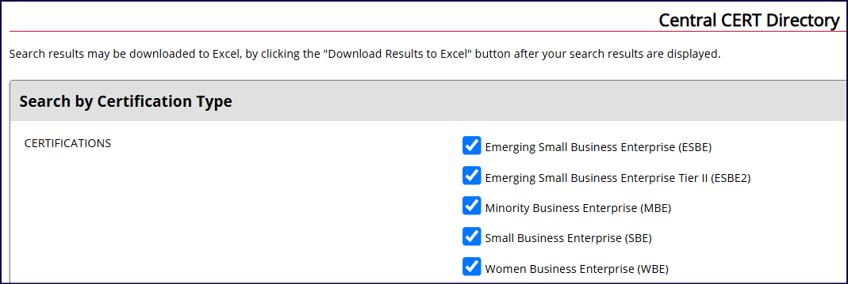
Targeted Vendors – p. 13, continued

Slide 12
Program Fiscal Management – Uniform Guidance Training
Notes:
This was a quick rundown of the updates to Chapter 13. Now we’ll talk about the Uniform Guidance Training.

Slide 13

Uniform Guidance (UG) Training
Proposed changes to UG effective October 1, 2026, if final
  May trigger requirements for UG training (Ch. 13, p. 19)
    Any new EAP fiscal staff must attend initial OMB UG training within 1 year
    EAP fiscal staff must take refresher courses within 1 year of LIHEAP-applicable OMB UG changes
Notes:
WAP is offering again this fall on Thursday, October 22, 2026, from 8:30-12:30.

Slide 14
Program Fiscal Management – Fiscal Reports Due Dates

Slide 15

Single Audits – Due Dates
Within 30 calendar days after receipt of the auditor's report or 9 months after end of audit period, whichever is earlier
Submit via email to Donna.Leonard@state.mn.us
If audit findings require follow-up & Commerce is a cognizant agency, it will issue Management Decision Letter (MDL)
SPs must submit any MDL received from another state agency
Notes:
Submitting Audit Reports
Service Providers must submit the most recent third-party financial audit to Commerce within 30 calendar days after the Service Providers’ receipt of the auditor's report or nine months after the end of the audit period, whichever is earlier, as required by 2 C.F.R. §200.512. Submit audits electronically to Donna Leonard at donna.leonard@state.mn.us.
Service Providers must send Commerce a copy of any management decision letter received from another state agency to Donna Leonard at donna.leonard@state.mn.us.

Slide 16

Monthly FSR – Due Dates
Monthly Financial Status Report (FSR) is due by 15th of each month
  If 15th falls on a holiday or weekend – next business day after
  September FSR is Final FSR for program year – due by 10/31
  EAP Coordinator and Fiscal Director must review FSR before submission

Slide 17

June FSR and Cash Request
State fiscal year end is June 30 – state closeout
June FSR, cash request, and payments must balance to penny
Cash requests that include the month of June must end on last day of June
  “To Date” must be no later than June 30
June FSR is a monthly FSR and is due by July 15
Notes:
State closeout and cash requests
As we near the end of the State Fiscal Year 2026, another reminder that the June FSR, cash request, and payments must balance to the penny. June Cash Request: The June Cash Request must end on the last day of June - i.e., the “To Date” must be no later than June 30, as that is the end of the State Fiscal Year.

Slide 18

Final Closeout – Due Date
SPs must close out program and submit final documents to Commerce at end of program year
  Final documents = Final Closeout Package
  Due by October 31 annually
    Encourage submitting earlier
    Final Cash Requests are not accepted after due date
  Submit to eap.mail@state.mn.us (Final FSR & CR – in eHEAT)
  More info in EAP Policy Manual, Ch. 12, p. 3
Notes:
SPs must close out program and submit final documents to Commerce at end of the program year.
Final documents are called Closeout Package.
EAP Final Closeout Package due by October 31 annually – we highly encourage submitting before the due date. Final Cash Requests are not accepted after the due date.
Submit to eap.mail@state.mn.us (Final FSR & CR – in eHEAT).
More info in EAP Policy Manual, Ch. 12, p. 3, Closeout section.

Slide 19

Final Closeout Package
  Final FSR
  Final cash request
    “To Date” must be no later than September 30
  Expenditure detail report
  List of EAP-related equipment over $10,000 and sensitive equipment
  List of continuing liabilities
  A check if cash payments exceed expenditures on Final FSR
Notes:
Final Cash Request: Submit via eHEAT. The Final Cash Request must end on the last day of September - i.e., the “To Date” must be no later than September 30, as that is the end of the federal fiscal year.

Slide 20
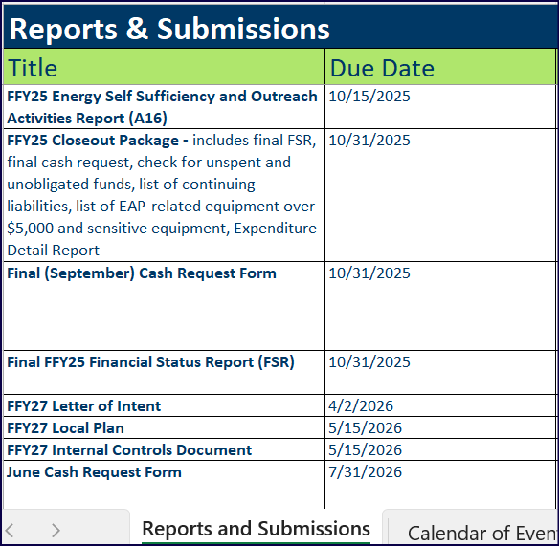
FFY27 Key Reports - Due Dates
“Reports & Submission” document
Key dates and calendar of events for entire program year
Published annually in The Energizer in late September or early October
In Toolkit on Commerce website
Notes:
This document lists due dates of key EAP documents, Commerce holiday closure dates, and other key dates. Please note there are two tabs: Reports and Submissions, Calendar of Events.

Slide 21
Q&A

