Slide 1
FFY27 Annual Training
Energy Assistance Program
Ch. 4 – Primary Heat

Slide 2
Primary Heat
Mandy Braaten

Slide 3
Topics
FFY27 Primary Heat, Chapter 4 Updates
  Update to “Does the household’s consumption data match the heating fuels on their application?” section; Chapter 4, Page 6
  Update to “Are the household’s energy costs included in their rent?” section; Chapter 4, Page 10

Slide 4
Does the HH consumption data match the heating fuels on their application?
Primary Heat Ch 4, Pg 6

Slide 5
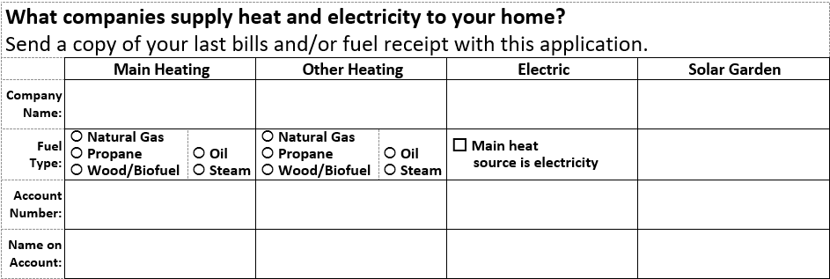
Does HH consumption data match heating fuels on application?
  Section updated to match current EAP application

Slide 6
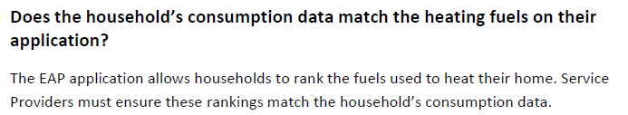
FFY26 Policy

Slide 7
FFY27 Policy Update
Changed “rank” to “designate/designations”
Added “as Main Heating, Other Heating, Electric, and Solar Garden.”
FFY27 Manual language:
Does the household’s consumption data match the heating fuels on their application?
The EAP application allows households to designate the fuels used to heat their home as “Main Heating,” “Other Heating,” “Electric,” and “Solar Garden.” Service Providers must ensure these designations match the household’s consumption data.

Slide 8
Are the HH energy costs included in their rent?
Primary Heat Ch 4, Pg 10

Slide 9
FFY26 Policy
Are the household’s energy costs included in their rent?
If a household’s energy costs are included in their rent, they can still receive a grant using the backup matrix. However, if the household is not required to pay for rent, heat and electricity costs, they are not vulnerable to rising energy costs and are ineligible for EAP.

Slide 10

FFY27 Policy Update
Originally posted in 4/14/26 Energizer
Added Section on how to handle HHs who pay lot rent or HOA fees when electric is included

Slide 11
FFY27 Policy Update
FFY27 Manual language:
Are the household’s energy costs included in their rent?
If a households energy costs are included in their rent, they can still receive a grant using the backup matrix.
If the household owns their home but pays lot rent or homeowner association (HOA) fees with electricity included, Service Providers should:
  Select “own” under “Do you own your home?” On the Housing Information accordion.
  On the Energy Providers accordion, add the Electric in Rent energy vendor.
  Make notes in the Household Notes that this household has electric included in their lot rent or HOA fees.

Slide 12
Q&A

Slide 13
FFY27 Annual Training
Energy Assistance Program
Ch. 8 – Benefit Payments & Refunds

Slide 14
Ch. 8 - Benefit Payment & Refunds
Marissa Squires

Slide 15
Benefit Payment & Refunds Topics
Additions to Designation of Energy Vendors, p. 2
Electricity Included in Rent, p. 3 New
Additions to Direct Payment, p. 4
Additions to Household Members Die, p. 8
Additions to Right to EAP Benefits, p. 12

Slide 16

Designation of Energy Vendors, p. 2
Language was added to clarify the importance of timely entry of signature dates in eHeat
Signing the app permits data sharing
Active apps without signature are invisible to EVs
Notes:
clarifying the importance of timely entry of signature dates in eHEAT

Slide 17
Designation of Energy Vendors Continued
Signature entry reminders - language was added
When logging a valid app, enter the signature date so that EVs can see the app and respond to consumption requests
However, when logging an app that lacks a signature, the signature date should be left blank to prevent vendors from seeing that the HH applied
  See Handling Applications Without Valid Signatures, Ch. 2 p. 13
Notes:
Third bullet. If they don’t have a signature, they notify HH by RFI, and then SP withdraws app (Ch 2, pg 13). I discuss this in Ch 2 presentation

Slide 18

Electricity Included in Rent, p. 3
  This section is NEW
  Explains differences for when to use Electricity Included in Rent or No Electric Vendor

Slide 19
Definition for Electricity in Rent (EIR)
When a HH has electric costs, but they are built into their costs for rent
HH may not get a separate bill or itemization on their rental statement, but they do have electric costs
Example:
  HH lives at a rental apartment where rent and electricity are billed monthly (e.g., $1,500 a month, rent with electricity included)

Slide 20
EIR Consumption
All EIR vendors have consumption “Requested” because consumption costs are unknown:
Electric costs are not itemized with the rent or they are, but the landlord or property management company is not a cooperative vendor and does not provide the consumption costs to EAP
Because of this unknown, the Backup Matrix (BUM) is triggered
The BUM looks at the primary heating source and housing type, but it then also factors in some electric costs

Slide 21
Definition for No Electric Vendor
When a HH has no electric costs, therefore their electric costs are not part of their financial burden
Examples:
  HH living “off the grid” and does not use or have access to electricity from a utility provider
  HH has camper on family member’s property. Uses electricity from the family member, but HH doesn’t have their own account and doesn’t pay the family member.

Slide 22

No Electric Vendor Consumption
By marking “No Electric Vendor” instead of adding EIR as a vendor:
  It tells eHEAT that the HH has no energy burden for electricity
  eHeat will only base the benefit on costs reported for heating
Notes:
Takeaway- it’s important to accurately enter the info so that consumption can be figured into the HH’s benefit

Slide 23

EIR or No Electric Vendor? – Scenario 1
HH lives on their friend’s property, with a camper that has been deemed as an eligible dwelling
HH uses an extension cord to use electricity from their friend’s house
HH does not pay rent
HH has own active heating account
HH does not pay or provide services to their friend in exchange for the electric
No Electric Vendor: HH uses electricity but doesn’t have to pay for it. No financial burden.

Slide 24

EIR or No Electric Vendor? – Scenario 2
HH lives in a duplex that they rent
Rent is at a set rate, electricity is included
Landlord uses part of the rent to pay for the electricity, and doesn’t include info to the HH about electric costs on their rental statement
EIR: HH has an electric energy burden, pays for it, but is not aware of costs. Consumption cannot be obtained by EAP.
Notes:
Emphasize: Which means the HH pays for electricity through their rent

Slide 25

Direct Payment, p. 4
Language was added
  Direct payments for less than $10 are not allowed
  When benefits are determined, generated direct payments of less than $10 are automatically added to the EV payment
Notes:
clarified to say that direct payments for less than $10 are not allowed. When benefits are determined, generated direct payments of less than $10 are automatically added to the energy vendor payment.

Slide 26
Household Members Die, p. 8 - Part 1
If a SP learns before the app is approved that a HH member dieds
  The remaining HH members may withdraw the app and reapply
    If they choose not to withdraw, they can be served based on the HH composition at the time they applied
Notes:
A HH member died BEFORE app approved
section it was clarified how Service Providers and energy vendors should handle applications where a household member died before or after the application is approved.

Slide 27

Household Members Die – Part 2
If a SP learns after the app is approved that a HH member dieds
  The remaining HH members continue to be served according to their most recent notification letter
Notes:
A HH member died AFTER app approved
section it was clarified how Service Providers and energy vendors should handle applications where a household member died before or after the application is approved – double check this in final manual

Slide 28

Household Members Die – Part 3
If a SP learns before the app is approved that all HH members died, the app must be closed. SPs must:
  Make notes in eHeat
  Send a letter to the HH address saying the app has been closed because all of the HH members have died
Notes:
Email could be preference, but don’t send an email they would not have access
All HH members died, BEFORE app is approved
section it was clarified how Service Providers and energy vendors should handle applications where a household member died before or after the application is approved

Slide 29
Household Members Die – Part 4
If a SP learns after the app is approved that all HH members died, see Right to EAP benefits section
If during the current program year and the HH has a balance owed with the EV, the EV should apply any EAP benefit remaining on the account towards the outstanding balance, where possible
Notes:
All HH members died, AFTER app approved
section it was clarified how Service Providers and energy vendors should handle applications where a household member died before or after the application is approved

Slide 30
Right to EAP Benefits, p. 12 – Part 1
Language was added in this section to clarify how SPs should handle apps where HH members have died
If a SP learns after any benefits have been paid that all members of a HH died (but all HH members were alive at the time of applying)
  The EV should consider any EAP benefit remaining on the account the property of the HH
  Follow MN unclaimed property requirements thus allowing its heirs to receive the credit
Notes:
it was clarified how Service Providers should handle applications where all household members of a household have died.

Slide 31

Right to EAP Benefits – Part 2
Language was added
Any payments that have not been made must be voided and the app closed. SP must:
  Make notes in eHeat and
  Send a letter to the HH address saying the remaining benefit payments have been canceled because all HH members have died
Notes:
Reiterating why- any payments already made, property of HH. Scheduled payments. Future payaments don’t want to make those
Not going after payments already made, but going after future payments (not yet) (new slied?)
it was clarified how Service Providers should handle applications where all household members of a household have died.

Slide 32

Right to EAP Benefits – Part 3
To summarize:
SPs should not go after payments already made
SPs should stop any future payments; want to make sure those are not paid
Notes:
Reiterating why- any payments already made, property of HH. Scheduled payments. Future payaments don’t want to make those
Not going after payments already made, but going after future payments (not yet) (new slied?)
it was clarified how Service Providers should handle applications where all household members of a household have died.

Slide 33

Right to EAP Benefits – Part 4
Language was added
If any HH members were deceased at the time of application, then the app may be considered possible suspected fraud
  SP should follow the relevant incident response policy in Chapter 10 – Incidents and Appeals
Notes:
A person who is dead is not valid HH member
it was clarified how Service Providers should handle applications where all household members of a household have died.

Slide 34
Q&A

