Slide 1
FFY27 Annual Training
Energy Assistance Program
Ch 3. – Program Eligibility Requirements

Slide 2
Chapter 3 – Program Eligibility Requirements
Ernest McCann

Slide 3
List of changes to Chapter 3
Addition to Ineligible Dwelling list (pg.14)
Addition to Tribal Per Capita Payments (pg.17)
Income Inclusions & Exclusions additions (pg.19 – 29)
Workforce Innovation and Opportunity Act (WIOA pg.29)
Explanation of DEED Wage Database (pg.35)
Additional Unearned Income Documentation guidance (pg.41)
MN Paid Leave info added (pg.44)
Updates to Appendix 3L

Slide 4
Addition to Ineligible Dwelling list (pg.14)
  Housing the household does not own and for which the household does not pay rent, heat, or electricity

Slide 5
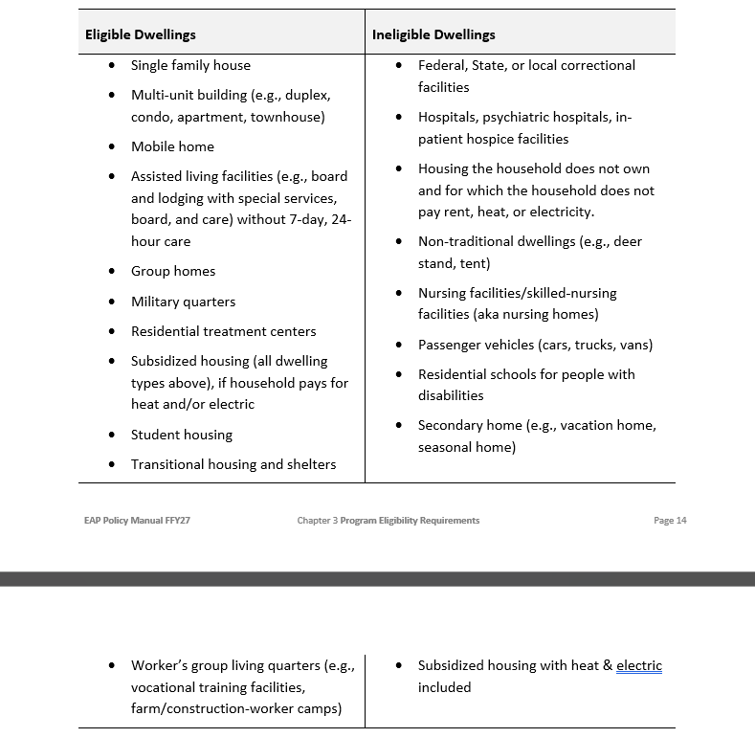
Dwelling Table
Dwellings table for FFY27. New entry is highlighted

Slide 6
Addition to Tribal Per Capita Payments (pg.17)
Any General Welfare Assistance payments to the Mille Lacs Band of Ojibwe Tribal members are generally considered countable EAP income unless they are from a documented, excludable funding source, such as COVID-related aid

Slide 7
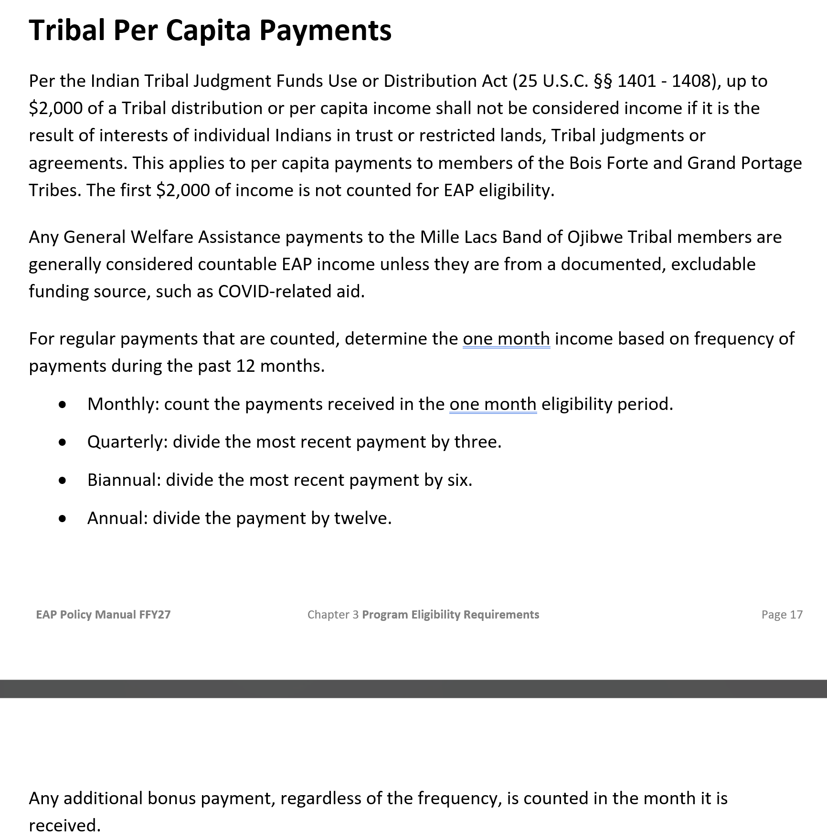
Per Capita info
Additional info added to the Tribal Per Capita Payments section highlighted

Slide 8
Income Inclusions & Exclusions Table (pg.19)
Added info regarding Minnesota Paid Leave:
Minnesota Paid Leave (MPL) is a state program implemented January 1, 2026 that provides wage replacement benefits for covered events in the form of payments and job protections. MPL payments are countable income for EAP purposes

Slide 9
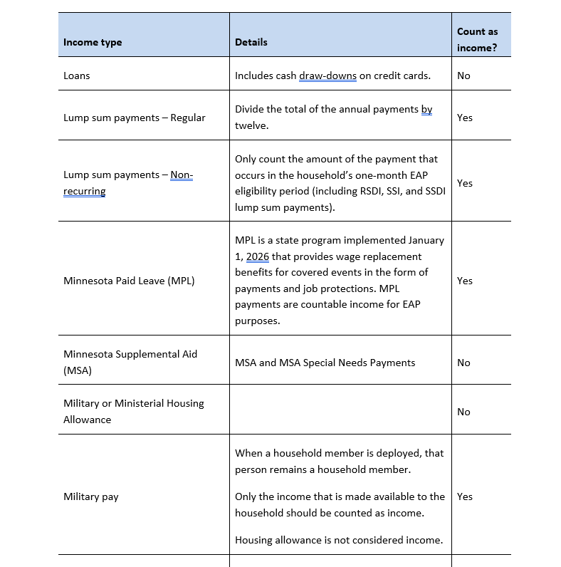
MN Paid Leave
Minnesota Paid Leave (MPL) highlighted in the FFY27 EAP policy manual

Slide 10
More Income Inclusions & Exclusions Table (pg.19)
Additional language in the Tribal per capita or General Welfare Assistance payments:
Count Tribal General Welfare Assistance payments unless the funds are from a source EAP does not count (e.g., Tribal judgment or trust funds, COVID-related, etc.)

Slide 11
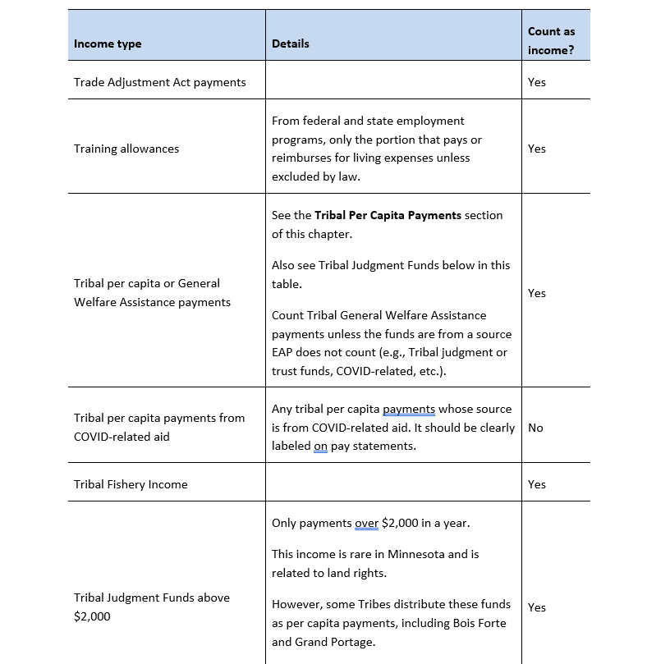
Tribal Per Capita
Additional language to the Tribal per capita or General Welfare Assistance payments highlighted

Slide 12
WIOA added to List of Excluded Income (pg.29)
Workforce Innovation and Opportunity Act (WIOA) of 2014 (P.L. 113-128) formerly the Workforce Investment Act (WIA) of 1998
Count all WIOA wage earnings, except those received by dependent household members who are 19 years old or younger or attending school K-12
Note: Changed from 18 to align with other dependent eligibility policies

Slide 13
Workforce Innovation and Opportunity Act
Exclude supportive services to all participants. Supportive services include assistance that enables people to participate in WIOA

Slide 14
Examples of excluded WIOA services
Transportation
Healthcare, Childcare
Handicapped assistance, meals, temporary shelter
Counseling, and other reasonable expenses that enable participation in WIOA

Slide 15
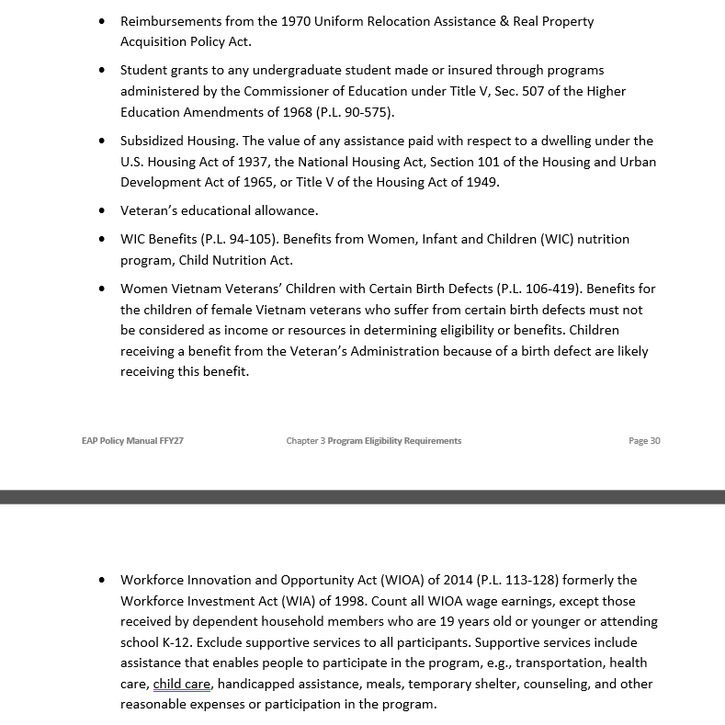
WIOA
Workforce Innovation and Opportunity Act in the list of Excluded Income in the FFY27 EAP policy manual

Slide 16
Explanation of DEED Wage Database (pg.33)
Added language:
When eHEAT requests DEED data, wage information is matched to household members using their Social Security Number and last name. Spelling or typographical inconsistencies can prevent DEED from returning wage information. Name differences between eHEAT and DEED may occur for household members who have changed their last name or have last names with punctuation, accents, or suffixes

Slide 17
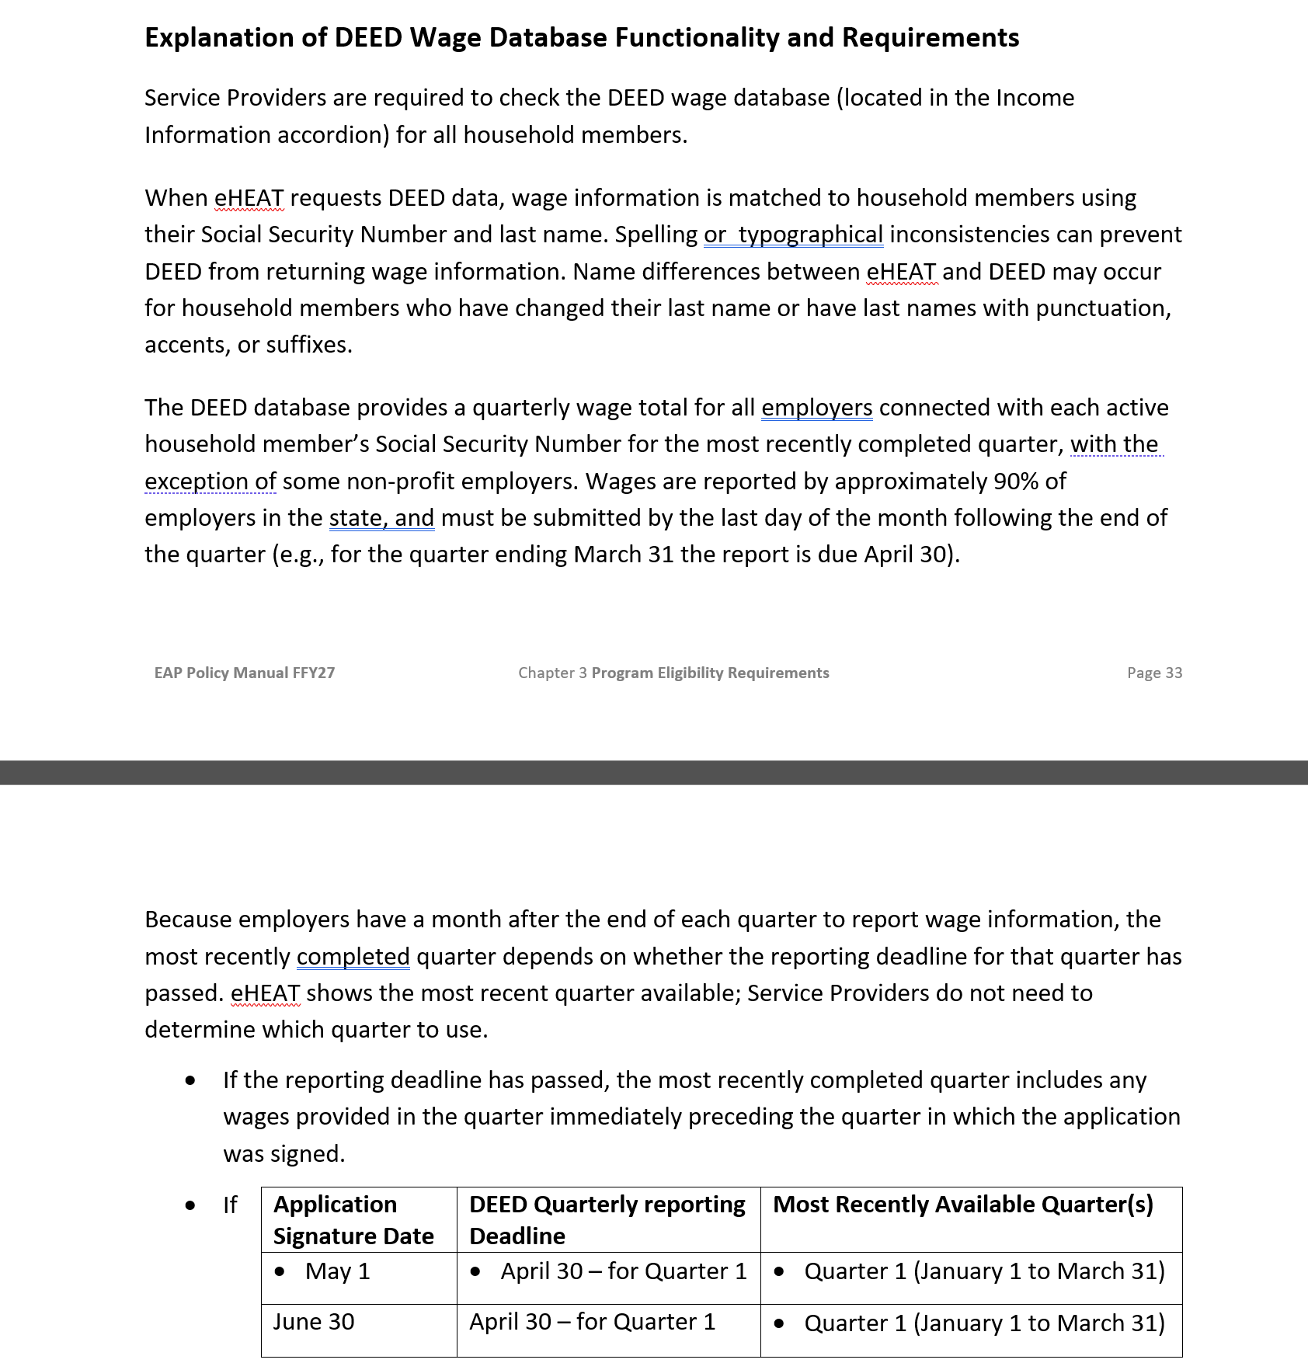
New DEED language
New DEED language is highlighted here

Slide 18
Unearned Income Documentation guidance (pg.40)
Households may use bank statements as documentation of unearned income. As a reminder, the purpose of this documentation is to show:
• The amount of income received
• Both the source and recipient of the income
• The timeframe in which the income was received

Slide 19
Unearned Income Doc guidance Continues (pg.40)
Service Providers may accept submissions that include only the relevant pages of a multi-page statement, (e.g., single page of the bank statement), however, these pages must contain the information listed above as well as identifying information (for both the bank and account holder) needed to verify the statements authenticity. These pages may not be redacted in any way; including debits and credits to the account

Slide 20
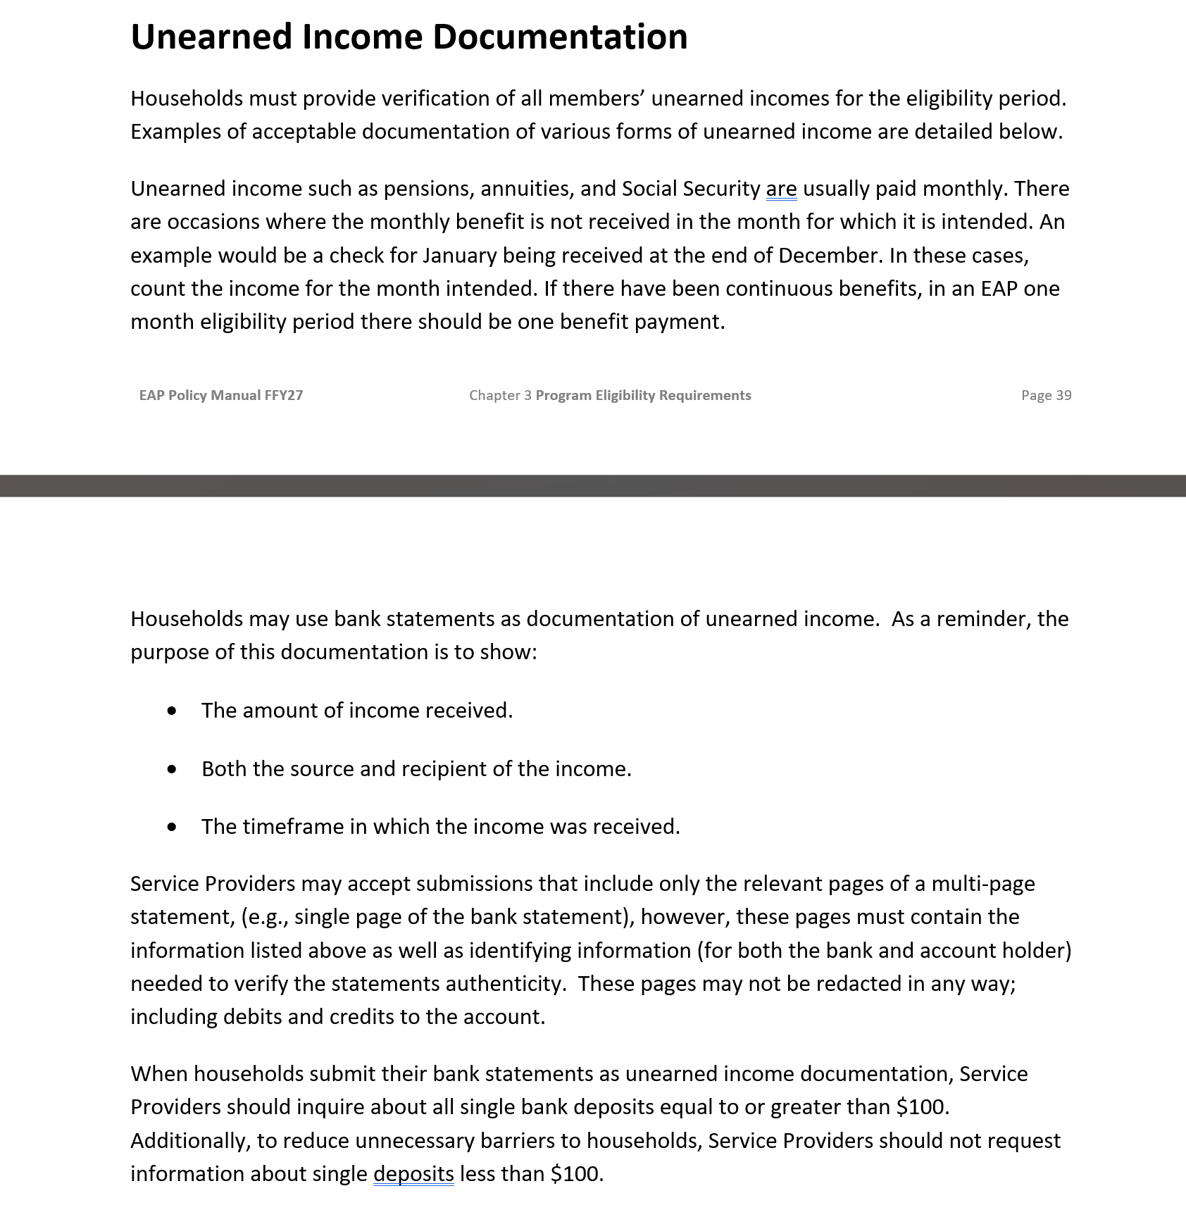
Unearned Income
New unearned income guidance as seen in the FFY27 EAP policy manual

Slide 21
Bank Statements Recap
A bank statement used to verify unearned income must:
Show the name of the bank and the name of the account holder
Show both the source and recipient of the income
Show the timeframe in which the income was received
Relevant pages of a multi-page bank statement may not be redacted in any way

Slide 22
MN Paid Leave info added (pg.44)
Workers’ Compensation, Short Term Disability, Long Term Disability, and Minnesota Paid Leave
When determining worker’s compensation, short- and long- term disability income, and Minnesota Paid Leave benefits, take care to count only wage reimbursement and not reimbursement for out of pocket medical costs, as they are not income
Minnesota Paid Leave benefits are considered wage replacement income and are countable for EAP eligibility
Minnesota Paid Leave benefit determination or payment statements

Slide 23
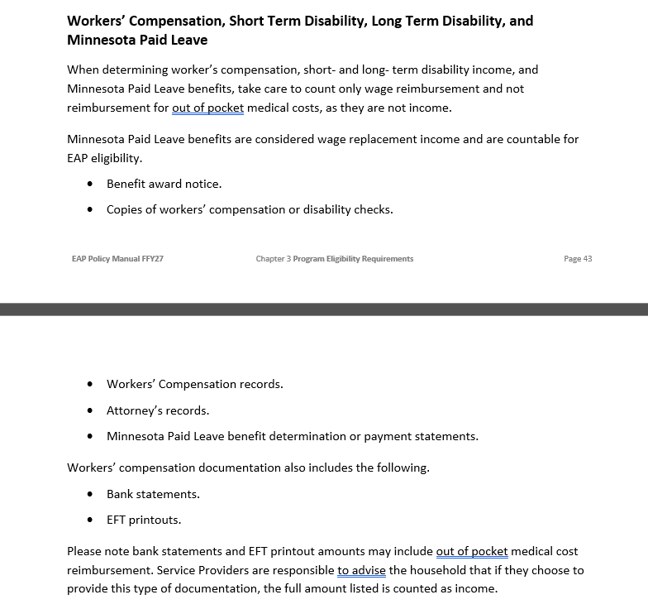
New info on MPL
Info on Minnesota Paid leave added to the FFY27 EAP policy manual

Slide 24
Updates to Appendix 3L
Appendix 3L – DEED Wage Income & UI Scenarios
Andy will provide info regarding the changes

Slide 25
Q&A

Slide 26
FFY27 Annual Training
Energy Assistance Program
DEED Wage Income & UI Scenarios (Appendix 3L)

Slide 27
DEED Wage Income & UI Scenarios (Appendix 3L)
Andy Grewell

Slide 28

Appendix 3L – Summary of Changes
New scenarios added
Additions to guidance
Reorganized for functionality
Clarified some Affidavit guidance

Slide 29
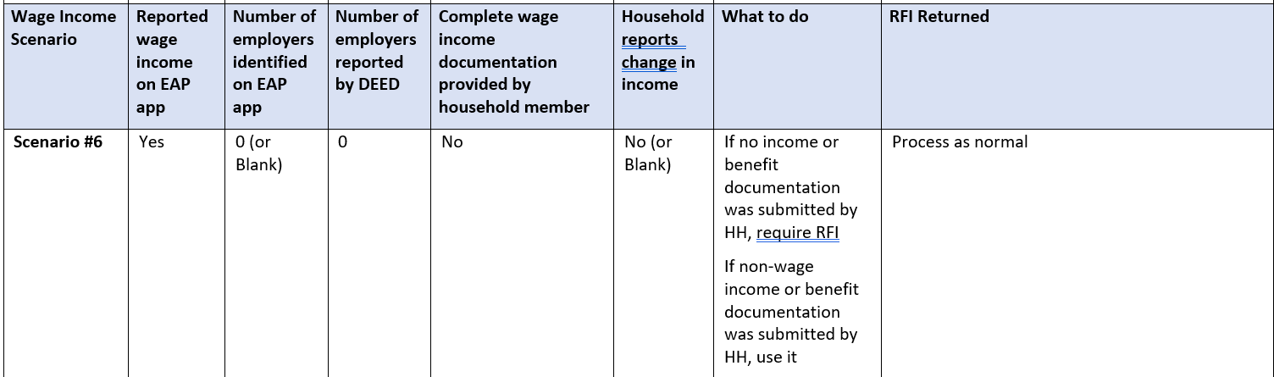
New scenarios added – Scenario #6
Scenario #6: When income is indicated, but most other income info is left blank
  No DEED info returned
  No complete wage income documentation provided
  No change in income indicated
  = Need RFI, then process normally

Slide 30
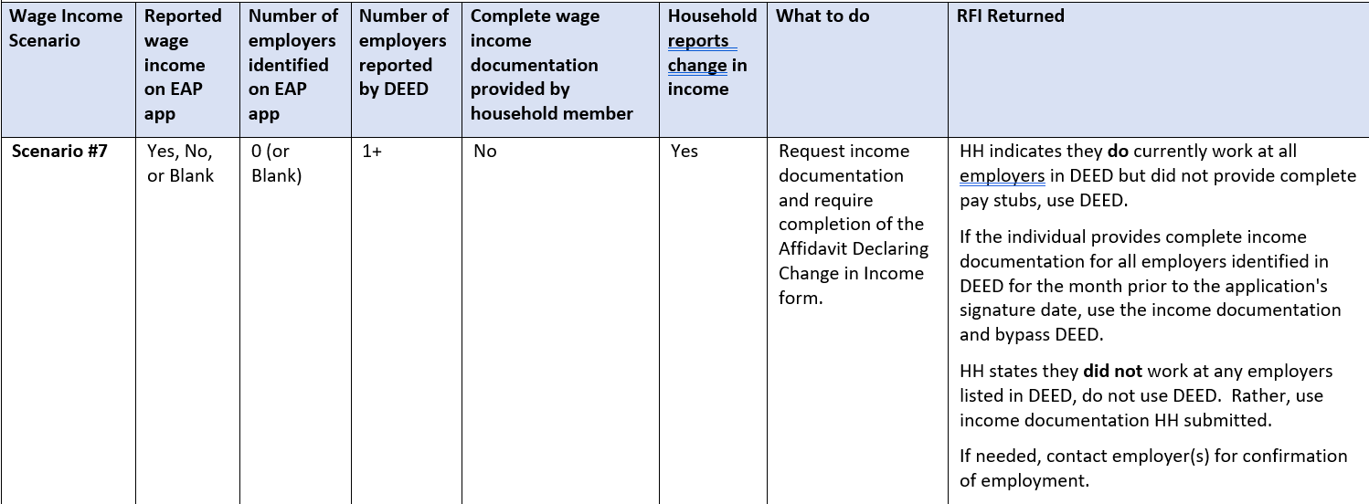
New scenarios added – Scenario #7
Scenario #7: When most income info is left blank, but evidence of income change, and DEED does return wage info
  Yes, Change in income indicated
  Yes, DEED info returned
  No complete wage income documentation provided
  = Need Affidavit

Slide 31
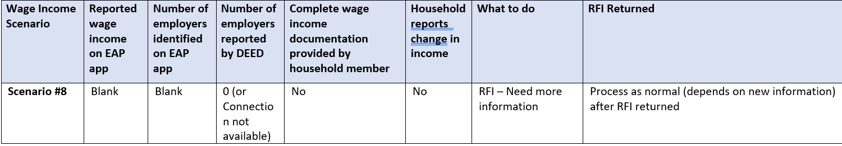
New scenarios added – Scenario #8
Scenario #8: When all or nearly all income info is left blank & no DEED wage info (or DEED connection unavailable)
  No DEED info returned
  No complete wage income documentation provided
  No income indicated
  = Need RFI, then process normally

Slide 32
Appendix 3L - Scenarios Quiz
App comes back with income indicated, no change to income indicated, 1 employer listed, DEED returns 2 employers
App blank on income section, change in income indicated, no DEED info returned
App comes back with income indicated, change in income indicated, 2 employers listed, no DEED info returned, complete paystubs for both employers provided
App comes back with income indicated, change in income indicated, 1 employer listed, DEED returns 1 employer
Use DEED
Use VIE
Use HH-supplied income
Use Affidavit

Slide 33

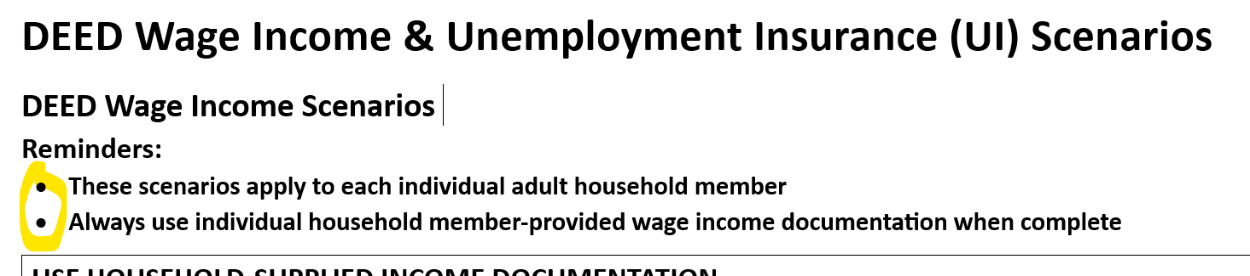
Appendix 3L – Reminders added to appendix text
  “These scenarios apply to each individual adult household member”
  “Always use individual household member-provided wage income documentation when complete”

Slide 34

Appendix 3L – Reorganized into four (4) main categories
  1. USE HOUSEHOLD-SUPPLIED INCOME DOCUMENTATION
  2. RFI REQUIRED
  3. USE DEED
  4. NO INCOME
  *No Unemployment Insurance (UI) scenarios were harmed during the update to this Appendix

Slide 35

Appendix 3L – Clarified Affidavit guidance 1/2
Affidavit Declaring Change in Income (Appendix 3K)
Reminder that this appendix is utilized to support the decision to bypass DEED data, usually due to a change in income

Slide 36

Appendix 3L – Clarified Affidavit guidance 2/2
Chapter 3, Pg 31-32 clarifies which application/DEED inconsistencies may require an Affidavit Declaring Change in Income:
  Change in income in the last six months
  Household indicated no income on the application, but DEED identifies wages
  Number of employers
  Response to the last day worked question indicates the household may have stopped working since DEED wages were reported
Any written or verbal information obtained or provided that suggests a decrease in income or job separation within the last six months

Slide 37

Appendix 3L – Policy Manual edits 1/2
“Use an Affidavit Declaring Change in Income (Appendix 3K) to document any of the income changes above and when DEED income in eHEAT will be bypassed.”
An affidavit is not necessary if:
The change is documented with full income documentation for the month prior to the application signature date and the reported employers match what is in DEED

Slide 38
Appendix 3L – Policy Manual edits 2/2
An affidavit is not necessary if:
More employers are identified in DEED than on the application and the household indicates no change in income (see Scenario 9 in Appendix 3L)
In this case, DEED wage data can be accepted without an affidavit

Slide 39
Appendix 3L – Key Takeaways
During the Spring of 2026, the JAD subject matter experts revisited the DEED guidance and scenarios appendix:
  Some changes were made the to the guidance and organization of Appendix 3L
  Decision was made to modify the guidance to reduce the need for the Affidavit Declaring Change in Income
  This may result in more appeals, but ultimately should result in fewer denials for insufficient information
Scenario 9 in the DEED Wage Income & UI Scenarios captures this

Slide 40
DEED Wage Income & UI Scenarios (Appendix 3L)
Questions?

