Slide 1
FFY27 Annual Training
Energy Assistance Program
Ch. 2 – Applications & Application Processing

Slide 2
Ch. 2 Applications and Application Processing
Marissa Squires

Slide 3

App and App Processing Topics
Clarification to Applications Requirements (p. 13)
Handling Applications Without Valid Signatures or With Composition Changes (p. 13-14)
  Split into two sections
  Info updated in both sections
Additions to Name on Energy Account (p. 18-19)

Slide 4

Topics List Continued
Additions to Defining Name Mismatches (p. 20)
Update to Household Membership Changes Before Approval (p. 22)
Additions to Withdrawn Applications (p. 23)

Slide 5

Applications Requirements, p. 13
Removed info
  For a valid app, all must be true
    Signed current year app signature page
    Have at least one HH member listed
    Include a signature by listed HH member or authorized person on behalf of listed HH member
    Be Postmarked or received by EAP on or before the app deadline
Notes:
“Still a valid, but denied end of program year”

Slide 6
Applications Requirements Continued
Language was reworded and updated for clarity
If there is a difference in the number of HH members listed on the app and the response to “how many people live in your home”
  SPs should not consider it an invalid app based solely on that discrepancy
  SPs must follow up with the HH
Notes:
Last 2 bullet points are new

Slide 7

Handling Applications Without Valid Signatures or With Composition Changes
Split into 2 sections (p. 13-15)
It was
  Handling Applications Without Valid Signatures or With Composition Changes
It is now
  Handling Applications Without Valid Signatures
  When To Require a New Signature or Log Date

Slide 8
Handling Applications without Valid Signatures, p. 13
SPs must do the following for apps without valid signatures:
Log the app in eHEAT
Send a request for info for a completed signature page and inform the HH the app is not valid until signed
If an energy emergency is identified, attempt to call the HH by phone, if available, to inform them their app is invalid and document in eHEAT
Do not request from or share any other inform with third parties
Withdraw the app in eHEAT via the Manage App dropdown
  Add notes detailing the reason for withdrawal
  Change “Send Letter” to “Cancel Letter” to ensure the letter is not sent to the HH
  Click the “Go” button to finalize the withdrawal
No additional follow up is necessary
Notes:
Read off all steps, and explain the policy before emphasizing change

Slide 9

Additions to Withdraw the App Step 5
5. Withdraw the app in eHEAT via the Manage App dropdown
  Add notes detailing the reason for withdrawal
  Change “Send Letter” to “Cancel Letter” to ensure the letter is not sent to the HH
  Click the “Go” button to finalize the withdrawal

Slide 10
When To Require a New Signature or Log Date, p. 14
If already approved or denied and the HH appeals the HH composition, the normal appeal process applies (see Chapter 10, Incidents and Appeals)
Added clarity that denied HHs whose appeals results in a HH composition change are handled the same as the approved HH with appeal-related composition changes
Notes:
now clarifies that denied households whose appeals result in a household composition change are handled the same as approved households with appeal-related composition changes.

Slide 11
Name on Energy Accounts, p. 18-19
Language was added to the info about accounts listed on app that are not in a HH member’s name
  All “In Rent” energy vendors are locked to “Landlord Account” name match status
  “Account Number” and “Name on Account” fields are locked as the primary HH member’s name for:
    “Landlord Account” name matches; and
    “No Account in HH Name” energy vendor
Notes:
MB will review/train on name on account broadly. Mention MB and JB presentations

Slide 12

Name on Energy Accounts – Direct Payments
If no energy vendors are in a
HH member’s name,
Match or Landlord Account Name match status,
the HH receives a direct payment for the minimum PHB amount
Notes:
it is directing them more about what is happening in eheat, this needs to happen in eheat to

Slide 13

Name on Energy Accounts – “Living” Added
Added “living” to Name on Energy Account section
This change was made to ensure payment are only made to accounts in the name of living HH members
Notes:
The word “living” was added to the Name on Energy Accounts section. This change was made to ensure payments are only made to accounts in the name of living household members.

Slide 14
Added “Living” HH Member
Ch. 2, p. 18
In addition, Crisis benefits may only be authorized for accounts in the name of a living HH member
Ch. 2, p. 19
The HH is only eligible to receive Crisis benefits if the account is in the name of a living HH member that was part of the approved app
Notes:
The word “living” was added to the Name on Energy Accounts section. This change was made to ensure payments are only made to accounts in the name of living household members.

Slide 15
Defining Name Mismatches (p. 20)
Reworded and added examples
Accounts with name mismatches include those in the name of:
  An attorney in fact (power of attorney), guardian, conservator, representative payee name
  A person who is not part of the EAP household
  Any account owners that are not members of the approved EAP HH
Notes:
Explain what account owners are - Sometimes account owners or just info purposes only. We are only discussing account owners
JB and/or SMe need to discuss

Slide 16

Name Mismatches Continued
Accounts with name mismatches include those in the name of:
  An individual not counted as a HH member (e.g., ineligible non-citizen)
  A deceased family member, regardless of their relationship to the app
  A business, even if owned by a HH member [ADDED]

Slide 17
Household Membership Changes Before Approval (p. 22)
If HH membership changes before the app is approved
The HH may either submit a new signature page including the new HH composition -OR-
Provide all member and income info based on the original app
If the HH is unable to provide the info for the original app, they need to reapply with info for their HH’s current membership
Notes:
Updated to indicate that if the household is unable to provide the information for the original application, they do not need to withdraw their application before reapplying.

Slide 18
Withdrawn Applications (p. 23)
An app is withdrawn:
If a HH member dies before benefits are provided:
  The remaining HH members may withdraw the app and reapply
  If they choose not to withdraw, they can be served based on the HH composition at the time they applied [ADDED]
  If a HH member dies after eligibility is determined, the remaining HH members are served according to their most recent notification letter [ADDED]
Notes:
clarified options a household may take if a household member dies before benefits are provided

Slide 19
Q&A

Slide 20
FFY27 Annual Training
Energy Assistance Program
Applications Changes & Mailing Timeline

Slide 21
Application Changes & Mailing Timeline
Ernest McCann

Slide 22
Topics – App Changes & Mailing Timeline
Application changes
Mailing Timeline

Slide 23
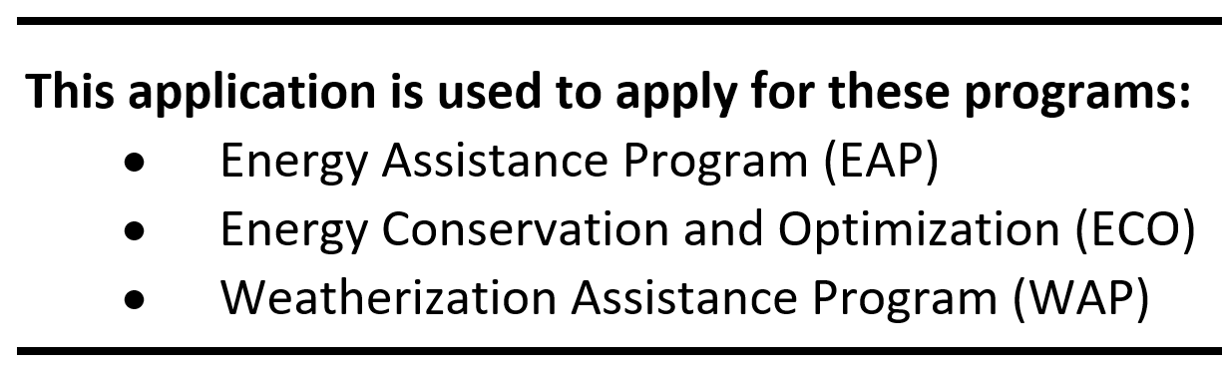
Addition to the Instructions Page
Energy Conservation and Optimization (ECO) added to the instruction page

Slide 24
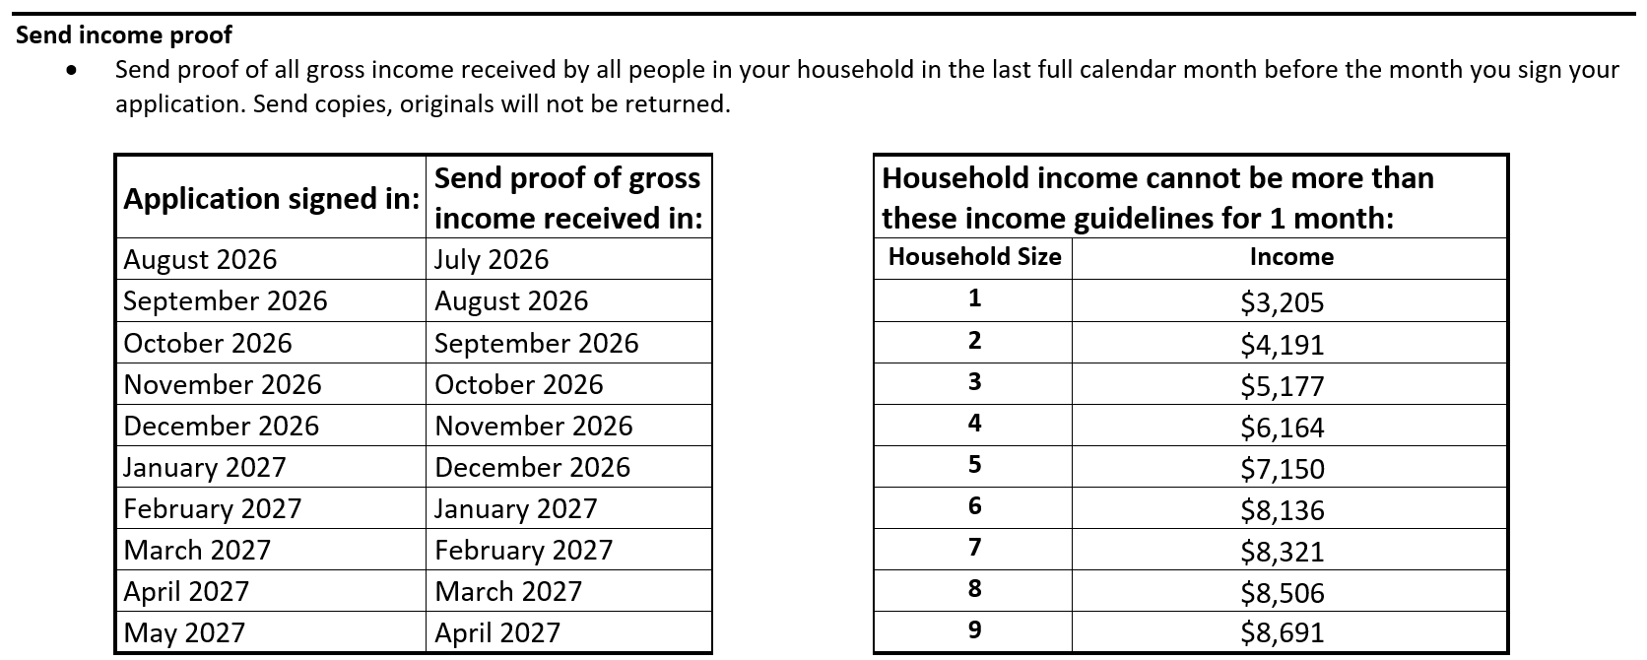
Updated income dates and income guidelines

Slide 25
Additions to ‘What proof to send’
Minnesota Paid Leave: Paid Leave Determination letter
Retirement Income including IRA income and Annuities: Benefit checks/stubs, bank statements or award letter
Pensions: Benefit checks/stubs, bank statements or award letter
When sending bank statements, if allowed as proof of income, please include all statements covering the month prior to your signature date. Altered statements are not accepted.

Slide 26
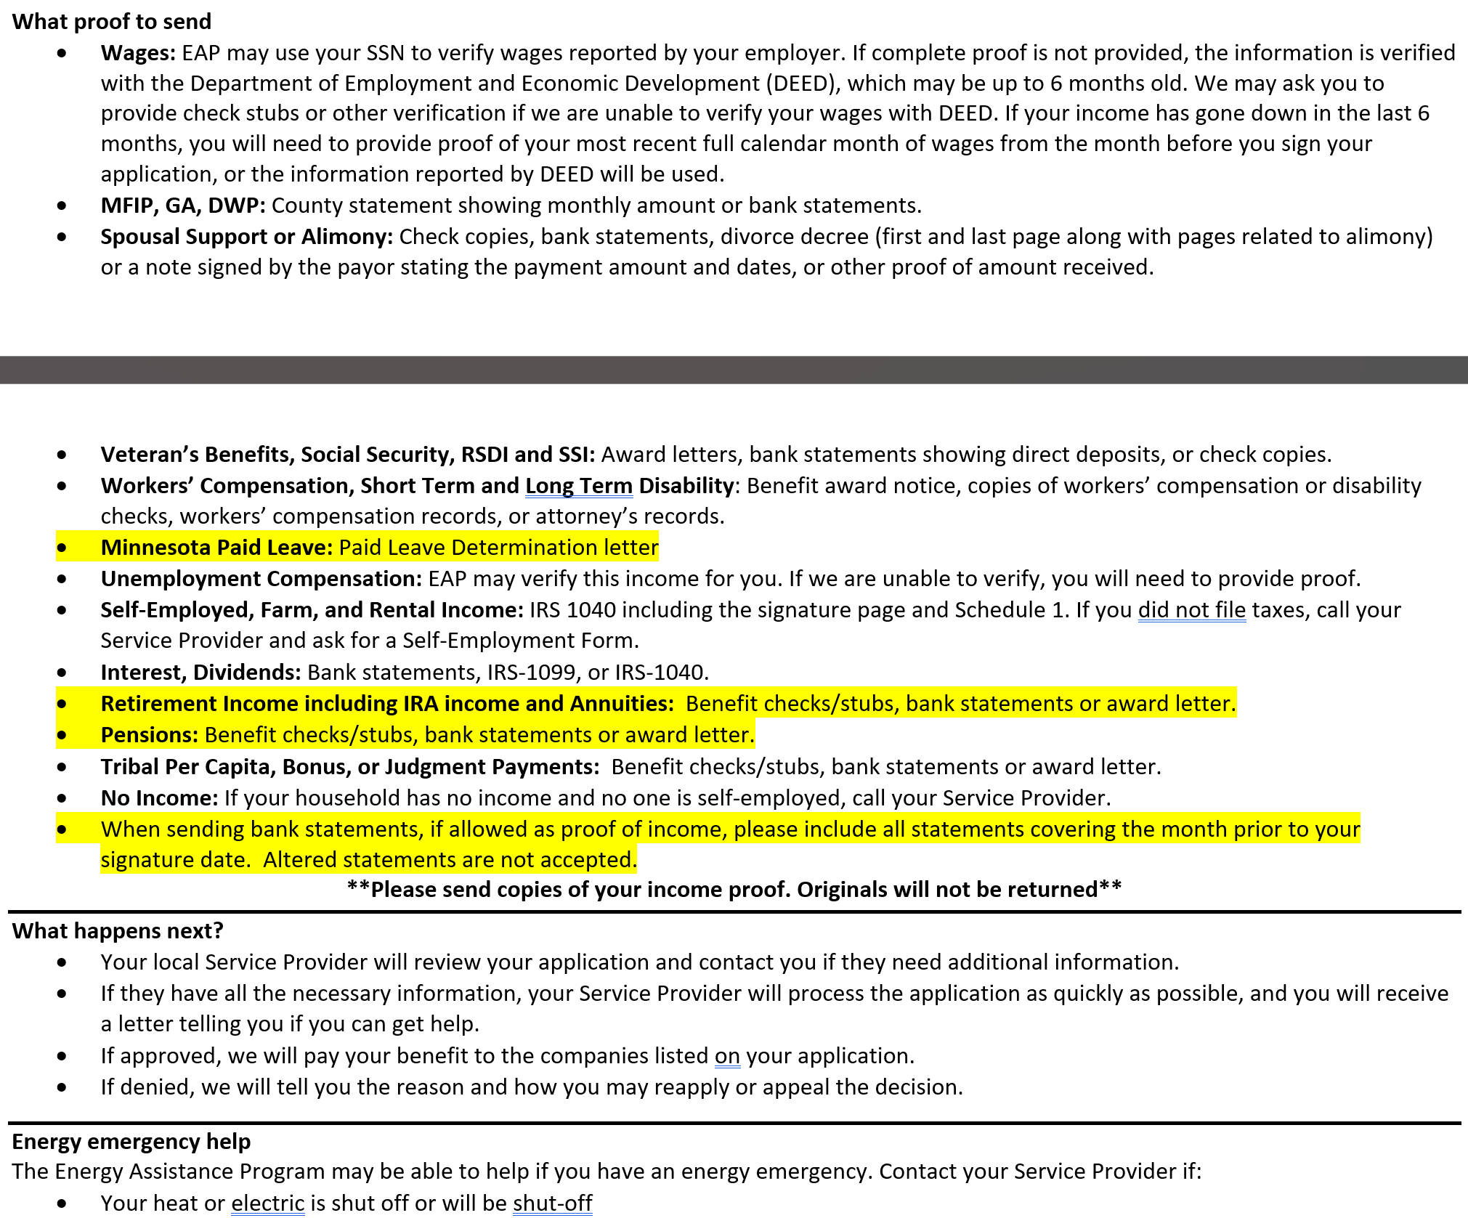
What Proof to send
New entries in the ‘what proof to send’ section highlighted

Slide 27
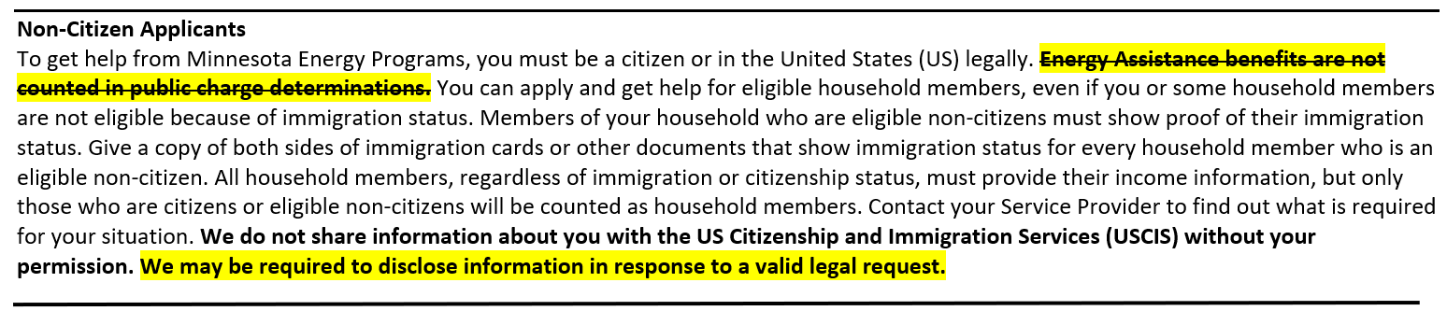
Changes to ‘Non-Citizen Applicants’ section
Removed “Energy Assistance benefits are not counted in public charge determination” due to recent federal Public Charge rule changes
Added “We may be required to disclose information in response to a valid legal request.”

Slide 28
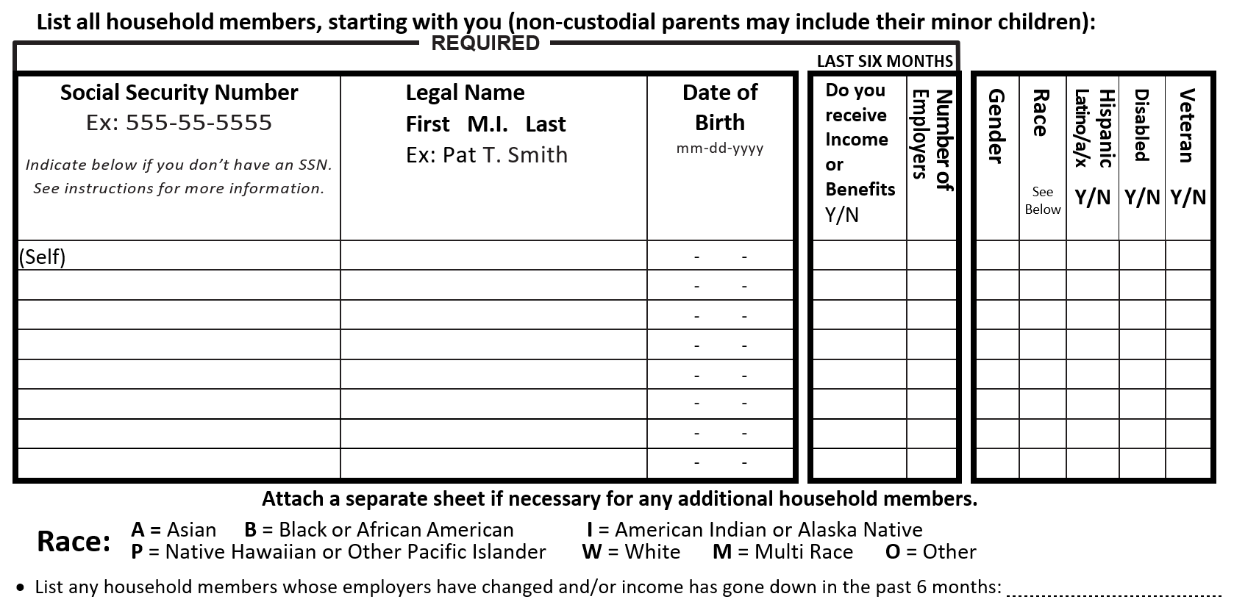
Household Members table redesigned

Slide 29
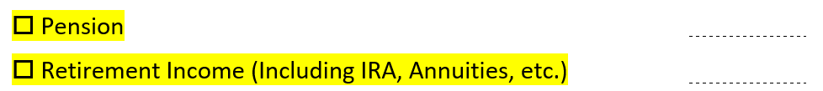
Additions to Income and Benefits sections
Addition to Income section
Addition to Benefits section
Note: Pensions are re-certifiable

Slide 30
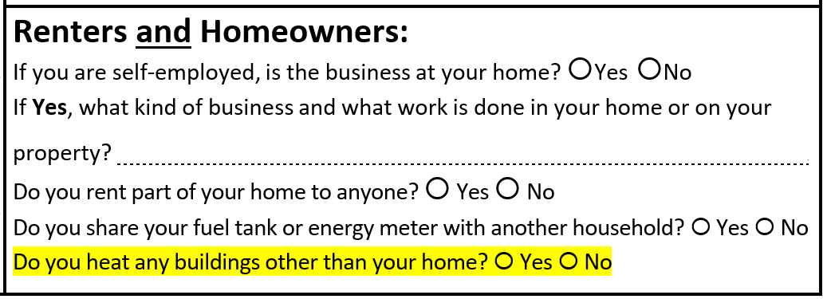
Addition to ‘Renters and Homeowners’

Slide 31
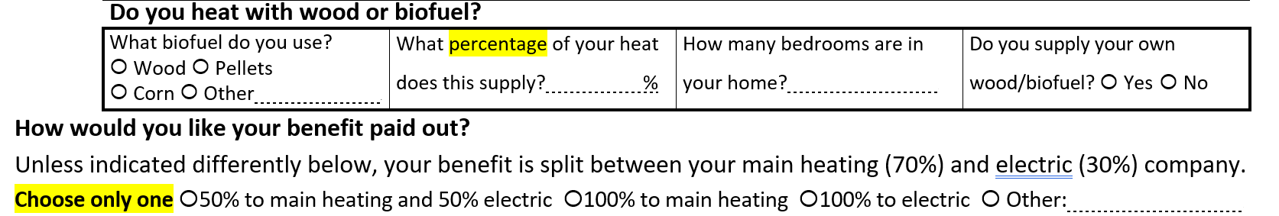
Addition to Part 4 Energy Providers

Slide 32
Added statement and bubble before Part 5
Wage income will be verified for the past six months. I have filled out the Household Information and Income section on page 2 of this form, including all income and benefits received. ○ Yes ○ No

Slide 33
Addition to Part 5
3. I authorize Commerce to share any income documentation submitted as part of my EAP application with the Minnesota Department of Revenue as necessary to verify eligibility for benefits and confirm the accuracy of income documentation

Slide 34
Planned FFY27 EAP application-related dates
Monday, August 17 - About 30,000 Recertification apps go into the mail
Tuesday, September 1 - SP-specific and translated apps can be made available at SP locations
Tuesday, September 1 - Online app is made available on the Commerce website
Tuesday, September 1 - About 20,000-30,000 Pre-filled apps begin going into the mail daily, with a total of about 51,000 apps
Friday, September 11 - Blank apps requested over the summer go into the mail
Friday, September 11 – Request form for mailed app is returned to the Commerce website
Tuesday October 1 - Email notifying prior year online applicants that online app is available

Slide 35
Q&A

