Slide 1
FFY27 Annual Training
Energy Assistance Program
Introduction; FFY26 in Review

Slide 2
Introduction & Overview
Michael Schmitz
EAP Director

Slide 3
Topics
Logistics
Introductions
Agenda for today and tomorrow
Breakthrough goals
FFY27 Approach
Training Overview

Slide 4
Logistics
No video – pre-recorded slides
Break & Lunch
Tribal Breakout Lunch – Day 1
Restrooms
Silenced phones

Slide 5

Networking Opportunity
Social Hour – Green Mill – 5PM
  Inside
  Outside (weather permitting)

Slide 6
State EAP Staff
Amanuel Asghedom
Mandy Braaten
Jon Brown
Natalia Fedorova
Andy Grewell
Ernest McCann
Michael Schmitz
S.Melaine Schwahn-Doyle
Sandra Seemann
Marissa Squires
Ian Villa-Watt

Slide 7

Welcome new and returning SP EAP Staff!
If you are new, stand up and wave

Slide 8
Day 1 Agenda
Introduction & Overview
FFY26 in review
Energy Affordability Office Director
Safe at Home services
eHEAT letters
Refunds review
Name on Account review
Ch. 13 – Program Fiscal Management
Resilience & Mindfulness
Ch. 3 – Program Eligibility Requirements
DEED Wage Income & UI Scenarios
eHEAT enhancements

Slide 9
Day 2 Agenda
Welcome back & reconnect
Ch. 2 – Applications & Application Processing
Ch. 4 – Primary Heat
Ch. 5 – Crisis
Ch. 6 – Energy Related Repair
Ch. 16 – Mechanical Contractors
Consumption refresher
Ch. 8 – Benefit Payments & Refunds
Application changes & Mailing timeline
Grant Fraud Awareness (Fraud, Waste, & Abuse)

Slide 10

FFY26 Breakthrough Goal
Last year we set a goal of improving application processing speed by 5%
Due to unprecedented challenges, we didn’t meet this goal
Days to work an app slowed by 5%
Days to terminal status slowed by 13%

Slide 11
FFY26 Breakthrough Goal Continued
Proposed 90% of SPs work an up in fewer than 30 days
  75% did it, up from 61% last year!
  Nearly 80% under 40 days
  96% 45 days or fewer
  Saw improvements for several SPs

Slide 12

FFY27 Breakthrough Goals
Intended to be big, audacious, and hard to reach
EAP’s goals:
  Regain form from a year ago – 5% overall improvement
  Get 90% of SPs under 30 days to work an app

Slide 13

How We Can Achieve FFY27 Breakthrough
Keep improving online app to get more complete apps
Better policy for DEED wage/unemployment insurance database
Better training – including sharing best practices
No federal shutdown/delayed funding
No large-scale administrative inefficiencies or mistakes

Slide 14

FFY27 Approach – Subject to Change
Funding likely to decrease slightly (~$115-123M)
Eligibility Threshold: 50% SMI
Average Primary Heat Benefit: $580+
  Minimum: $200+
  Maximum: $1,400
Crisis Max: $600

Slide 15

FFY27 Approach - continued
10% EAPWX Transfer
Startup funds on 10/1
  ERR at least $1M
  $3M Admin
  $1M A16

Slide 16

FFY27 Contingency Plan
If significant funding cut is known
  Potentially cut eligibility threshold to limit number of apps
If there’s a federal shutdown prior to CR
  Have sufficient funds reserved for limited Crisis availability

Slide 17
FFY27 PPA Assignments

Slide 18

FFY27 Policy Development
Many sources for FFY27 policy improvements
  Program audits
  Issues identified by SPs and Commerce in FFY26
  Policy Advisory Committee (PAC)
  EACA
  eHEAT Next Gen

Slide 19
FFY27 JAD Participants
SP participation was essential – thank you!
  Tammy Alto
  Lisa Anderson
  Pat Elizondo
  Andrea Goeden
  Nora Guerra
  Rachel Landreau
  Kendra Lund
  Joan Markon
  Stephanie McClanahan
  Sheila Ous
  Jean Pelletier
  Sandra Pyles

Slide 20

Annual Training: Intentions
Prepare for FFY27
Train-the-trainer
  Program & policy changes
  Areas of concern
Excludes EAP 101, policy making

Slide 21
Annual Training: Approach
PowerPoint presentations by topic
Q&A between – hold questions
Issue a turn-around document (TAD)
PPTs available by topic on Commerce website
Recordings of PPTs available soon
List of Policy Manual Changes

Slide 22

Ice Breaker
Find someone around you
Hopefully, someone you don’t know well
What is something you are curious about or want to learn more about?

Slide 23
FFY26 in Review
Michael Schmitz

Slide 24
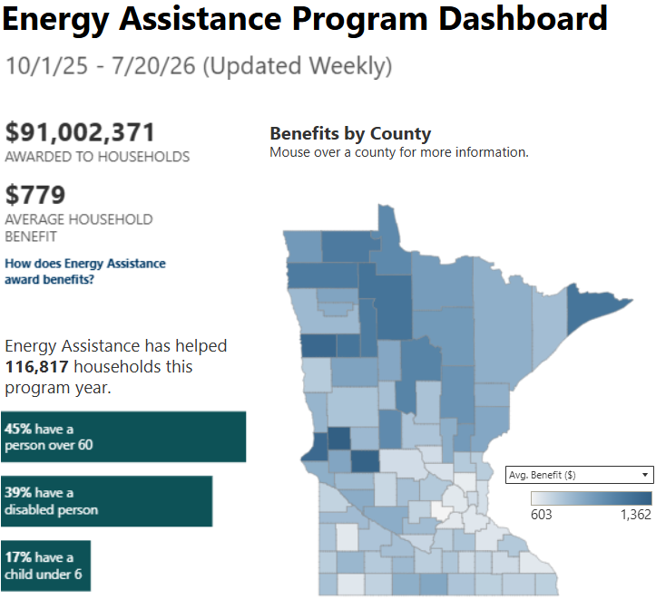
EAP Dashboard

Slide 25
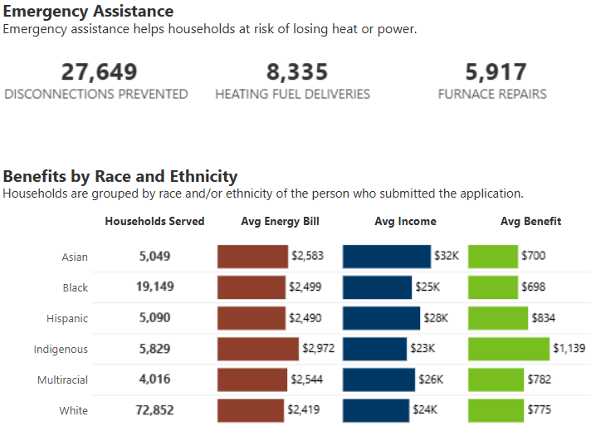
EAP Dashboard – Emergency Assistance

Slide 26
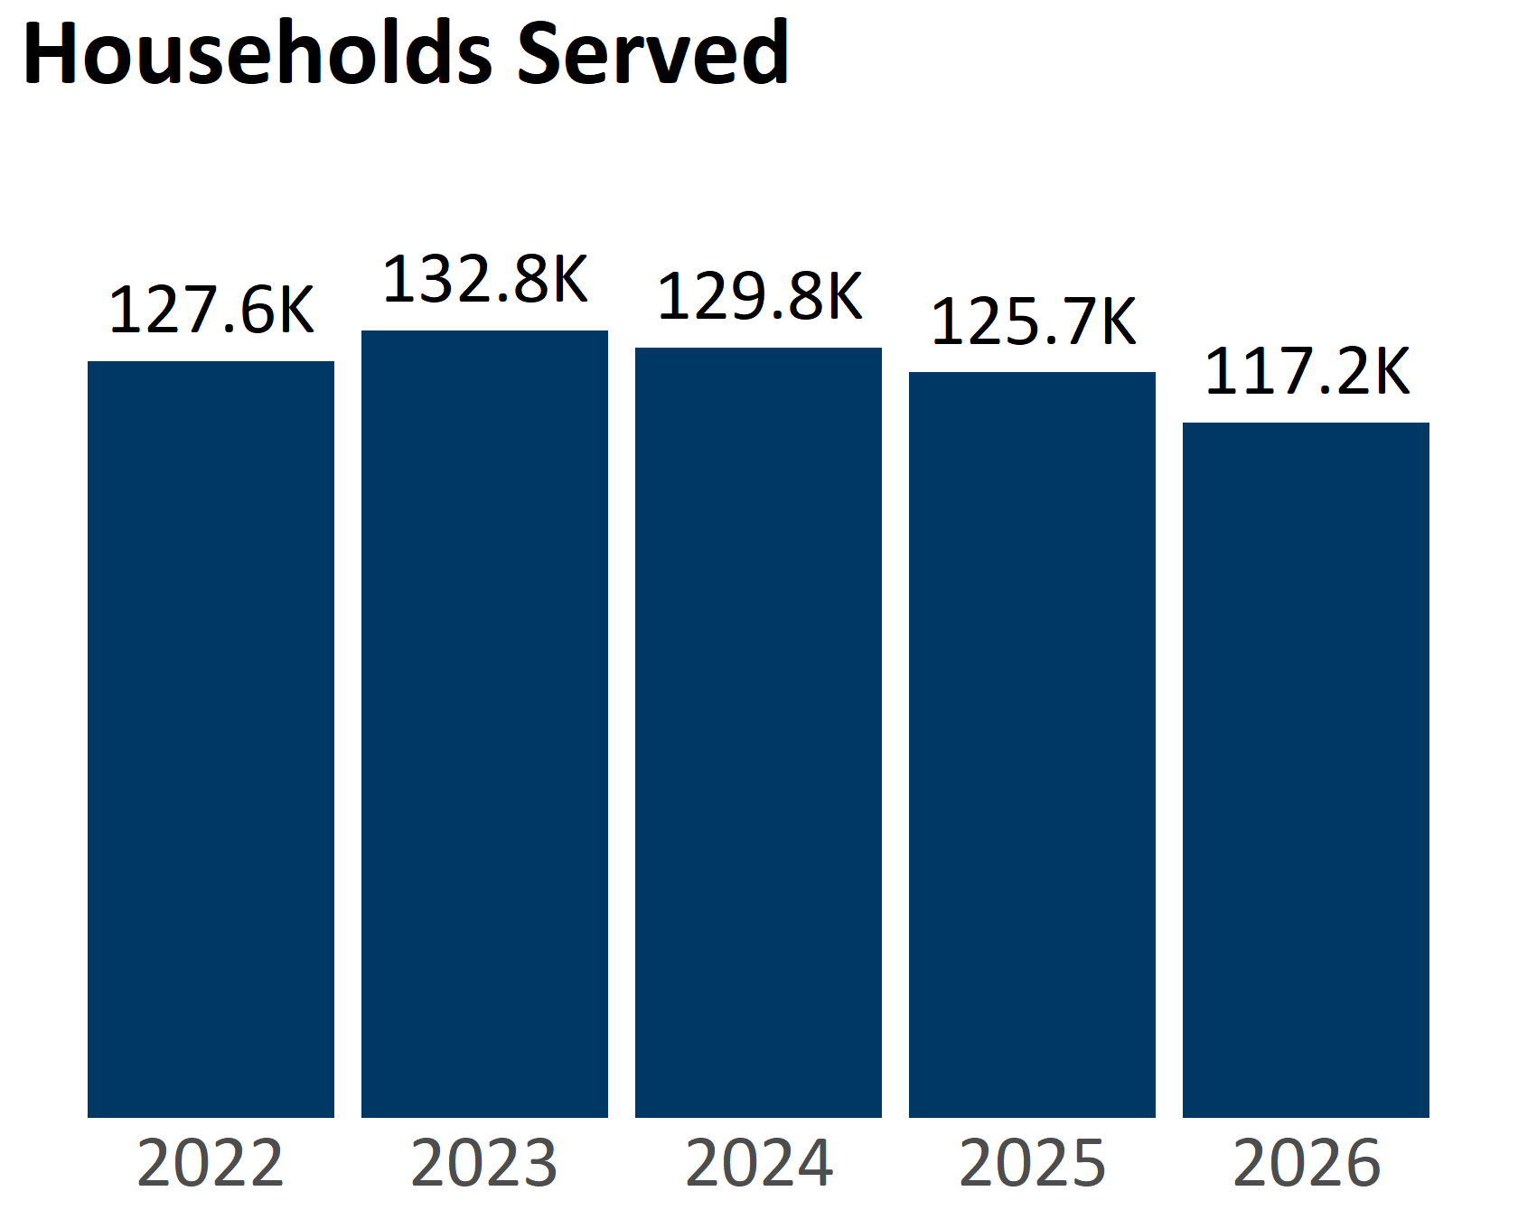
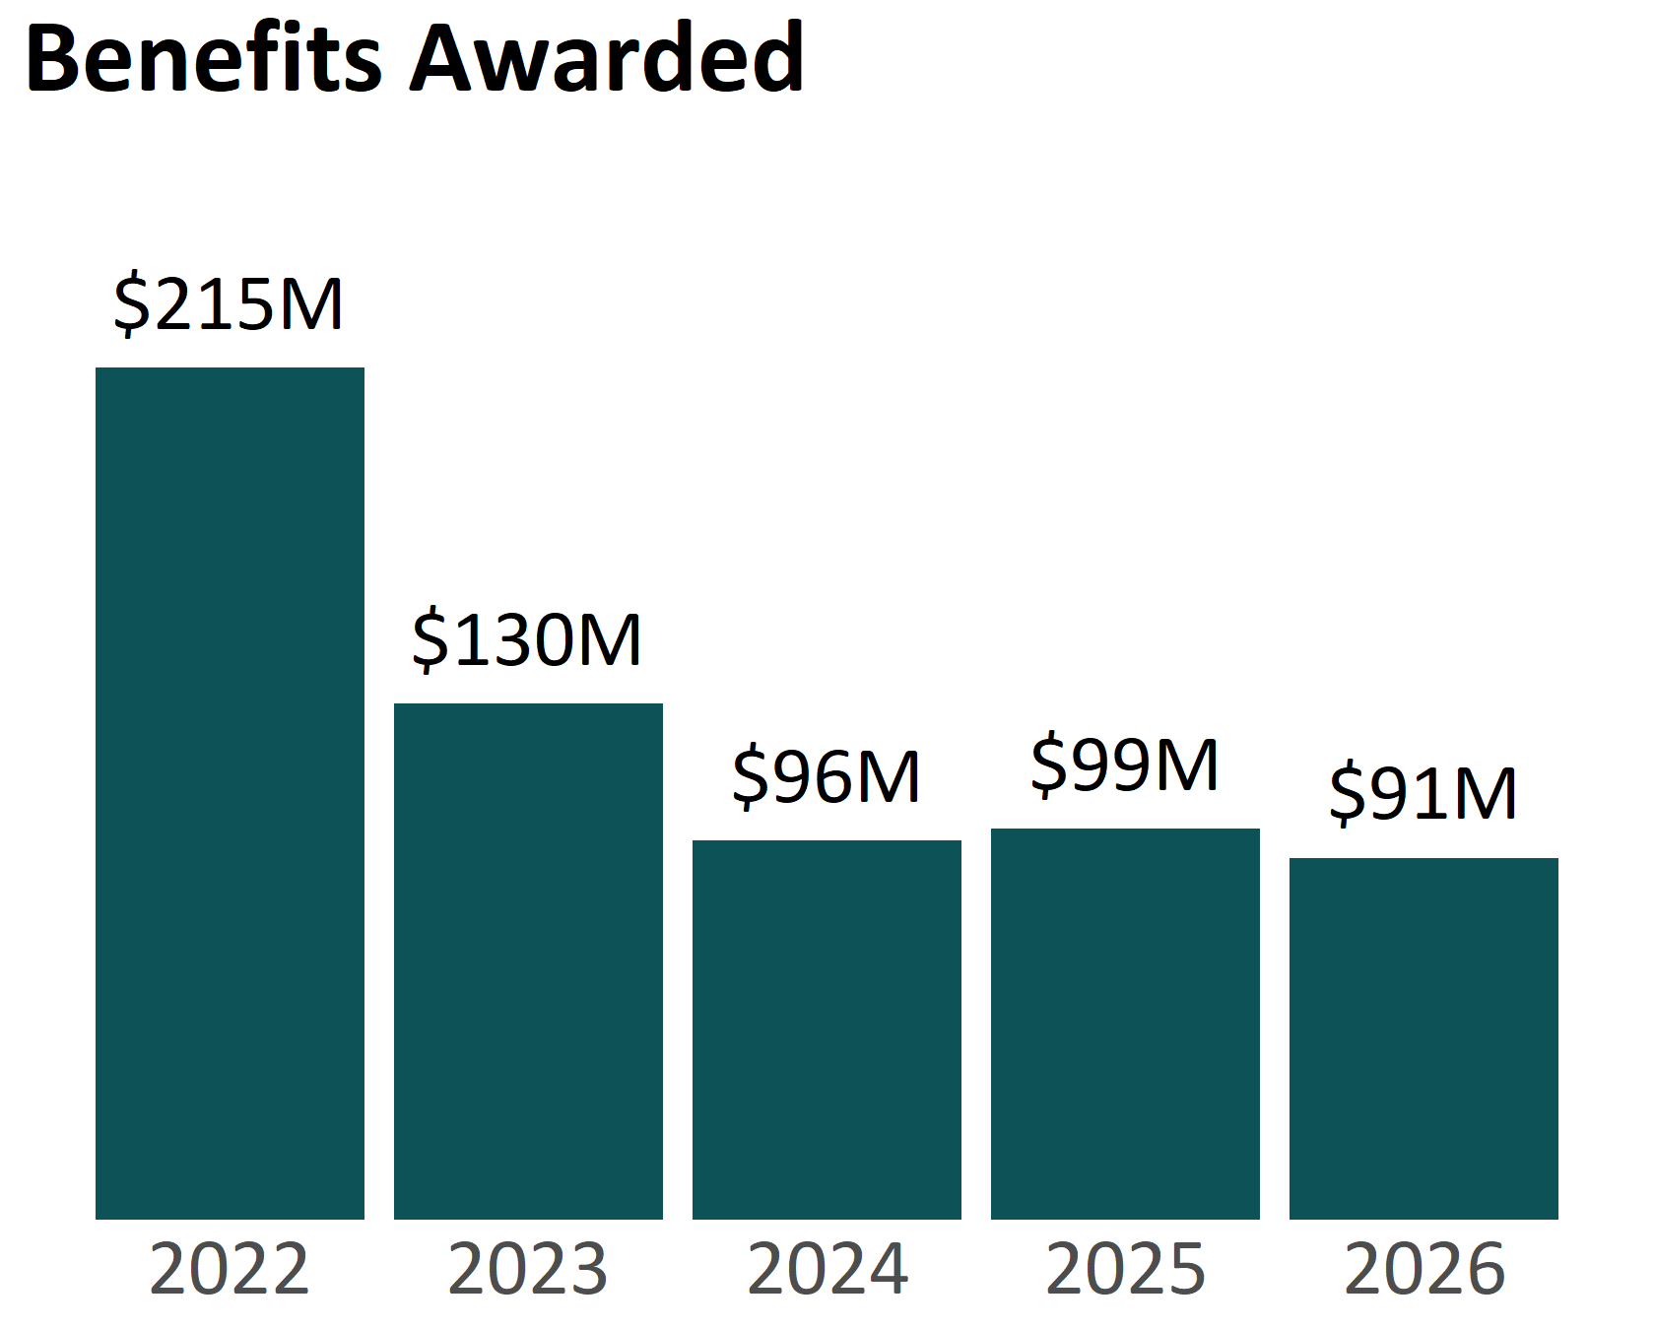
Households Served and Benefits Awarded

Slide 27
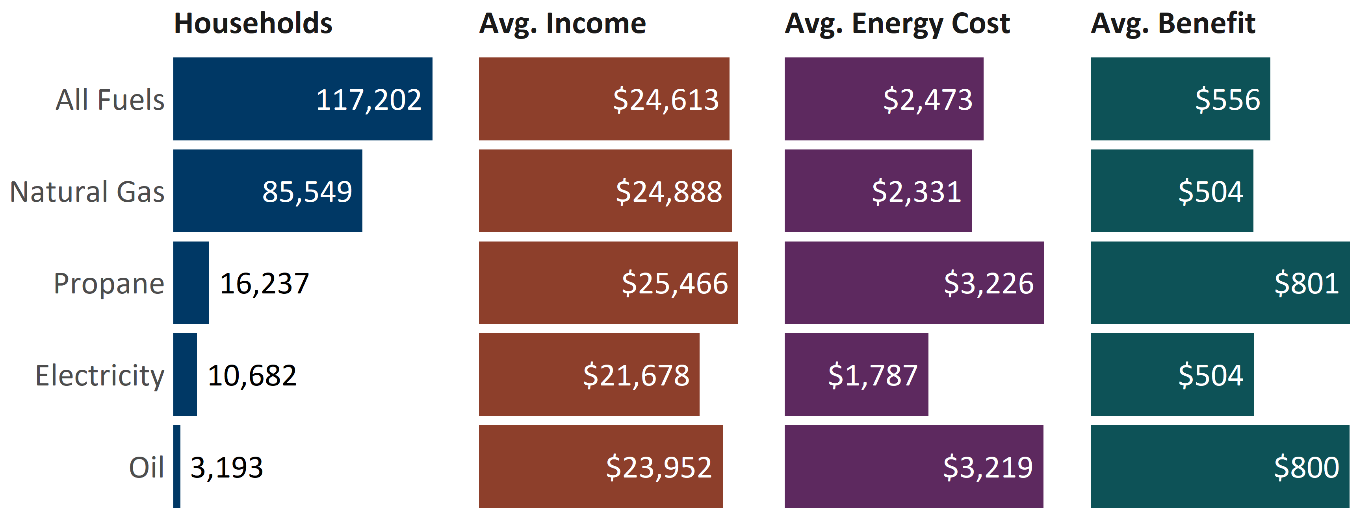
Primary Heat Benefits by Main Heating Fuel

Slide 28
Crisis Participation
Program Year | Crisis Max | Participation Rate | Total Awarded | Avg. Awarded
2022 | $3,000 | 31.2% | $37.4M | $938
2023 | $3,000 | 35.3% | $48.5M | $1,033
2024 | $600 | 34.6% | $21.5M | $479
2025 | $600 | 31.4% | $18.8M | $477
2026 | $600 | 28.9% | $16.1M | $477

Slide 29
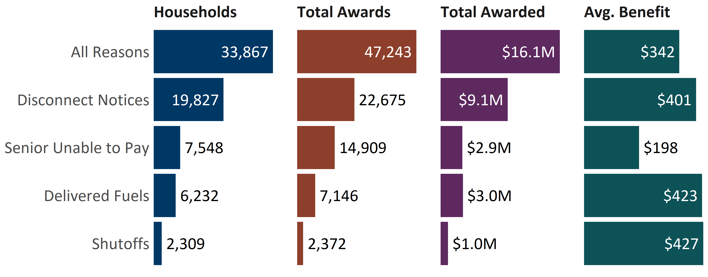
Crisis Benefits

Slide 30
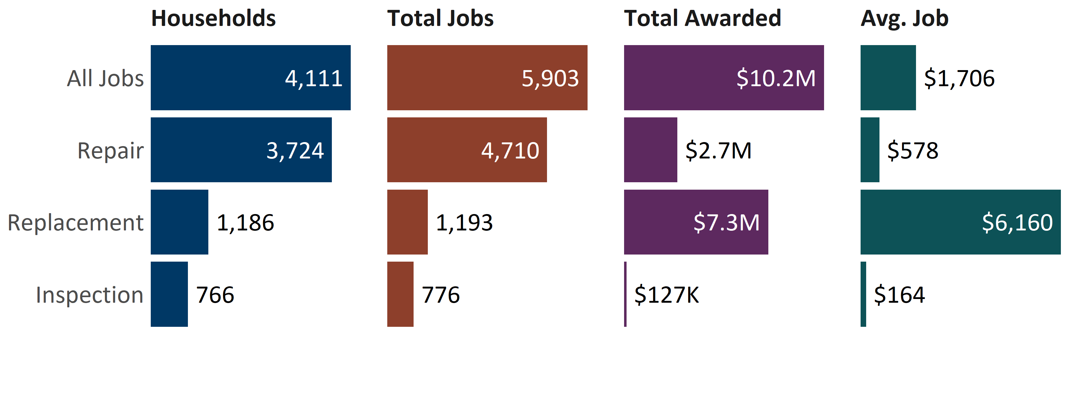
ERR Benefits

Slide 31
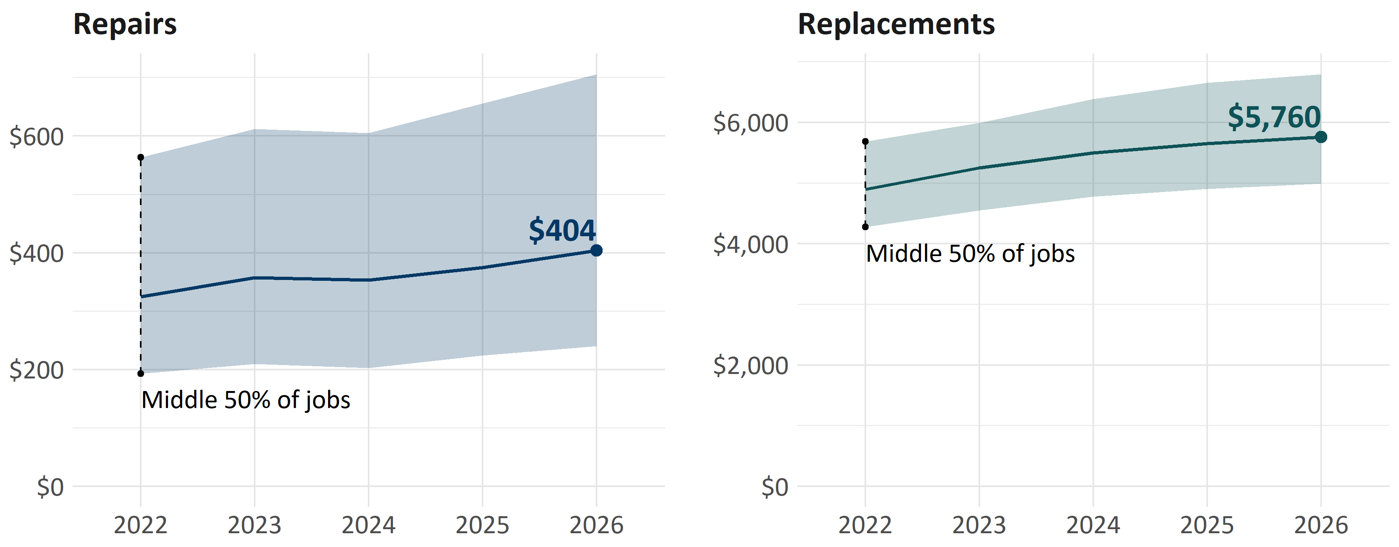
Median ERR Costs Over Time

Slide 32
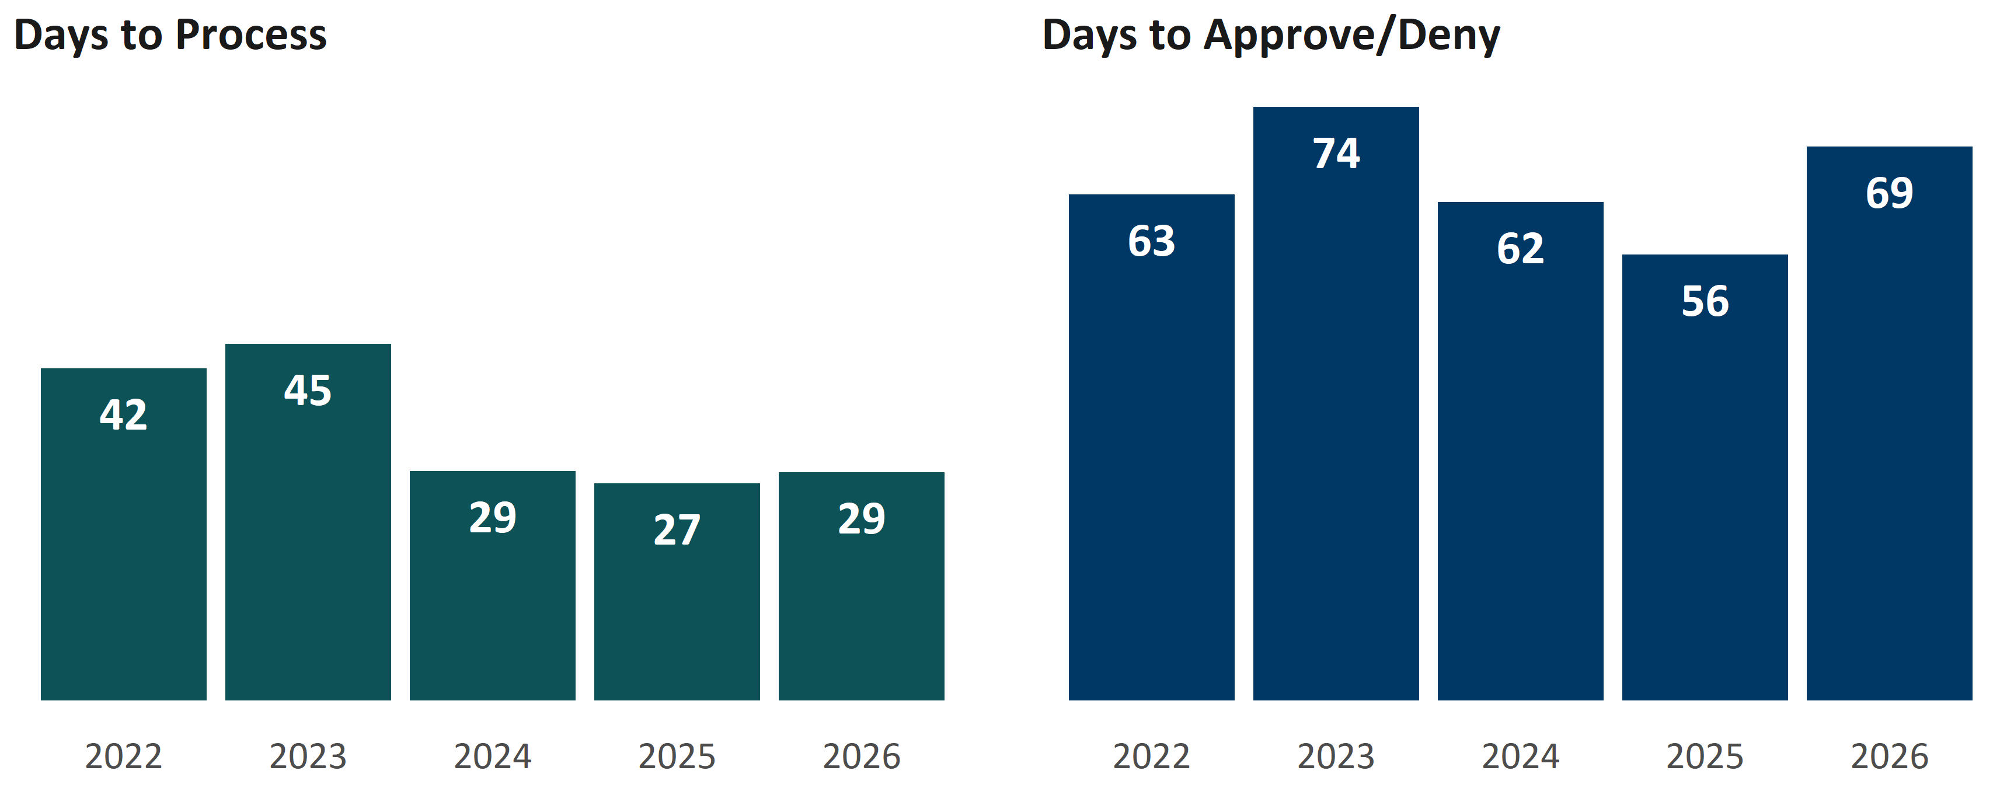
Application Processing Speed

Slide 33
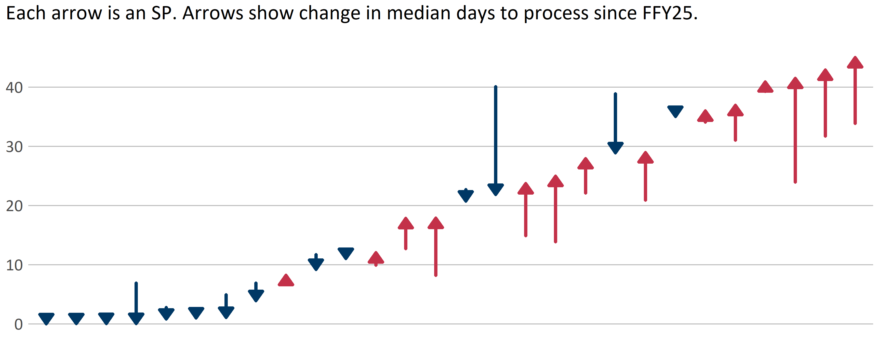
Processing Time Increased Slightly in FFY26

Slide 34
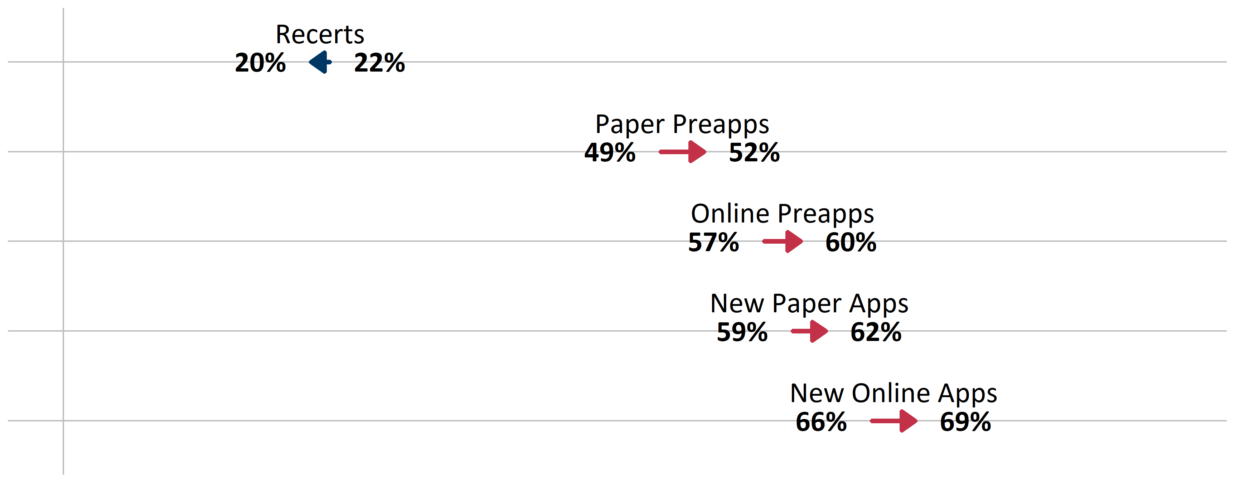
Percentage of HHs with Info Request, FY25-FY26

Slide 35
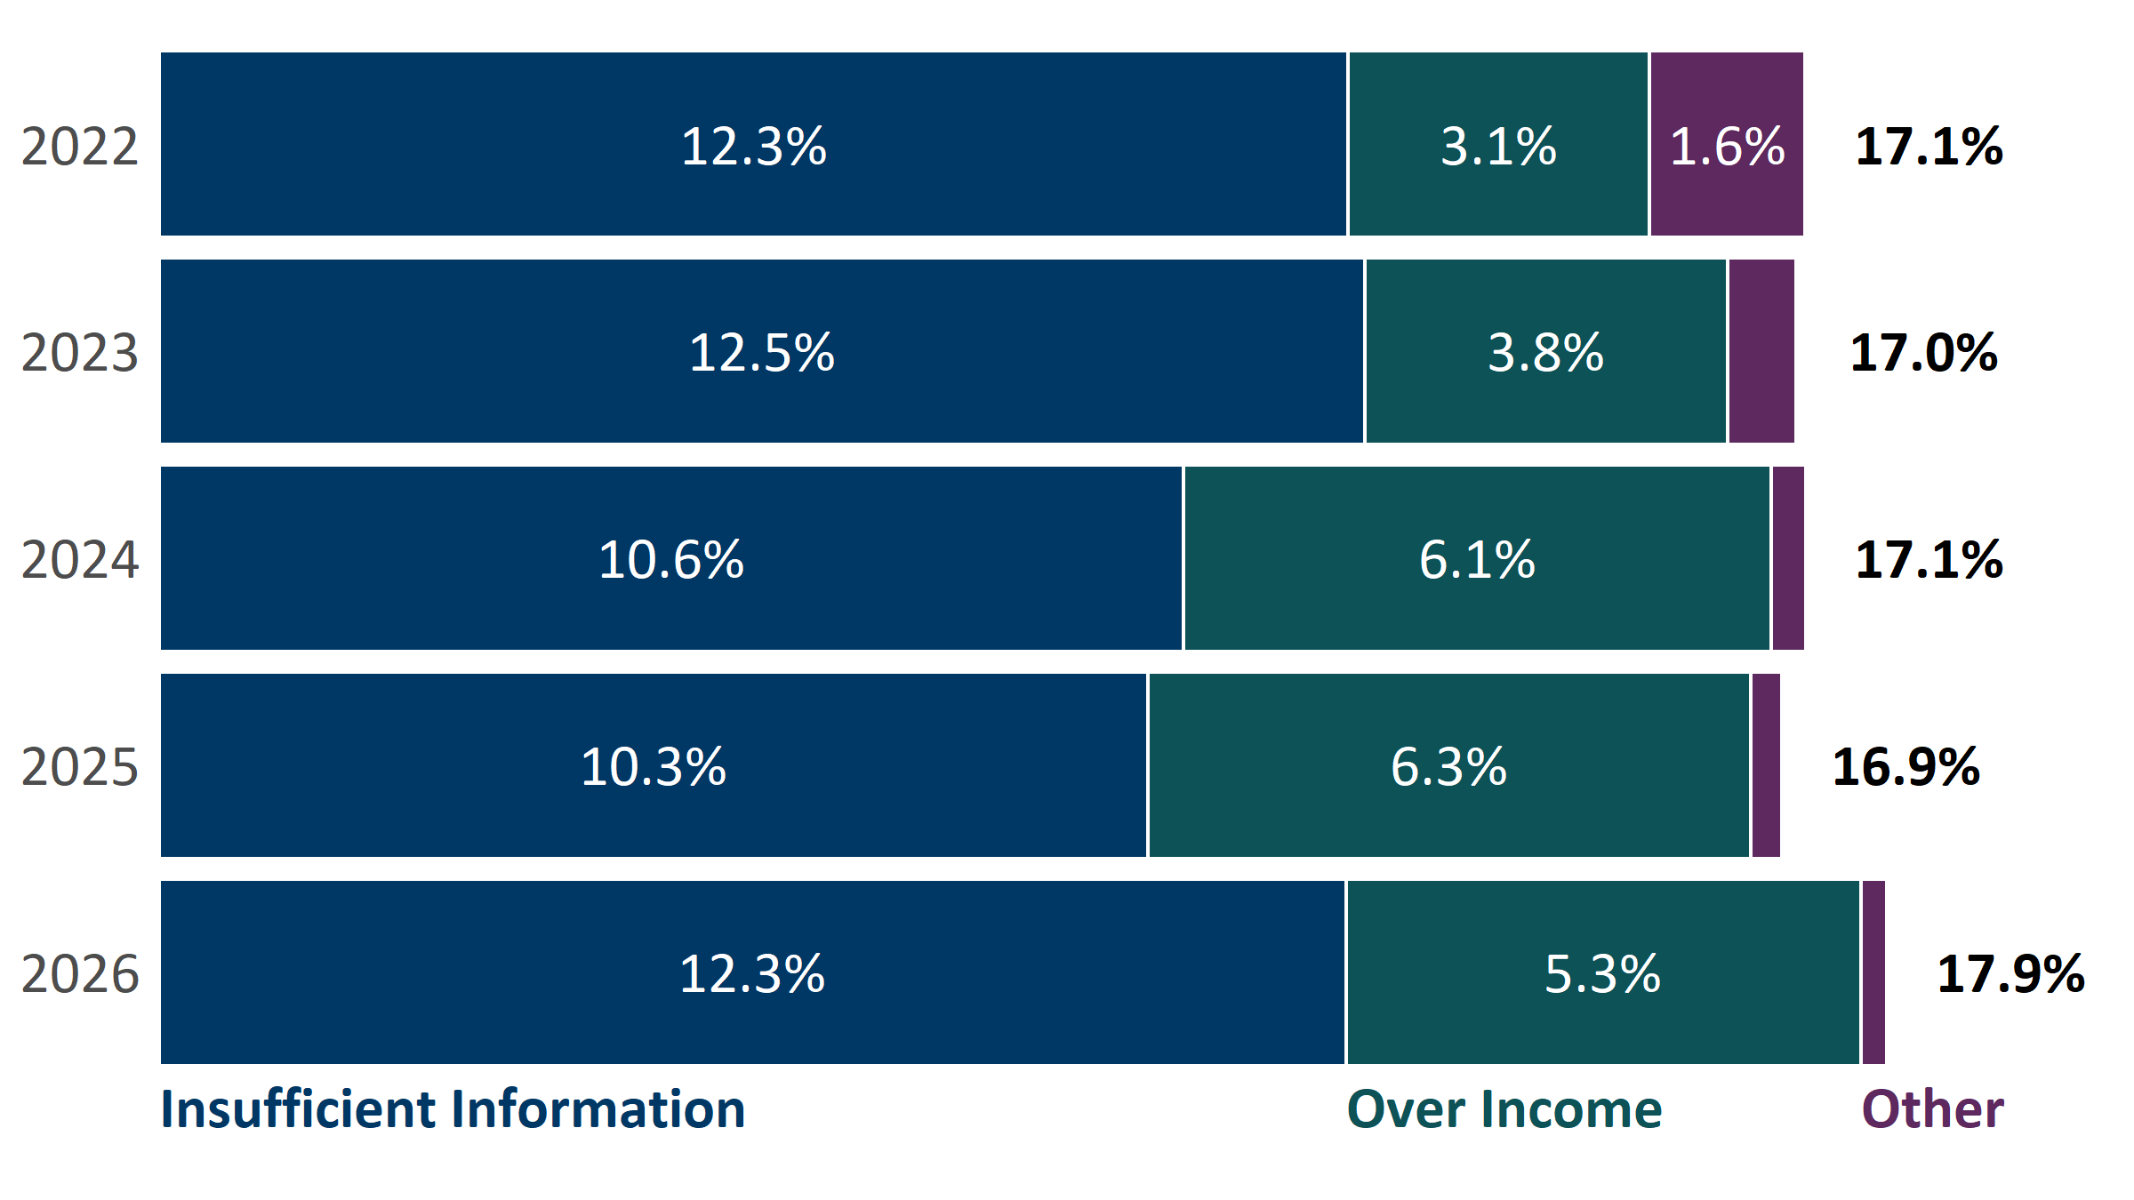
Denial Rates and Reasons

Slide 36
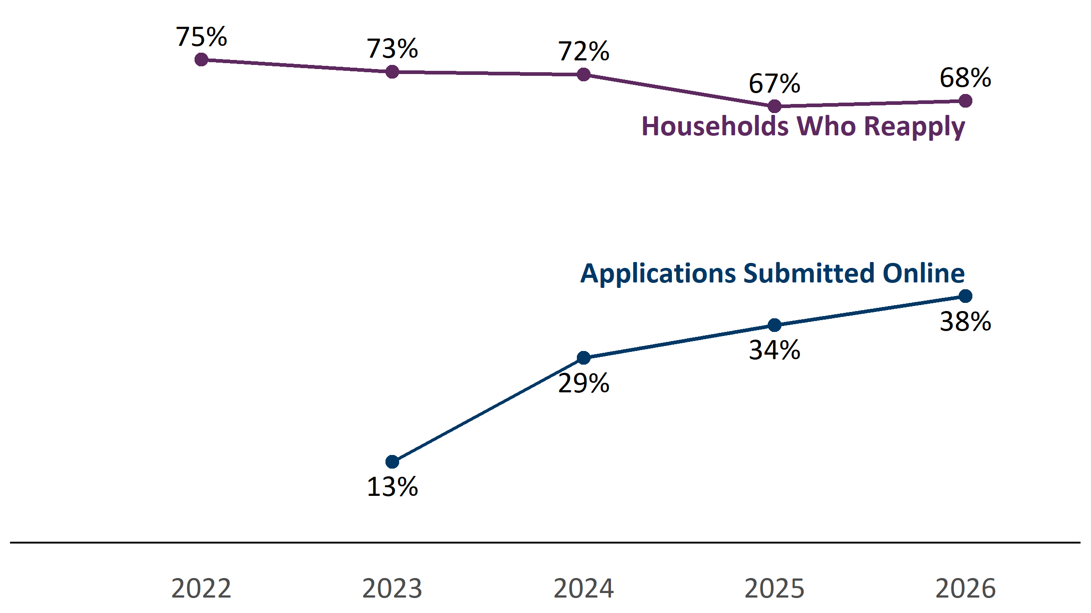
Application Methods

