Slide 1
FFY27 Annual Training
Energy Assistance Program
Safe at Home services (SAH)

Slide 2
Safe at Home services (SAH)
Sandra Seemann

Slide 3

SAH topics
General Safe at Home services info
EAP-related SAH info
  Logging apps from SAH HH in eHEAT
  Online apps from SAH HHs
  Energy Related Repair (ERR) for SAH
  Homeownership documentation for ERR
  SAH training/support resources

Slide 4
General Safe at Home services info

Slide 5

Safe at Home (SAH) services
Division of the MN Secretary of State’s Office
A tool for someone with extreme safety needs
Issues a special address that others are required to accept
Provides address confidentiality services
Currently serving nearly 5,500 individuals in about 2,600 HHs
Notes:
e.g. survivors of domestic assault, survivor of sexual assault, those with professional safety concerns (e.g., getting threats related to their job, such as a government official, etc.)

Slide 6

Tool for extreme safety needs
For people afraid for their safety or who reside with someone who fears for their safety
SAH issues alternate address the person uses as their home, work, or school address – all participants have same PO Box but are also assigned a unique Lot #
By law, MN public & private entities must accept the SAH address as person’s address for all reasons
A SAH participant’s address is a PO Box in St Paul, no matter where they live in MN
Notes:
e.g. survivors of domestic assault, survivor of sexual assault, those with professional safety concerns (e.g., getting threats related to their job, such as a government official, etc.)

Slide 7
SAH address must be accepted
Examples
Driver’s License / State ID card
Auto / renter’s insurance
School enrollment
Form 1-9 / New employment
County-based services
WIC / Energy Assistance
Permits to carry or purchase
Income Tax Filing
Court appearance / Service of Process
Bank Account
Library card
Police reports
Dog License

Slide 8

What you really need to know
A SAH participant:
  Uses their assigned PO Box address, not their real address
  Does not disclose their SSN on the EAP app
  Will redact their real address on documentation they provide
Energy company portals won’t show SAH HH’s real address

Slide 9
Notice to Government Entity & SAH contact
Notice to Government Entity
Receiving a notice to government entity is a rare instance
If you get this notice, call the SAH office at 651-201-1399
SAH contact information
Email: safe.athome@state.mn.us
Phone: 651-201-1399
Monitored Monday – Friday, 8:00AM to 4:30PM

Slide 10
Energy Assistance Program-related SAH info

Slide 11
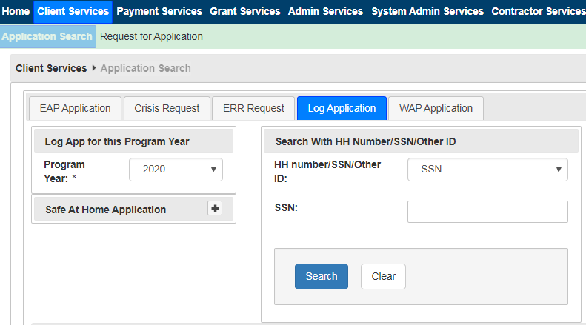
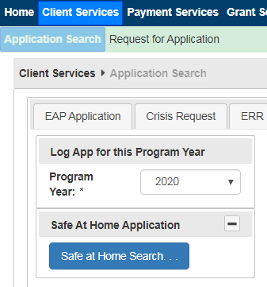
Logging SAH apps in eHEAT
  SAH apps are logged separately from non-SAH apps

Slide 12
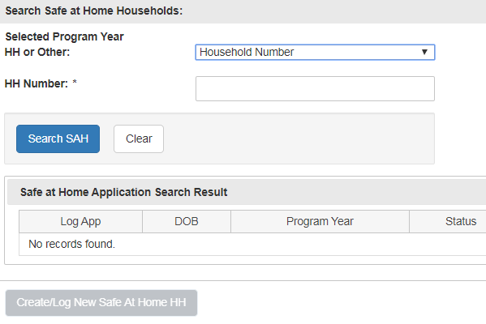
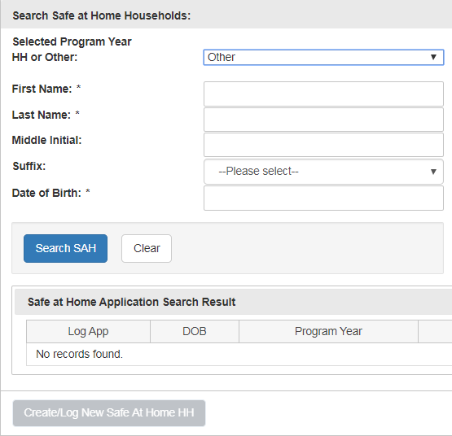
Logging SAH apps in eHEAT - search
  Can log using HH#, then click ‘Search SAH’
  Or can select Other to search by the applicant’s name

Slide 13
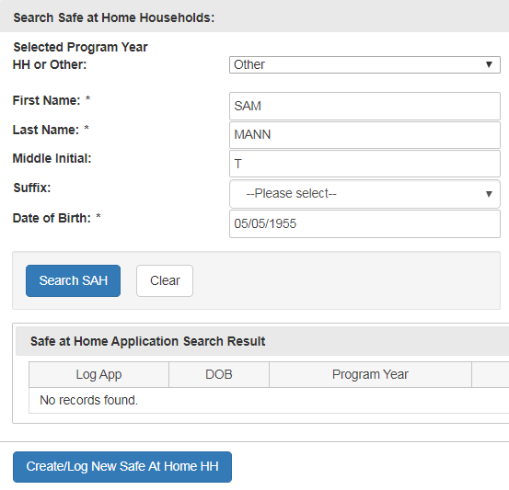

Logging SAH apps in eHEAT - search cont.
  After entering name & DOB, click ‘Search SAH’
  eHEAT will either find that person or return the message: Search Results: No records found for Name: XX DOB: XX
  If no record is found, click “Create/Log New Safe At Home HH”
0

Slide 14
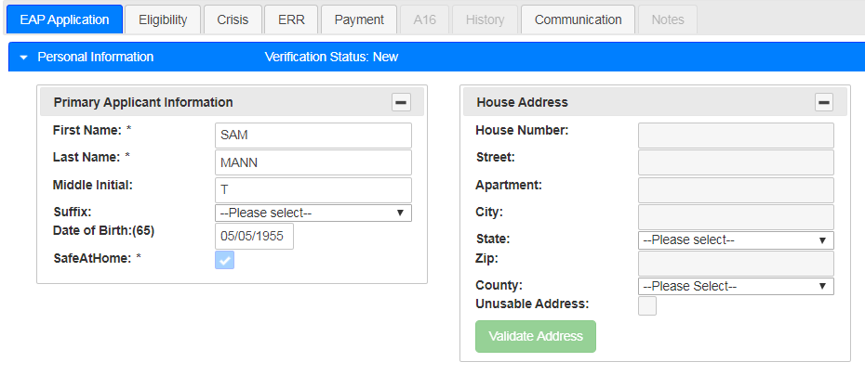
Logging SAH apps in eHEAT – Home address
  No House Address can be entered for the SAH HH
0

Slide 15
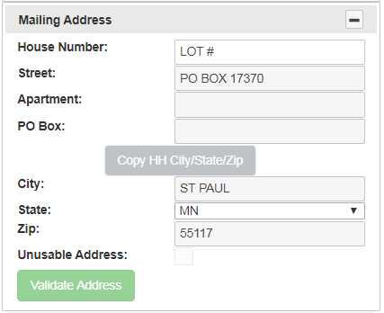
Logging SAH apps in eHEAT – Mail address
  The universal SAH address is auto-filled in eHEAT
  SP enters the HH’s unique LOT #
9876

Slide 16
SAH logging control
Prevents accidentally logging SAH apps as a non-SAH app
If trying to log a prior year SAH app, as a non-SAH app, eHEAT warns: “This application is a Safe at Home household.”
If a prior year SAH HH applies and is no longer a SAH participant, log the application as a new HH

Slide 17
HH moves into or out of SAH
What if a pre-logged HH submits app and they moved into or out of SAH program?
  Cannot “switch” a HH in eHEAT to or from SAH
  Their circumstances are very different - think of them as a new HH
  Enter them into eHEAT as a new HH (either via regular logging or SAH logging, as appropriate)

Slide 18
SAH HHs should not use the online app
SPs should discourage SAH HHs from applying with online app
  Online app includes sensitive info the SAH HH should not provide, such as real home address and SSNs
The Manual’s Online Applications from SAH Households section guides SPs on handling online apps from SAH HHs

Slide 19

If a SAH HH applies online
How to handle online app from a SAH HH
1. Determine if applicant applied in a prior year
2. Print the .pdf app summary document
3. Reject the online app, using the “Other” reason
4. Use the app summary document like a paper app
  If the HH previously applied as a SAH HH, log the app under the previously established HH number (via the SAH app logging system)
  If the HH is new to EAP, log the new app (via the SAH app logging system)
5. For the SAH HH’s safety, redact any HH private info, such as a home address, SSN, etc., included in online app-related documentation

Slide 20

Communication best practices with SAH HHs
Issue: Snail mail delays are worse for SAH HHs - mail goes first to PO Box at Secretary of State’s office, then gets packaged & mailed to HH’s real address
Best customer service to SAH HHs:
  Encourage HH to select email as preferred mail type
  If possible, contact HH directly by phone rather than send RFI letter, especially if timeframe is short

Slide 21
Energy Related Repair for SAH households

Slide 22

Energy Related Repair (ERR) for SAH
  It is impossible to provide ERR without the HH’s physical address
  HH must decide if they are willing to share their address for ERR
  Contractors must work with SP & others to safeguard SAH participants’ identity and address
  Must reduce paper trail as much as possible and never have the SAH participant’s name & address linked

Slide 23
ERR for SAH – SAH Notice to Govt. Entity
If SAH participant submitted SAH Notice to Government Entity, EAP SP must get signed consent from the SAH participant before providing any HH info (e.g., phone number) to an ERR contractor
SP explains to MC it is a SAH HH and steps needed to keep the HH safe
Do not use SAH participant’s name when communicating with MCs

Slide 24
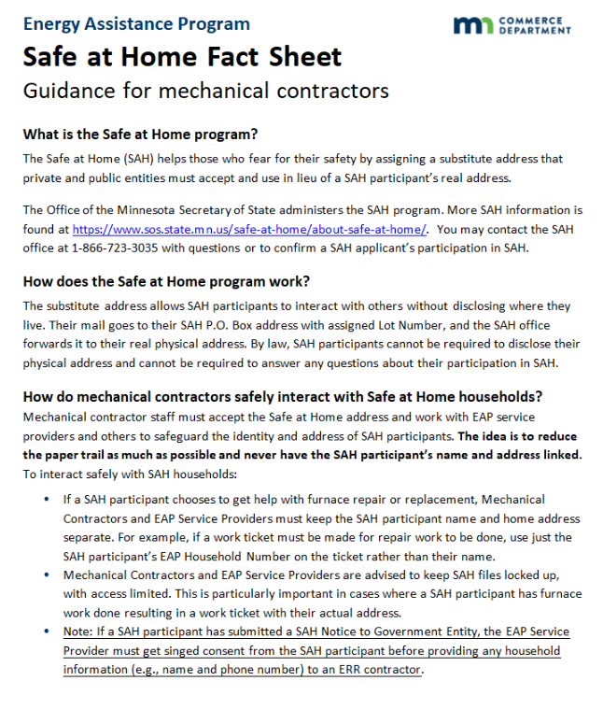
ERR for SAH – MC Fact Sheet
Resource to share with MC working with SAH HH: Safe at Home Fact Sheet - for mechanical contractors

Slide 25
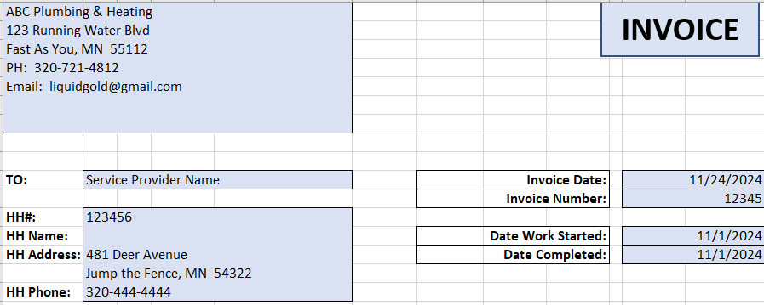
ERR for SAH – safe interactions
MCs & SPs must keep SAH participant’s name & address separate
If the job requires a work ticket, use just the EAP HH# on ERR documents & not the SAH participant’s name
If any HH member name is on the ERR documents, remove the name
Use the HH# on ERR documents.
Name should be blank.
Remove name if it is on ERR-related document, e.g., invoice or work order.

Slide 26

ERR for SAH – safe interactions, cont.
To interact safely with SAH HHs MCs and SPs must lock up SAH files, with access limited
  Especially important if the ERR job results in work ticket with the SAH participant’s actual address

Slide 27

ERR for SAH – homeownership documentation
Even SAH HHs must prove home ownership to get ERR services
Once documentation is verified, SP must redact the name from the document
ERR-related documentation that includes a real HH address should be kept separately from the SAH HH’s regular file

Slide 28
SAH training/support resources

Slide 29
Safe at Home training videos
  SP EAP staff must watch SAH videos at start-up and for new staff on-boarding
  A prior year’s training by Dianna Umidon from Safe at Home services will be available for training staff
  This SAH training will also be available

Slide 30
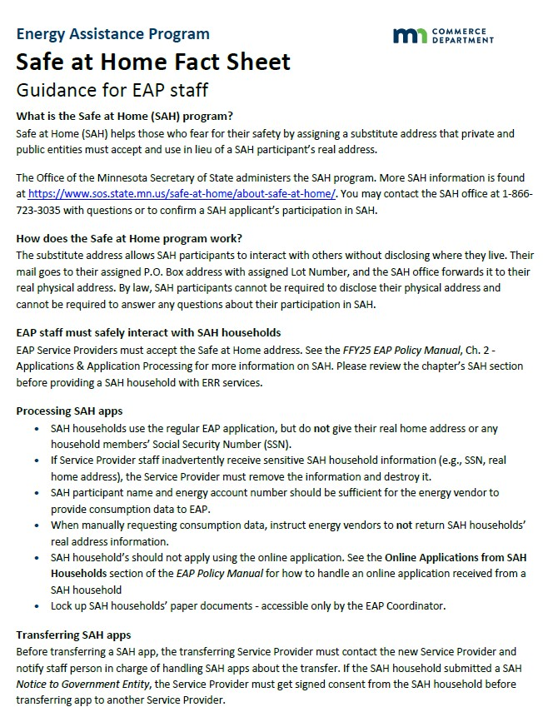
SAH resource – EAP staff fact sheet
SAH resource
  SAH Fact Sheet – Guidance for EAP Staff
    How staff safely interact with SAH HHs and process their app
    On EAP Toolkit http://mn.gov/commerce-stat/pdfs/sah-fact-sheet.pdf

Slide 31
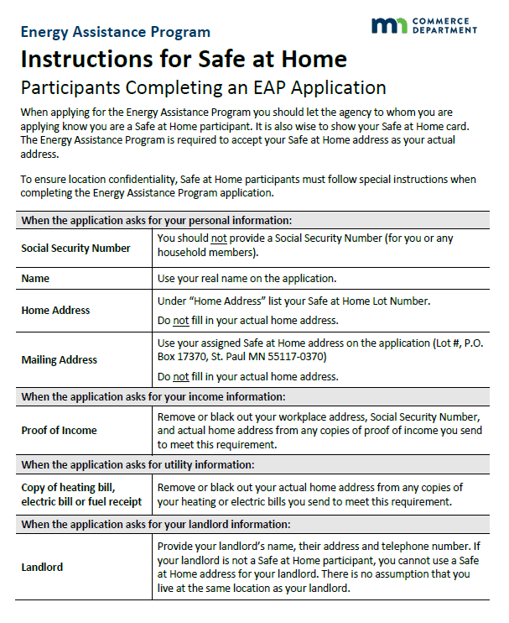
SAH resource – App instructions for SAH HHs
SAH resource
  Instructions for Safe at Home Participants Completing an EAP Application (Appendix 2A)
  On EAP Toolkit: http://mn.gov/commerce-stat/pdfs/instruct-sah-completing-eap-app.pdf

Slide 32
Q&A

