Slide 1
FFY27 Annual Training
Energy Assistance Program
Grant Fraud Awareness – Fraud/Waste/Abuse

Slide 2
Grant Fraud Awareness – Part 1
Andy Grewell

Slide 3

Grant Fraud Awareness – Topics
Topics
Learning Objectives
Definitions
Fraud Risk Factors
Fraud Scheme Characteristics
Internal Control Activities
Agency Responsibilities and Reporting

Slide 4

Grant Fraud Awareness – Learning Objectives
Identify some fraud risk factors
Recognize some common fraud schemes and red flags in grant programs
Describe activities that support fraud prevention
Describe reporting channels and whistleblower protections

Slide 5
Grant fraud diverts resources from the community
Minnesota Legislature
Agency
Grantees & Subgrantees
Grant funds supporting a public purpose
FRAUD?

Slide 6
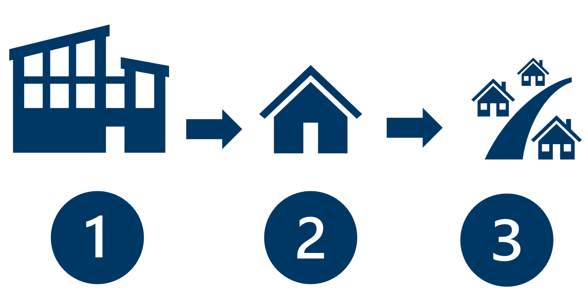
Definitions: Grant
Grant
Transfer of cash or something of
value to a recipient to support
a public purpose authorized by law.
A grant involves three parties:
a granting agency (Commerce)
a grantee (SPs), and
a final recipient of service (EAP HHs)

Slide 7
Definitions: Misuse
Misuse
The improper use of public resources, funds, or programs for personal benefit, to the detriment of others, or in a manner inconsistent with their intended purpose.
Includes Waste & Abuse
Example:
Spending grant funds for ineligible or unnecessary expenses or activities that are not directly aligned with the grant program or its goals.

Slide 8

Definitions: Fraud Risk
Fraud Risk
Broader concept that includes potential fraud events and vulnerabilities related to an agency’s state grant program
Something could happen

Slide 9

Definitions: Fraud
Fraud
Involves obtaining something of value through willful misrepresentation.
Determined through the judicial or other adjudicative system.
Something has happened

Slide 10
Definitions: Fraud Mechanism
Fraud Mechanism
The method by which fraud is committed.
Examples:
False documentation
Shell companies
Kickbacks

Slide 11
Fraud Risk Triangle Model
Opportunity
Weakness in system or process that could be exploited.
Incentive or Pressure
A motivation (want or need) that makes someone consider committing fraud
Rationalization
How individuals convince themselves their actions are justified, ‘not that bad’,
or worth the risk.

Slide 12
Fraud Risk Triangle Model – Examples
Opportunity
Weak internal controls
Lack of oversight
Poor segregation of duties
Inadequate documentation
Incentive or Pressure
Financial difficulties
Performance pressure
Unrealistic deadlines
Personal pressures
Rationalization
“Everyone does it”
“I’ll pay it back”
“I deserve this”
“The rules are unfair”

Slide 13
Fraud scheme characteristics: Definitions
GAO (US Government Accountability Office):
Grant Program or Operation Target – where the funds are being taken from
Participant – fraudster and facilitators
Activity – fraudulent behaviors or actions (could be financial or nonfinancial)
Mechanism – the system, process, or technique used to carry out fraudulent activities (e.g., contract fraud, cybercrime, fictional vendor)
Impact – the outcomes of the fraud committed (could be financial or nonfinancial such as a social impact); reputational damage to all parties

Slide 14
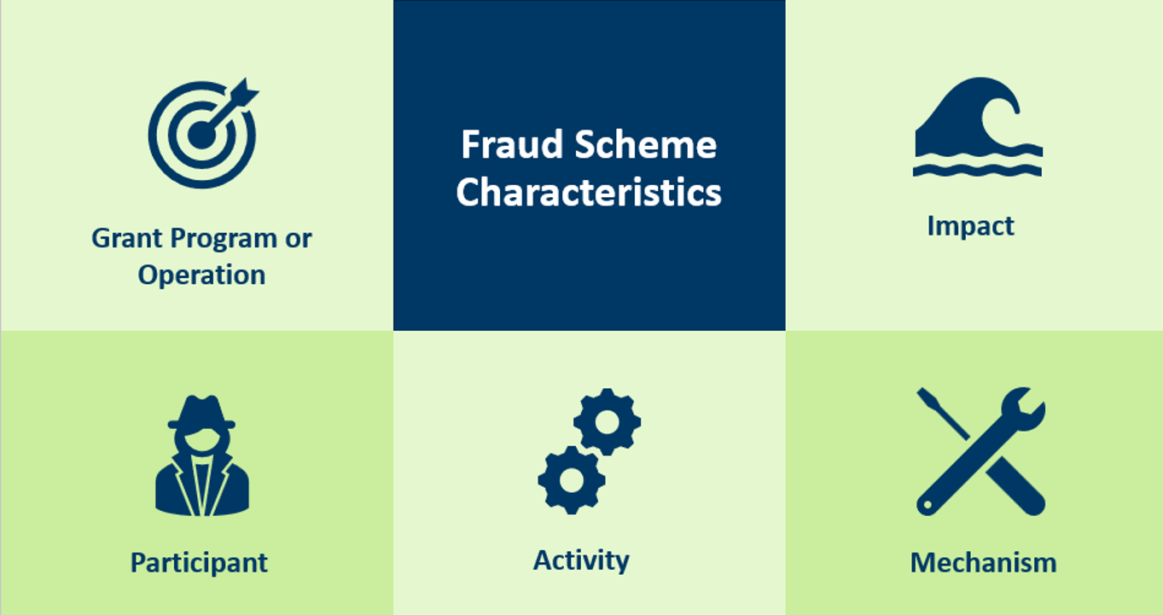
Fraud scheme characteristics

Slide 15

Hypothetical ERR Fraud Scenario 1/2
An SP brings on a new contractor to provide ERR services
The contractor submits invoices for services which are then paid by the SP
Upon inspection, not all authorized work was completed, but work was invoiced

Slide 16

ERR Fraud Scenario 2/2
The services provided aren’t typical for ERR
No verification of services performed
Some required safety checks are skipped

Slide 17

ERR Scenario Red Flags
New or unverified contractors
Invoices approved without supporting documentation
Incomplete verification of work (e.g., ERR Completion Certificates)
Unusual repairs and services, some safety checks skipped

Slide 18
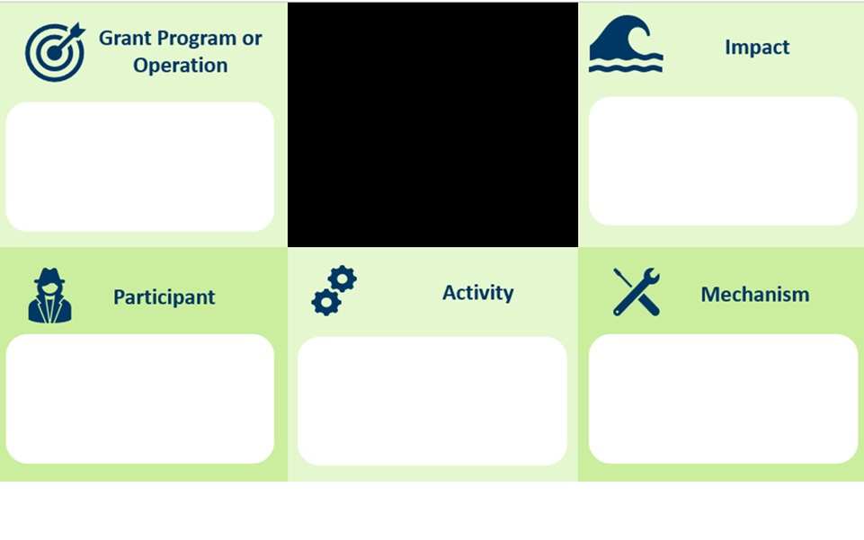
Fraud scheme characteristics - ERR
ERR Fraud Example
Work not completed; cold, unhappy clients, wasted energy & $
Energy-Related Repair (ERR) Program
Misrepresentation; incomplete and false documentation
Invoicing for work not completed
ERR Contractor

Slide 19
Examples of Fraud Mechanisms 1/3
Fraud Mechanism | Related Activities
Cooking the Books | Altering accounting records Manipulating financial documentation Falsifying accounting entries
Misrepresenting Expended Funds | False reporting of required program compliance Manipulating financial documentation
Fictitious Vendor | Employee with procurement responsibilities submits bills from a non-existent vendor Creating false companies to receive payments Shell companies

Slide 20
Examples of Fraud Mechanisms 2/3
Fraud Mechanism | Related Activities
Misuse of Funds | Using awarded funds for unauthorized purposes Funneling funds to personal accounts Overpaying vendors to conceal improper use
Ghost Employee or Beneficiary | Nonexistent employee or beneficiary created Phantom payroll entities Fake program participants
False Invoice | Using invoices for goods or services not rendered Falsified invoices and receipts Altered financial records

Slide 21
Examples of Fraud Mechanisms 3/3
Fraud Mechanism | Related Activities
Payroll Mischarging | Improper payroll charging to grant accounts Charging personal time to grant projects Misallocating employee costs
Misrepresenting Eligibility | False statements about organizational capacity Misrepresentation of matching funds Fabricated letters of support
Fake Claim | Claim for expenses not incurred Claim for services not rendered Claim for goods not delivered

Slide 22
Daily Fraud Prevention Activities
Verifying applicant information
Following policy & procedures
Keeping duties separate
Document grant activities and decisions
Monitor employee, vendor, and contractor performance and watch for unusual patterns or activities
Internal
Control
Activities

Slide 23

Service Provider Reporting
First step: Document what you observe
Next: Report to Commerce via Incident Report Form (eap.mail@state.mn.us)
Commerce will analyze, obtain more information, and possibly refer to one or more of the following:
Office of Grants Management (OGM)
Office of Legislative Auditor (OLA)
Bureau of Criminal Apprehension (BCA)
Minnesota Department of Revenue (DOR)
Notes:
State agencies are statutorily required to report certain situations, like suspecting fraud or other types of misuse of public funds.

Slide 24

Whistleblower Protections
Whistleblower protections apply to good faith reporting
You cannot be retaliated against for reporting suspected fraud
Your identity will be protected to the extent possible under the law

Slide 25

Grant Fraud Awareness – Key Takeaways
Fraud involves obtaining something of value through willful misrepresentation
Grant fraud diverts resources from the community
Your agency’s oversight is critical to ensuring grant funds have intended public impact
Our role is not to prove fraud, but rather to recognize potential indicators, gather objective facts within our role, and report the concerns through the appropriate process

Slide 26
Q&A – Part 1

Slide 27
Waste, Fraud & Abuse / EAP
S.Melaine Schwahn-Doyle

Slide 28
Fraud in EAP

Slide 29
What is Fraud (with an EAP slant)
EAP fraud has three characteristics defined in Ch 10 pp 2-3
  Suspected or intentional deception
  A false statement or omission, concealment, or misrepresentation of info
  Done to obtain something for personal or business gain, to assist or harm others, and/or misuse of program funds
Notes:
Page 2: Events including suspected or intentional deception, omission, or concealment made for personal gain, to assist or harm others and/or misuse of program funds. (NOTE: this does not highlight business gain)
Page 3: Fraud is an event of suspected intentional deception, omission, or concealment made for business or personal gain, to assist or harm others and/or to misuse program funds.

Slide 30
Key Reminder when considering fraud
People can make a mistake without committing fraud
Not every error is fraud
  Ex. A person does not complete a field on the app. Could there be legitimate reasons for skipping or missing it?
Not every policy violation is fraud
  Ex. A person syphons fuel from their residential LP tank to power their RV, go-kart, or minibike
Evidence, not suspicion alone, should guide your next steps

Slide 31
Comparing Fraud, Waste & Abuse
Fraud vs. Waste vs. Abuse
***Fraud requires intent; the others don’t
Fraud
Intentional deception
Requires intent
May involve false statements or concealment/omission
Waste
Inefficient use of resources
Usually no intent
Results in unnecessary costs
Abuse
Improper actions inconsistent with policy
May or may not involve intent
Often involves misuse or inappropriate practices

Slide 32
4 Reasons we are focusing on fraud, 1/4
  Fraud presents one of the greatest risks to EAP funds
    Significant risk to program integrity
    Involves intentional deception to obtain benefits that are not authorized
    Reduces funds available for eligible HHs
    Fraud, especially when control environments do not detect or adequately investigate it, can have long-lived negative impressions about EAP, the grantee (Commerce or State of MN, and the sub-grantee (SP agency))

Slide 33
4 Reasons we are focusing on fraud, 2/4
  2. Fraud requires SP action
    SPs are in the best position to notice unusual patterns, inconsistencies, or potential red flags during application processing or payments
    The earlier the fraud is detected, the greater the likelihood it can be prevented or improper payments minimized

Slide 34
4 Reasons we are focusing on fraud, 3/4
  3. Fraud requires specific reporting requirements
    EAP policy requires incident reporting
    If suspected fraud is determined, additional reporting or referral to local law enforcement is required
    As previously reviewed, a state agency (e.g., Commerce) also must report certain activities for civil or criminal purposes
    This session provides an overview on identifying, investigating, and reporting suspected EAP fraud

Slide 35
4 Reasons we are focusing on fraud, 4/4
  Waste & abuse can be addressed in other ways; they also require different prevention strategies than fraud
    Staff training
    Policy clarifications/questions
    Quality assurance reviews
    Process improvements
    Monitoring and desk analysis
    Individual training & technical assistance
Notes:
While this presentation focuses on suspected fraud, the same principles of objective documentation, asking questions, and reporting requirements also may apply to significant instances of waste and abuse.

Slide 36

Where does fraud happen in EAP?
  It can happen anywhere. Fraud is about behavior.
  1. Within the SP organization
    Employees
    Contractors
    Vendors
    Other partners

Slide 37
Where does fraud happen in EAP, continued
  2. External to the SP organization
    Applicants/HHs
    Landlords
    Vendors or mechanical contractors
    Others interacting with EAP

Slide 38
Recognizing possible indicators
  Indicators are not proof of fraud; they are points needing clarification
  Inconsistent info between apps or documents
  Changes to key eligibility info without explanation
  Questionable or altered documentation
  Conflicting info from HH & 3rd parties
  Multiple apps with differing info or doesn’t align with records
  Lack of cooperation with verification requests

Slide 39
Questions you should ask yourself
Before reaching conclusions, ask:
  Is there another reasonable explanation?
  Is info missing?
  Can this be verified? How? By whom?
  Could this simply be an error? Have they made this error previously?
Get to the bottom of it & start your investigation

Slide 40

Contacting the household
Maintain a neutral, professional tone to avoid sounding like an interrogation
Ask open-ended questions so the person is telling you info in their own words vs answers of “Yes” or “No”
  Helps clarify inconsistencies or uncover other details

Slide 41
Contacting the household, continued
Don’t accuse
Document your observations (what they said or didn’t say, variations in any info, . . .)

Slide 42

Primary purpose of investigating
Your investigation’s primary purpose is to establish facts. Some activities in your investigation may include:
  Contacting the HH; requesting clarification
  Reviewing the app history
  Comparing available documentation
  Verifying info with appropriate 3rdparties
  Reviewing e-records and eHEAT notes
  Documenting your findings/observations
  Conclude whether you suspect possible fraud

Slide 43

Open-ended questions
Examples of framing open-ended questions
In your words, please explain. . .
Has anything changed since your last app?
Help me understand why. . .
When did this happen. . .
Who submitted the info?
Can you provide documentation?

Slide 44

Contacting 3rd parties
When you contact 3rd parties (e.g., landlord, EV, county)
Emphasize confidentiality & neutrality
Remember, you are verifying info, not interviewing them
Never disclose suspected fraud or unnecessary HH info
Document who you talked to, date/time, & info provided

Slide 45
Initial suspicion
When the math doesn’t math & you suspect possible fraud
Document your observations
  Suspected fraud is considered a reportable incident event (Ch 10 p 2)
Initial incident reporting is due to eap.mail right away
  You may do a small amount of investigation beforehand, but timeliness is important
Incident report template Appendix 10A (MS Word)–in EAP Toolkit

Slide 46

Next steps after initial reporting
More work may be needed
Commerce will review and may:
  Request additional info
  Ask follow-up questions
  Ask you to review other program years
  Determine next steps & timelines
  Determine when the matter is referred to local law enforcement
  Determine any additional mandated reporting

Slide 47
Examples of possible suspected fraud situations you might investigate
A complaint of misuse of EAP resources
A credible complaint that contradicts app info that affecting eligibility or benefits
Knowledge that a HH has applied in more than one location
  The SP where the HH applied last is in charge of the investigation, as that is where the suspected fraud begins with the second app

Slide 48
More examples of possible suspected fraud situations you might investigate
Public info from law enforcement activities, the news media, or public news releases
Whistleblower feedback that is routed anonymously through Commerce feedback channels
Trends or patterns with unauthorized work being billed
Inflating invoices inconsistent with typical or agreed-upon pricing or falsified info being submitted

Slide 49

Small Group Exercise

Slide 50
Small group – real example #1
Situation: A HH applied for EAP as a HH of one person for several program years. During a crisis verification process, the fuel vendor provided info that another individual lives in the home. The other person was able to confirm the fuel type and other details needed for the Crisis.
In small groups, discuss the following:
  What are your initial concern(s)?
  What questions to ask and to whom?
  What additional info would you gather?
  Would you report this to Commerce? Why/Why not?

Slide 51
Discussion of example #1
What caught your attention?
Is this an error, waste, abuse, or possible fraud?
What would you verify? Any additional info needed?
What would you document?
Would you report it? Why or why not?

Slide 52
Small group – real example #2
Situation: A duplicate account check control identified a potential concern that the same person appeared to have submitted multiple EAP apps. The review showed that the same applicant had been served under two different HH#s. A 3rd app was submitted & flagged before additional benefits were issued. All three apps had the same EV account.
In small groups, discuss the following:
  What are your initial concern(s)?
  What questions to ask and to whom?
  What additional info would you gather?
  Would you report this to Commerce? Why/Why not?

Slide 53
Discussion of example #2
What caught your attention?
Is this an error, waste, abuse, or possible fraud?
What would you verify? Any additional info needed?
What would you document?
Would you report it? Why or why not?

Slide 54

Documentation reminders
Document your observations objectively
“Applicant stated. . .”
“EV account history shows. . .”
“County property records or records official indicate that. . .”
“The app states. . .& Person X signed it on. . .”
“The HH stated they had 15% left in tank. The EV reported 37%”

Slide 55

Documentation reminders, continued
Be professional
Do not call names
Do not assume
Report objective info
Your documentation has the potential to be seen by others

Slide 56
Key takeaways
Fraud requires intent
  Not every error, inconsistency, or policy violation is fraud
Be alert to red flags (they are not the proof)
  Recognize indicators that warrant a closer look
Follow the facts
  Gather objective info & verify what you can before reaching conclusions
Document observations, not assumptions
  Record what you saw, heard, or verified. Avoid opinions.

Slide 57
Key Takeaways, continued
Know when & how to report
  Follow your agency's procedures and the EAP Policy Manual (Incidents & Appeals Ch 10) reporting requirements for suspected fraud
Protect EAP’s program integrity
  Identifying and reporting suspected fraud helps ensure limited EAP funds are available for eligible HHs. When in doubt, ask. If you're unsure whether something should be reported, consult your internal risk manager, PPA, or eap.mail rather than ignoring the concern.

Slide 58
Parting thought
Our role is not to prove fraud, but rather to recognize potential indicators, gather objective facts within our role, and report the concerns through the appropriate process

Slide 59

Q&A

Slide 60
Q&A – Part 2

Slide 61
Post-training Survey
Did FFY27 EAP Annual Training meet your expectations? Why or why not?
What did you like best about FFY27 Annual Training?
What did you like least about FFY27 Annual Training?
What changes do you suggest to improve FFY28 Annual Training?
Do you have suggestions for topics or speakers for FFY28 Annual Training?
Any additional comments or feedback?

