Slide 1
FFY27 Annual Training
Energy Assistance Program
Consumption refresher

Slide 2
Energy Vendors and Consumption
Jon Brown

Slide 3
Topics
Consumption Overview
Consumption Statuses
Consumption Scenarios
Consumption and Benefits with Unique Vendors and Fuel Types

Slide 4
Consumption Overview

Slide 5
Consumption purpose
Cost info is used to determine HH’s grant amounts
Reported costs are also used to develop our benefit tables and backup matrix
When no cost and consumption data is available, we use the backup matrix to assign the HH an “average” cost for their housing and fuel type

Slide 6
Consumption collection
EVs provide cost and consumption data
Early/Annual Consumption
  Consumption files listing all Approved HHs from the previous year are available for EVs to download in early August
  EVs can start providing bulk consumption data prior to beginning of program year (August-October) once eHEAT is rolled over to the next program year
  Can upload data files into eHEAT in bulk or enter individually

Slide 7
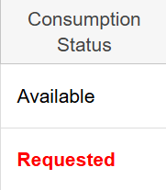
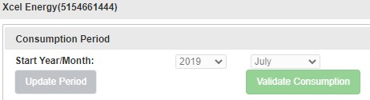
Consumption collection - ongoing
On going
  Newly logged HHs with EVs listed create a consumption request
  EVs can enter the info in eHEAT directly
  Service Providers may also enter in the data if provided by the EV or accessed from the EV’s portal
  For Xcel, Service Providers can use the “Validate Consumption” button in eHEAT

Slide 8
Consumption collection – EV non-response
Lack of response from EVs
  If you experience difficulties with a particular EV:
    Offer technical assistance/training on consumption if needed
    Remind them of their obligation in vendor agreement
      5. Timely provide at the request of the customer, the Service Provider or the State, info on applicant HH's’ home energy costs, dwelling consumption data, delivery dates, bill payment history, arrearage history or post-delivery info. This info will be provided in the format requested.
      6. Provide dwelling consumption data within 5 business days of the request in eHEAT.
      7. Respond promptly to consumption requests for crisis situations.
  Contact Commerce Vendor Manager for support if still no response

Slide 9
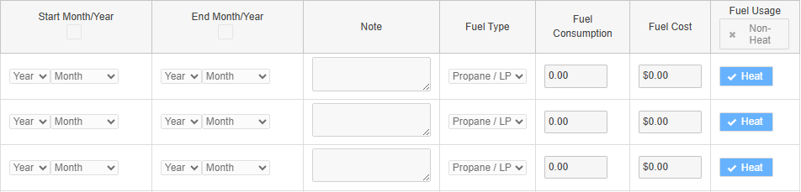
Consumption data
Consumption data includes:
  Date range
    12 consecutive months within a 16-month window – June through September
  Fuel type
  Units of energy
    Gallons, cords, kWh, etc.
  Cost
  Heating or non-heating

Slide 10
Consumption – fees included/not included
Hazmat Fees
Water
Late Fees
Fuel Factor
Taxes
Interest
kWh
Delivery Charge
Include
Exclude
Expedited Delivery Charge

Slide 11
What makes up consumption costs?
  Taxes and fees if typically, part of the bill
  Should not include late payment fees, interest, or other irregular charges
  Key distinction is whether the HH is routinely or regularly charged these fees regardless of other circumstances
  Must exclude non-energy charges (water, trash, etc.)

Slide 12
What makes up consumption costs? - example
HH is charged interest on a delinquent account and a fee to have their tank tested because it was empty
If the HH was not behind on their account or did not let the tank go empty, they wouldn’t be charged these fees
If certain fees are always charged regardless of the HH’s actions, then they would be considered “fees typically part of the bill” and should be included in the consumption costs
  Examples: Hazmat fees, taxes, fuel cost, etc.

Slide 13
Understanding reported cost & consumption data

Slide 14
Reported cost & consumption data
We use a static 16-month window vs. a rolling calendar
Since usage demand shifts over the seasons, we don’t look at most recent costs. Instead, 12 months ensures we capture the full picture of energy costs, not seasonal
EAP benefits can be thought of as a reimbursement for previous years energy costs
  The window ends before the program year it will be used in

Slide 15
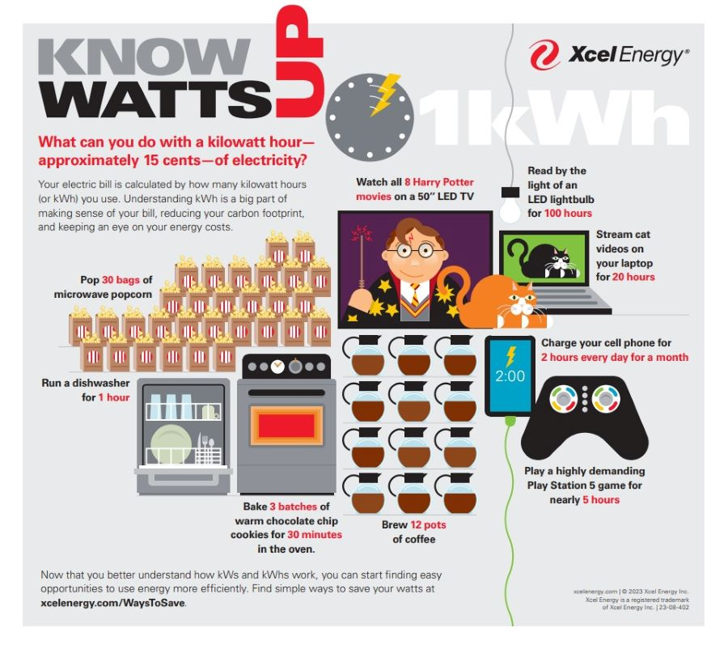
What can you do with a kilowatt?
Understanding reported cost and consumption data

Slide 16
Energy source, units & BTUs
Energy source/fuel | Physical units and Btu
Electricity | 1 kilowatthour=3,412 Btu
Natural gas | 1 therm=100,000 Btu
Heating oil | 1 gallon=138,500 Btu
Propane | 1 gallon=91,452 Btu
Wood | 1 cord=20,000,000 Btu
A cord of wood equals about 218 gallons of propane or 145 gallons of heating oil
A therm of natural gas equals approximately 30 kWh of electricity

Slide 17

Ocean-going tanker

Slide 18





Average heating cost by fuel type
Understanding reported cost and consumption data
Average heating cost by fuel type for FFY25 EAP HHs
Propane
Wood
Electric
Fuel Oil
Natural Gas
$733
$1180
$1378
$1517
$1712
Less
More

Slide 19





Average heating cost by housing type
Understanding reported cost and consumption data
Average total energy costs by housing type for FFY25 EAP HHs
Mobile Home or Home
Townhouse or Triplex
Duplex
Fourplex
Apartment
$1137
$1608
$1875
$2105
$2450
Less
More

Slide 20
Red Flags
Red Flags include:
Really high consumption but low reported costs or vice versa
  Ex: 14,000 kWh and $200 in costs
  Ex: 120 gallons of propane and $2,760
Overall high consumption and cost
  Could be a case of business use of home, meter problem, etc.
Housing type doesn’t match with consumption amount
  Ex: Apartment has super high heating or electric costs

Slide 21
Consumption Statuses

Slide 22
Status – what it means/impact on benefits
Status | What it means | Impact on benefits
Requested | No info available. Triggers request for vendor | Based on backup matrix
Available | Consumption info provided by the EV | Based on reported costs if all vendors are “Available”
Not Available | EV does not have consumption info | Based on backup matrix
Valid | Reported consumption is considered accurate and applicable to current situation | Based on reported costs if all vendors are “Valid”
Invalid | Reported consumption is known to be inaccurate or no longer applicable to current situation | Based on backup matrix
Full Year Consumption “Yes” | Reported consumption costs are available and cover a full year | Based on reported costs if all vendors are “Full Year: Yes”
Full Year Consumption “No” | Reported consumption costs are available but cover less than a full year | eHEAT compares the reported costs against the backup matrix and choses the higher of the two

Slide 23
Consumption Scenarios

Slide 24
Less than 12 months reported consumption, 1/3
There may be various reasons why 12 months is not available
      New build
      Previously vacant property
      Vendor unwilling to provide dwelling data
  Even if consumption data for a HH does not cover 12 months it is important to enter the data that is available
  Report the actual beginning and ending dates
  If no costs are available should mark “Not Available”

Slide 25

Less than 12 months reported consumption, 2/3
Extended absence
Actual consumption should be used for these HHs if possible
If not available, enter 1/$1, indicate as actual 12 months – min benefit
Service disconnected
If a HH’s energy service was disconnected for 30 days or more during the 12-month consumption period:
  If voluntary, report as full 12 months
  If involuntary, reduce the end date of the consumption by the number of months the HH was disconnected

Slide 26

Less than 12 months reported consumption, 3/3
EV consumption date range only reports 11-months
  EV billing twice in one month causes the issue
  Consumption provided covers 365 days, or as close without exceeding
Consumption and cost are correct
  If left, backup matrix triggered and larger of two benefits awarded
  Guidance
    Service Provider leaves the consumption with the 11-month range
    Allow eHEAT to calculate grant based on provided info

Slide 27
HH switches propane vendor
The HH switched propane vendors but hasn’t received a delivery from the new EV
The previous propone vendor has entered consumption
Consumption for the new propane vendor is “Requested”
What do we do with the reported consumption?
  Remove the previous propane vendor since they no longer serve the HH
  Make previous propane vendor “Inactive” and mark consumption “Invalid”
  Make previous propane vendor “Inactive” but use reported consumption
  Enter consumption from the previous vendor under the new vendor

Slide 28
HH switches propane vendor, cont.
Answer is “C”
Even though they no longer serve the HH, consumption info is valid
Since fuel type didn’t change, we use the costs so the HH’s benefit is based on the actual consumption for that fuel type at that address
They are made “Inactive,” so we don’t make payments to them
For the new vendor, Service Providers should enter “0/$0” for the consumption and cost so that the “Requested” status changes to “Available” and benefits are based on actual costs

Slide 29
HH switches main heating fuel
HH recently switched from propane to natural gas
The propone vendor has entered consumption
The natural gas vendor marks consumption “Not Available”
What do we do with the reported consumption?
  Remove the propane vendor since they no longer serve the HH
  Make propane vendor “Inactive” and mark the consumption “Invalid”
  Make propane vendor “Inactive” but use reported consumption
  Change natural gas consumption from “Not Available” to “0/$0” and keep propane consumption valid so benefit is based on actual costs

Slide 30
HH switches main heating fuel, cont.
Answer is “A”, but “B” could also work
Removing an EV eliminates the consumption which is like making “Inactive” and “Invalid” if you wanted to keep the history
If you had consumption from the natural gas provider you would want to do “A,” remove the vendor so “Invalid” won’t trigger backup matrix
Ultimately, we want to base the benefit on natural gas costs NOT propane costs

Slide 31
HH moves but keeps main heating fuel type
HH moved cities but still uses natural gas
The previous vendor enters “Not Available” because they moved
The new natural gas vendor enters full year consumption
What do we do with the reported consumption?
  Remove the old vendor since they no longer serve the HH
  Make old vendor “Inactive,” and make consumption “Invalid” for both vendors since the HH hasn’t lived there a year
  Make old vendor “Inactive” but leave consumption “Valid”
  Don’t do anything – the main fuel is natural gas at both places, and the backup matrix will be triggered because one record is “Not Available”

Slide 32
HH moves but keeps main heating fuel type, cont.
Answer is “A”
Removing a vendor eliminates the consumption and since we have consumption from the new location, we don’t want backup trigged by “Not Available”
You could make the old vendor “Inactive” and change consumption to “0/$0” to avoid backup matrix if you wanted to keep the old vendor but ideally just remove the vendor
But it’s not the HH’s consumption…
Even though reported consumption at new address is not current HH’s it is still likely more accurate than backup matrix

Slide 33
Unique Vendors and Fuel Types

Slide 34
“In Rent” vendors
Three types: Electricity, Heat, and Heat and Electricity
  All default and are locked to:
    Match status “Landlord Account”
    Consumption status “Requested”
  Backup matrix triggered for apps with “in rent” vendor
  Some or all benefits may be a direct pay to HH

Slide 35
“In Rent” vendors, cont.
Heat in Rent with Electric Vendor
  Benefit is paid to electric vendor first
  Greater of $400 or reported consumption cost
  Any remaining benefit is a direct payment
  Overrides any selected percent to electric
  This same benefit payout rule applies to vendors with “Landlord Account,” paying the “Match” vendors first

Slide 36
Subsidized “In Rent” vendors
Subsidized Heat in Rent
  If HH has an electric provider, benefit is determined based on their reported electric costs
  If no actual electric costs, HH gets minimum benefit
Subsidized Heat and Electricity in Rent
  No energy burden and are not eligible for EAP

Slide 37
Solar Gardens
Solar gardens produce energy instead of consume it
Because of this, solar garden EVs:
  Report subscription costs as consumption cost
  Report kWh produced instead of kWh consumed
Since the credits are deducted before the bill is calculated, if subscription costs are not provided the electric consumption must be made “Invalid”

Slide 38
Wood and Biofuel
We don’t typically get consumption from EVs for wood/self-cut/biofuel
Instead, the application asks HHs for info about their home and heating habits
This info is used to complete the Biofuel worksheet which calculates the cost and consumption amounts

Slide 39
Wood and Biofuel, cont.
HHs that have wood/biofuel and another heat source may change how they heat each year
If reported use increases/decreases 30% or more:
  Mark consumption “invalid” for the non-biofuel vendor
  Complete the biofuel worksheet
eHEAT selects either the backup matrix for the primary fuel type listed or the reported biofuel consumption cost, whichever is greater

Slide 40
Wood and Biofuel Backup Matrix?
Since prices vary greatly statewide and data is limited Commerce does not produce a wood backup matrix
  When a HH heats with biofuel and uses their home for business or has a shared meter:
    Don’t check the “Shared meter” box in eHEAT if biofuel is primary fuel
    If biofuel is not the primary fuel, the “Shared meter” box must be checked
    If consumption data for the primary heating fuel is not available, biofuel consumption should not be entered. If already entered, make it invalid. The backup matrix will be used in place of actual consumption
    If no other heating type and no consumption available contact Commerce

Slide 41
Shared Meters
Sometimes a single meter serves more than one HH. In these cases, check the “Shared meter” box:
  Duplexes/multifamily houses
  Multiple dwellings on a single property
  Other unique situations
Shared meter consumption should not be used as it does not represent the HH's usage

Slide 42
Business Use of Home
Consumption for HHs who run a business from their home does not accurately represent home energy costs
Because the consumption is altered by their business use SPs must check the “Shared meter/Business Use of Home” box
eHEAT will use either actual consumption or the backup matrix, whichever provides the lower benefit

Slide 43
Other Shared Meter/Business Use of Home reasons
Renting out part of their home
  HHs renting out part of their home that are not part of the HH
  If the renter is considered part of the landlord HH, do not check the “Shared meter” box in eHEAT
Outbuildings
  EAP does not include heat for a garage or other outbuildings in home energy costs
  Check “Shared meter” box for these and eHEAT will use either actual consumption or the backup matrix, whichever is the lower benefit

Slide 44
Commercial accounts
EAP is for residential home energy costs. Consumption costs from commercial accounts are generally not allowed
Commercial energy costs can only be included if the HH operates a farm or other business with a single meter for commercial and residential energy use
If this is the case, the “Shared meter/Business Use of Home” option must be checked in eHEAT

Slide 45
Q&A

