Slide 1

Energy Assistance Program
FFY26 Annual Training
Energy Vendors;
Name on Account;
Refunds Refresher

Slide 2
Energy Vendors
Jon Brown

Slide 3
Energy Vendors
Topics
Name on Energy Accounts
Energy Vendor Audit
Proposed Refunds

Slide 4
Name on Energy Accounts

Slide 5
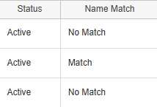

Energy Vendors
Name on Energy Accounts
Can only pay accounts in HH member's name
Name on Account = Match. Payment allowed
Account with only HH member name listed
Account with HH member as the owner and non-HH member as a non-owner
  A deceased person’s name on the account for historical info is allowed if the they are not an account owner
Match

Slide 6
Energy Vendors
Name on Energy Accounts
Name on account = No Match. Payment not allowed
Account in non-HH member name
Account in HH member and non-HH member name
  POA, guardian, or conservator can’t be account owner
When all energy vendors are “No match”:
  Add “No account in HH name (15426)” energy vendor
  Defaults to minimum PH benefit direct pay to HH
No Match
Notes:
Check manual to see if I can keep POA or need to - change POA Apps with an attorney-in-fact

Slide 7
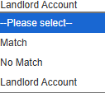
Energy Vendors
Name on Energy Accounts
Name on account = Landlord Account. Direct payment allowed
Default status for “In Rent” energy vendors
Any energy vendor can be a Landlord Account
Landlord Account
Notes:
Split into 2 slides

Slide 8
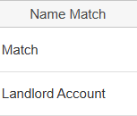


Energy Vendors
Name on Energy Accounts
Payment must first go to energy vendors with a name match
  Benefit is $400 or actual consumption, whichever is greater
  Remaining benefit can be distributed to HH as direct payment
If no accounts in HH name but have account in name of landlord HH may receive their entire benefit as a direct payment
Notes:
Split into 2 slides

Slide 9

Energy Vendors
Name on Energy Accounts
Why the change?
  Recent US HHS guidance reinforcing equitable treatment of renters
  Old policy disproportionately affected renters
    More than 80% of FFY25 HHs without an account in a HH member’s name are renters
    More renters with all “No Match” energy vendor accounts resulted in more renter HHs getting $200 minimum benefit
Notes:
Split into 2 slides

Slide 10
Energy Vendors
Name on Energy Accounts
    Manual updates
Chapter 2 p. 18-20
  “Landlord Account” added as a potential alternative to “No Match”
  Added description of when to select this and what it does
  Account in landlord name removed from mismatch examples
Notes:
Split into 2 slides

Slide 11
Energy Vendors
Name on Energy Accounts
Manual updates
Chapter 8 p. 4-6
Added description of how to manage payments to HHs (including direct payments) when an account is in the name of a landlord
Chapter 15 p. 6
Updated language to reflect that HHs with landlord accounts should not automatically receive the minimum benefit
Notes:
Split into 2 slides

Slide 12
Energy Vendor Audit

Slide 13
Energy Vendors
Energy Vendor Audit
New deadline – September 1
Old deadline (Nov 1) was after end of program year
  Some issues discovered during monitoring found too late to remedy
September 1 deadline allows issues to be discovered and fixed before end of program year
Notes:
Make timeline own slide

Slide 14
Energy Vendors
Energy Vendor Audit Timeline
Deadline
Review
Samples
Follow up
Report
Service Provider
Vendor Manager
Service Provider
Vendor Manager
Vendor Manager
By September 1: Submit “Energy Vendor Audit Tool” to eap.mail
Reviews audit and requests monitoring samples
Within 10 days:
Provide requested documents to vendor manager
Follow up on monitoring issues if needed
Summary report provided to PPAs for fPAVs
Notes:
Make timeline own slide

Slide 15
Proposed Refunds

Slide 16
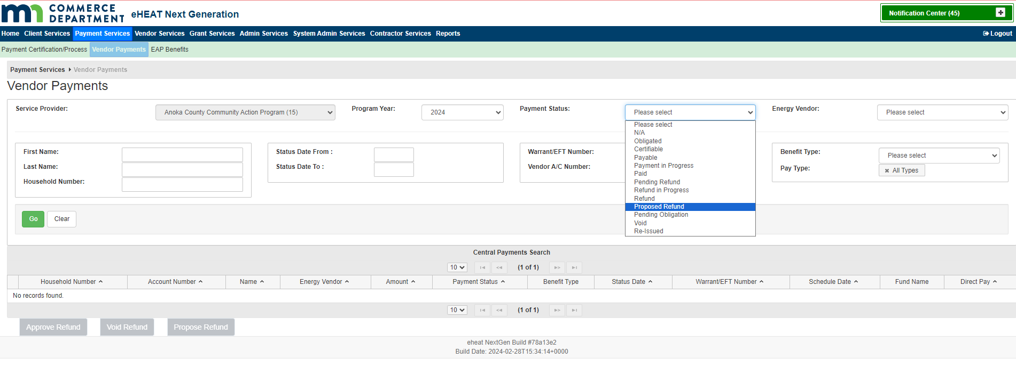
Energy Vendors
Proposed Refunds
“Proposed Refunds” can only be found on the Payment Services menu on the Vendor Payments tab
Search Payment Status “Proposed Refund”
All “Proposed Refunds” will show in the results
Energy vendor is not required to do the search

Slide 17
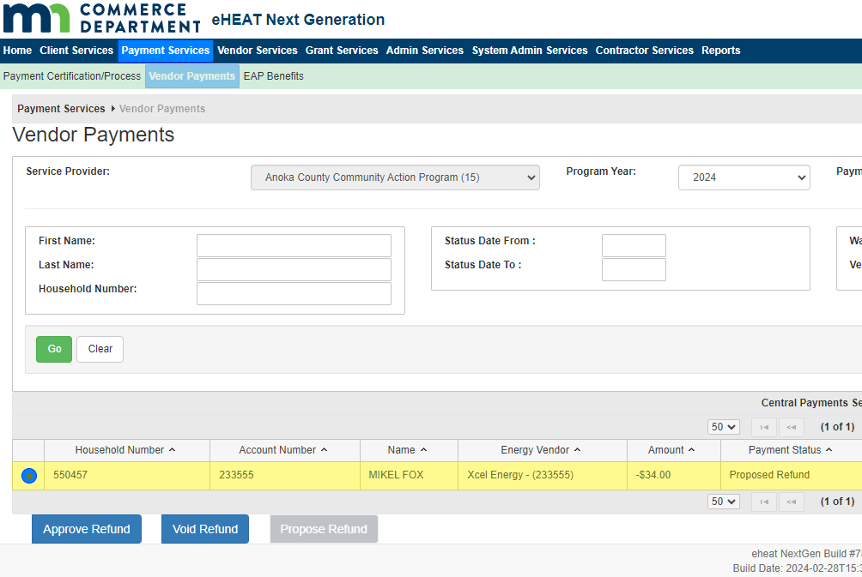
Energy Vendors
Proposed Refunds
To Approve or Void the “Proposed Refund” select the radio button next to the refund you want to determine
The “Approved Refund” and “Void Refund” buttons are now available

Slide 18

Energy Vendors
Proposed Refunds
SPs should check for “Proposed Refunds” at least weekly
Don’t leave refunds in “Proposed Refunds” status
  Approve if you have the info
  Void if you don’t have the info
Energy vendors can subscribe to be
notified when “Proposed Refund” is voided
Energy vendor can re-enter refund if needed

Slide 19
Q&A

