Slide 1

Energy Assistance Program
FFY26 Annual Training
eHEAT Enhancements

Slide 2
eHEAT Enhancements
Jon Brown

Slide 3
eHEAT Enhancements
Topics
Deployed Enhancements
Planned Enhancements
Clarifications and Reminders

Slide 4
eHEAT Enhancements
Enhancements
Name on account
Name Match info for energy vendors
Email Error Report
Percent to electric from online apps
Dollar amounts added to Crisis and ERR reports
Household link to household application summary
Delivery confirmation total for energy vendor

Slide 5
eHEAT Enhancements
Enhancements
Energy vendors paid through ERR
Order of “How did you hear about EAP?” choices
Name on Account on Crisis screen
Blank app request report
Notes when sending RFI Letters
Edit log date
Crisis Payable control

Slide 6
eHEAT Enhancements
Enhancements
Accept Delivery info control
Demographic search 60 and over
Undo Resolved Crisis
New Crisis report for vendors
"Direct Express" income proof

Slide 7
eHEAT Enhancements
Planned Enhancements
Personal signatures
Direct pays less than $10
Signature page includes HH members
No signature date prevents vendors from seeing apps
Clarifications
Consumption from pre-logged apps

Slide 8
Deployed Enhancements

Slide 9
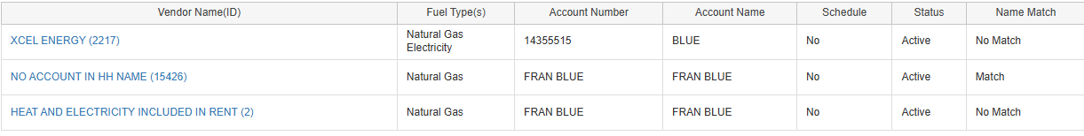
eHEAT Enhancements
Name on account
  Energy vendors with “No Match” in the Name Match field can’t receive payments
  New energy vendor “No account in HH name”
    Add if none of the HH’s EV accounts are in a HH member's name
    Needed to send direct payment to HH
    “Match,” Account Number, and Account Name locked to primary name

Slide 10
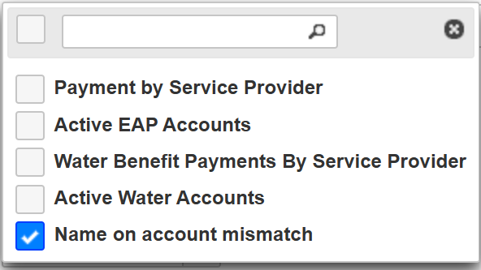
eHEAT Enhancements
Name Match info for energy vendors
  Name Match field
  Shows if HHs energy account is a name match or not
  Found under the Vendor Information section of the Application Summary
  Name on account mismatch report
  HHs indicated as “No Match” show on report
  Shows App ID, Account #, Account Name,
  App Name, HH number, and SP Name

Slide 11
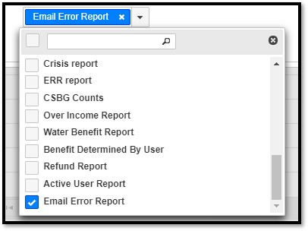
eHEAT Enhancements
Email Error Report
  Shows all HHs in selected program year that returned an error when trying to send an email
  Shows the HH number, email, letter type attempted to send, and date/time of the attempt
  Can also search on the Communication Management screen for “Email Status: Error”

Slide 12

eHEAT Enhancements
Percent to electric from online apps
  Online application shows 0 instead of blank when household selects 0% to electric
  Dollar amounts added to Crisis and ERR reports
  Dollar amounts were added to these two reports per SP request

Slide 13
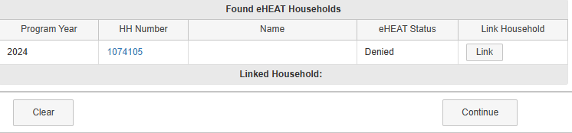
eHEAT Enhancements
Household link to household application summary
  When validating online applications, if there is a HH to link to, the HH number now links to the HH application summary

Slide 14
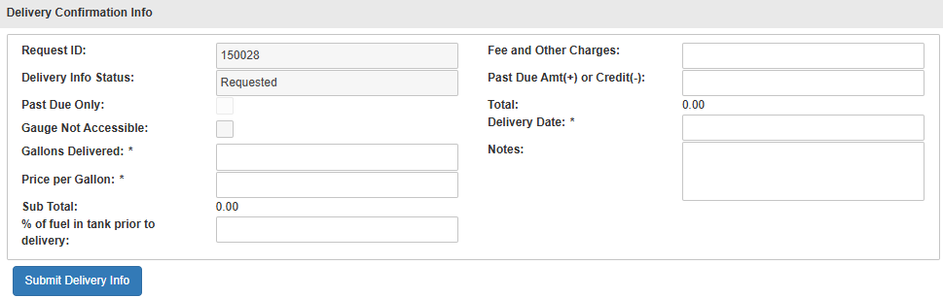
eHEAT Enhancements
Delivery confirmation total for energy vendor
  “Total” section on the energy vendor’s delivery confirmation page now auto totals as information is entered
  This should help energy vendors confirm the details entered equal the amount of the delivery and lessen Crisis payment errors

Slide 15
eHEAT Enhancements
Energy vendors paid through ERR
Energy vendor performing standard tasks (like fuel delivery or tank setting) as part of an ERR job need a mechanical contractor profile in eHEAT
Contractors must have a signed contractor agreement to be selected and paid
Commerce can link an energy vendor’s contractor profile to their existing energy vendor profile if they have a signed vendor agreement
Energy vendors doing actual contractor work (repair or replacement), or if they can’t be paid through their energy vendor account, must register and sign up as a standard mechanical contractor

Slide 16
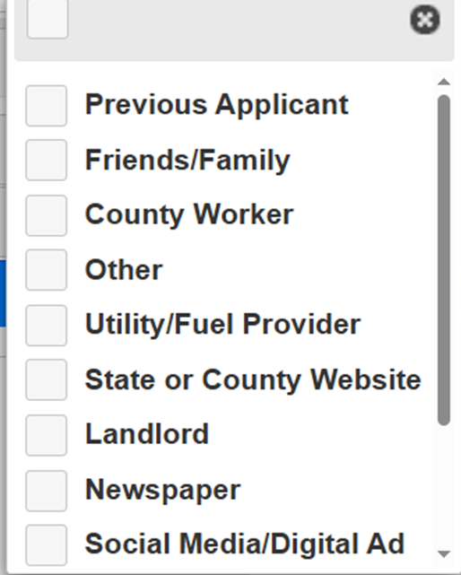
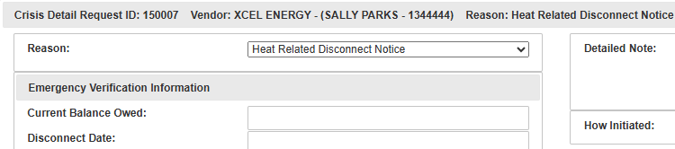
eHEAT Enhancements
Order of “How did you hear about EAP?” choices
  The order has been changed to most common to least common
  Name on Account on Crisis screen
  Name on account is listed with the account number
  Displays on the top after energy vendor name

Slide 17
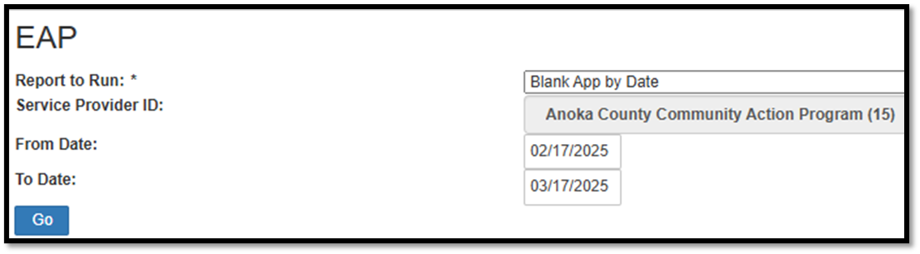
eHEAT Enhancements
Blank app request report
  Report is called “Blank App by Date”
  Shows all blank app requests submitted over a selected timeframe
  Includes name of the person, their address and the date it was entered (Request_dt_tm) and the date we sent the file to be mailed (Processed_dt_tm)

Slide 18
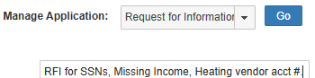

eHEAT Enhancements
Notes when sending RFI Letters
  Can enter notes before sending RFI letters through eHEAT
  Previously, notes could only be entered when sending non-eHEAT RFI letters
  Notes are entered before hitting “Go” and proceeding to the letter
  Notes only save and show up under Application Notes if you “Save and Send” the letter. If the “Save and Send” action is not done, the notes will not be saved

Slide 19
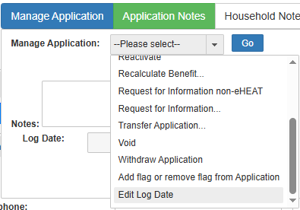

eHEAT Enhancements
Edit Log Date
  Adjust an apps log date using the manage app function
  “Edit Log Date” feature must be added to user to be able to make the change
  Requires notes and can’t be a future date
  Log date for “Pre-logged” and “Approved” apps cannot be edited
  Function turned off after application deadline

Slide 20
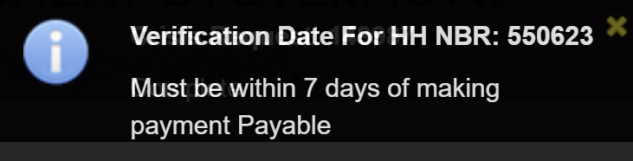
eHEAT Enhancements
Crisis Payable control
EAP policy requires Crisis payments to be made “Payable” within 7 calendar days from the date of Crisis information verification
Control checks date and gives an error if date is greater than 7 days:
  Delivered fuel within 7 days of the acceptance of delivery confirmation information
  Connected within 7 days of verification date

Slide 21
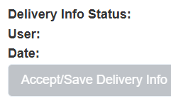
eHEAT Enhancements
Accept Delivery info control
SPs could accept delivery confirmation information at any point on a Crisis request, even well after a request was complete and paid
To prevent accidental accepting, the “Accept/Save Delivery Info” button now locks once the distribution status is “Complete”
Before payment is “Payment in Progress” Crisis requests can be made “In Progress” again if there is a need to update or accept new delivery information
Also note that if delivery information is accepted while the benefit is “Obligated” the amount updates

Slide 22
eHEAT Enhancements
Demographic search 60 and over
  Search results previously included HH members that had not yet turned 60 but would at some point in the program year
    Problem for Crisis outreach to HHs who were not eligible
  Report now returns results based on the HH members’ age day the search is run
    Prior year search results display HHs with members who were 60 or over in the program year being searched (not their current age)

Slide 23
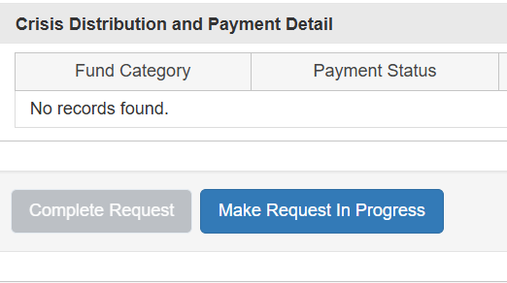
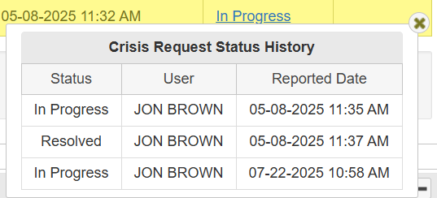
eHEAT Enhancements
Undo Resolved Crisis
  Previously when a Crisis benefit was determined and it was “Resolved,” the Crisis request was locked and could not be used
  SPs can now revert “Resolved” Crisis requests to “In Progress”

Slide 24
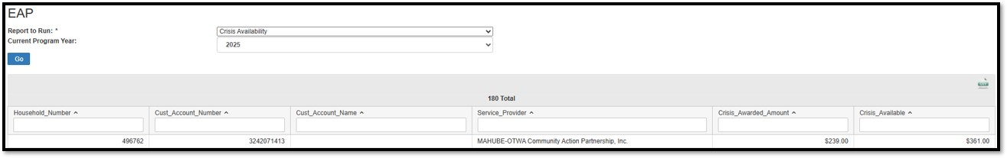
eHEAT Enhancements
New Crisis report for vendors
  New report for energy vendors shows them all their HHs and how much Crisis has been used and how much is still available
    Amounts match the SP Crisis screens and are based on obligated amounts
    Results can be exported
  Energy vendor users need to add “Crisis Availability” report to access the report

Slide 25
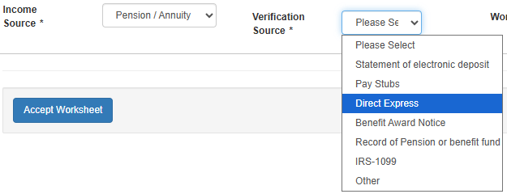
eHEAT Enhancements
"Direct Express" income proof
  Direct Express was added as an income verification option for SSI, Retirement, and Pension/Annuity

Slide 26
Planned Enhancements

Slide 27
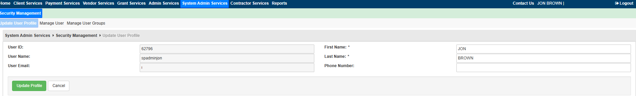
eHEAT Enhancements
Personal signatures
  SP users will be able to set a default personal signature for letters
  Will be on the Update User Profile page
  If no personal signature is set up the agency default signature will be used

Slide 28

eHEAT Enhancements
Direct payments less than $10
  To prevent issuing small checks, eHEAT will now stop generating direct payments of less than $10
  If a direct pay benefit is under $10, it will be added to the energy vendor payment

Slide 29
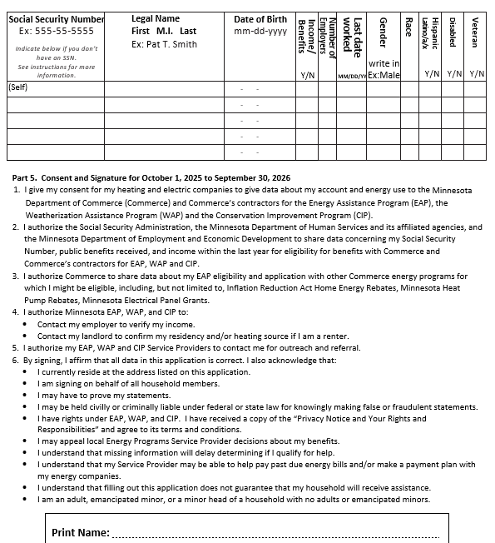
eHEAT Enhancements
Signature page includes HH members
  Added the HH members section to the signature page
  This addition addresses concerns around consent for all HH members

Slide 30

eHEAT Enhancements
Blank signature date controls
  No signature date prevents energy vendors from seeing apps
  Will not show up when looking for consumption requests
    Pre-logged apps will show

Slide 31
eHEAT Clarifications and Reminders

Slide 32
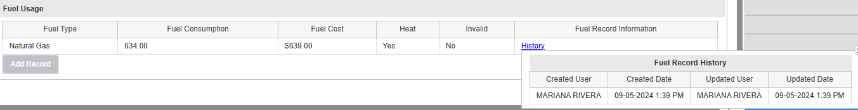
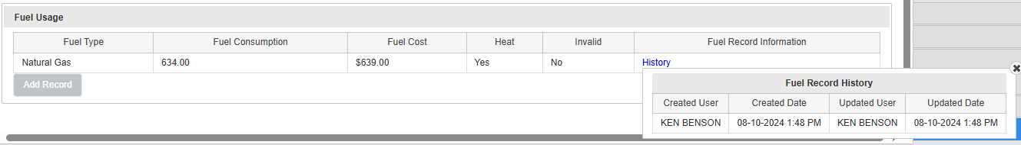
eHEAT Enhancements
Consumption from pre-logged apps
  When online apps with a pre-logged app are logged, any consumption from the pre-logged app is pulled forward to the newly logged app
  When looking at consumption history, the name of the person who logged the online app will show in the history as entering consumption
  Pre-logged app shows history of who originally entered consumption
Online App
Pre-logged App

Slide 33
Q&A

