Slide 1

Energy Assistance Program
FFY26 Annual Training
Ch. 12 – Communication, Info & Reports; Ch. 13 – Fiscal Management

Slide 2
Ch. 12 – Communication, Info & Reports
Natalia Fedorova

Slide 3

Program Fiscal Management
Topics
Intro
FFY26 Fiscal Policy Changes
Fiscal Staff Training Reminder
FFY26 EAP Grant Contract Updates
Planning for Program Year
FSR Spending Trends
Funding Schedule & Allocation Estimates
Group Work & Recommendations

Slide 4
Program Fiscal Management – FFY26 Fiscal Policy Changes

Slide 5

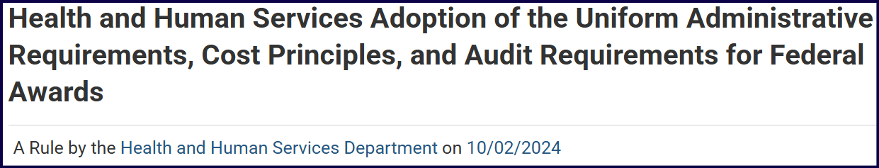
Program Fiscal Management
Intro
Minimal FFY26 EAP fiscal policy changes
Brought on by OMB Uniform Guidance (UG) changes in 2024
HHS adopted 8 OMB UG changes effective 10/01/24
Equipment threshold, de minimus rate, etc.
HHS adopted the rest of the changes effective 10/01/25

Slide 6

Program Fiscal Management
FFY26 EAP Fiscal Changes – Overview
Equipment definition and equipment disposition threshold increased to:
At or above $10,000, up from $5,000, as applicable
Notes:
The main change that had impact on the Policy Manual and the Contract was the increase in Equipment Definition and Equipment Threshold to $10,000 – up from $5,000.

Slide 7

Program Fiscal Management
FFY26 EAP Fiscal Changes – Overview
EAP Policy Manual & EAP Grant Contract updated to reflect OMB UG 2024 revisions
FFY26 EAP Manual: Ch. 12, Ch. 13, & Appendix 13B
FFY26 EAP Grant Contract: Section 15, p. 9
Personal Property, State Property and Exception Section

Slide 8


Program Fiscal Management
FFY26 Fiscal Changes – Ch. 12, p. 4
Ch. 12 – Communication, Information, & Reports
Information and Reporting section, Closeout subsection
“The EAP Final Closeout Package for EAP must include:
A list of EAP-related equipment over $10,000 and sensitive equipment (as defined in Ch. 13 – Program Fiscal Management) purchased during the program year. If no inventory was purchased, type that statement into the “Service Provider Note” box on the Final FSR.”

Slide 9


Program Fiscal Management
FFY26 Fiscal Changes – Ch. 13, p. 16
Program Fiscal Management, Property Management Section
Property Management Requirements Subsection:
“Procedures for managing equipment with a per unit cost $10,000 or greater and all sensitive equipment, whether acquired in whole or in part with EAP funds, until disposition takes place will, as a minimum, meet the following requirements”

Slide 10

Program Fiscal Management
FFY26 Fiscal Changes – Ch. 13, p. 19
Program Fiscal Management, Purchase Requests Section
Personal Property, State Property and Exceptions Subsection
“Service Providers must obtain purchase or disposition approval for equipment that is nonexpendable, tangible personal property having a useful life of more than one year and a per unit acquisition cost of $10,000 or greater. Service Providers using EAP funds must seek approval for all vehicle purchases.”

Slide 11

Program Fiscal Management
FFY26 Fiscal Changes – Ch. 13, p. 19
Ch. 13 – Program Fiscal Management, Purchase Requests Section, Closing Date for Purchase Requests Subsection
PART 3 – Disposal or Transfer
“Approval must be obtained for disposal of equipment with a current per unit fair market value in excess of $10,000 and sensitive equipment of any cost.”

Slide 12


Program Fiscal Management
FFY26 Fiscal Changes – Appendix 13B, p. 2
Appendix 13B –The Service Provider Purchase/Disposition Request Form
Service Provider must obtain purchase or disposition approval for equipment, meaning an article of nonexpendable, tangible personal property having a useful life of more than one year and an acquisition cost which equals the lesser of (a) the capitalization level established by the governmental unit for financial statement purposes, or (b) $10,000.
Notes:
In the “Non-expendable personal property procurement or disposition” paragraph

Slide 13

Program Fiscal Management
FFY26 Fiscal Changes – Appendix 13B, p. 2
Appendix 13B –The Service Provider Purchase/Disposition Request Form, Instructions (Parts 1, 2, & 3)
Part 3 – Disposal or Transfer
Approval must be obtained for disposal of equipment with a current per unit fair market value in excess of $10,000.

Slide 14


Program Fiscal Management
FFY26 Fiscal Changes – FFY26 EAP Grant Contract, p. 9
Section 15. Personal Property, State Property and Exception
15.1. Personal Property. Any purchase of non-expendable personal property that has a useful life greater than one year and a per unit cost of ten thousand dollars ($10,000.00) or greater must have the State’s prior written approval.

Slide 15

Program Fiscal Management
Fiscal Staff Training
Any new EAP fiscal staff must attend initial Office of Management & Budget (OMB) Uniform Guidance (UG) training
Within one (1) year of hire
EAP fiscal staff must take refresher courses
Within 1 year of LIHEAP-applicable OMB UG changes
Most recent changes in 2024
Commerce WAP offers OMB UG training to SPs every fall
Commerce EAP will send out info via the Energizer

Slide 16
FFY26 EAP Grant Contract Updates

Slide 17


Program Fiscal Management
FFY26 EAP Grant Contract Updates – Intro
MN Office of Grants Management (OGM) changes 07/01/25
Affected OGM Policies:
08-04-Grant Contract Agreements & Award Notifications and 08-06-Pre-Award Risk Assessment
Based on legislation passed during 2025 Legislative Session
These policy changes went into effect July 1, 2025
FFY26 EAP Grant Contract updated to reflect these changes
Grantee = Service Provider
Notes:
This year OGM Policies 08-04 (Grant Contract Agreements and Award Notifications) and 08-06 (Pre-Award Risk Assessment) required updates.
The Minnesota Legislature’s yearly work was supposed to end Monday, May 19 but lawmakers adjourned with unfinished business. Lawmakers had a July 1 deadline to complete the remainder of the budget or face a partial government shutdown.
Commerce received notice on 6/9/25 of the upcoming 7/1/25 changes. OGM posted the changes on their website 7/1/25.
The updated policy is effective July 1, 2025. It applies to all grant contract agreements and grant award notifications that result from RFPs posted on or after July 1, 2025. This policy also applies to any formula grants, single source grants, or legislatively named grants with an effective date on or after July 1, 2025.

Slide 18
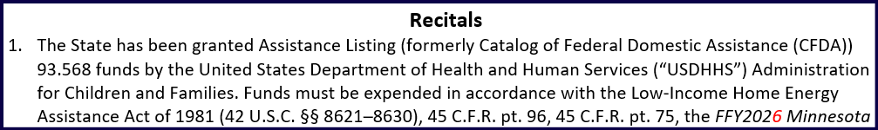
Program Fiscal Management
FFY26 EAP Grant Contract Updates – p. 1, Recitals
P. 1, Recitals, Subsection 3
New language:
The Grantee agrees that administrative costs must be necessary and reasonable as a condition of this grant
Old language:
The Grantee agrees to minimize administrative costs as a condition of this grant
Notes:
FFY26 EAP Grant Contract Updates – p. 1, Recitals
P. 1, Recitals
New language:
The Grantee agrees that administrative costs must be necessary and reasonable as a condition of this grant
Old language:
The Grantee agrees to minimize administrative costs as a condition of this grant

Slide 19

Program Fiscal Management
FFY26 EAP Grant Contract Updates – p. 4, Sect. 4.3.9
Part of Section 4.3. Contracting and Bidding Requirements
New language:
4.3.9. The Grantee must not contract with vendors who are suspended or debarred by the State of Minnesota or the federal government
Old language:
4.3.9. The Grantee must not contract with vendors who are suspended or debarred in MN
Notes:
FFY26 EAP Grant Contract Updates – p. 4, Sect. 4.3.9
New language:
The Grantee must not contract with vendors who are suspended or debarred by the State of Minnesota or the federal government
Old language:
The Grantee must not contract with vendors who are suspended or debarred in MN

Slide 20

Program Fiscal Management
FFY26 EAP Grant Contract Updates – p. 4, Sect. 6
P. 4, Section 6. Authorized Representatives – NEW paragraph
NEW paragraph ADDED:
The Grantee must clearly post on the Grantee’s website the names of, and contact information for, the Grantee’s leadership and the employee or other person who directly manages and oversees this Grant Contract Agreement on behalf of the Grantee
Commerce must monitor compliance with this requirement
Notes:
FFY26 EAP Grant Contract Updates – Page 4, Section 6. Authorized Representatives:
NEW paragraph added at the end of this section:
“The Grantee must clearly post on the Grantee’s website the names of, and contact information for, the Grantee’s leadership and the employee or other person who directly manages and oversees this Grant Contract Agreement on behalf of the Grantee.”
Commerce must monitor SP compliance with this requirement.

Slide 21
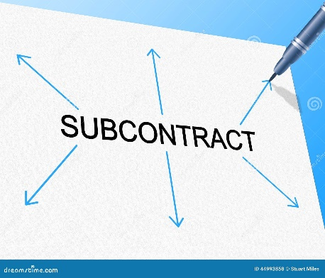
Program Fiscal Management
FFY26 EAP Grant Contract Updates – p. 5, Sect. 8 (NEW SECTION)
P. 5, Sect. 8. Subcontracting and Subcontract Payment
NEW section ADDED
What this means for SPs is that they can’t go out and subcontract out EAP
The EAP Manual already had a related requirement
“SPs must get written permission from Commerce to subcontract or assign any or all of a program” (Ch. 1, p. 4, Subcontracting EAP)
Notes:
FFY26 EAP Grant Contract Updates – p. 5, Sect. 8 (NEW)
P. 5, Section 8. Subcontracting and Subcontract Payment
A new section has been added. How does this affect Service Providers? – This means that you can’t just source out Energy Assistance Program, and there are additional requirements around it, now in MN Law – this would be in addition to what we already have in the Manual.
(The Manual, Ch. 1, p. 4: Subcontracting the Energy Assistance Program: Service Providers must get written permission from Commerce to subcontract or assign any or all of a program.)

Slide 22
Program Fiscal Management
FFY26 EAP Grant Contract Updates – p. 5, Sect. 8 (NEW SECTION)
P. 5, Sect. 8. Subcontracting and Subcontract Payment
New language:
8.1. A subrecipient is a person or entity that has been awarded a portion of the work authorized by this Grant Contract Agreement by Grantee. The Grantee must document any subaward through a formal legal agreement. The Grantee must provide timely notice to the State of any subrecipient(s) prior to the subrecipient(s) performing work under this Grant Contract Agreement.
Notes:
FFY26 EAP Grant Contract Updates – p. 5, Sect. 8 (NEW)
P. 5, Section 8. Subcontracting and Subcontract Payment
A new section has been added. How does this affect Service Providers? – This means that you can’t just source out Energy Assistance Program, and there are additional requirements around it, now in MN Law – this would be in addition to what we already have in the Manual.
(The Manual, Ch. 1, p. 4: Subcontracting the Energy Assistance Program: Service Providers must get written permission from Commerce to subcontract or assign any or all of a program.)

Slide 23
Program Fiscal Management
FFY26 EAP Grant Contract Updates – p. 5, Sect. 8 (NEW SECTION)
P. 5, Sect. 8. Subcontracting and Subcontract Payment
New language (cont.):
8.2. The Grantee must monitor the activities of the subrecipient(s) to ensure the subaward is used for authorized purposes; is in compliance with the terms and conditions of the subaward, Minnesota Statutes § 16B.97, Subd.4 (a) 1, and other relevant statutes and regulations; and that subaward performance goals are achieved.
Notes:
FFY26 EAP Grant Contract Updates – p. 5, Sect. 8 (NEW)
P. 5, Section 8. Subcontracting and Subcontract Payment
New language (cont.):
The Grantee must monitor the activities of the subrecipient(s) to ensure the subaward is used for authorized purposes; is in compliance with the terms and conditions of the subaward, Minnesota Statutes § 16B.97, Subd.4 (a) 1, and other relevant statutes and regulations; and that subaward performance goals are achieved.
16B.97 GRANTS MANAGEMENT.
Subd. 4.Duties.
(a) The commissioner shall:
(1) create general grants management policies and procedures that are applicable to all executive agencies. The commissioner may approve exceptions to these policies and procedures for particular grant programs. Exceptions shall expire or be renewed after five years. Executive agencies shall retain management of individual grants programs;

Slide 24
Program Fiscal Management
FFY26 EAP Grant Contract Updates – p. 5, Sect. 8 (NEW SECTION)
P. 5, Sect. 8. Subcontracting and Subcontract Payment
New language (cont.):
8.3. During this Grant Contract Agreement, if a subrecipient is determined to be performing unsatisfactorily by the State’s Authorized Representative, the Grantee will receive written notification that the subrecipient can no longer be used for this Grant Contract Agreement.
Notes:
FFY26 EAP Grant Contract Updates – p. 5, Sect. 8 (NEW)
P. 5, Section 8. Subcontracting and Subcontract Payment
New language (cont.):
8.3. During this Grant Contract Agreement, if a subrecipient is determined to be performing unsatisfactorily by the State’s Authorized Representative, the Grantee will receive written notification that the subrecipient can no longer be used for this Grant Contract Agreement.

Slide 25
Program Fiscal Management
FFY26 EAP Grant Contract Updates – p. 5, Sect. 8 (NEW SECTION)
P. 5, Sect. 8. Subcontracting and Subcontract Payment
New language (cont.):
8.4. No subagreement shall serve to terminate or in any way affect the primary legal responsibility of the Grantee for timely and satisfactory performances of the obligations contemplated by the Grant Contract Agreement.
Notes:
FFY26 EAP Grant Contract Updates – p. 5, Sect. 8 (NEW)
P. 5, Section 8. Subcontracting and Subcontract Payment
New language (cont.):
8.4. No subagreement shall serve to terminate or in any way affect the primary legal responsibility of the Grantee for timely and satisfactory performances of the obligations contemplated by the Grant Contract Agreement.

Slide 26
Program Fiscal Management
FFY26 EAP Grant Contract Updates – p. 5, Sect. 8 (NEW SECTION)
P. 5, Sect. 8. Subcontracting and Subcontract Payment
New language (cont.):
8.5. The Grantee must pay any subrecipient in accordance with Minnesota Statutes § 16A.1245.
8.6. The Grantee and any subrecipients must not contract with vendors who are suspended or debarred by the State of Minnesota or the federal government.
Notes:
FFY26 EAP Grant Contract Updates – p. 5, Sect. 8 (NEW SECTION) – Section 8. Subcontracting and Subcontract Payment
New language (cont.):
8.5. The Grantee must pay any subrecipient in accordance with Minnesota Statutes § 16A.1245.
8.6. The Grantee and any subrecipients must not contract with vendors who are suspended or debarred by the State of Minnesota or the federal government.
2024 Minnesota Statutes, Chapter 16A, Section 16A.1245:
16A.1245 PROMPT PAYMENT TO SUBCONTRACTORS.
Each state agency contract must require the prime contractor to pay any subcontractor within ten days of the prime contractor's receipt of payment from the state for undisputed services provided by the subcontractor. The contract must require the prime contractor to pay interest of 1-1/2 percent per month or any part of a month to the subcontractor on any undisputed amount not paid on time to the subcontractor. The minimum monthly interest penalty payment for an unpaid balance of $100 or more is $10. For an unpaid balance of less than $100, the prime contractor shall pay the actual penalty due to the subcontractor. A subcontractor who prevails in a civil action to collect interest penalties from a prime contractor must be awarded its costs and disbursements, including attorney's fees, incurred in bringing the action.

Slide 27

Program Fiscal Management
FFY26 EAP Grant Contract Updates – p. 10, Sect. 21
P. 10, Section 21.3. Termination for Insufficient Funding
NEW paragraph ADDED
It means state agencies can more easily suspend contracts or grants (instead of terminating) if federal funds are lost
This Photo by Unknown Author is licensed under CC BY-SA

Slide 28
Program Fiscal Management
FFY26 EAP Grant Contract Updates – p. 10, Sect. 21
P. 10, Section 21.3. Termination for Insufficient Funding
NEW paragraph ADDED:
In the event of temporary lack of funding or appropriation, the State may pause its obligations under this Grant Contract Agreement without terminating it.
This pause will be for the duration of the lack of funding or appropriation and shall not be considered a termination of the Grant Contract Agreement.
Notes:
FFY26 EAP Grant Contract Updates – p. 10, Sect. 21
P. 10, Section 21.3. Termination for Insufficient Funding
NEW paragraph ADDED:
In the event of temporary lack of funding or appropriation, the State may pause its obligations under this Grant Contract Agreement without terminating it.
This pause will be for the duration of the lack of funding or appropriation and shall not be considered a termination of the Grant Contract Agreement.

Slide 29
Program Fiscal Management
FFY26 EAP Grant Contract Updates – p. 10, Sect. 21
P. 10, Section 21.3. Termination for Insufficient Funding
NEW paragraph ADDED (cont.):
The Grantee will be notified in writing of the temporary pause, and the Grantee’s ability to provide services may be temporarily suspended during this period.
The State will provide reasonable notice to the Grantee of the lack of funding or appropriation and shall notify the Grantee once funding is restored or appropriated, at which point the provision of services under the Grant Contract Agreement may resume.
Notes:
FFY26 EAP Grant Contract Updates – p. 10, Sect. 21
P. 10, Section 21.3. Termination for Insufficient Funding
NEW paragraph ADDED (cont.):
The Grantee will be notified in writing of the temporary pause, and the Grantee’s ability to provide services may be temporarily suspended during this period.
The State will provide reasonable notice to the Grantee of the lack of funding or appropriation and shall notify the Grantee once funding is restored or appropriated, at which point the provision of services under the Grant Contract Agreement may resume.

Slide 30
Program Fiscal Management
FFY26 EAP Grant Contract Updates – p. 10, Sect. 21
P. 10, Section 21.3. Termination for Insufficient Funding
New paragraph added (cont.):
The State will not be assessed any penalty if the Grant Contract Agreement is terminated due to insufficient funding.
The State must provide the Grantee notice of the lack of funding within a reasonable time of the State’s receiving notice.
EAP Grant Contract already contained this condition at end of the section
Notes:
FFY26 EAP Grant Contract Updates – p. 10, Sect. 21
P. 10, Section 21.3. Termination for Insufficient Funding
New paragraph added (cont.):
The State will not be assessed any penalty if the Grant Contract Agreement is terminated due to insufficient funding.
The State must provide the Grantee notice of the lack of funding within a reasonable time of the State’s receiving notice. (The EAP Grant Contract already contained this condition at end of this section.)

Slide 31
Program Fiscal Management – Planning for FFY26
Notes:
We’ll now switch gears and talk about Planning & Budgeting for next Program Year.

Slide 32
Program Fiscal Management
EAP Funding Situation
LIHEAP funds have been flat (with some exceptions) for over a decade
With inflation, administrative funds have actually decreased in real terms
This is hard for all EAP Service Providers (SPs)
We want to help SPs think proactively about their budgets
Notes:
EAP Funding Situation
As you know, LIHEAP funds have been flat (with some exceptions) for over a decade. With inflation (and considering the number of applications have been increasing over the years), administrative funds have actually decreased in real terms. (While the number of apps are increasing – so SPs are doing more work with the same amount of funding.) This is hard for all EAP Service Providers (SPs) – and we understand that. And so, considering these challenges and level of unpredictability around funding - We want to help SPs think proactively about their budgets. Also, share and learn new ideas during the Group Discussion – and how to best operate within these constraints.

Slide 33

Program Fiscal Management
Some SP Spending Trends on FSRs
Running low on funds very early
Spending disproportionately high amounts early on
Underspending on A16 and over-spending on Admin
And then correcting later on
Running out of funds altogether
Notes:
Each month we review SPs’ Financial Status Reports (FSRs).
Here are some things we’ve seen.
Some SP Spending Trends on FSRs
Some are Running low on funds very early – Spending disproportionately high amounts early on.
Some are Underspending on A16 and over-spending on Admin - And then correcting later on.
Running out of funds altogether.
It might make sense in some cases to spend more up front – but sometimes it appears disproportionate; we have seen some SPs who in relation to their staffing and production spend a lot up front.

Slide 34
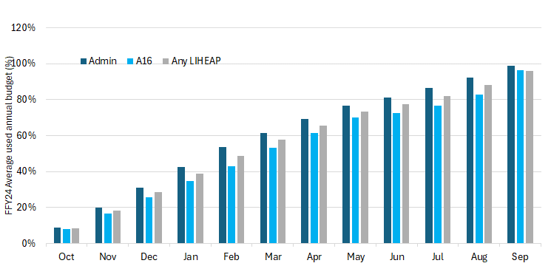
Program Fiscal Management
Average Used Annual Budget by Month (%) – FFY24
Notes:
Here’s a graph based on the FFY24 FSR data that shows an average spend in each category by month in FFY24. Categories include Admin & A16, and overall spend. We see that overall it’s a generally proportionate spend throughout the Program Year, with Admin funds which are the dark blue columns being used at a higher rate than A16 funds.

Slide 35
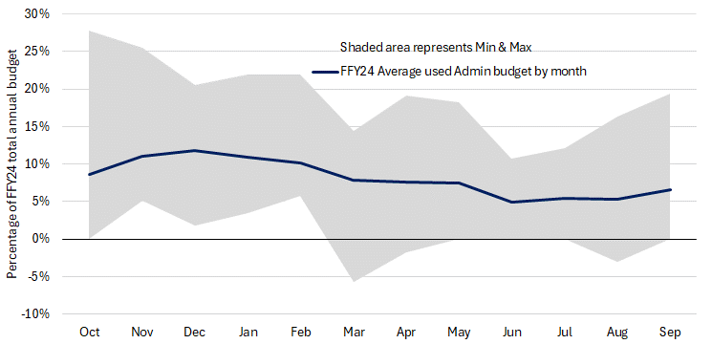
Program Fiscal Management
Used % of Admin Budget by Month – FFY24
28% of an SP’s annual Admin budget spent in Oct
A negative Admin budget adjustment in Mar: SP re-coded Admin to A16
Notes:
This Chart shows the Used Percentage of Admin Budget by Month in FFY24. The dark blue line showing the Average Used Admin Budget each month is pretty smooth overall. It shows each month the average across the network is about 8-10%. While the average gives the appearance of Admin expenditures being smooth, or consistent, across the year, at the SP level we often see a lot of variation or inconsistency over time – which is exactly what the shaded areas are. Basically, it shows the differences between the Service Providers: some start off with high spend and taper off later in the program year, some start out slowly and catch up later, some are somewhere in the middle. E.g., in January, the variation is as great as 28% and as little as 0%. On the Max line: In October, one SP used 28% of their annual Admin budget. On the Minimum Line: In October, 1 SP spent 0%. In March, we had a negative Adjustment of 5%. This SP re-coded their Admin to A16 after reviewing their payroll, which resulted in a larger A16 and negative Admin in March. In April & in August, we are seeing a couple of minor Admin adjustments, as well. We can see that they (negative Admin adjustments) are starting in March, after heaving Admin use in the first few months of the Program Year.

Slide 36
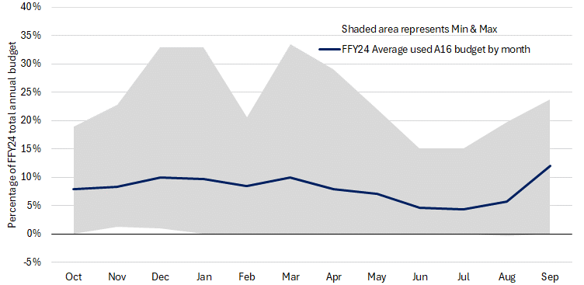
Program Fiscal Management
Used % of A16 Budget by Month – FFY24
Because this SP re-coded their Admin to A16 in Mar, they reported larger A16 expenditures (33%) and neg. Admin
Notes:
This chart shows the A16 Spend by Month in FFY24.
The dark blue line showing the Average Used A16 Budget is also relatively smooth, showing a pretty consistent usage, peaking in September.
While the average gives the appearance of A16 expenditures being smooth, or consistent, across the year, at the SP level we often see a lot of variation or inconsistency over time – which is exactly what the shaded areas are.
Comment Box to the right: For example, this SP recoded their Admin to A16 after reviewing their payroll, which resulted in a larger A16 (33%) and negative Admin in March.

Slide 37
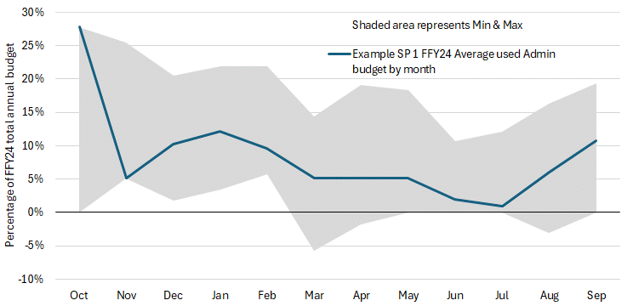
Program Fiscal Management
Example – Used % of Admin Budget by Month – FFY24
A high Admin spend in Oct (27% of annual Admin budget), adjusted in Nov, & an even spend during PY, peaking in Jan & Sep.
Notes:
This is an example SP Admin spend.
They had a pretty high Admin spend in October (27% of their annual Admin budget), adjusted in November, and then a pretty even spend throughout the year, peaking again in January & September.

Slide 38
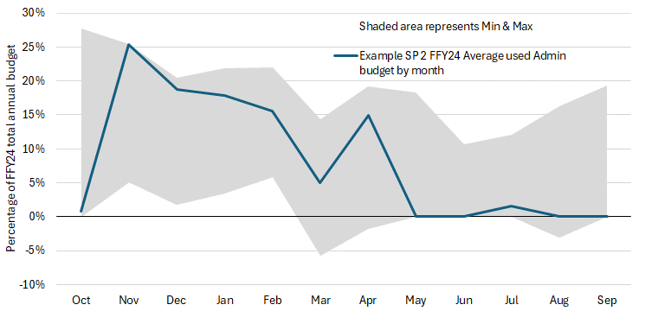
Program Fiscal Management
Example – Used % of Admin Budget by Month – FFY24
Used only 1% of total Admin budget in Oct, but had high Admin spend in Nov (25% of annual Admin budget), with higher spend during 1st few months of PY
Notes:
This is an example of another SP Admin spend.
They had 1% of their annual Admin budget in October, but a high Admin spend in November (25% of their annual Admin budget), with a higher spend during 1st few months of the program year.

Slide 39
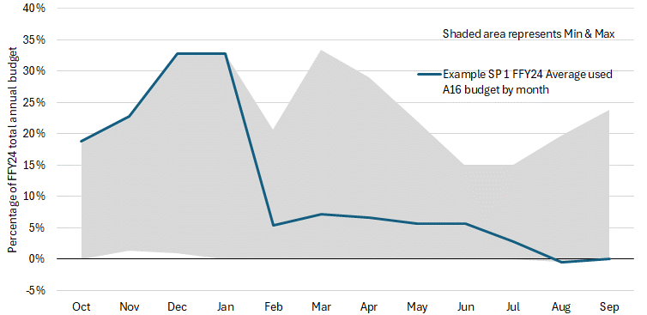
Program Fiscal Management
Example – Used % of A16 Budget by Month – FFY24
This SP had a high A16 spend during 1st few months of PY (18% in Oct, 22% in Nov, & 32% of annual budget in both Dec & Jan).
Notes:
This is an example SP A16 spend (outlier). In this example, the SP spent a ton of it right away. They accounted for the max spend of A16 in the first 4 months, at 32% of their annual budget in both Dec & Jan. This is a bit different from other SPs where they typically spend more of Admin in the beginning.

Slide 40
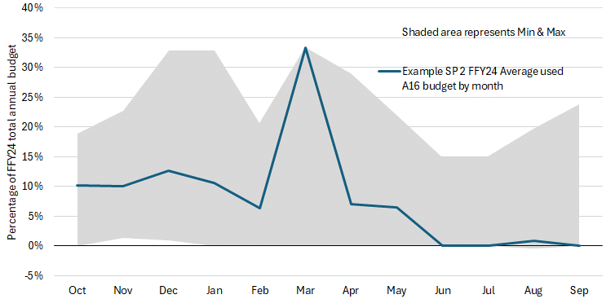
Program Fiscal Management
Example – Used % of A16 Budget by Month – FFY24
FSR Adjustment:
-SP recoded Admin to A16
-This resulted in large A16 (33%) & negative Admin
Notes:
This is an example SP A16 spend (outlier).
This is an example of an SP who recoded some of their payroll from Administrative to A16, resulting in a very large A16 Expenditure for March 2024 (33%). They also had to do a negative Admin adjustment for March. “Their staff who were doing A16 activities did not code their timecards correctly, so they were able to make an adjustment.”

Slide 41
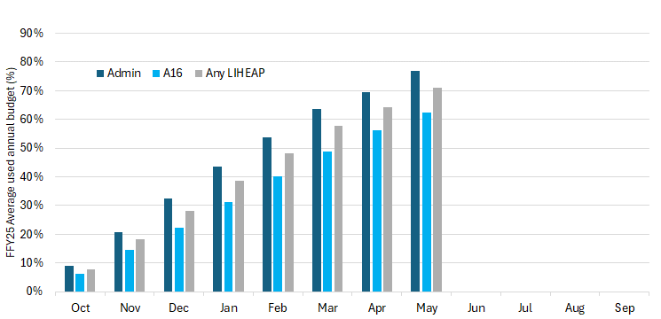
Program Fiscal Management
Average Used Annual Budget by Month (%) – FFY25
Notes:
FFY25:
The FFY25 Average Used Annual Budget by Month looks somewhat similar to that for FFY24, with, again, Admin funds being used at a faster pace than those for A16.

Slide 42
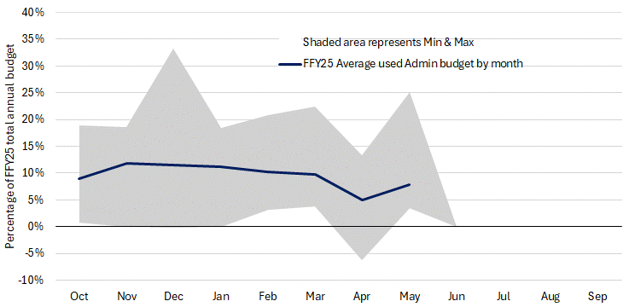
Program Fiscal Management
Used % of Admin Budget by Month – FFY25
33% of an SP’s annual Admin budget spent in Dec
Another FSR Adjustment:
-SP recoded Admin to A16
-This resulted in negative Admin & large A16 (see next slide)
Notes:
This is a chart of the FFY25 Admin Spend through May of 2025.
When we look at the shaded areas that represent Minimum & Maximum spend for a particular month, we can see the outliers.
In terms of the Max, one SP used up 33% of their annual Admin budget in December.
As for the Minimum spend, we can see a negative Admin adjustment in April. This SP recoded their Admin to A16, which resulted in negative Admin and a larger A16, as you can see on the next slide.

Slide 43
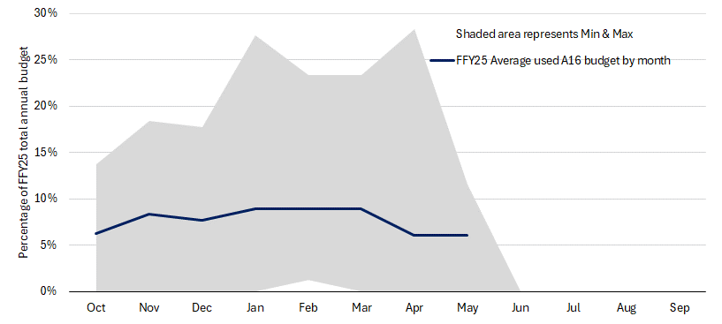
Program Fiscal Management
Because this SP re-coded their Admin to A16 in Apr, they reported larger A16 expenditures (26%) and neg. Admin
Used % of A16 Budget by Month – FFY25
Notes:
FFY25 A16 Spend - Here are the outliers.
The negative Admin adjustment in April resulted in a larger A16 expenditure report in April for that SP, accounting for the peak in April – which was 26% of their annual A16 budget.

Slide 44

Program Fiscal Management
Spending Trends – Hypothetical Examples of Trade-Offs
SP Input: What are some pros, cons, & effects or situations that you see?
#1: Spending more at the beginning
Pros: Helps with application processing
Cons: You have less at the end
Effects: Layoffs | Lots of temporary staff | Supplementing with non-federal funding
Notes:
These were examples of different types of spending across the network. They all have their own Pros, Cons, and Effects. So what are they? Let’s look a little more closely at these spending trends and discuss some hypothetical examples of trade-offs. This might also be a good time to connect with others to see what they are experiencing and what their situations are. So, #1: Spending more at the beginning – You get more apps in the beginning, you have more staff – so it makes sense.
It helps with application processing
But, you have to be careful, as it means you’ll have less at the end.
So, what are some of the effects?
Layoffs
Lots of temporary staff
Supplemental with non-federal funding
Ask SPs: You are the experts – What are some of the situations that you see? What would be some pros, cons, and effects? Feel free to just raise your hand and share.

Slide 45
Program Fiscal Management
Spending Trends – Hypothetical Examples of Trade-Offs
SP Input: What are some pros, cons, & effects or situations that you see?
#2: Smooth expenditures
Cons: Less staffing and a larger backlog
Pros: Works with some SPs – seem to be smaller ones with long-time staff who work on other programs in the “off-season”
Effects: No need for layoffs | No temporary staff
Notes:
Spending Trend #2: Conversely, smooth expenditures may mean less staffing and, therefore, a larger backlog
Works with some SPs
Seems to be smaller ones with long-time staff who work on other programs in the “off-season”
Effects: No need for layoffs | No temporary staff
Ask SPs: What are some of the situations that you see? What would be some pros, cons, and effects of this spending trend?

Slide 46

Program Fiscal Management
Planning for the Year – Considerations
Understanding When Funding is Available and How Much
Have to base on historical trends
Major cuts would impact budgets in unpredictable ways
Not one-size fits all
SPs vary in size and organizational structure

Slide 47



Program Fiscal Management
Typical SP Funding Schedule – EXAMPLE
 | October 1 |  | Early November |  | March-April
 | Start-Up Funding |  | Initial Award |  | Final Award
SP Admin | $3M | 33% | $5M | 57% | $864K | 10%
SP A16 | $1M | 17% | $4.2M | 73% | $600K | 10%
SPs receive more Admin upfront than A16
When we get 1st Award, it might seem SPs get a disproportionate amount of A16, but that’s because they get a disproportionate amount of Admin at Start-Up
By early November SPs received 90% of both Admin & A16
Notes:
This is an example of a Typical SP Funding Schedule. Naturally, it revolves around the federal funding timeline, except for Start-up.
I’d like to stress that this table is just an EXAMPLE, and it’s an example of the FFY25 Allocation Estimates. So, generally, Service Providers have 3 rounds of funding:
1. The 1st Round of Funding happens on October 1st – that’s the Start-Up Funding. We typically issue $3 million in Administrative Funds or Admin to Service Providers, which translates into 33% of the Service Providers’ annual Admin budget, so that’s the 3rd of the total Admin funding that SPs receive right off the bat on October 1st. We also issue $1M in A16 funds, and that’s 17% of the total A16 budget for the program year.
2. Then, the 2nd Round of Funding happens somewhere Early November (sometimes late October), after we receive our Initial Award from the HHS. At that time, Service Providers get about $5 million in Administrative funds, which is about 57% of their total Admin funding for the year, and about $4.2 million in A16 funds, which is about 73% of their total annual A16 budget. When we get our 1st Award, it might seem they get a disproportionate amount of A16, but that’s because they get a disproportionate amount of Admin at Start-Up. SPs get more Admin upfront than they do A16 – at Start-Up – which makes sense, as you need to hire and train staff, process applications, etc. – basically, start out the PY. Please note that by early November, after we receive our 1st Award, SPs received 90% of their total annual funding for both Admin & A16. 3. Then, the 3rd Round typically happens during March-April, after we receive our Final Award – the remaining 10% of funding, at which point we issue 10% of both Admin & A16 to SPs, which are about $864K in Admin & $600K in A16 funds to SPs.

Slide 48

Program Fiscal Management
#1: Start-Up Funding – October 1
FFY26 SP Start-Up Funding = $4M
$3M Administrative (Admin)
$1M Assurance 16 (A16)
Funds available as of October 1
Provided from carried over funds from FFY25
Additional funds allocated as funding is received
Notes:
Startup Funding: Each year Commerce is allowed to carry over up to 10% of the previous year’s regular LIHEAP funds. Total carryover is as much as $11M, although it is typically less. With this carryover funding, EAP provides Service Providers with startup funding on October 1. Startup funding typically includes $3M in administrative funds, $1M for Outreach/ESS (A16) funds, and $1M or more for ERR.
Only Admin and A16 funds are allocated using the allocation percentages; ERR is a program fund is available as Service Provider obligate funds for ERR tasks.

Slide 49

Program Fiscal Management
#2: Initial Federal Award – October-November
Each year Congress appropriates additional LIHEAP funding
Actual awards to states arrive between Oct 15-Nov 15
90% of a total annual award is provided in this timeframe
Commerce allocates additional Admin and A16 funds once initial award is received
FFY22 | FFY23 | FFY24 | FFY25
Nov 1, 2021 | Nov 4, 2022 | Oct 24, 2023 | Oct 31, 2024
Notes:
Initial Federal Award – Each year Congress appropriates additional LIHEAP funding. While appropriations should be completed prior to October 1, actual awards to states arrive between October 15 and November 15. Typically, 90% of a total annual award is provided in this timeframe. EAP allocates additional administrative and A16 funds once the initial award is received. (Note that the total funding allocated for the startup and initial award, combined, is based on initial award. That is, if $8.1M would be available for allocation to EAP Service Providers for administrative funds based on an initial award of $112M, because $3M was already allocated for startup, only $5.1M more would be allocated once the initial award is received.)

Slide 50


Program Fiscal Management
#3: Remaining Federal Funds – March-April
US HHS releases remaining 10% of regular LIHEAP award during new calendar year
Typically, during March-April
Once Commerce receives this award, it allocates remaining funds available for EAP SPs
FFY22 | FFY23 | FFY24 | FFY25
Apr 21, 2022 | Mar 23, 2023 | Apr 22, 2024 | May 1, 2025
Notes:
Remaining Federal Funds – Typically US Health & Human Services releases the remaining 10% of the regular LIHEAP award at some point during the new calendar year. When this occurs is unpredictable and depends on when Congress decides on the actual budget for the relevant fiscal year. Once Commerce receives this award, the remaining funds available for EAP Service Providers is allocated.

Slide 51

Program Fiscal Management
SP Allocation Estimates for the Whole Year
The 8/20/25 Energizer to include estimates of FFY26 EAP Admin and A16 allocations by SP
For the Whole Program Year
Will also include best guess at timing
These are only estimates; actual allocation amounts & timing may differ
So that SPs have info for FFY26 planning and budgeting
Notes:
So, we’ve just went over the Timing of when Service Providers receive EAP funding from Commerce. In terms of the amounts:
The Energizer newsletter 8/20/25 to include estimates of FFY26 EAP Administrative and A16 allocations by SP
For the Whole Program Year
Will also include best guess at timing
These are only estimates; actual allocation amounts & timing may differ
So that SPs have info for FFY26 planning and budgeting

Slide 52
Program Fiscal Management
Annual Allocation Percentage (%) for every EAP SP
Commerce determines % of available Admin and A16 funds for each SP
Based on data in two (2) previous program years (PYs):
# of households served
# of households denied
Represents % of total statewide EAP workload at each SP
Notes:
Allocation Percentage: Each year Commerce determines an allocation percentage for every EAP Service Provider.
This is the percentage of available Admin and A16 funds that will be allocated by Service Provider.
The allocation percentage is based on:
The number of households (HHs) in the two previous program years served with Primary Heat, Crisis, and ERR; as well as
The number of HHs denied due to being over income, providing insufficient information, or lack of program funds.
It represents the percentage of the total statewide EAP workload at each Service Provider.

Slide 53
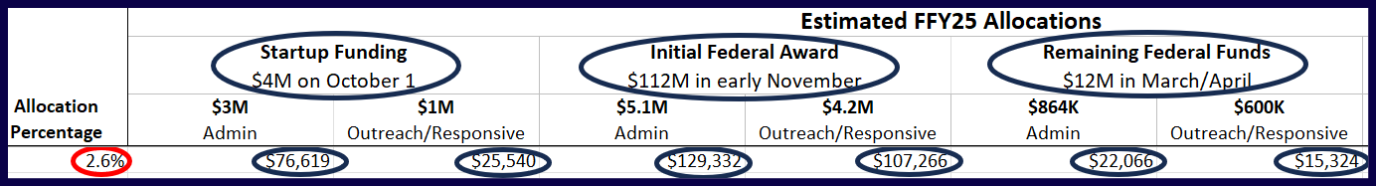
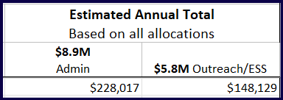
Program Fiscal Management
SP Allocation Estimates for Whole Year – EXAMPLE
The 8/20/24 Energizer newsletter estimate for FFY25:

Slide 54

Program Fiscal Management
Group Work
Break into groups of 4-5 of people around you for 5-10 min.
Talk about how you do things at your agency
Volunteers to say something about their discussion
Sample Topics:
What are some things your organizations does really well with fiscal management
What types of interactions or information is shared between EAP Coordinator and Fiscal Department
How do you communicate your changing Admin needs to Fiscal, e.g., Hiring Plan changes
Information-sharing methods, e.g., The Energizer – how does that work
Notes:
You are the experts – you do this every day – and now we’d like you to break into small groups and talk about how you do things at your agency.
Turn around and talk to your neighbor about how they do things.
We’ll have volunteers from each group to say something about their discussion.

Slide 55

Program Fiscal Management
Recommendations
Be proactive
Work with fiscal and executive directors early
Be aware of the flow of funds – both coming in and going out
Notes:
What can an SP do?
Be proactive
Review your total Allocation Estimates for the year
Work with fiscal and executive directors early
Before the start of the PY
Be aware of the flow of funds – both coming in and going out

Slide 56

Program Fiscal Management
Recommendations (cont.)
Think across programs/departments
Are there opportunities to fund FTEs with multiple funding strings?
Share expenses on fixed costs?
Are there non-federal funds available to supplement if needed?
E.g., Minnesota Community Action Grant (MCAG)
Notes:
What can an SP do? (cont.)
Think across programs/departments
Are there opportunities to fund FTEs with multiple funding strings?
Share expenses on fixed costs?
Are there non-federal funds available to supplement if needed?
E.g., Minnesota Community Action Grant (MCAG)

Slide 57

Program Fiscal Management
Recommendations (cont.)
Analyze and make adjustments based on past year
If you run out of funds this year, think about what’s driving that
Do you have the right number of employees working?
Maybe come up with a plan
Notes:
Recommendations (cont.)
And, finally, Analyze and make adjustments based on past year.
If you run out of funds this year, think about what’s driving that:
Do you have the right number of employees working?
Mabe come up with a plan – based on the earlier recommendations
Meet with your leadership and fiscal team to discuss and come up with a plan for the next program year

Slide 58

Q&A

