Slide 1

Energy Assistance Program
FFY26 Annual Training
Assurance 16 Reporting; Key Change Notification

Slide 2
Assurance 16 (A16) Reporting
Ian Villa-Watt

Slide 3

A16 Reporting
New Reporting Format
Excel Format
Added categories of referral and ESS activities
No more proactive reports

Slide 4
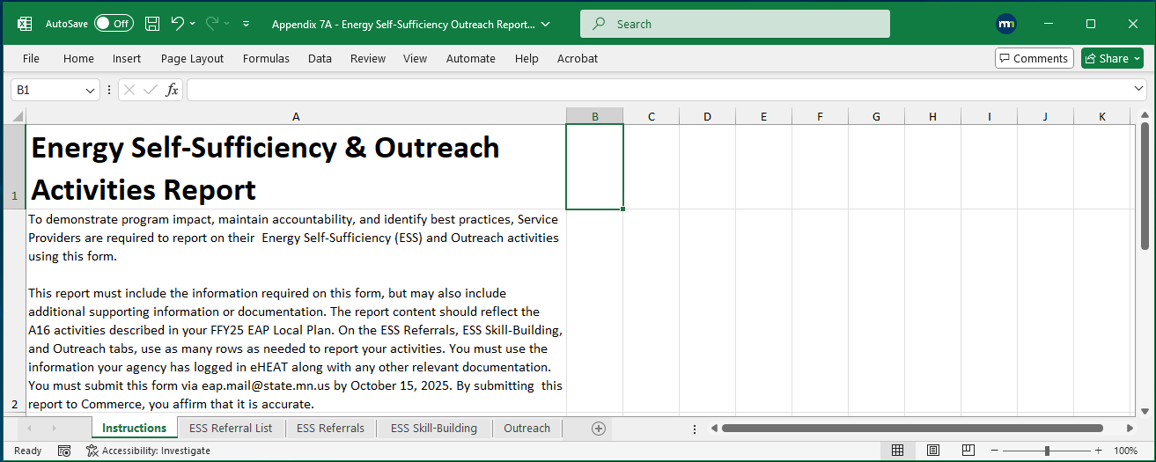
A16 Reporting

Slide 5
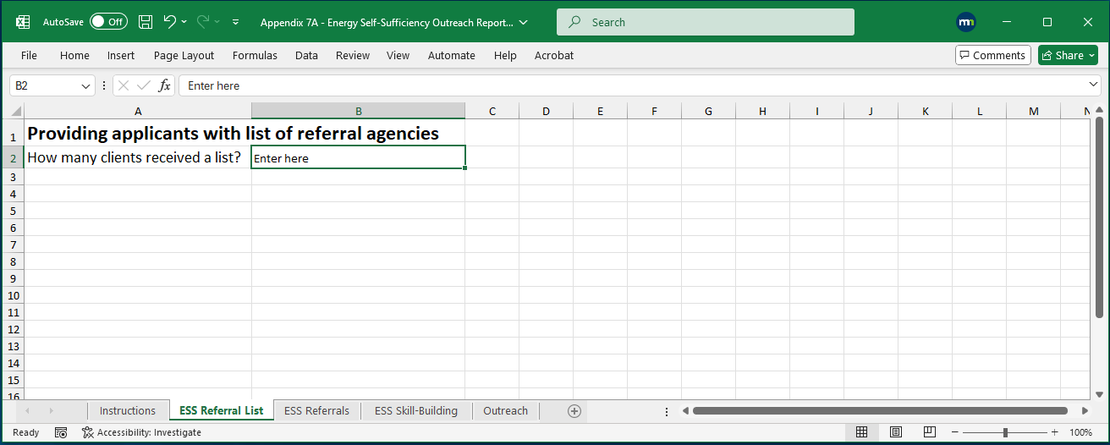
A16 Reporting

Slide 6
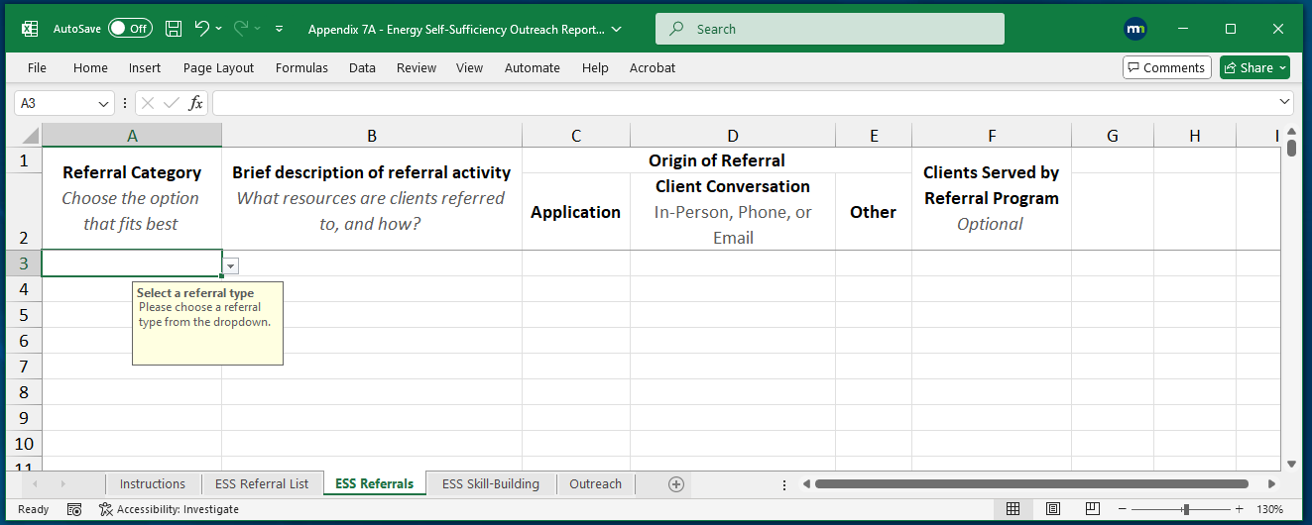
A16 Reporting

Slide 7
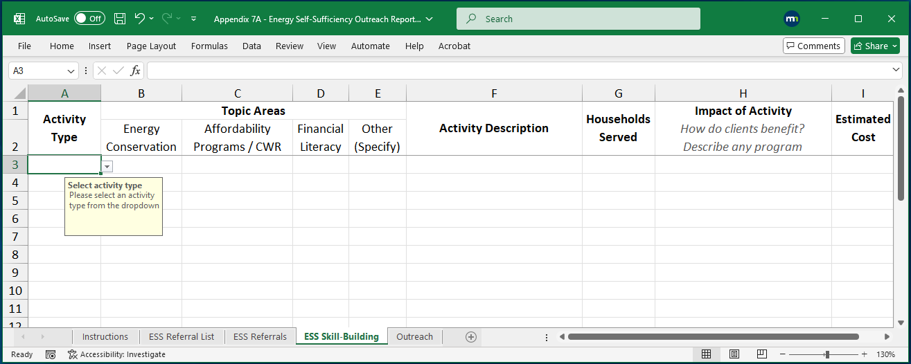
A16 Reporting

Slide 8
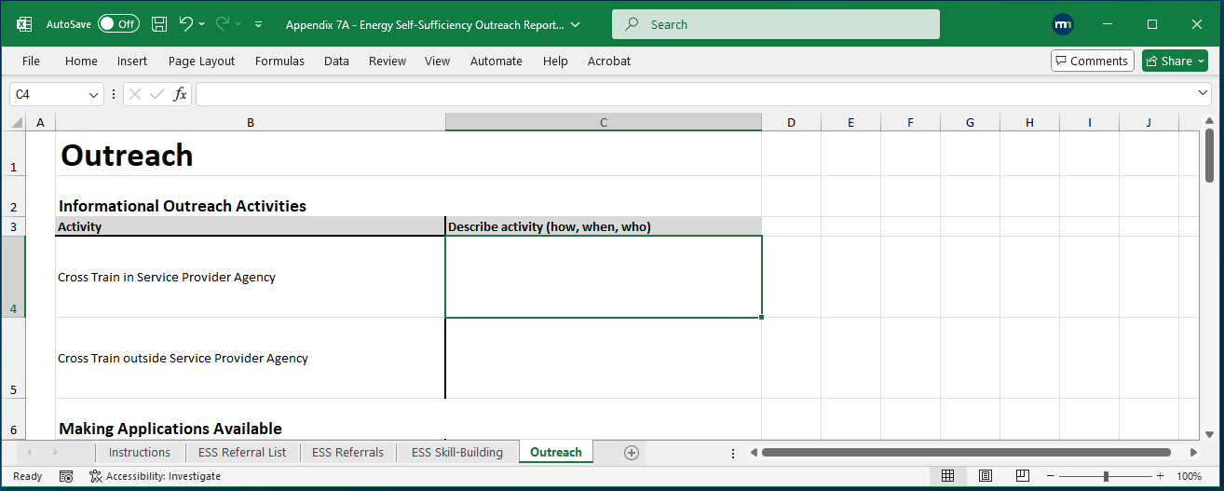
A16 Reporting

Slide 9
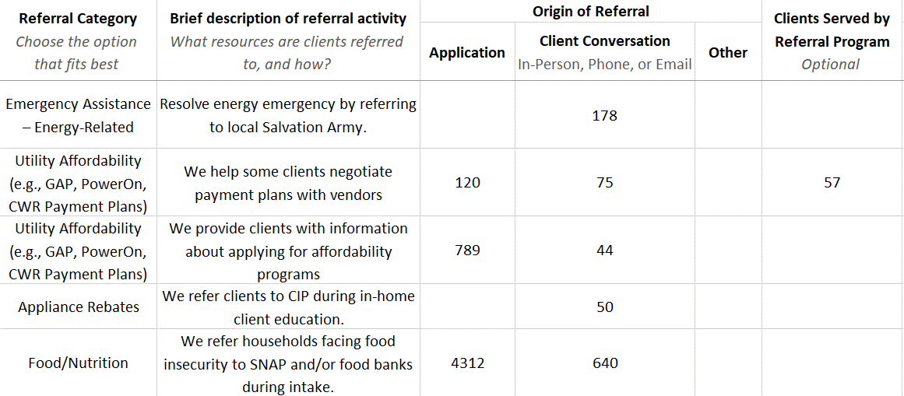
A16 Reporting

Slide 10
A16 Reporting
The type of need a referral or advocacy activity is addressing

Slide 11
A16 Reporting
Appliance Rebates | Employment/ Workforce | Personal Finance | Transportation
Cash Assistance | Food/Nutrition | Phone Affordability | Utility Affordability
Children & Youth | Housing/ Homelessness | Seniors/Aging | Veterans
Emergency Assistance – Energy | Legal Aid | Taxes | Weatherization
Emergency Assistance – Other | Health | Technology | Other

Slide 12
A16 Reporting
The type of need a referral or advocacy activity is addressing

Slide 13
A16 Reporting
A complete sentence describing what services clients are referred to and how it generally happens.

Slide 14
A16 Reporting

Slide 15
A16 Reporting
Where does the referral activity originate from?

Slide 16
A16 Reporting
Client expresses a need through a local question response or writes a note on their app

Slide 17
A16 Reporting
A need comes up while you talk to a client

Slide 18
A16 Reporting
Other ways you find out about client needs – should be uncommon

Slide 19
A16 Reporting
You might not always have this information…

Slide 20
A16 Reporting
You might not always have this information…
…but in some cases, you might

Slide 21
A16 Reporting
You can put referrals to multiple programs/services on one line if they are in the same category

Slide 22
A16 Reporting
But it may help to break out activities in the same category

Slide 23

A16 Reporting
So how do I track this?
Your tracking sheet doesn’t need to look like the report
It doesn’t have to be complicated
Let’s see some examples

Slide 24
A16 Reporting
Too Minimal
Program/Service | Week of 4/1 | Week of 4/8 | Week of 4/15
Salvation Army Heat Share | 5 | 23 | 4
CWR | 154 | 35 | 28
Affordability Program Info | 49 | 23 | 48
CIP | 12 | 21 | 17
Food Bank | 8 | 6 | 32
How do we know the origin of the referral?

Slide 25
A16 Reporting
Try This Instead
Program/Service | Week of 4/1 | Week of 4/8 | Week of 4/15
Mailed Referrals
CWR Flyer
Food Bank Pamphlet
In-Person, Phone, or Email Referrals/Advocacy
Salvation Army Heat Share
Payment Plan Negotiation
Affordability Program Info
CIP
Origin: application
Origin: Client conversation

Slide 26
A16 Reporting
Try This Instead
Program/Service | Week of 4/1 | Week of 4/8 | Week of 4/15
Mailed Referrals
CWR Flyer
Food Bank Pamphlet
In-Person, Phone, or Email Referrals/Advocacy
Salvation Army Heat Share
Payment Plan Negotiation
Affordability Program Info
CIP
Category: utility affordability
Category: Emergency Assistance (Energy-Related)

Slide 27
A16 Reporting
What if the category is ambiguous?
Program/Service | Week of 4/1 | Week of 4/8 | Week of 4/15
Mailed Referrals
County DHS
. . .
In-Person, Phone, or Email Referrals/Advocacy
County DHS
. . .
Category: ???
Category: ???

Slide 28
A16 Reporting
What if the category is ambiguous?
Program/Service | Week of 4/1 | Week of 4/8 | Week of 4/15
Mailed Referrals
County DHS Programs Flyer
. . .
In-Person, Phone, or Email Referrals/Advocacy
County DHS – SNAP
County DHS – Various
. . .
Category: Other
Category: Food/Nutrition
Category: Other

Slide 29
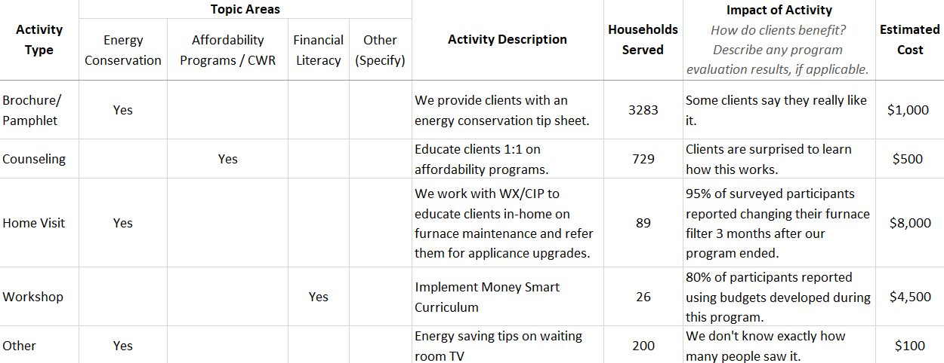
A16 Reporting

Slide 30
A16 Reporting
The type of skill-building activity you are conducting

Slide 31

A16 Reporting
ESS Activity Categories
Brochure/Pamphlet: tip sheets, flyers, mailers, etc.
Counseling/Coaching: 1-on-1 education (in-person/phone/virtual)
Class/Workshop: enroll clients in a sit-down or virtual education program
Home Visit: visit a client’s home to provide customized education

Slide 32
A16 Reporting
The topic area(s) your program/activity addresses – can indicate more than one

Slide 33
A16 Reporting
ESS Topic Areas
Energy Conservation: educating HHs about reducing usage, furnace maintenance, etc.
Affordability Programs/CWR: educating HHs about programs, payment plans, etc.
Financial Literacy: teaching budgeting or other skills to help clients manage costs

Slide 34
A16 Reporting
A few complete sentences about what the activity is

Slide 35
A16 Reporting

Slide 36
A16 Reporting
The number of HHs served by your program (for class/workshop only include those who completed the course)

Slide 37
A16 Reporting
Tracking Simple ESS Activities*
Program/Service | Week of 4/1 | Week of 4/8 | Week of 4/15
. . .
ESS Activities
Mailed energy conservation tip sheet
Provided energy education to client
. . .
. . .
A “Brochure/Pamphlet” activity addressing the “Energy Conservation” topic area
A “Counseling/Coaching” activity addressing “Energy Conservation” topic area
*for workshops, classes, or home visits, you report based on attendance or participation records

Slide 38
A16 Reporting
Describe the key findings of any measurement efforts

Slide 39
A16 Reporting
Estimate the total cost of the activity

Slide 40
A16 Reporting
Estimating Cost
We want a rough idea of where you invest the most resources
Activity | Estimate Cost by Adding Up the Following
Brochure/ Pamphlet | Time to design Printing costs
Counseling/ Coaching | Staff time (avg wage × avg session length × HHs served) Materials, if any

Slide 41

A16 Reporting
Don’t Double Count
Activities in your referral/advocacy numbers should not be double-counted in skill-building
Distinction between referrals/advocacy and skill-building may not always be clear – you’ll need to decide on better fit
Educating clients about low-income programs

Slide 42
A16 Reporting
Don’t Double Count
What about a home visiting program that results in referrals to CIP?
Count the home visits as ESS skill-building
Count the CIP referrals on the referral tab
The referrals are an added benefit of an educational program, so counting separately is OK

Slide 43
A16 Reporting
Feedback is OK
You may be asked to revise and resubmit your report
It’s year one
Don’t worry

Slide 44
Q&A

Slide 45
Key Change Notification
Marissa Squires

Slide 46

Ch. 12 - Key Changes
Topics
Review of policy
Essential info needed
When and how to submit key change notification
Notes:
Emphasize and explain importance to contracting, and in general if we don’t have point of contact for EAP and fiscal needs

Slide 47
Ch. 12 - Key Changes
What are Key Changes?
Interim or permanent status
Examples (but not an exhaustive list)
EAP Coordinator
Person who supervises the EAP Coordinator
Executive Director
Board Chair
Tribal Chair
Fiscal Director
Fiscal contact
(Ch. 12 – Communication, Information and Reports, p. 9-10)

Slide 48

Ch. 12 - Key Changes
Info Needed – All Key Changes
Timing of change: start and/or end dates of key change
New staff person’s contact info
Full name
Email
Phone number
(Ch. 12 – Communication, Information and Reports, p. 10-11)

Slide 49
Ch. 12 - Key Changes
Info Needed – All Key Changes
Hiring transition info
If more than a week exists between end and start date for this position, how will EAP service be maintained until the new staﬀer is active?
Ensuring EAP delivery
How will the SP ensure the new or interim staffer is knowledgeable and skillful in EAP delivery?
(Ch. 12 – Communication, Information and Reports, p. 11)

Slide 50

Ch. 12 - Key Changes
Info Needed – Required Attachment by Role
Executive Director or person who supervises the EAP Coordinator
Email or letter from the Chair’s Office or Authorized Representative describing the change
(Ch. 12 – Communication, Information and Reports, p. 11)

Slide 51
Ch. 12 - Key Changes
Info Needed – Required Attachment by Role
Tribal Chair, Board Chair or Authorized Representative
Board minutes or signed letter from the Chair or Authorized Representative including
Appointment of role, and
Notification of authority
Example: “[name], [title] is the new Authorized Representative Board Chair for [name of Service Provider] effective [date]”
and
(Ch. 12 – Communication, Information and Reports, p. 11)
Notes:
Discuss appointment of role on this slide, go into notification of authority on the next

Slide 52
Ch. 12 - Key Changes
‘Notification of authority’
They can sign the contract on behalf of the SP
Official documentation must clearly indicate their authority

Slide 53
Ch. 12 - Key Changes
Notification of authority examples
Signed statement
The Board of Directors has given Dwight Schrute, Board Chair, the authority to sign contracts, grant awards, amendments to existing contracts…. The authority will remain in place until or if such authority has been revoked by action of the Board of Directors

Slide 54
Ch. 12 - Key Changes
Notification of authority examples
Board minutes
Board member Ann Perkins moved to approve Leslie Knope, Board Chair, as signer on contracts on behalf of SP when required by SP Fiscal Policies. Motion was passed

Slide 55
Ch. 12 - Key Changes
When to report – Submit information timely
Late reports of key changes can delay contracting for the SP
It clarifies and verifies who will be signing the contract
All key positions are listed in the Local Plan and solidified and signed as part of the contract package each year
Late reports of other types of key changes (EAP Coordinator, fiscal contact) this can delay other key program functions
Notes:
Ex for last bullet- FSRs, trying to track down a fiscal contact

Slide 56
Ch. 12 - Key Changes
When to report – Submit information timely
Effective communication, including timely reporting, supports a strong internal control framework
Late reports are considered in overall program audit activities

Slide 57
Ch. 12 - Key Changes
How to report
Send to eap.mail@state.mn.us and assigned PPA
Completed Key Change Notification form including any needed attachments
-OR-
Email with needed info including any needed attachments
Policy doesn’t specify who needs to submit the change
(Ch. 12 – Communication, Information and Reports, p. 11)

Slide 58
Q&A

