Slide 1

Energy Assistance Program
FFY26 Annual Training
Ch 6 – Energy Related Repair;
Ch 15 – Mechanical Contractors

Slide 2
Ch. 6 – Energy Related Repair
S.Melaine Schwahn-Doyle

Slide 3
Ch 6 Energy Related Repair (ERR)

Slide 4
Ch 6 Energy Related Repair (ERR)
Ch 6 ERR Topics
Timeframes for ERR Service
Fuel Type Changes
  Elective Fuel Type Changes
  Medically Necessary Fuel Type Changes
Fuel for Leak Testing
ERR Entry into eHEAT - process for ERR over $10,000

Slide 5
Ch 6 Energy Related Repair
Ch 6 ERR Topics, continued
Space Heater Safety - Appendix 6F
ERR File Documentation - invoice requirements table
Ch 16 Mechanical Contractor (MC) Topics
MCs must provide space heater safety info in certain situations
  Appendix 6F

Slide 6
Timeframes for ERR Service

Slide 7

Ch 6 ERR
Timeframes for ERR Service
Clarification only. No change to the 18/48 hour rules
Clarification on temp heat options & preferred order

Slide 8
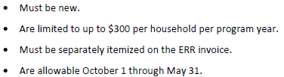

Ch 6 ERR
Timeframes for ERR Service
Limitations
Safety education & new Appendix 6F

Slide 9

Ch 6 ERR – Timeframes for ERR Service
Temporary lodging
Lead with this option
Staying with family, friends, or using other community resources

Slide 10
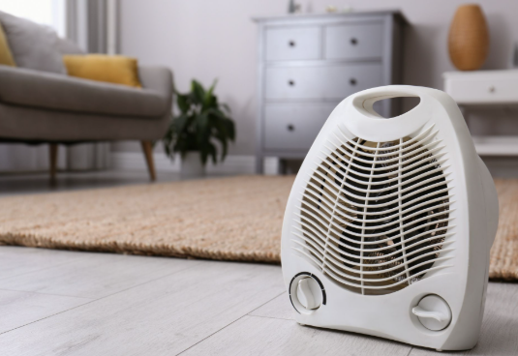
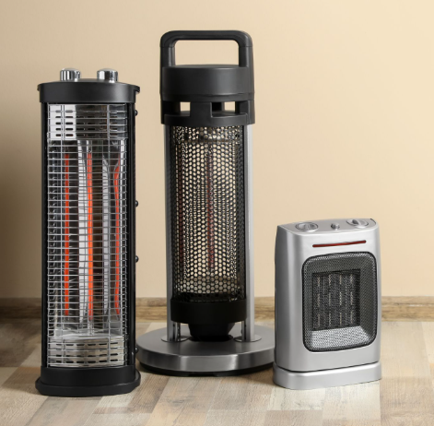
Ch 6 ERR – Timeframes for ERR Service
MC-supplied space heaters
Only used if HH is unable to find temp housing to keep safe
SPs should use MCs that have the ability and commitment to supply these
May be loaned or new
  If new, limited to $300 per HH per program year and must be separately itemized on the ERR invoice
  Allowable Oct 1 through May 31

Slide 11

Ch 6 ERR – Timeframes for ERR Service
Hotel stay
  Only allowed if HH cannot find temp housing and MC cannot provide timely temp heat
  SP must request approval through their Program Performance Auditor or eap.mail before expending funds
  Allowable for up to two (2) nights
  Some SPs have asked about hotel type – use reasonable standard accommodations

Slide 12

Ch 6 ERR – Timeframes for ERR Service
Education Requirements
  HH is responsible for protecting their dwelling – reminders are helpful
  SP or MC must provide education on preventing water system freezing
  Space heater education
New!

Slide 13
Space Heater Safety

Slide 14

Ch 6 ERR – Space Heater Safety
Space Heater Safety - Appendix 6F
One-pager from National Fire Protection Association
Highlights important safety precautions when using a space heater
SPs should provide this resource to their mechanical contractors
Also referenced in Ch 16 MC chapter

Slide 15
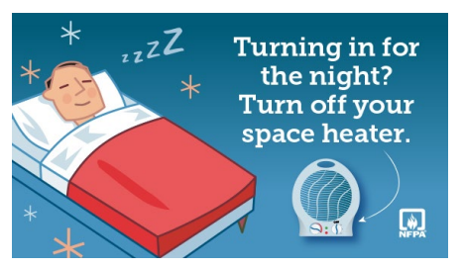
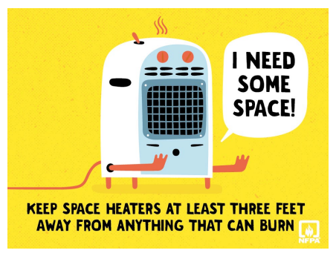
Ch 6 ERR – Space Heater Safety
Appendix 6F
The second page provides optional images useful for social media

Slide 16

Ch 6 ERR – Space Heater Safety
Questions about space heater safety
Does an MC need to provide space heater safety even if the space heater is loaned out to the HH?
Yes, there is no distinction between loaners/owners
Does the safety info need to be provided to the HH in paper form?
The policy is silent. SPs may use either, but should be aware that paper distribution may have added benefits for HHs
Is it mandatory that Appendix 6F is used?
Other versions are acceptable; App 6F is one good example from the NFPA. Social media or website outreach resources on p2 are also included

Slide 17
ERR Entry into eHEAT

Slide 18
Ch 6 ERR
ERR Entry into eHEAT section Ch 6 p17
No policy changes
Manual updates with process steps for added clarity
FY26 EAP Policy Manual language updates

Slide 19
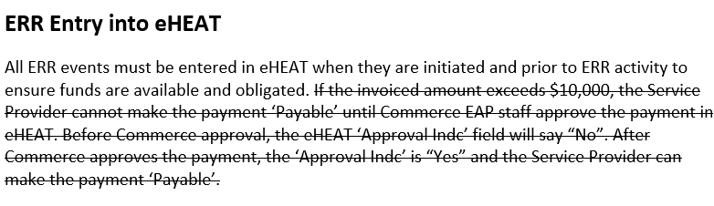
Ch 6 ERR – Entry Over $10,000
Prior policy did not provide specific steps
Steps are helpful, especially if infrequently used
FFY25

Slide 20
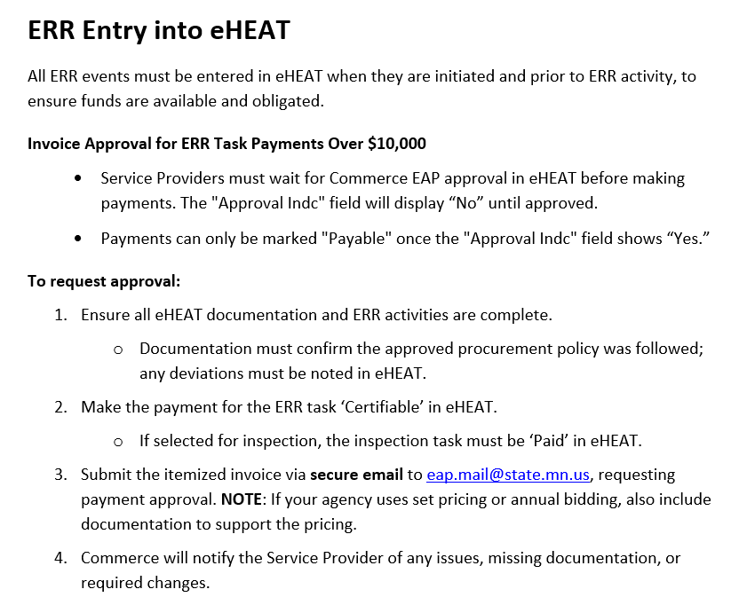
Ch 6 ERR – Entry Over $10,000
FFY26
ERR Entry into eHEAT section
ERRs > $10,000 require the “Approval Indc” field to show “Yes”
FFY26 policy includes steps to request approval

Slide 21
Ch 6 ERR – Entry Over $10,000
ERR Entry into eHEAT – steps for ERR over $10,000
Ensure all eHEAT info and ERR activities are complete
  Documentation must confirm the approved procurement policy was followed; any deviations must be noted in eHEAT
  Make the payment for the ERR task ‘Certifiable’ in eHEAT
If selected for inspection, the task must be ‘Paid’ in eHEAT
Email itemized invoice to eap.mail@state.mn.us
  Set or annual bidding agencies should also include documentation to support the pricing
Commerce will notify SP of any issues

Slide 22
ERR File Documentation

Slide 23
Ch 6 ERR
ERR File Documentation – Ch 6 p23
No policy changes
Formatting changes for clarity
Reminder: ERR File Documentation section highlights all requirements
  Applicable to all ERR
Notes:
Manual J (or equiv.) if required, homeownership documentation, completion cert, completed and paid inspection task in eHEAT and replacement inspection tool, itemized invoice, commerce approvals, if necessary (ERR fuel, ownership or other exceptions), bids/work orders, eHEAT data entry including notes. See Manual for exhaustive list p23-24. Reiterate the same requirements regardless of invoice amount.

Slide 24
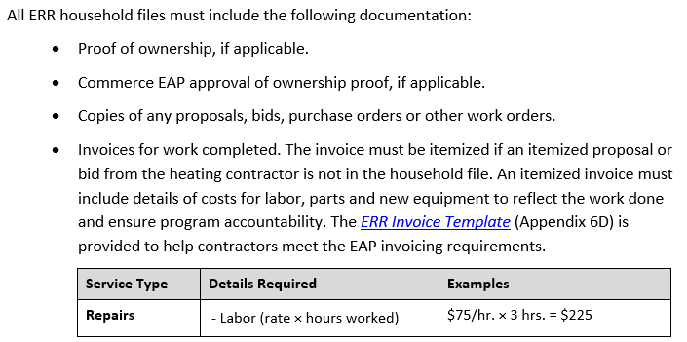
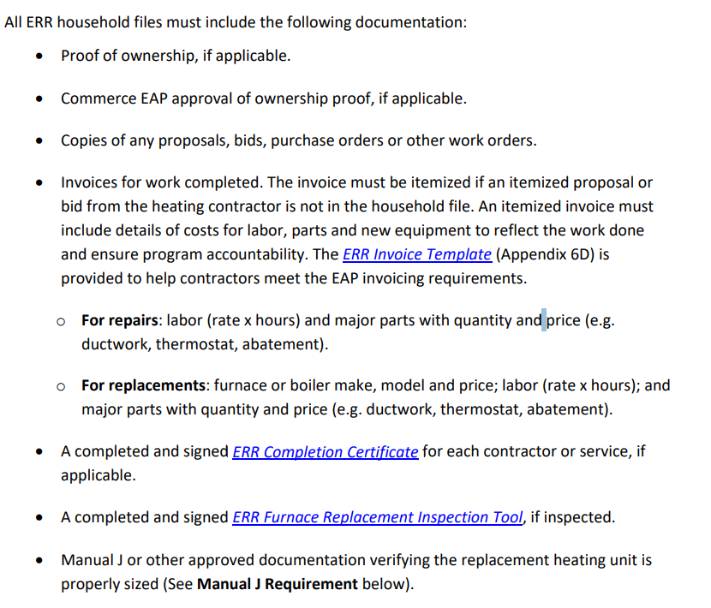
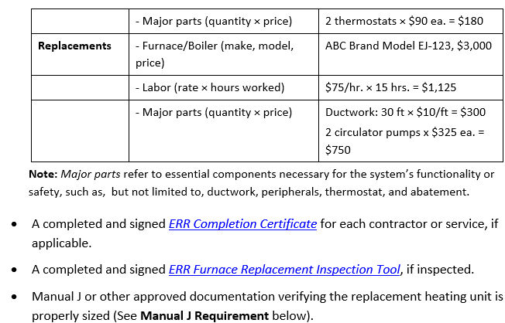
Ch 6 ERR – File Documentation
OLD from FFY25

Slide 25
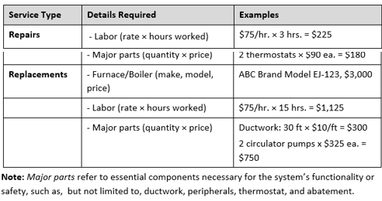

Ch 6 ERR – File Documentation
Table format with examples
“Major Parts” defined
  Essential components necessary for the system’s functionality
  Ex. ductwork, peripherals, thermostat, abatement
Notes:
Documentation requirements are the same for all ERR, regardless of invoice amounts.

Slide 26
Fuel Changes

Slide 27
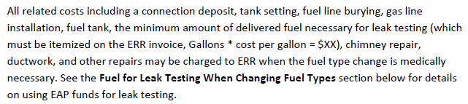
Ch 6 ERR – Fuel Changes
Medically Necessary Fuel Type Changes
Added allowable min fuel for leak testing, when required
Organized differently
Same costs as considered in an elective fuel change analysis
FFY25
FFY26
Added to Manual in FFY26

Slide 28
Ch 6 ERR – Fuel Changes
Elective Fuel Type Changes – Ch 6 p11
Added allowable min fuel for leak testing, when required
Added clarity for items required in cost analysis
Removed “LP” – applies to all fuel lines
Previously, these costs were not explicitly stated

Slide 29
Fuel for required Leak Testing

Slide 30
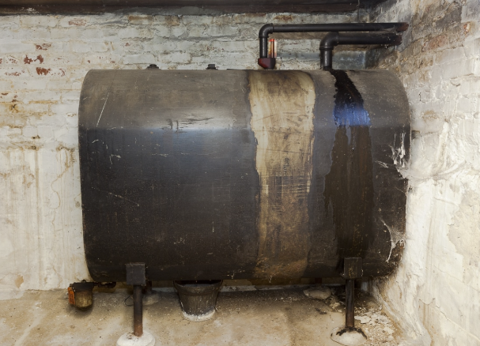
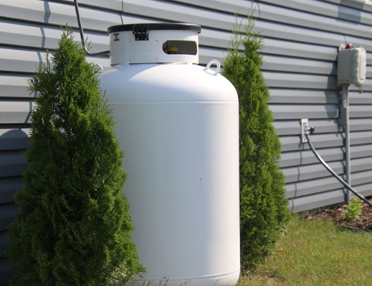
Ch 6 ERR – Fuel Changes requiring Leak Testing
Required Leak Testing with fuel changes Ch 6 pp 12-13
Policy addition: Describes when fuel for leak testing is allowable when an ERR replacement is being done along with a fuel change out

Slide 31
Ch 6 ERR – Fuel Changes requiring Leak Testing
All three benefit types may be used
HH or SP may also contribute with non-EAP funds
Order of benefits used to pay for leak testing:
  PH
  Crisis (only if PH exhausted)
  ERR (only if both PH & Crisis are exhausted)

Slide 32
Ch 6 ERR – Fuel Changes requiring Leak Testing
Includes the minimum amount of delivered fuel necessary for leak testing
Must be itemized (Gallons * cost per gallon = $XX)
Preference to have MC obtain fuel and add to ERR invoice
  Options exist to set up EV in eHEAT if not already an EAP EV
  Contact eheat.doc
  If EV is doing mechanical contractor work, they must register as an MC & sign a full MC agreement
  Service Providers must include ERR Task notes

Slide 33
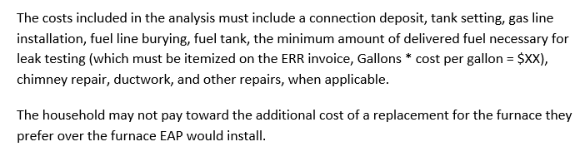
Ch 6 ERR – Fuel Changes requiring Leak Testing
Required Leak Testing with fuel changes
Reminder: Leak testing costs must be part of your cost analysis when doing elective fuel changes Ch 6 p 11

Slide 34
Ch 16 Mechanical Contractors

Slide 35
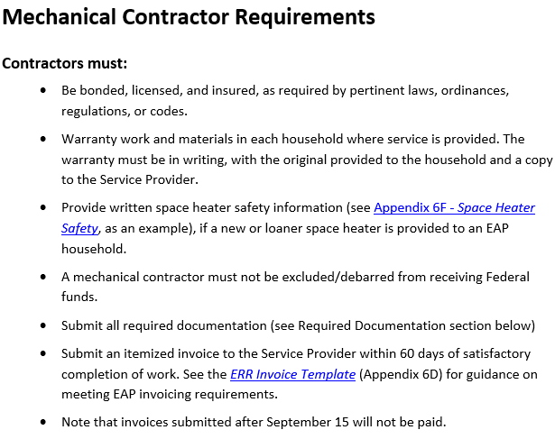
Ch 16 – Mechanical Contractors
Added requirement to provide written space heater safety info
Temporary loaned or purchased new and provided to the HH to keep
No other changes

Slide 36

Q&A

