Slide 1

Energy Assistance Program
FFY26 Annual Training
Addressing Crisis Before Funding is Available;
Ch 3 – Crisis

Slide 2
Addressing Crisis Before EAP Funding is Available
Ernest McCann

Slide 3
Addressing Crisis Before EAP Funding is available
New wording for FFY26 policy manual (Ch 5, p 12)
Changes made for clarity and consistency
Table is removed, use Option A or B at your discretion

Slide 4
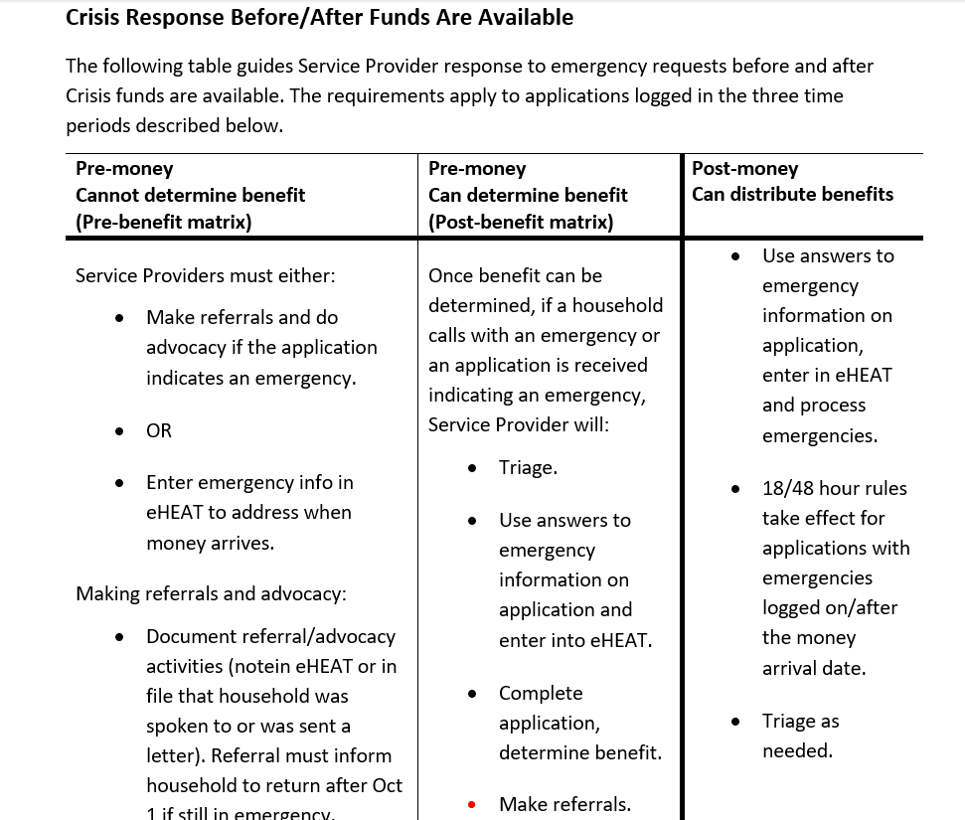
Addressing Crisis Before EAP Funding is available

Slide 5
Addressing Crisis Before EAP Funding is available
Crisis Response Before Funds Are Available
When a household has an energy emergency before Crisis funds are available, Service Providers must do one of the following:

Slide 6
Addressing Crisis Before EAP Funding is available
Option A: Make referrals and advocate for the household
Address the situation by making referrals and/or advocating on behalf of the household. The household must be told to call back after November 1 if referral and advocacy activities do not resolve their emergency. (Service Providers are not required to determine the outcome of referral activities.) These activities must be documented in a household’s Application Notes in eHEAT. Commerce may audit these notes for completeness and reasonableness as part of routine monitoring activities. After referral/advocacy activities have been documented, Service Providers must return the application to log date order for further processing

Slide 7
Addressing Crisis Before EAP Funding is available
Option B: Enter the emergency in eHEAT to process later
Create a new Crisis request in eHEAT and enter the emergency information for processing after funds become available. If Service Providers can determine a Primary Heat benefit for the household, they may also determine the Crisis benefit amount even if funding is not yet available. Once funding is available, normal Crisis policies apply to these emergencies

Slide 8

Example #1
October 1, Pierre submits their EAP application which indicates they have no heating fuel
Option A
Refer Pierre to local community resources
Ask that Pierre reach out after November 1 if they need Crisis assistance
Document efforts in eHEAT
Return application to log date order for processing
Option B
Create a new Crisis request in eHEAT and enter emergency info for processing when Crisis funding becomes available
If Primary Heat benefit can be determined, also determine the Crisis benefit

Slide 9

Example #2
October 1, Betty submits their EAP application which indicates their heat is currently shut off, their account is with a vendor you’ve worked with for years
Option A
Refer Betty to local community resources and connect with the vendor
Ask that Betty reach out to you after November 1 if they still need Crisis assistance
Document efforts in eHEAT
Return application to log date order for processing
Option B
Create a new Crisis request in eHEAT and enter emergency info for processing when Crisis funding becomes available
If Primary Heat benefit can be determined, also determine the Crisis benefit

Slide 10

Q & A

Slide 11
Q&A

Slide 12
Ch. 5 – Crisis
Mandy Braaten

Slide 13
Crisis
Topics
Name on Account
Crisis Eligibility Decision Chart (Appendix 5A)

Slide 14
Name on Account

Slide 15
Crisis Eligibility
HH accounts not in the name of a HH member listed on the original app are not eligible for Crisis
Payments can only be made to accounts in a HH member’s name
If someone new joins the HH after the app is approved and the energy vendor account is in their name, they are not eligible for Crisis for that account
The account must be in the name of a HH member who was part of the original app
(Ch. 2 – Crisis, p. 2-5)

Slide 16


Crisis Eligibility
  A HH can establish or re-establish an energy account in a HH member’s name utilizing Crisis funds (e.g., deposit)
    HH must be eligible for Crisis
    Account must be established prior to Crisis payment being paid to that account
    SP should not re-determine PH benefits if HH gets the account in their name after app approval
Crisis funds may be used to assist HH with a shared meter but only if the name on account matches a HH member listed on the original app

Slide 17
Crisis Eligibility
  HH accounts in a landlord's name are not eligible for Crisis
    Effective January 1, 2025, state legislation (Minn. Stat. 504B.216, subd. 12) prohibits a landlord from disconnecting a tenant’s utility service for failure to pay utility service charges.
  If landlord disconnects service
    Negotiate with utility company on behalf of HH
    HH contact PUC’s Consumer Affairs Office (https://mn.gov/puc/consumers/)
    Additional info tomorrow during presentation from Attorney Generals Office

Slide 18
Crisis Eligibility Decision Chart
Appendix 5A
Use to determine if HH is eligible to receive a Crisis benefit
Great tool for new staff

Slide 19
Scenarios

Slide 20
Scenario 1
Annabelle emailed a request for Crisis as she received a disconnect notice from her electric company in the amount of $500. The electric account is in her niece's name, but the LP account is in Annabelle’s name. Annabelle received PH funds that were paid to her LP vendor, however, these funds have been exhausted. The niece lives across town and cannot help pay the electric bill. Is the HH eligible for Crisis funds?

Slide 21
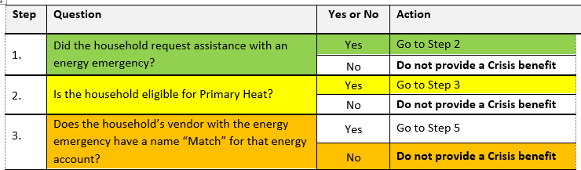
Scenario 1
HH requests Crisis
Received PH for Electric
No PH funds remain
Received disconnect notice from electric company
Elec in niece’s name
Niece lives in another HH
Decision: HH is not eligible for Crisis

Slide 22
Scenario 2
  Arnold would really like help with his fuel bill. He moved into a fabulous rental and was even happier to hear the fuel bill was in the landlord's name, however, the landlord just called to advise Arnold the tank is at 5% and the landlord is unable to fill the tank. We assisted Arnold with PH funds towards his electric account. Can we provide Crisis assistance to Arnold for fuel?

Slide 23
Scenario 2
HH requests Crisis
Received PH for electric
At 5% in LP tank
LP in landlord's name
Landlord unable to pay for delivery
Decision: HH is not eligible for Crisis

Slide 24
Scenario 3
  Zillia called and is at 32% in her LP tank. She has $100 in PH funds remaining but was told by her energy vendor they cannot deliver for that amount. They explained in detail how costly it is to get the truck out on the road, let alone deliver only $100 in PH funds. Is there anything we can do to help Zillia get a delivery?

Slide 25
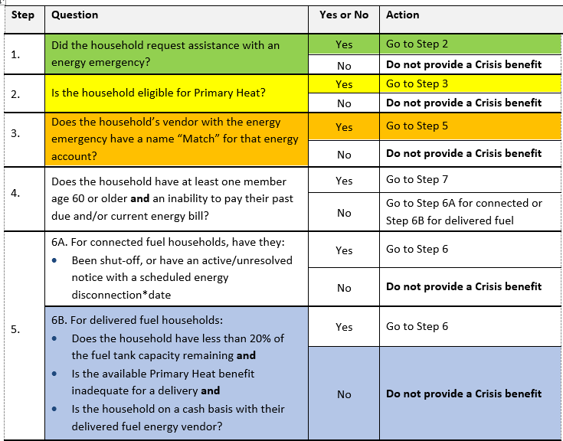
Scenario 3
HH requests Crisis
Received PH for LP
Has $100 in PH funds remaining
Refusal to deliver
LP account in HH name
At 32% in LP tank
Decision: HH is not eligible for Crisis

Slide 26
Scenario 4
  Smith called for help with an LP delivery. Smith’s LP account is in his name, but he has used all his PH money. He is at 10% and his energy vendor has refused to deliver unless Smith can pay at time of delivery. Smith has no money and is unable to comply with the energy vendors requirements. He is extremely grateful his electric heat isn’t on off peak so his house will remain heated, however, it is so expensive to run. Can we help Smith with a Crisis fuel delivery?

Slide 27
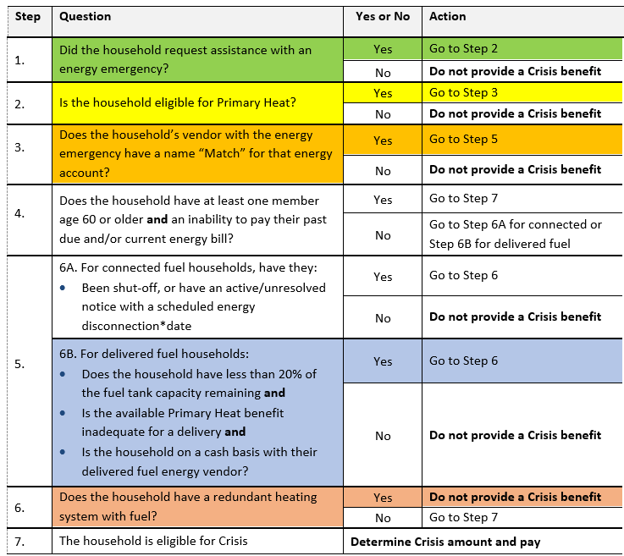
Scenario 4
HH requests Crisis
Received PH for LP
LP account in HH name
At 10% in LP tank
Has no PH funds remaining
Refusal to deliver
Redundant electric heat
Decision: HH is not eligible for Crisis

Slide 28

Q&A

