Slide 1

Energy Assistance Program
FFY26 Annual Training
Ch 3 – Program Eligibility Requirements;
DEED Guidance

Slide 2
Ch. 3 – Program Eligibility
Marissa Squires

Slide 3

Ch. 3 Program Eligibility
Extreme Minnesota
World’s quietest room is in Orfield Laboratories
in Minneapolis
It absorbs 99.99% of sound
Orfield Laboratories is also home to Sound 80 Studios
  Bob Dylan and Prince recorded there
  Saint Paul Chamber’s Orchestra’s “Appalachian Spring,” which became the first piece of digital classical music to win a Grammy
https://www.orfieldlabs.com/about
https://www.google.com/url?sa=i&url=https%3A%2F%2Fwww.smithsonianmag.com%2Fsmart-news%2Fearths-quietest-room-you-can-hear-yourself-blink-180948160%2F&psig=AOvVaw3eobNhxNyIcwZoe8oyghxf&ust=1753203813353000&source=images&cd=vfe&opi=89978449&ved=0CBYQjRxqFwoTCMiSmKm3zo4DFQAAAAAdAAAAABAE

Slide 4

Ch. 3 Program Eligibility
Topics
Dividend Income
Update to UI Benefits
Verification of Income & Expenses (VIE) - Appendix 3D
Affidavit Declaring Change in Income (Affidavit) - Appendix 3K

Slide 5
Ch. 3 Program Eligibility
Dividend Income
Income Inclusions and Exclusions – Appendix 3A: when the IRS Form 1040 is used as dividend income proof
  Previous direction: Count both ordinary (found on line 3b) and qualified dividends (found on line 3a) as HH income
  FFY26 Manual change: only count ordinary dividends (line 3b) as HH income
(Ch. 3 – Program Eligibility Requirements, p. 20)

Slide 6
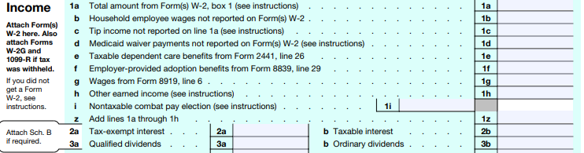
Ch. 3 Program Eligibility
Dividend Income
Why just line 3b?
  Ordinary dividends include the qualified dividends and are only separated on the tax form as they are taxed at a different rate

Slide 7

Ch. 3 Program Eligibility
Update to UI Benefits
There were issues last fall with DEED data of UI benefits
  Continue to use the DEED UI data as presented or can use HH provided UI documentation
  Online Income Verification Appendix 3G
(Ch. 3 – Program Eligibility Requirements, p. 43)

Slide 8
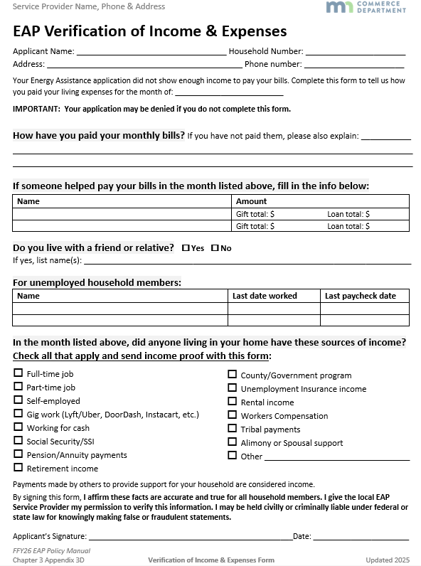
Ch. 3 Program Eligibility
VIE - Appendix 3D
Updated version

Slide 9
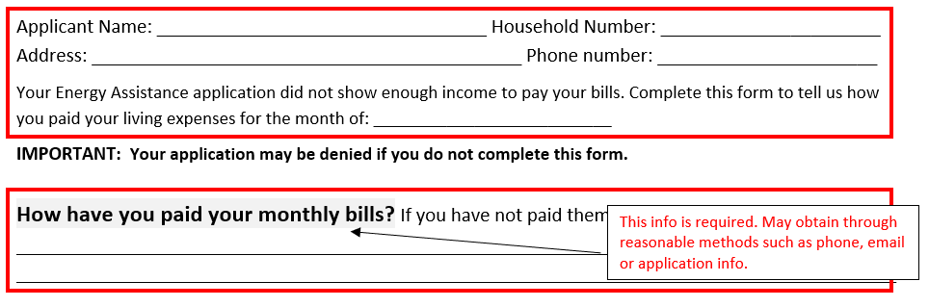
Ch. 3 Program Eligibility
Notes:
Changed the monthly bills from check boxes to free form.

Slide 10
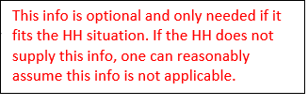
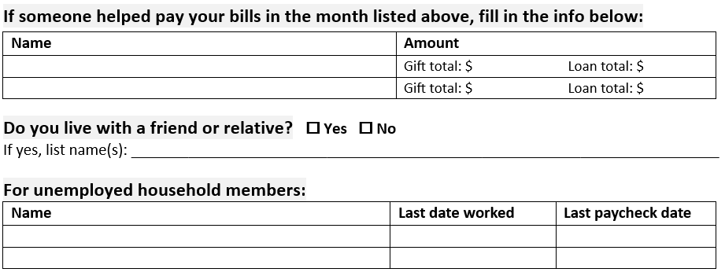

Ch. 3 Program Eligibility
Notes:
Simplified the rest of the form too/ some formatting changes

Slide 11
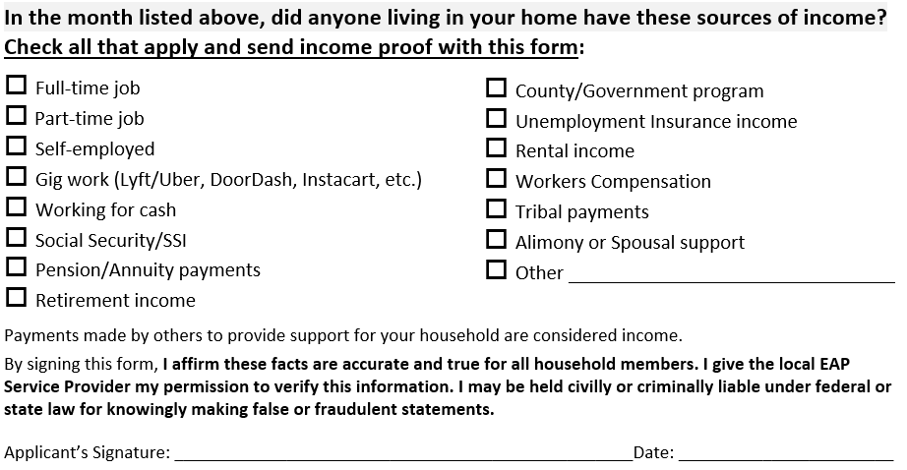
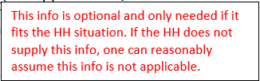
Ch. 3 Program Eligibility
The VIE must be signed by one of the EAP application’s named members (see Ch. 2 Signature Requirements section).
If VIE is signed, but missing the date, use the date received or postmarked date, whichever is earlier, as the signature date.

Slide 12
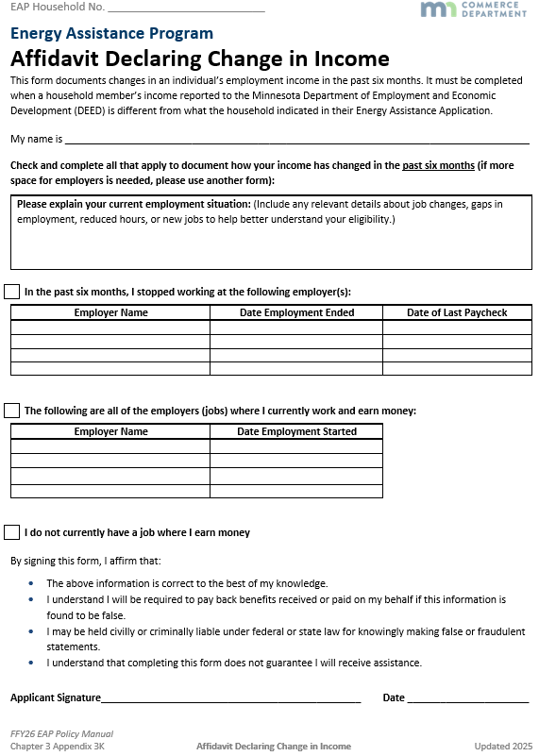
Ch. 3 Program Eligibility
Affidavit - Appendix 3K
Updated version
Also available
  As a Request for Information letter attachment
  English fillable
  Spanish
  Spanish fillable

Slide 13




Ch. 3 Program Eligibility
New
Same as FFY25, formatting changed
Notes:
Formatting changed for each section/question into a table format
Questions are the same, added the first question.

Slide 14
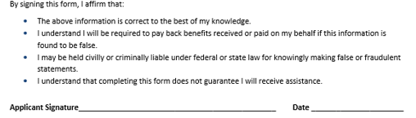
Ch. 3 Program Eligibility

Slide 15
Q&A

Slide 16
DEED Guidance
Andy Grewell

Slide 17
DEED Guidance & Appendix 3L
Topics
  Policy background & FFY25 changes
  Changes to FFY26 policy manual
  Appendix 3L: DEED Wage Income & Unemployment Insurance (UI) Scenarios
  Quiz!
  Q&A

Slide 18
DEED: Policy background & FFY25 changes
We’re through a full year!
  Using DEED is now more familiar; a bit of a shaky start, but we adapted, learned, and finished strong
  There were minimal Commerce-level appeals
  The tech worked
  Reduced RFIs by ~4,000 across the state (= fewer denials)
  Discussed DEED info handling at 3+ JAD sessions

Slide 19

DEED: Policy background & FFY25 changes
Looking back at policy changes issued in the Energizer:
  Handling DEED income clarification - Complete wage information provided with application
  Denied HH reapplication guidance
  Accept/Bypass worksheet
  Handling unemployment insurance updates
  When DEED is down
Notes:
Most of these changes were right away in Oct or Nov
Last was Feb

Slide 20

DEED: Policy background & FFY25 changes
Energy Conference presentation - Into the Weeds: DEED Wage Data and eHEAT Enhancements:
tinyurl.com/4ed5wh5t
Also available in EZ # 36
Published 6/3/25

Slide 21
DEED: Changes to FFY26 policy manual – Ch. 3
The Earned Income Documentation section was renamed to Wage Income Documentation
New guidance was added to the Wage Income Documentation section, including general information on the use of wage data and Unemployment Insurance income information from the DEED database

Slide 22

DEED: Changes to FFY26 policy manual – Ch. 3
New subsections include:
  Deciding when to use DEED versus HH-provided income documentation
  Reconciling DEED Wage Income and Unemployment Insurance (UI) Income
DEED Earned Income Scenarios information is now solely contained in Appendix 3L

Slide 23

DEED: Changes to FFY26 policy manual – Ch. 3
Wage Income Documentation section revamped
  Now organized around this key question: has the HH’s income recently changed? If no, we use DEED.

Slide 24

DEED: Changes to FFY26 policy manual – Ch. 3
So… what constitutes a change?
  Inconsistencies between the HH’s application responses and DEED
  New information obtained that suggests a change – written or verbal

Slide 25

DEED: Changes to FFY26 policy manual – Ch. 3
So… what constitutes a change?
  Inconsistencies between the HH’s application responses and DEED
    Application says income decreased
    DEED shows more employers than indicated on application
    Application and DEED employers do not appear to be the same
    Last date worked is during or before the eligibility month
Notes:
DEED shows more employers than indicated on application (via “# of employers” or “Income Y/N”)

Slide 26
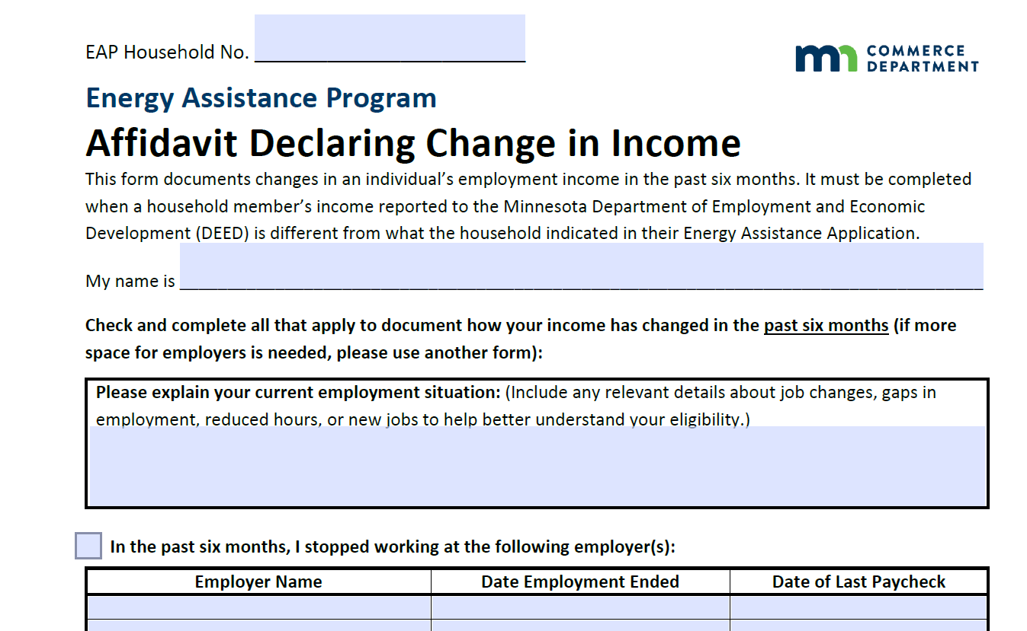
DEED: Changes to FFY26 policy manual – Ch. 3
So… what constitutes a change?
  New information obtained that suggests a change – written or verbal
    Any verbal reports of income changes should be documented in the ‘Application Notes’ field
    Always use an Affidavit Declaring Change in Income to document any of the income changes above.

Slide 27
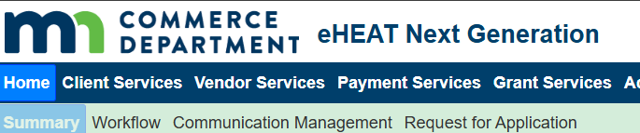
DEED: When to use DEED vs. HH income data
When to use data:
  It is available, it matches the application details, and there is no indication of a recent income change, and
  The HH does not provide complete wage income documentation for all employers listed in DEED for the eligibility month.
DEED
Notes:
Change this series -

Slide 28

DEED: When to use DEED vs. HH income data
HH-provided
Use HH-provided data when:
  The HH provides complete wage income documentation for all employers listed in DEED for the eligibility month, or
  DEED wage income data is unavailable for a specific employer

Slide 29
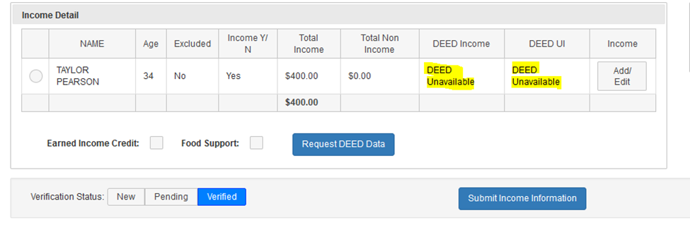

DEED: When to use DEED vs. HH income data
Use HH-provided data when:
  When “DEED Unavailable” is shown in the HH’s Income Detail screen due to DEED connection disruption.

Slide 30
DEED: When to use DEED vs. HH income data
Use HH-provided data when:
  If any employer in the DEED data is no longer current, ignore all DEED information and collect current wage income documentation for all employers from HH - partial DEED data is not acceptable

Slide 31

DEED: When to use DEED vs. HH income data
Summary
If an applicant’s income has changed in the past 6 months:
  They must submit complete pay stubs from each of their current employers
  If they’ve stopped working at an employer DEED says they have, they must submit an Affidavit Declaring Change in Income
Notes:
SPLIT

Slide 32
DEED: When to use DEED vs. HH income data
Summary
If an applicant’s income has not changed in the past 6 months:
  We use DEED wage data unless the applicant has submitted pay stubs for all DEED employers
  If the application says this person has more employers than DEED shows, we request pay stubs for these additional employers
Notes:
SPLIT

Slide 33

DEED: Changes to FFY26 policy manual – Ch. 3
Reconciling DEED Wage Income and Unemployment Insurance (UI) Income. When HHs have UI:
  Accept the DEED UI information.
  Confirm the employment situation; UI payments may indicate that employers listed in DEED is no longer accurate
  Request income documentation and require completion of the Affidavit Declaring Change in Income

Slide 34
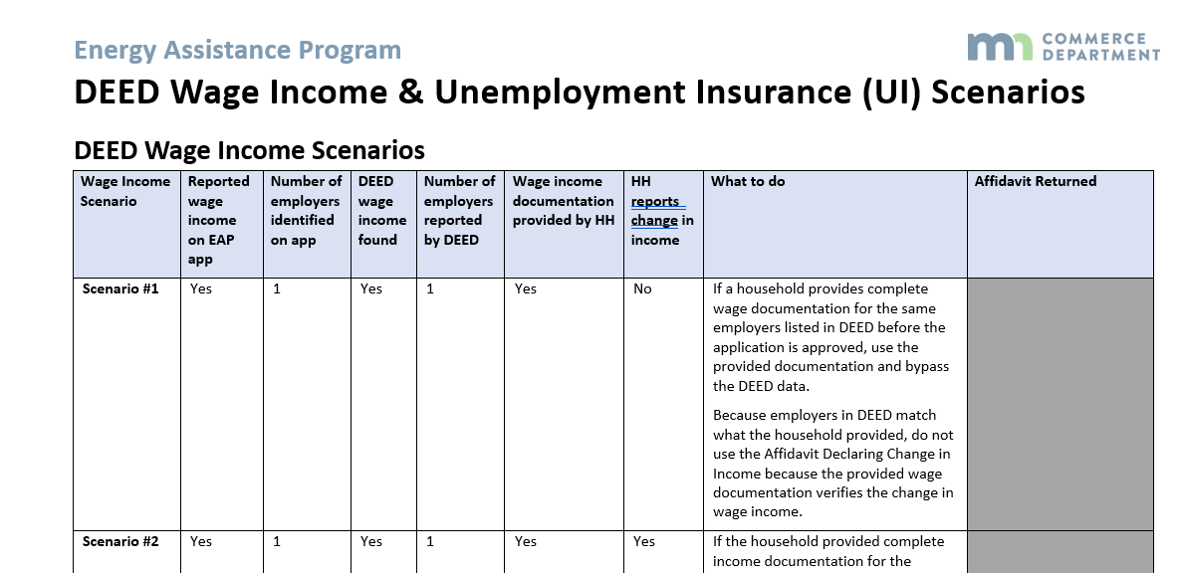
DEED: Appendix 3L
Appendix 3L: DEED Wage Income & Unemployment Insurance (UI) Scenarios
Added new scenarios, including when application is missing info or info is omitted
Use as reference for training

Slide 35
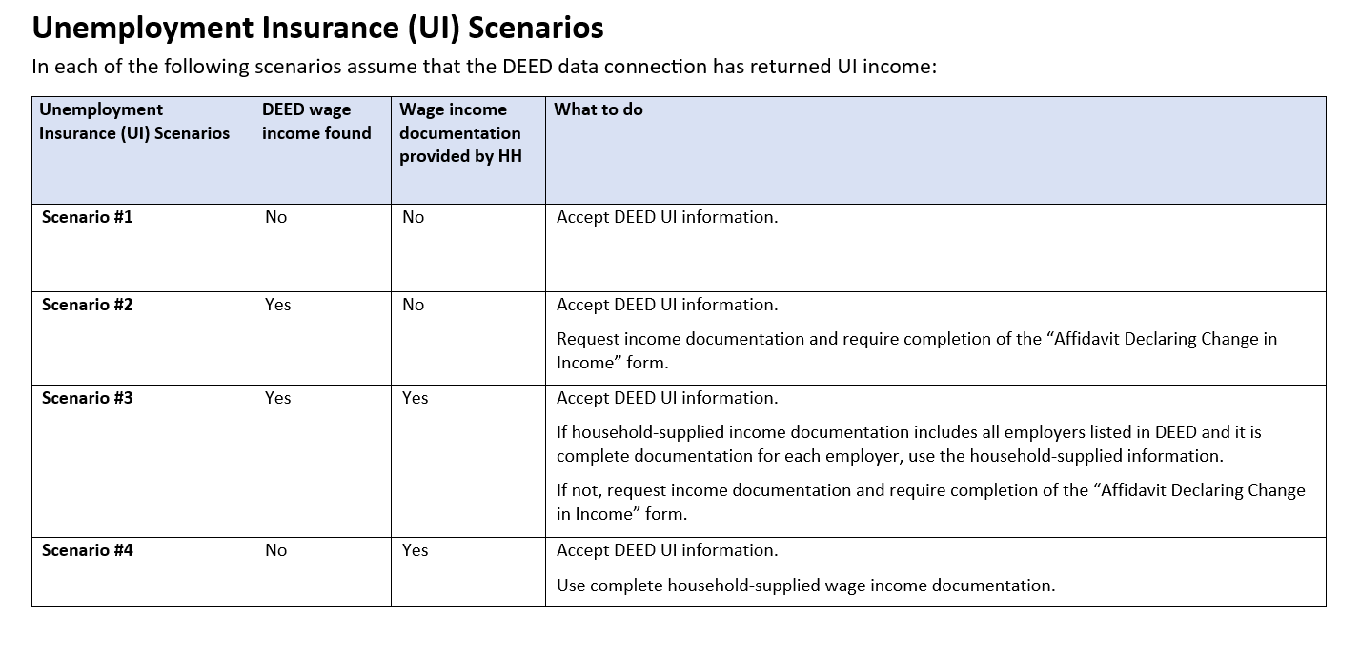
DEED: Appendix 3L
Appendix 3L: DEED Wage Income & Unemployment Insurance (UI) Scenarios
Added UI scenarios section
Use as reference for training

Slide 36

DEED Guidance & Appendix 3L
Quiz!

Slide 37
Quiz Review
The quiz covers some common scenarios (but not all possible ones)
  HH submits incomplete pay stubs, but DEED is available
  HH has DEED income but no longer works
  HH has DEED income from multiple quarters
  HH has an employer that doesn’t report to DEED
  DEED shows more employers than HH indicates
  HH submitted paystubs for all DEED employers

Slide 38
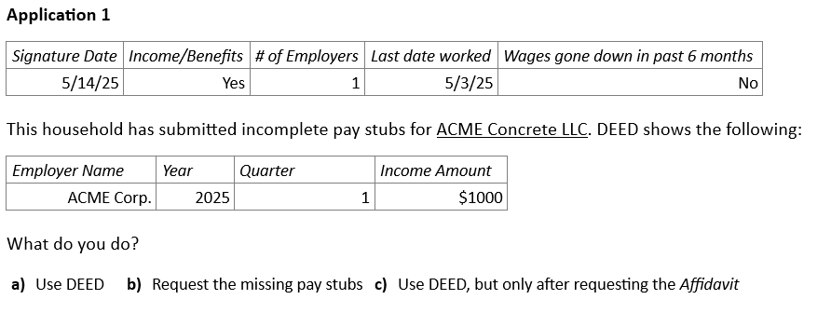

Quiz Review
We can use DEED because there is clearly no change in income during the eligibility period
Notes:
Make section bigger – font etc

Slide 39
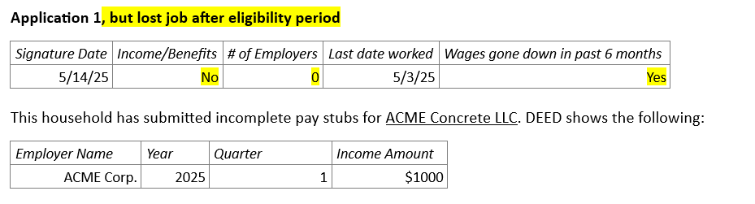
Other Examples
It’s possible the DEED data is accurate. But employment separations aren’t always clean; the applicant could have had reduced hours, pay withheld, etc. We need the affidavit and pay stubs to be confident about the HH’s income.

Slide 40
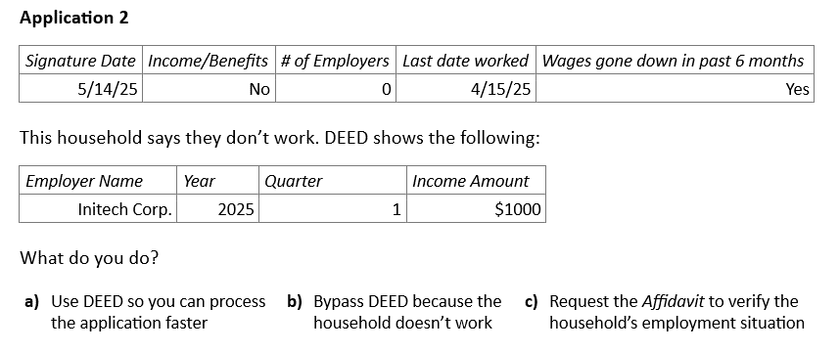
Quiz Review
We need the Affidavit to bypass DEED income

Slide 41
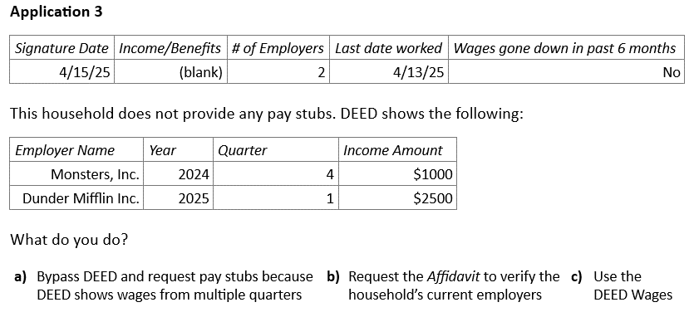
Quiz Review
During a reporting month, you may need to use data from multiple quarters

Slide 42
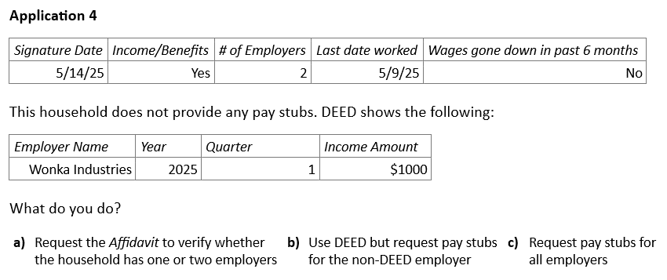
Quiz Review
If income hasn’t changed, you can use DEED wages plus pay stubs for employers that don’t report to DEED

Slide 43
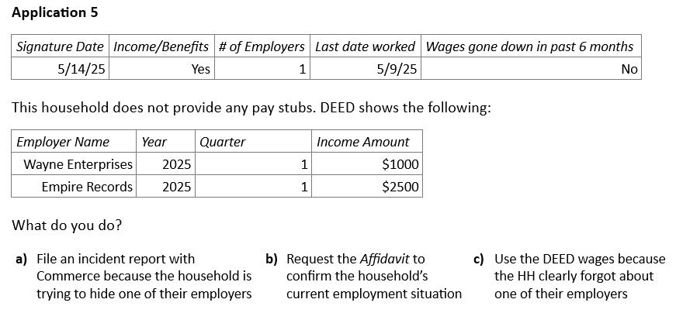
Quiz Review
If DEED shows employers the HH didn’t tell us about, we use the Affidavit

Slide 44
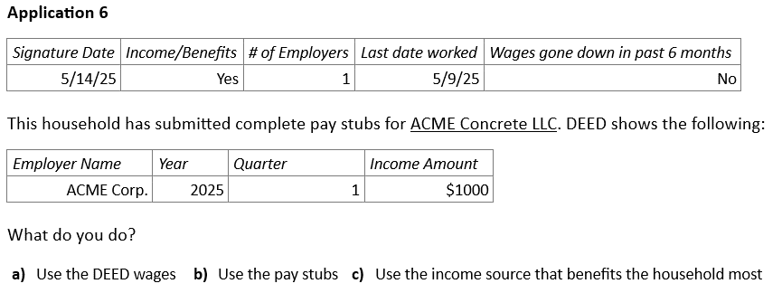
Quiz Review
If the HH provides complete pay stubs, we always use them

Slide 45
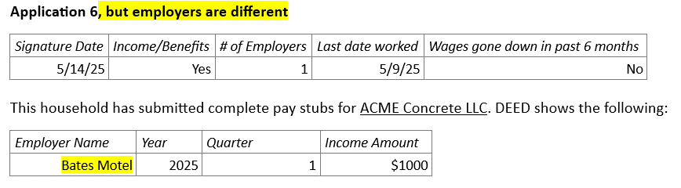
Other Examples
We can’t just accept the pay stubs because DEED is showing a different employer. We need the Affidavit to confirm that “# of Employers” is incorrect or that the applicant no longer works at the Bates Motel.

Slide 46
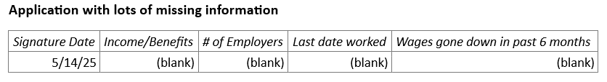
Other Examples
Because Income/Benefits and # of Employers were left blank (and complete HH-supplied income documentation was not provided) we would request the missing info.
Notes:
Income / Benefits = blank, # Employers = blank, no DEED = no income

Slide 47
Q&A

