Slide 1

Energy Assistance Program
FFY26 Annual Training
Ch 2 – Application Processing;
Application Requirements

Slide 2
Ch. 2 – Application Processing
Sandra Seemann

Slide 3
Ch 2 – Applications & Application Processing
Topics
New Application Requirements section
New Handling Applications Without Valid Signatures or With Composition Changes section
Application and Forms Submission and Signature Alternatives
Logging in Applications Received
Name on Energy Accounts, Additional Scenarios, Defining Name Mismatches
Manage Application Dropdown (Appendix 2C) additions
Safe at Home

Slide 4
Ch 2 – Applications & Application Processing
Application Requirements
An upcoming application requirements presentation will fully explain the changes in this chapter related to app requirements
  New Application Requirements section details what is required for an app to be considered valid
  New Handling Applications Without Valid Signatures or With Composition Changes section details handling these type of apps
(Ch. 2 – Applications & Application Processing, p. 13-14)

Slide 5

Ch 2 – Applications & Application Processing
Application & Forms Submission & Signature Alternatives
Updated this section to include forms
  Allowable application and form signatures include:
  Handwritten signature on mailed or delivered paper application or form.
  Handwritten signature on faxed or scanned documents. For example, an EAP household may take a picture of their completed, signed and dated paper application or form and email it to the Service Provider. The pictures must be legible.
  A picture of the text and handwritten signature below, electronically submitted along with a completed fillable PDF application or form.
(Ch. 2 – Applications & Application Processing, p. 14)

Slide 6

Ch 2 – Applications & Application Processing
Logging in Applications Received
Updated section to explain that after Sept. 15, SP must log both online and paper applications within one business day of receipt
(Ch. 2 – Applications & Application Processing, p. 15)

Slide 7
Ch 2 – Applications & Application Processing
Name on Energy Accounts
Extensive “Name on Energy Accounts” presentation up next
  Name on Energy Accounts section update - EV accounts can be designated as “Landlord Account” instead of “No Match” when account is in not a HH member’s name
    Definitions of account name matches/mismatches updated accordingly
  Also, if an EV keeps a deceased person’s name on the account for historical info, they must list a living HH member as the “owner” of the account
    And the deceased person cannot be listed as an account owner
(Ch. 2 – Applications & Application Processing, p. 18)

Slide 8
Manage Application Dropdown (Appx 2C)

Slide 9
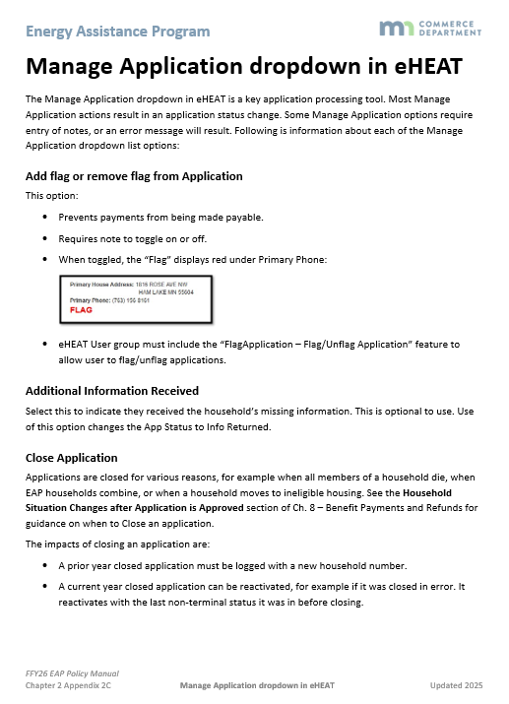
Manage Application Dropdown (Appx 2C)
Manage Application Dropdown (Appx. 2C) updates
  Added info on recent dropdown additions:
    Add flag or remove flag from application
    Edit log date
    Enter Application Notes before sending eHEAT Request for Info letter

Slide 10
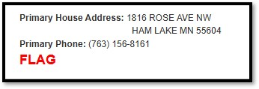
Manage Application Dropdown (Appx 2C)
  Add flag or remove flag from application
  This has been in eHEAT for awhile, but have added to Appx 2C
  Adding a flag:
  Prevents payments from being made payable
  Requires note to toggle on or off
  When toggled, “FLAG” displays under Primary Phone:
  eHEAT User group must include the “FlagApplication – Flag/Unflag Application” feature for users to have this ability

Slide 11
Manage Application Dropdown (Appx 2C)
  Edit log date
Only users whose assigned User Group includes the “Edit Log Date” can use this function
Editing the log date requires notes and cannot be a future date
Log date for Pre-logged and Approved apps cannot be edited
After app deadline, function is turned off and SPs must get Commerce EAP assistance to edit a log date

Slide 12
Manage Application Dropdown (Appx 2C)
Enter Application Notes before sending eHEAT Request for Information letter
  SPs can enter notes before sending RFI letter through eHEAT
  Notes are entered before hitting “Go” and proceeding to letter
  Must click “Save and Send” to save the notes

Slide 13
Safe at Home

Slide 14

Safe at Home
Safe at Home (SAH) – slight name change
Safe at Home “program” transitioned to Safe at Home “services” to better describe what Safe at Home provides

Slide 15
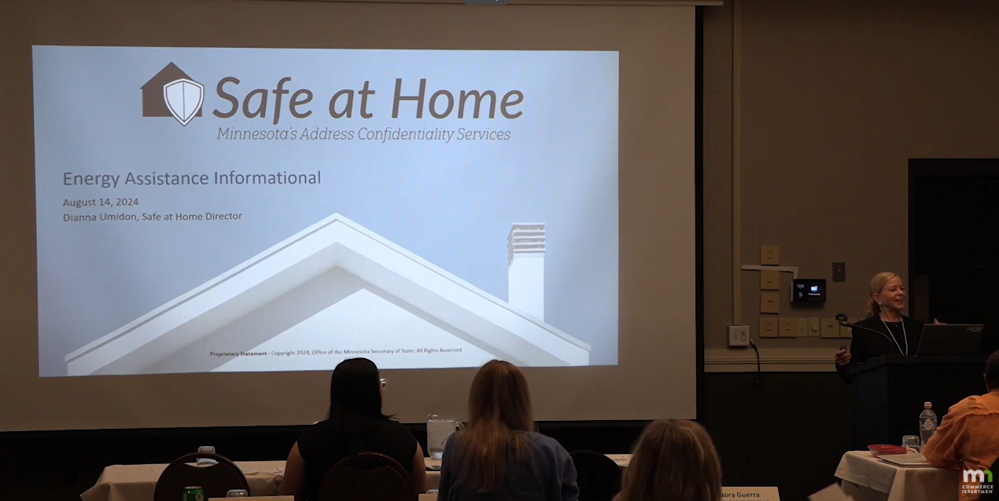
Safe at Home
SAH training videos
  SP EAP staff must watch SAH videos at start-up and for new staff on-boarding
    Training by Dianna Umidon from Safe at Home
      PPT version; recording
    EAP-specific SAH training
      PPT version; recording

Slide 16
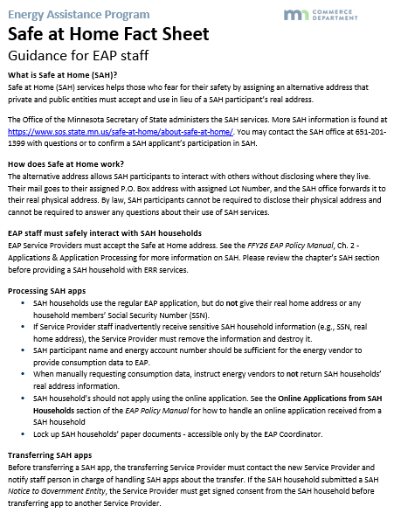
Safe at Home
SAH resources
SAH Fact Sheet for EAP staff
  How staff safely interact with SAH HHs and process their app
  On EAP Toolkit http://mn.gov/commerce-stat/pdfs/sah-fact-sheet.pdf

Slide 17
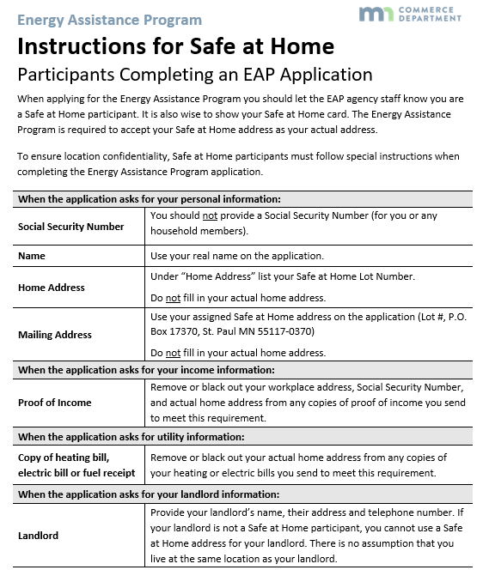
Safe at Home
SAH resources
  Instructions for Safe at Home Participants Completing an EAP Application (Appendix 2A)
  On EAP Toolkit: http://mn.gov/commerce-stat/pdfs/instruct-sah-completing-eap-app.pdf

Slide 18
Q&A

Slide 19
Application Requirements
Mandy Braaten

Slide 20
Application Requirements
Topics
Defining a valid application
Handling applications without signatures
Defining a new application
  Before approval
  After approval

Slide 21

Application Requirements
Commerce received several appeals/questions from SPs
  How to handle apps with new signature pages
  How to handle HH composition changes
  Historically the program treated a “new” signature page as a new app
  Manual not clear on what was and was not a new application
  Manual did not clearly describe how to handle changes in the HH
Policy discussed at mini-JAD in June
Policy language drafted and reviewed by JAD SME
FFY26 EAP Manual updated

Slide 22
Defining a Valid Application

Slide 23
Application Requirements
To be considered valid, an app must:
  Be a current year app with a signed signature page;
  Have at least one HH member listed;
  Include a signature by a listed HH member or a person authorized to sign on behalf of a listed HH member, and
  Be postmarked or received by EAP on or before the app deadline
eHEAT enhancement will prevent energy vendors from viewing invalid apps
(Ch. 2 – Applications & Application Processing, p. 13)

Slide 24


Application Requirements
    Suzy submitted an app including HH members, income, energy vendor info and her signature. When staff came to log the app, they realized the app was from the prior program year. No changes were made to the app since last year, is this app valid?
      No, an app must be from the current program year

Slide 25
Application Requirements
    A HH submitted an app with no HH member info. The app advised 4 people live in the HH. SP verified last year’s app shows the 4 HH members with associated info. Can SP use last years info on current year app?
      No, an app is not valid if it does not have at least 1 HH member listed. In this case, the app must include the 4 members living in the home at the time of applying.

Slide 26
Handling Applications Without Signatures

Slide 27
New Process Ch2, p 13-14
HH without valid signatures or with composition changes:
Log app
Send request for info
Requiring completed signature page
Do not add a signature date in eHEAT
Inform HH app is not valid until received
Withdraw app in eHEAT
eHEAT enhancement in the works
If emergency was identified on app, attempt to call HH
Inform HH app is invalid
Document efforts in eHEAT
No additional follow up is required

Slide 28
Application Requirements
Do not request or share info with third parties
HH has not consented to sharing info (e.g., consumption, DEED, UI)
If number of HH listed on app differs from “How many people live in your home”, do not consider invalid
Opportunity to ask HH questions to determine accurate info
Proceed accordingly
(Ch. 2 – Applications & Application Processing, p. 13)

Slide 29
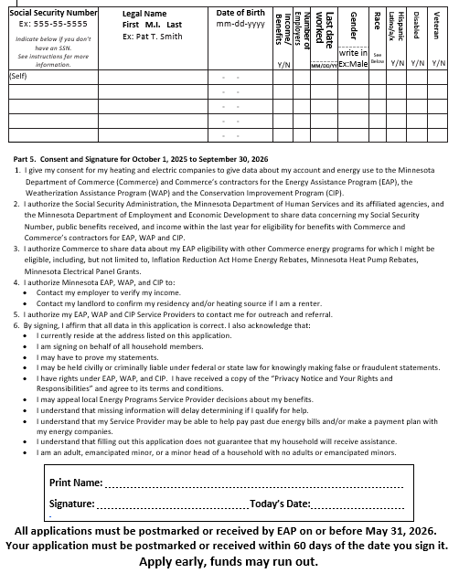
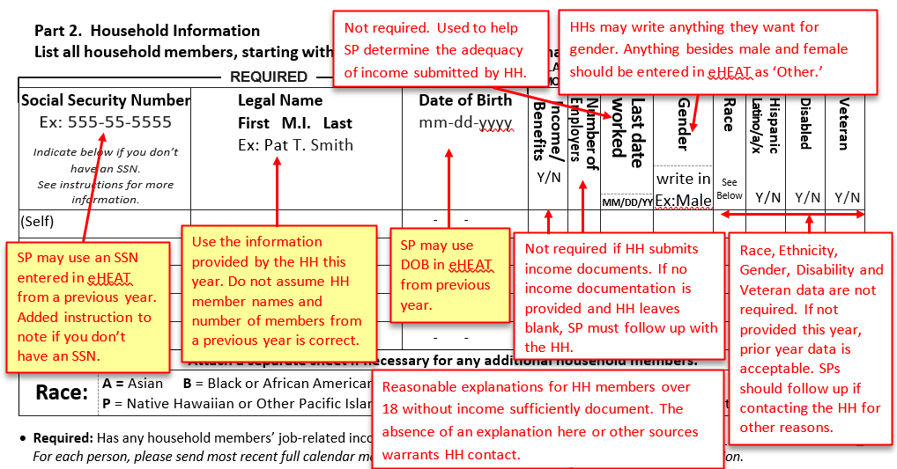
Application Requirements
New Signature Page Created
Includes HH member info
  Complete as detailed on Application Requirements Tool

Slide 30
Application Requirements
    The SP requested a signature page be completed by the HH. The HH returned the form signed but did not complete the HH member info at the top of the form. Is this signature page valid?
      No, the signature page must include accurate HH member info to be considered valid. The HH member info cannot be blank, it must include, at minimum, one HH member. The SP can refer to the Application Requirements Tool for info requirements

Slide 31
Application Requirements
    An app was received with no signature. Staff will be sending the request for info along with a signature page to the HH for completion. Staff noticed there was info missing on the app regarding income and energy vendor info. Can staff add that to the request for info?
      Yes, the SP can ask the HH for additional info but cannot contact third parties until a signed signature page is received

Slide 32
Defining a New Application

Slide 33

Application Requirements
Before approval
Consider an app new if:
  A new signature page is received
    App withdrawn or denied OI and reactivated
    App denied insufficient info (HH chooses to reapply)
  HH composition has changed since applying
    HH chooses to reapply
  HH declares HH composition was inaccurate at time of applying
    HH must reapply
(Ch. 2 – Applications & Application Processing, p. 13-14)

Slide 34
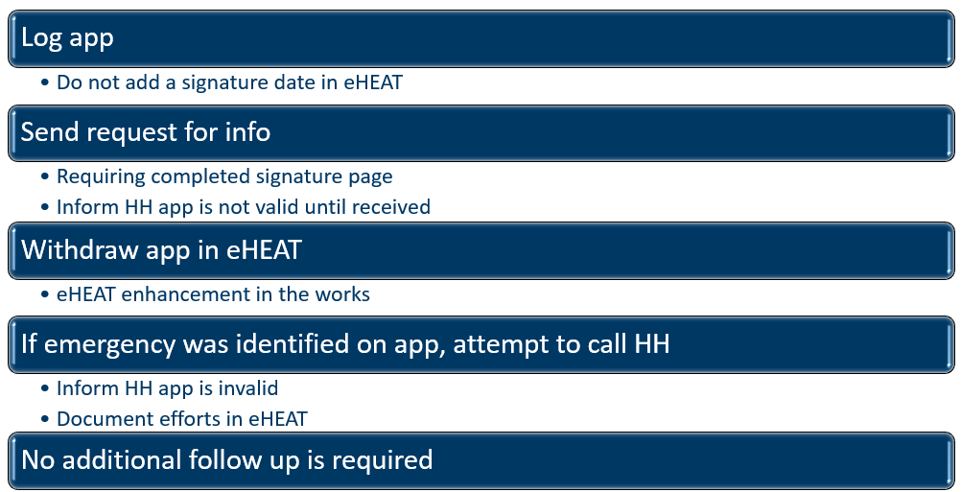
Application Requirements
Before approval
A new app requires SP to follow the process for handling invalid apps or apps with composition changes as previously outlined.
(Ch. 2 – Applications & Application Processing, p. 13-14)

Slide 35


Application Requirements
A New App = A New Log Date
  eHEAT automatically assigns a new log date for denied over-income and withdrawn apps
  Denied insufficient info apps keep their original log date. If the HH submits a new signature page SPs must use the “edit log date” function in the manage application dropdown menu
(Ch. 2 – Applications & Application Processing, p. 13-14)

Slide 36

Application Requirements
After approval:
  HH appeals HH composition
    Follow normal appeals process (Ch 10, Incidents and Appeals)
    A new signature page is required
    Do not change original log date or signature date in eHEAT
    Retain new signature page in HH file, note in eHEAT
    If an overpayment or suspected fraud is identified, treat as an incident
(Ch. 2 – Applications & Application Processing, p. 13-14)

Slide 37
Application Requirements
    Bill called to discuss his app. He applied in September, his app has not been approved, and his living situation has drastically changed. Bills 4 grandkids have recently moved into the house. What are Bills options?
    Bill can either continue with the original app prior to the changes in HH members or withdraw his app and reapply with his grandkids as HH members. SP would follow the new process for HH with composition changes. If Bill chooses to withdraw his original app and submit a new signature page with complete HH member info, his app will be reactivated and assigned a new log date, signature date and be placed in log date order for processing.

Slide 38
Application Requirements
    HH applied for EAP online and realized they did not include their aunt or mom on the app. Their app has not been approved. The HH has all pertinent info and is ready to provide. What are the HH next steps?
      SP will need to follow new process for HH with composition changes including the withdrawal of the original app. HH will supply a new signature page with appropriate HH member info. When the signature page is received, the application will be reactivated with a new log date, signature date and placed in log date order.

Slide 39
Application Requirements
    Is there any time a HH can simply provide the SP with HH member data without requiring a new signature page and it becoming a new application with new log date and signature date?
  The only time this would be allowable is if the application was approved and the HH appealed. In that situation you would follow the process previously detailed on HH appeals HH composition.

Slide 40
Application Requirements
    Jenny received her EAP eligibility letter and realized she only listed herself in the household.
    Jenny may appeal her eligibility with the SP. The SP may send Jenny a new signature page via eHEAT. Once returned, SP will not adjust log date or signature date. Info will be updated in eHEAT, the new signature page will be retained with the original HH file, SP will make detailed notes in eHEAT and recalculate the PH benefit. If overpayment or SP suspects fraud, SP will follow incident protocols in Chapter 10 of the EAP Policy Manual

Slide 41

Q&A

Slide 42
Application & Mailing
Ernest McCann

Slide 43

Application Changes and Mailing
Topics
Application changes
Mailing Timeline

Slide 44
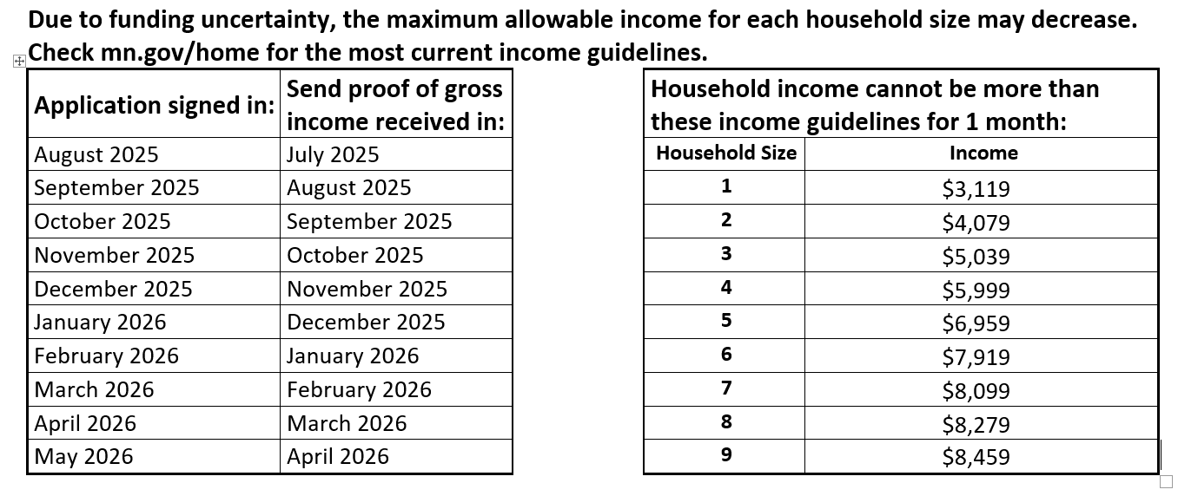
Application Changes
Dates and Income Guidelines Updated

Slide 45
Application Changes
‘What proof to send’ section on first page
Wages: EAP may use your SSN to verify wages reported by your employer. If complete proof is not provided, the information is verified with the Department of Employment and Economic Development (DEED), which may be up to 6 months old. We may ask you to provide check stubs or other verification if we are unable to verify your wages with DEED. If your income has gone down in the last 6 months, you will need to provide proof of your most recent full calendar month of wages from the month before you sign your application, or the information reported by DEED will be used
New text

Slide 46
Application Changes
‘What proof to send’ section starting on first page
Spousal Support or Alimony: Check copies, bank statements, divorce decree (first and last page along with pages related to alimony) or a note signed by the payor stating the payment amount and dates, or other proof of amount received
New text

Slide 47

Application Changes
If a HH indicated last year they prefer email, it is now marked on the pre-app
Only on printed apps
Email address will be printed if they included one on last year’s app
This is to increase email communication to cut down on mailing costs
If a HH picked US mail last year then nothing is marked on the pre-app

Slide 48
Application Changes
‘How did you hear about Energy Assistance?’ section updated
Order was changed to reflect frequency of answers

Slide 49
Application Changes
Formatting and language change
Changed to

Slide 50
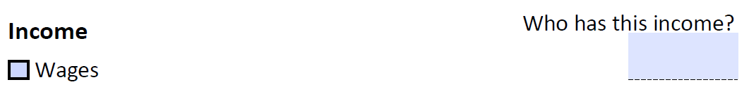
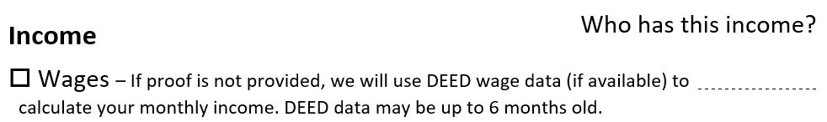
Application Changes
Formatting and language change
Changed to

Slide 51
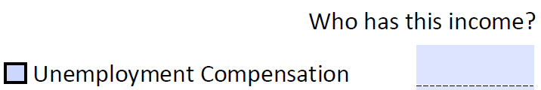
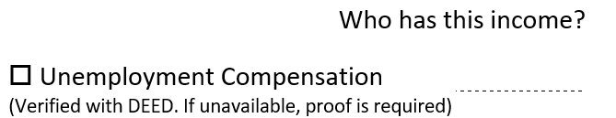
Application Changes
Formatting and language changes to this section
Changed to

Slide 52
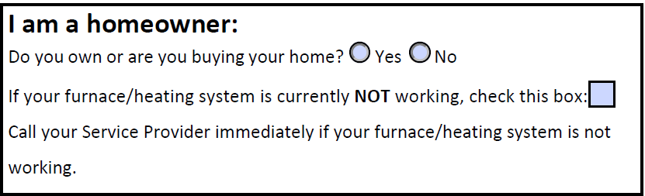
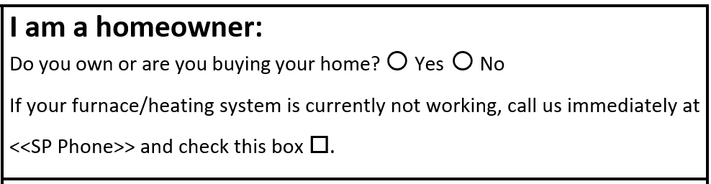
Application Changes
‘I am a homeowner’ section updated
Changed to

Slide 53
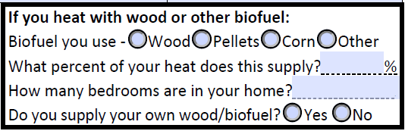
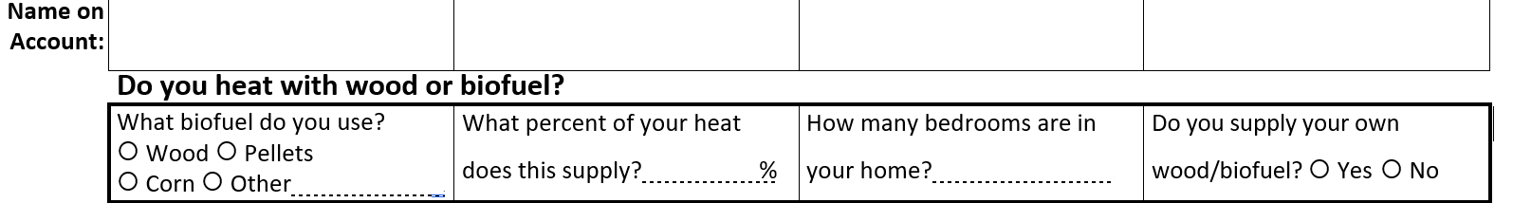
Application Changes
‘Do you heat with wood or biofuel?’ section updated
Changed to

Slide 54
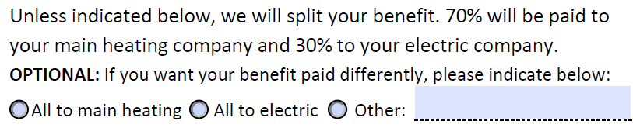
Application Changes
‘How would you like your benefit paid out?’ added
OLD
NEW

Slide 55
Application Changes
Part 5. language update
3. I authorize Commerce to share data about my EAP eligibility and application with other Commerce energy programs for which I might be eligible, including, but not limited to, Inflation Reduction Act Home Energy Rebates, Minnesota Heat Pump Rebates, Minnesota Electrical Panel Grants
New text

Slide 56

Mailing Timeline

Slide 57
Mailing Timeline
Planned FFY26 EAP application-related dates
Mon, Aug. 18 – About 32,000 Recertification apps go into the mail
Tues, Sept. 2 – Online app is made available
Tues, Sept. 2 – SPs should post the FFY26 app on their website, make it available in their office, supply their partners with them, & ask partners to recycle any remaining FFY25 apps
Tues, Sept. 2 – About 20,000-30,000 Pre-filled apps begin going into the mail daily, with a total of about 60,000 apps
Fri, Sept. 12 – Blank apps requested over the summer sent out
Fri, Sept. 12 – Request form for mailed app is returned to the Commerce website
Wed, Oct. 1 – Email to households that applied for FFY25 via the online app

Slide 58

Q & A

