Slide 1

Energy Assistance Program
FFY26 Annual Training
Introduction;
FFY25 Data

Slide 2
Introduction & Overview
Michael Schmitz
Director

Slide 3
Introduction & Overview
Topics
Logistics
Introductions
Agenda for today and tomorrow
Breakthrough Goals
FFY26 Approach
Training Overview

Slide 4

Introduction & Overview
Logistics
No video – pre-recorded slides
Breaks & Lunch
Restrooms
Silence Cell Phones

Slide 5
Introduction & Overview
Logistics
Social Hour – Green Mill – 5PM
  Inside
  Outside (weather permitting)

Slide 6
Introduction & Overview
State EAP Staff
Amanuel Asghedom
Mandy Braaten
Jon Brown
Natalia Fedorova
Andy Grewell
Ernest McCann
Michael Schmitz
S.Melaine Schwahn-Doyle
Sandra Seemann
Marissa Squires
Ian Villa-Watt

Slide 7
Introduction & Overview
Welcome new and returning SP EAP Staff!
Notes:
Anyone 30+ years; 15-30? 5-14?

Slide 8
Introduction & Overview
Day 1 Agenda
Intro/Overview/Commerce
FFY25 data
Ch. 2 – Application processing
Application requirements
Energy Vendors; Name on Account; Refunds refresher
Ch. 3 – Program eligibility
DEED guidance
Addressing Crisis before EAP funding is available
Ch. 5 – Crisis
Preventing burnout
Ch. 12 – Communications, Info & Reports
Ch. 13 – Fiscal management
Debrief

Slide 9
Introduction & Overview
Day 2 Agenda
Welcome back & reconnect
Data practices
Ch. 6 – Energy Related Repair
eHEAT enhancements
Office of the Attorney General
Ch. 12 – Key change notification
Ch. 7 – Assurance 16
Online application refresher
Application & mailing
Monitoring
Utility customer protections
Debrief

Slide 10

Introduction & Overview
FFY25 Breakthrough Goal
Last year we set a goal of improving application processing speed by 10%
Thanks to your hard work we (mostly) did it!
Days to worked improved by 5%
Days to terminal improved by 14%

Slide 11
Introduction & Overview
FFY25 Breakthrough Goal
Also proposed 90% of SPs under 30 days to work an app
  61% were able to do it
  75% were under 40 days
  96% were under 45 days
  Did see improvement for several SPs
  who were above 30 days

Slide 12

Introduction & Overview
FFY26 Breakthrough Goal
Intended to be big, audacious, and hard to reach goals
EAP’s goals:
  Build on last year - 5% overall improvement
  Get 90% of SPs under 30 days to work an app

Slide 13

Introduction & Overview
FFY26 Breakthrough Goal
How can we do it?
  Keep improving online app to get more complete apps
  More experience and better policy for DEED wage/unemployment insurance database
  Better training – including sharing best practices
  Setting goals, monitoring, and being accountable

Slide 14

Introduction & Overview
FFY26 Draft Approach – subject to change
Funding likely to remain flat or decrease (~$115-125M)
Eligibility Threshold: 50% SMI
Average Primary Heat Benefit: $550
  Minimum: $200+
  Maximum: $1,400
Crisis Max: $600

Slide 15

Introduction & Overview
FFY26 Draft Approach
10% EAPWX Transfer
Startup funds on 10/1
  ERR at least $1M
  $3M Admin
  $1M A16

Slide 16

Introduction & Overview
FFY26 Draft Approach – Contingency Plan
If significant funding cut is known
  Potentially cut eligibility threshold to limit number of apps
Hard to know what Congress will do
NEADA cautiously optimistic

Slide 17

Introduction & Overview
FFY26 Draft Approach – Contingency Plan
If funding level is unknown prior to mailing
  Proceed as usual
  May run out of money earlier than expected

Slide 18
Introduction & Overview
FFY26 PPA Assignments

Slide 19

Introduction & Overview
FFY26 Policy Development
Many sources for FFY26 policy improvements
  Program audits
  Issues identified by SPs and Commerce in FFY25
  Policy Advisory Committee (PAC)
  EACA
  eHEAT Next Gen

Slide 20
Introduction & Overview
FFY26 Policy Development
JAD participants were essential – thank you!
  Tammy Alto
  Pat Elizondo
  Andrea Goeden
  Nora Guerra
  Rachel Landreau
  Kendra Lund
  Joan Markon
  Stephanie McClanahan
  Jean Pelletier
  Sandra Pyles
  Amy Zimmerman

Slide 21

Introduction & Overview
Overview of Annual Training: Intentions
Prepare for FFY26
Train-the-trainer
  Program & policy changes
  Areas of concern
Excludes EAP 101, policy making

Slide 22
Introduction & Overview
Overview of Annual Training: Approach
PowerPoint presentations by topic
Q&A between – hold questions
Issue a turn-around document (TAD)
PPTs available by topic on Commerce website
Recordings of PPTs available soon
List of Policy Manual Changes

Slide 23

Introduction & Overview
Ice breaker
Find someone around you
Hopefully, someone you don’t know well
Describe a favorite or surprising thing about the place you live
This Photo by Unknown Author is licensed under CC BY-NC-ND

Slide 24

Extreme Minnesota
Did you know?
Minnesota is not the coldest state in the US!
Which state is and what rank is MN?
  Alaska is coldest, with average temp of 28.9
  North Dakota – 43.7
  Wyoming – 44.3
  Montana – 44.5
  Maine – 45
  Minnesota – 45.5

Slide 25
Q&A

Slide 26
FFY25 Data
Ian Villa-Watt

Slide 27







Households Served in FFY25
125,661
Households served
294,134
People
63,892
Seniors
57,101
People with disabilities
33,428
Children under 6

Slide 28
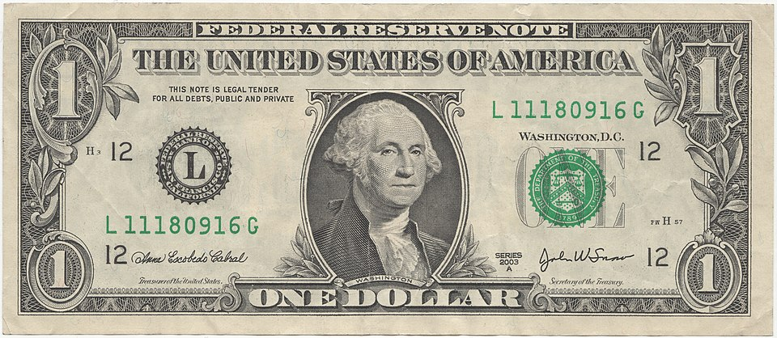
Households Served in FFY25
Average Annual Income: $24,022
Annual Energy Bill: $2,292 (9.5% of income)
Average PHB: $543 (23.7% of energy costs)
Notes:
Better impact than expected due to decreases in both fuel cost and usage

Slide 29



Who Does EAP Help?
But how does EAP help:
  Senior households?
  Single parents?
  Adults who live alone?
Household composition is another way of looking at the numbers

Slide 30

Who Does EAP Help?

Slide 31
Who Does EAP Help?
Seniors (Not Working)

Slide 32
Who Does EAP Help?
Seniors (Not Working)
Single Parent (Working)

Slide 33
Who Does EAP Help?
Seniors (Not Working)
Single Parent (Working)
Dual Parent (1+ Working)

Slide 34
Who Does EAP Help?
Seniors (Not Working)
Single Parent (Working)
Single Adult (Not Working)
Dual Parent (1+ Working)

Slide 35
Who Does EAP Help?
Seniors (Not Working)
Single Parent (Not Working)
Single Parent (Working)
Single Adult (Not Working)
Dual Parent (1+ Working)

Slide 36
Who Does EAP Help?
Seniors (Not Working)
Single Adult (Working)
Single Parent (Not Working)
Single Parent (Working)
Single Adult (Not Working)
Dual Parent (1+ Working)

Slide 37
Who Does EAP Help?
All Other
Households
Seniors (Not Working)
Single Adult (Working)
Single Parent (Not Working)
Single Parent (Working)
Single Adult (Not Working)
Dual Parent (1+ Working)

Slide 38

Who Does EAP Help?
The Median Household
1 member, age 72
Earns $17,388/yr
Lives at 24% SMI
18 years in home
$1,503 energy bill
Seniors (Not Working)
Primary Income Sources
83% Social Security
7% SSI
5% Pension
4% Various
Applications & Benefits
86% were reapplying
8% applied online
$399 Primary Heat benefit
22% received Crisis
36,102
households

Slide 39



Who Does EAP Help?
The Median Household
Female age 36, 2 kids
Earns $32,688/yr
Lives at 27% SMI
5 years in home
$1,816 energy bill
Single Parent (Working)
Primary Income Sources
88% Wages
3% Child Support
3% Self-Employment
6% Various
Applications & Benefits
59% were reapplying
51% applied online
$456 Primary Heat benefit
37% received Crisis
17,334
households

Slide 40

Who Does EAP Help?
The Median Household
3 adults, 2 children
Earns $45,410/yr
Lives at 30% SMI
6 years in home
$2,455 energy bill
Dual Parent (1+ Working)
Primary Income Sources
85% Wages
6% Self-Employment
9% Various
Applications & Benefits
63% were reapplying
44% applied online
$534 Primary Heat benefit
39% received Crisis
17,111
households

Slide 41

Who Does EAP Help?
The Median Household
Age 53
Earns $11,808/yr
Lives at 16% SMI
8 years in home
$1,071 energy bill
Single Adult (Not Working)
Primary Income Sources
52% Social Security
20% SSI
10% Other
7% Unemployment
4% General Assistance
6% Various
Applications & Benefits
72% were reapplying
28% applied online
$425 Primary Heat benefit
26% received Crisis
15,730
households

Slide 42
Who Does EAP Help?
The Median Household
Female age 38, 2 kids
Earns $11,700/yr
Lives at 9% SMI
5 years in home
$1,661 energy bill
Single Parent (Not Working)
Primary Income Sources
25% Social Security
22% MFIP
15% SSI
13% Unemployment
11% Child Support
8% Other
6% Various
Applications & Benefits
62% were reapplying
43% applied online
$657 Primary Heat benefit
38% received Crisis
9,303
households

Slide 43

Who Does EAP Help?
The Median Household
Age 47 (61% female)
Earns $20,377/yr
Lives at 28% SMI
8 years in home
$1,305 energy bill
Single Adult (Working)
Primary Income Sources
76% Wages
12% Social Security
6% Self-Employment
5% Various
Applications & Benefits
55% were reapplying
41% applied online
$353 Primary Heat benefit
31% received Crisis
7,835
households

Slide 44
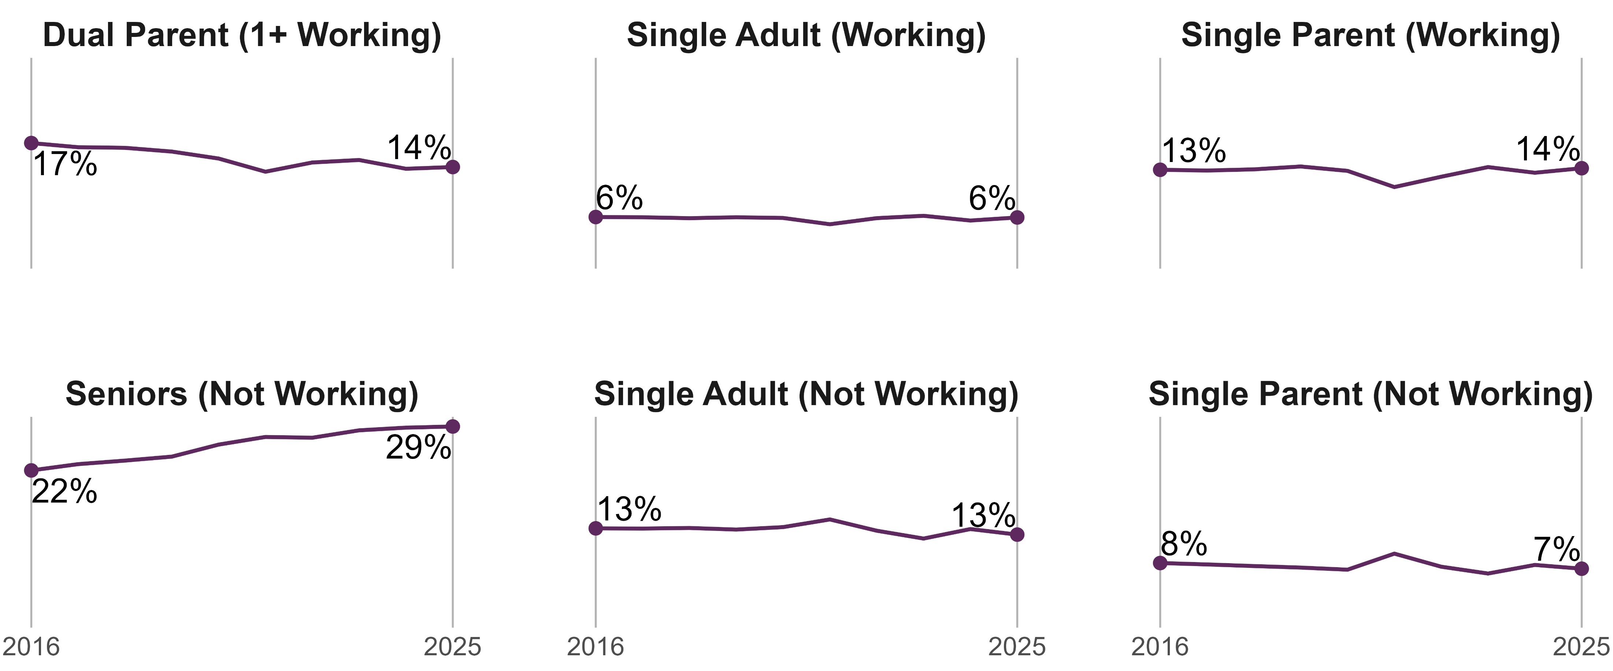
EAP is Serving More Seniors

Slide 45
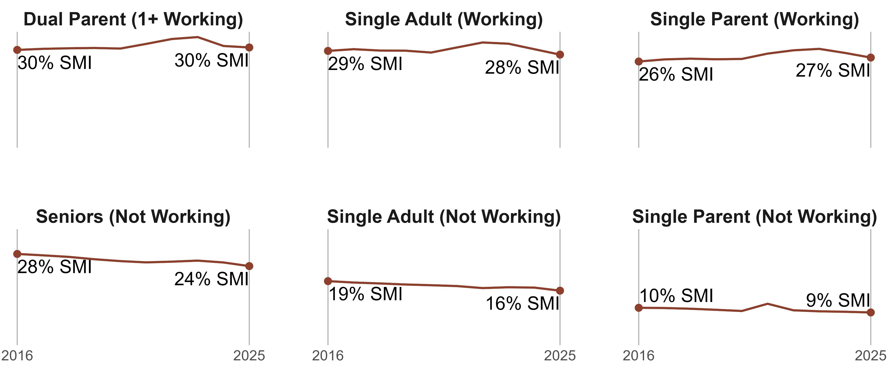
Fixed Incomes Aren’t Keeping Up

Slide 46
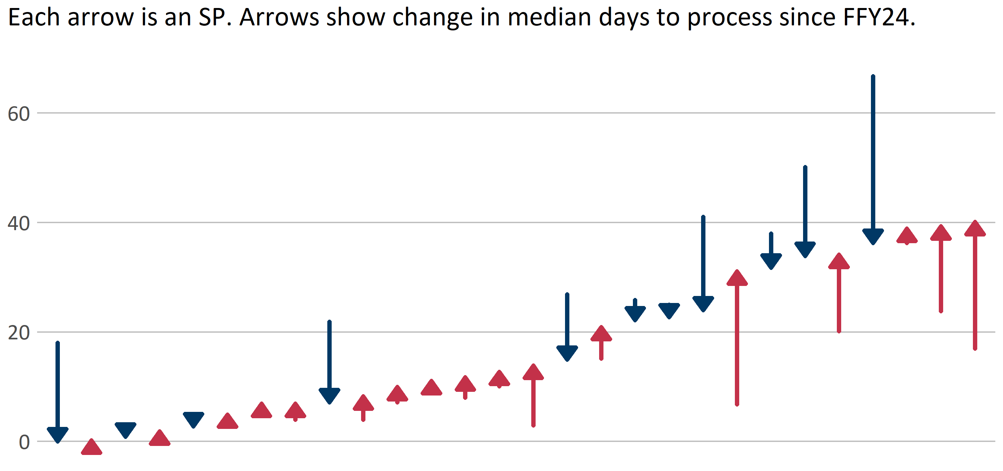
Fewer Outliers in FFY25

Slide 47
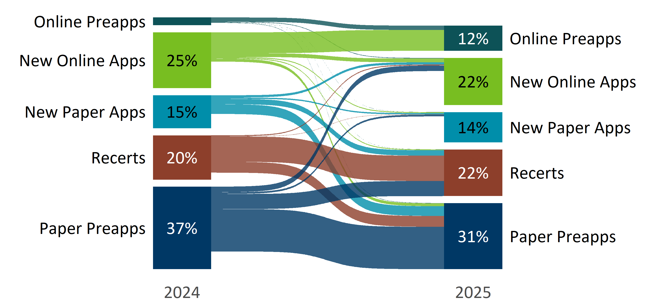
More Households Are Applying Online

Slide 48
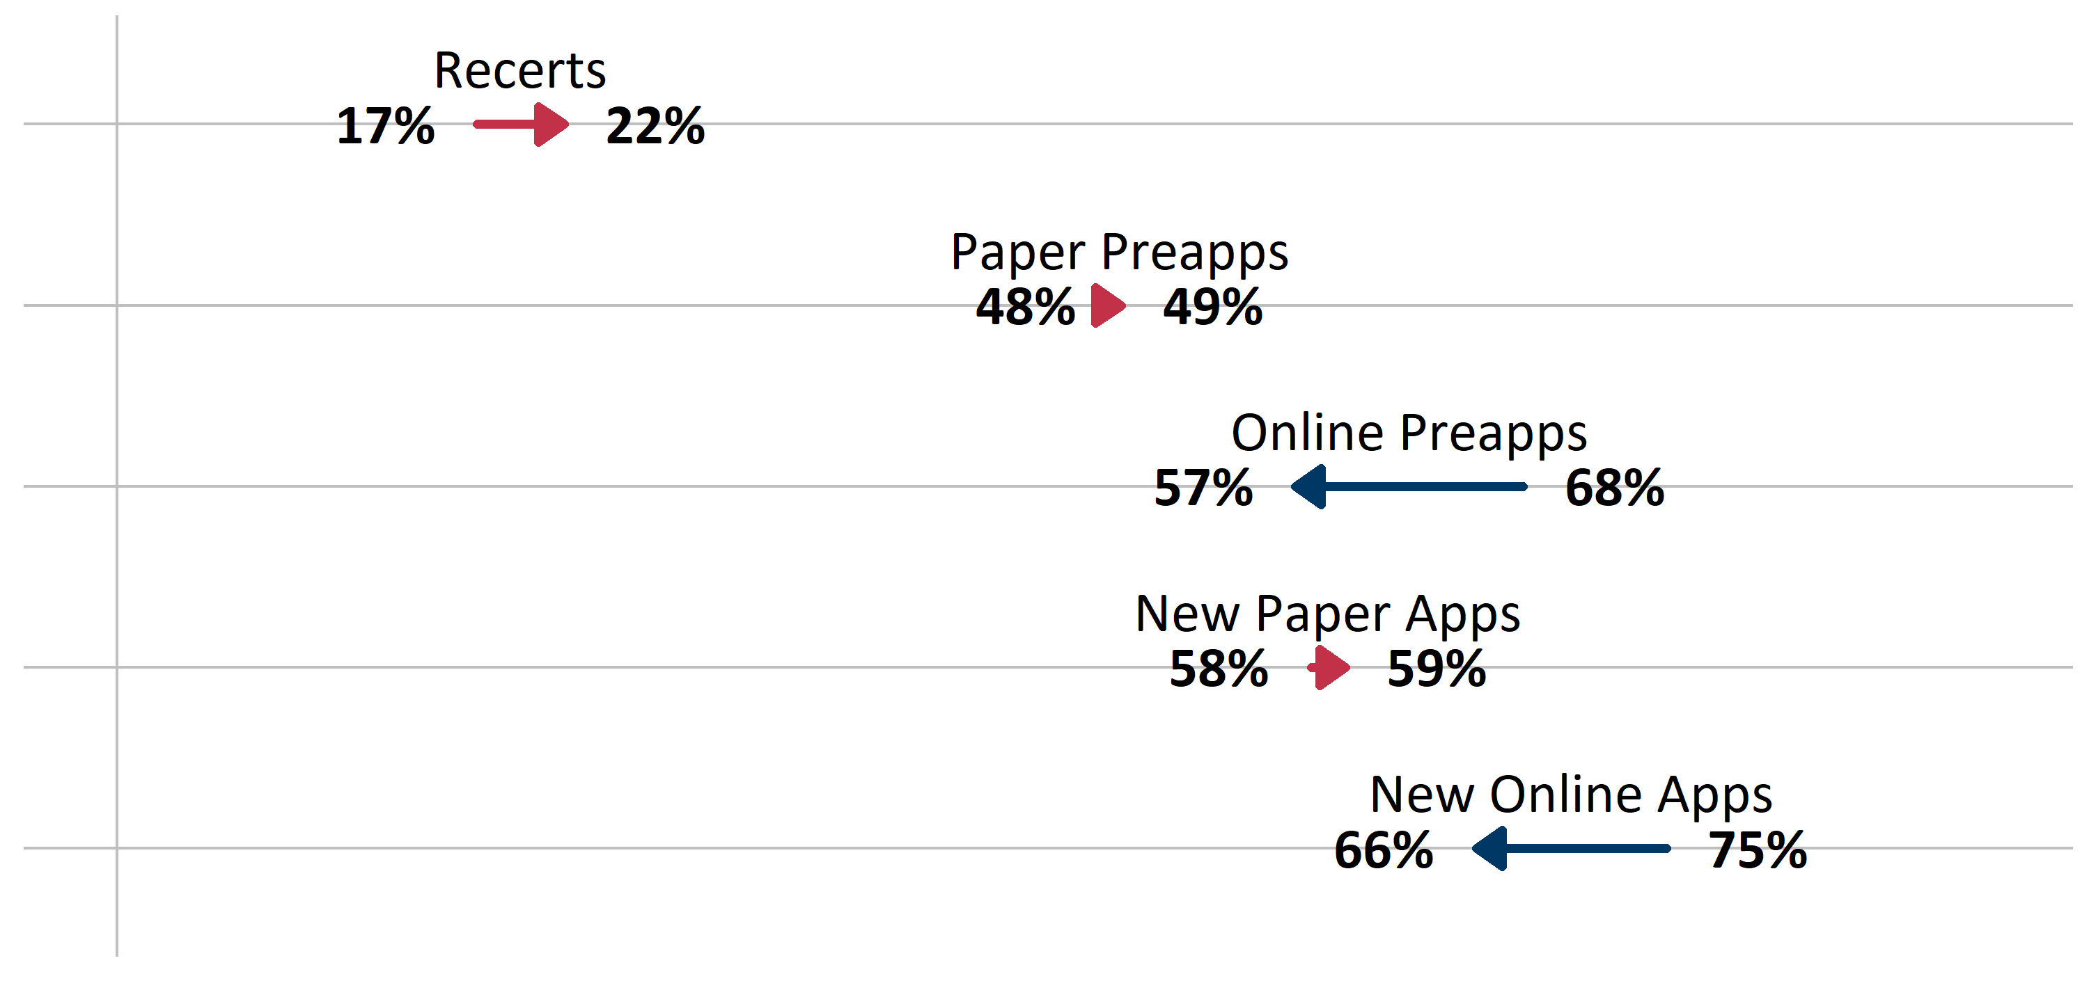
Fewer Info Requests for Online Apps

Slide 49
Impact of DEED Data Connection
With online apps, we can see how often a person indicates no wages but has them added later
In FFY24:
  Before the DEED soft launch, 51,378 people indicated no wages. Of those, 1,012 (2%) had wages added later.
  After the DEED soft launch, 7,450 people indicated no wages. Of those, 411 (5.5%) had wages added later. Was it a fluke?
In FFY25:
  75,582 people indicated no wages. Of those, 4,254 (5.6%) had wages added later. That’s a 286% relative increase compared to pre-DEED apps in FFY24.

Slide 50

Q & A

